Slide 1
Dressing for the Weather
Unit 7
It’s raining
华南师范大学外文学院 蒋亚珠

Slide 2
Now another year has come

Slide 3
Like the last and the one before

Slide 4
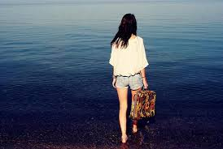
I'm waiting in the cabin by the shore

Slide 5
When the night comes crawling in

Slide 6
Bells chimes and tamber ring

Slide 7
I thought I heard you knocking on the door

Slide 8
Hear the drops of drizzle time

Slide 9
About the long gone fairytale

Slide 10
I let them know my wish again

Slide 11
Raindrops falling on the rooftop

Slide 12
And again they bring up all the long gone memories

Slide 13
Raindrops falling on the rooftop

Slide 14
I will never give up
Hope I will meet you here

Slide 15
Last year I'm the one before

Slide 16
In the cabin by the shore

Slide 17
You gave mud hut chamber change the breadth

Slide 18
Remember how we scratched the names

Slide 19
In the tree right by the lake

Slide 20
I went over to see if it's still there

Slide 21
When you hear the bells from far

Slide 22
I'll be waiting there in the dark

Slide 23
And send my wish upon a star

Slide 24
Raindrops falling on the rooftop

Slide 25
And again they bring up
All the long gone memories

Slide 26
Raindrops falling on the rooftop

Slide 27
I will never give up
Hope I will meet you here

Slide 28
Happy end of every year

Slide 29
You will find me waiting here

Slide 30
For you to come along

Slide 31
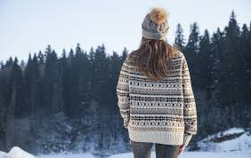
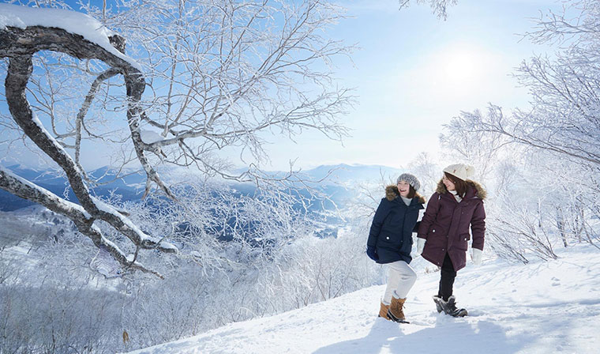
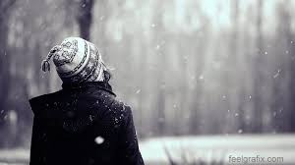
Right down to the shore

Slide 32
Raindrops falling on the rooftop
And again they bring up

Slide 33
All the long gone memories

Slide 34
Raindrops falling on the rooftop

Slide 35
I will never give up

Slide 36
Hope I will meet you here

Slide 37
Unit 7

