Slide 1
Topic：Personal hygiene
作者：2017级英语师范6班袁佩莹
单位：华南师范大学外文学院

Slide 2
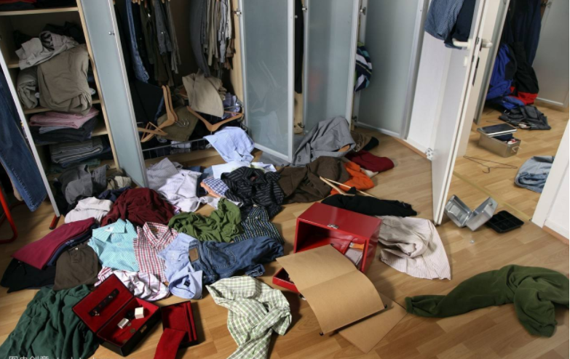
Oh no what a mess

Slide 3
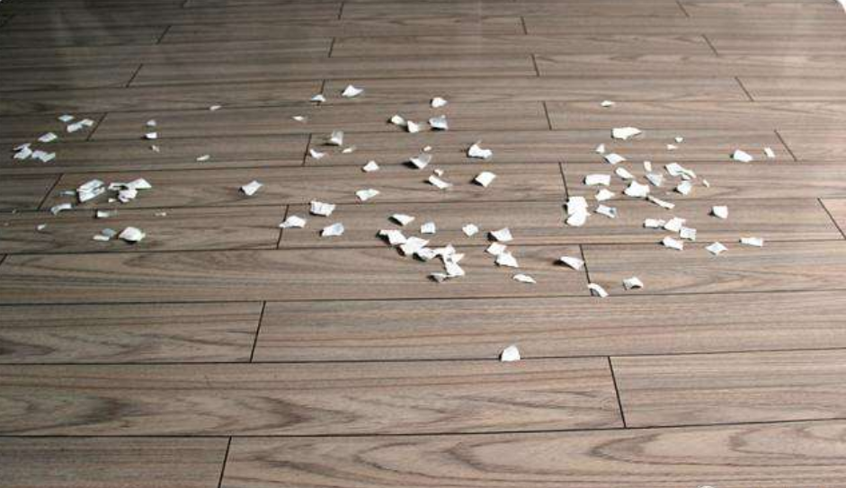
I spilled glitter on the floor now
Watch your
step

Slide 4
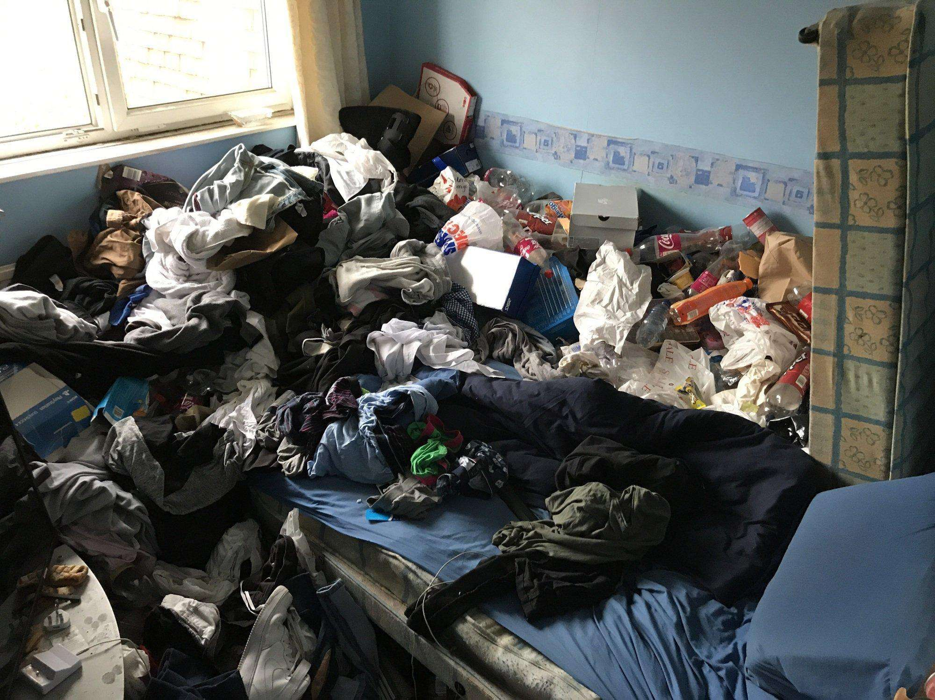
Oh no I must confess

Slide 5
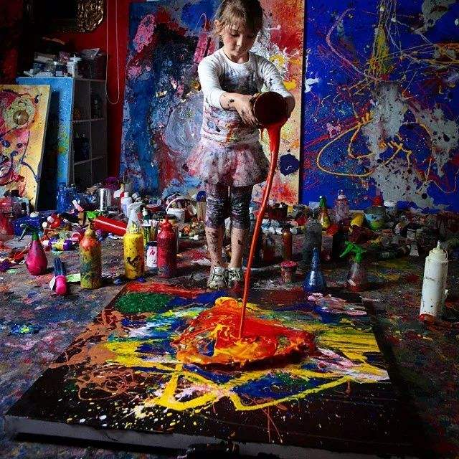
I spilled paint everywhere now
What a
mess

Slide 6
But it’s okay
I know what to do

Slide 7
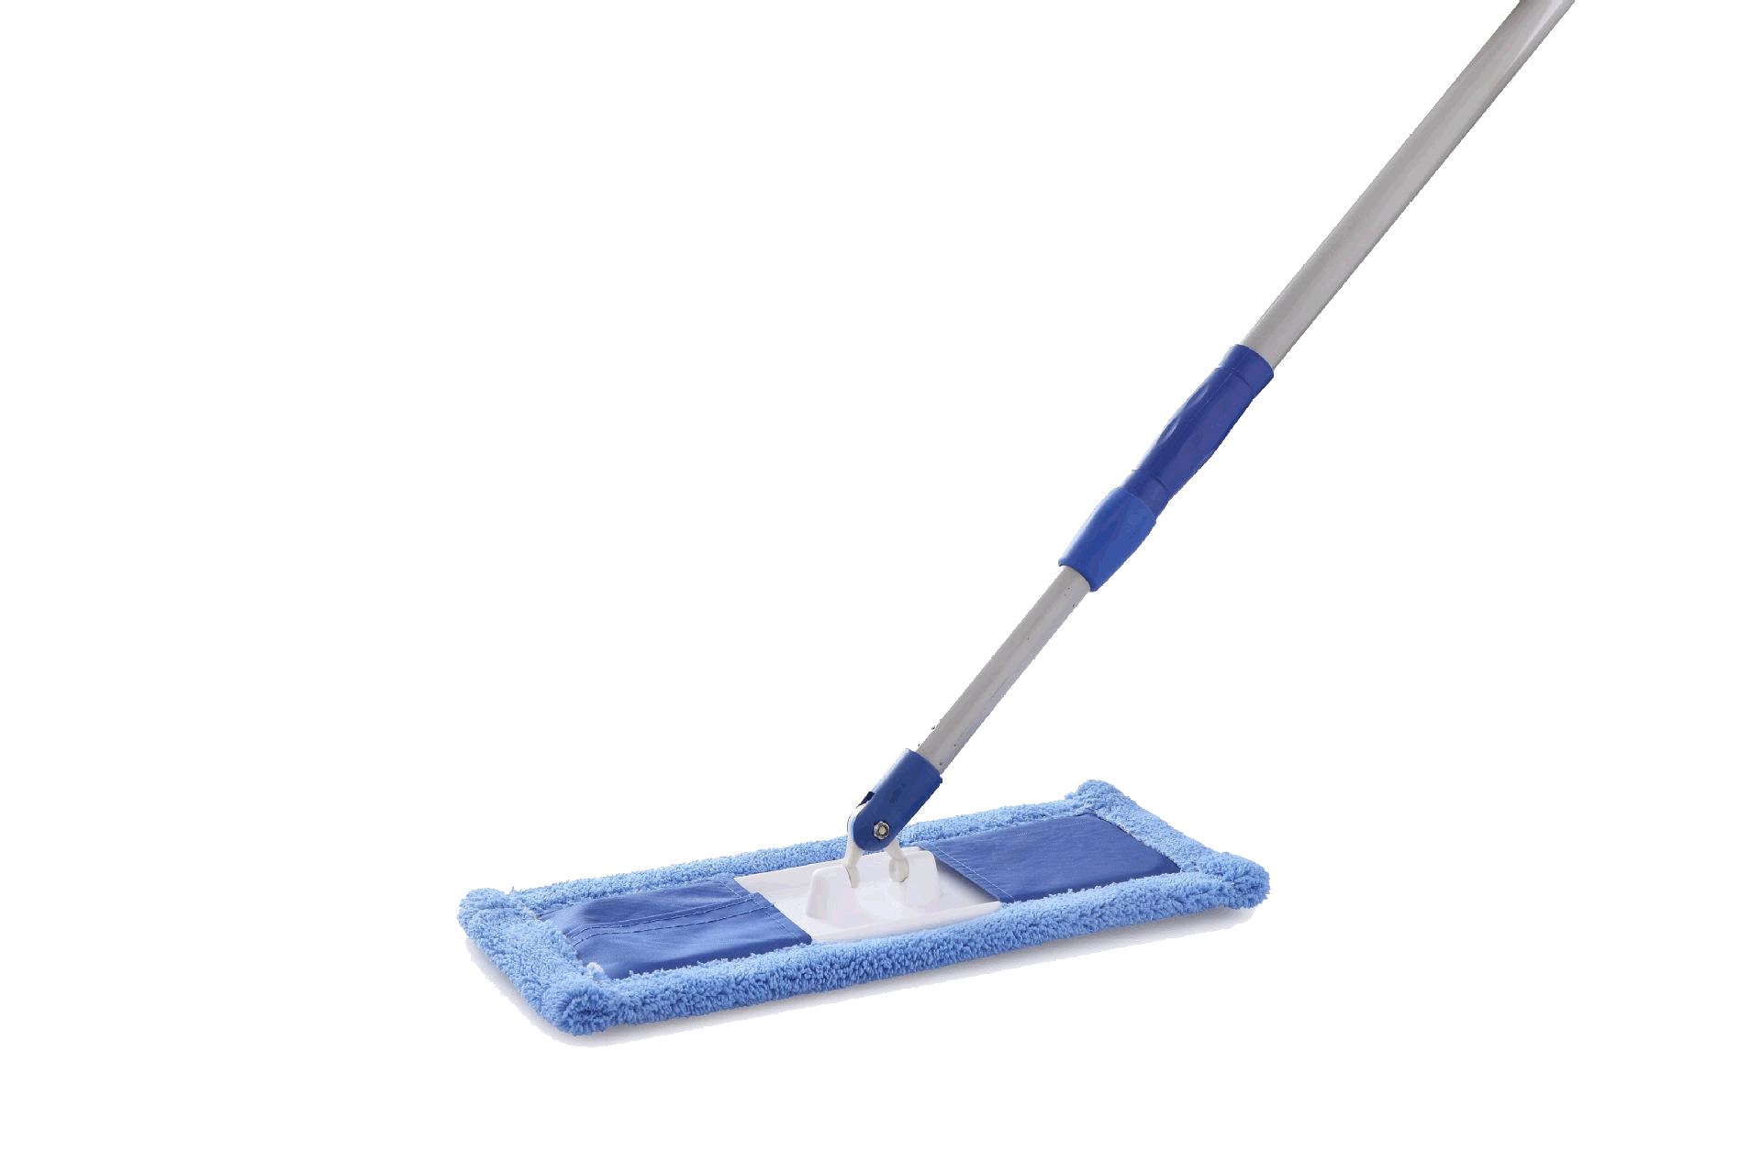
I’ll grab a sponge
and grab a broom
and a mop

Slide 8
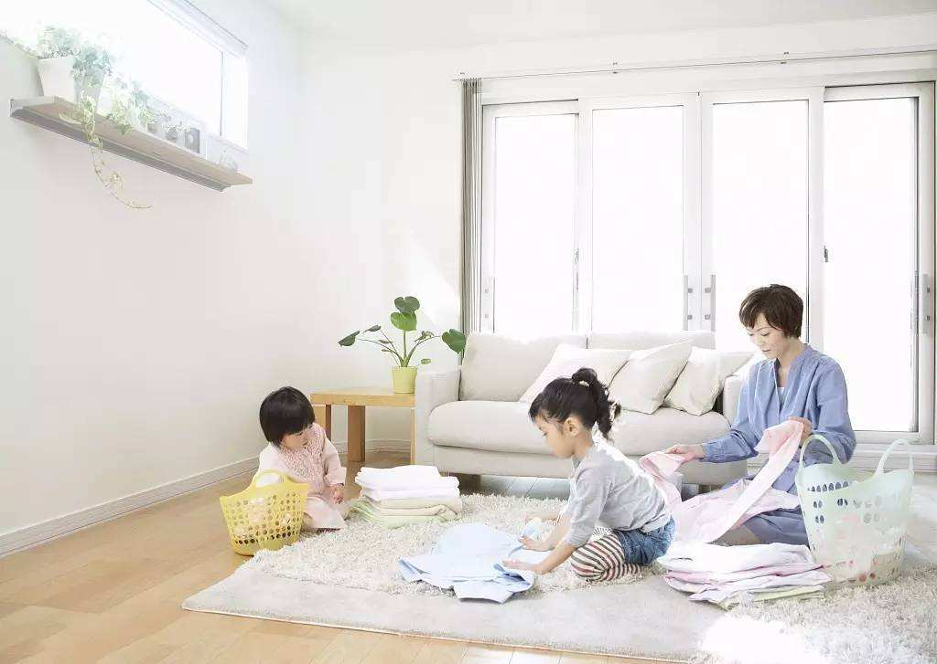
And I’ll clean today

Slide 9
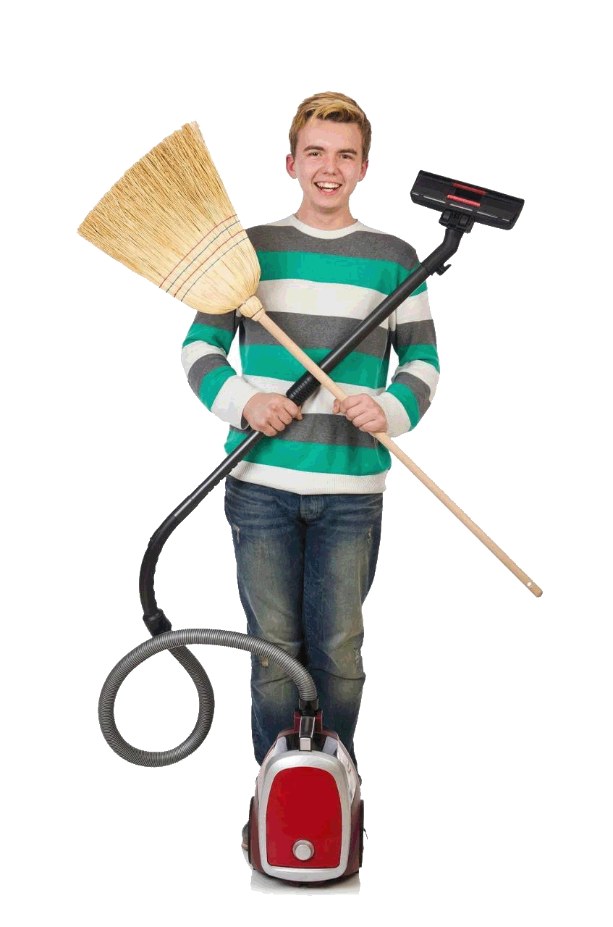
Every mess I make

Slide 10
And I’ll wash away

Slide 11
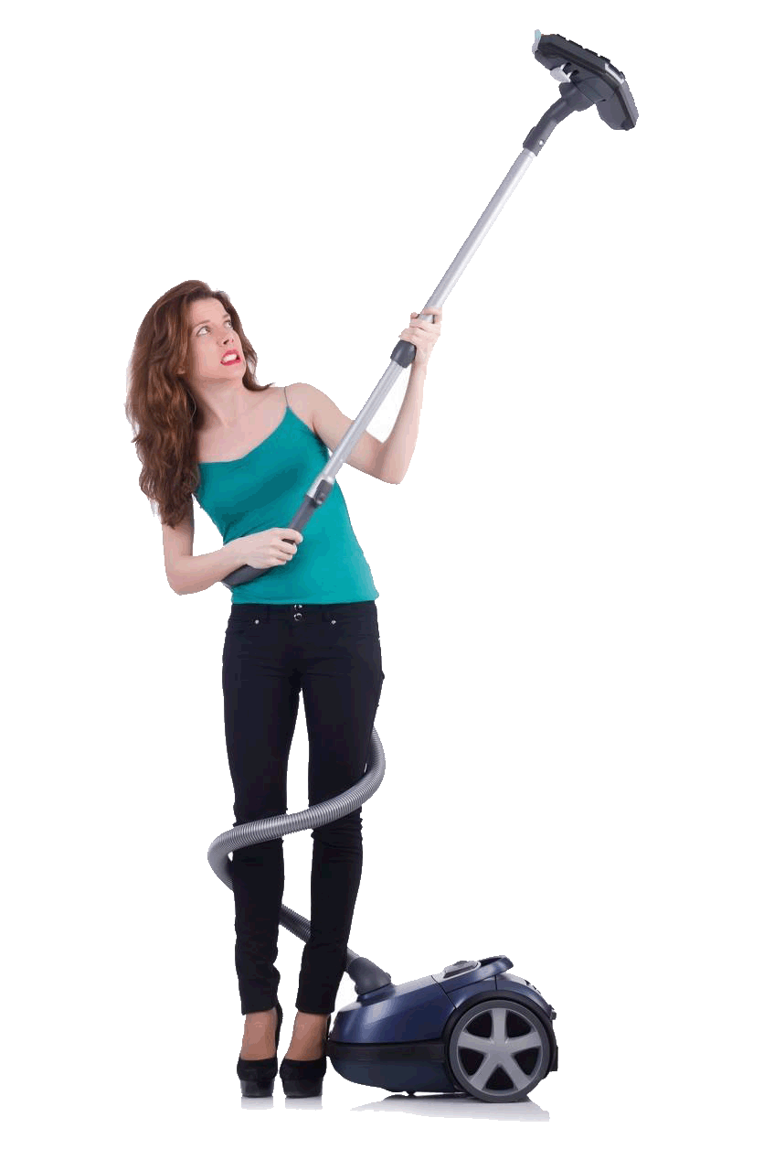
Every mess I make

Slide 12
Oh no what a mess

Slide 13
I spilled glue on the floor now
Watch your
step

Slide 14
Oh no I must confess
I dropped paper everywhere now

Slide 15
What a mess

Slide 16
But it’s okay
I know what to do

Slide 17
and a mop
and grab a broom
I’ll grab a sponge

Slide 18
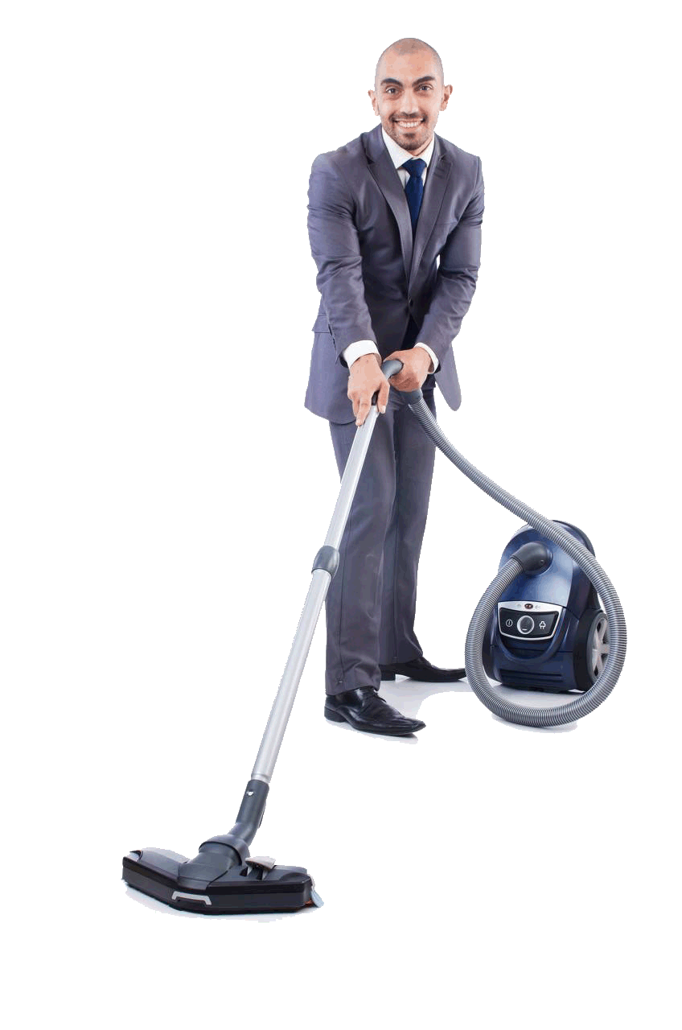
And I’ll clean today
Every mess I make

Slide 19
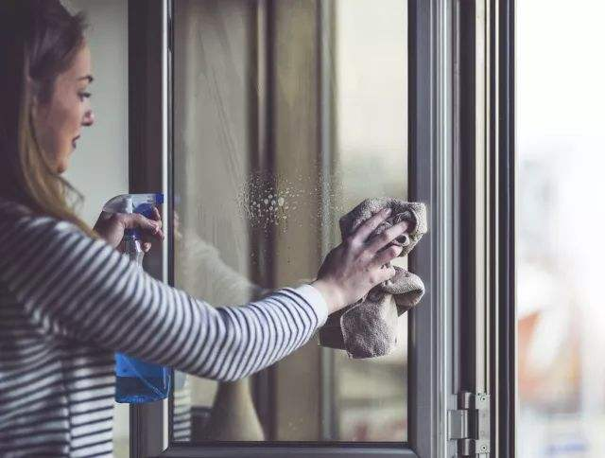
And I’ll wash away
Every mess I make

Slide 20
And I’ll clean today
Every mess I make

Slide 21
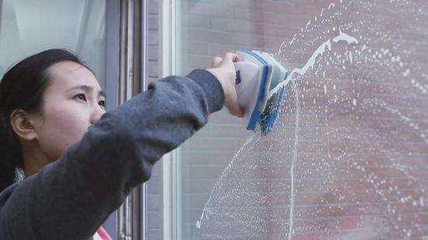
And I’ll wash away
Every mess I make

Slide 22
Shake to the beat

Slide 23
Move your feet

Slide 24
Clean clean clean now
Make it
neat

Slide 25
Shake to the beat

Slide 26
Move your feet

Slide 27
Clean clean clean now
Make it
neat

Slide 28
Clean

Slide 29
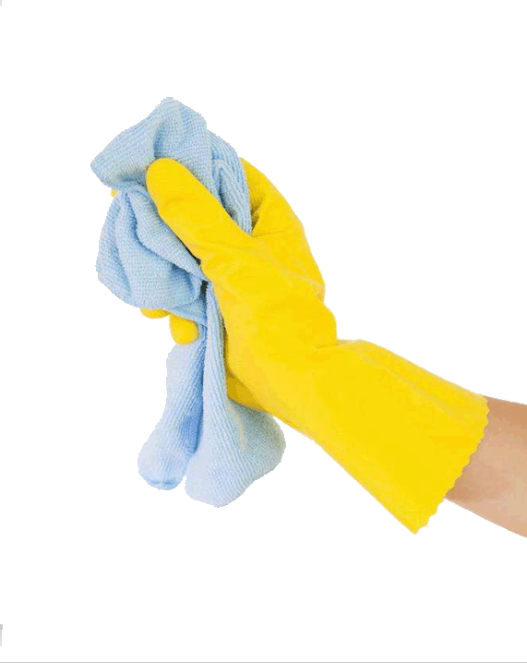
Scrub

Slide 30
Give it a little love

Slide 31
Clean

Slide 32
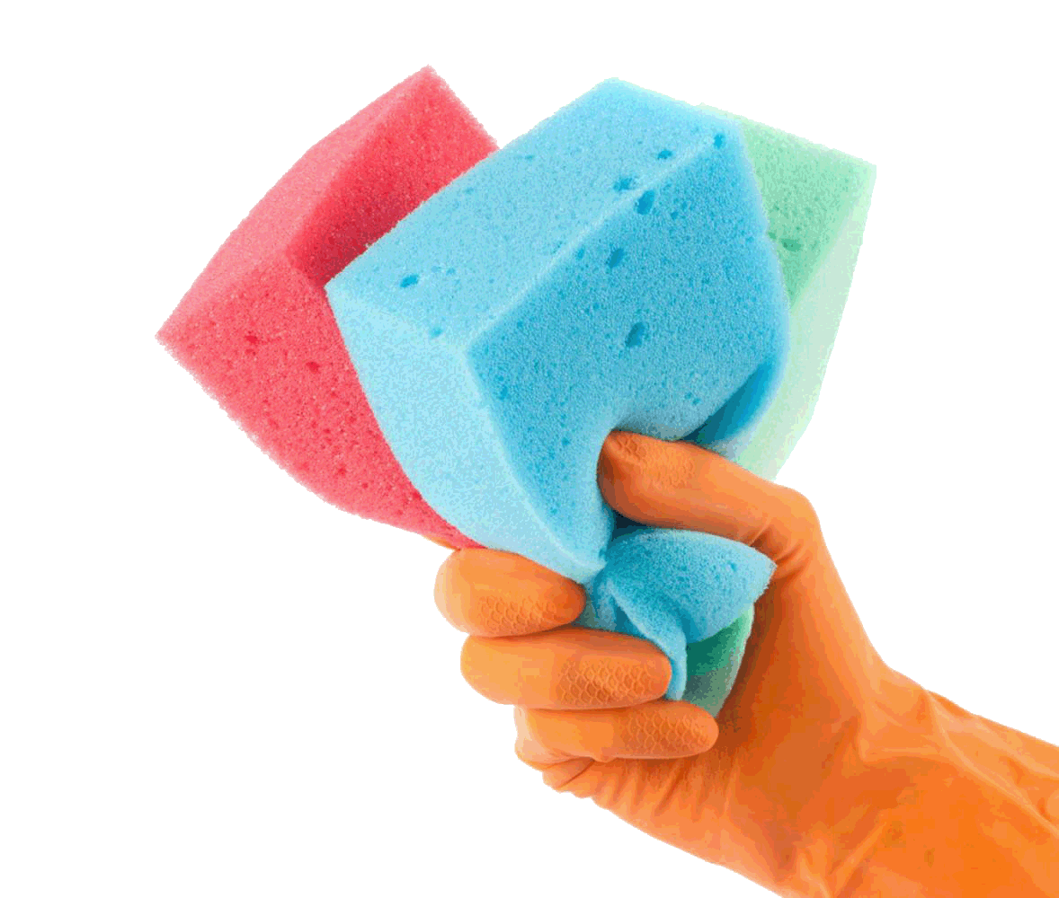
Scrub

Slide 33
Until it’s all done

Slide 34
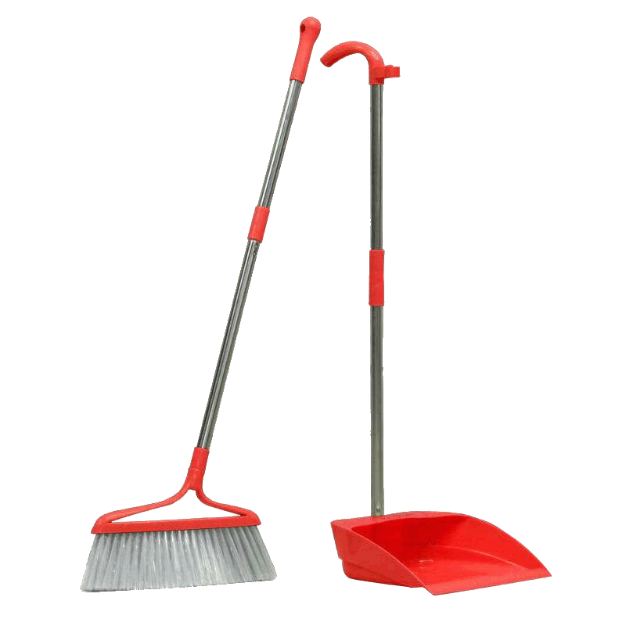
Sweep

Slide 35
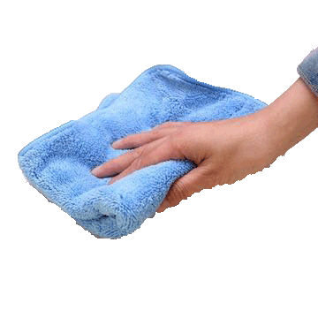
Mop

Slide 36
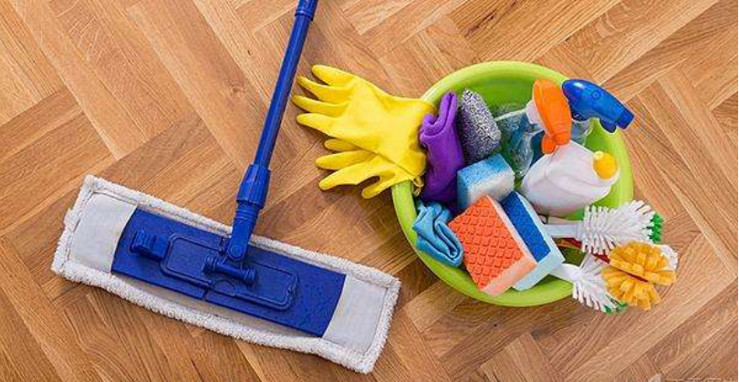
Give it all you got

Slide 37
Sweep

Slide 38
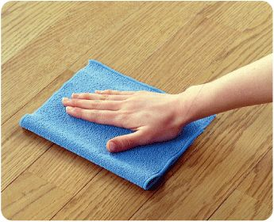
Mop

Slide 39
Until it‘s all done

Slide 40
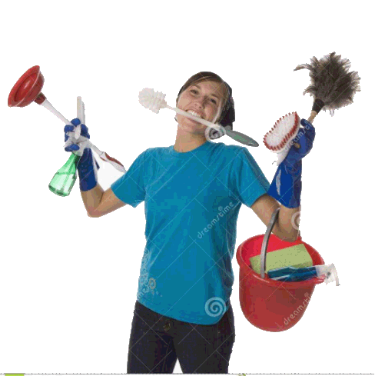
And I’ll clean today

Slide 41
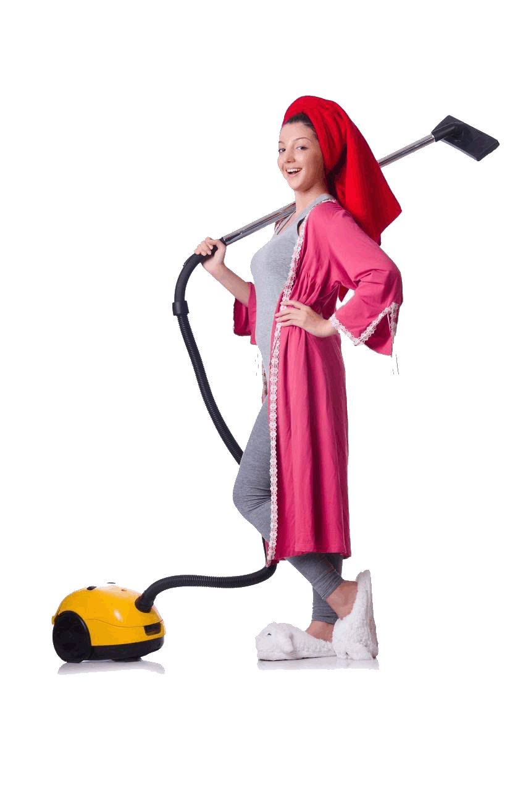
Every mess I make

Slide 42
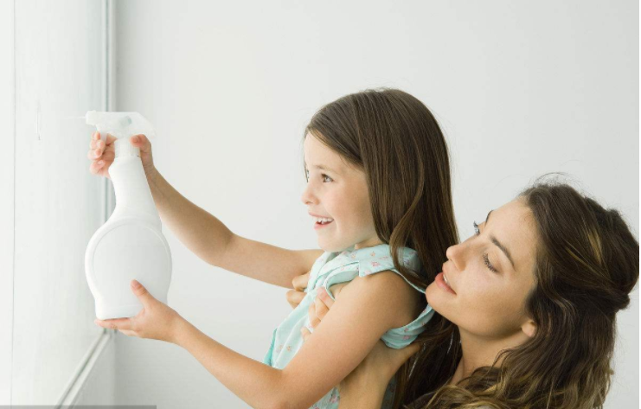
And I’ll wash away

Slide 43
Every mess I make

Slide 44
Over

