Slide 1
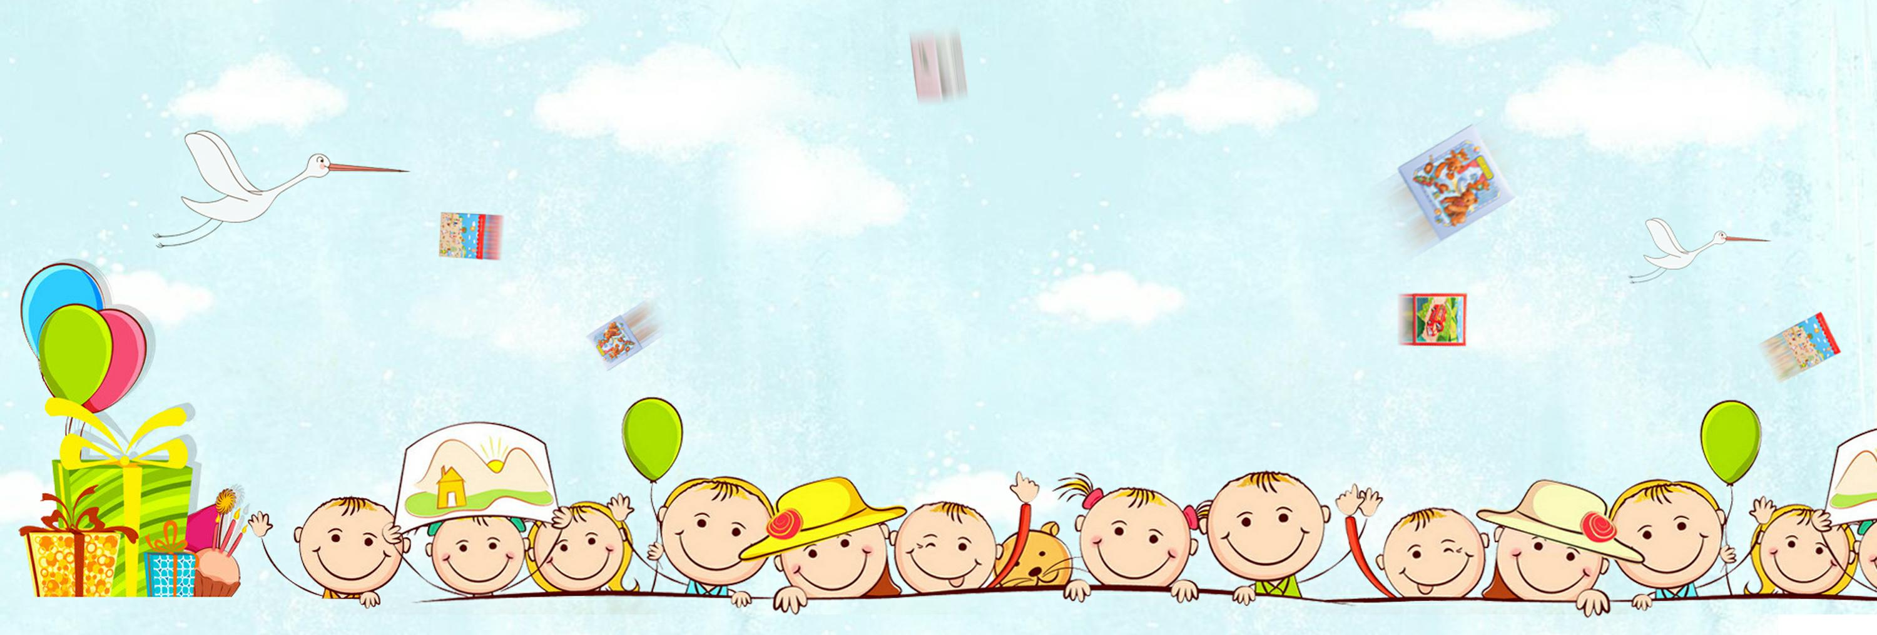
Personal hygiene
Song: I am a very clean child
作者：施小慧
单位：华南师范大学外文学院

Slide 2

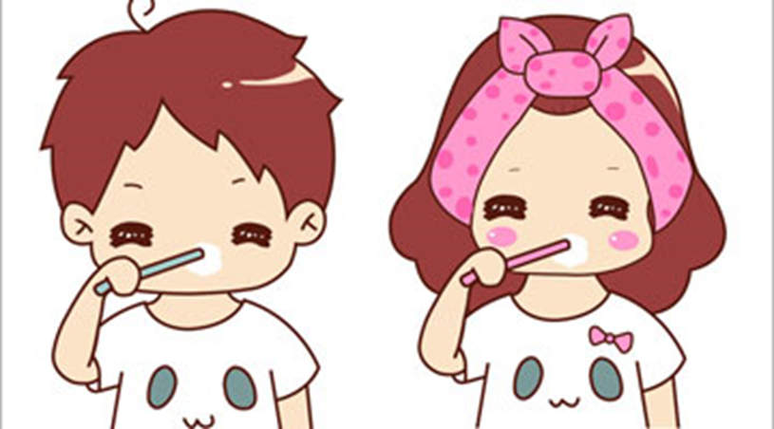



Sparkle sparkle sparkle like I brush my teeth

Slide 3
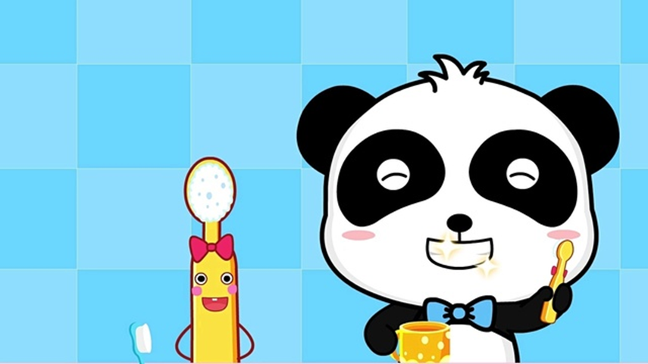

We set smile me feel
so I say hello

Slide 4


Splashy splashy I'll go wash my face

Slide 5

Without you for green I say hello

Slide 6
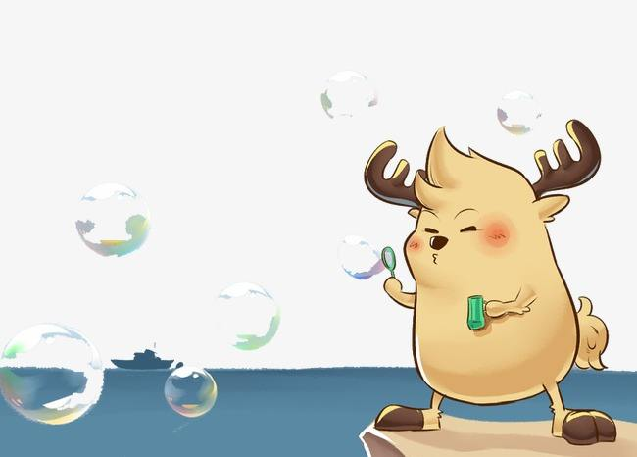
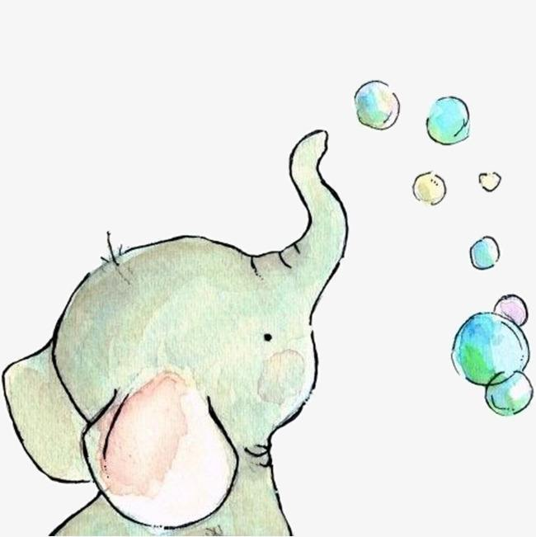

Fluffy fluffy fluffy
bound see bubbles

Slide 7
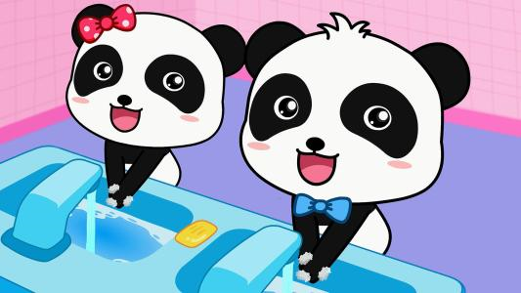
I wash my hands so clean

Slide 8

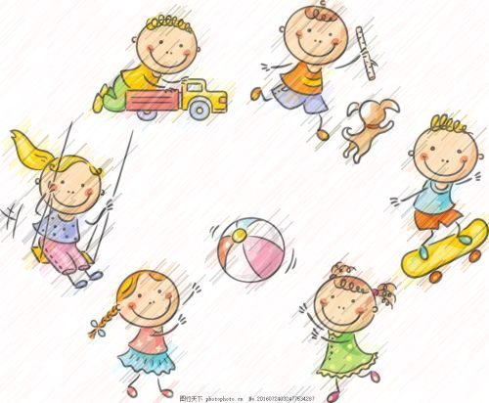
May get my vise

Slide 9

Free grand free grand to like pretty flowers

Slide 10

Without you for green I say hello

Slide 11

Friend had to tell I am glowing

Slide 12

Like a bright star

Slide 13
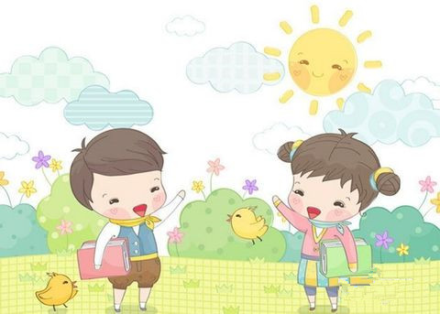
Everyone says hello when finds smile

Slide 14
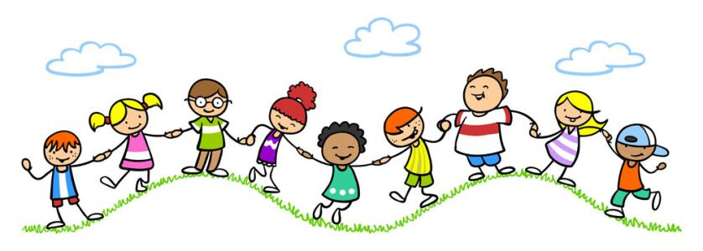
I am a very clean child

Slide 15
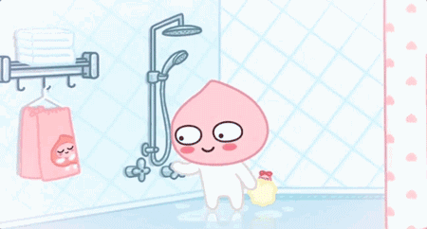
I'll go take a bath
Scrappy scrappy scrappy

Slide 16

Let the rap with so scrappy scrappy
I feel so clean body and mental

Slide 17


I am a very clean child
I am a very clean child

