Slide 1
Oxford English
Unit 3
Health and food
赖玢琳
华南师范大学外文学院

Slide 2
The Greatest
Sia

Slide 3
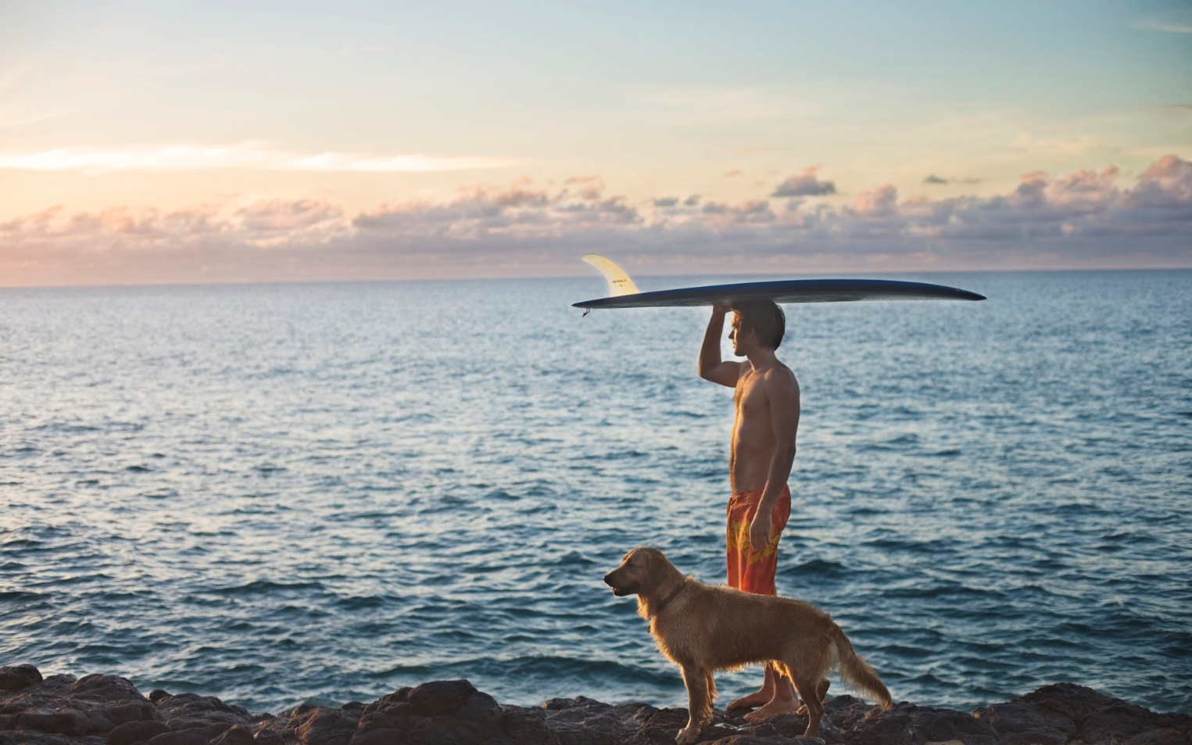
Uh-oh running out of breath but I
Oh I I got stamina

Slide 4
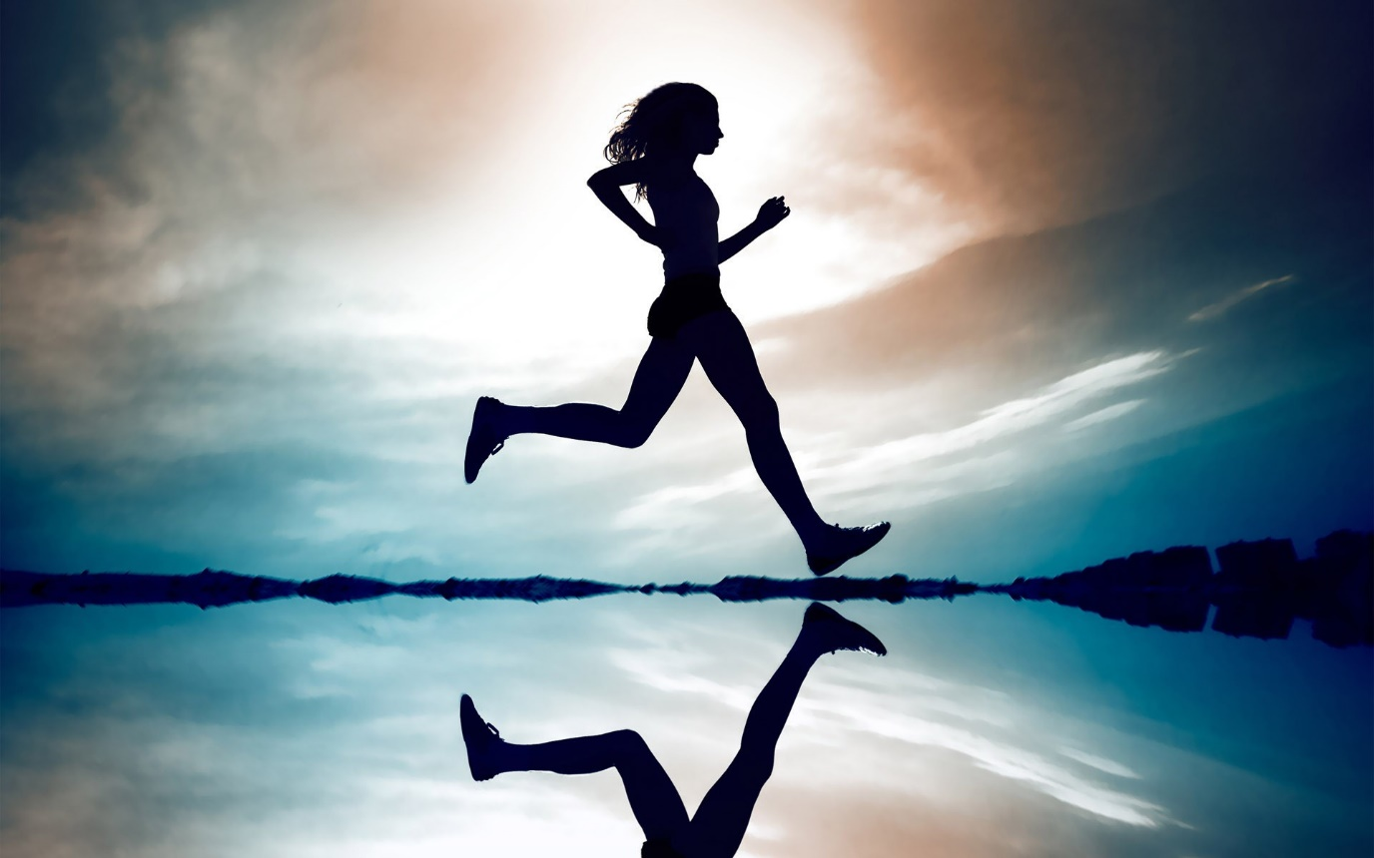
Uh-oh running now I close my eyes
Well oh I got stamina

Slide 5
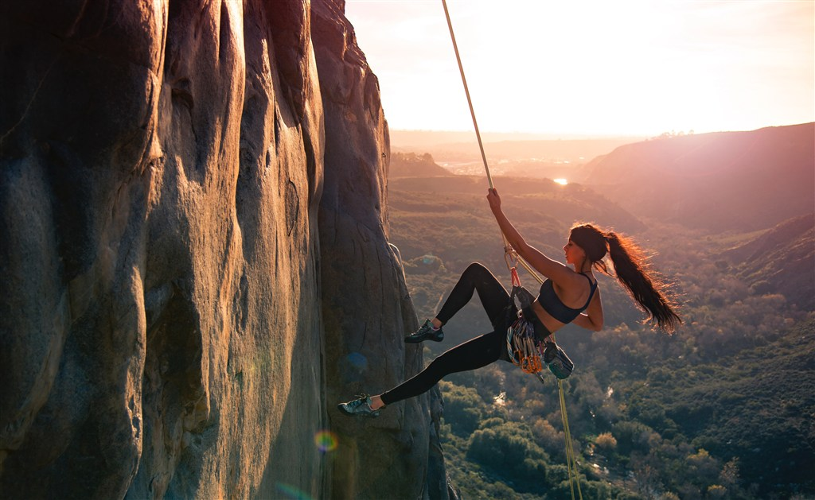
And uh-oh I see another mountain to climb
But I I got stamina

Slide 6
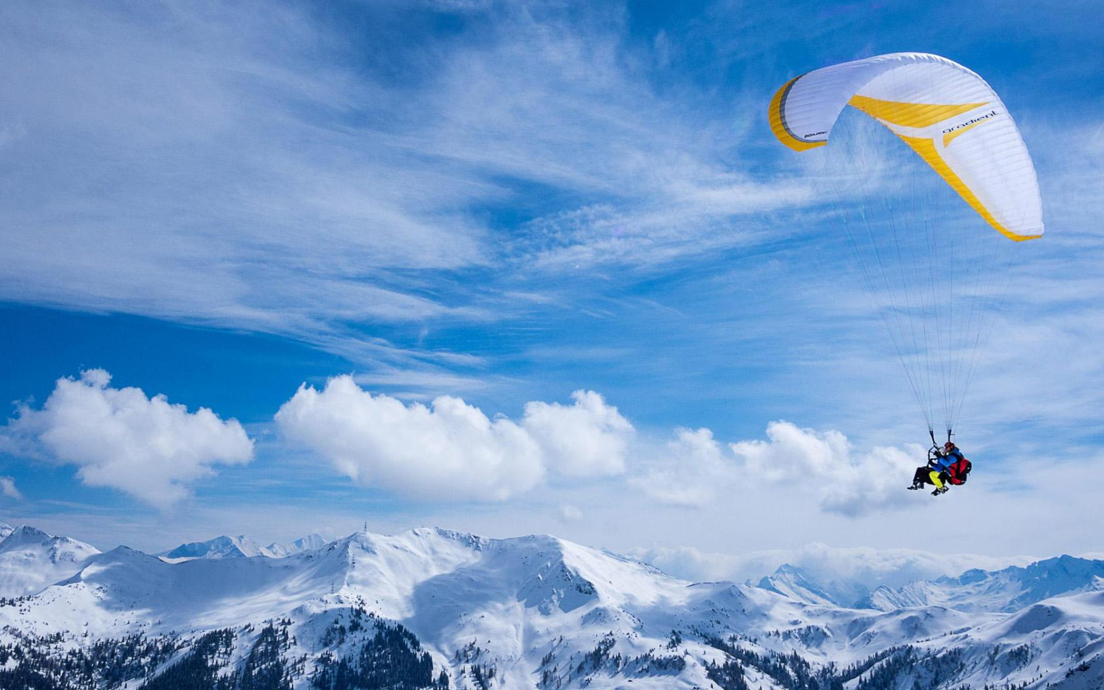
And uh-oh I need another love to be mine
Cause I I got stamina

Slide 7
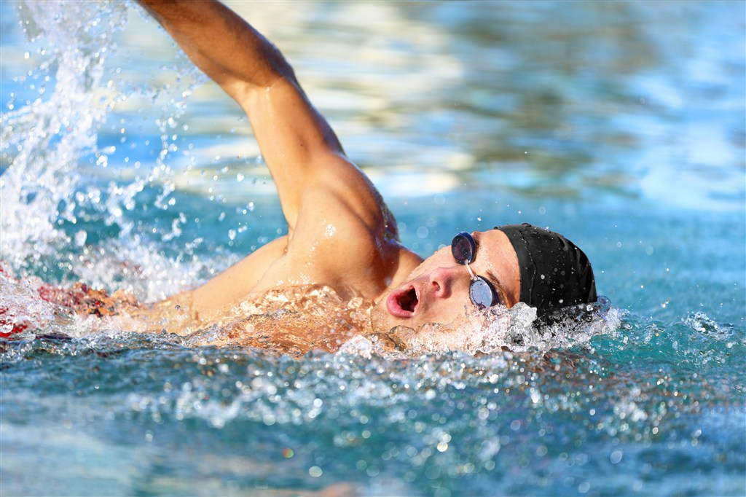
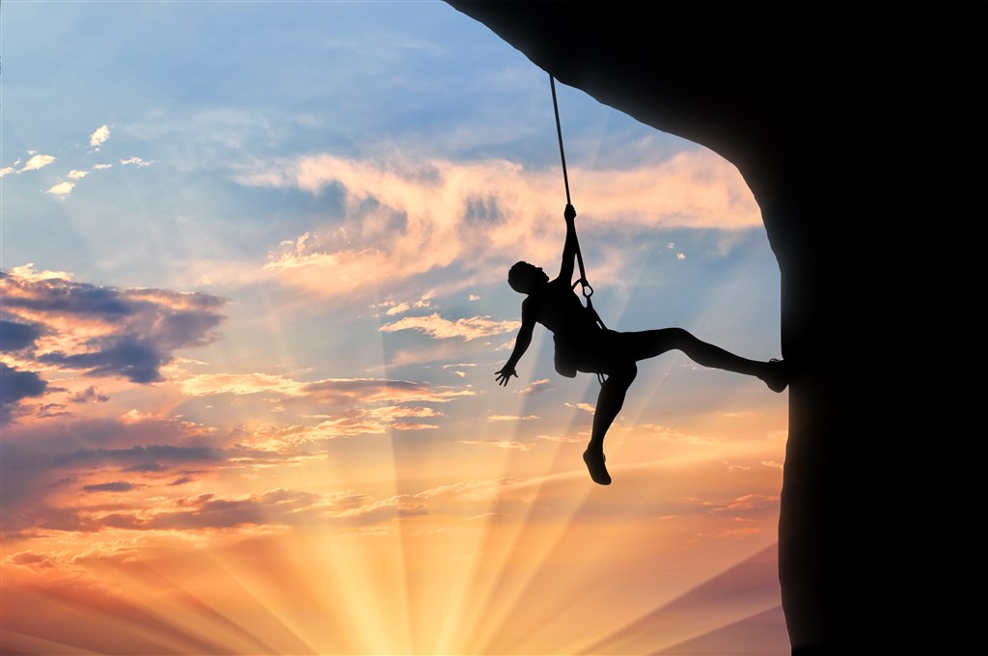
Don't give up I won't give up
Don't give up no no no
Don't give up I won't give up
Don't give up no no no

Slide 8
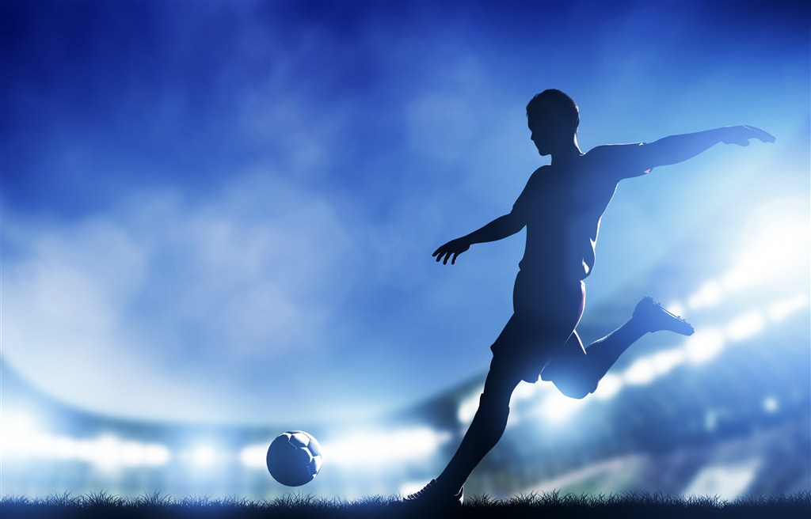
I'm free to be the greatest I'm alive

Slide 9
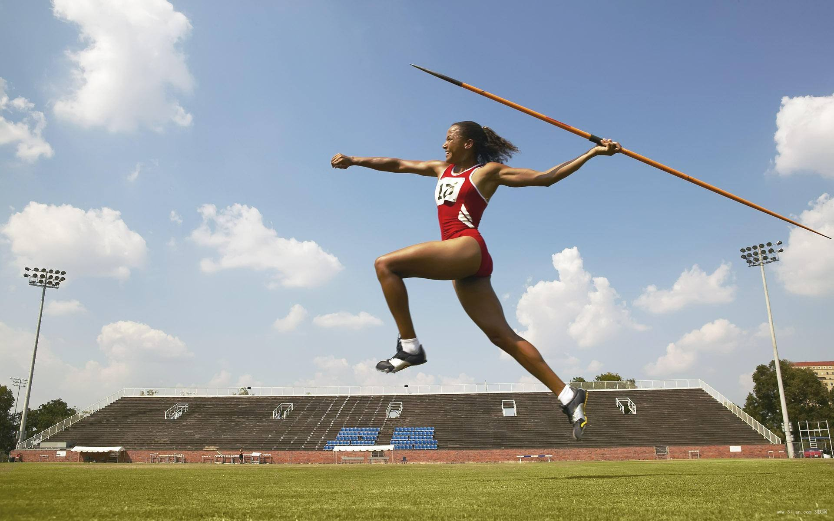
I'm free to be the greatest here tonight the greatest
The greatest the greatest alive
The greatest the greatest alive

Slide 10
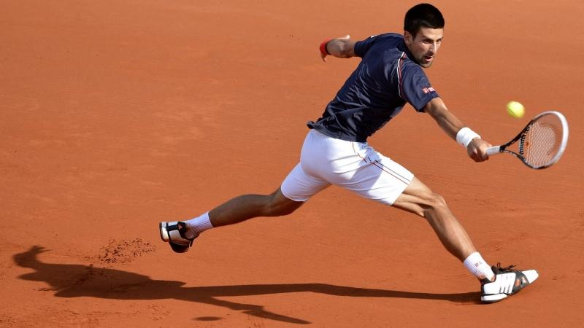
Well uh-oh running out of breath but I
Oh I I got stamina

Slide 11
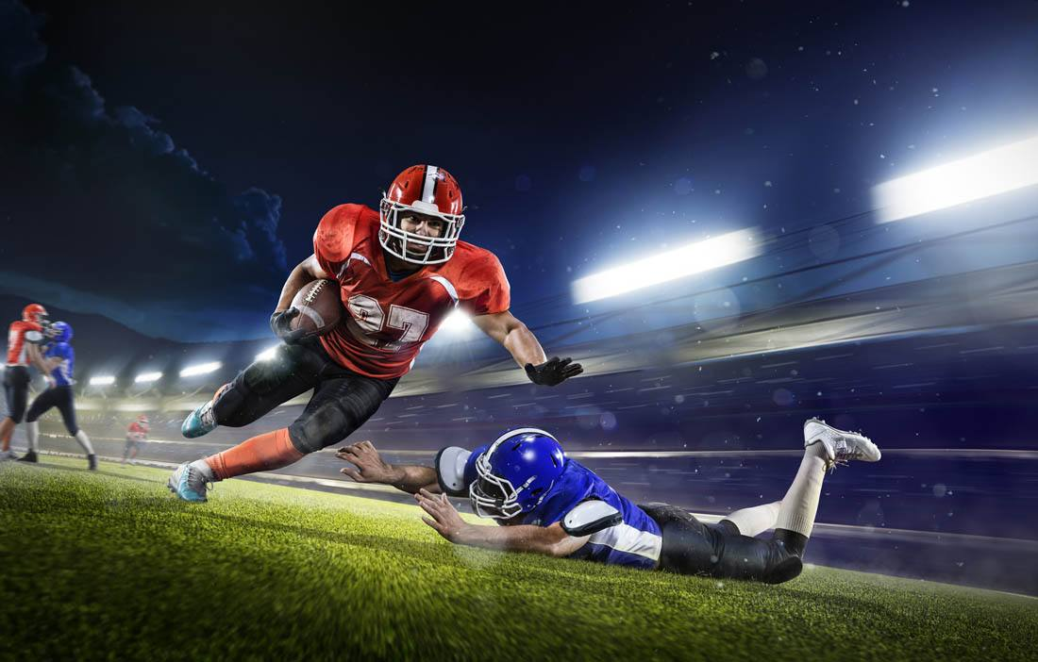
Uh-oh running now I close my eyes
But oh I got stamina

Slide 12
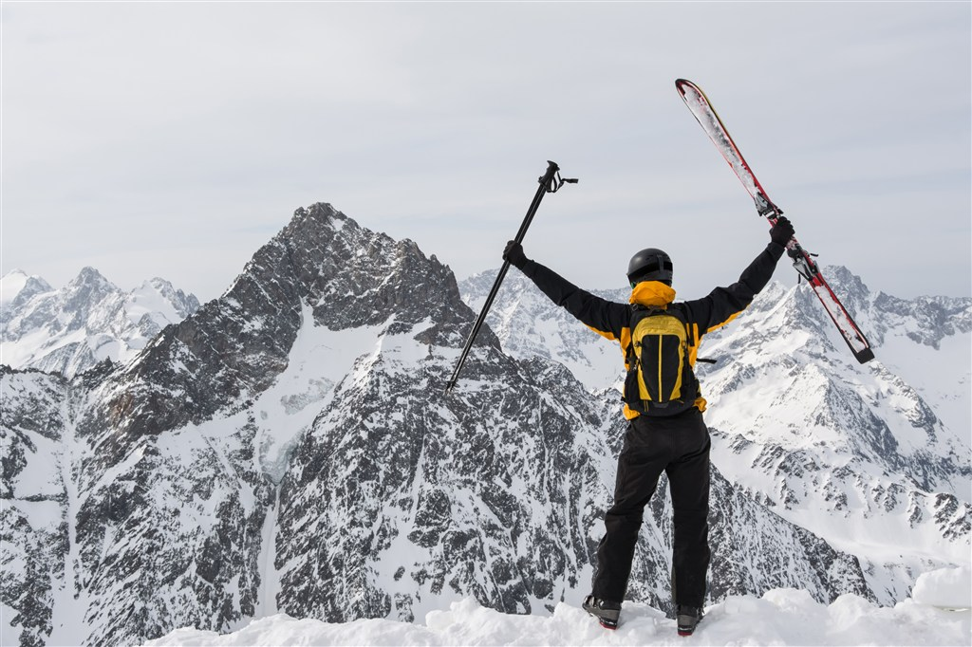
And oh yeah running to the waves below
Uh-oh I got stamina

Slide 13
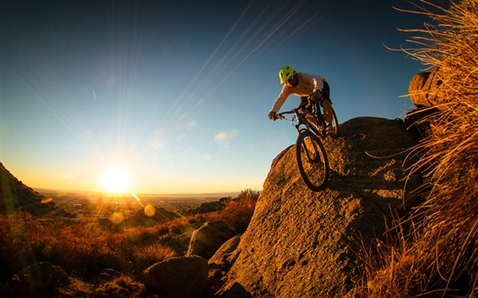
And oh yeah I'm running and I'm just enough
And uh-oh I got stamina

Slide 14
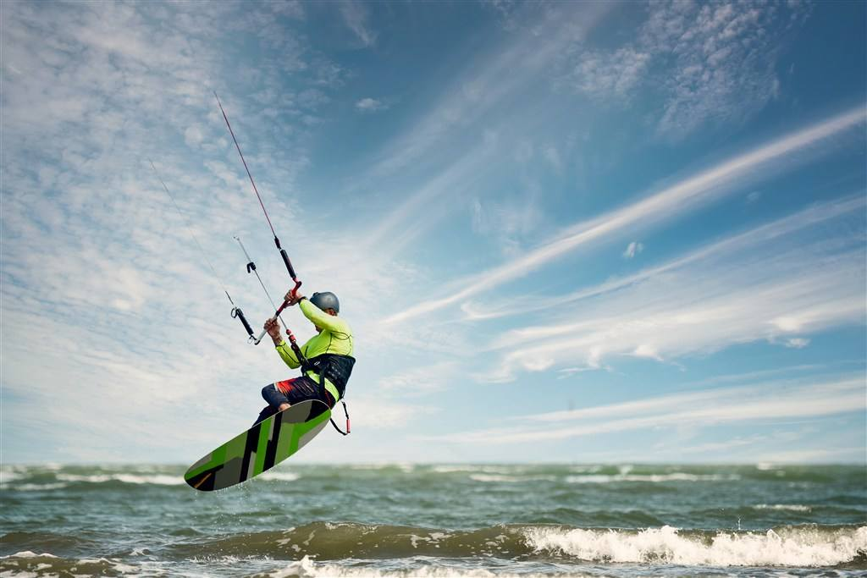
Don't give up I won't give up
Don't give up no no no
Don't give up I won't give up
Don't give up no no no

Slide 15
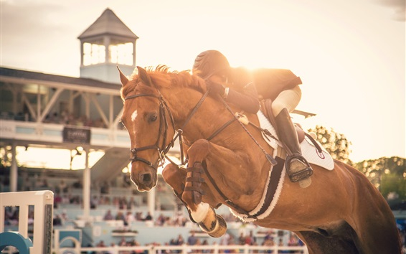
I'm free to be the greatest I'm alive

Slide 16
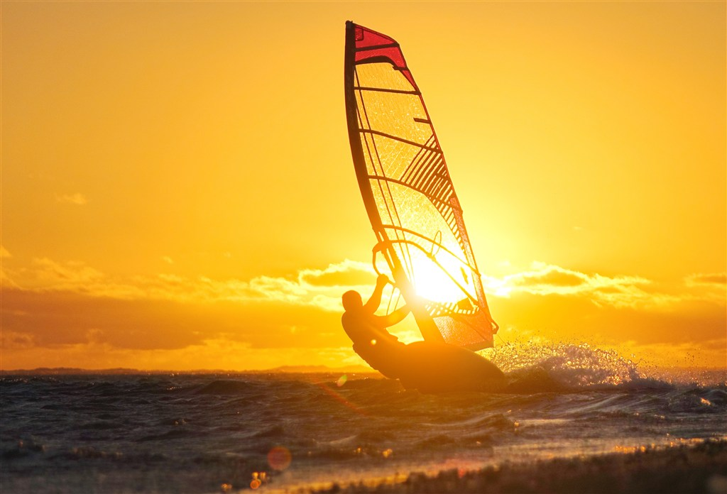
I'm free to be the greatest here tonight the greatest
The greatest the greatest alive
The greatest the greatest alive

Slide 17
Oh-oh I got stamina

