Slide 1
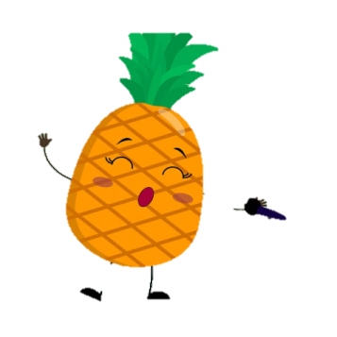
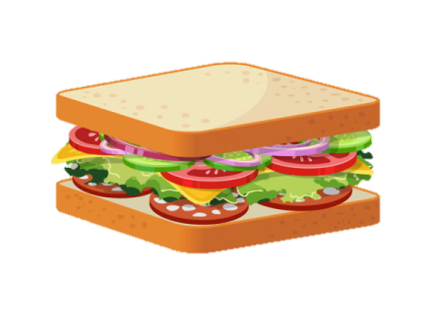
Products
作者：林敏纯
单位：华南师范大学外文学院

Slide 2
Unit 4 Let’s go shopping
Song: Shopping
Singer: Barenaked Ladies
教材：沪教版初中英语七年级下Unit4
Let’s go shopping

Slide 3
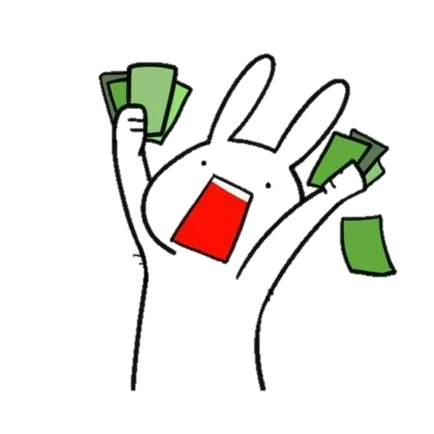
Shopping
Well you know that it's going to be alright
I think it's gonna be alright

Slide 4
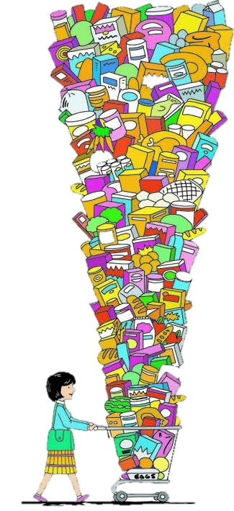
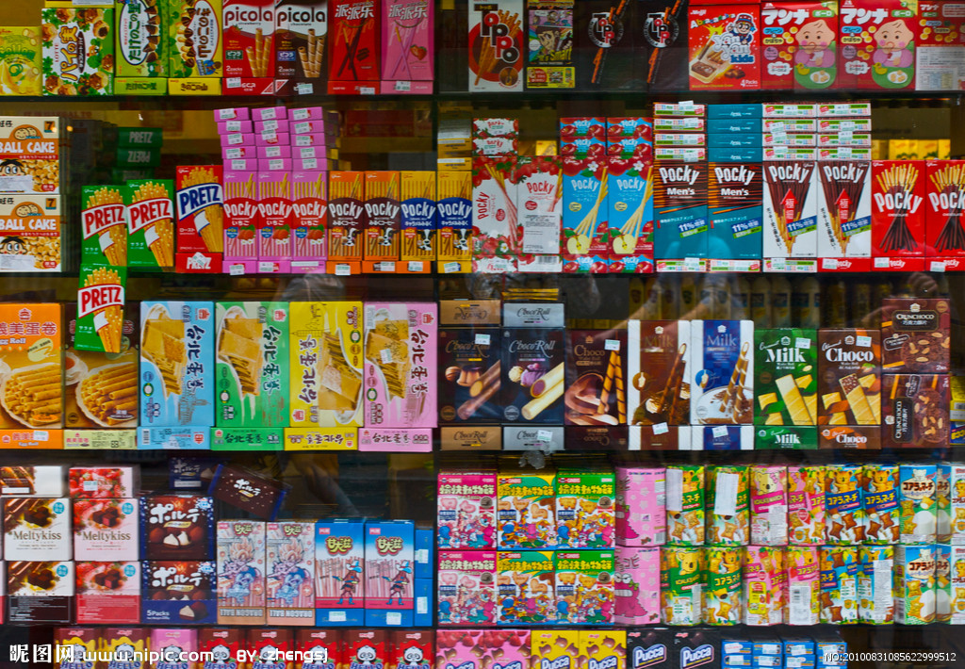
单击此处输入标题文本
PART
01
When we go shopping
Everything will always be alright

Slide 5
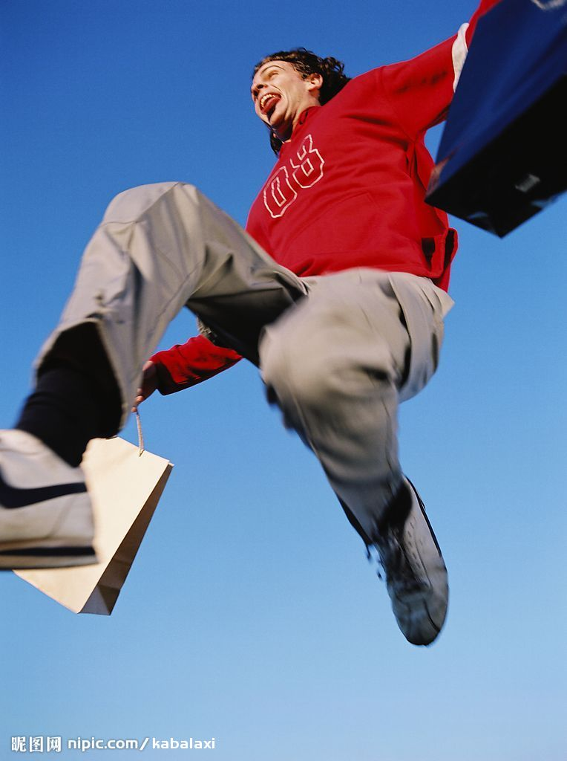
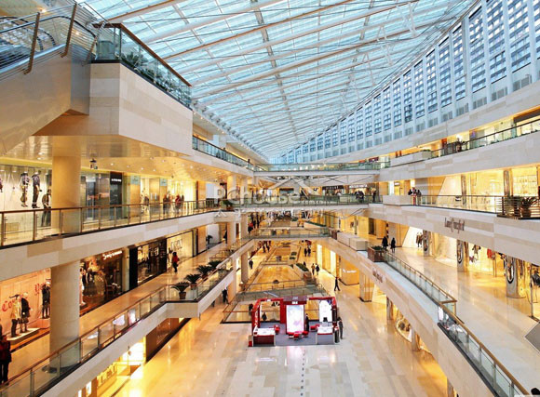
Well you know that it's going to be alright
When we go shopping

Slide 6
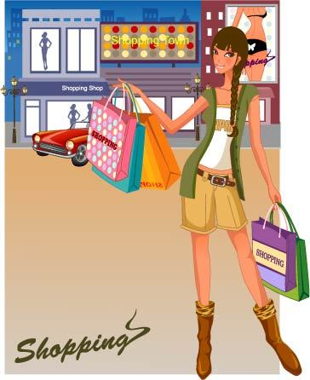
It's always lalalalala...
Shopping spree begin

Slide 7
lalalalala...
Everybody wins

Slide 8
So shut up...

Slide 9
And never stop
Let's shop

Slide 10
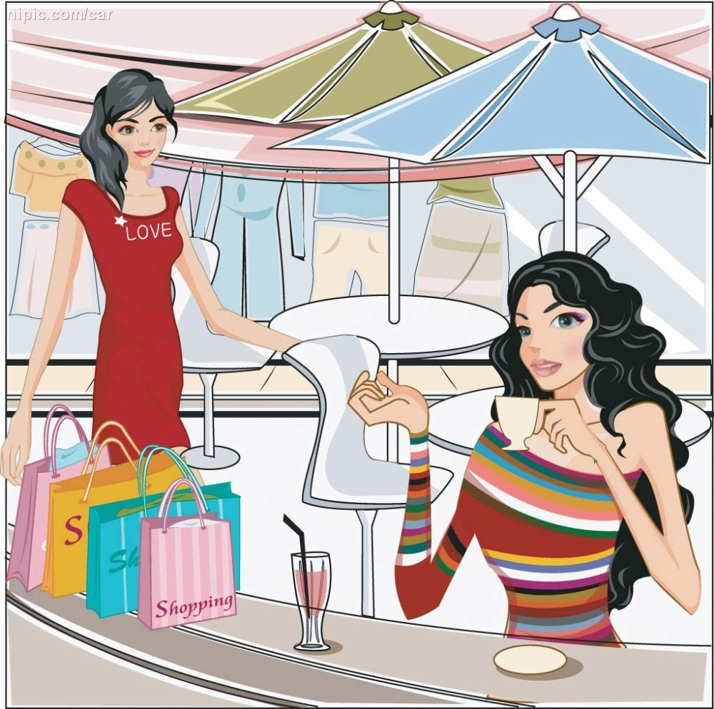
Until we drop

Slide 11
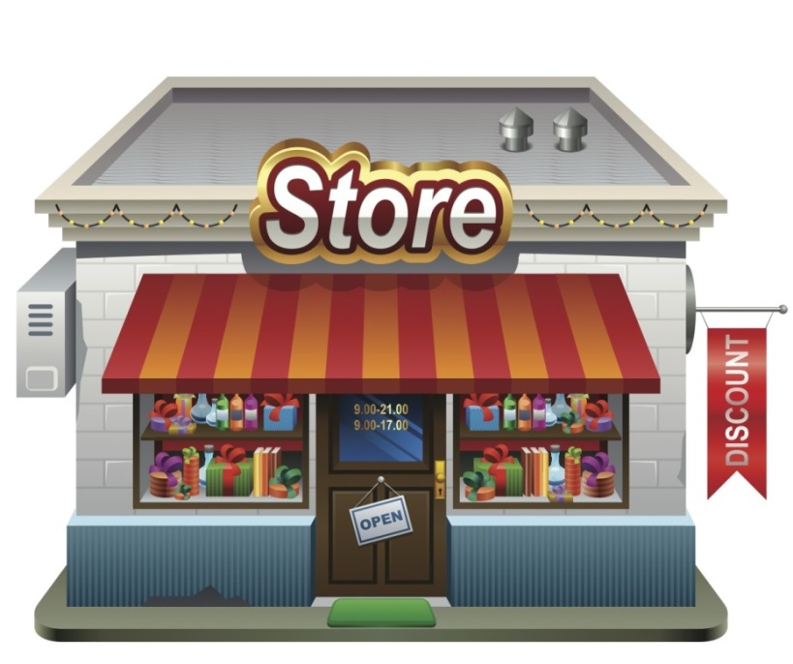
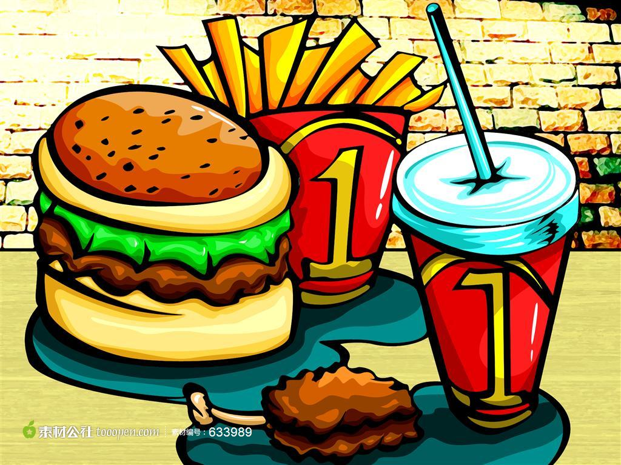
Well you know that it's going to be alright
I think it's gonna be alright

Slide 12
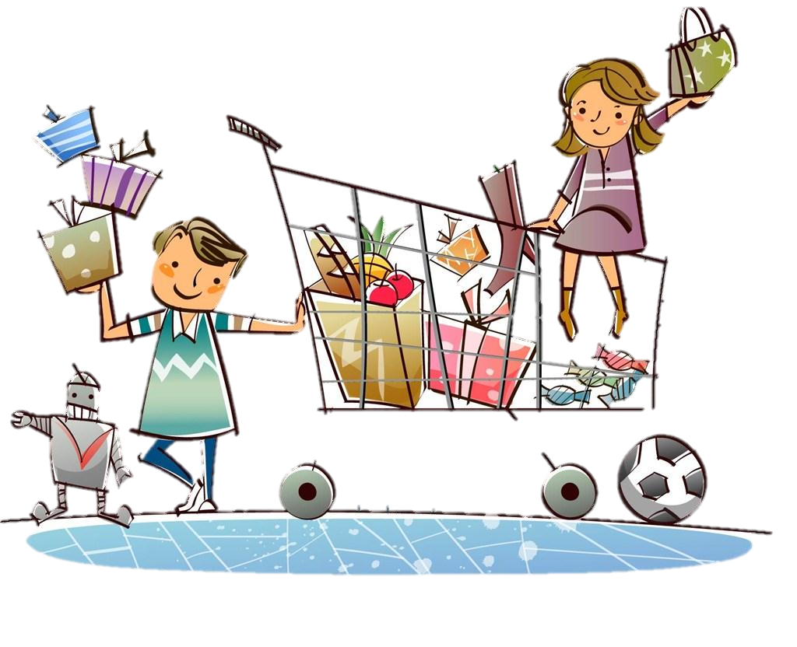
Everything will always be alright
When we go shopping

Slide 13
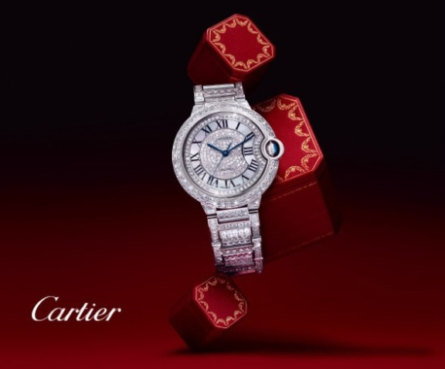
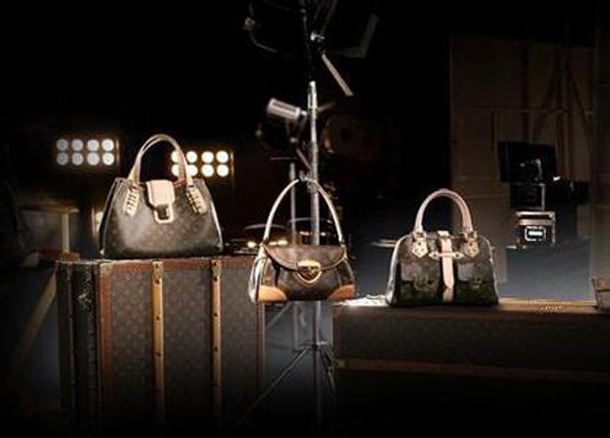
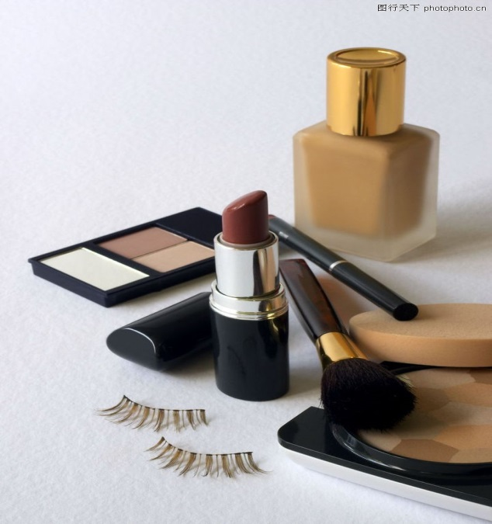
It's always lalalalala...
Shopping never end

Slide 14
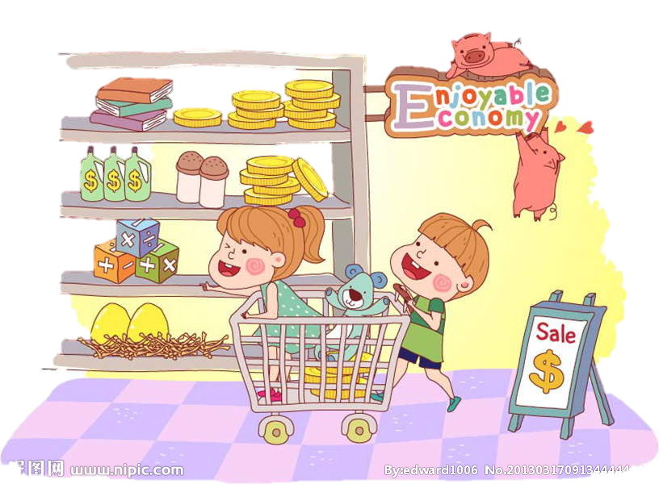
lalalalala...
Shopping with our friends

Slide 15
Shopping once again

Slide 16
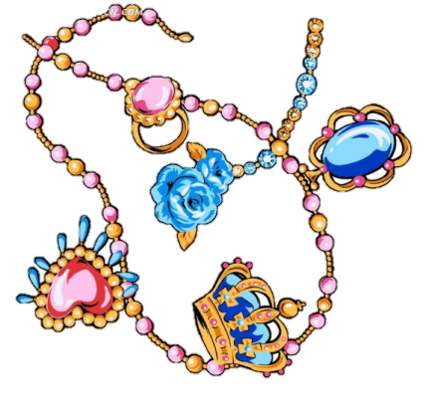
It's always lalalalala...

Slide 17
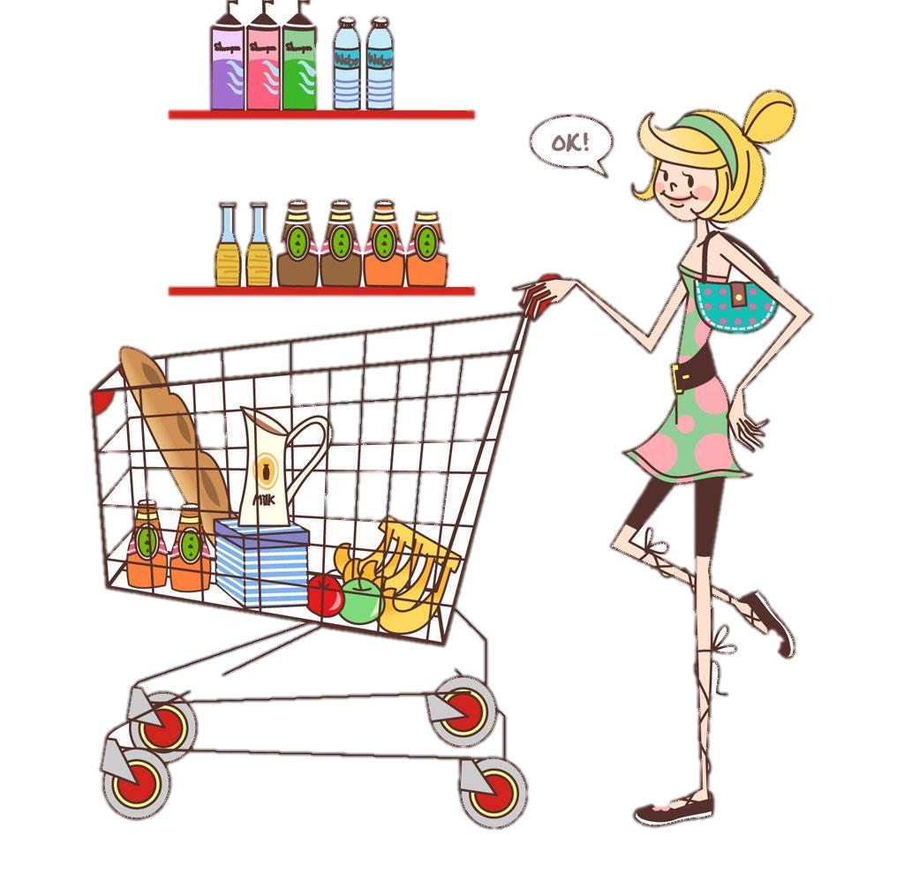
Until you've got all the stuff
It's never enough

Slide 18
When the going gets rough
Just shop with somebody tough

Slide 19
Well you know that it's going to be alright
I think it's gonna be alright

Slide 20
Everything will always be alright
When we go shopping

Slide 21
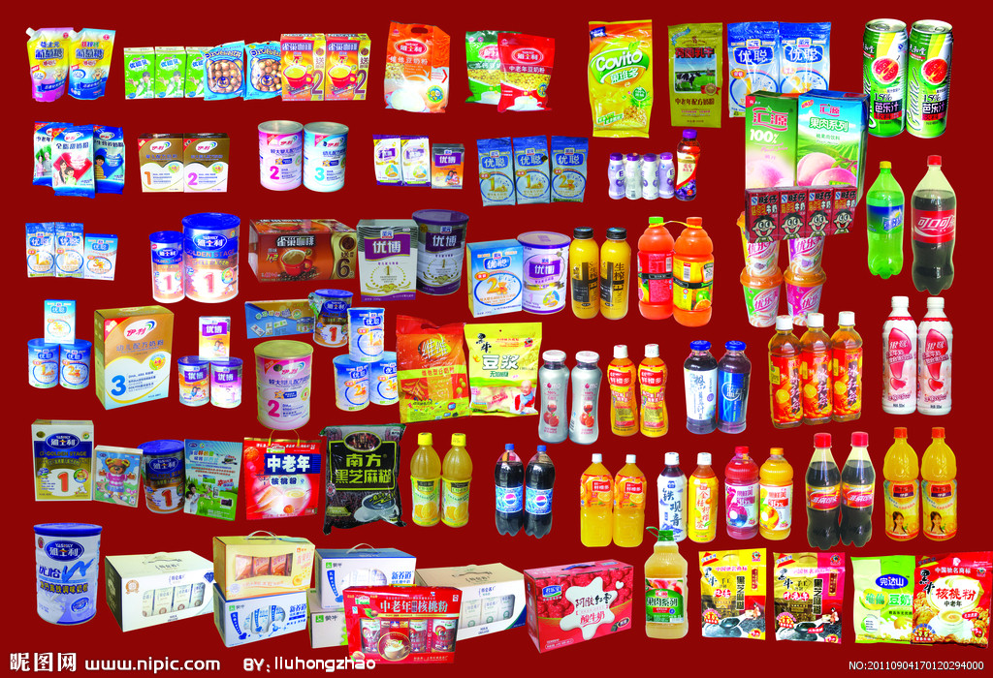
Well you know that it's going to be alright

Slide 22
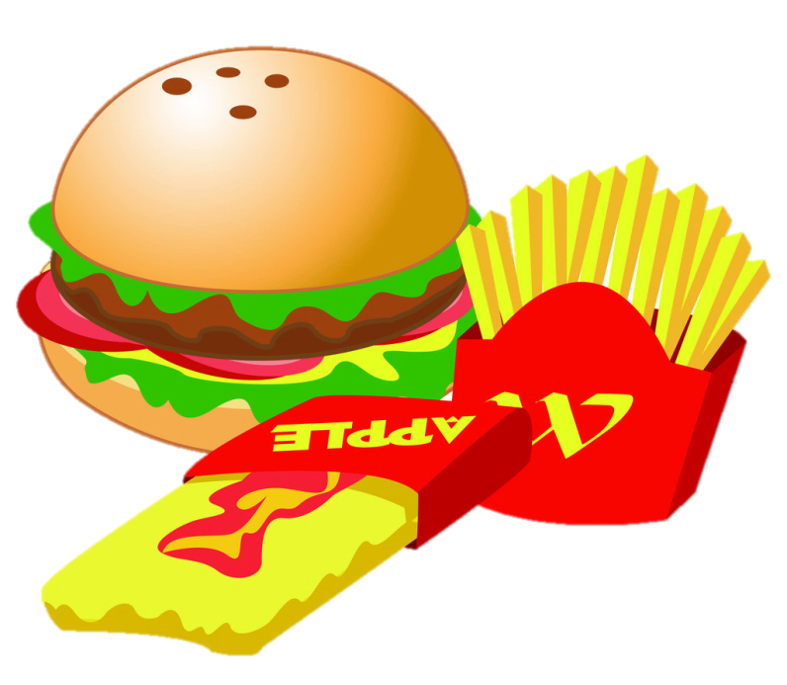
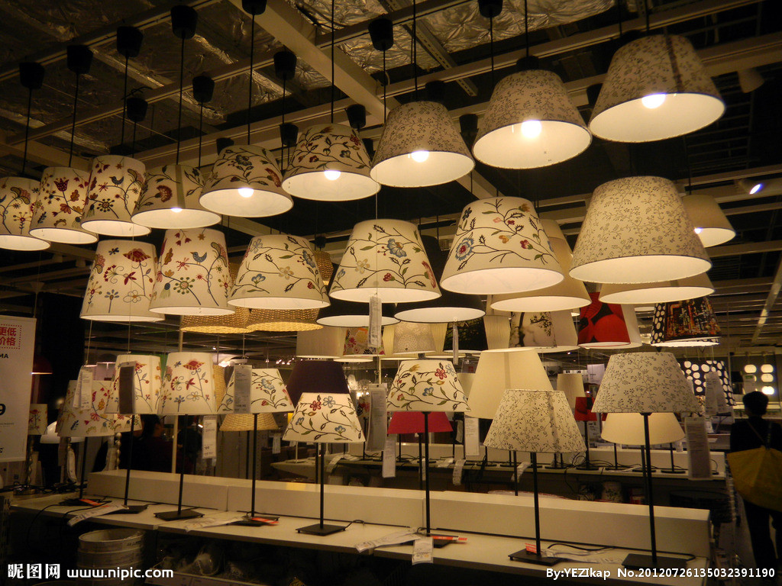
Everything will always be alright
I think it's gonna be alright

Slide 23
When we go shopping

Slide 24
It's always lalalalala...

Slide 25
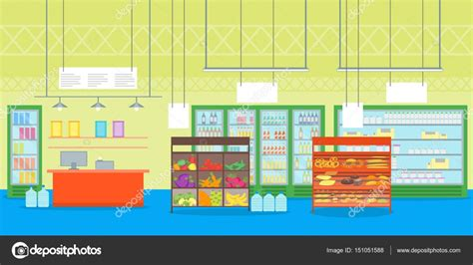
When we go shopping

Slide 26
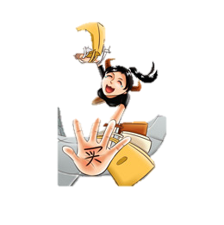
It's always lalalalala...

