Slide 1
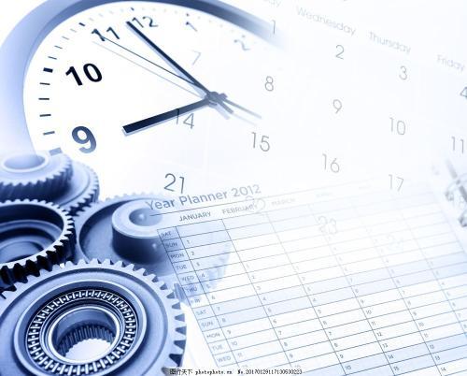
Song : What time is it
Singer: Zac Efron、Vanessa Anne Hudgens、Ashley Mizassaro
High School Musical Cast
教材：人教版初中英语七年级下
U2 What time do you go to school?
主题内容：安排
单位：华南师范大学外文学院
作者：杨瑾

Slide 2
Party
Study
Breakfast
Wash&Brush
Time And Activity Arrangement
Get up
What time is it? Summer time!

Slide 3
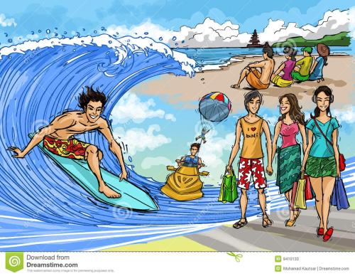
It's our vacation!

Slide 4
What time is it? Party time! That's right,say it loud.
What time is it? The time of our lives!
Anticipation.

Slide 5
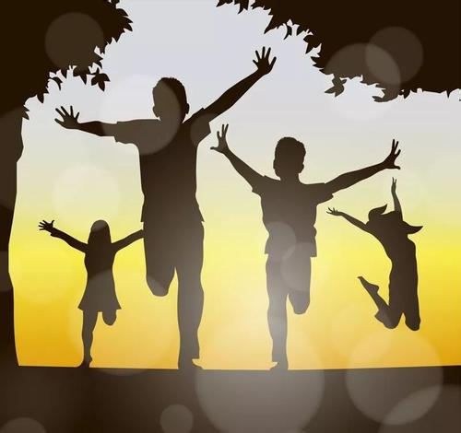
What time is it? Summer time!
School's out,scream and shout!
Finally summer's here.
Good to be chilling out.

Slide 6
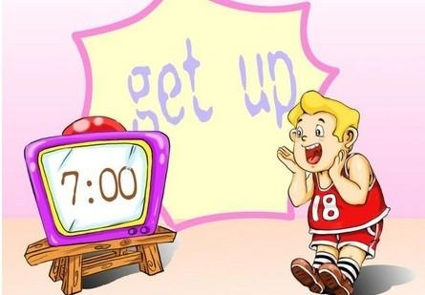
What time is it? It is time to...
I'm off the clock,The pressures out.
Now my girl's what it's all about.

Slide 7
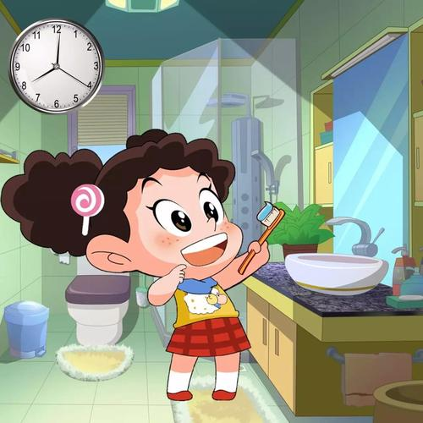
Ready for some sunshine.
For my heart to take a chance.
I'm here to stay,Not moving away.
Wash and
brush time

Slide 8
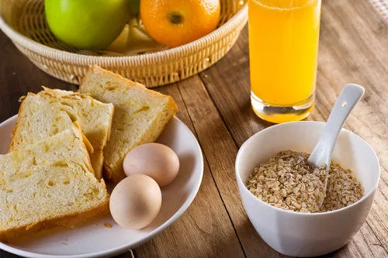
Ready for a summer romance.
Everybody ready,going crazy,yeah we're out.
Come on and let me hear you say it now right now.
Breakfast Time

Slide 9
Study Time
Don't forget to study!
What time is it ？
Summer time.
It's our vacation.

Slide 10
Party time!
That's right,say it loud.
What time is it?

Slide 11
What time is it ?
Time of our lives.
Anticipation!

Slide 12
What time is it? Summer time!
School's out,scream and shout!
Goodbye to the rules no summer school.

Slide 13
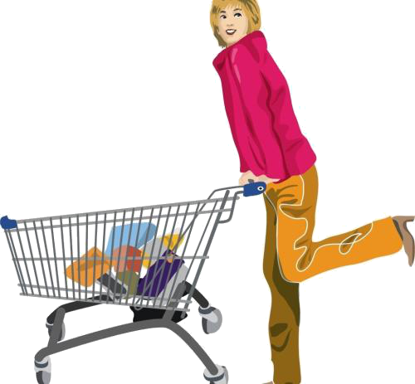
I'm free to shop till I drop.
It's an education vacation.
And the party never has to stop.
Time
Shopping

Slide 14
We've got things to do we'll see you soon.
And we're really gonna miss you all.
Goodbye to you and you.
And you and you.
Bye-bye until next fall.

Slide 15
Everybody ready going crazy yeah we're out.

Slide 16
come on!
And let me hear you say it now.
Right now!

Slide 17
What time is it? Summer time!
It's our vacation!

Slide 18
What time is it?
Party time!
That's right!
Say it loud!

Slide 19
What time is it?
Time of our lives.
Anticipation.

Slide 20
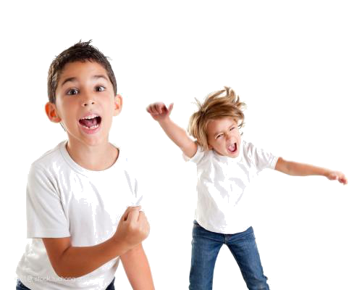
What time is it?
Summer time.
School's out scream and shout.

Slide 21
No more waking up at 6 a.m.
'Cause now the times is all our own.

Slide 22
Enough already.We're waiting.
Come on, let' s go.
Go out of control.

Slide 23
Alright.

Slide 24
Cleaning time
Everybody!

Slide 25
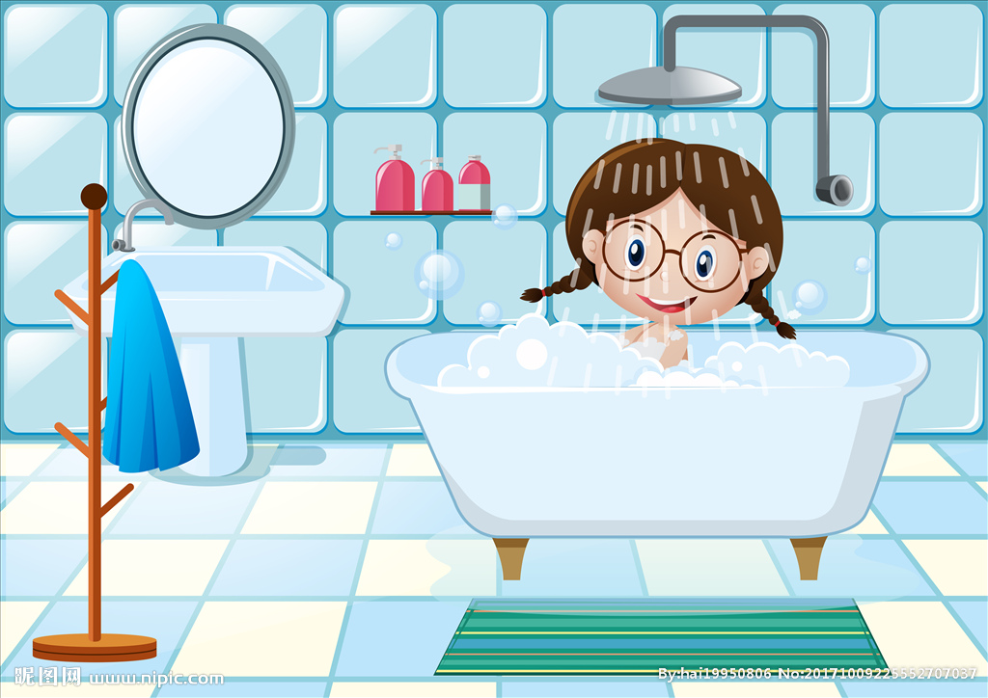
Bath time

Slide 26
Come on!

Slide 27
School's pride let's show it.
We're champions and we know it.
Wildcats are the best.
Red white and gold.

Slide 28
When it's time to win we do it.
We're number one we prove it.

Slide 29
Let's live it up party down.
That's what the summer's all about.

Slide 30
Summer time！
What time is it?
Summer time is finally here.
Let's celebrate.
We wanna hear your loud and clear now.

Slide 31
Sleep time
School's out.
We can sleep as late as we want to.
It's our time now.
We can do whatever we wanna do.

Slide 32
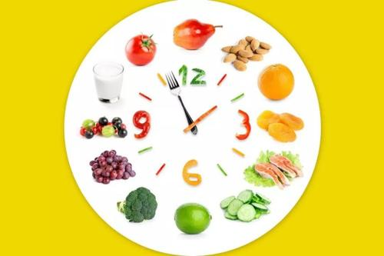
What time is it?
It's summer time.
We're loving it.

Slide 33
Come on
and say again now.

Slide 34
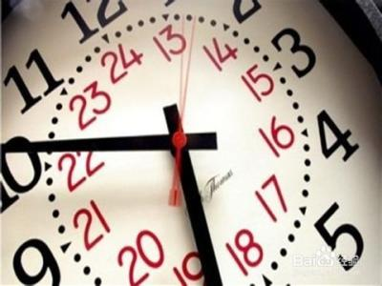
What time is it?
It's party time!

Slide 35
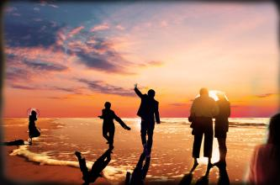
Let's go and have time of our lives.

Slide 36
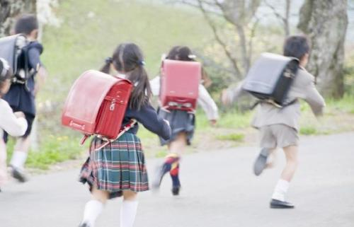
Let's learn to arrange our time!
Thank you!

