Slide 1
教材：外研版八年级下册
Module 9 Friendship
单位：华南师范大学外文学院
作者：曾预晴

Slide 2
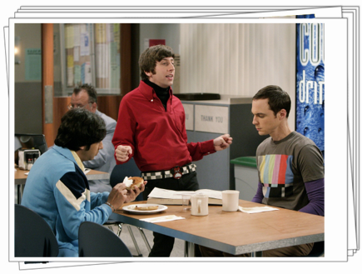
When you have no light
to guide you
I will come to you
And no one to walk to
walk beside you
Oh ,I will come to you

Slide 3
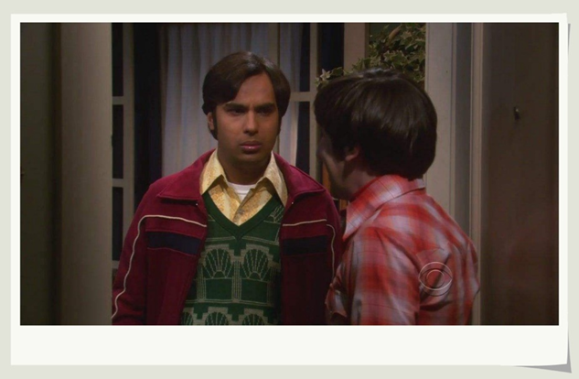
When the night is dark and stormy
You won't have to reach out for me

Slide 4
I will come to you
Oh I will come to you
Sometimes when all your dreams may have seen better days

Slide 5
And you don't know how or why, but you've lost your way
Have no fear when your
tears are fallin'

Slide 6
I will hear your spirit callin
And I swear I'll be there come what may

Slide 7
When you have no light to
guide you
And no one to walk beside you
I will come to you
Oh ,I will come to you

Slide 8
When the night is dark and stormy
You won't have to reach out for me

Slide 9
Oh I will come to you
I will come to you

Slide 10
Oh, la……
I will come to you la
'Cause even if we can’t
be together
We'll be friends now
and forever

Slide 11
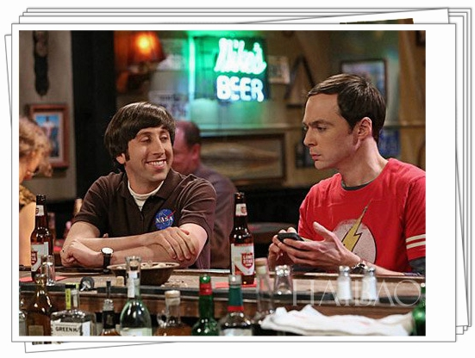
And i swear that i'll be
there come what may
When the night is dark and stormy

Slide 12
You won't have to reach out for me
I will come to you
Oh i will come to you
Oh……

Slide 13
We all need somebody we can turn to
Oh
Someone who'll always understand

Slide 14
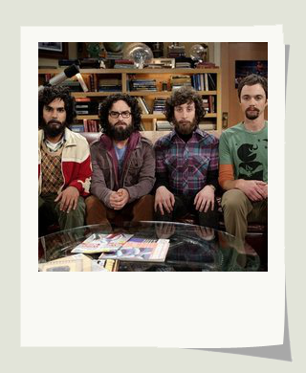
And you need the strength to keep tryin'
Oh…
So if you feel that your
soul is dyin'
La…
I'll reach out and take your hand

Slide 15
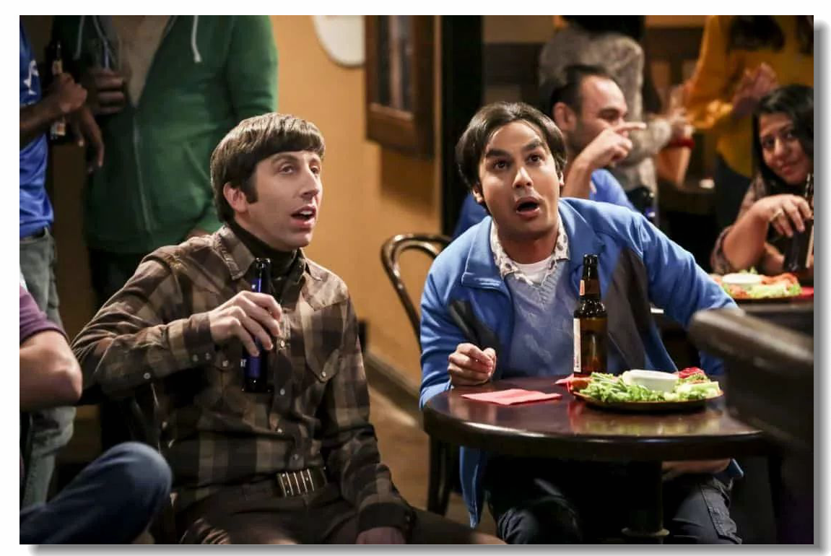
Hey…La…
I will reach out for you
Ho oh I will come to you

Slide 16
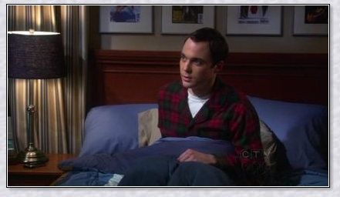
When you have no light
to guide you
I will come to you
And no one to walk
beside you
Oh i will come to you

Slide 17
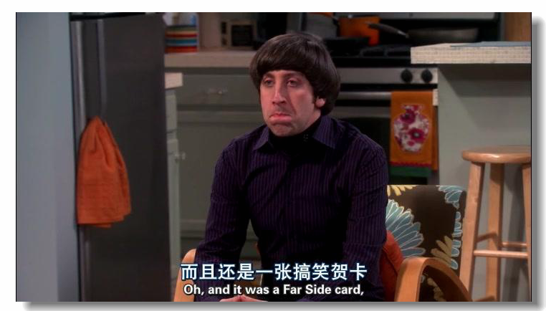
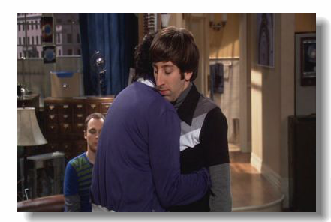
I will come to you
You won't have to reach out for me
Oh I will come to you
When the night is dark and stormy

Slide 18
Oh I will come to you
I will come to you

Slide 19
Thank you for listening

