Slide 1
主题内容：娱乐活动 (Entertainments)
作者：倪悦
单位：华南师范大学外文学院

Slide 2
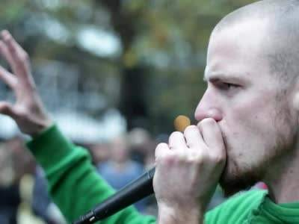
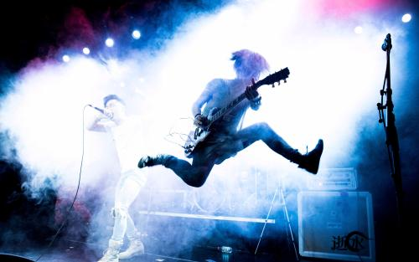
Somebody once told me
the world is gonna roll me

Slide 3
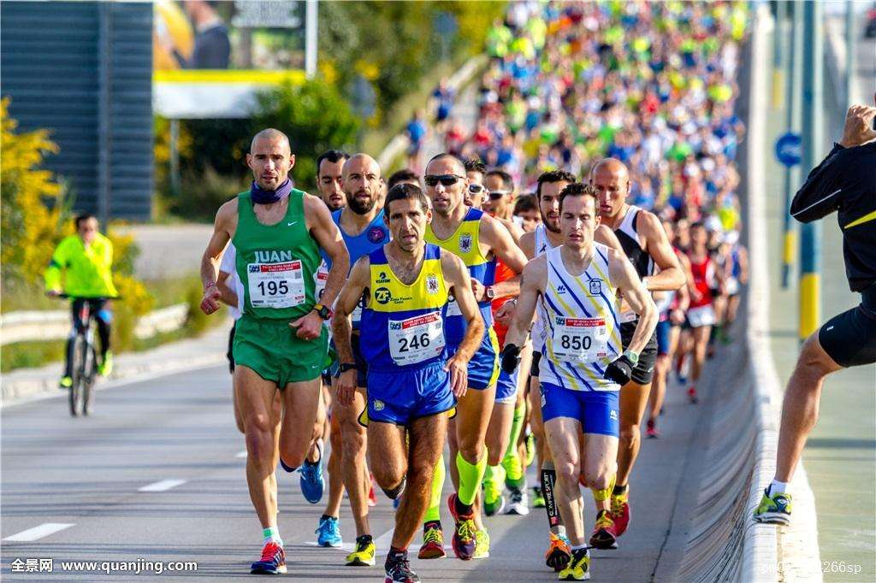
I ain't
the sharpest tool
in the shed

Slide 4
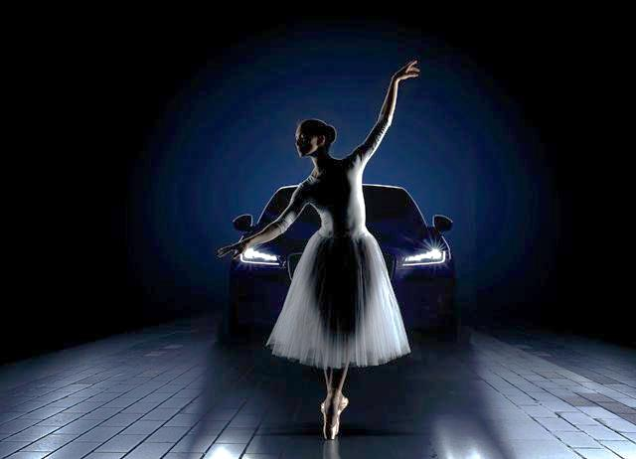
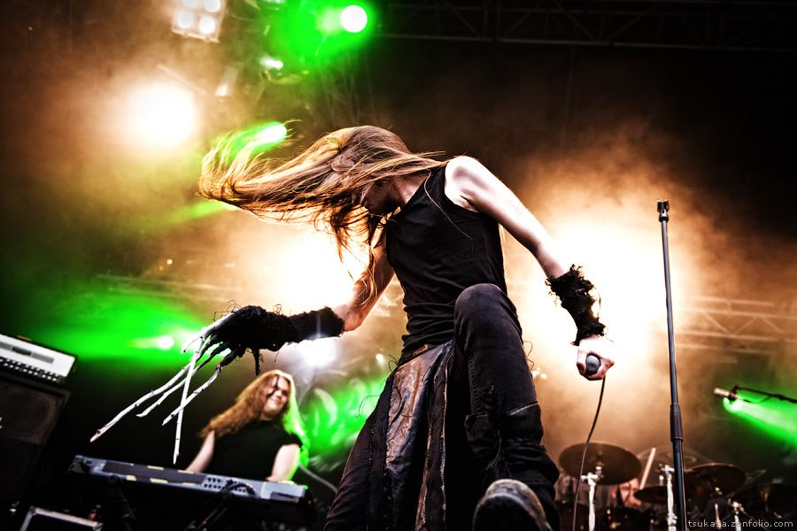
She was looking kind of dumb with her finger and her thumb
In the shape of an "L" on her forehead

Slide 5
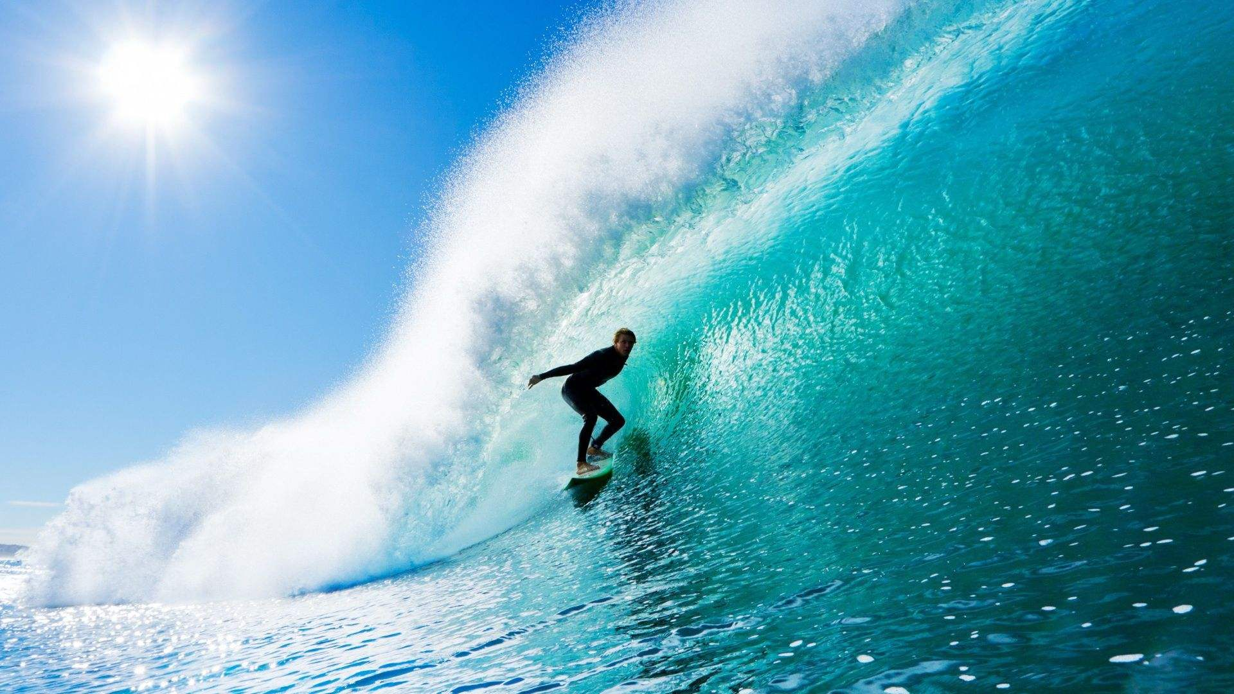
Well, the years start coming and they don't stop coming

Slide 6
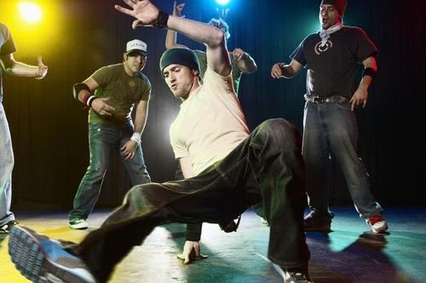
Fed to the rules and I hit the ground running

Slide 7
Didn't make sense not to
live for fun

Slide 8
Your brain gets smart but your head gets dumb

Slide 9
So much to do
So much to see

Slide 10
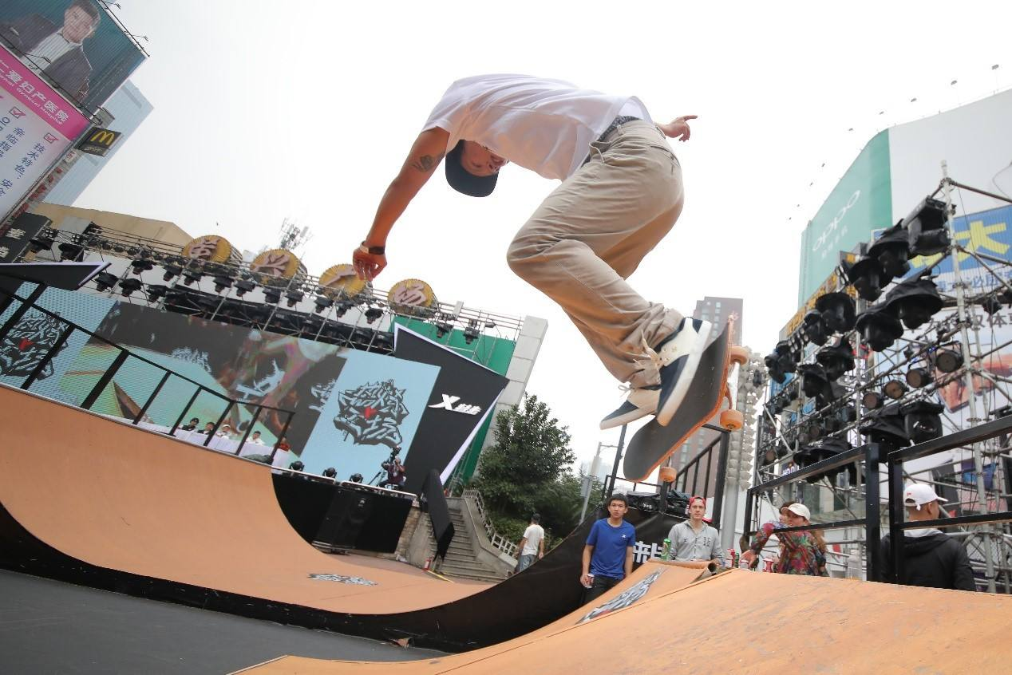
So what's wrong with taking the back streets?

Slide 11
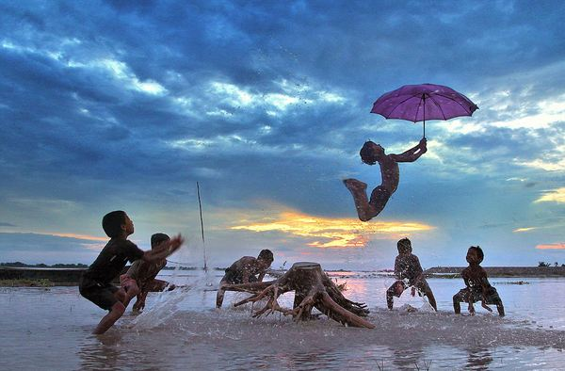
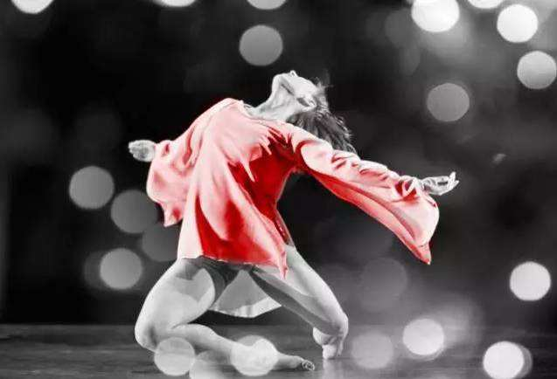
You'll never know if you don't go
You'll never shine if you don't glow

Slide 12
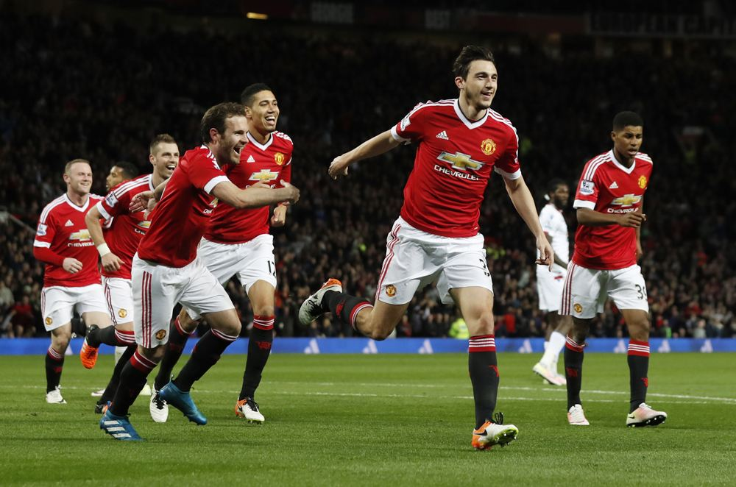
Hey, now, you're an All Star get your game on, go play
Hey, now, you're a Rock Star get the show on get paid

Slide 13
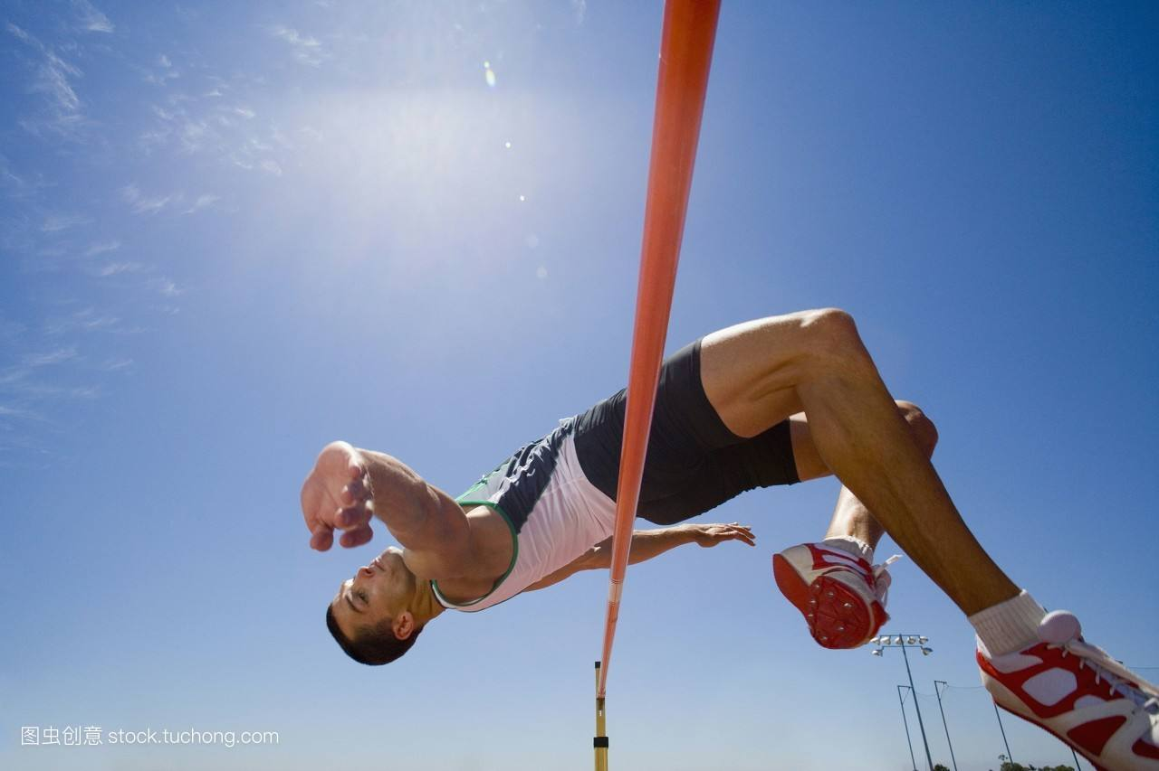
Only shooting stars break the mold
And all that glitters is gold

Slide 14
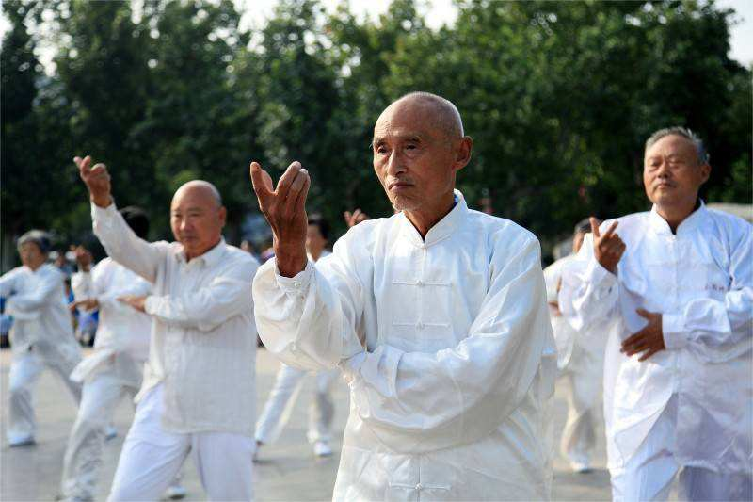
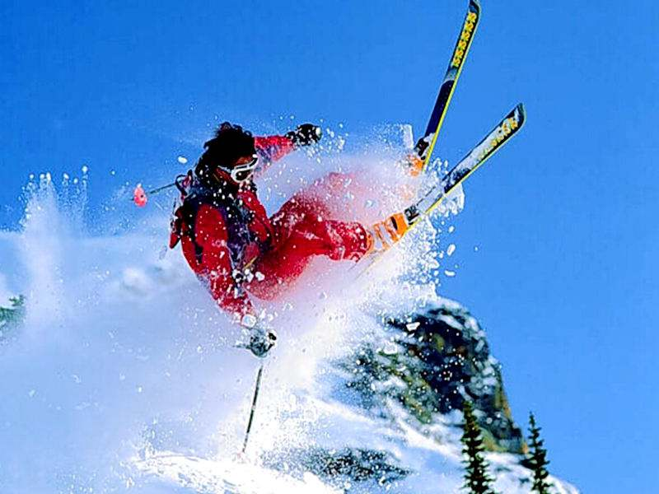
It's a cool place and they say it gets colder
You're bundled up now but wait till you get older

Slide 15
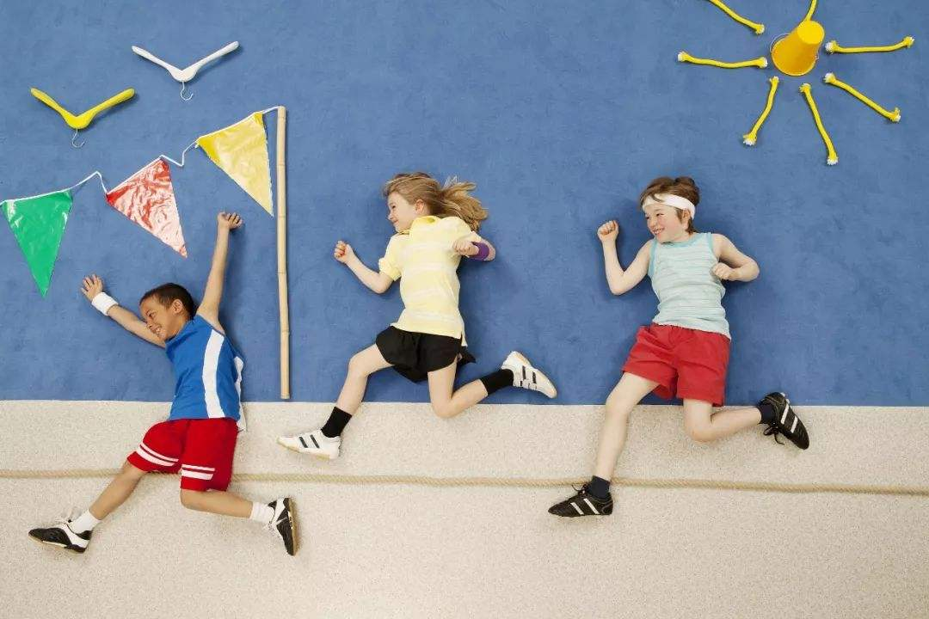
Judging by the hole in the satellite picture
But the meteor men beg to differ

Slide 16
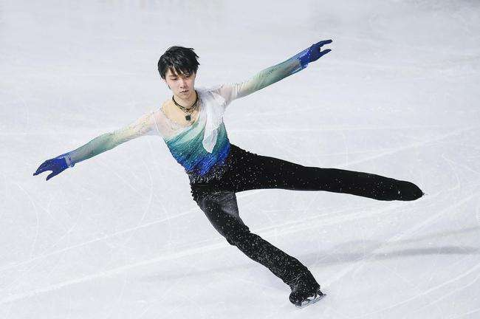
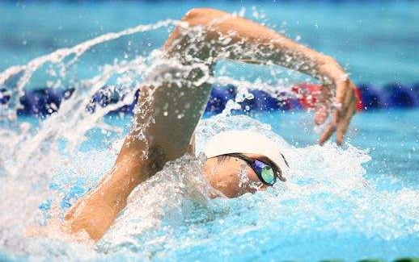
The ice we skate is getting pretty thin
The water's getting warm so you might as well swim

Slide 17
My world's on fire. How about yours?
That's the way I like it and I'll never get bored.

Slide 18
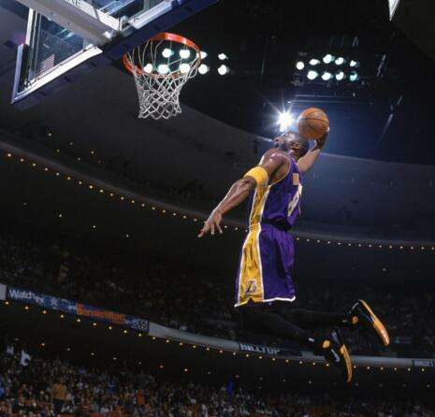
Hey, now, you're an All Star get your game on, go play
Hey, now, you're a Rock Star get the show on get paid

Slide 19
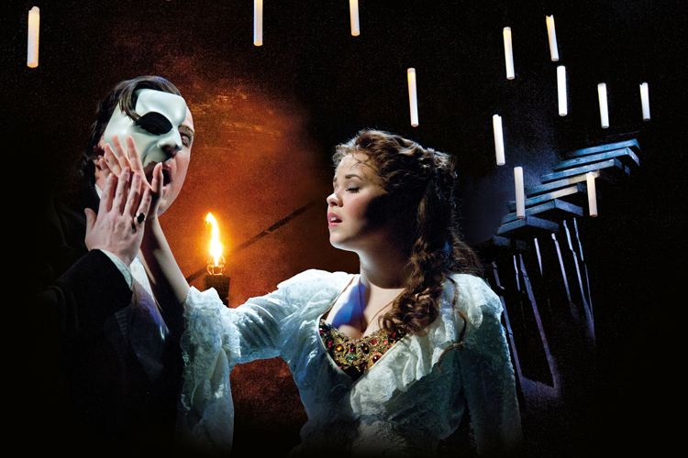
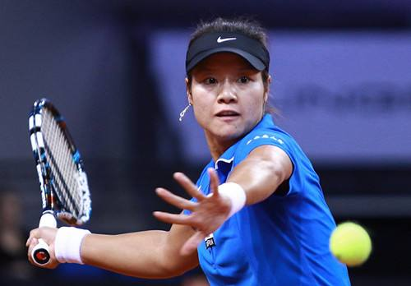
And all that glitters is gold
Only shooting stars break the mold

Slide 20
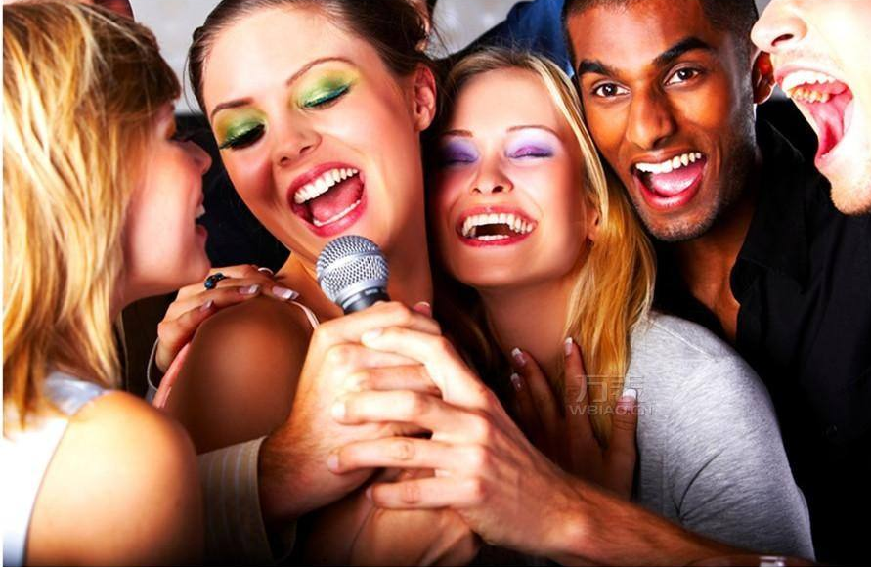

Slide 21
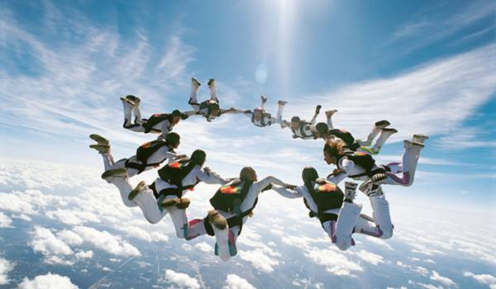
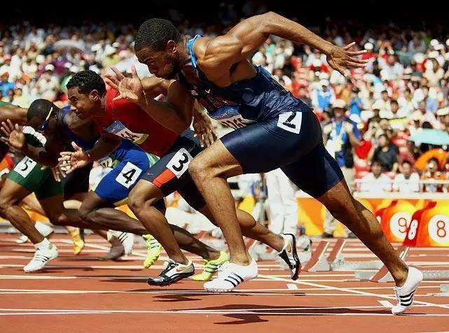
Hey, now, you're an All Star get your game on, go play
Hey, now, you're a Rock Star get the show on get paid

Slide 22
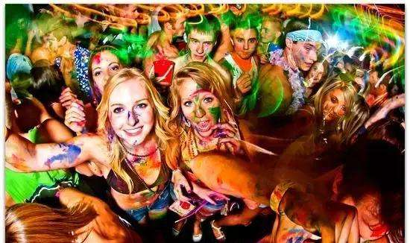
And all that glitters is gold
Only shooting stars

Slide 23
Somebody once asked, could I spare some change for gas
I need to get myself away from this place

Slide 24
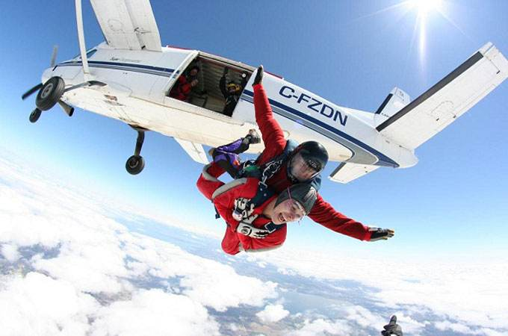
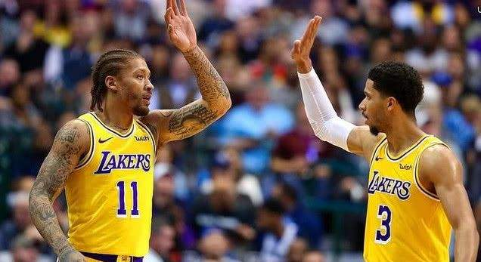
I said, Yep, what a concept. I could use a little fuel myself
And we could all use a little change

Slide 25
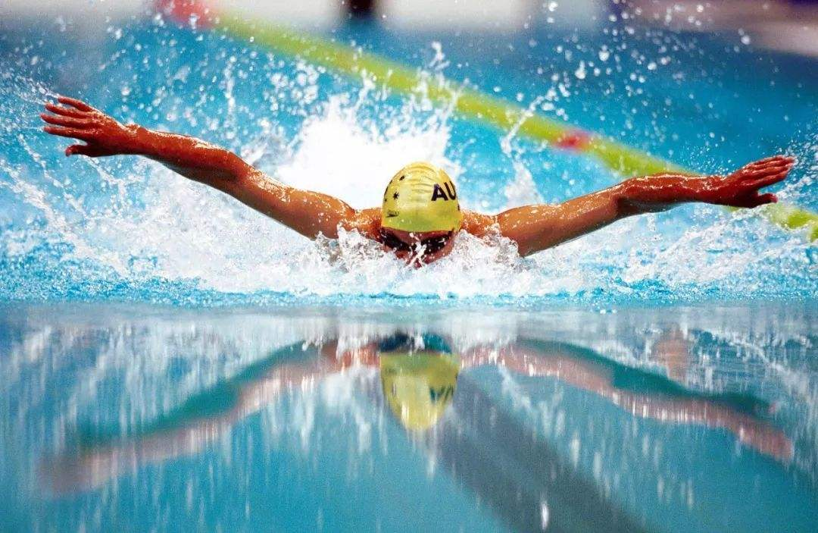
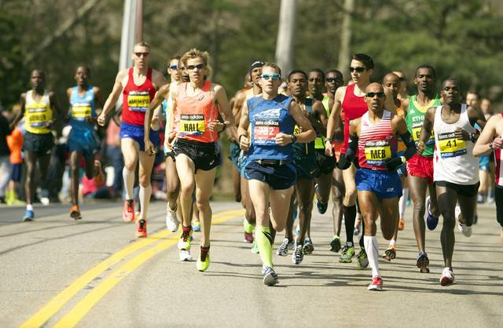
Well, the years start coming and they don't stop coming
Fed to the rules and I hit the ground running

Slide 26
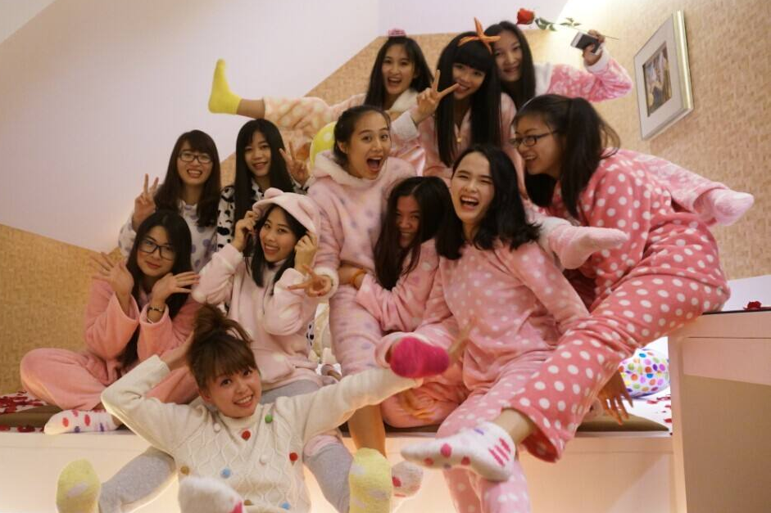
Didn't make sense not to
live for fun
Your brain gets smart but your head gets dumb

Slide 27
So much to do
So much to see

Slide 28
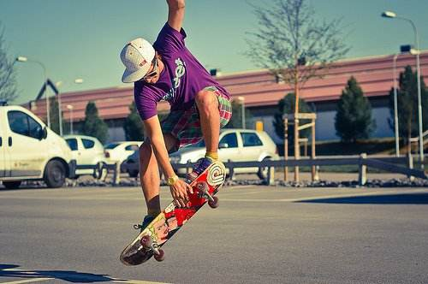
So what's wrong with taking the back streets?

Slide 29
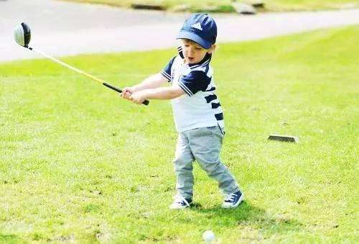
You'll never know if you don't go
You'll never shine if you don't glow

Slide 30
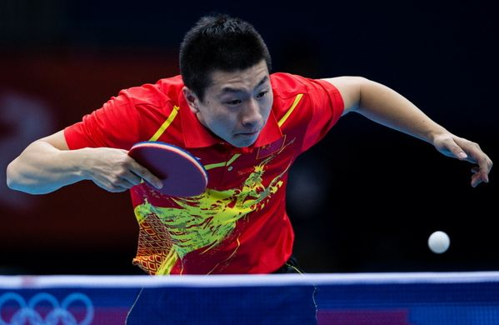
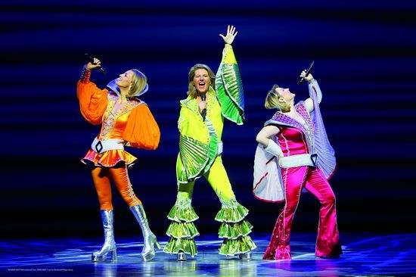
Hey, now, you're a Rock Star get the show on get paid
Hey, now, you're an All Star get your game on, go play

Slide 31
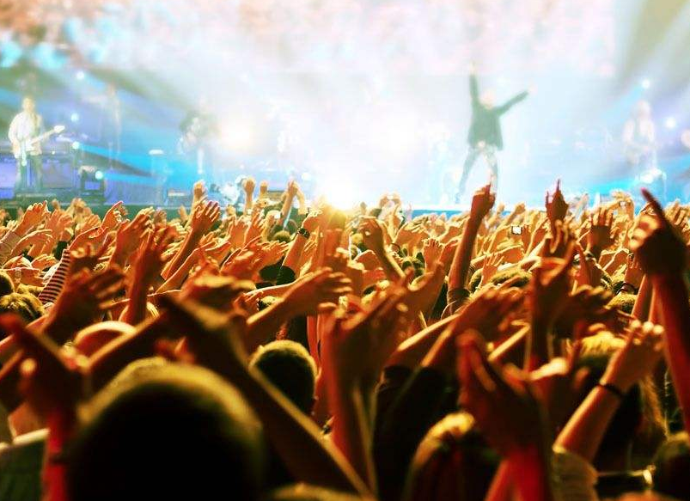
Only shooting stars break the mold
And all that glitters is gold

Slide 32
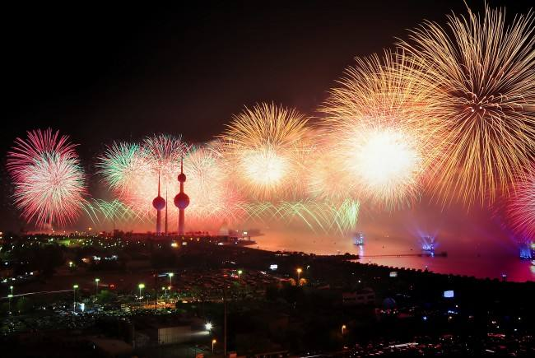
And all that glitters is gold
Only shooting stars break the mold

