Slide 1
外教社义务教育教科书七年级下册
Unit 9 Leisure Activities
适用主题：游戏与休闲
作者：陈佳璇
单位：华南师范大学外文学院

Slide 2
Woah-oh-oh-oh
It's always a good time

Slide 3
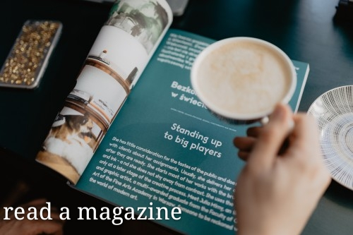
Woah-oh-oh-oh
It's always a good time

Slide 4
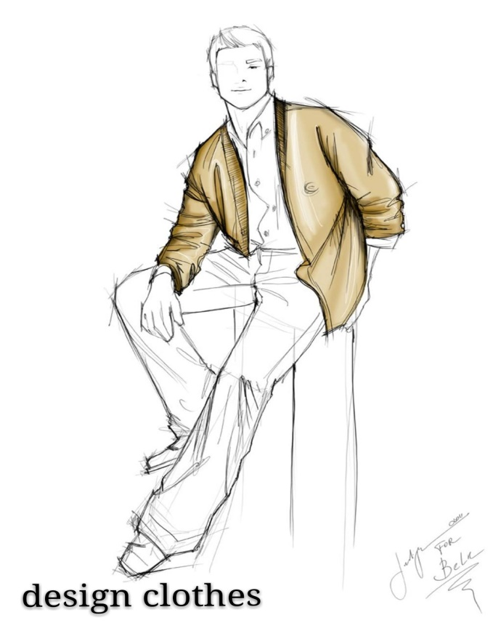
What's up with this Prince song inside my head
Woke up on the right side of the bed

Slide 5
Hands up if you're down
to get down tonight

Slide 6
Cause it's always a good time

Slide 7
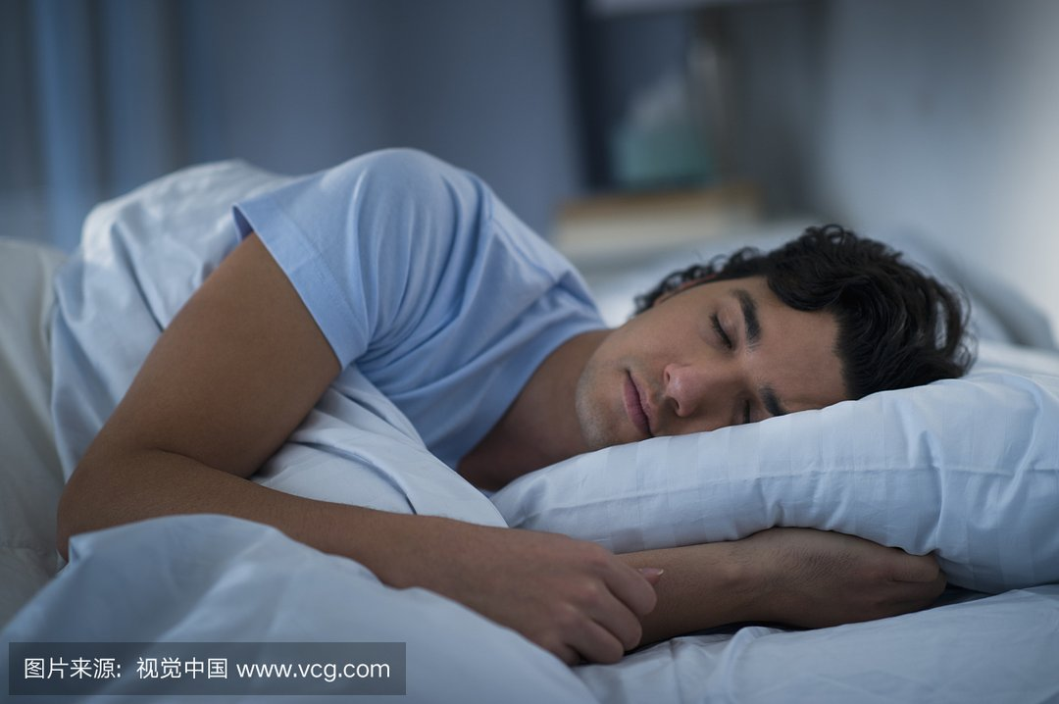
Slept in all my clothes like I didn't care
Hopped into a cab take me anywhere

Slide 8
I'm in if you're down to get down tonight

Slide 9
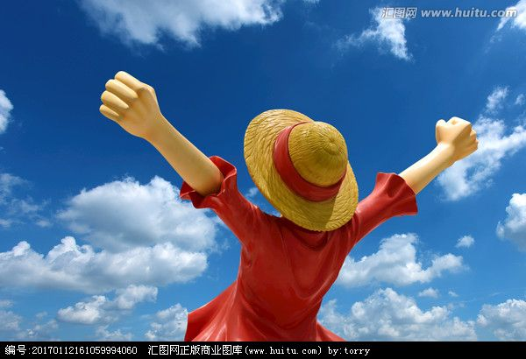
Cause
it's
always
a
good
time

Slide 10
Good morning and Good night

Slide 11
I wake up at twilight

Slide 12
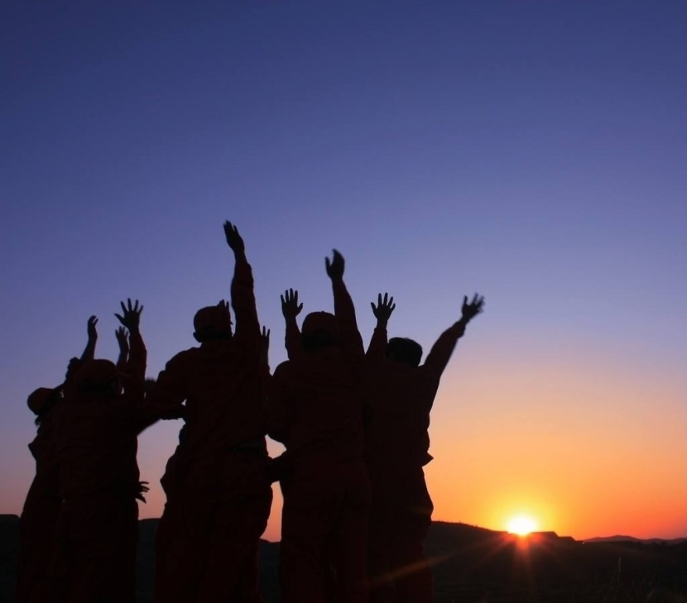
It's always a good time
It's gonna be alright
We don't even have to try

Slide 13
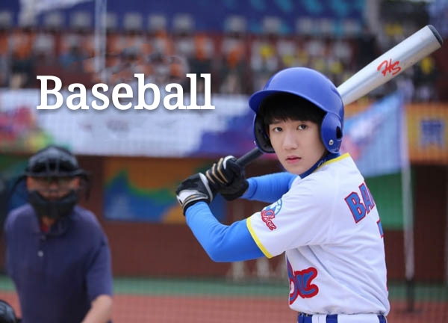
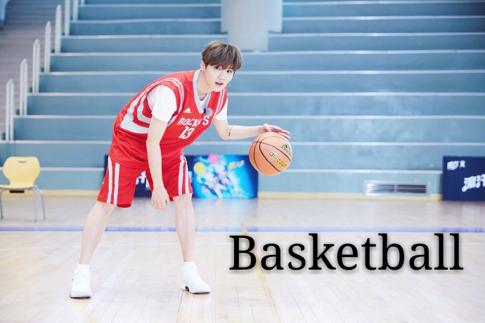
Woah-oh-oh-oh Woah-oh-oh-oh
We don't even have to try, it's always a good time
Woah-oh-oh-oh Woah-oh-oh-oh
Woah-oh-oh-oh
It's always a good time

Slide 14
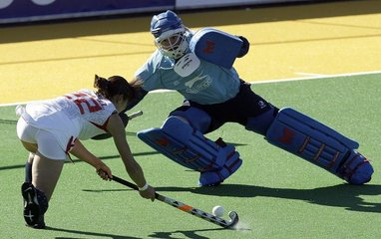
Feet down dropped my phone in the pool again
Hockey
Rugby

Slide 15
Checked out of my room hit the ATM

Slide 16
Cause it's always a good time
Let's hang out if you're down to get down tonight

Slide 17
Good morning and Good night

Slide 18
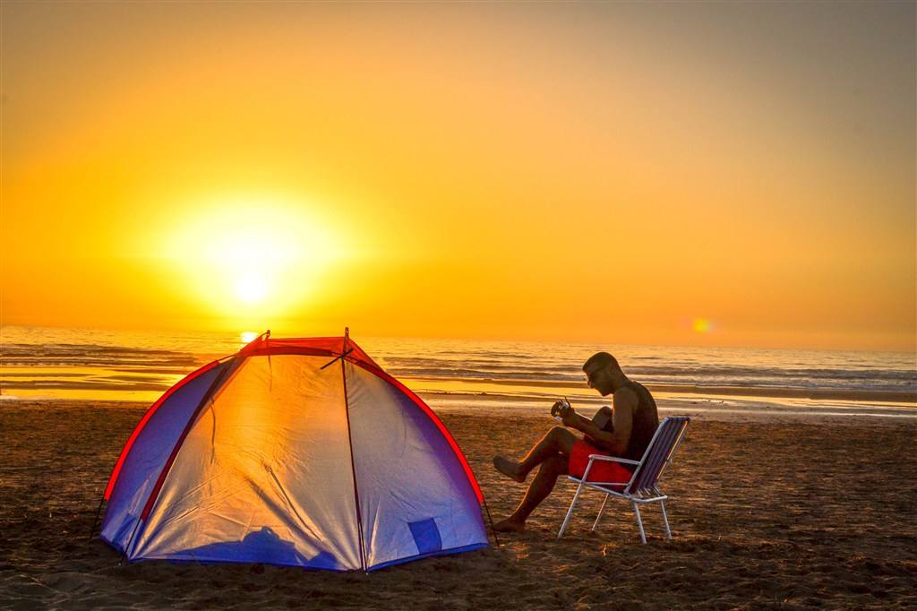
I wake up
at twilight

Slide 19
It's always a good time
We don't even have to try
It's gonna be alright

Slide 20
It's always a good time
Woah-oh-oh-oh
Woah-oh-oh-oh

Slide 21
Woah-oh-oh-oh
Woah-oh-oh-oh Woah-oh-oh-oh
It's always a good time
We don't even have to try, it's always a good time

Slide 22
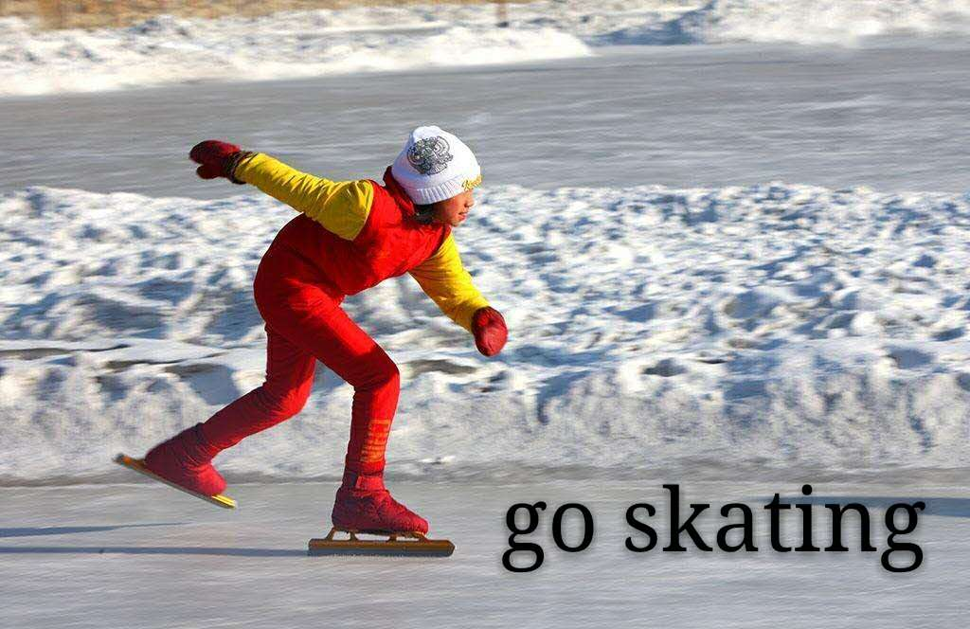
Woah-oh-oh-oh
We don't even have to try, it's always a good time

Slide 23
Doesn't matter when
Doesn't matter where
Doesn't matter when
It's always a good time
It's always a good time then
It's always a good time there
It's always a good time then

Slide 24
We don't even have to try,
it's always a good time
Woah-oh-oh-oh Woah-oh-oh-oh
It's always a good time
Woah-oh-oh-oh

Slide 25
Woah-oh-oh-oh
Woah-oh-oh-oh Woah-oh-oh-oh
It's always a good time
We don't even have to try, it's always a good time

Slide 27
THANKS FOR WATCHING!

