Slide 1
外国语言文化学院
姓名：郭浩群
学号：20170221020
对应教材：初中英语八年级人教版
Unit5Do you want to watch a game show?
话题：个人兴趣
子话题：游戏与休闲（Games and leisure）

Slide 2
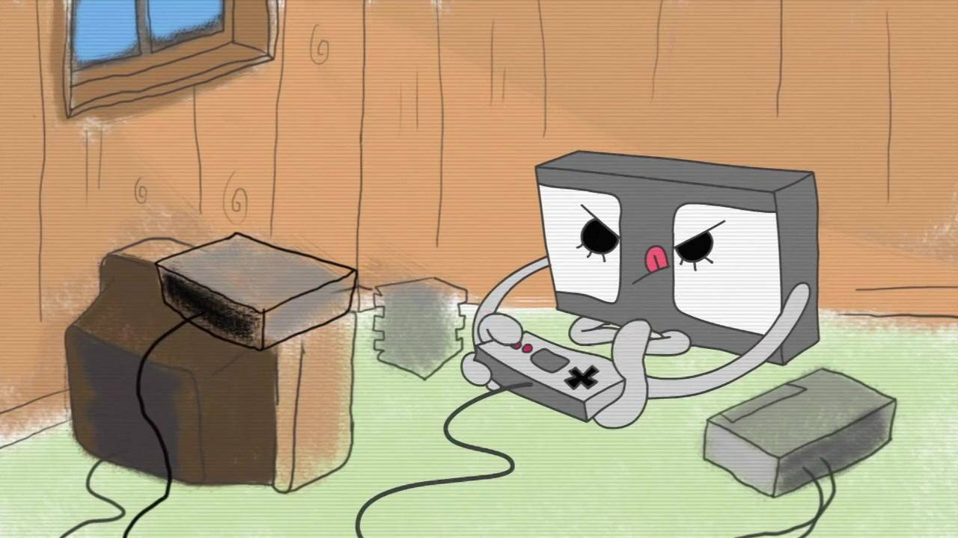
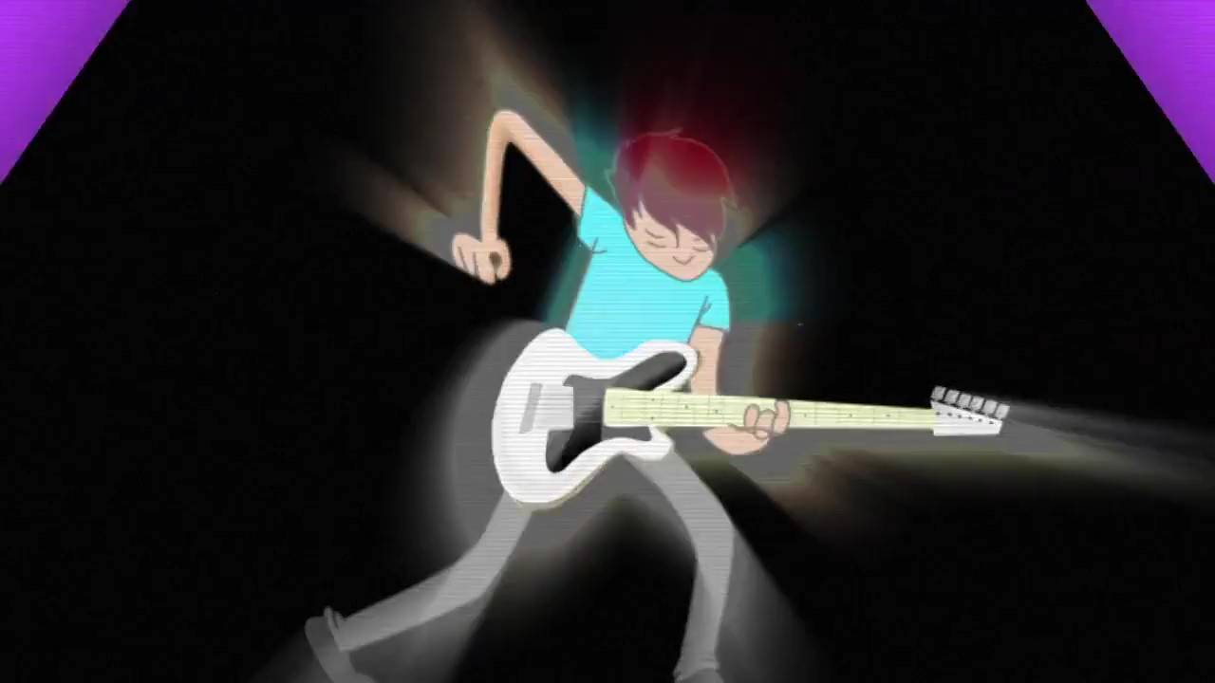
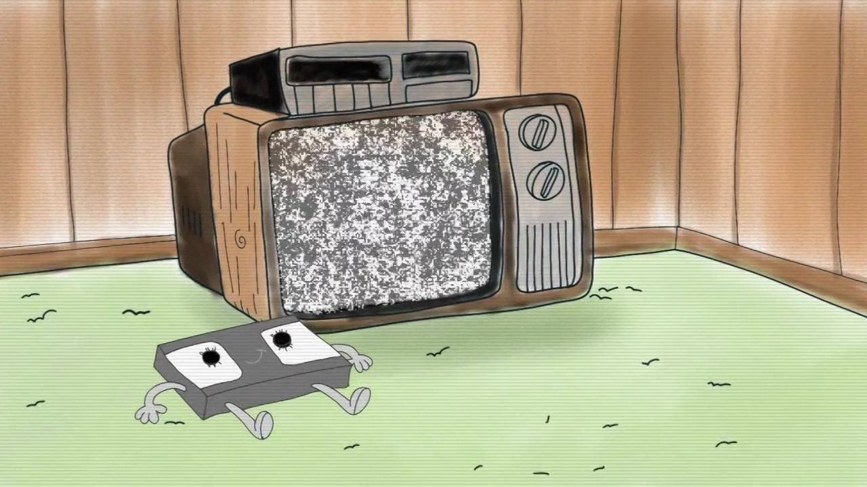
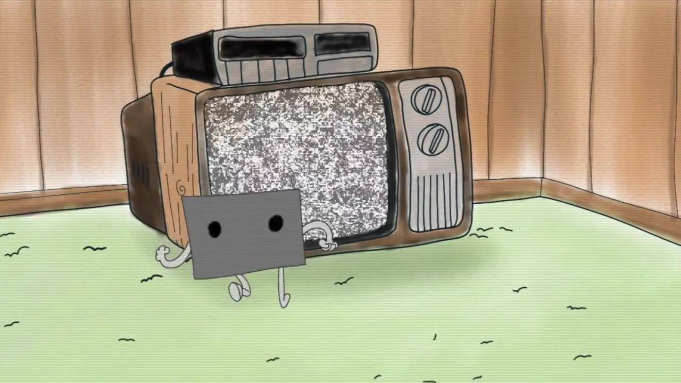
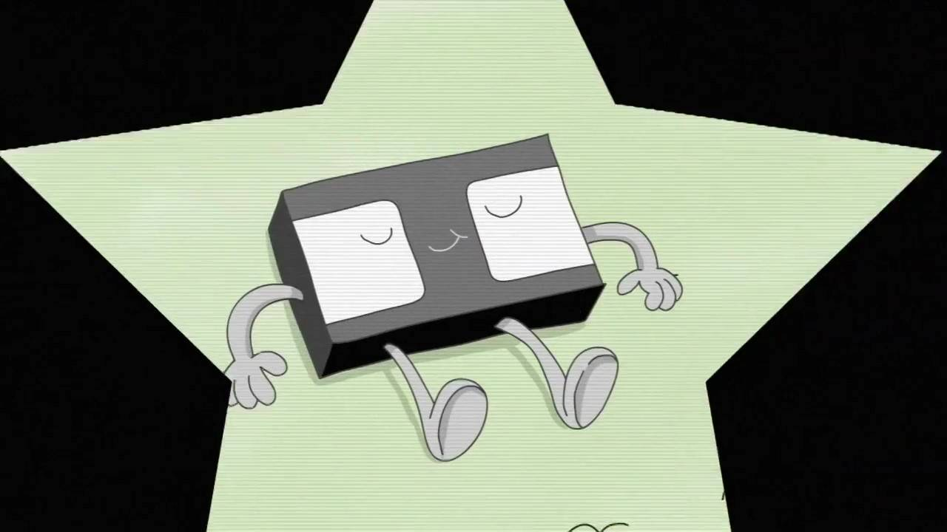
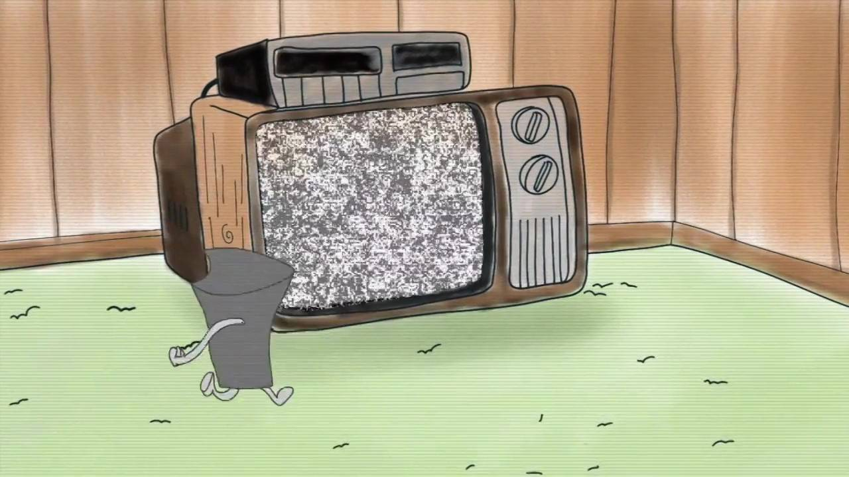
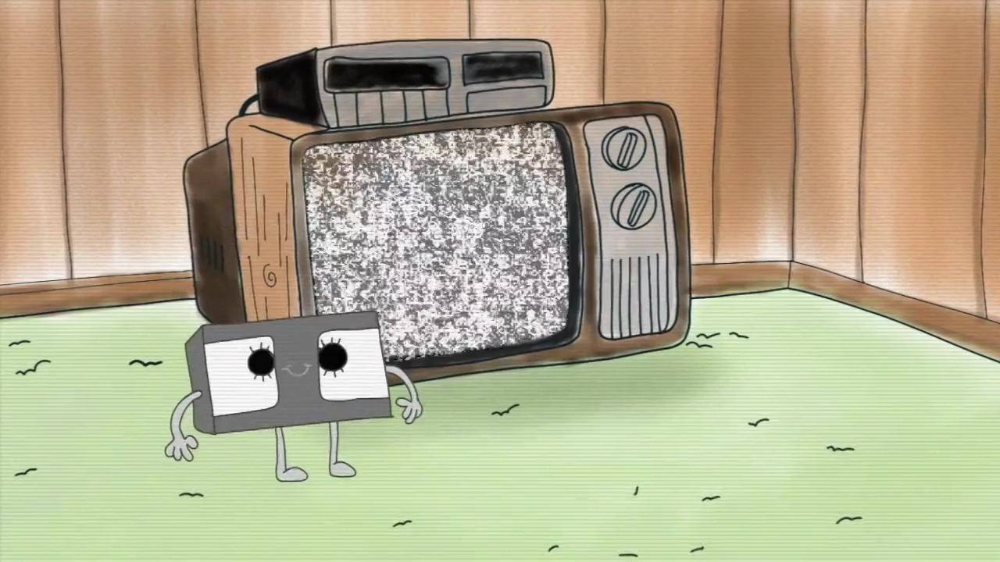
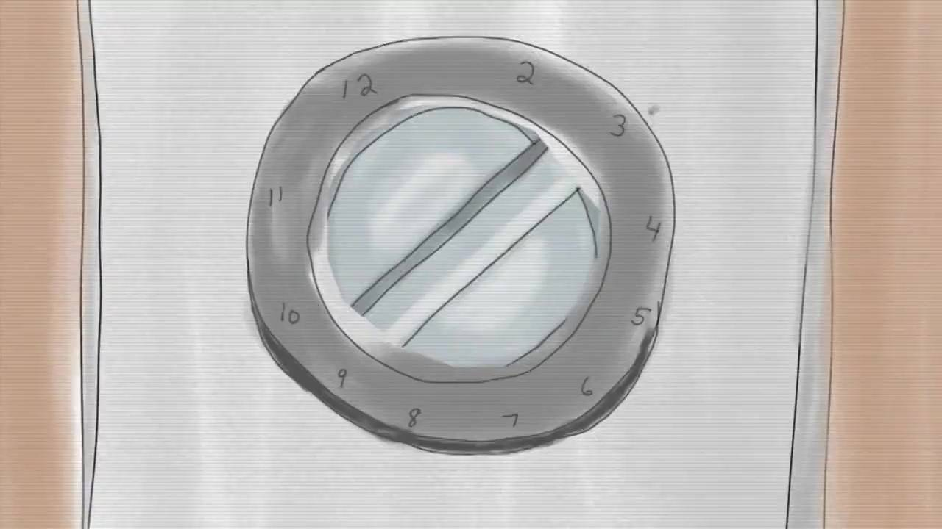
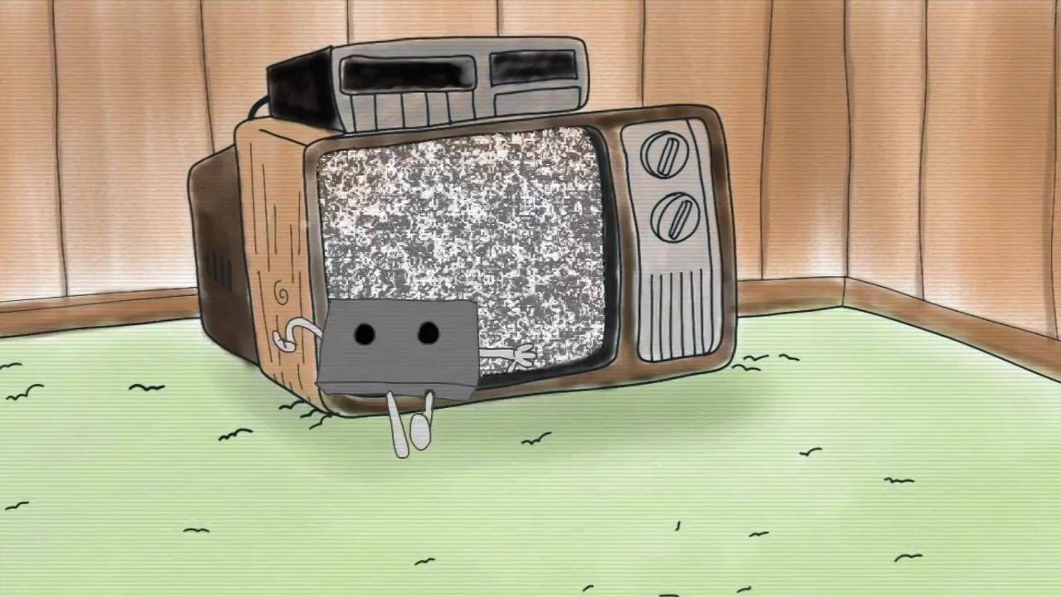
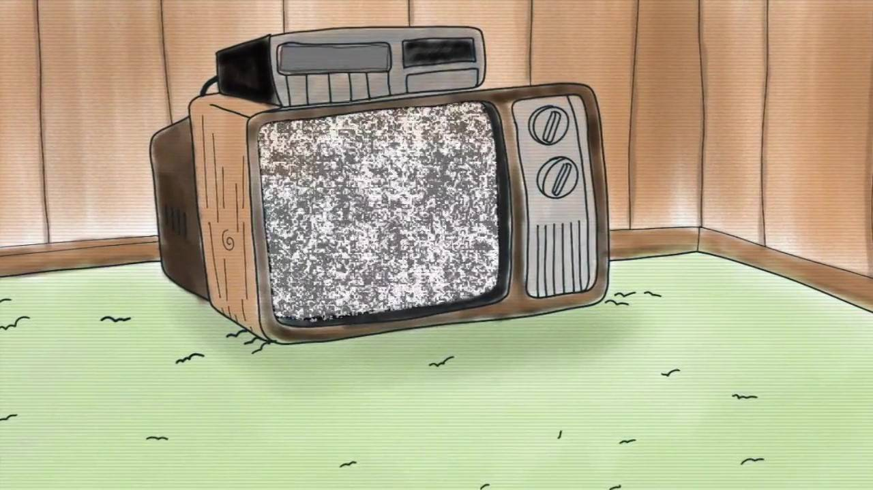
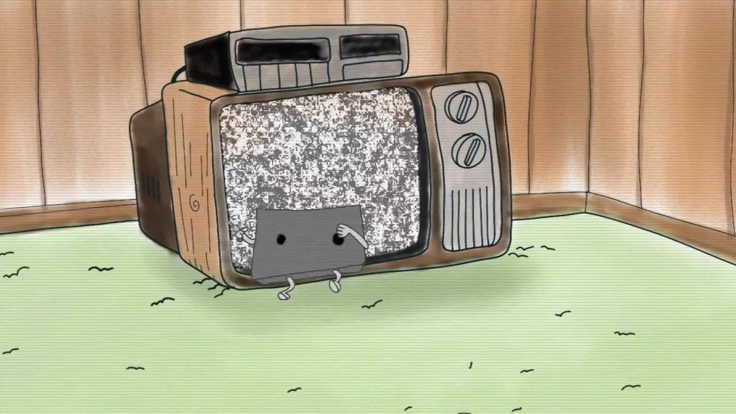
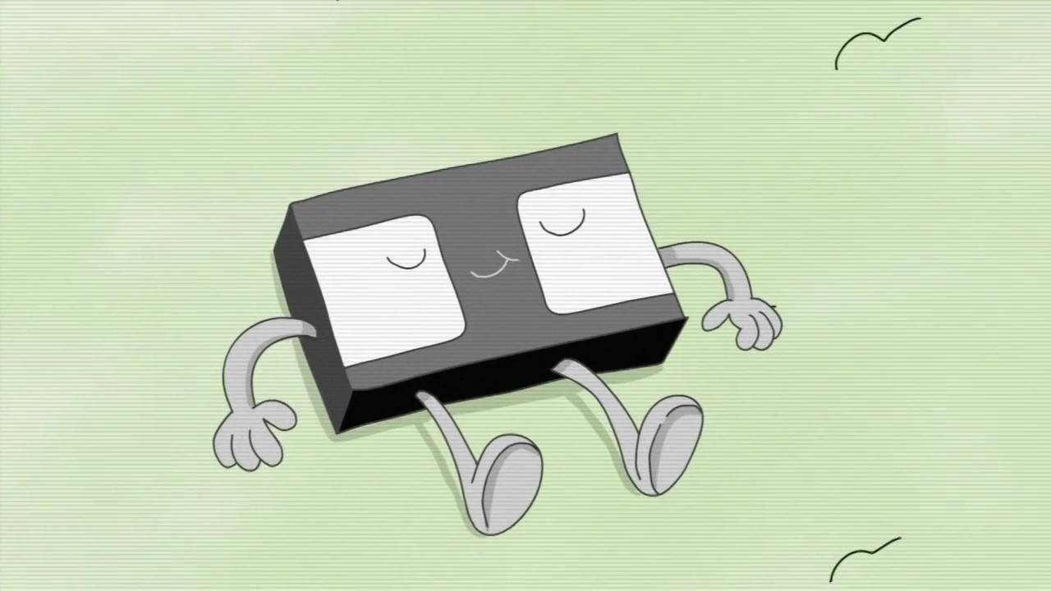
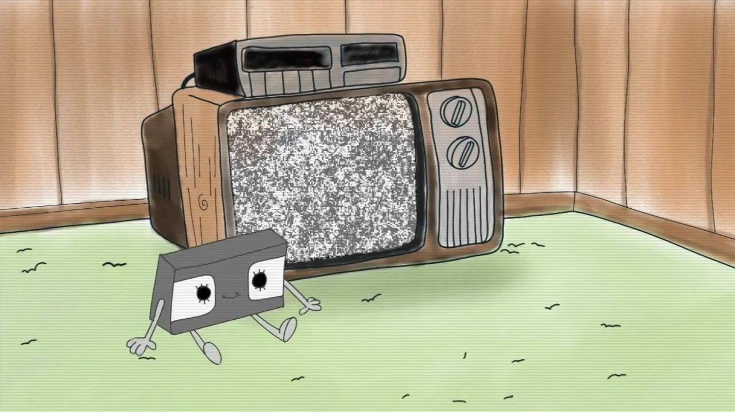
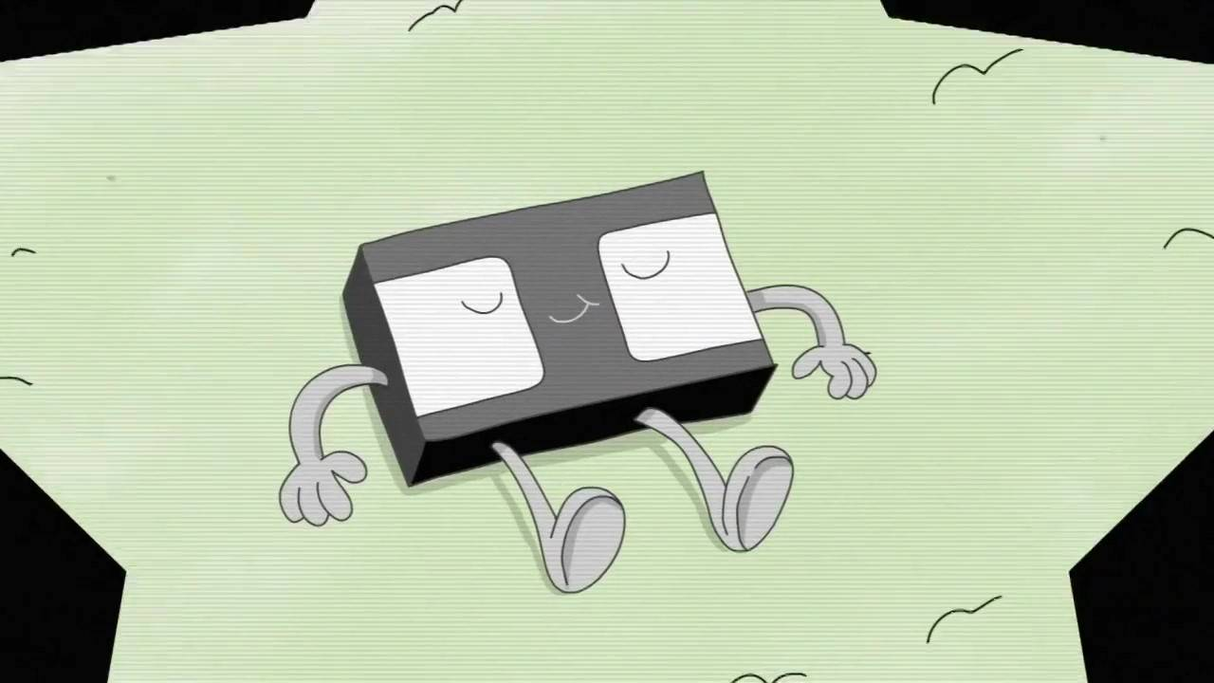
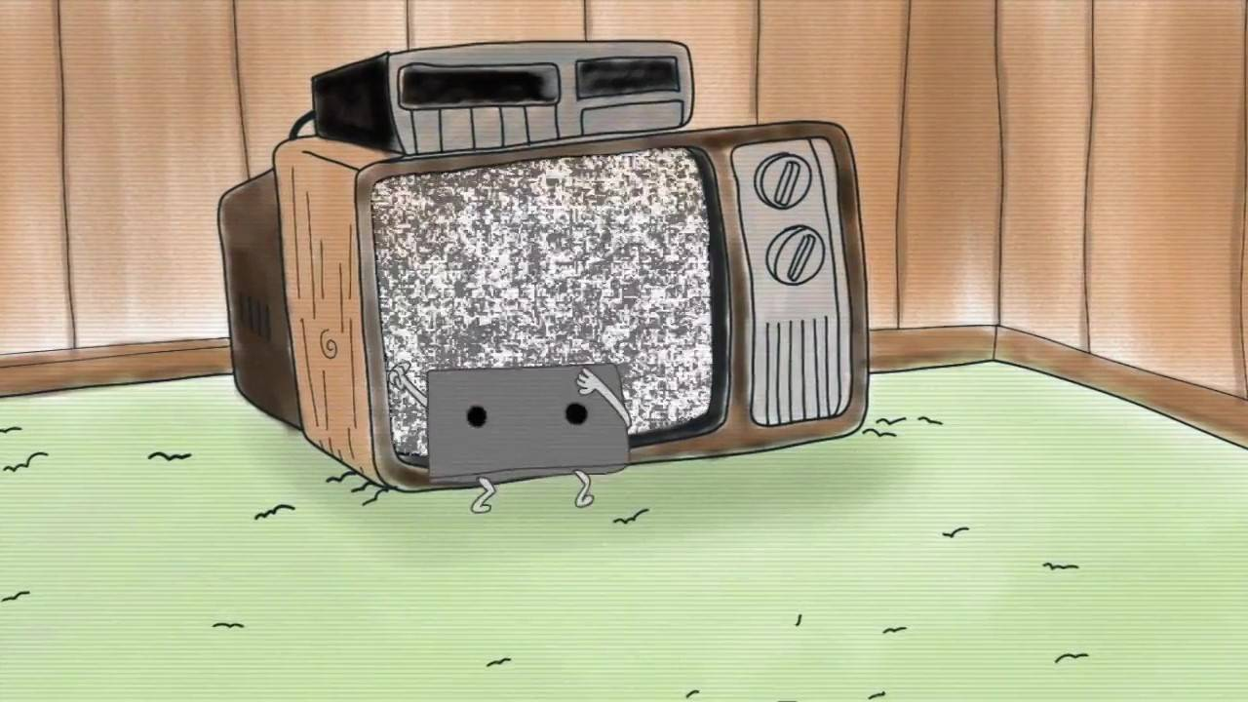
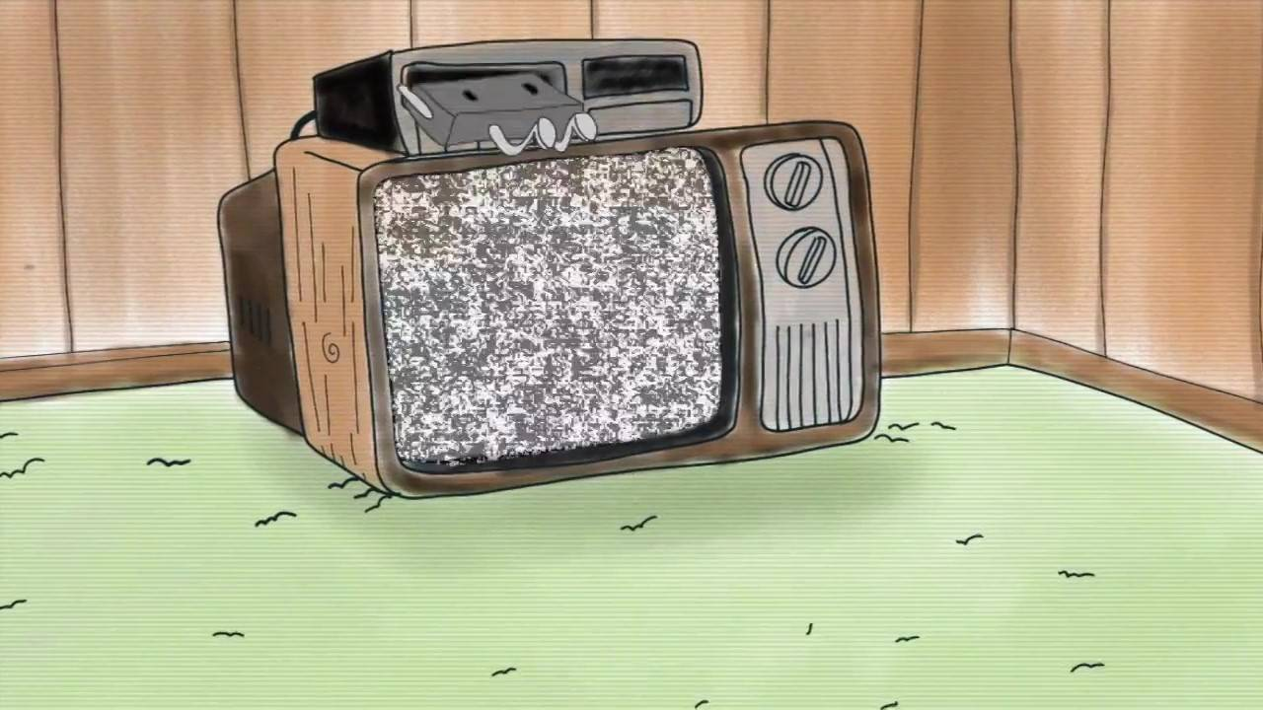
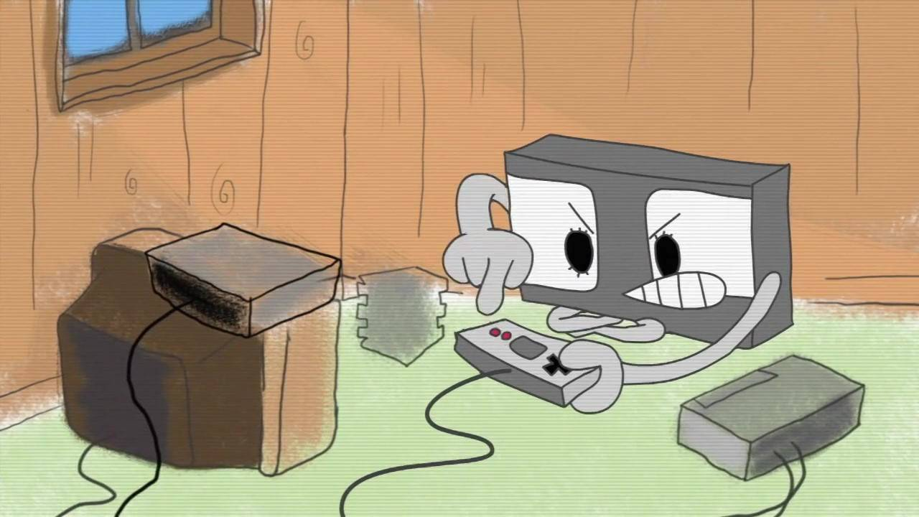
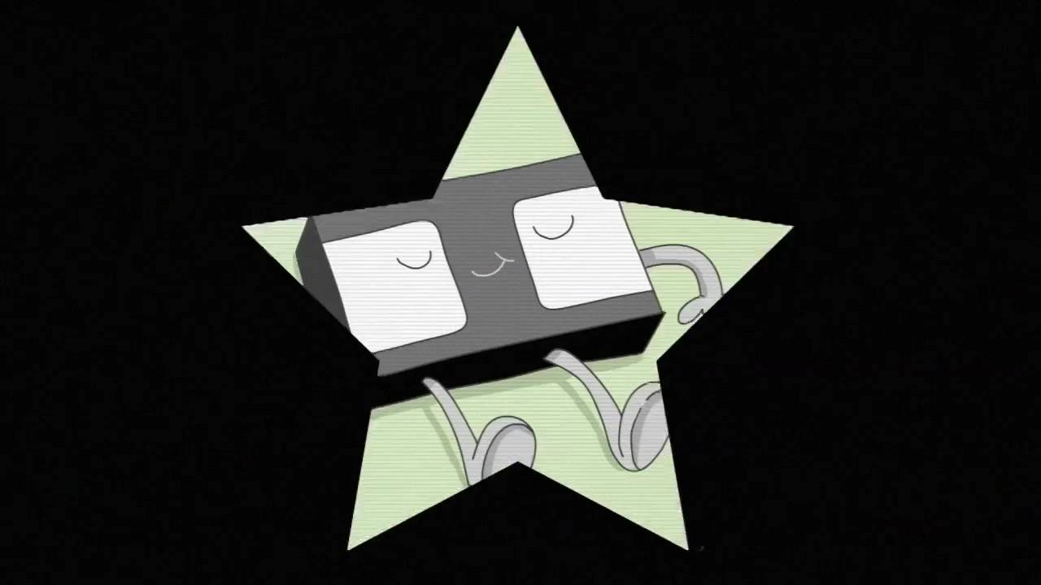
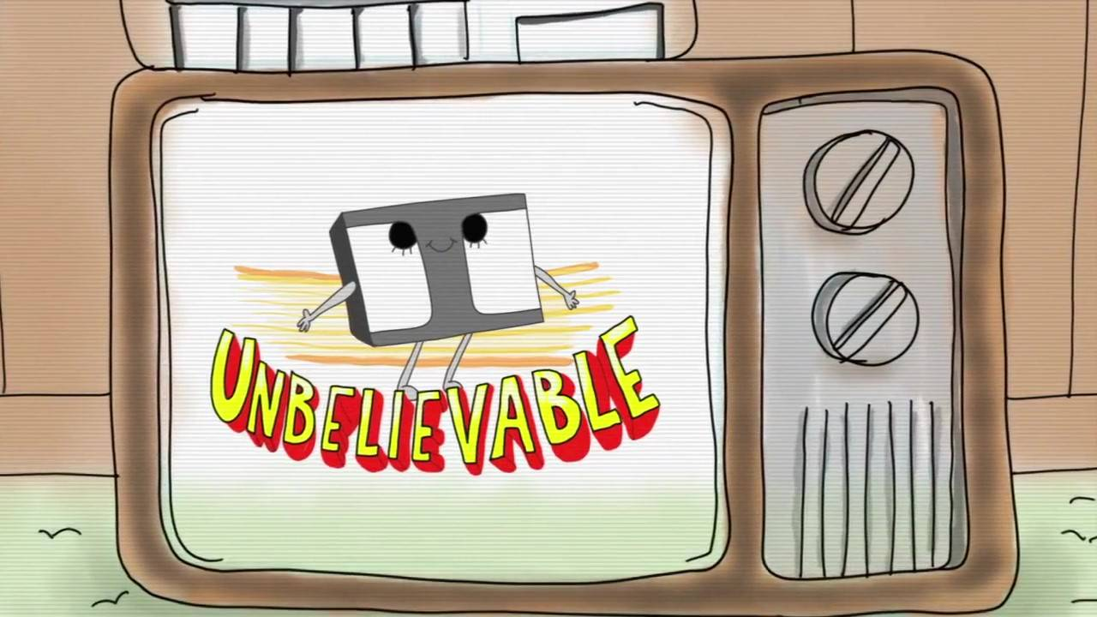
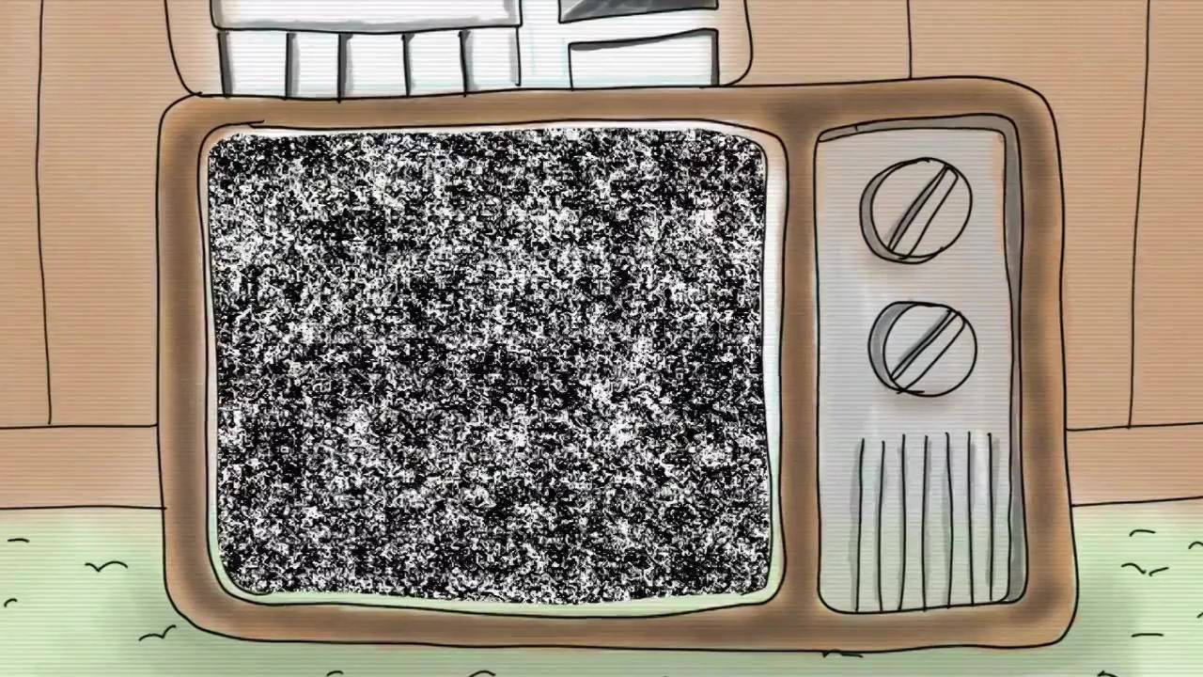
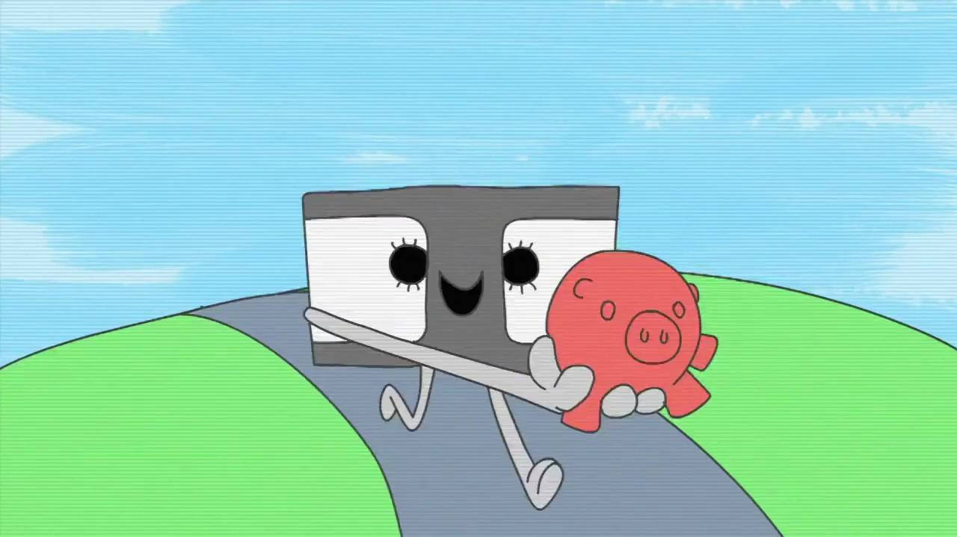
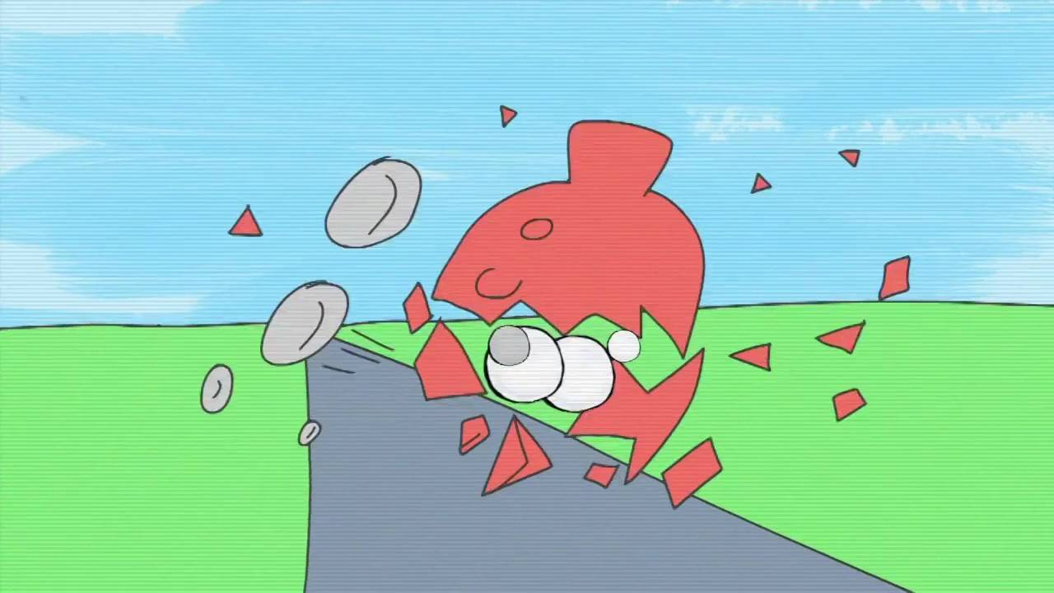
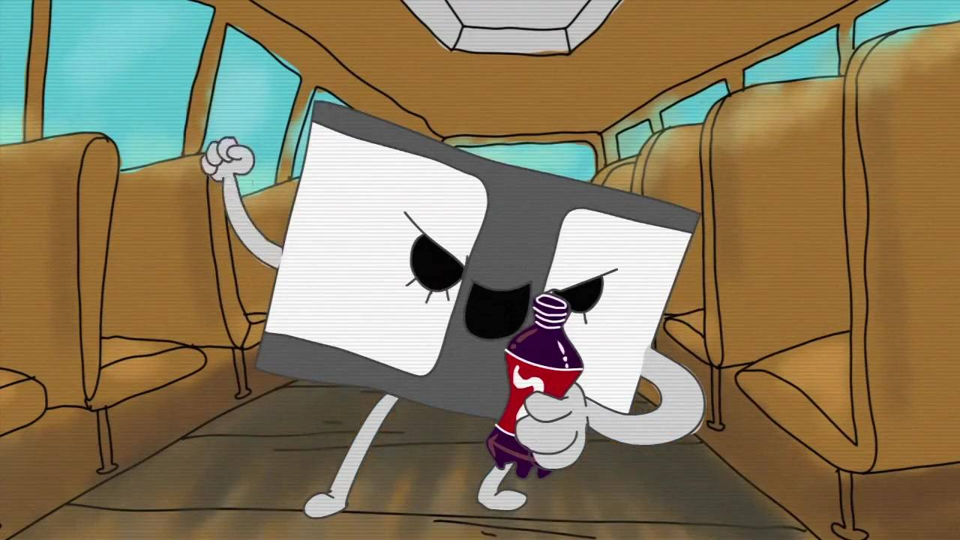
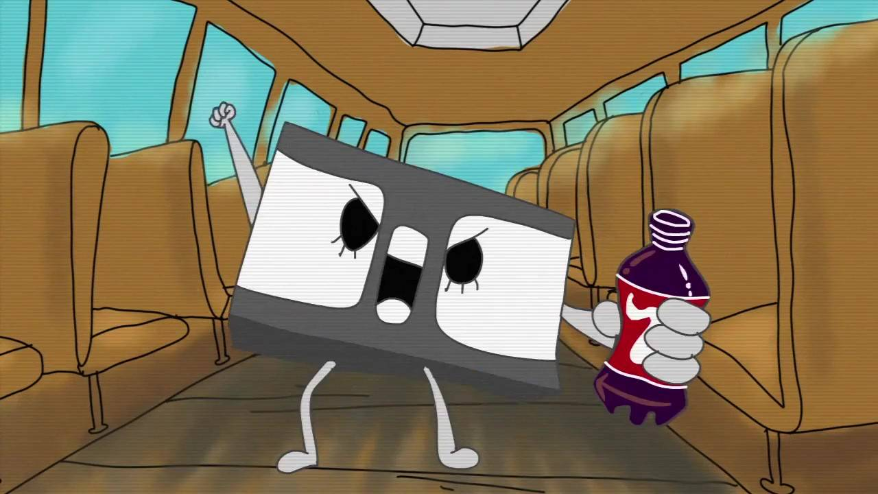
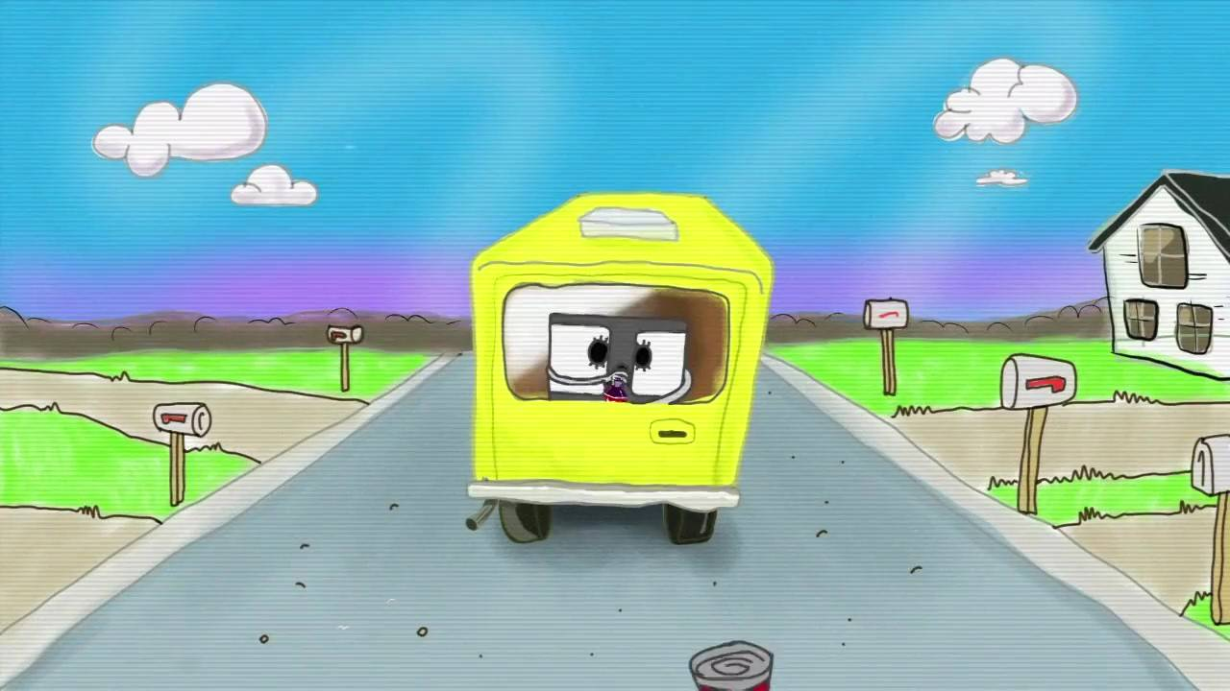
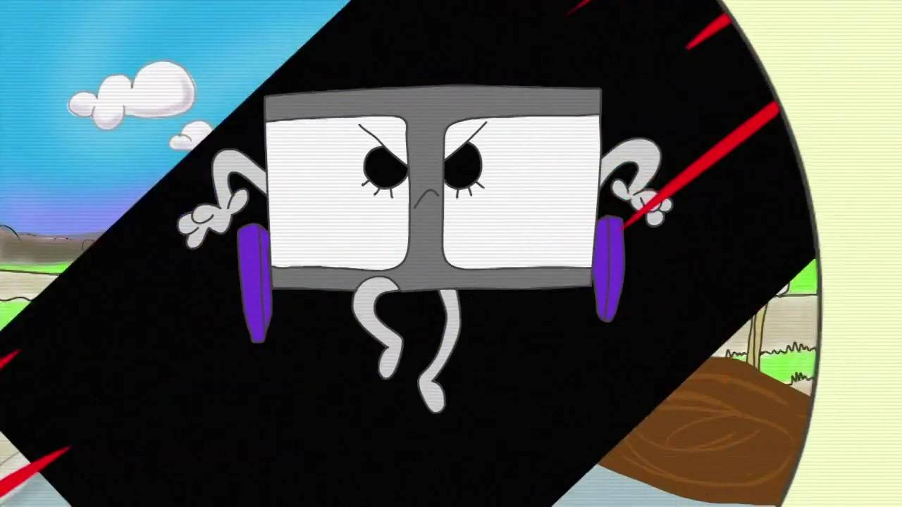
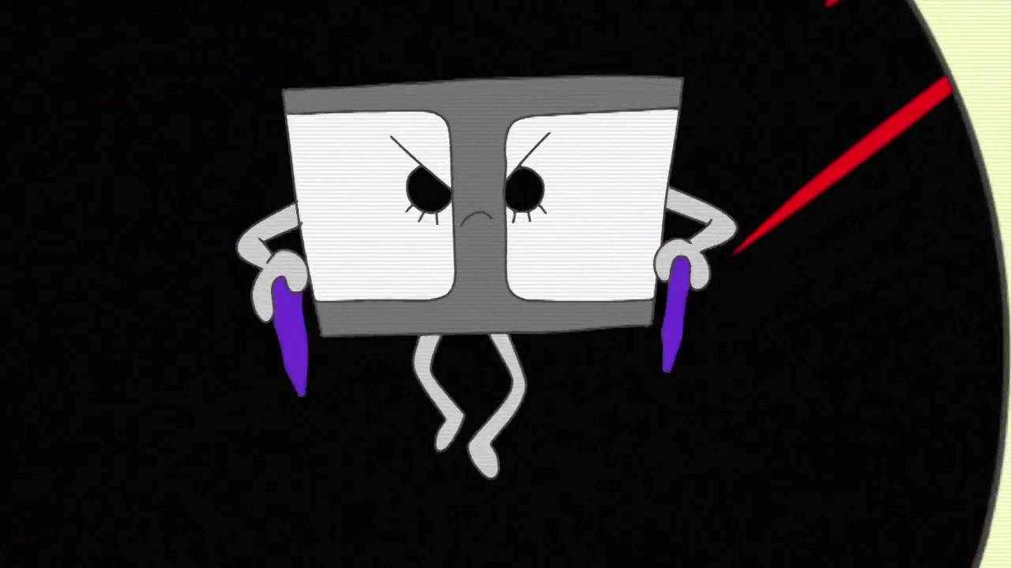
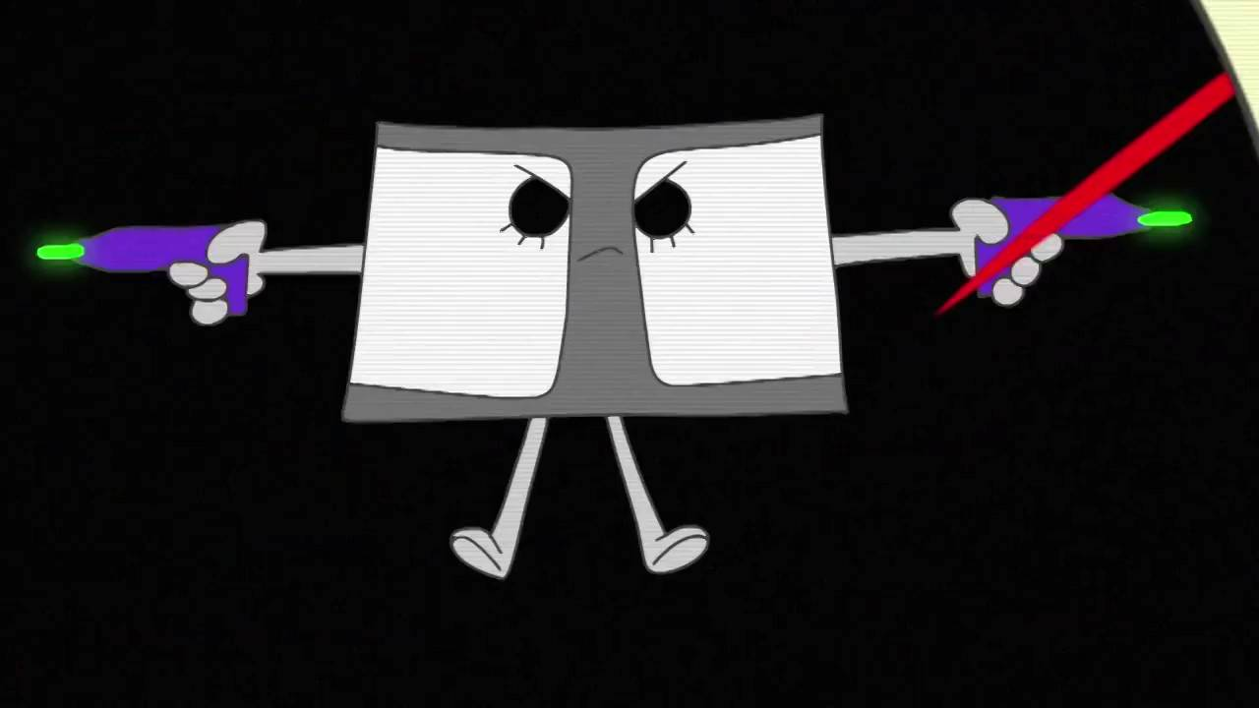
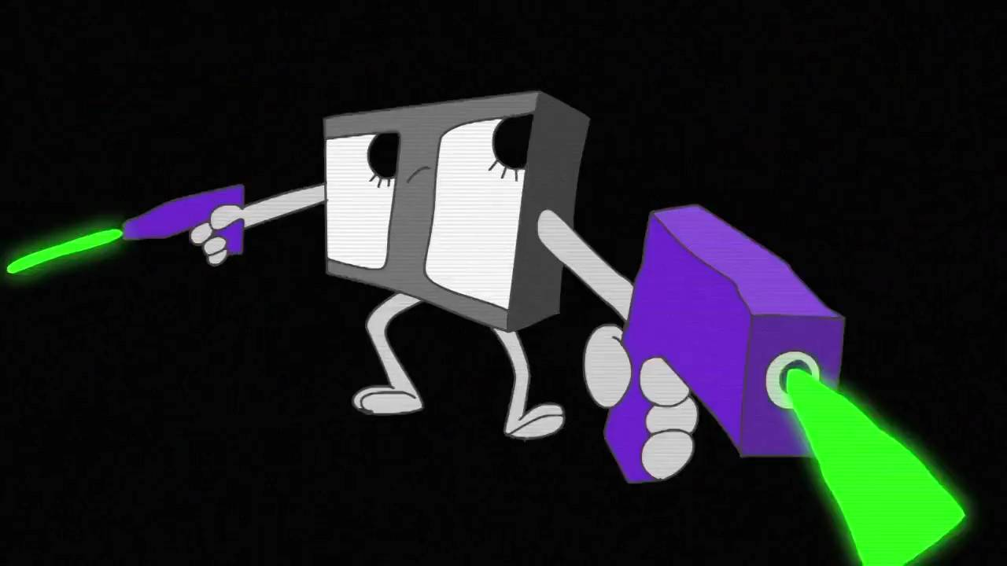
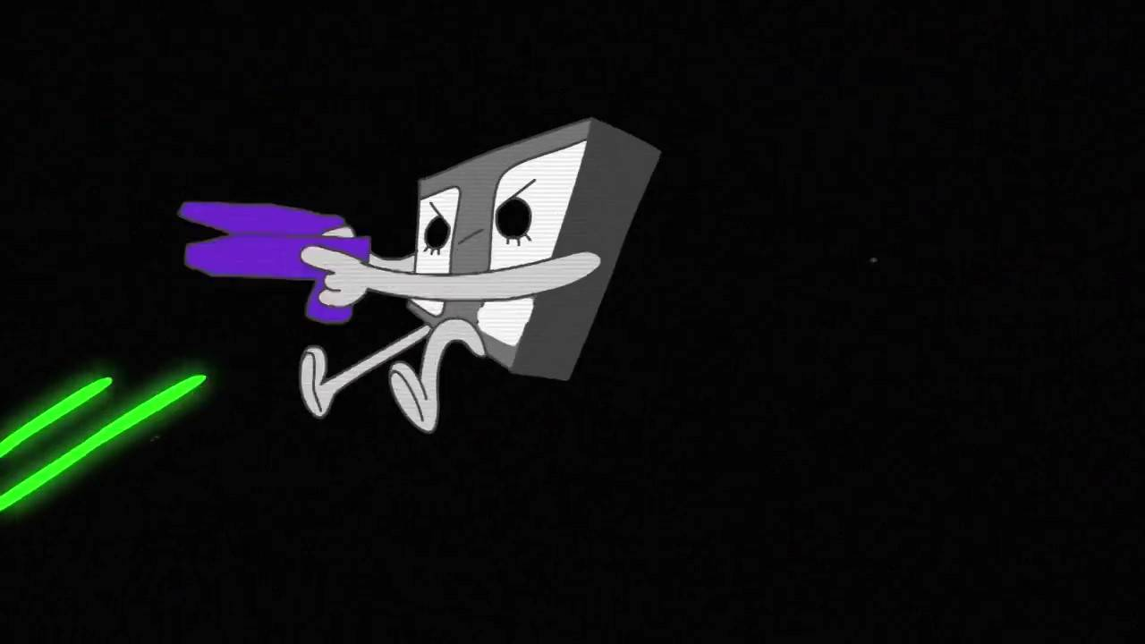
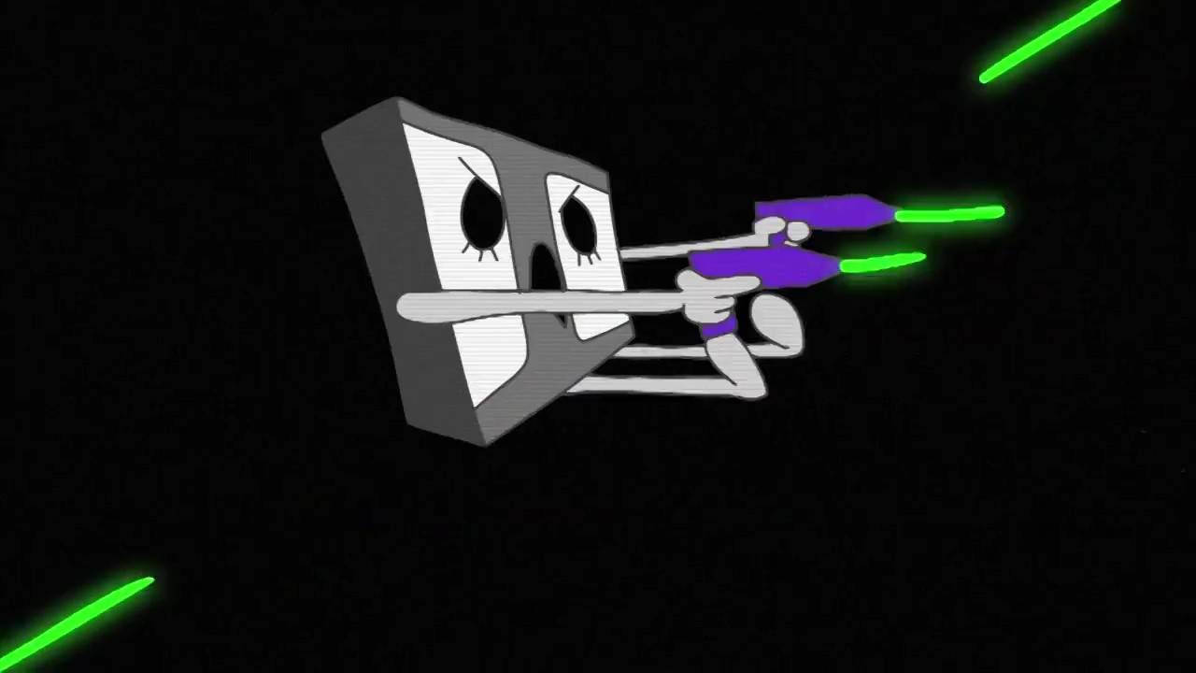
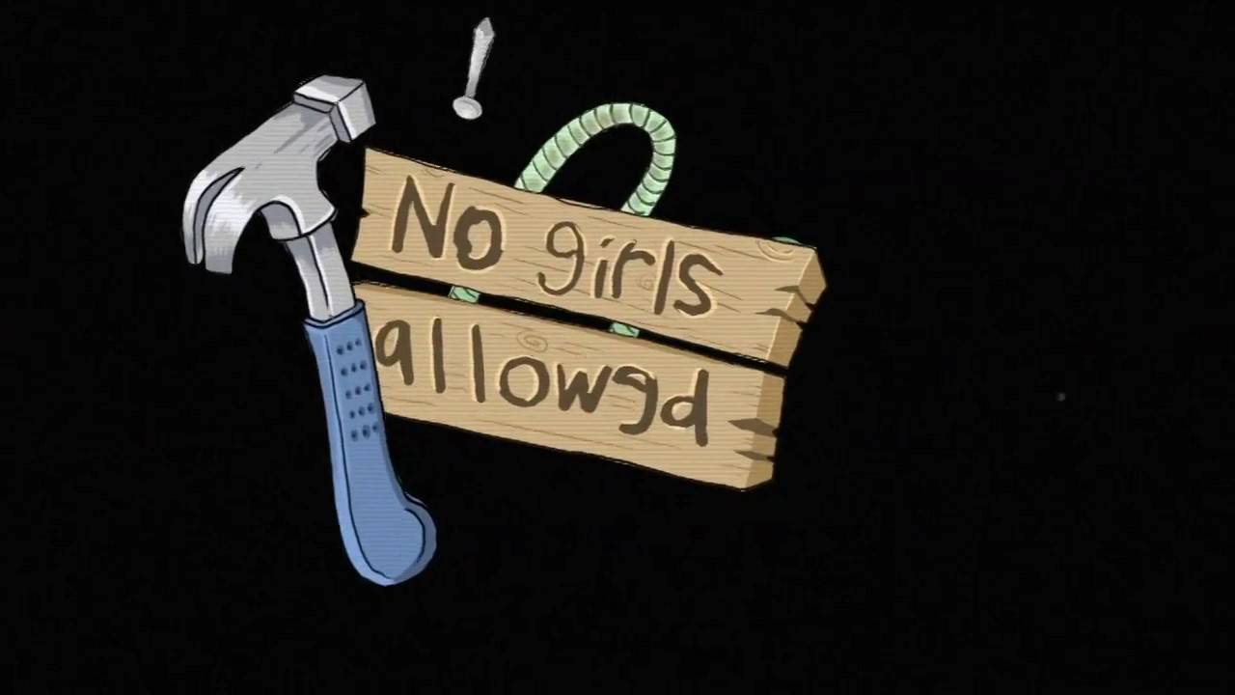
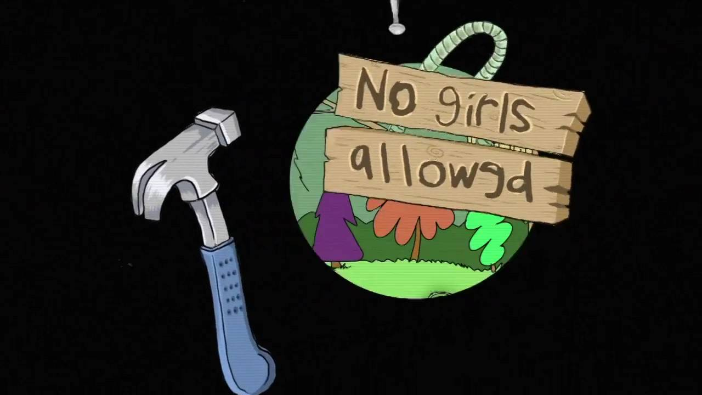
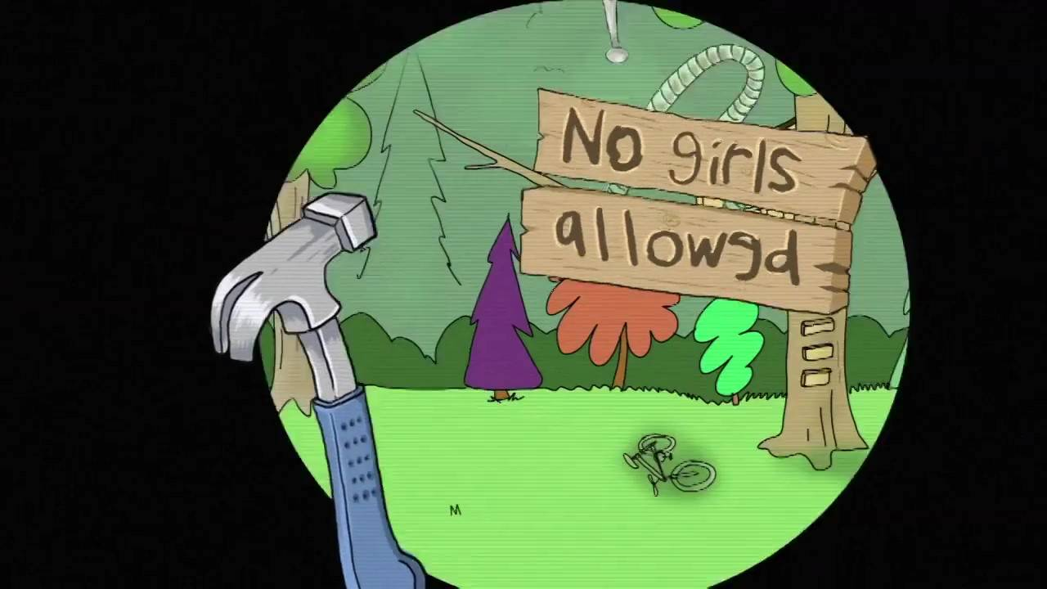
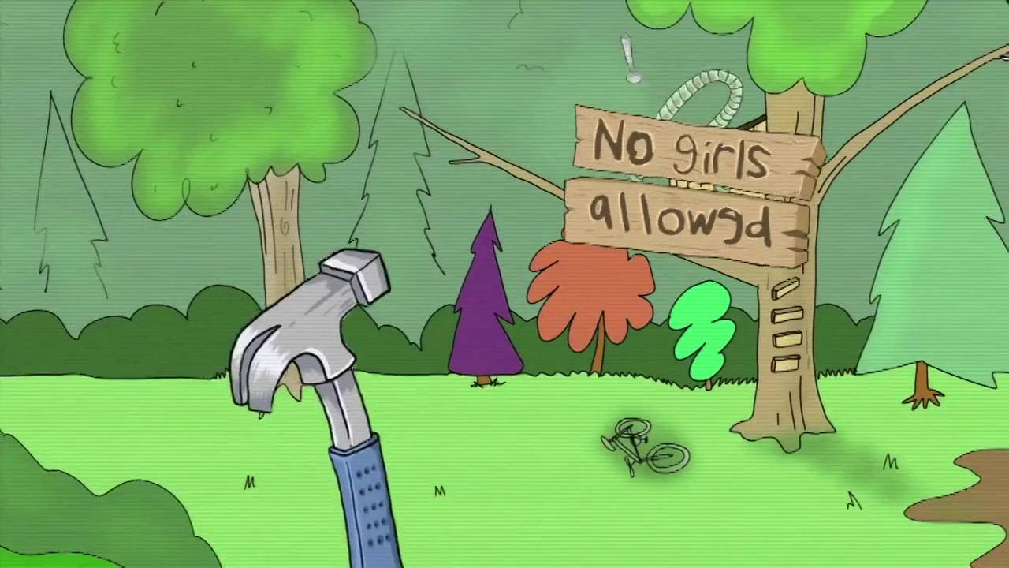
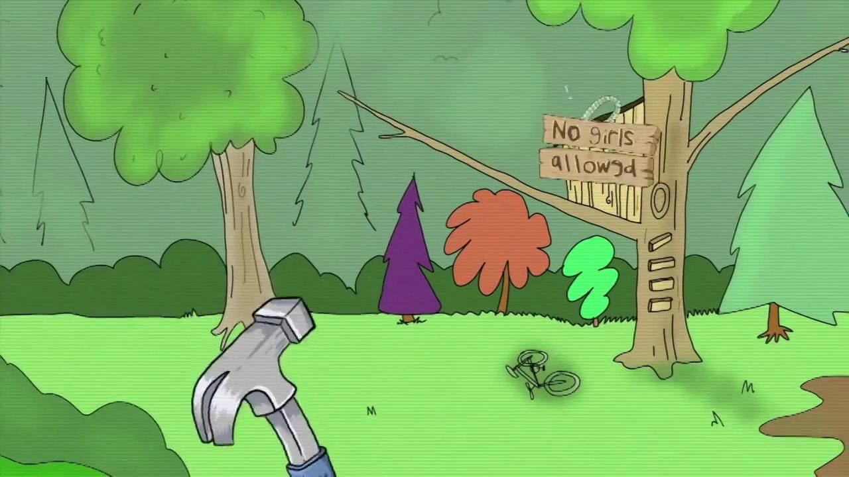
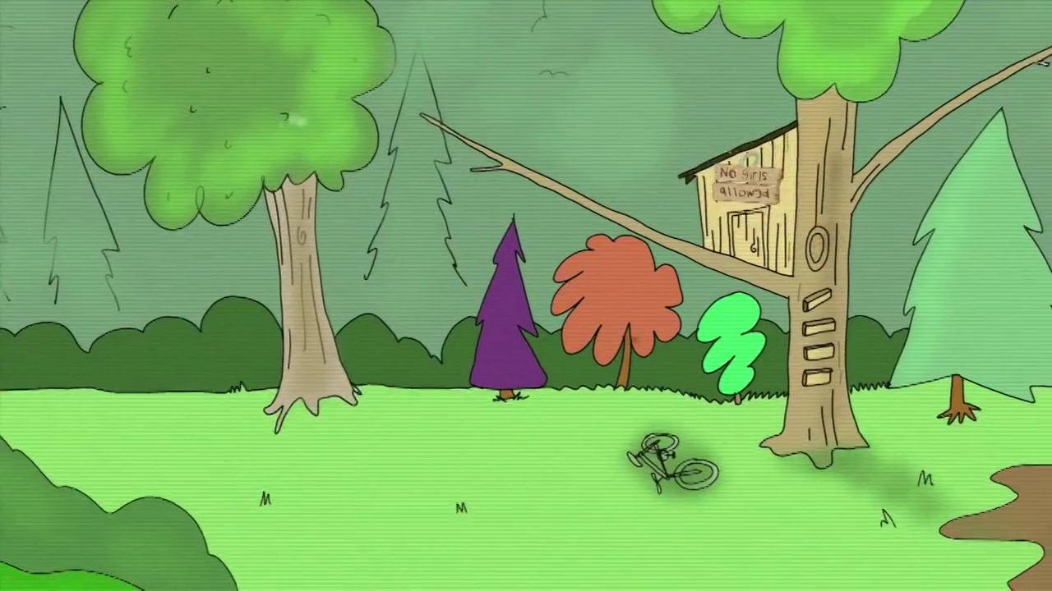
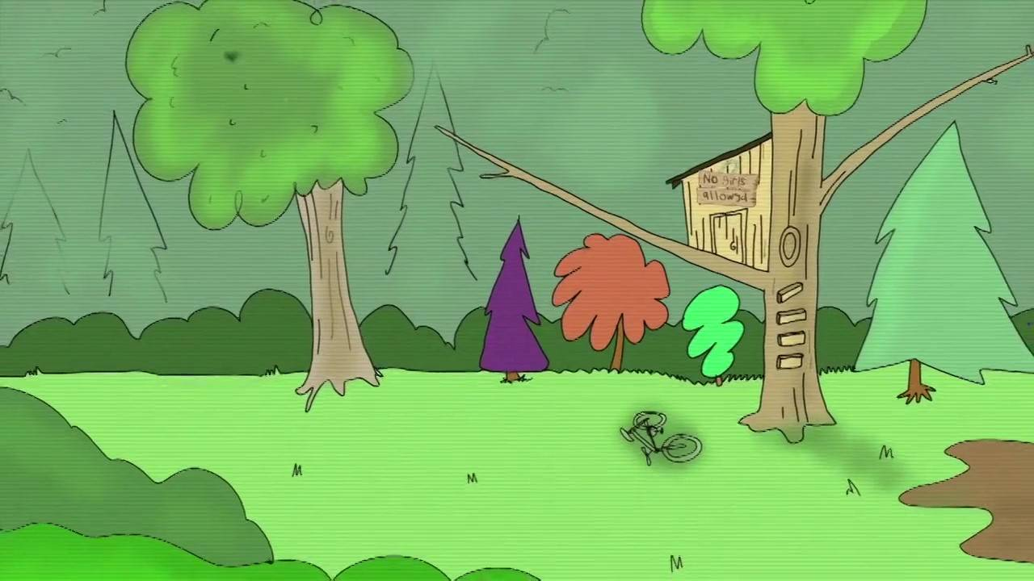
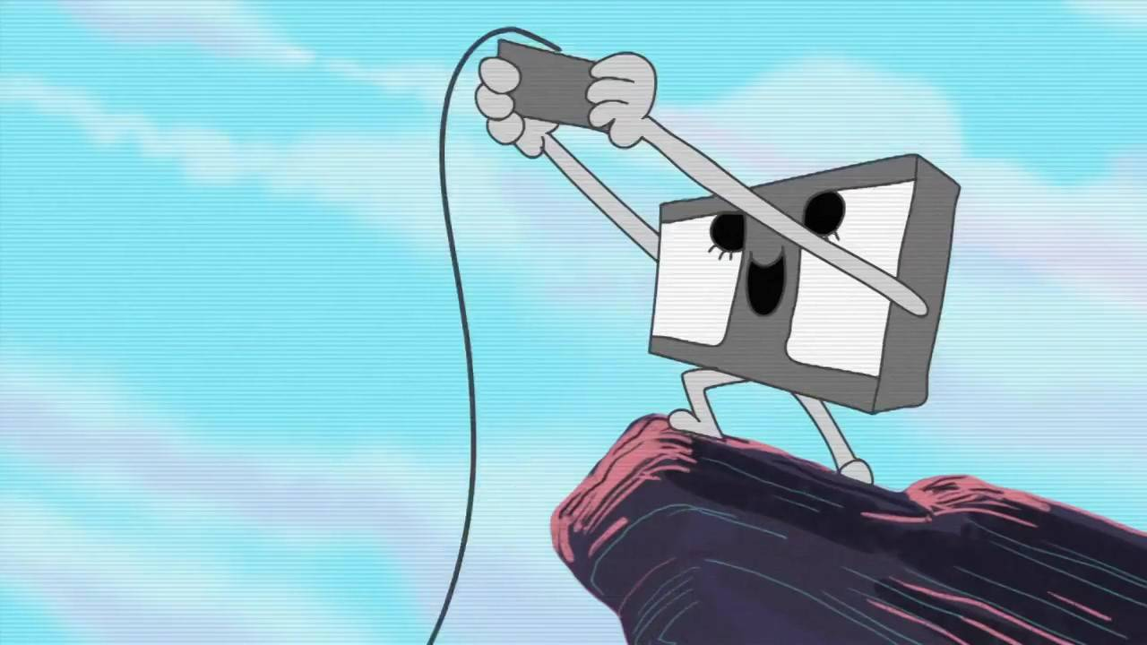
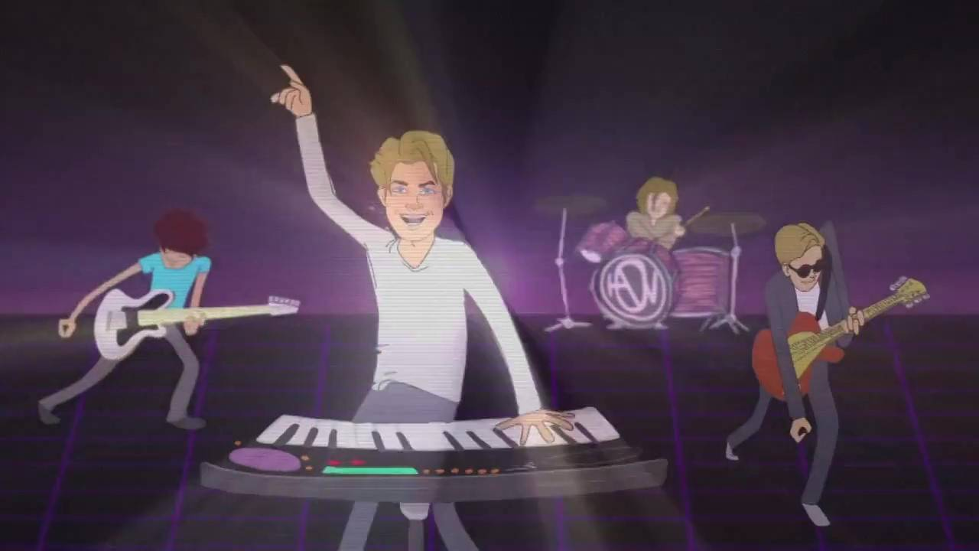
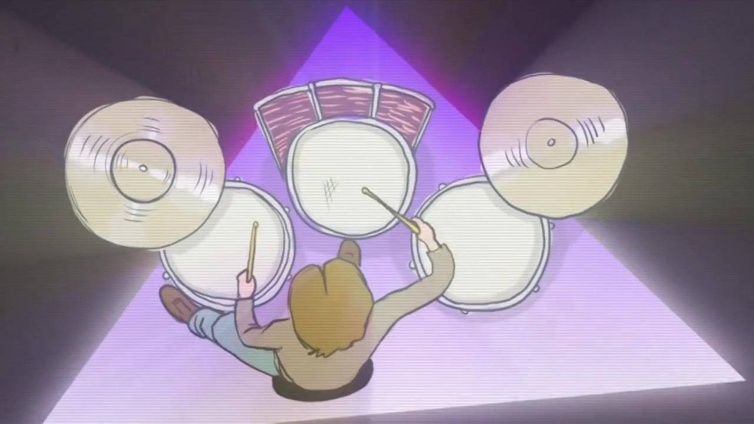
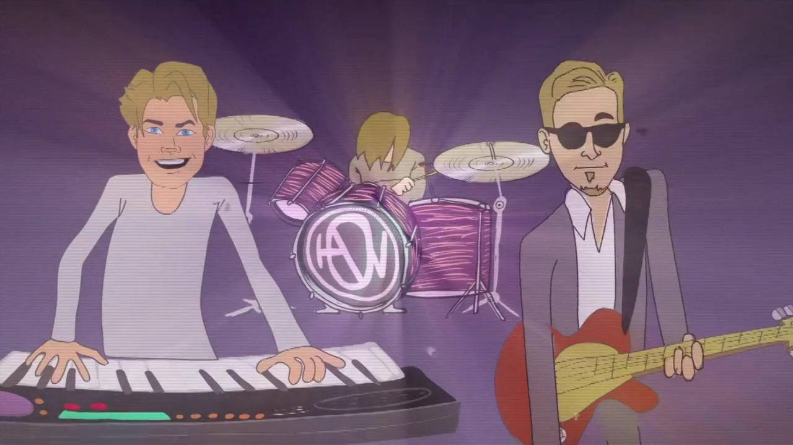
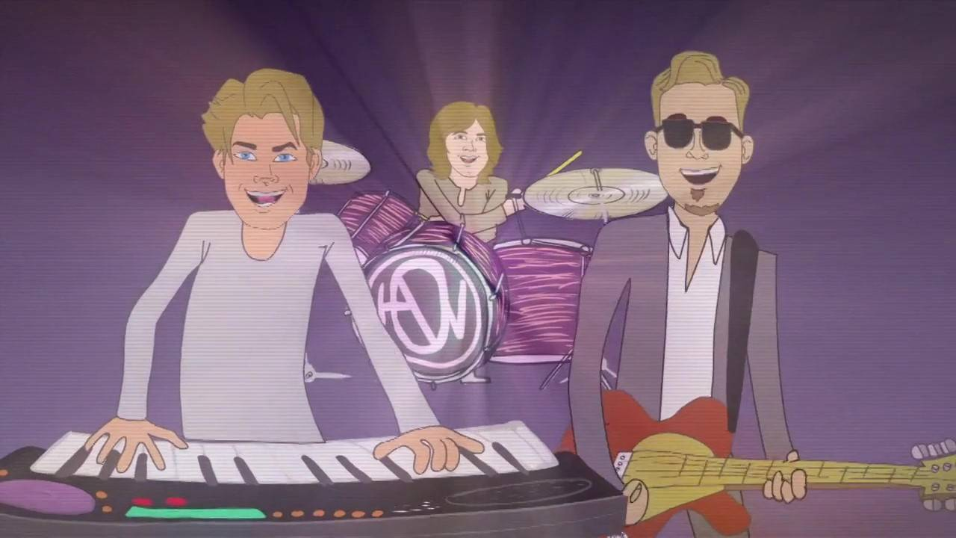
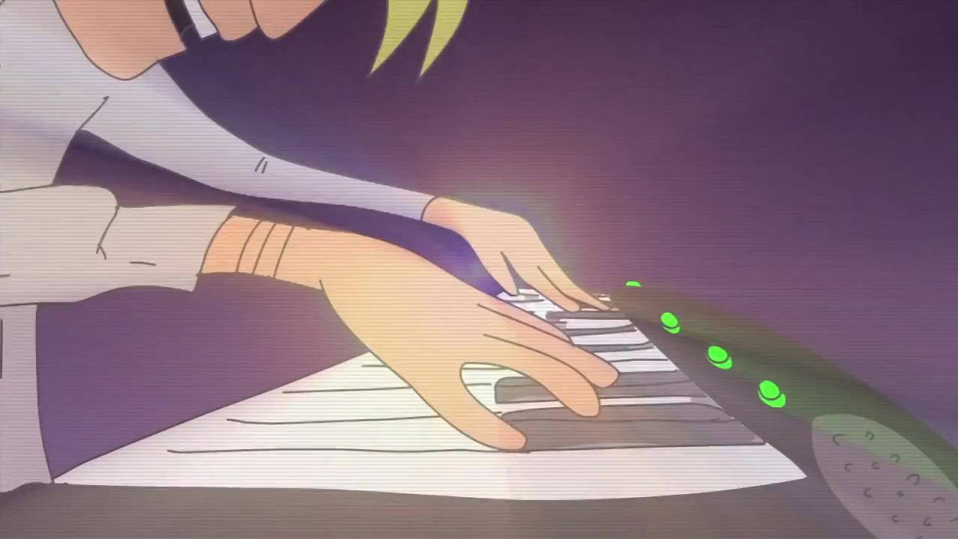
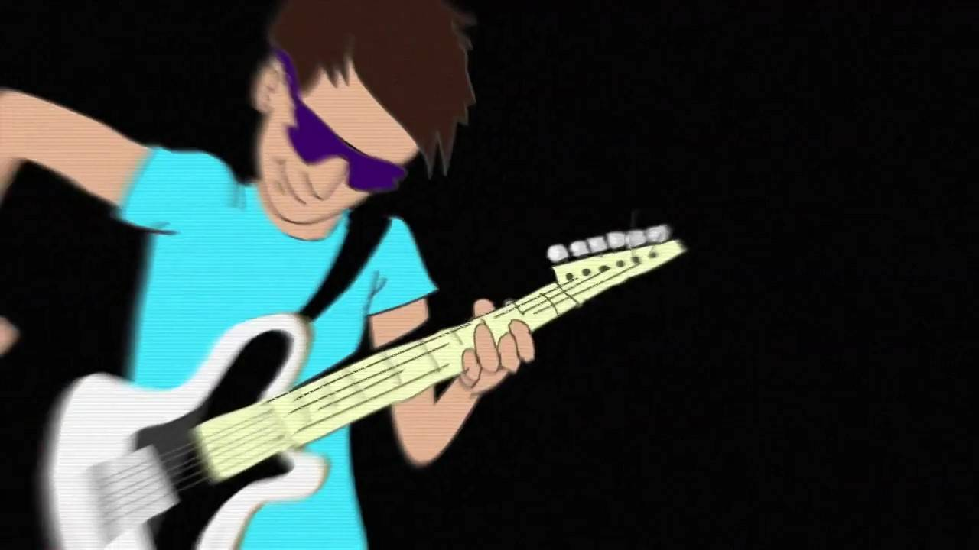
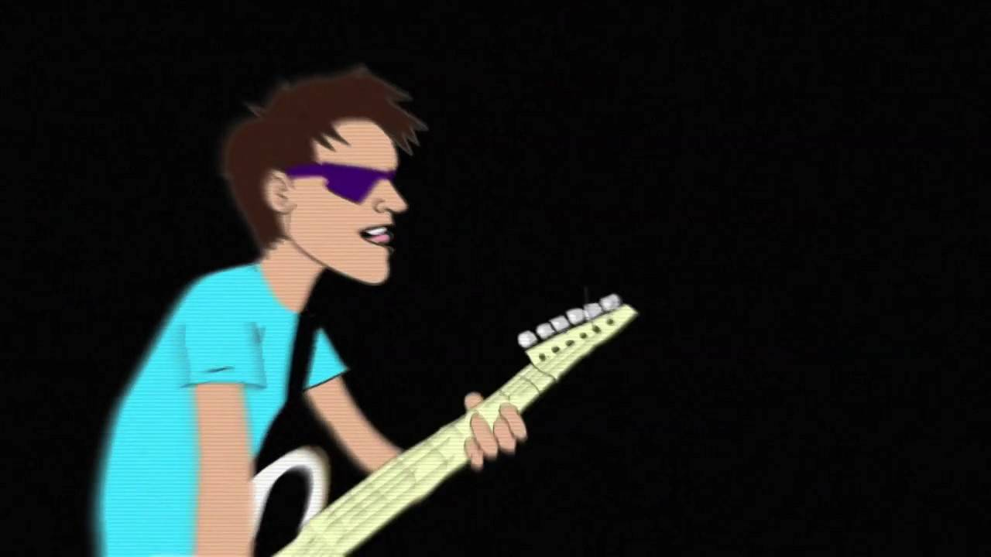
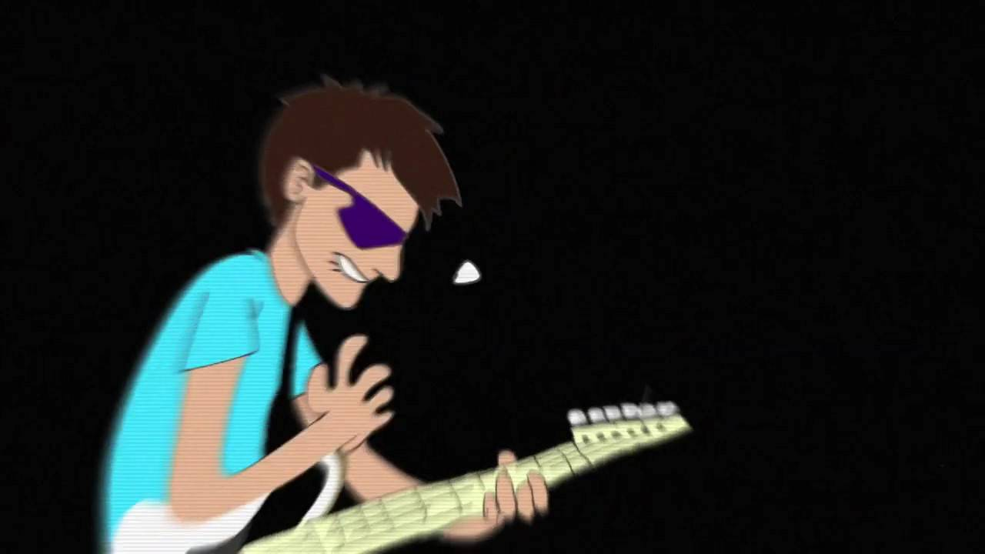
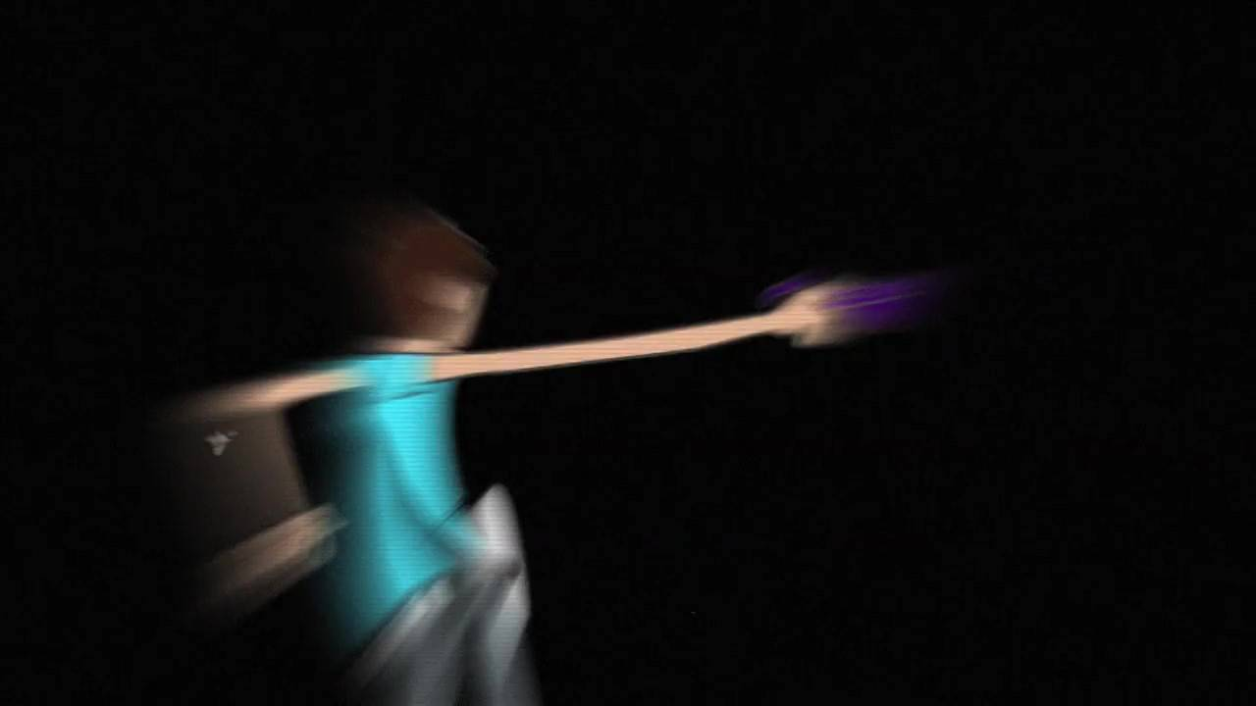
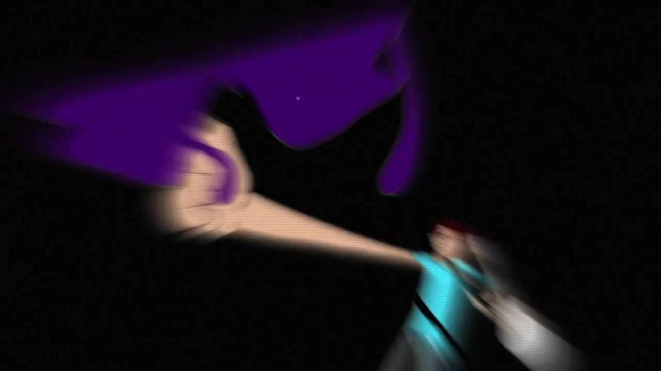
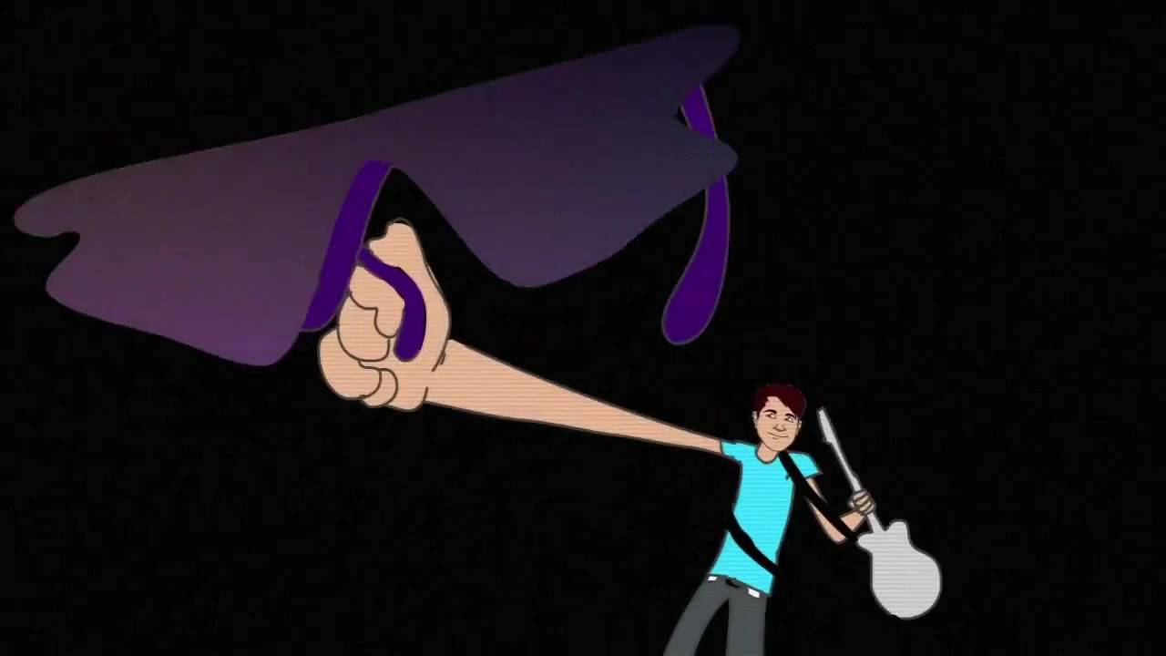
It’s unbelievable,
it’s unbelievable
It’s unbelievable
When I was a kid I spent my Saturday’s blowing on Nintendo games
When I was a kid I saved up all my dough so I could buy C-3PO
Put Mentos in my Diet Coke in the back seat of the bus
It’s unbelievable This is as good as it gets
You haven’t seen nothing yet
It’s
unbelievable
It’s
It’s
unbelievable
It’s unbelievable Don’t know what’s gonna happen next
The newest thing was Lion King,
and I could feel the love
Don’t know what’s gonna
happen next
This is as good as it gets
When I was a kid I ate SpaghettiOs, played laser tag and G.I.Joes
And if you vowed "No Girls Allowed" , then you could join the club
You haven’t seen nothing yet

Slide 3
When I was a kid I dreamed of Power Wheels Stayed up late watching action films

Slide 4
And I won’t lie, my friends and I, were too legit to quit

Slide 5
When I was a kid I lived for ColourTRIS, ate Dr. Pepper jelly beans

Slide 6
My favorite part of Jurassic Park was how real the Raptors looked

Slide 7
When I was a kid I still had VHS, watched Fresh Prince and Jazzy Jeff

Slide 8
Zac Murris owned the first cell phone, and it was off the hook

Slide 9
It’s unbelievable This is as good as it gets It’s unbelievable Don’t know what’s gonna happen next

Slide 10
It’s unbelievable You haven’t seen nothing yet It’s unbelievable, it’s unbelievable

Slide 12
Gak, pogs and Floam and Home Alone, Berenstain Bears and bean bag chairs

Slide 13
My L.A. looks and Goosebumps books, oh, Etch-A-Sketch, what happened next

Slide 14
Grape Juicyjuice and Dr. Seuss, piggy-back rides and Slip N' Slides

Slide 15
Mcdonold's fries, those were the best, what happens next

Slide 16
It’s unbelievable This is as good as it gets It’s unbelievable Don’t know what’s
gonna happen next

Slide 17
It’s unbelievable You haven’t seen nothing yet It’s unbelievable, those were the days. Oh!

Slide 18
It’s unbelievable When I think back on them, man It’s unbelievable Cause baby those were the days

Slide 19
It’s unbelievable It ruled in so many ways It’s unbelievable
it’s unbelievable

Slide 21
I'm so amazed, those were the days

