Slide 1
教材：人教版七年级下册
课文：U12 What did you do last weekend ?
主题： Weekend Activities
歌曲： The Weekend
作者：于涵
单位：华南师范大学外文学院

Slide 2
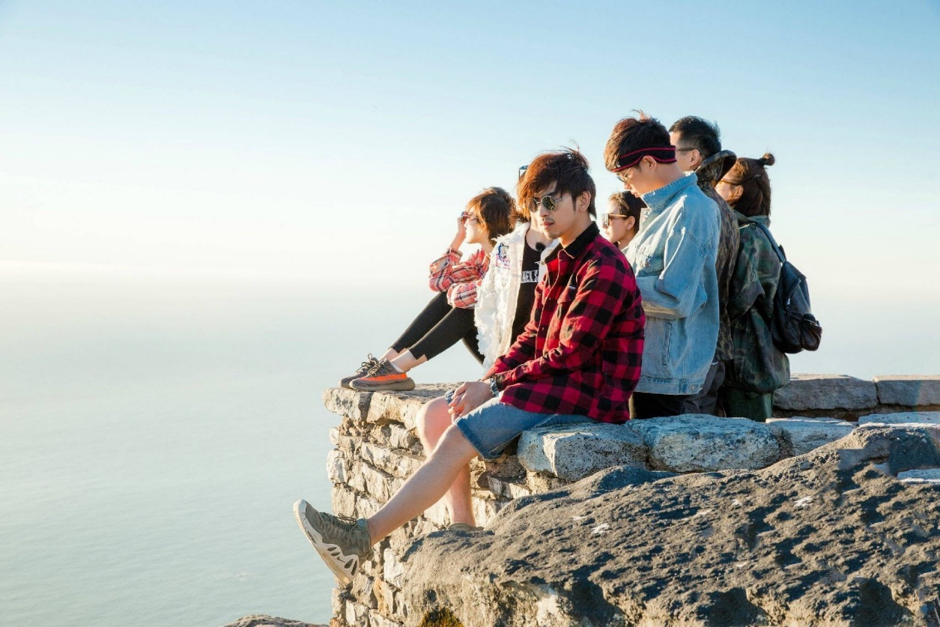
What if every day I woke up late

Slide 3
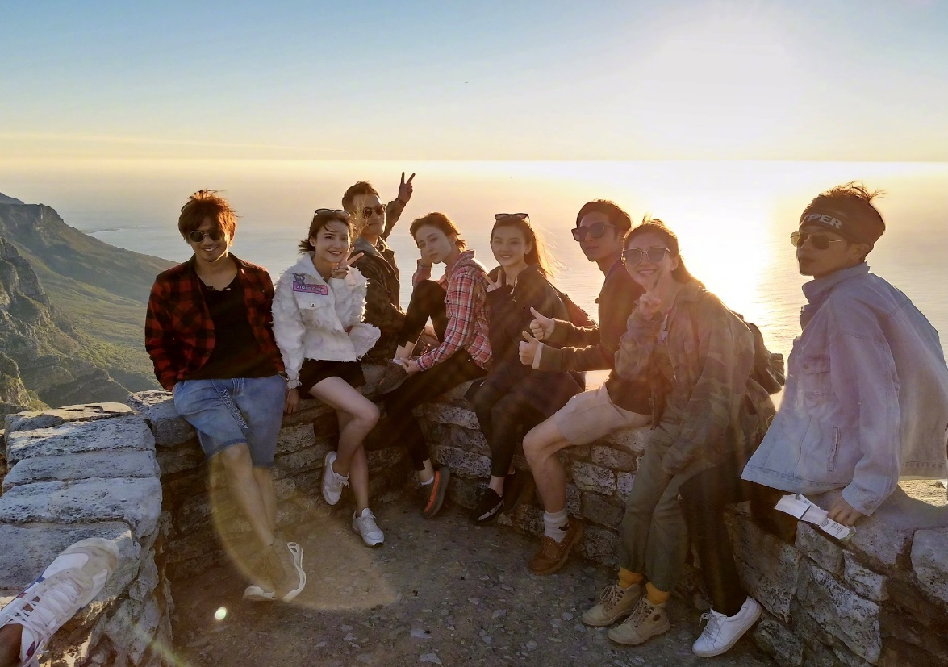
I did whatever I felt like

Slide 4
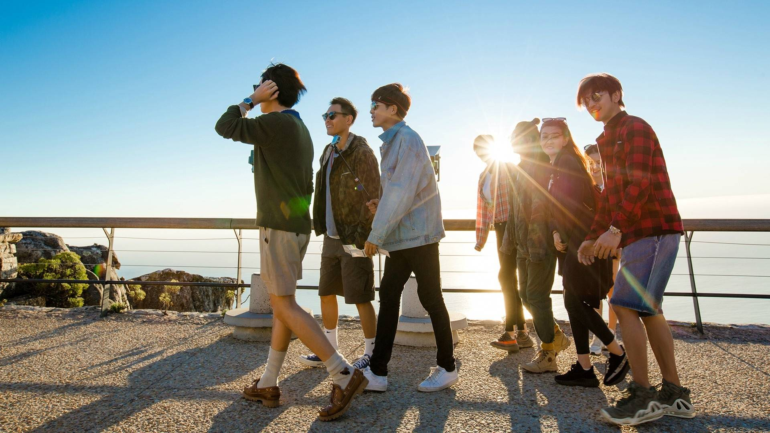
I felt clever I'd go on adventures

Slide 5
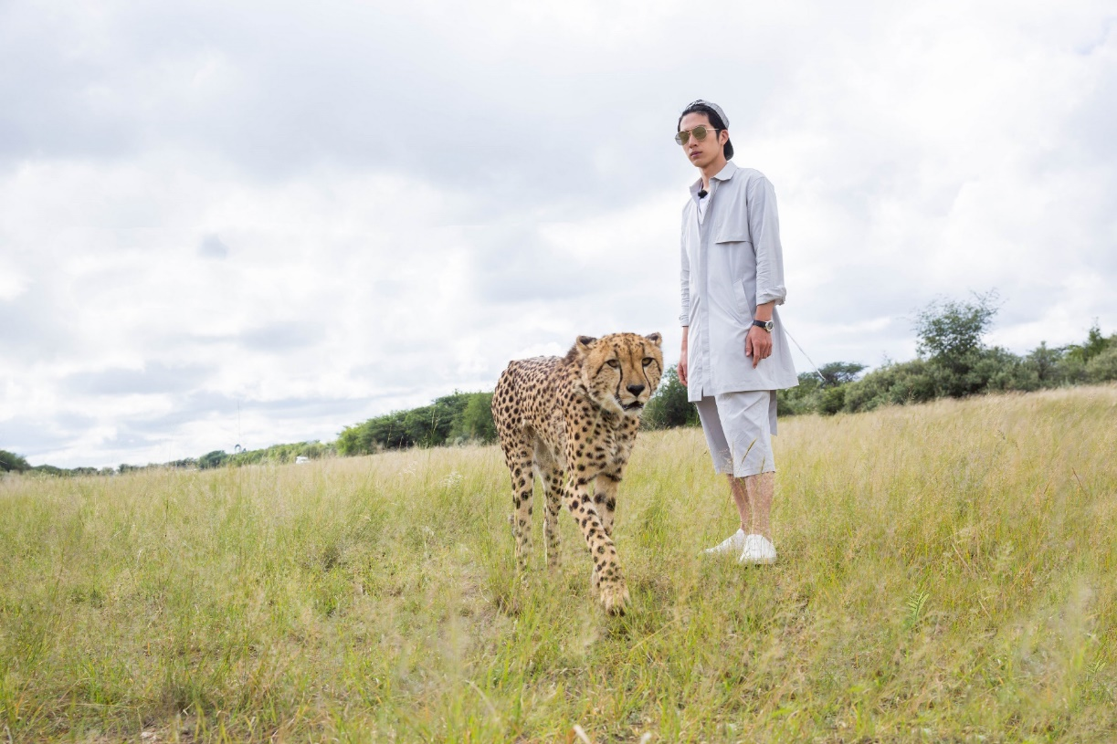
I'd run with lions in the dead of night

Slide 6
Wouldn't it be nice

Slide 7
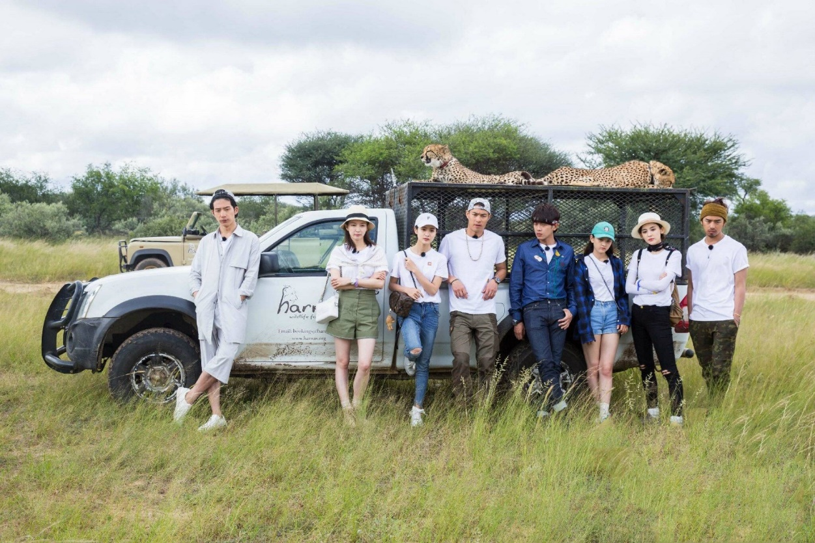
To Saturdays and Sundays

Slide 8
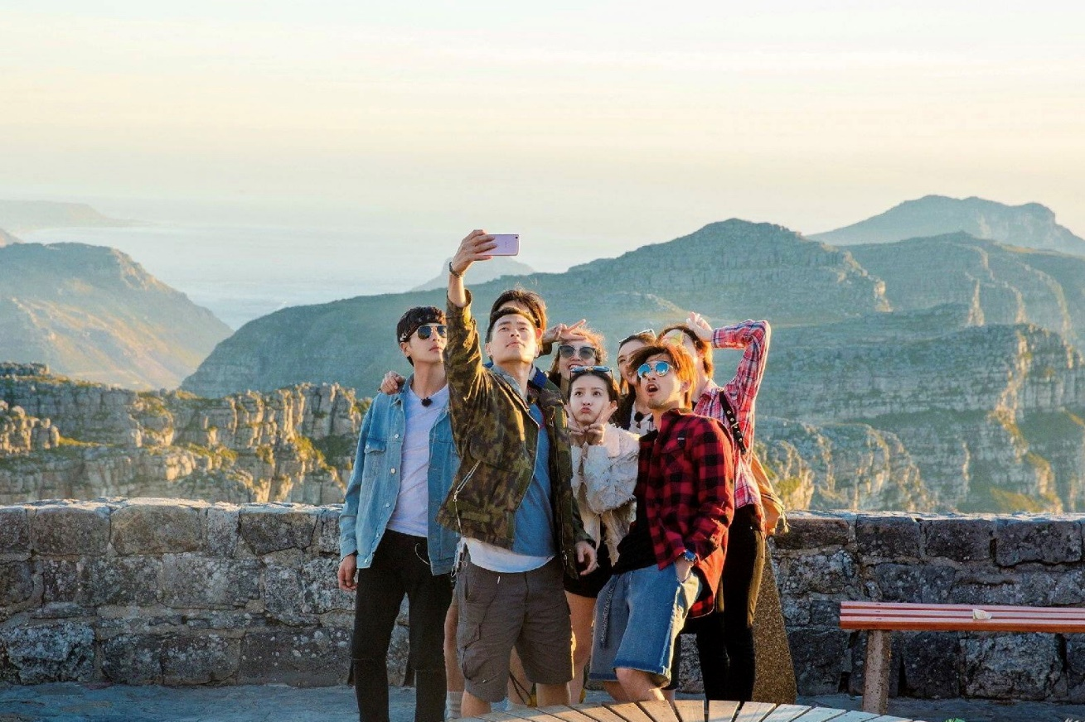
When I fall down I know I've got this weekend to live

Slide 9
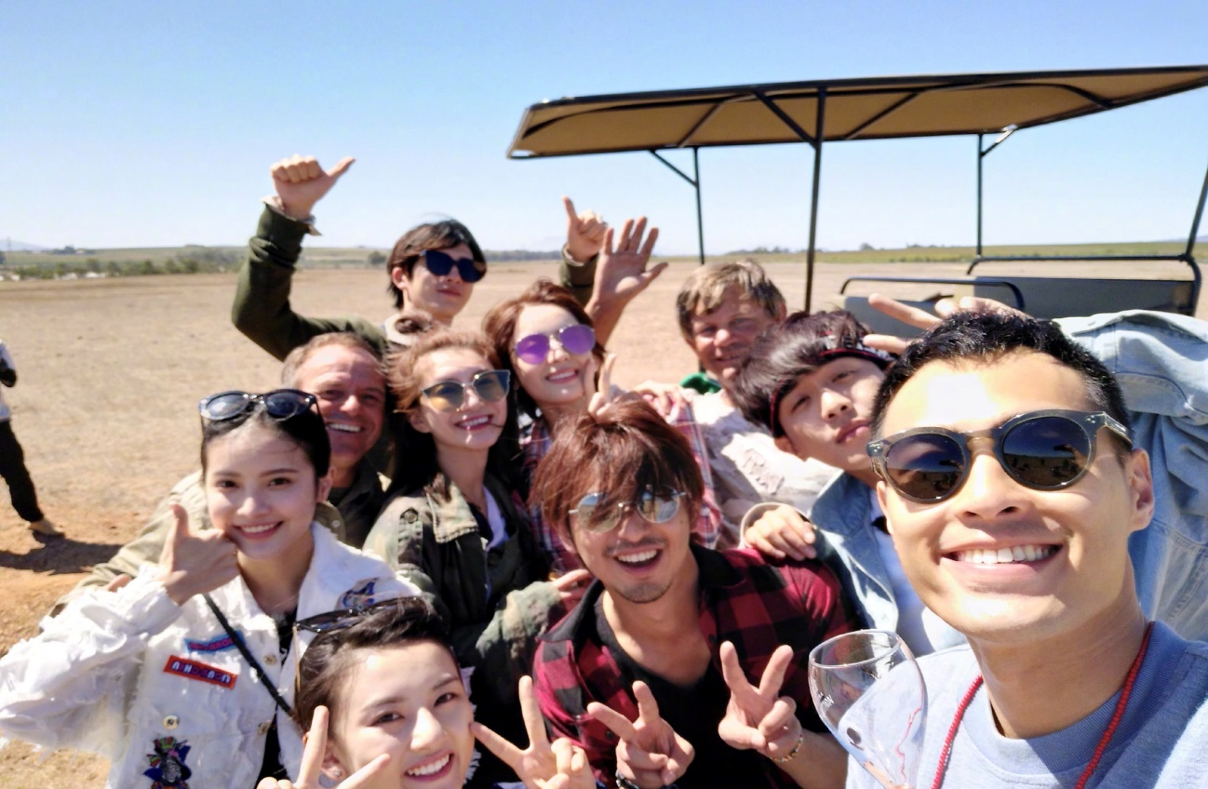
I'm gonna get my freak on

Slide 10
It carries me

Slide 11
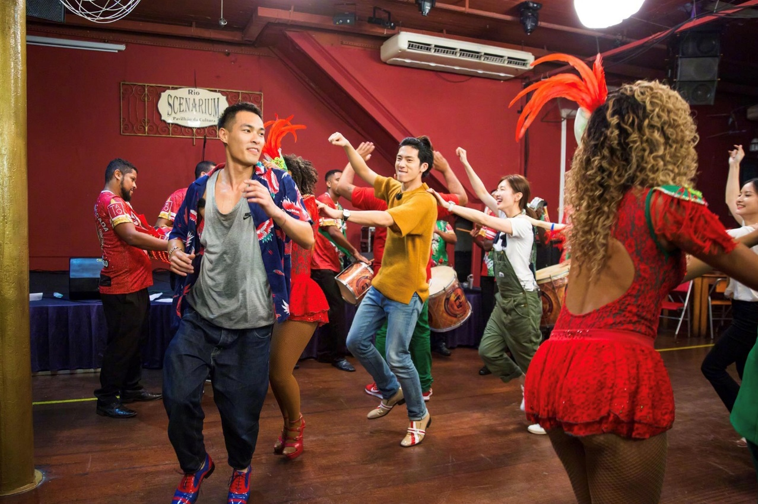
And we'll be rocking our playlist I won't back down

Slide 12
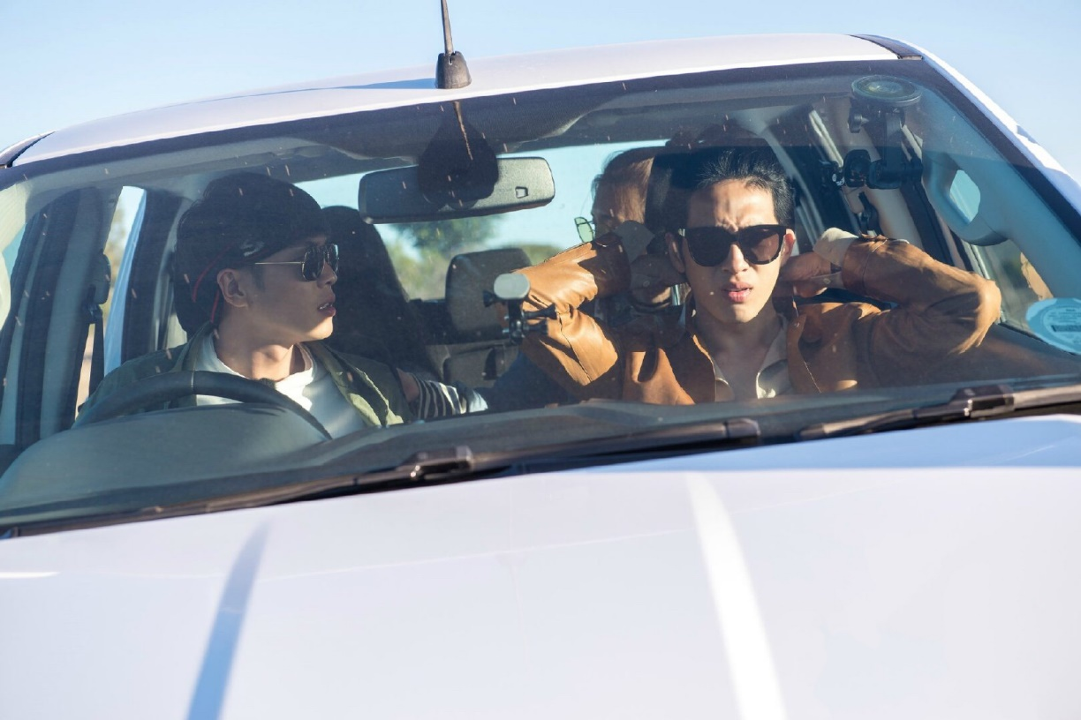
I'll live it up like Hendrix

Slide 13
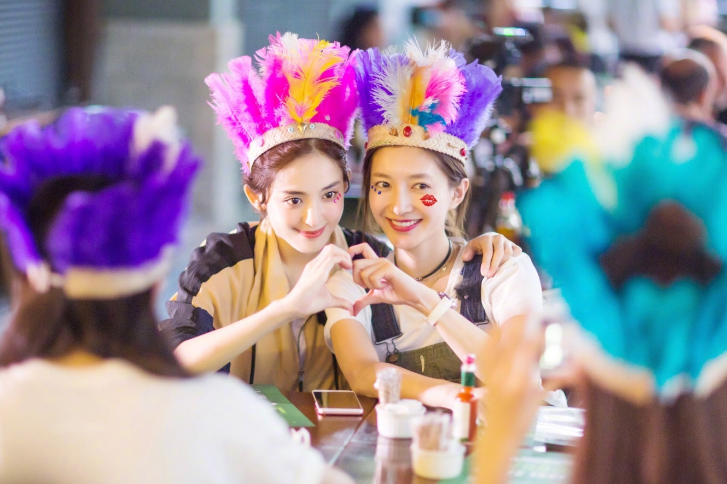
Now I'll paint my face just like
KISS

Slide 14
Let's own this town

Slide 15
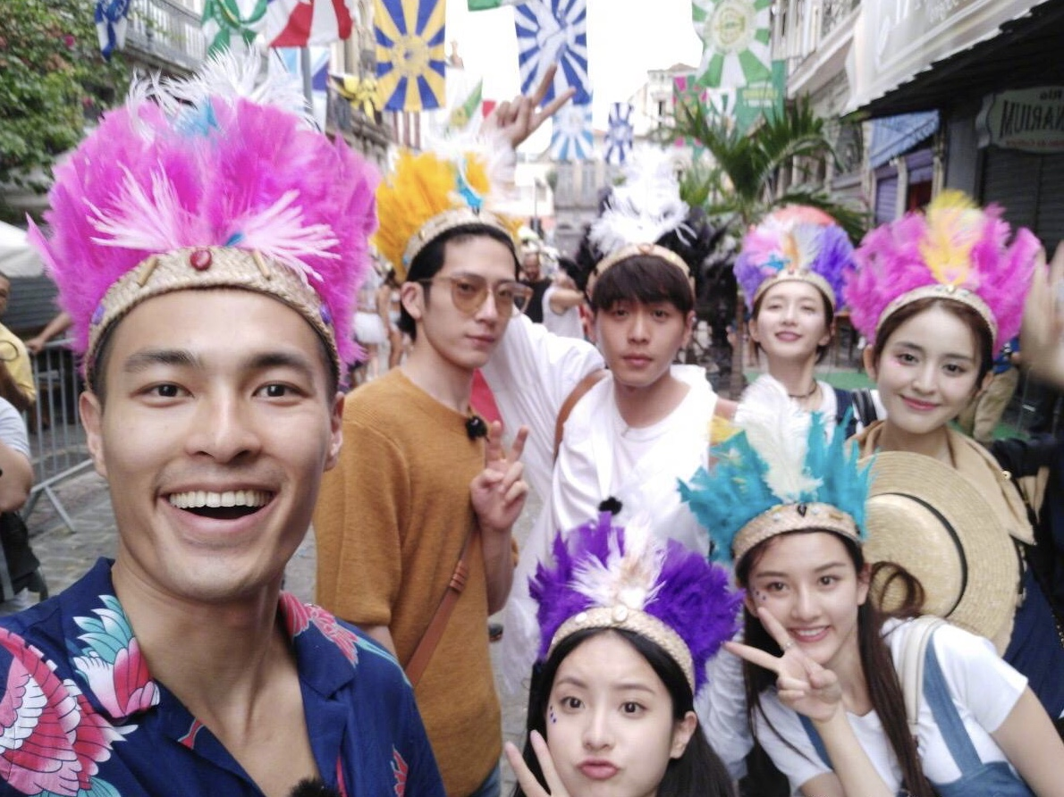
It's all about the weekend
So let's get down
Get down

Slide 16
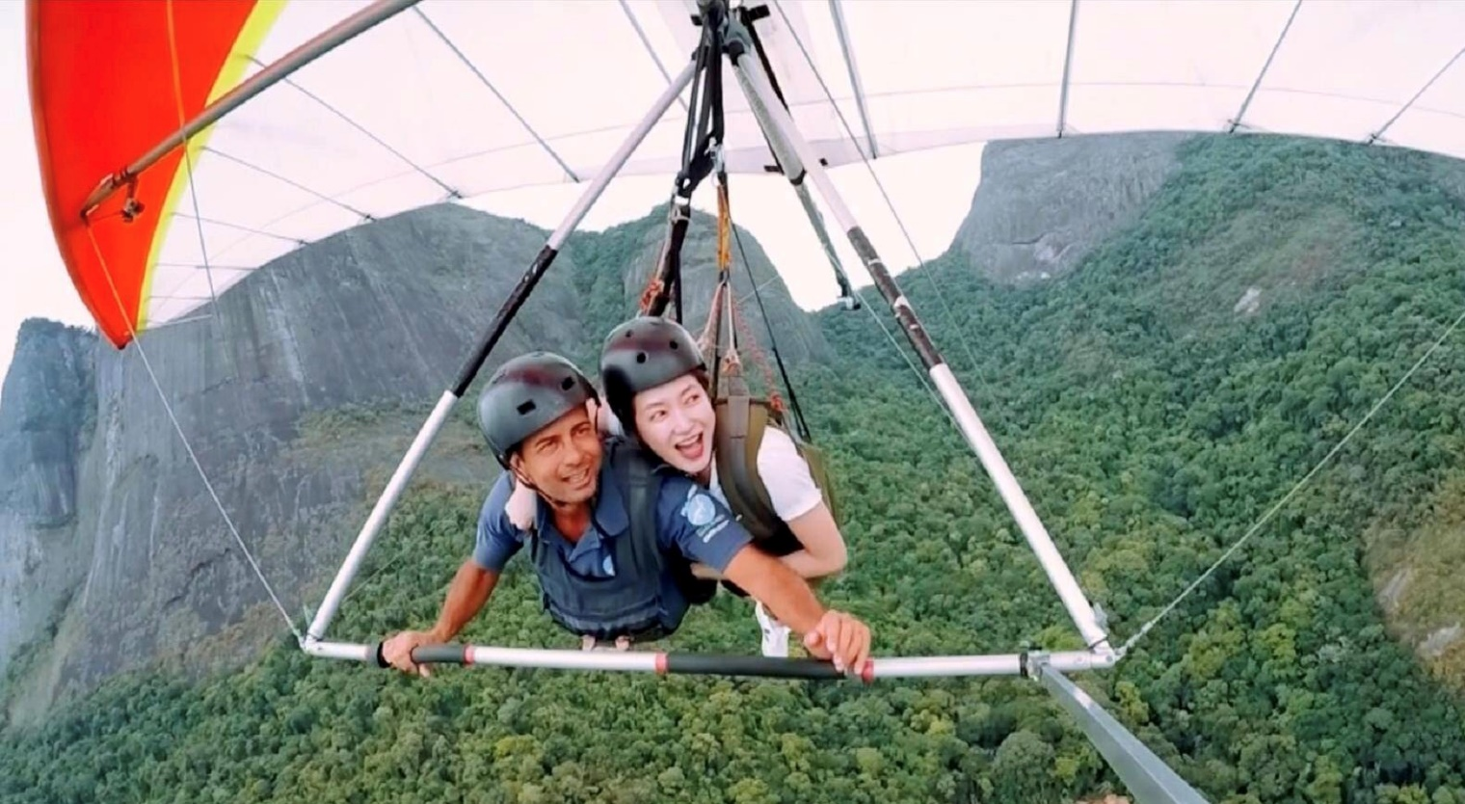
It's time to flaunt our innocence

Slide 17
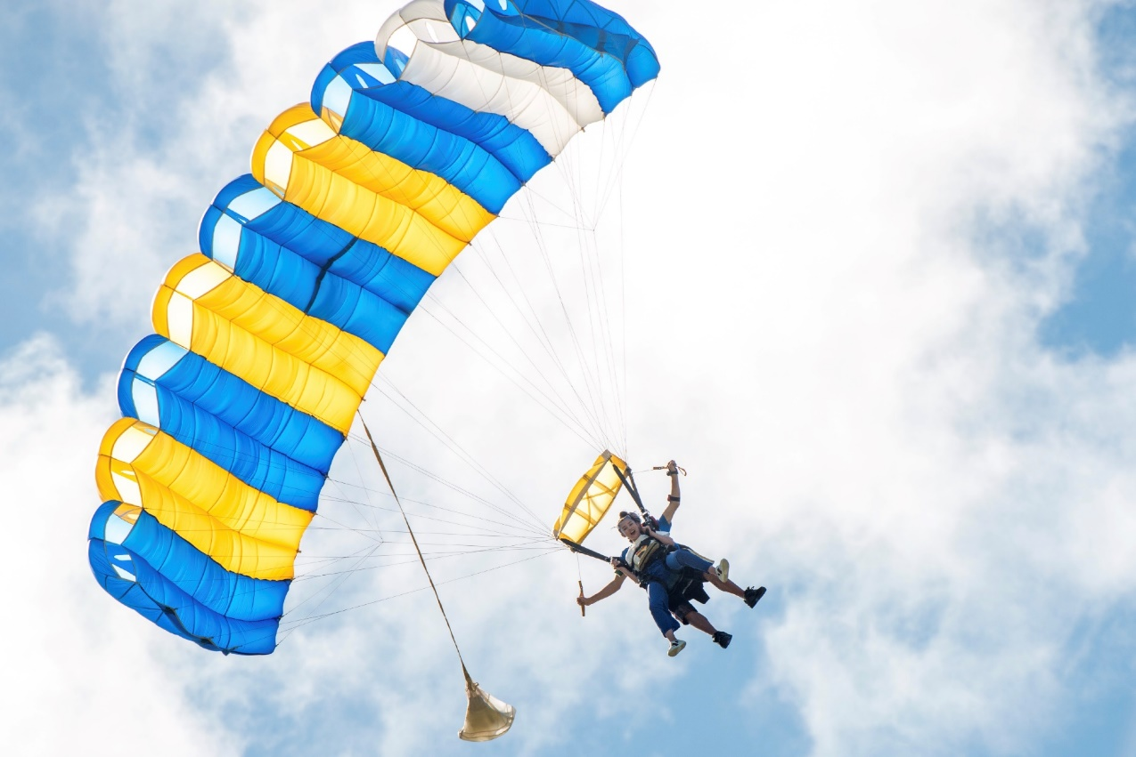
Try new things that don't make sense

Slide 18
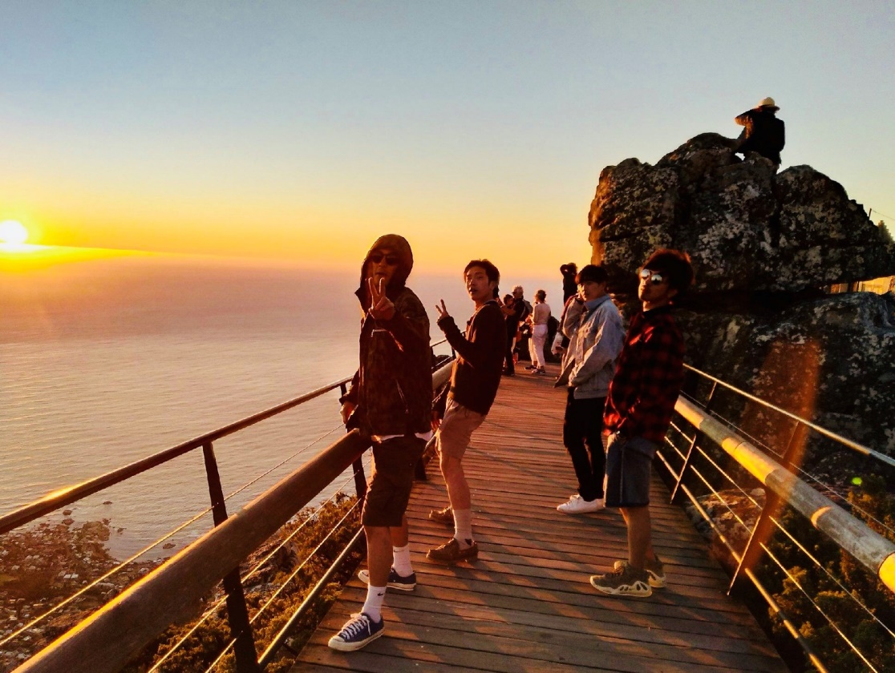
Or maybe just hang out with friends

Slide 19
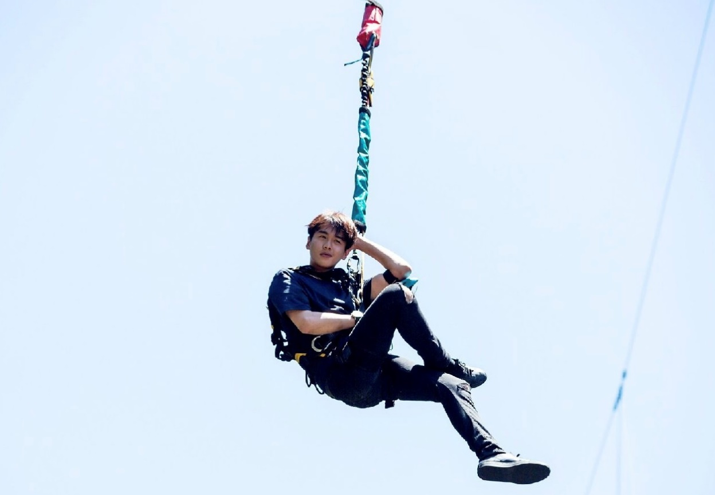
I can wait a lifetime

Slide 20
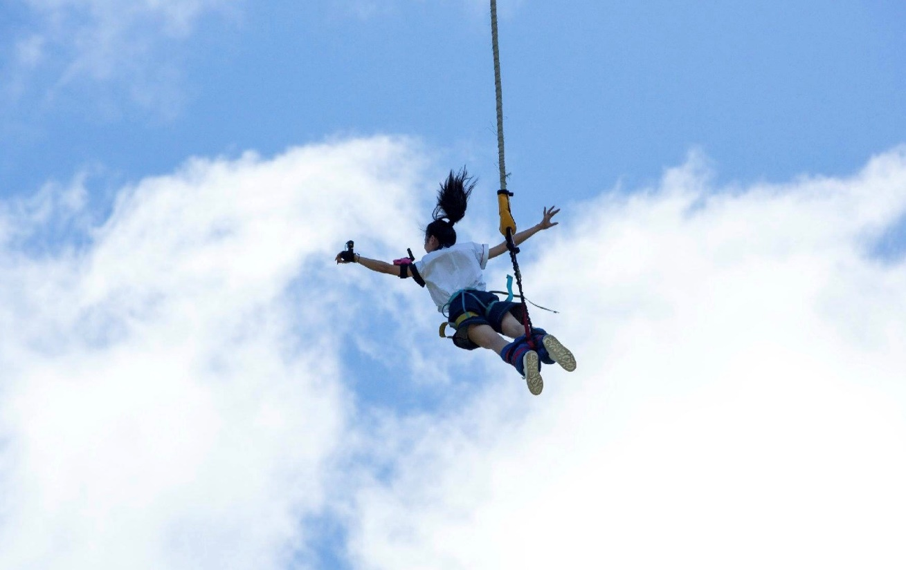
Or I could lose a lifetime
If I don't change my ways

Slide 21
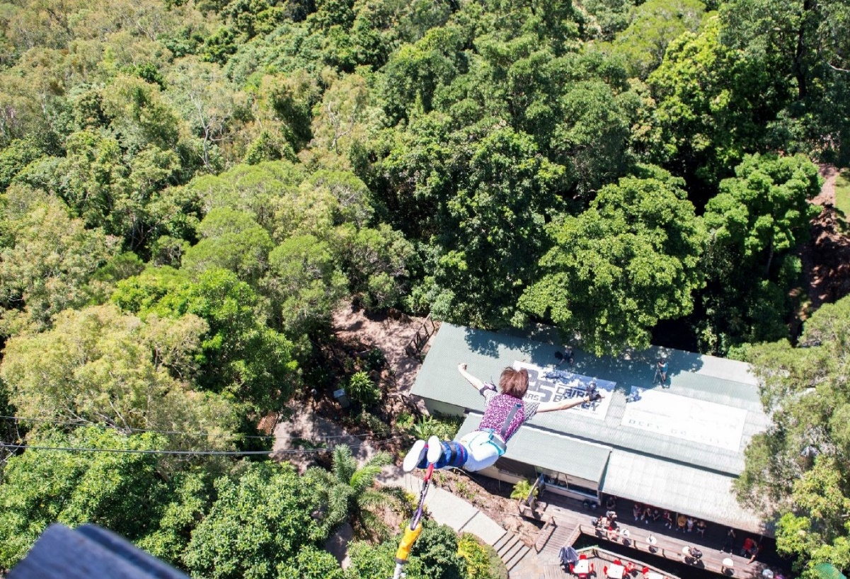
Get out of this rat race
We could do this right

Slide 22
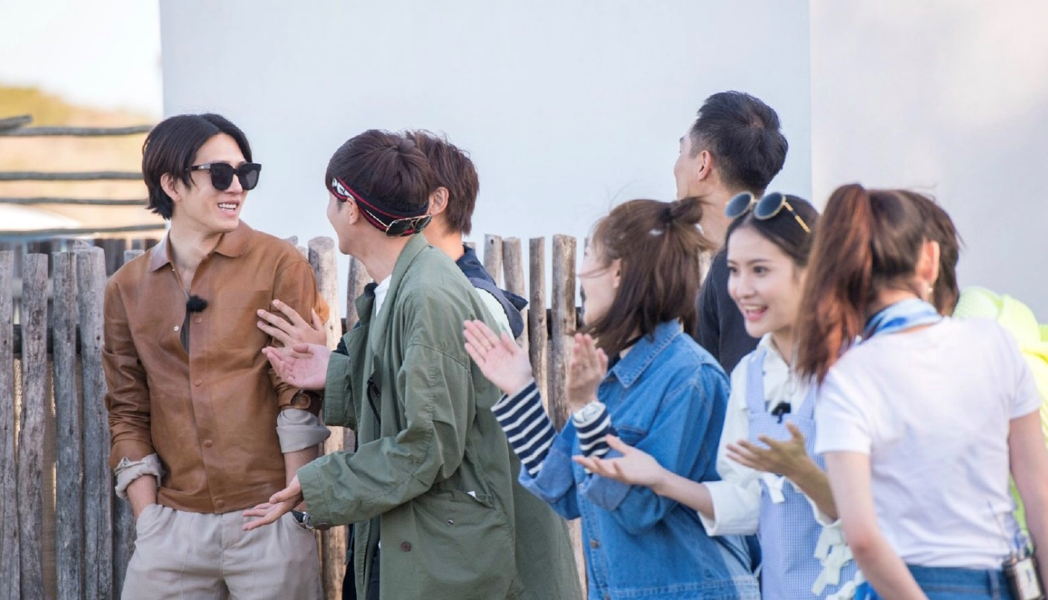
To Saturdays and Sundays

Slide 23
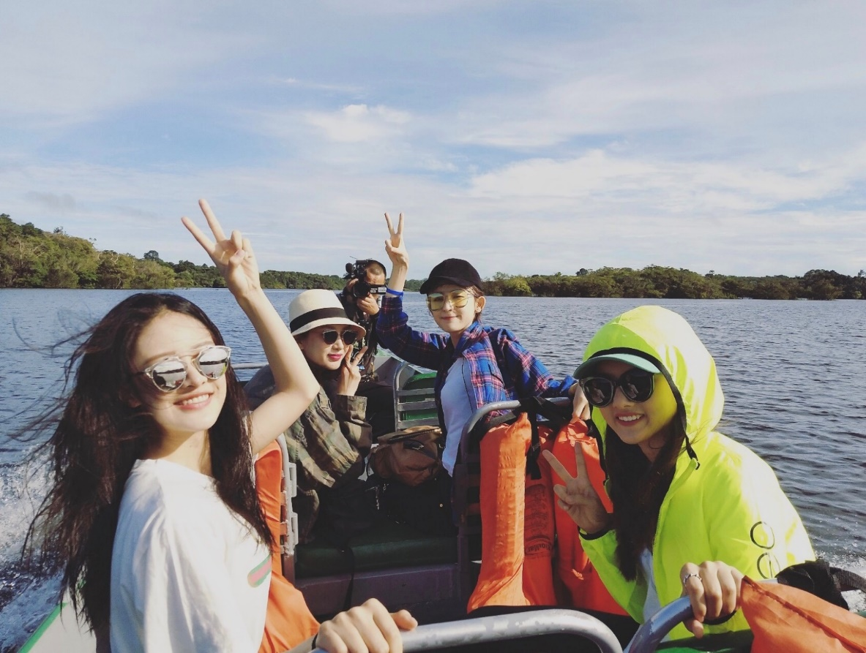
When I fall down I know I've got this weekend to live

Slide 24
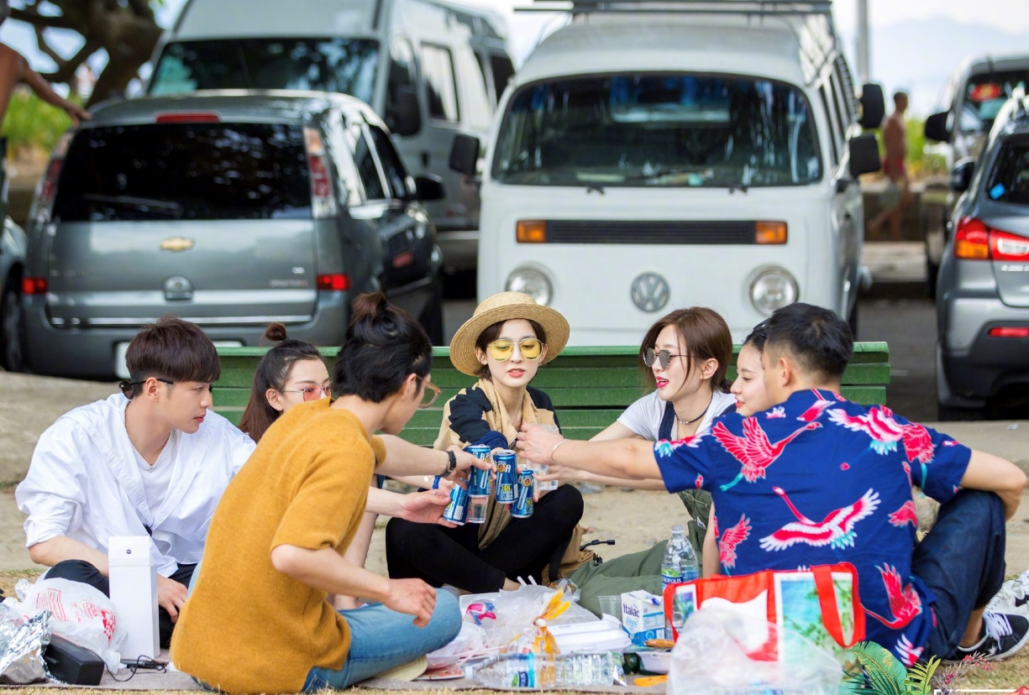
I'm gonna get my freak on

Slide 25
It carries me

Slide 26
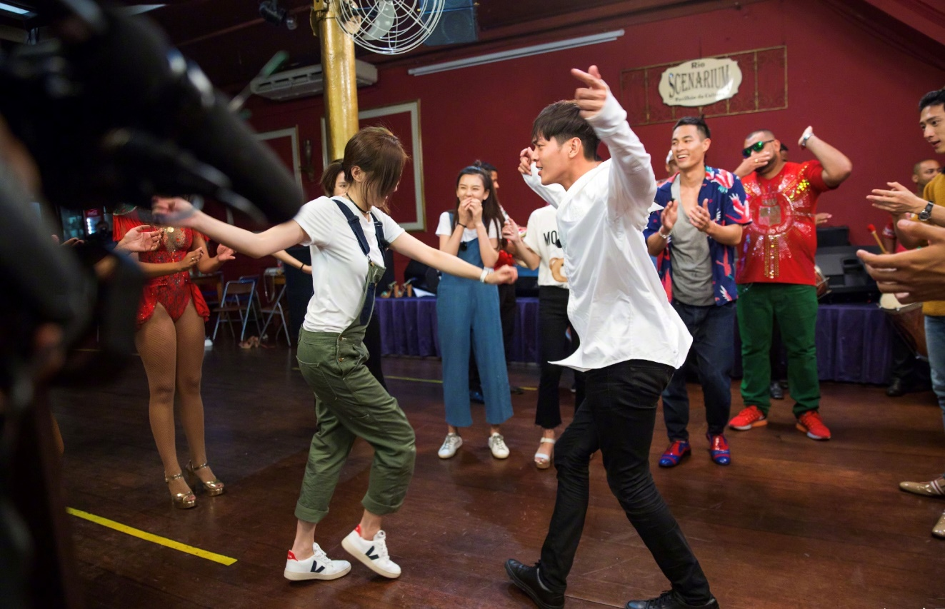
And we'll be rocking our playlist I won't back down

Slide 27
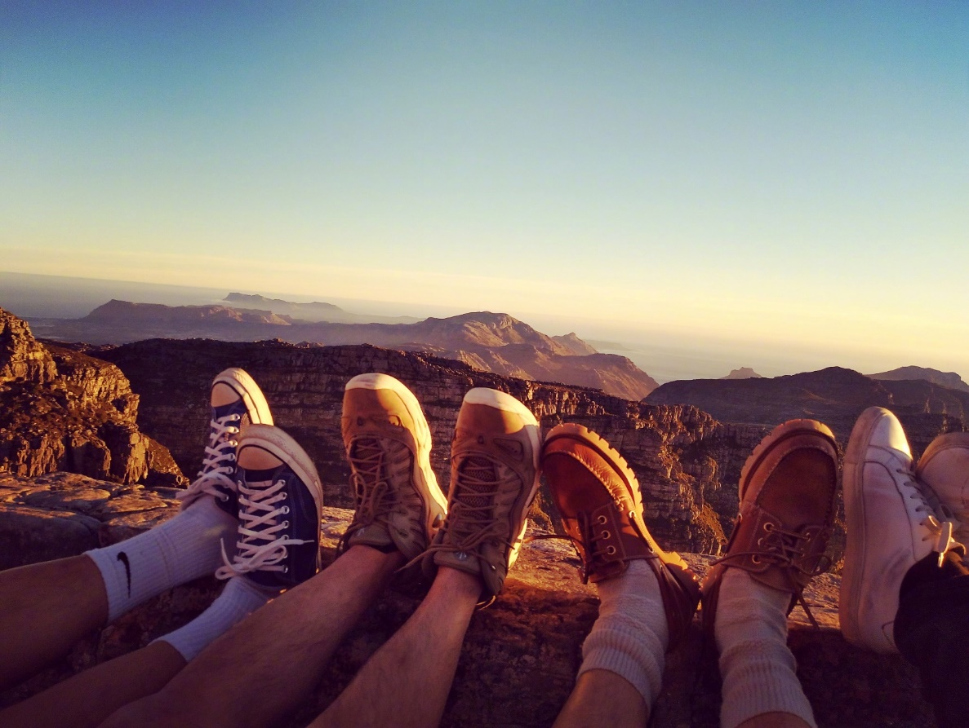
I'll live it up like Hendrix

Slide 28
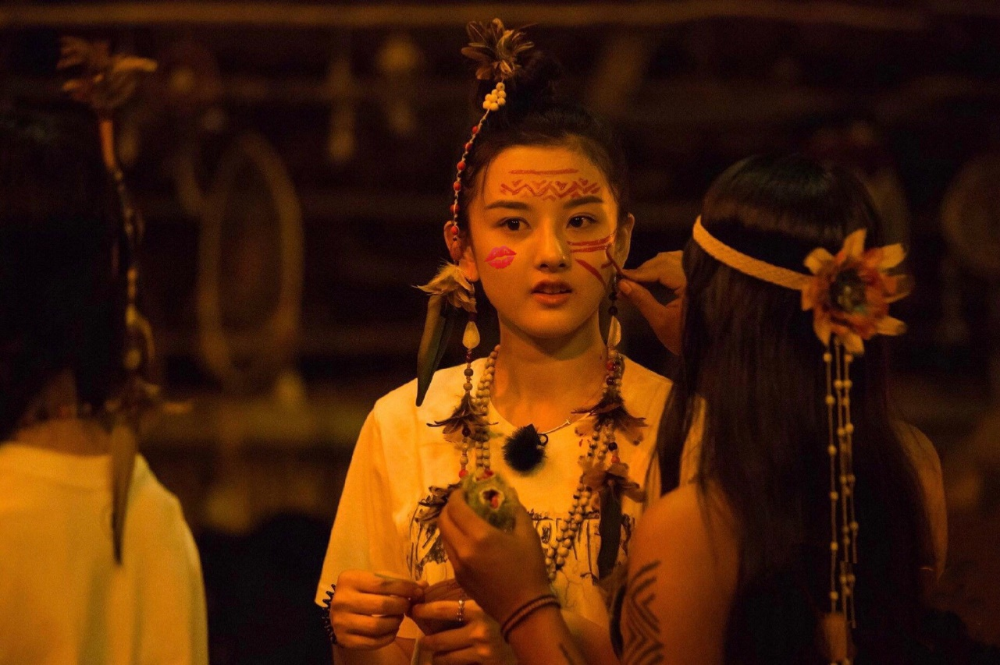
Now I'll paint my face just like
KISS

Slide 29
Let's own this town

Slide 30
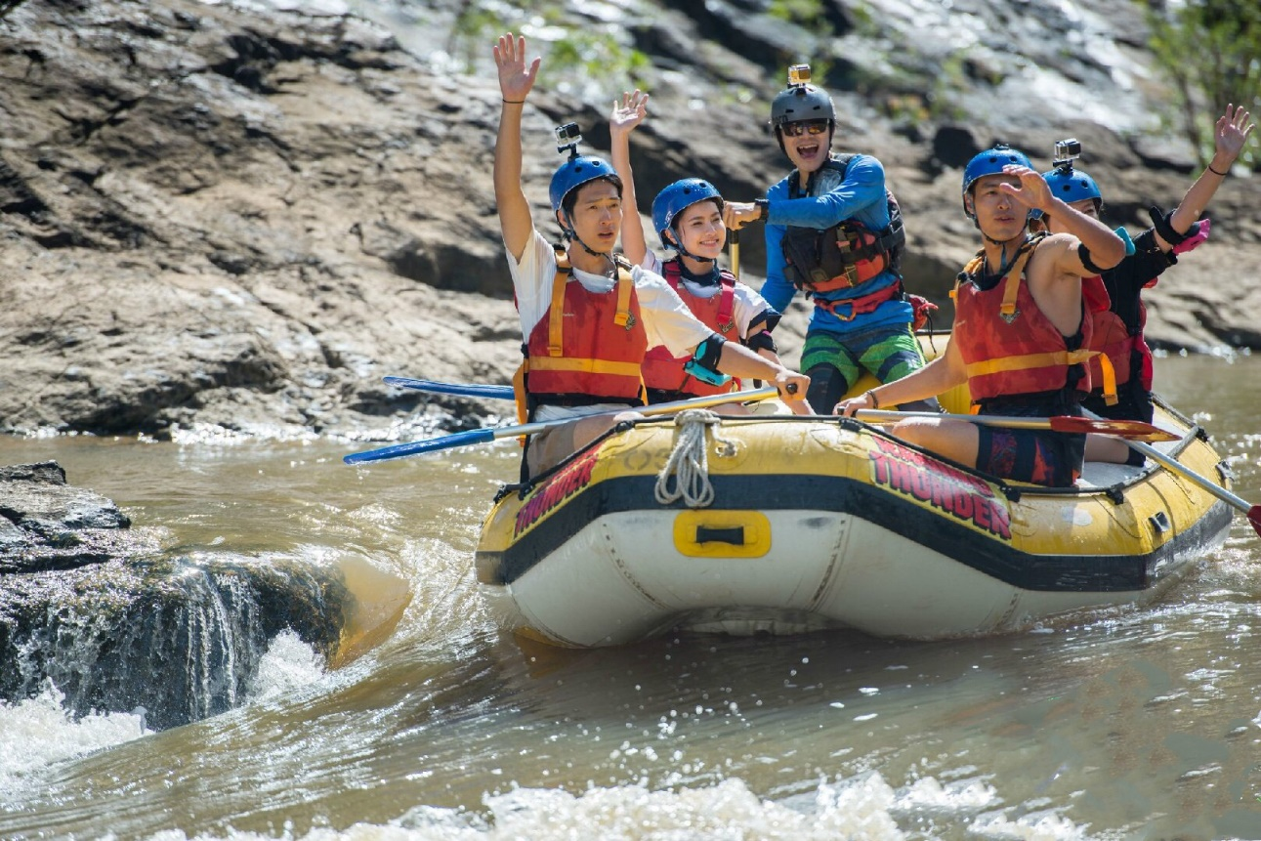
It's all about the weekend
So let's get down

Slide 31
Wouldn't it be nice

Slide 32
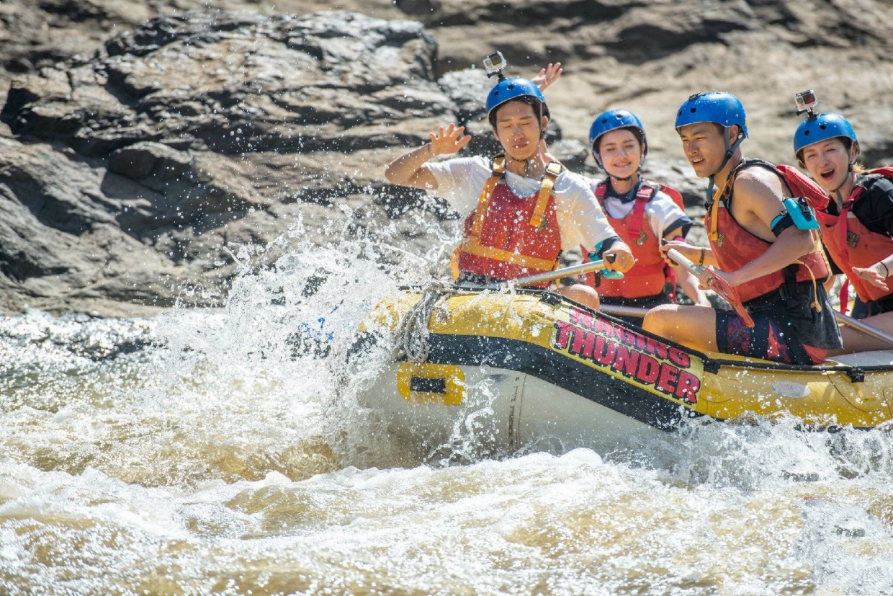
To Saturdays and Sundays

Slide 33
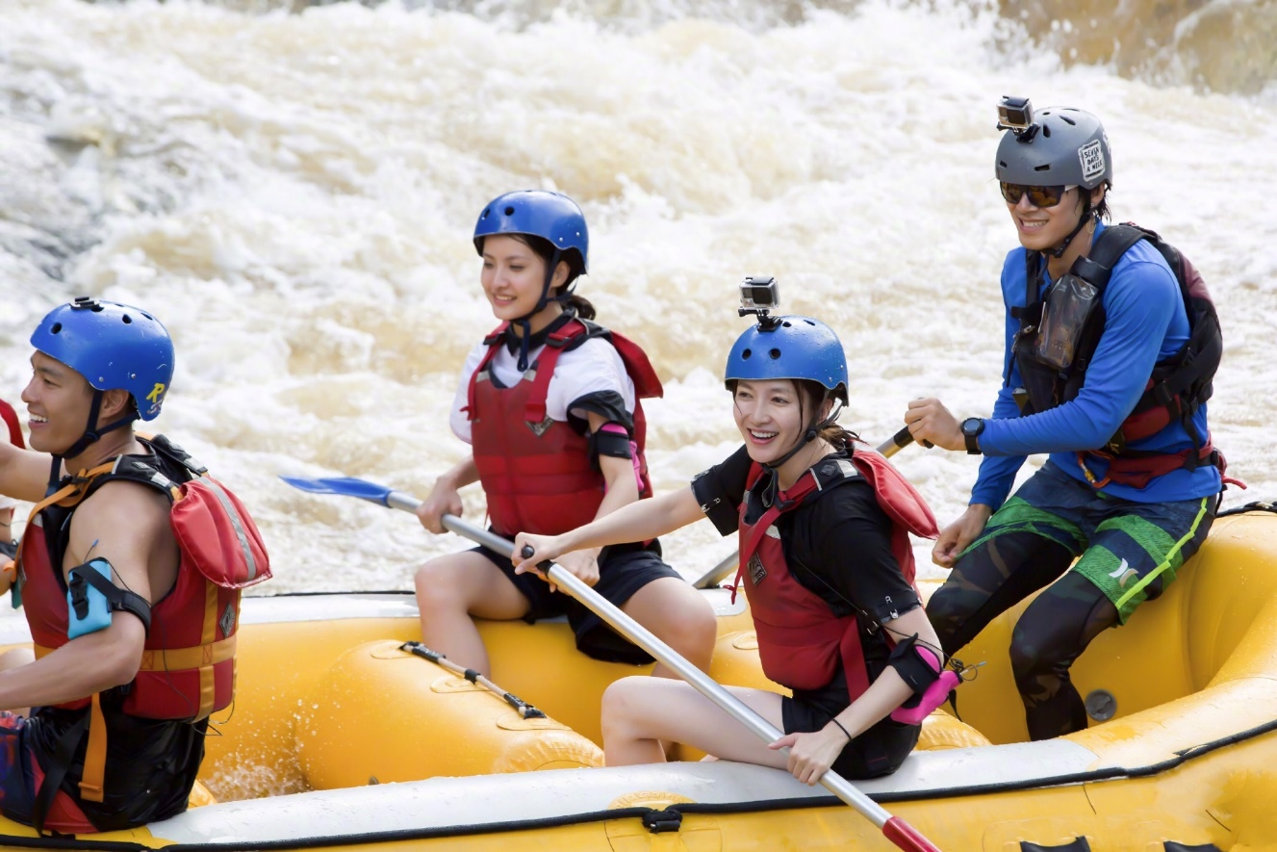
When I fall down I know I've got this weekend to live

Slide 34
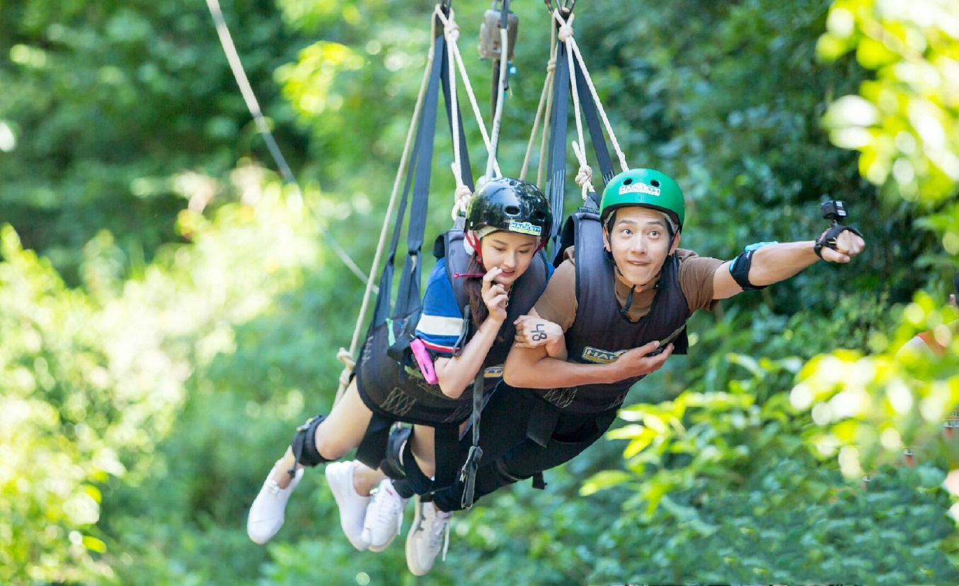
I'm gonna get my freak on

Slide 35
It carries me

Slide 36
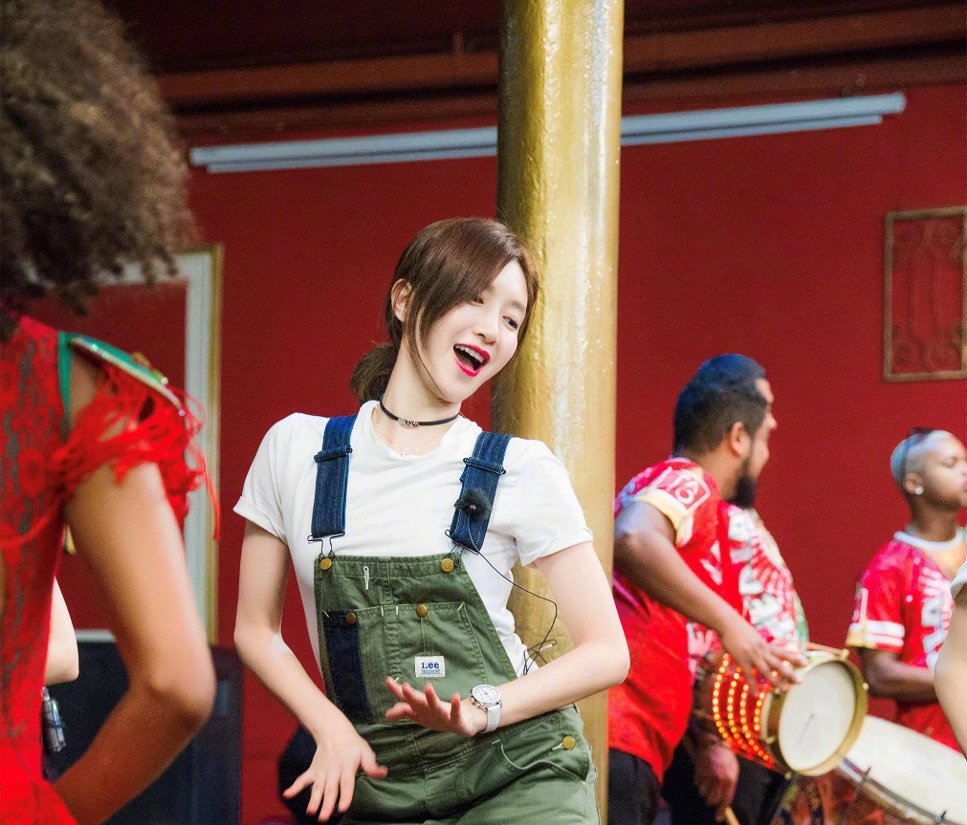
And we'll be rocking our playlist

Slide 37
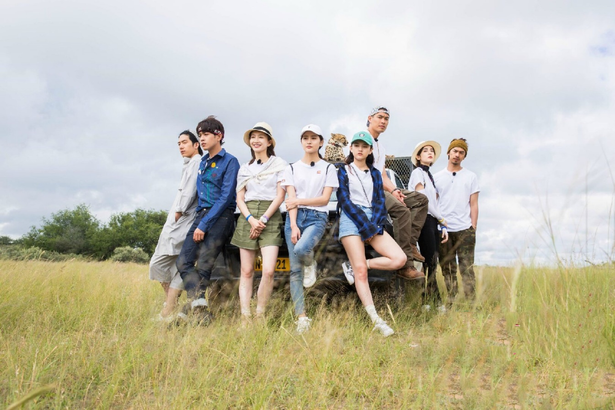
When I fall down I know I've got this weekend to live

Slide 38
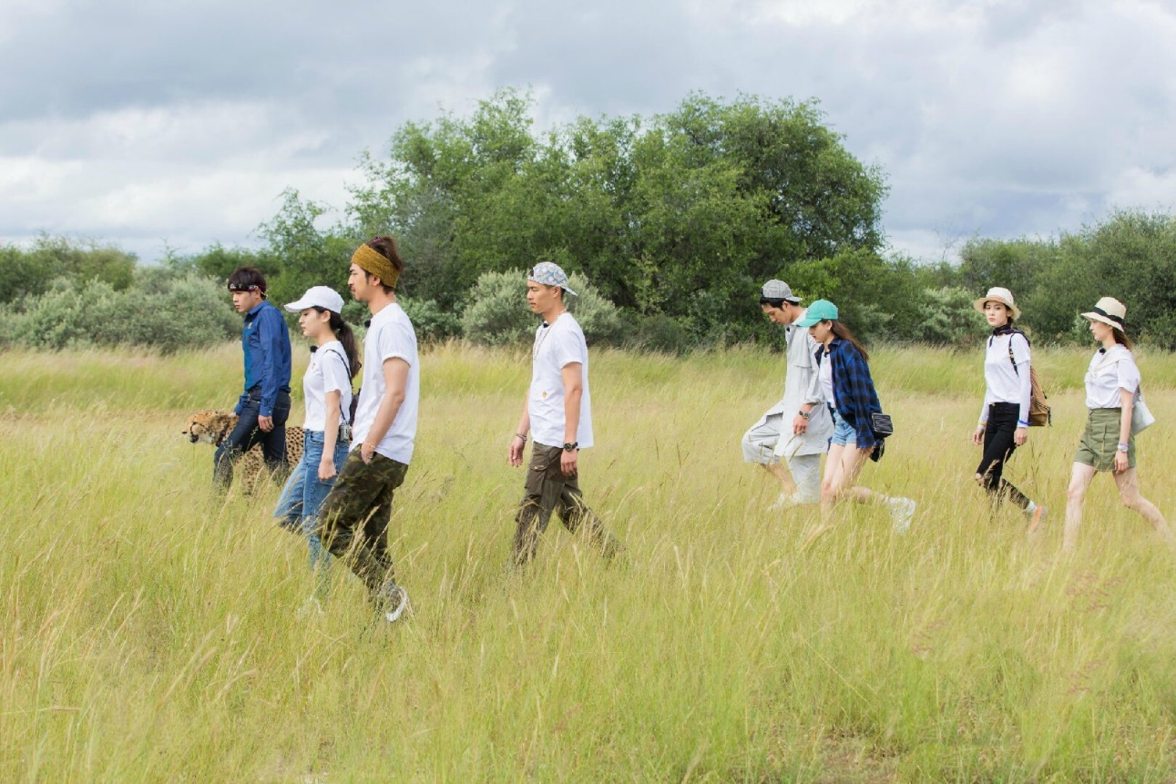
I'm gonna get my freak on

Slide 39
It carries me

Slide 40
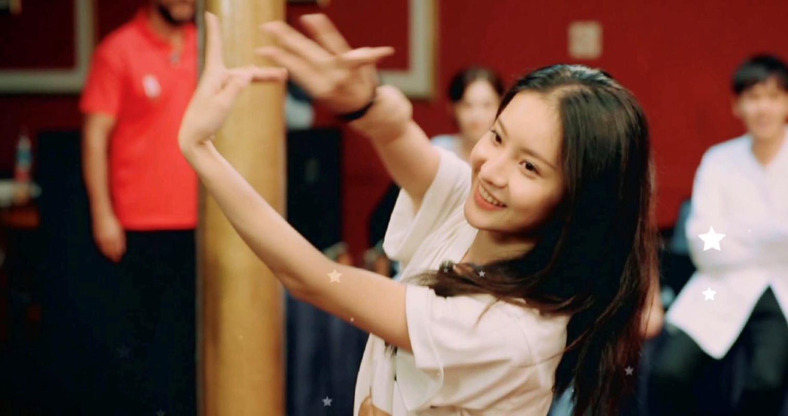
And we'll be rocking our playlist I won't back down

Slide 41
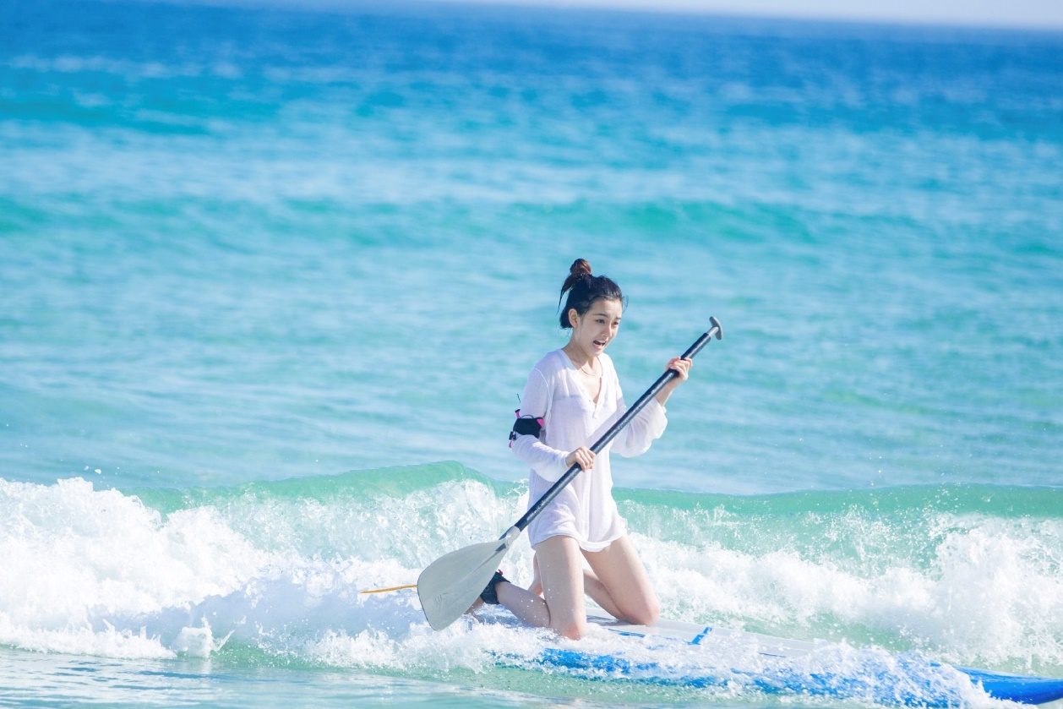
I'll rock out like Nirvana

Slide 42
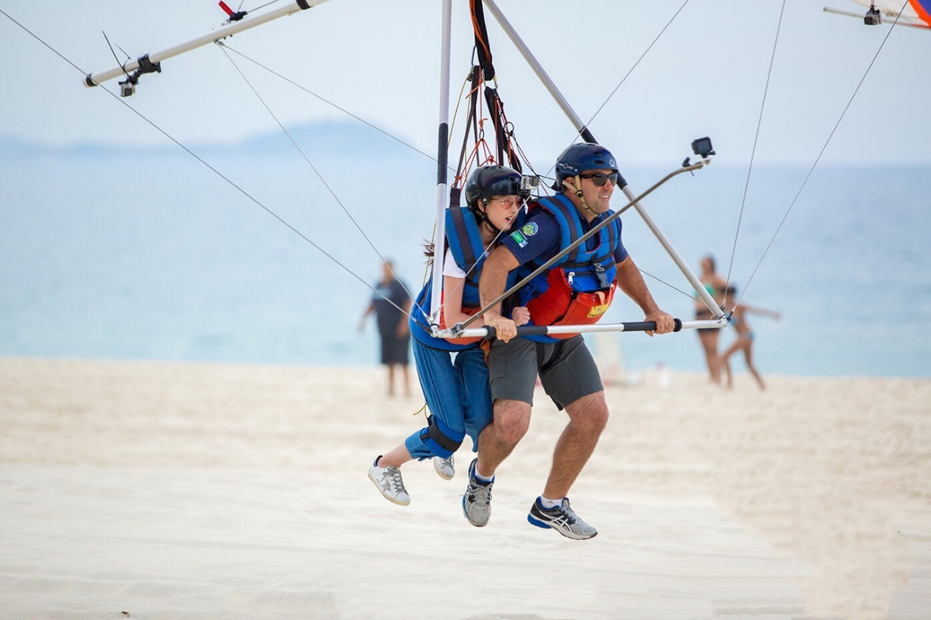
Now we time lose like Madonna

Slide 43
It carries me

Slide 44
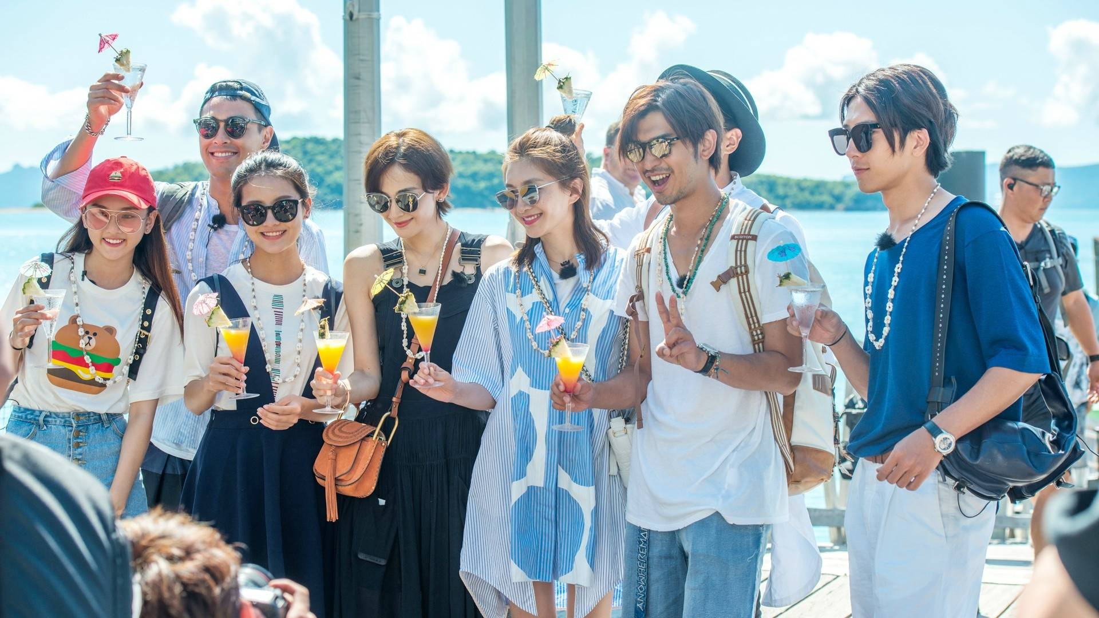
It's all about the weekend

Slide 45
Let’s get down

