Slide 1
歌名：High School Musical
歌手：Cast
教材：人教版7BUnit4
作者：黄美媛
单位：华南师范大学外文学院

Slide 2
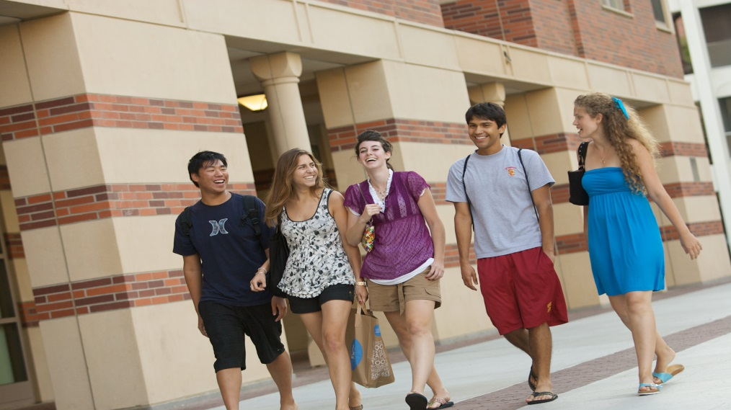
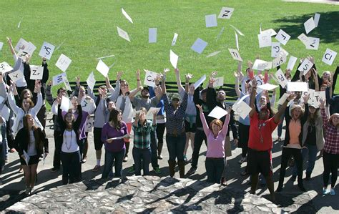

Slide 3
Looking forward
From center stage
Graduation Day
Time to get
the FUTURE started

Slide 4
What we leave
What we take with us

Slide 5
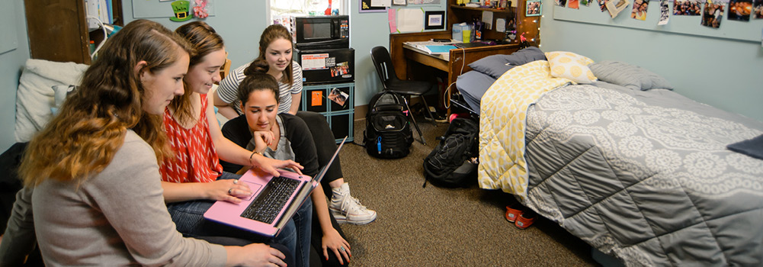
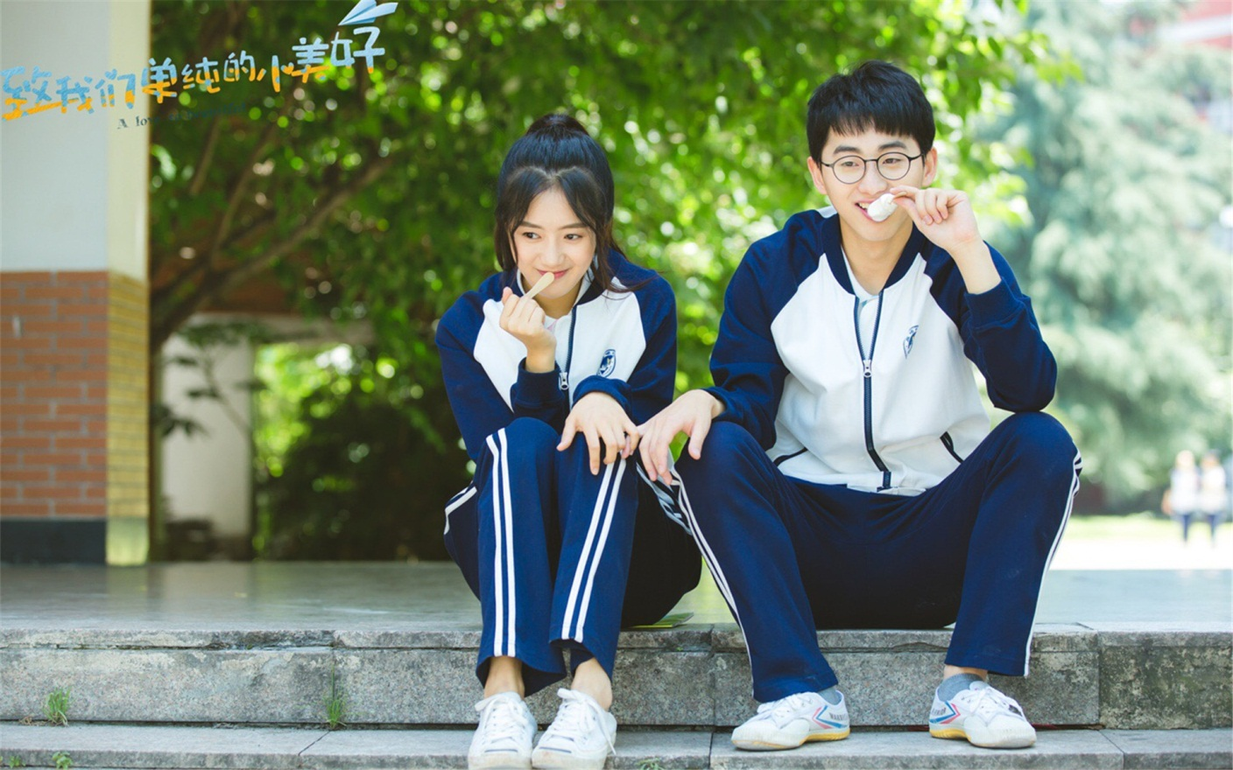
No matter what it’s somethin’ we’re apart of

Slide 6
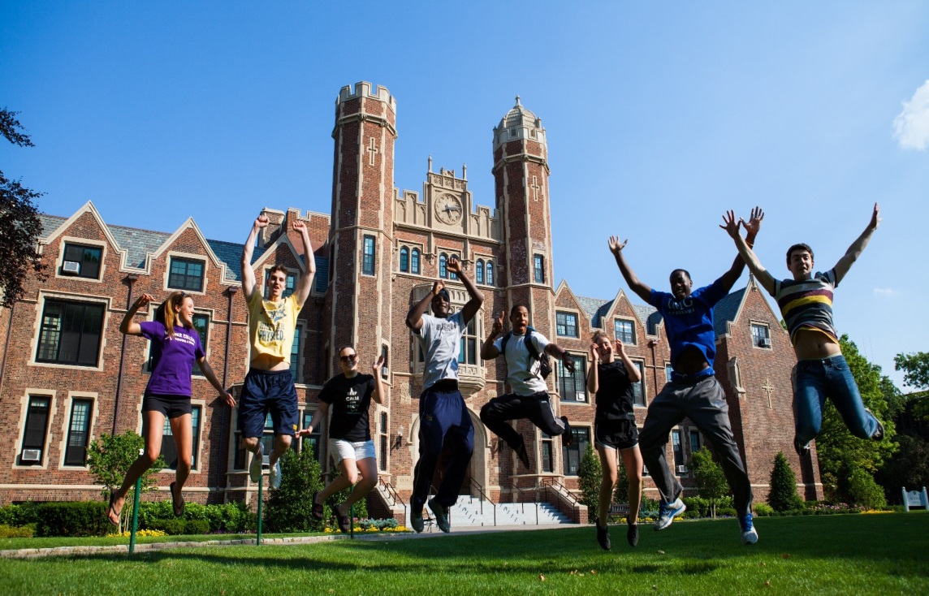
We learn to fly
together

Slide 7
I just hope
the rest of my life

Slide 8
To feel as GOOD as

Slide 11
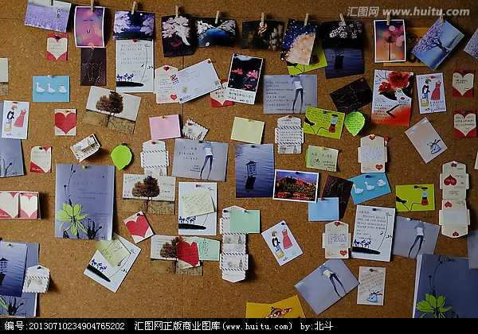
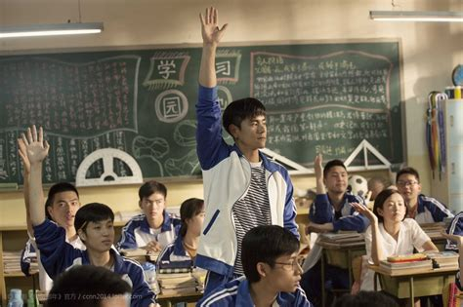
Who says we have to let it go

Slide 12
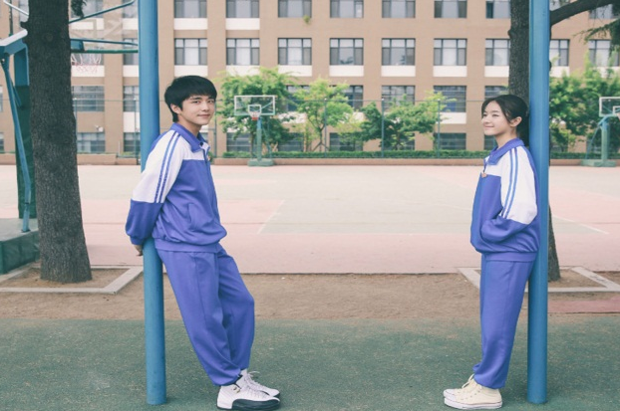
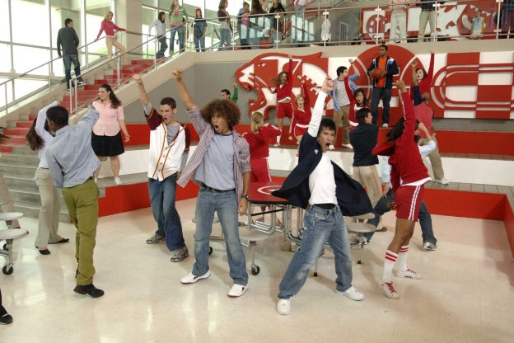
It’s the BEST part we’ve ever known

Slide 13
We'll hold on to
Step into the future

Slide 15
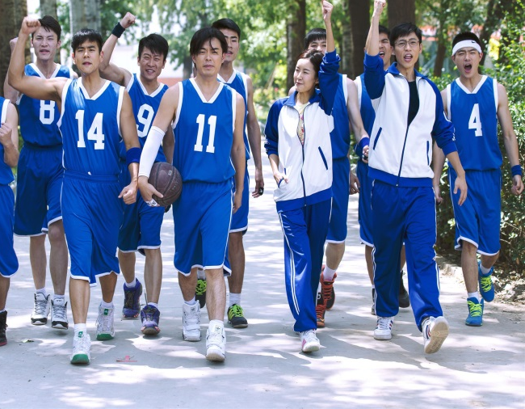
Let’s celebrate where we come from

Slide 16
With friends who've been there all along

Slide 17
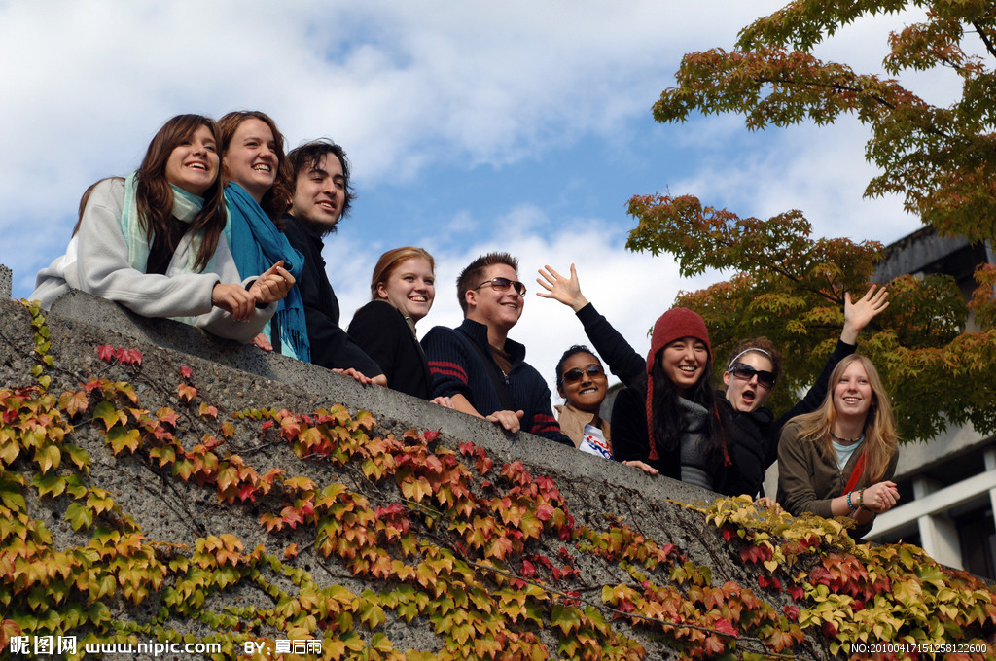
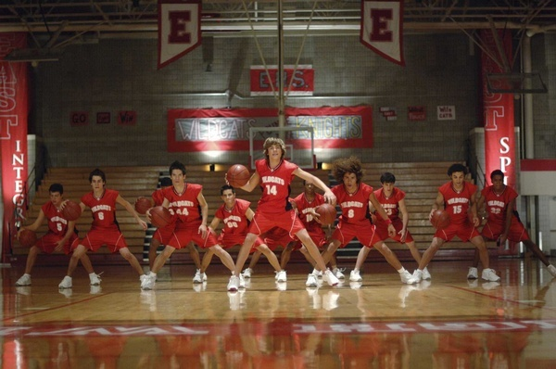

Slide 18
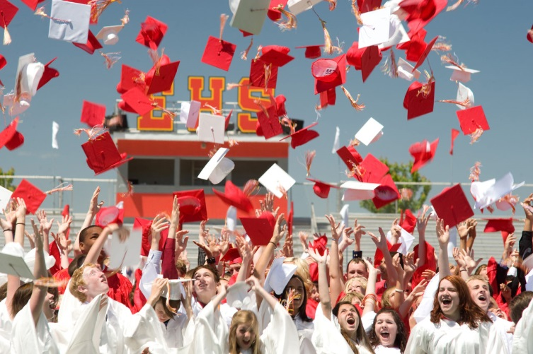
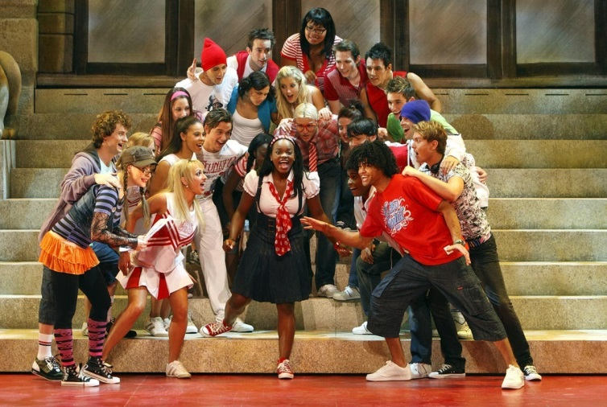
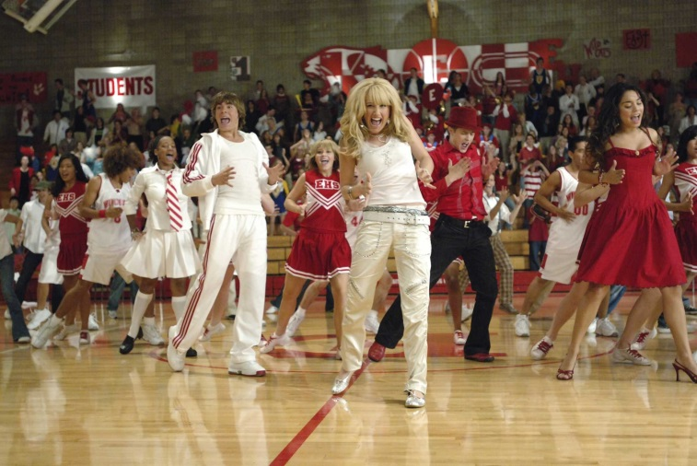
OUR
High School
High School
Musical

Slide 19
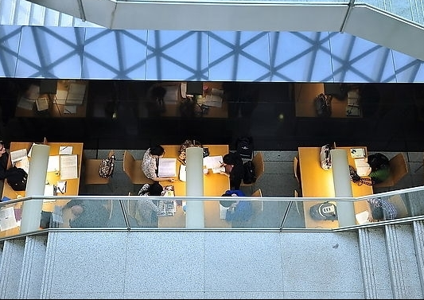
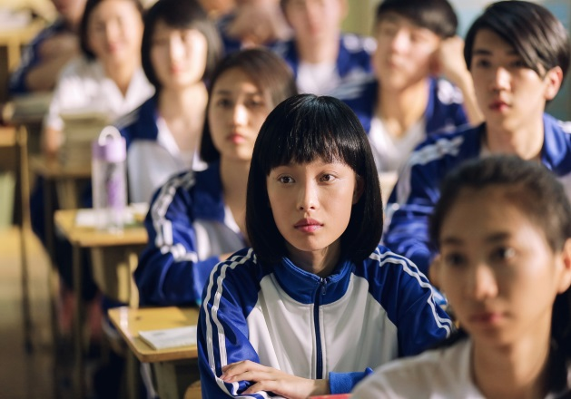
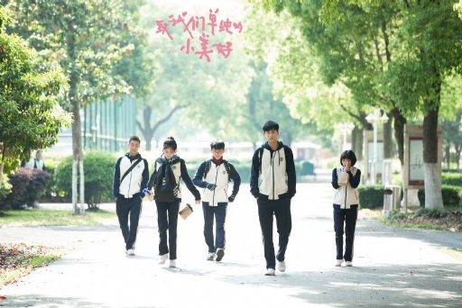
Improvisation without a script
no ones written it

Slide 20
And now we have the chance
too

Slide 21
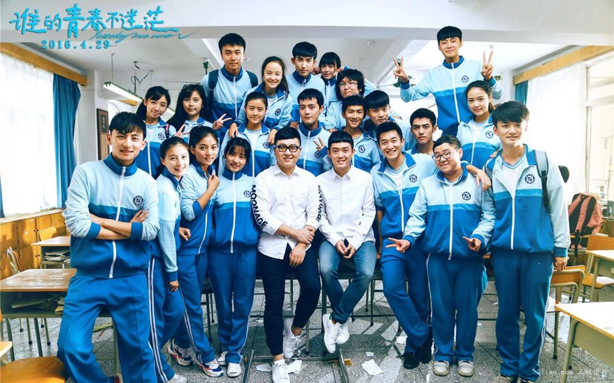
Someday we'll be lookin' back memories we've had

Slide 22
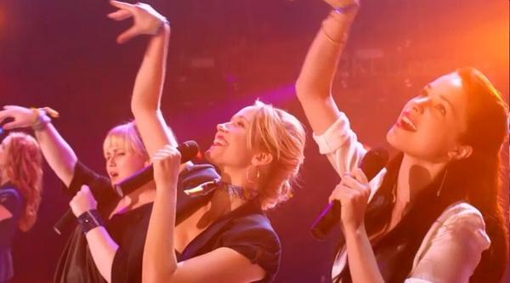
All the songs that we lived through

Slide 23
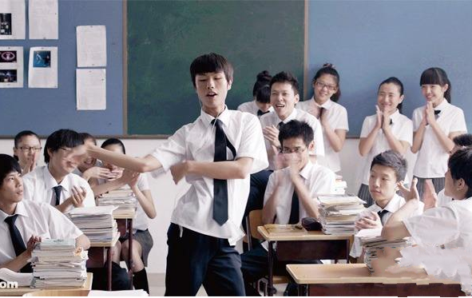
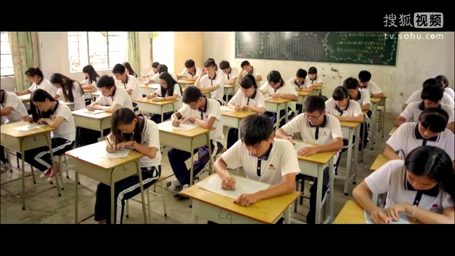
The BEST of times so why leave them behind

Slide 24
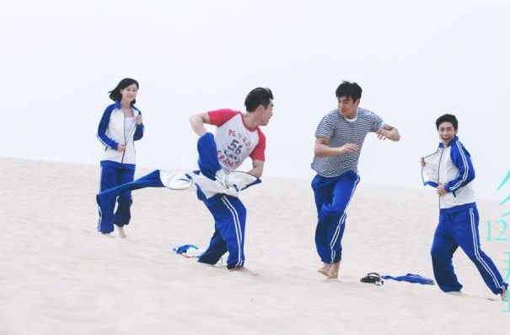
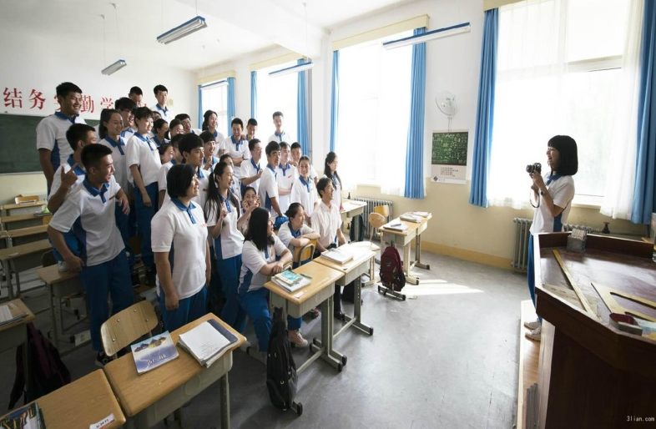
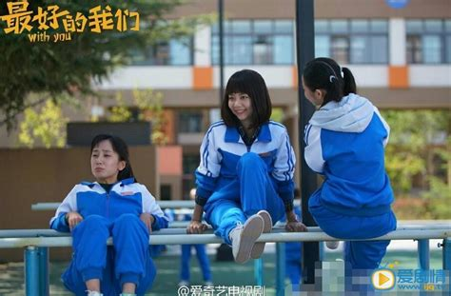
Why
can't the rest of my life be like
MY

Slide 25
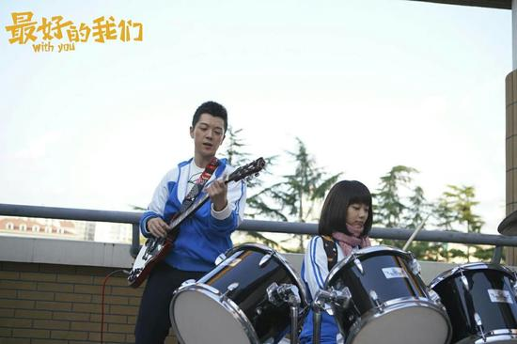
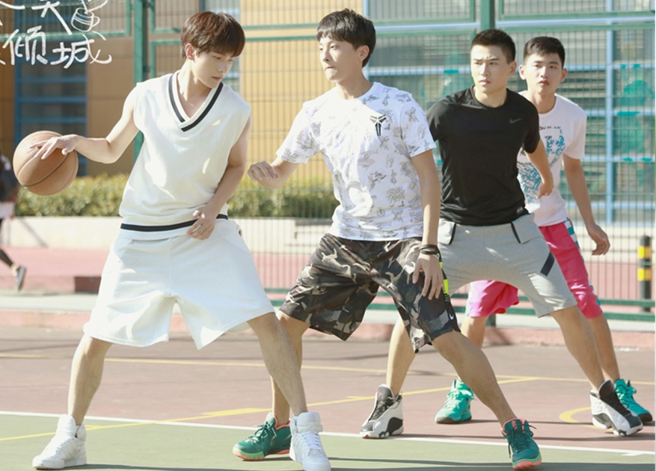
High
School
Musical

Slide 26
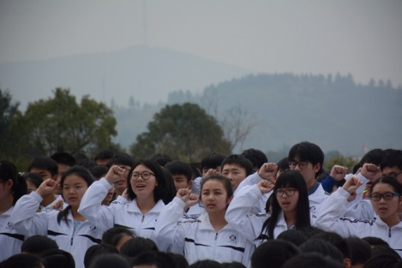
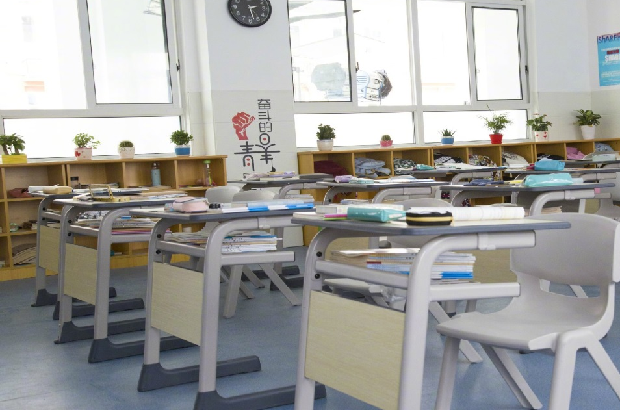
Who says we have to let it go

Slide 27
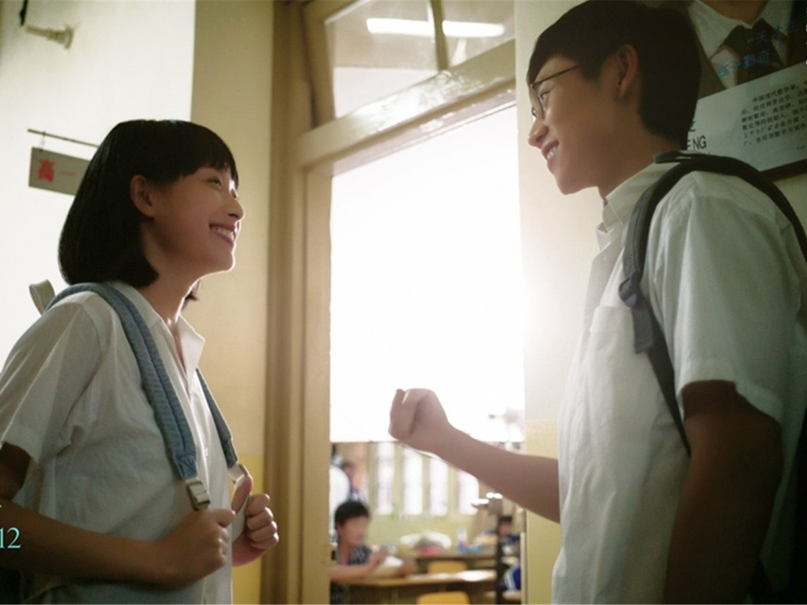
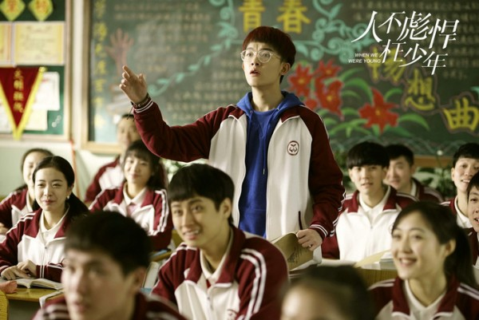
It's the best part we've ever known

Slide 28
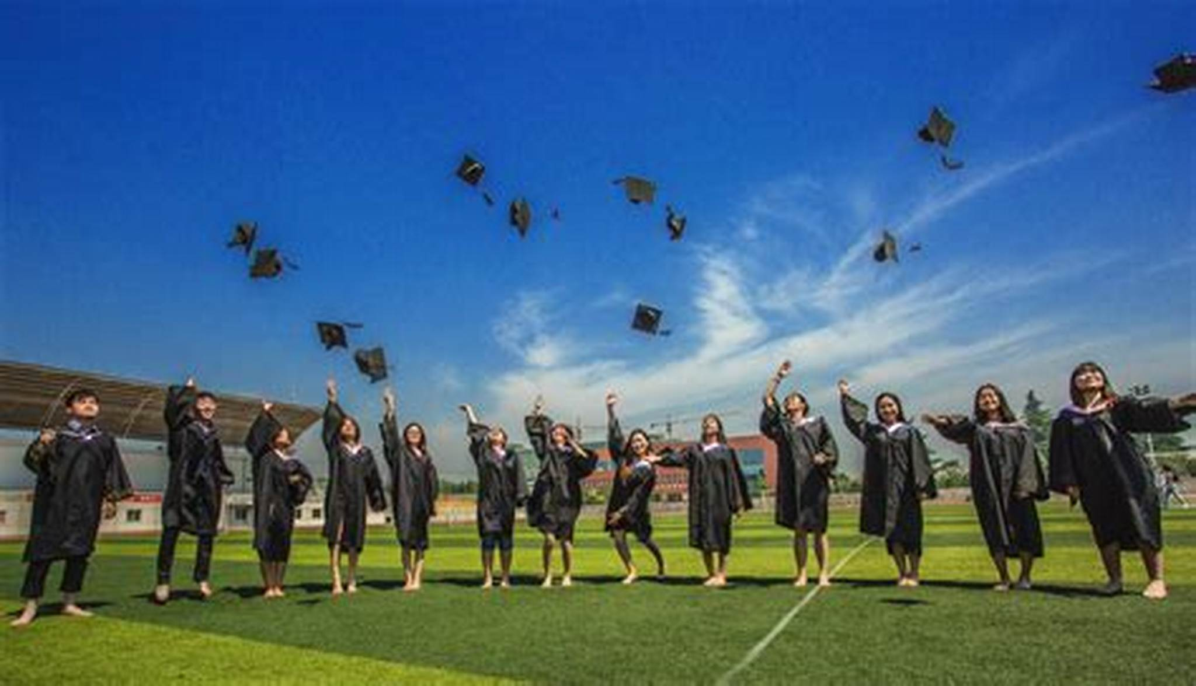
Step into the future

Slide 29
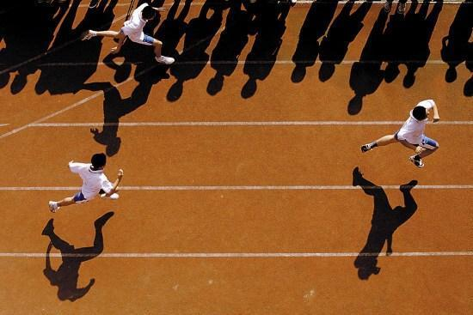
We'll hold on to

Slide 31
Let’s celebrate where we come from

Slide 32
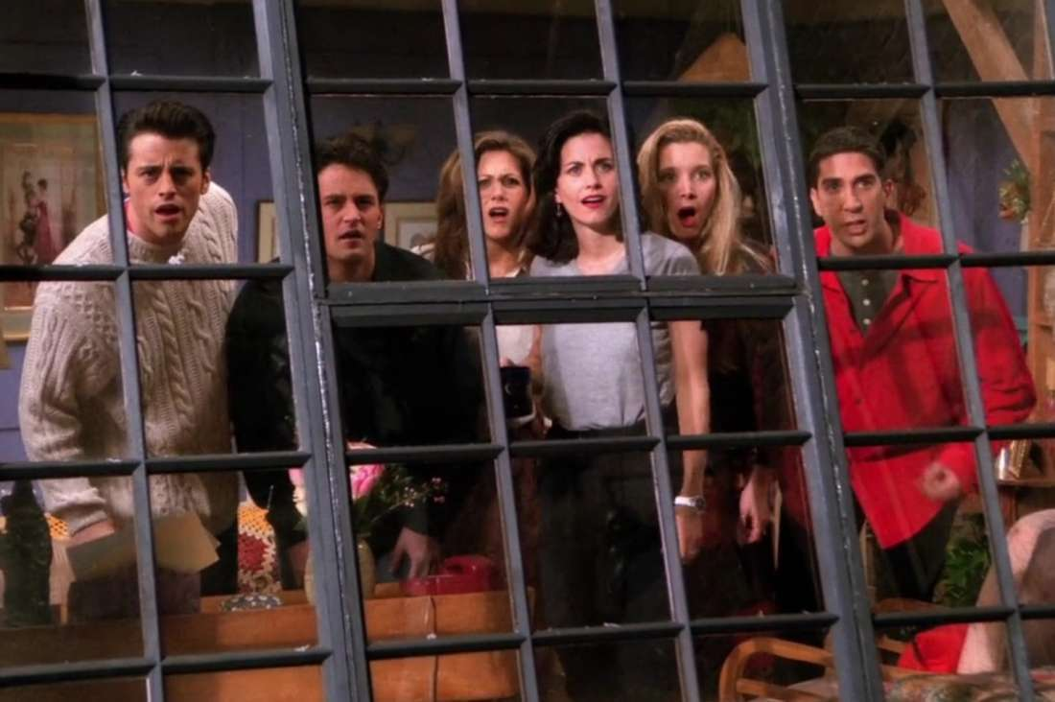
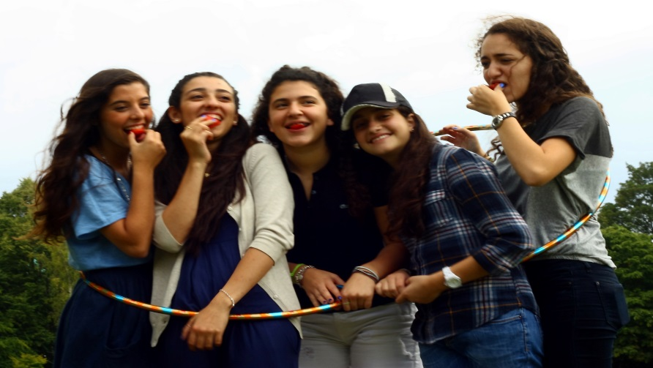
With friends who've been there all along just like

Slide 33
Now
we
finally
realize

Slide 34
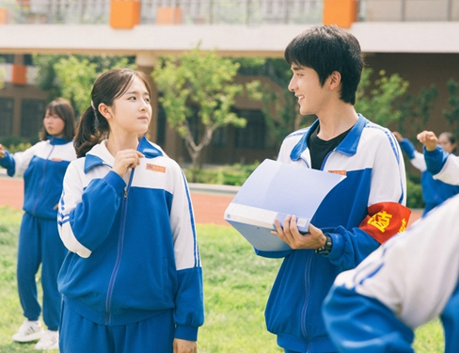
Who we are it just took some time

Slide 35
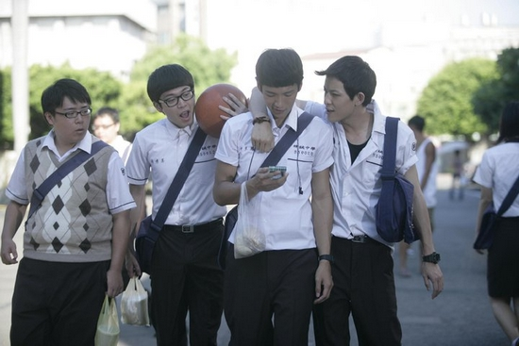
That you learn and to live to see the truth

Slide 36
Can't you see the truth

Slide 37
Nothing's ever impossible

Slide 38
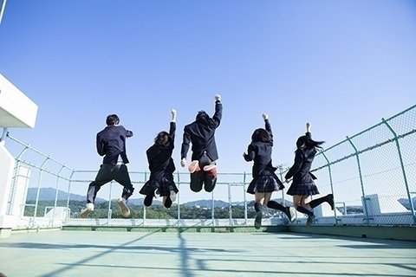
Into the future with every fall

Slide 39
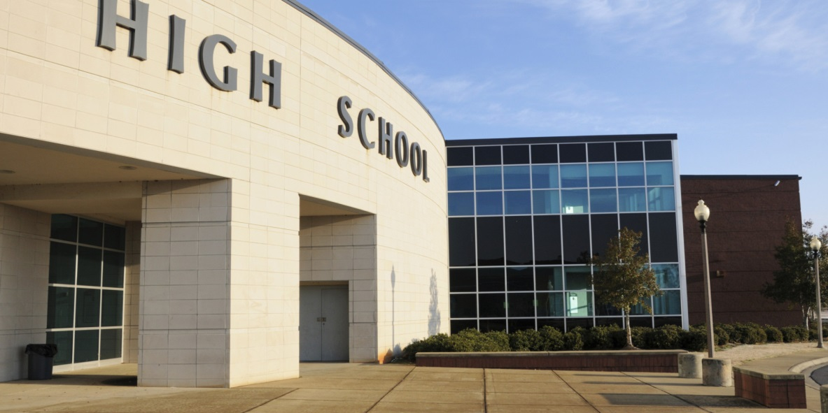
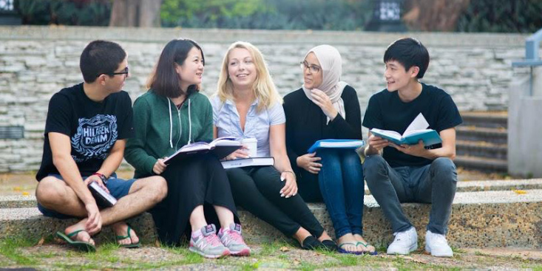
Until forever
we'll always
have
high school

Slide 40
Turn the party let’s celebrate

Slide 41
Cause the worlds one big stage

Slide 42
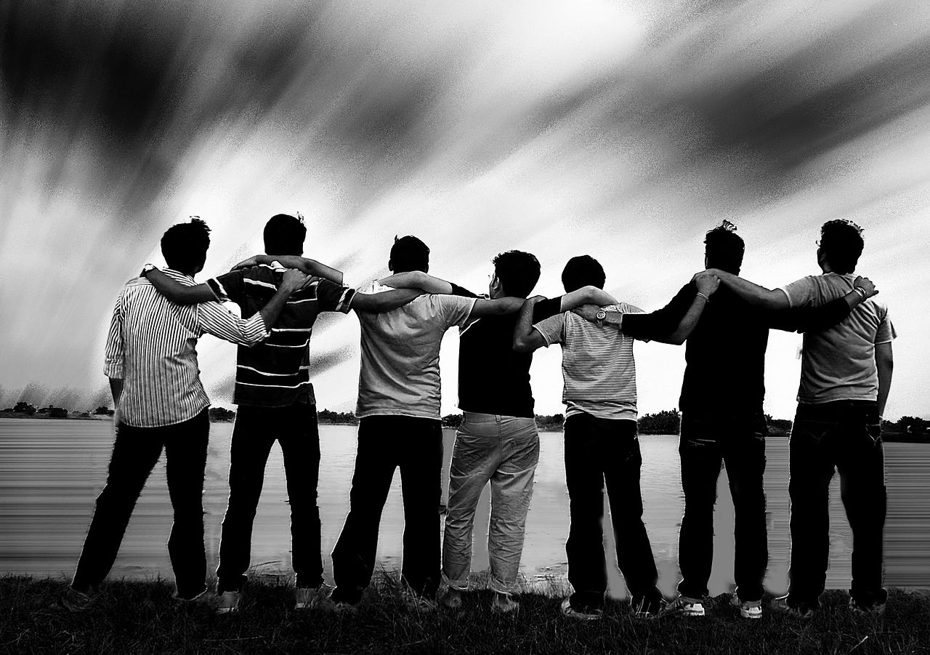
And in it what you want it can be yours

Slide 43
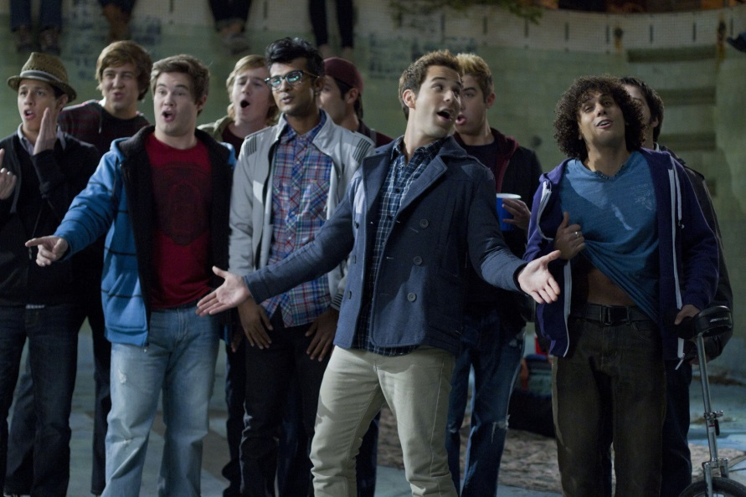
Everybody sing yeah

Slide 44
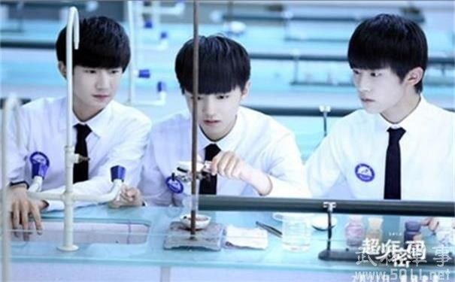
Can you show us now
we're wanna go
It's what got us here we know

Slide 45
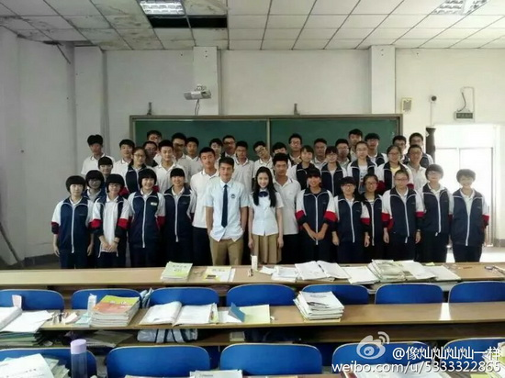
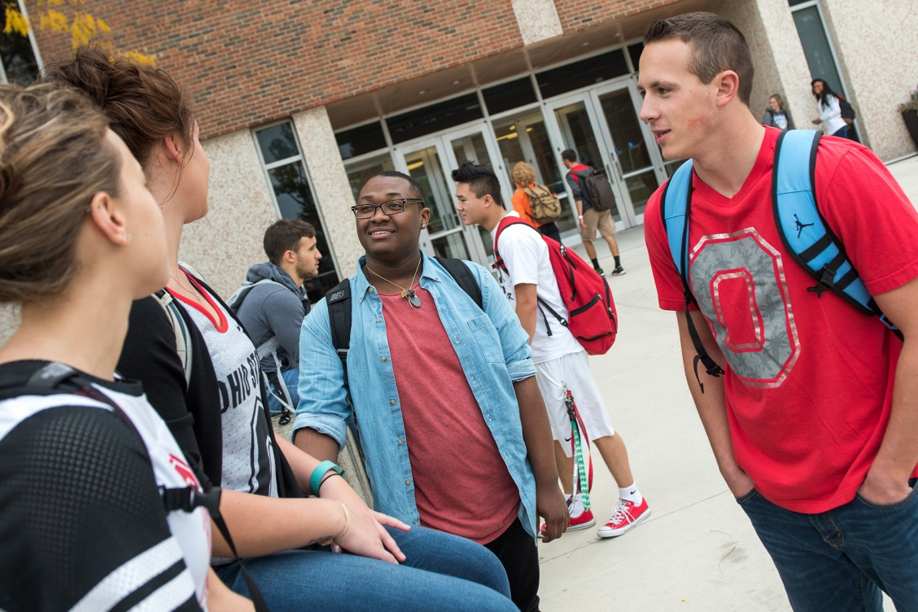
High school lives on forever more

Slide 46
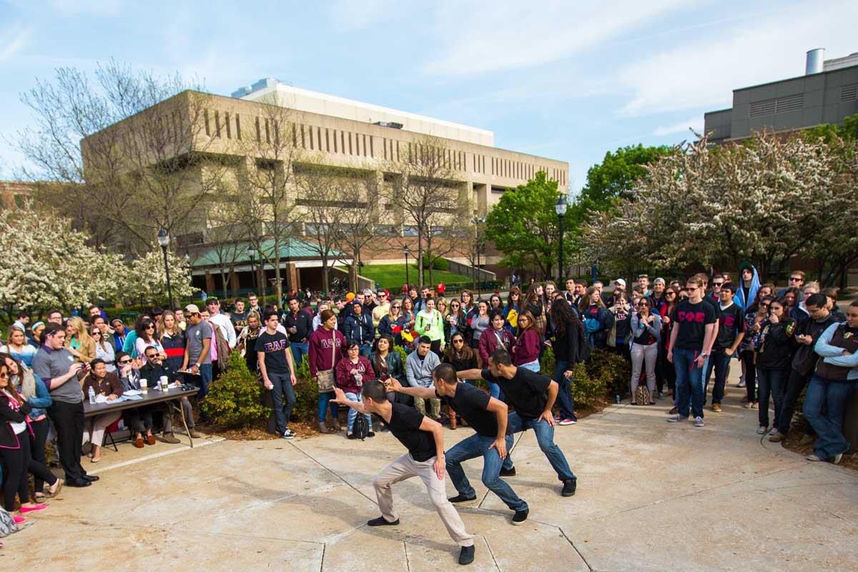
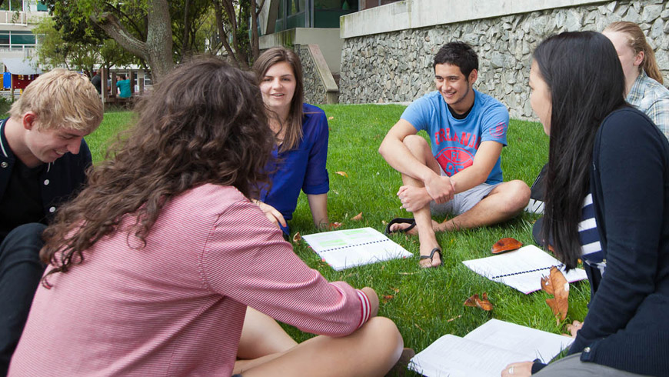
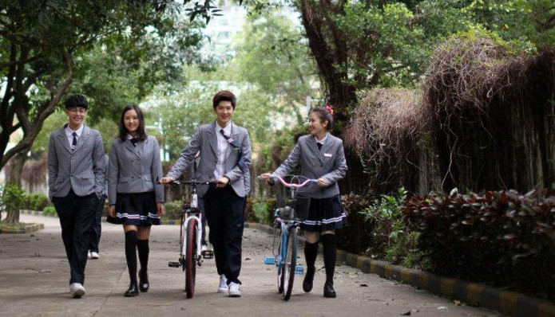
High school high school musical

Slide 47
High
school
musical

Slide 48
Who says we have to let it go

Slide 49
It's the best part we've ever known

Slide 50
Step into the future

Slide 51
We'll hold on to

Slide 52
High school musical

Slide 53
Let’s celebrate where we come from

Slide 54
With friends who've been there all along

Slide 55
I wish my life could
feel like
a

Slide 57
Who says we have to let it go

Slide 58
It's the best part we've ever known

Slide 59
Step into the future

Slide 60
We'll hold on to

Slide 61
High school musical

Slide 62
Let’s celebrate where we come from

Slide 63
All together makes it better

Slide 64
Memories that last forever

Slide 65
I want the rest of my life
To feel just like a

