Slide 1
TEENAGE LIFE Singer:Daz Sampson
课件主题：学校生活
作者：英师三班 梁思琪
单位：华南师范大学外文学院

Slide 2
NOW
HEAR THIS

Slide 3
What did you learn at school today ?
That's what the teachers used to say
But they don't know Don't understand, do they ?

Slide 4
When it‘s been a long time since they had a teenage life.
Saying "Just be nice, always think twice"
Why do they always give advice ?

Slide 5
What did you learn at school today? That‘s what the teachers used to say. But they don't know. Don't understand, do they ?

Slide 6
When it‘s been a long time since they had a teenage life.
Saying "Just be nice, always think twice"
Why do they always give advice ?

Slide 7
Dwelling on the past, from back when I was young
Thinking of my school days and trying to write this song

Slide 8
Classroom schemes and dreams
Man they couldn't save me
Cos my days were numbered when I signed down on “Ivy”

Slide 9
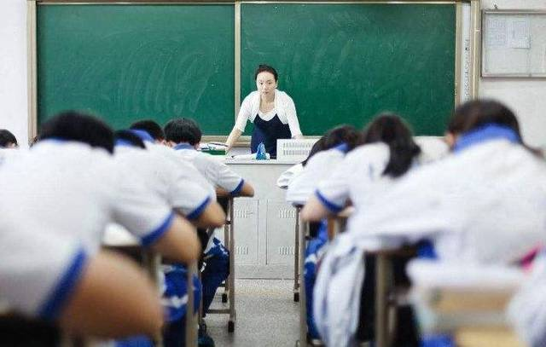
Teenage kicks running out what could we do I still show respect to my boys who made it through And getting told off Mr T how my life would be

Slide 10
Then giving him a signal So everyone could see Sunshine and shade

Slide 11
Those girls I'd serenade
Thinking of those sixth form chicks that misbehave

Slide 12
Hoping that those days would go on and on forever. Every day something new. Just friends running together.

Slide 13
But suddenly school ends Your teenage life gone All your mates are growing up now They're moving on

Slide 14
And now I'm looking back
I'll tell you what I know
Do you listen to your
teacher ?
No I don't think so

Slide 15
What did you learn at school today ?
That's what the teachers used to say
But they don't know Don't understand, do they ?

Slide 16
When it‘s been a long time since they had a teenage life.
Saying "Just be nice, always think twice"
Why do they always give advice ?

Slide 17
Now if you treat the kids fine
Together they will shine (shine)
And if you give the kids time
They won't do the crime Won't do the crime

Slide 18
Now my bad old ways
Now my bad old ways
Were during my school days
Were during my school days
Messing on those grade A's
Messing on those grade A's
My life is just a haze
My life is just a haze

Slide 19
I'm going through the struggle Five ten and kicking back So I could lock my flow Lace it up now on the track

Slide 20
Oh yeh I felt the pain Whilst chasing all the fame I'm being told I'm nothing Just a player in the game
Oh yeh I felt the pain Whilst chasing all the fame
I'm being told I'm nothing Just a player in the game

Slide 21
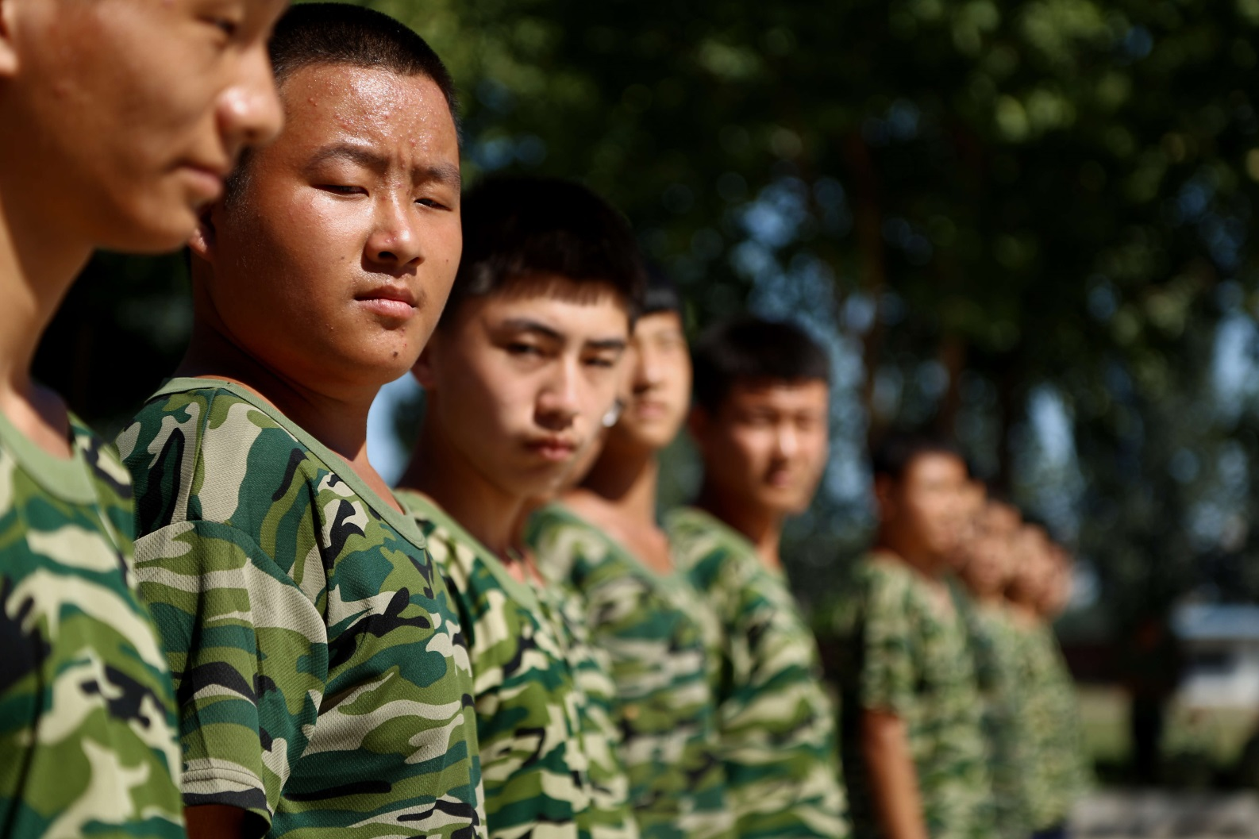
But now I walk tall, stand proud for you to see. I'm driving these fast cars, it's five stars for me.

Slide 22
"What did you learn at school today?"
That's what the teachers used to say
But they don't know
Don't understand, do they?

Slide 23
Why do they always give advice Saying "Just be nice, always think twice" When it's been a long time since they had a teenage life
(When it's been a long time since they had a teenage life)

