Slide 1
Unit 4 Why don’t you talk to your parents
作者：苏卓思
教材：人教版八年级下册
单位：华南师范大学外文学院
skip

Slide 2
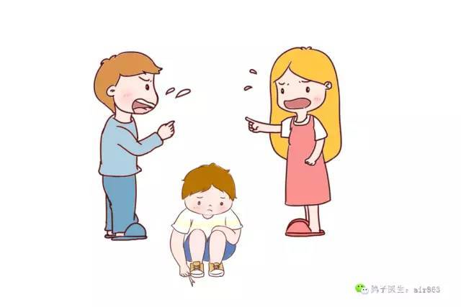
I will not make the same mistakes that you did
家庭矛盾常常让孩子不知所措
skip

Slide 3
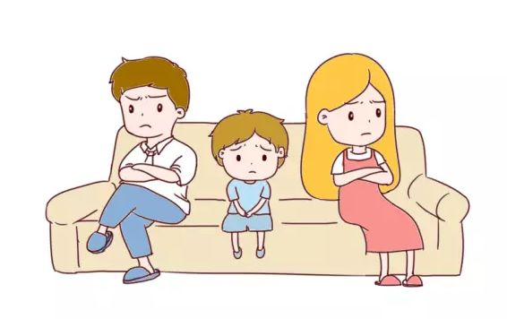
I will not let myself cause my heart so much misery
skip

Slide 4
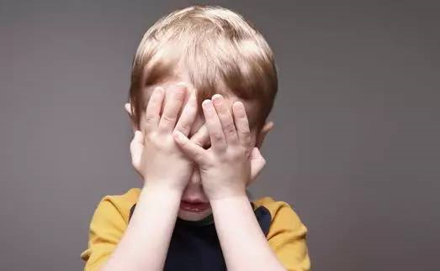
父母的争吵影响孩子的情绪
让孩子内心压抑
I will not break the way you did you fell so hard
skip

Slide 5
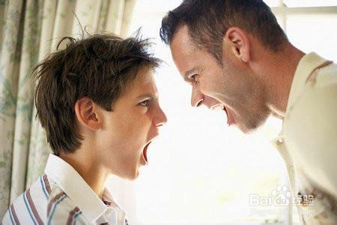
不恰当的沟通方式让孩子内心更加无助
I learned the hard way, to never let it get that far
skip

Slide 6
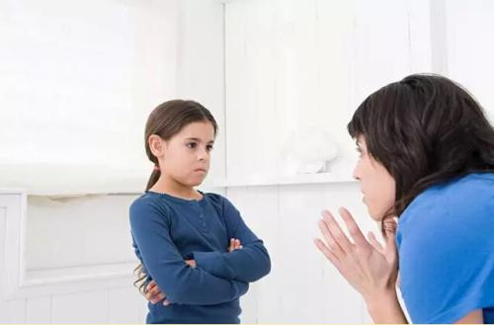
because of you
I never stray too far from the sidewalk
skip

Slide 7
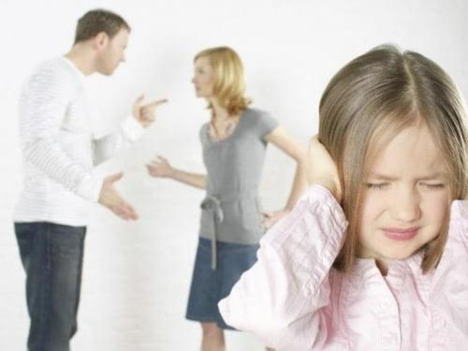
父母间的争吵让孩子内心受到更深创伤
Because of you
I learned to play on the safe side so I don’t get hurt
skip

Slide 8
Because of you
I find it hard to trust not only me,
but everyone around me
父母与孩子的关系跌入冰点
skip

Slide 9
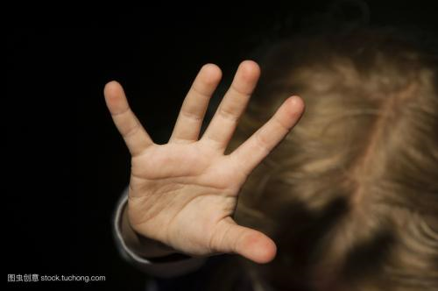
Because of you
I am afraid
skip

Slide 10
父母无形的偏爱也会让孩子感到失落和孤独
I lose my way and its not too long before you point it out
skip

Slide 11
久而久之，兄妹之间也逐渐产生误解和隔阂
I can not cry
because I know that’s weakness in your eyes
skip

Slide 12
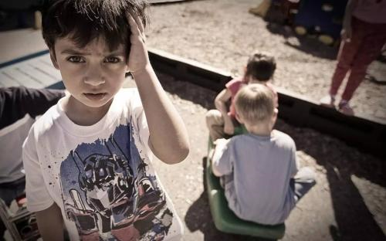
I ’m forced to fake a smile, a laugh everyday of my life
兄妹之间也变得越来越疏远
skip

Slide 13
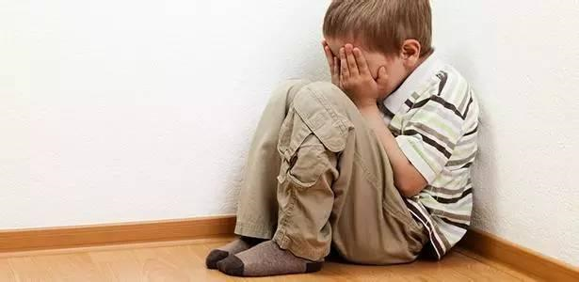
my heart can’t possibly break
when it wasn’t even whole to start with
skip

Slide 14
为了避免自己受到伤害，孩子的内心都建起了坚硬的保护壳
Because of you
I never stray too far from the sidewalk
skip

Slide 15
沟通的缺乏让孩子对家人越来越冷淡，越来越疏远
because of you
I learned to play on the safe side
so I don’t get hurt
skip

Slide 16
because of you
I find it hard to trust not only me, but everyone around me
skip

Slide 17
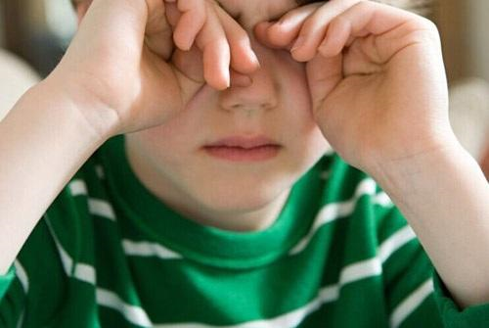
because of you
I am afraid
skip

Slide 18
在遇到家庭矛盾时，不论是孩子，还是父母都应该主动沟通
I watched you die
I heard you cry every night in your sleep
skip

Slide 19
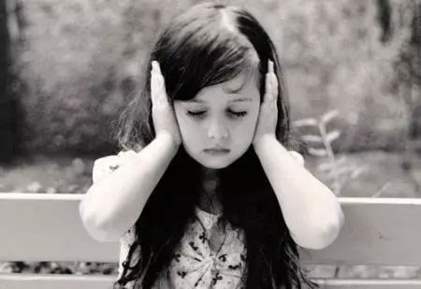
沉默和忍让只会让自己受到更深的伤害。
I was so young
you should have known better than to lean on me
skip

Slide 20
孩子应该勇敢地与父母沟通，说出自己内心的想法
you never thought of anyone else
you just saw your pain
skip

Slide 21
说话心平气和，语气委婉，更有利于沟通和交流的进行
and now I cry
in the middle of the night over the same damn thing
skip

Slide 22
家人与孩子之间如果能有平等、坦诚的交流与互动，会让孩子有更多的家庭归属感
Because of you
I never stray too far from the sidewalk
skip

Slide 23
because of you
I learned to play on the safe side so i don’t get hurt
skip

Slide 24
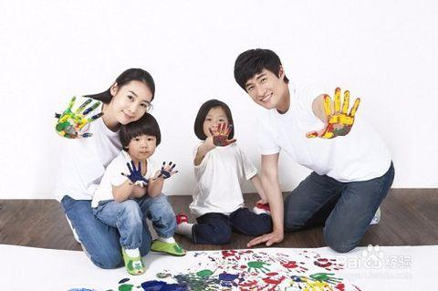
多组织和举行家庭活动能是家庭的氛围变得更和睦，温馨
I tried my hardest just to forget everything
Because of you
skip

Slide 25
because of you
I don’t know how to let anyone else in
skip

Slide 26
because of you
I’m ashamed of my life because its empty
家人相处也要讲究方式方法，需要努力经营，建立一个健康和谐的家庭
skip

Slide 27
because of you
I am afraid
skip

Slide 28
Because of you

