Slide 1
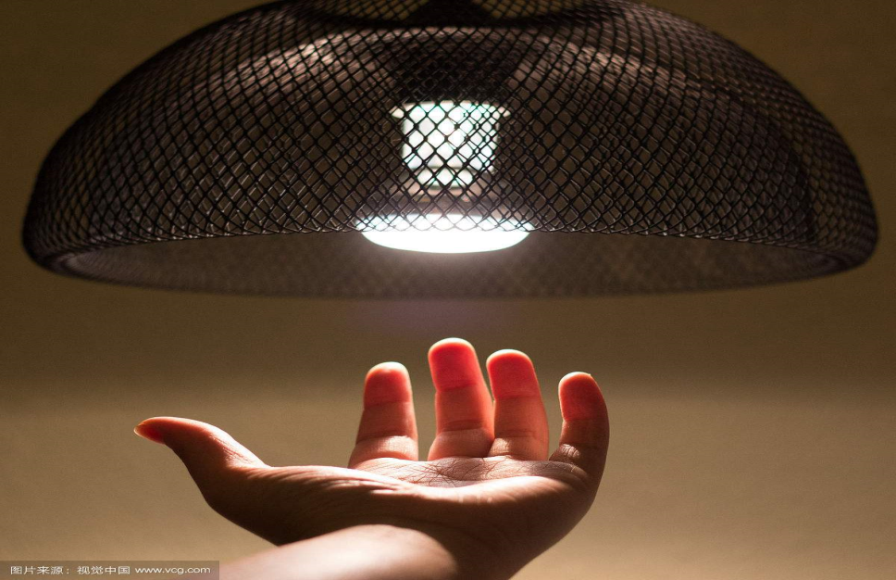
Furniture & household items
蓝玲

Slide 2
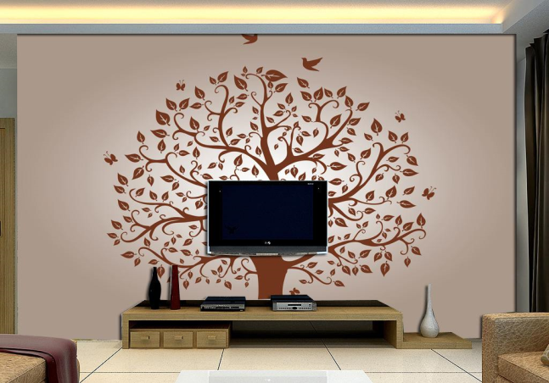
just wanna see

Slide 3
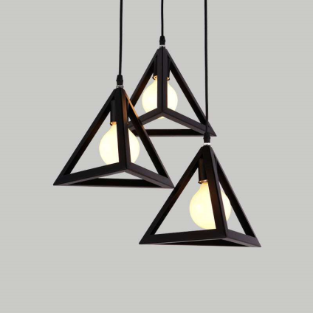
I just wanna see the light

Slide 4
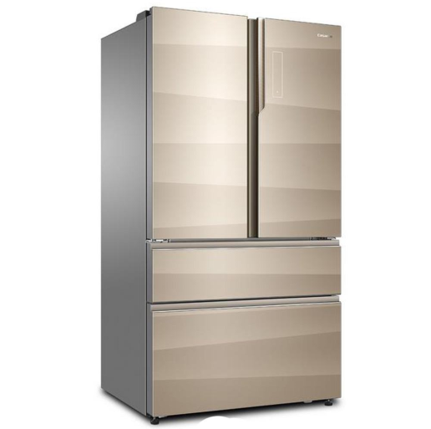
I just wanna see

Slide 5
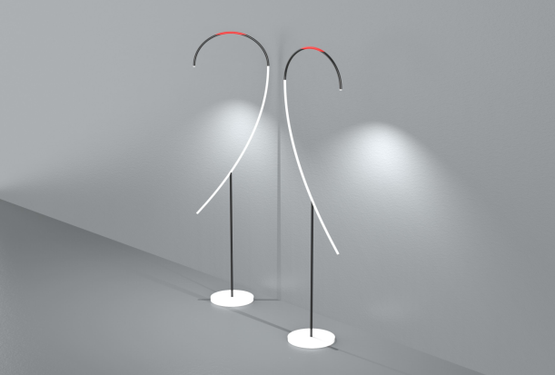
I just wanna see the light

Slide 6
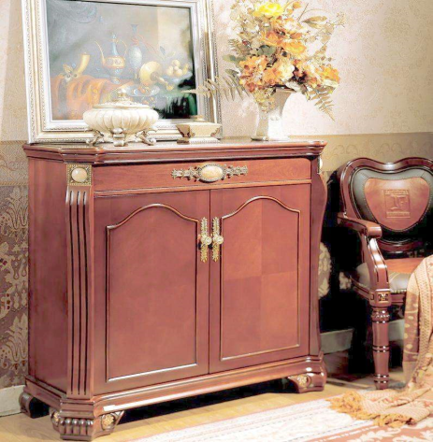
I just wanna see

Slide 7
I just wanna see the light

Slide 8
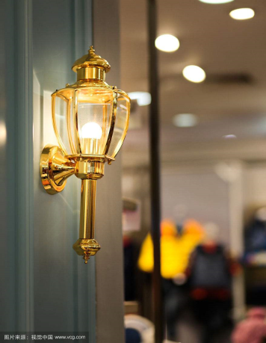
I just wanna see the light

Slide 9
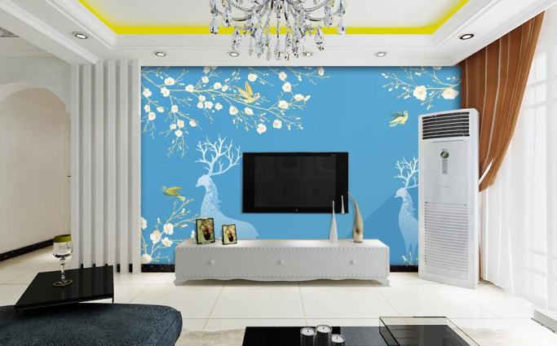
Even if it makes me blind

Slide 10
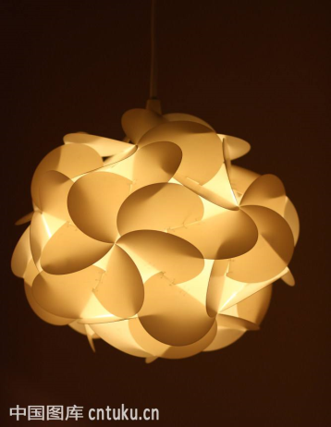
I just wanna see the light

Slide 11
Breathing, leave it all behind

Slide 12
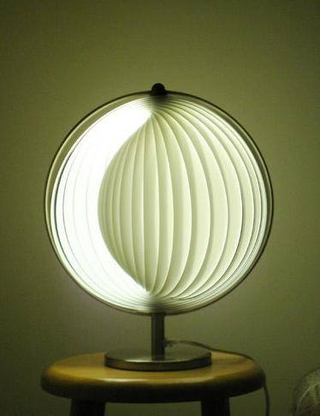
I just wanna see the light

Slide 13
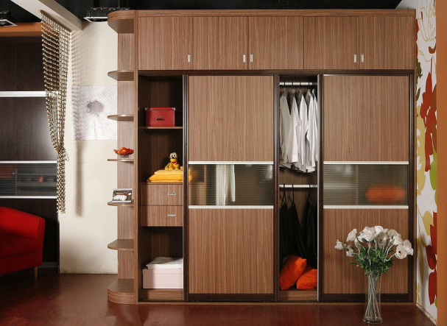
Even if it makes me blind

Slide 14
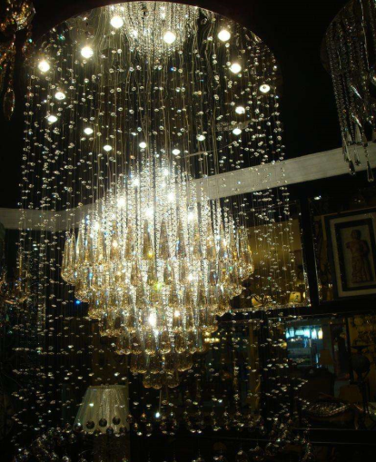
I just wanna see the light

Slide 15
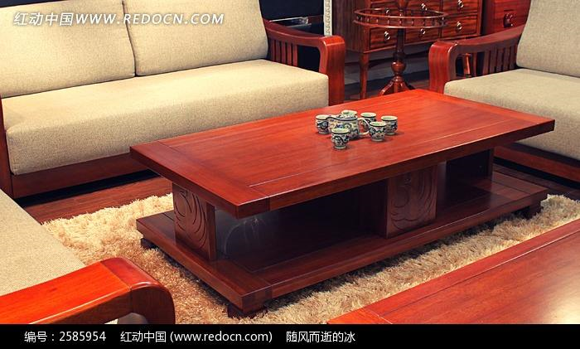
Breathing, leave it all behind

Slide 16
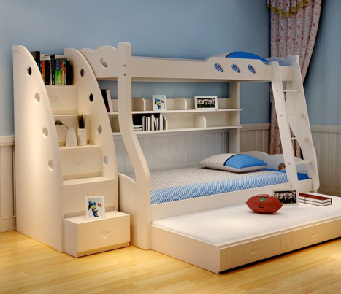
I just wanna see the light

Slide 17
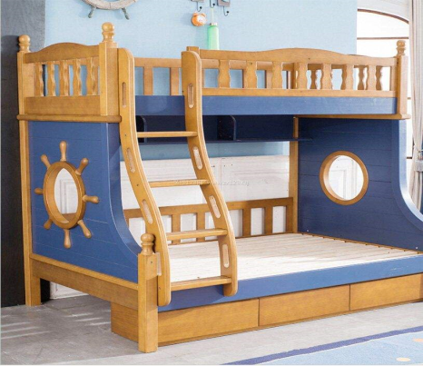
I just wanna see the light
I just wanna see the light

Slide 18
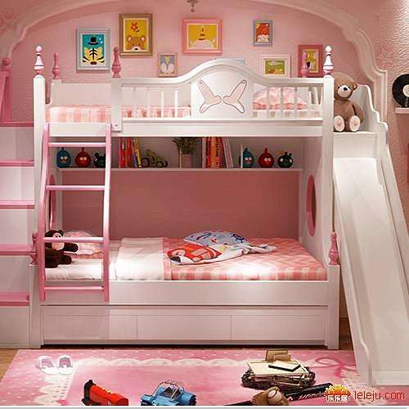
I just wanna see the light
I just wanna see the light

Slide 19
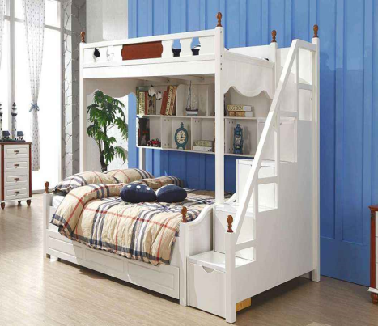
I just wanna see the light
I just wanna see the light

Slide 20
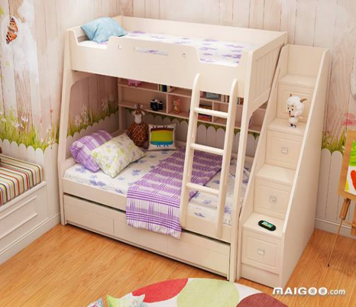
I just wanna see the light
I just wanna see the light

Slide 21
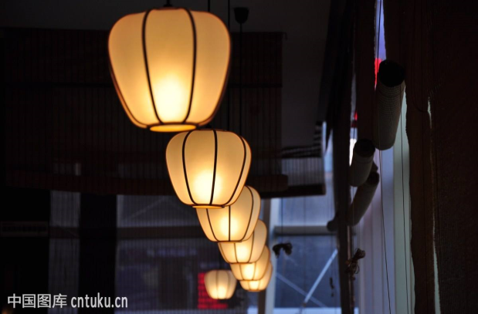
Light, light, light, light, light

Slide 22
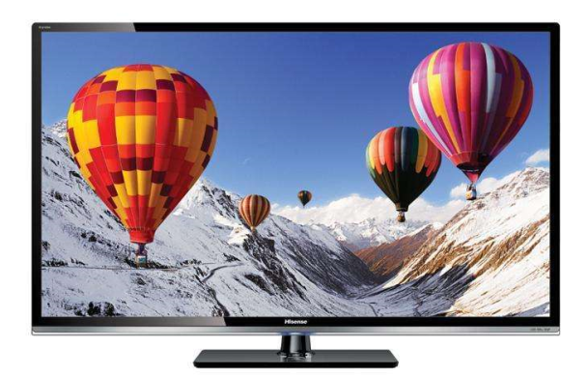
I just wanna see the light

Slide 23
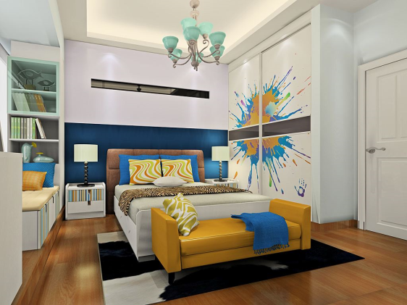
I just wanna see the light

Slide 24
Even if it makes me blind

Slide 25
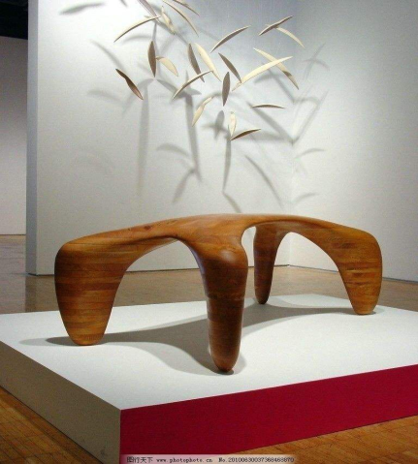
I just wanna see the light

Slide 26
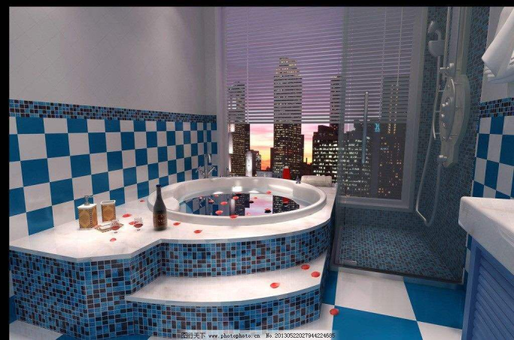
Breathing, leave it all behind

Slide 27
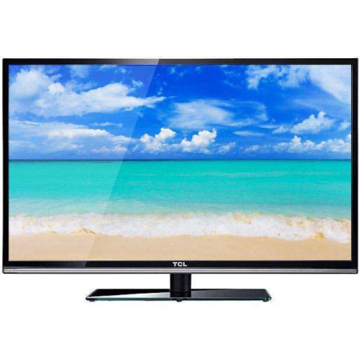
I just wanna see the light

Slide 28
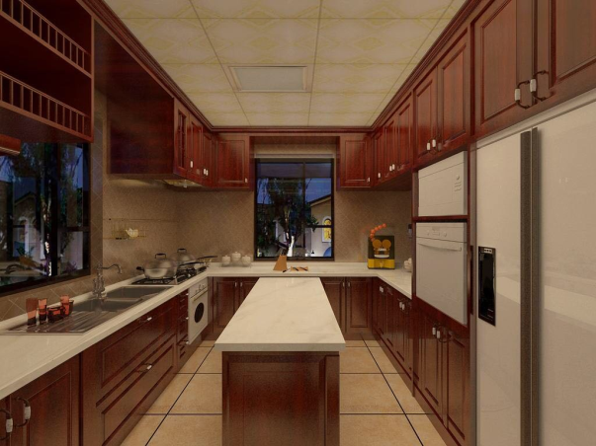
Even if it makes me blind

Slide 29
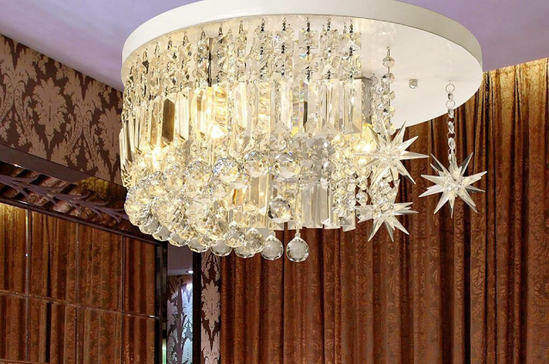
I just wanna see the light

Slide 30
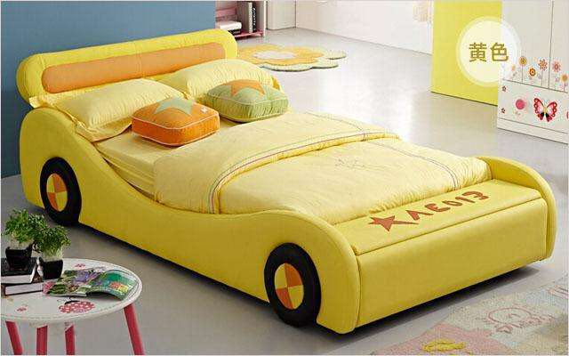
Breathing, leave it all behind

Slide 31
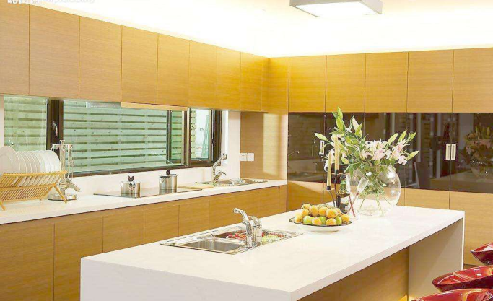
I just wanna see the light

Slide 32
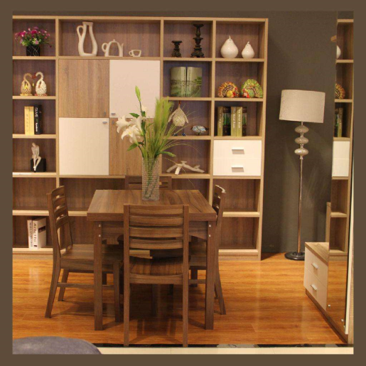
Even if it makes me blind

Slide 33
I just wanna see the light

Slide 34
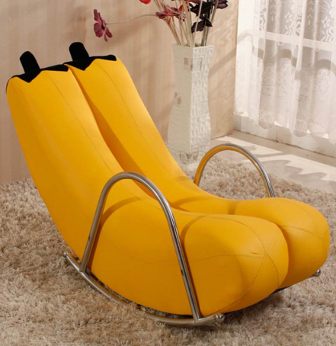
Breathing, leave it all behind

Slide 35
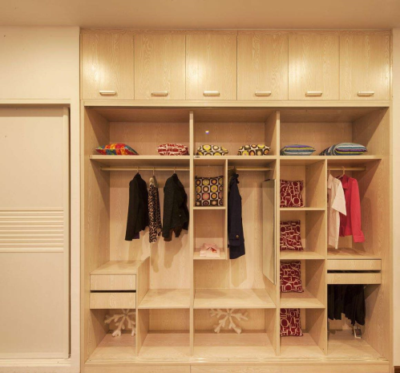
I just wanna see the light

Slide 36
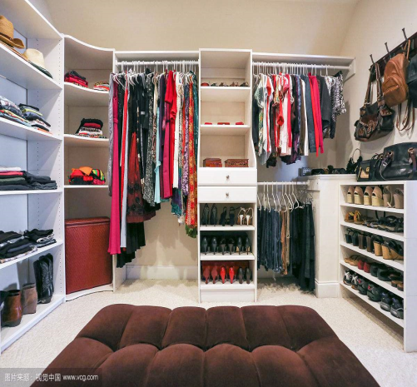
I just wanna see the light
I just wanna see the light

Slide 37
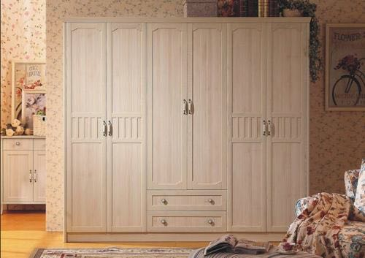
I just wanna see the light
I just wanna see the light

Slide 38
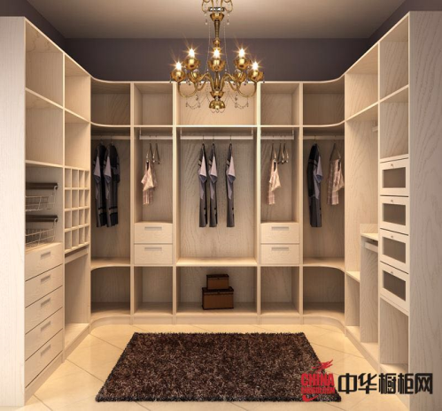
I just wanna see the light
I just wanna see the light

Slide 39
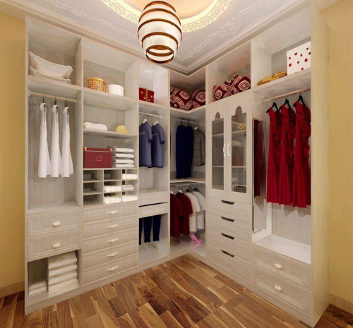
I just wanna see the light
I just wanna see the light

Slide 40
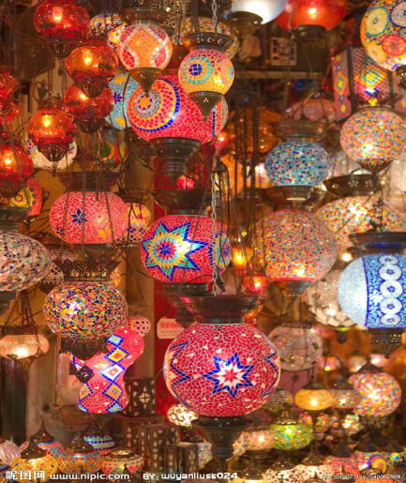
Light, light, light, light, light
Light, light, light, light, light

Slide 41
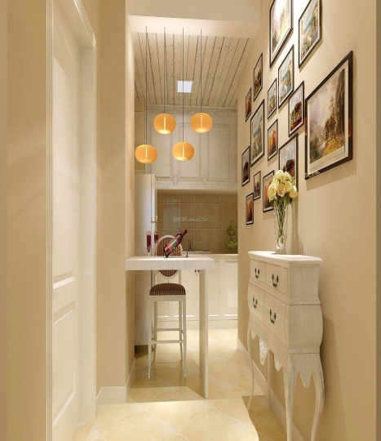
I just wanna see the light

Slide 42
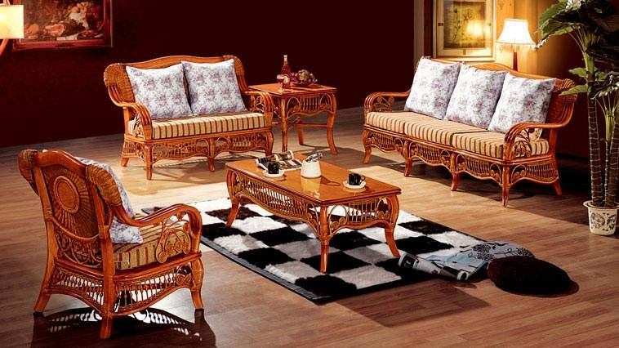
I just wanna see the light

Slide 43
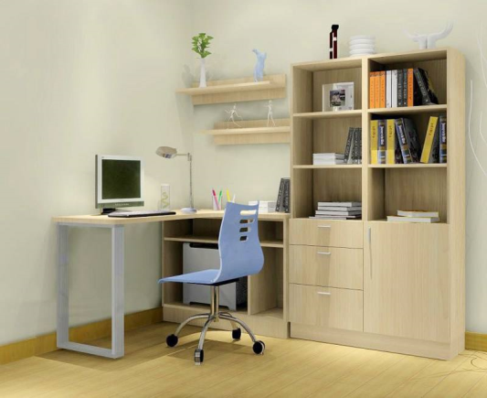
I just wanna see

Slide 44
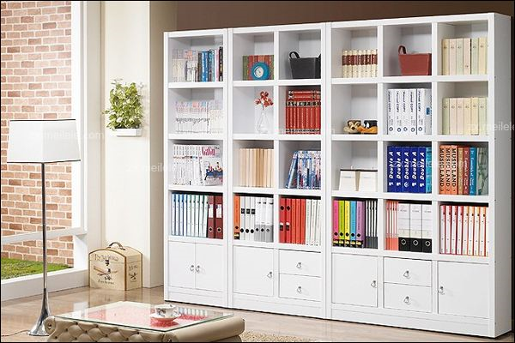
I just wanna see the light

Slide 45
I just wanna see

Slide 46
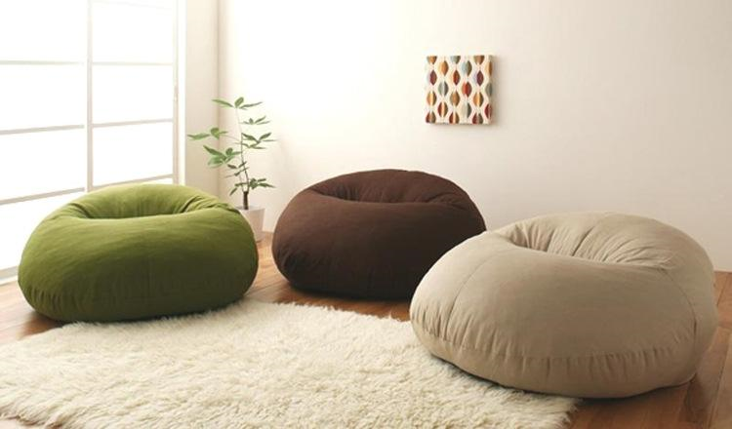
I just wanna see the light

Slide 47
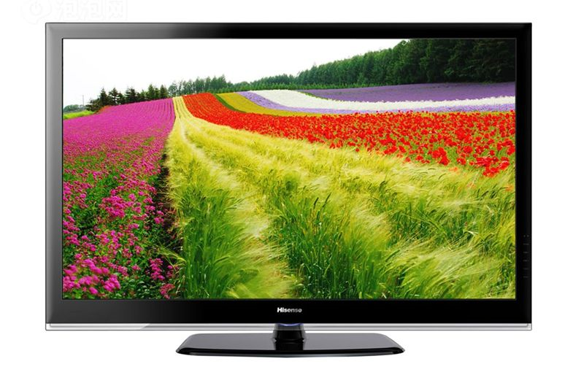
I just wanna see

Slide 48
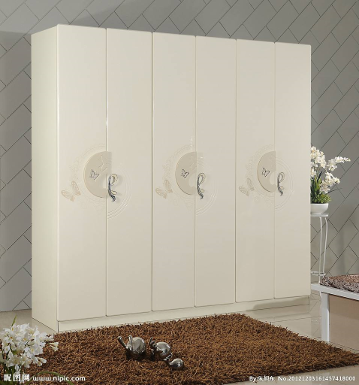
I just wanna see the light

Slide 49
I just wanna see the light

Slide 50
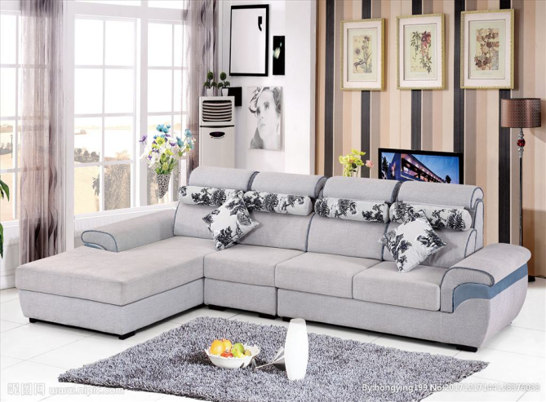
I just wanna see the light
I just wanna see the light

Slide 51
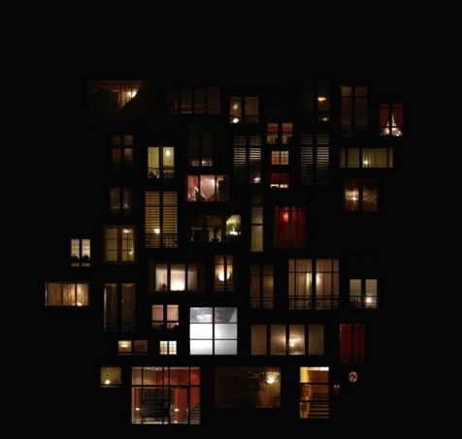
Even if it makes me blind

Slide 52
Even if it makes me blind

Slide 53
Thanks for watching

