Slide 1
Kinds of homes
Song: Home on the range
Singer: Lisa Loeb
单位：华南师范大学外文学院
作者：许秋容

Slide 3
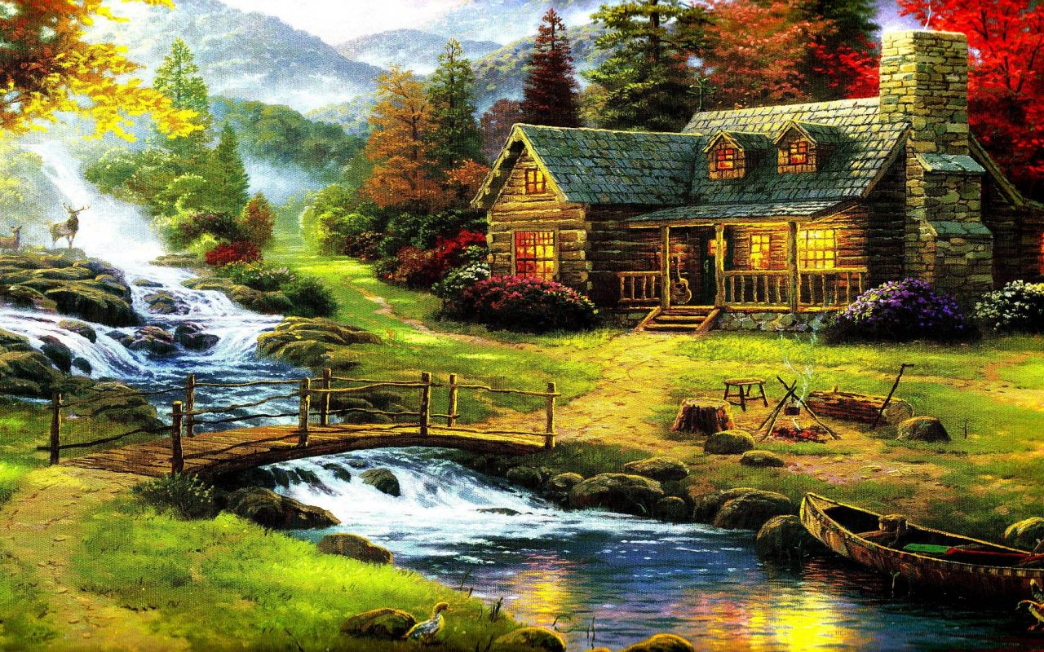

Slide 4
Oh, give me a home

Slide 5
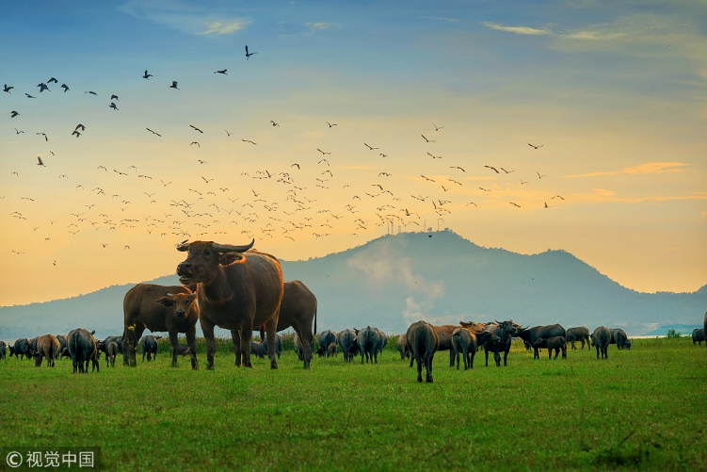
Where the buffalo roam

Slide 6
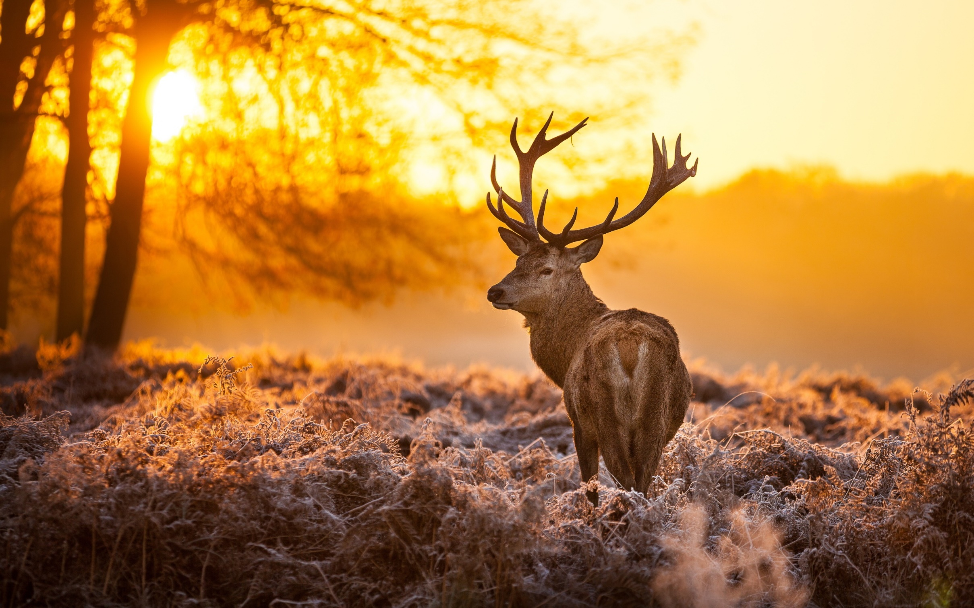
Where the deer and the antelope play

Slide 7
Where seldom is heard a discouraging word

Slide 8
And the skies are not cloudy all day

Slide 9
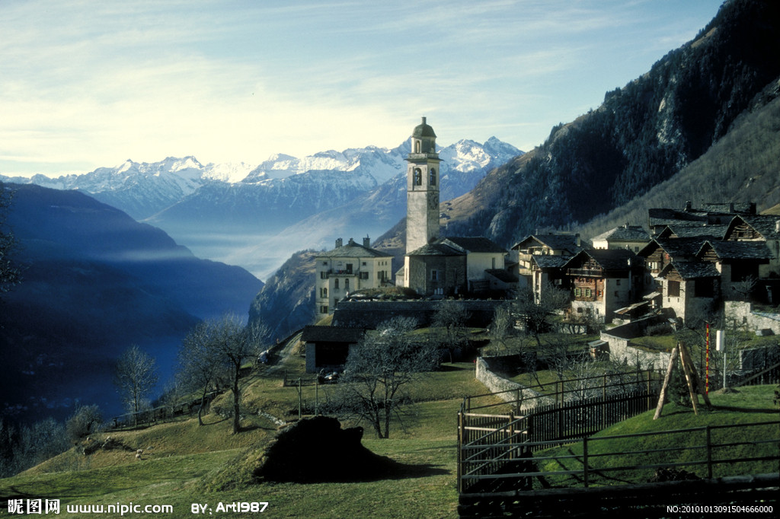
Home, home on the range

Slide 10
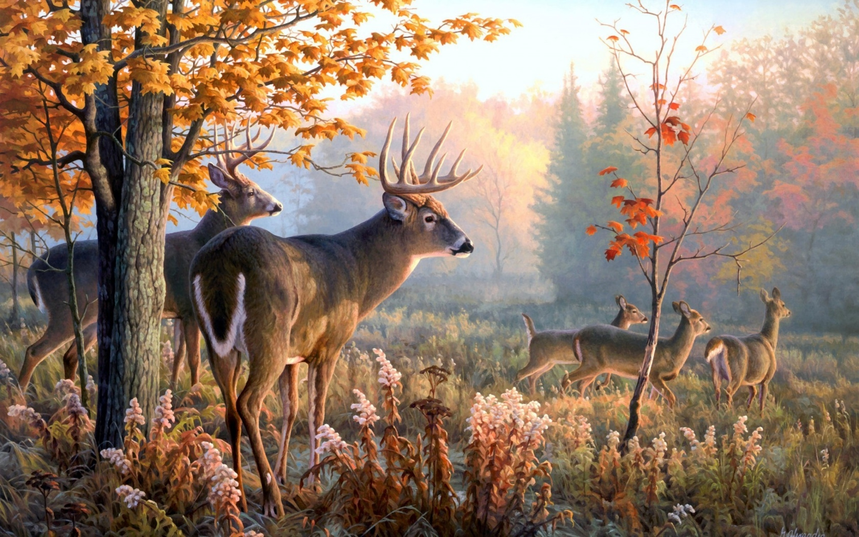
Where the deer and the antelope play

Slide 11
Where seldom is heard a discouraging word

Slide 12
And the skies are not cloudy all day

Slide 13
Oh, give me a land
where the bright diamond sand

Slide 14
Flows leisurely down to the stream

Slide 15
Where the graceful white swan
goes gliding along

Slide 16
Like a star in a heavenly dream

Slide 17
Home, home on the range

Slide 18
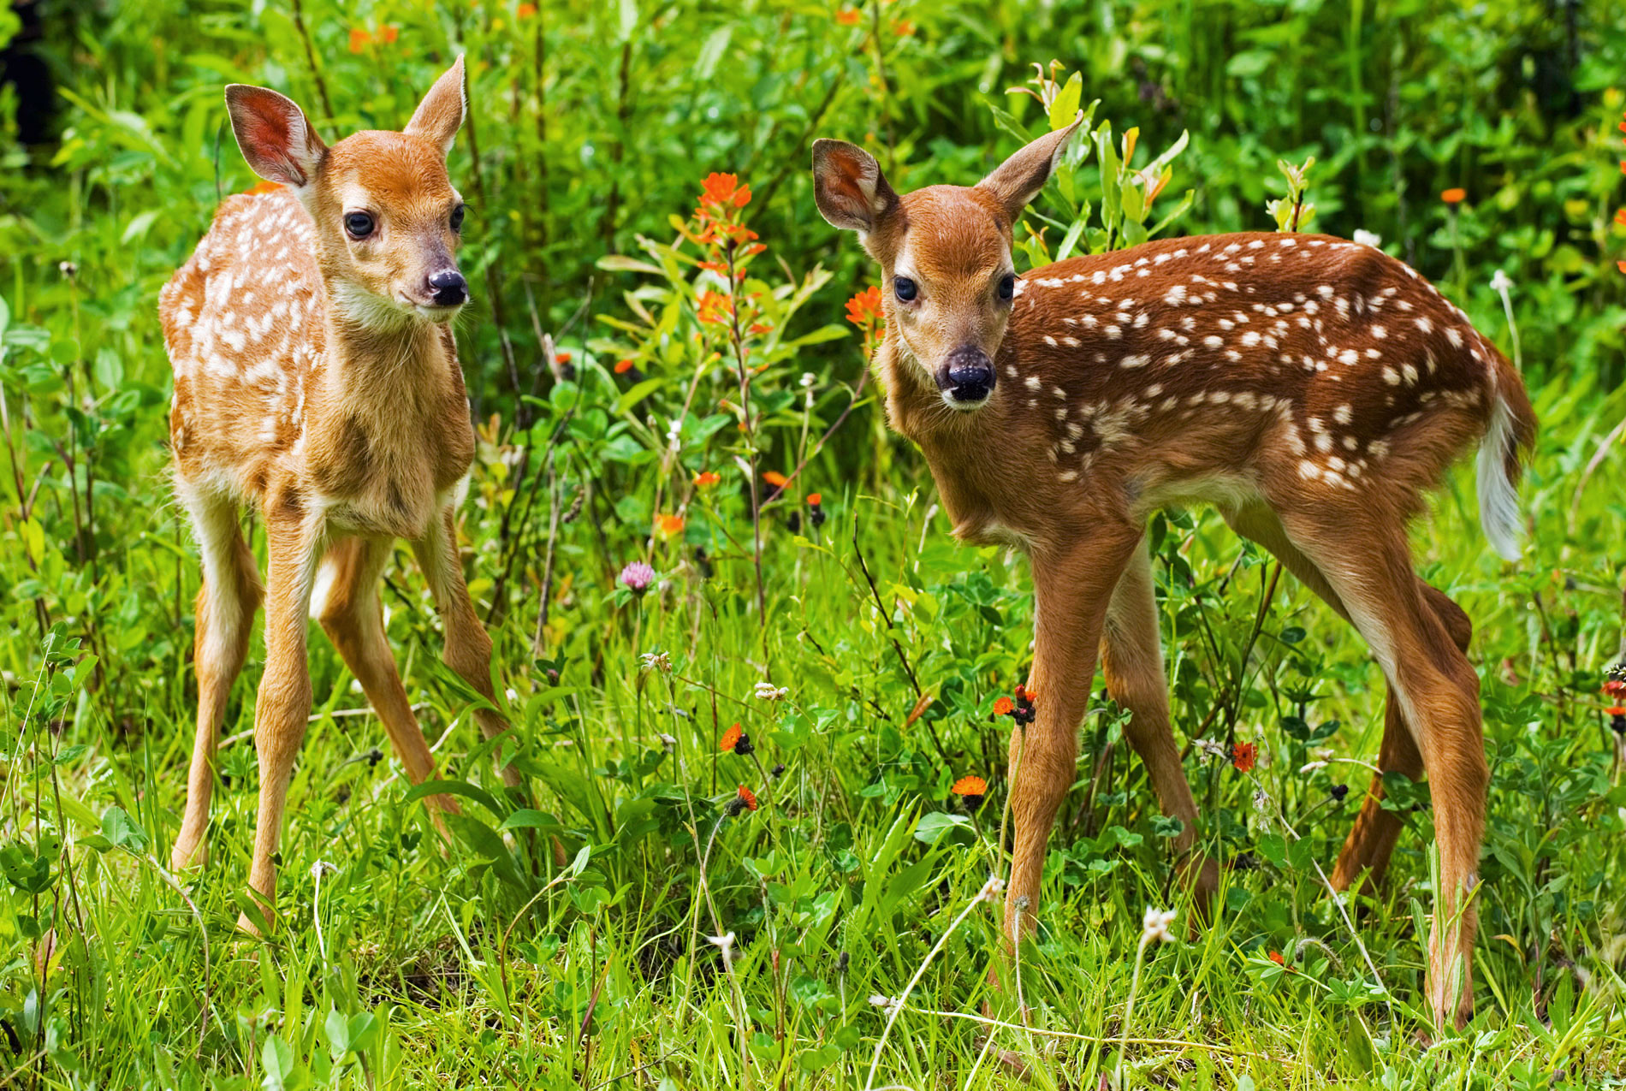
Where the deer and the antelope play

Slide 19
Where seldom is heard a discouraging word

Slide 20
And the skies are not cloudy all day

Slide 21
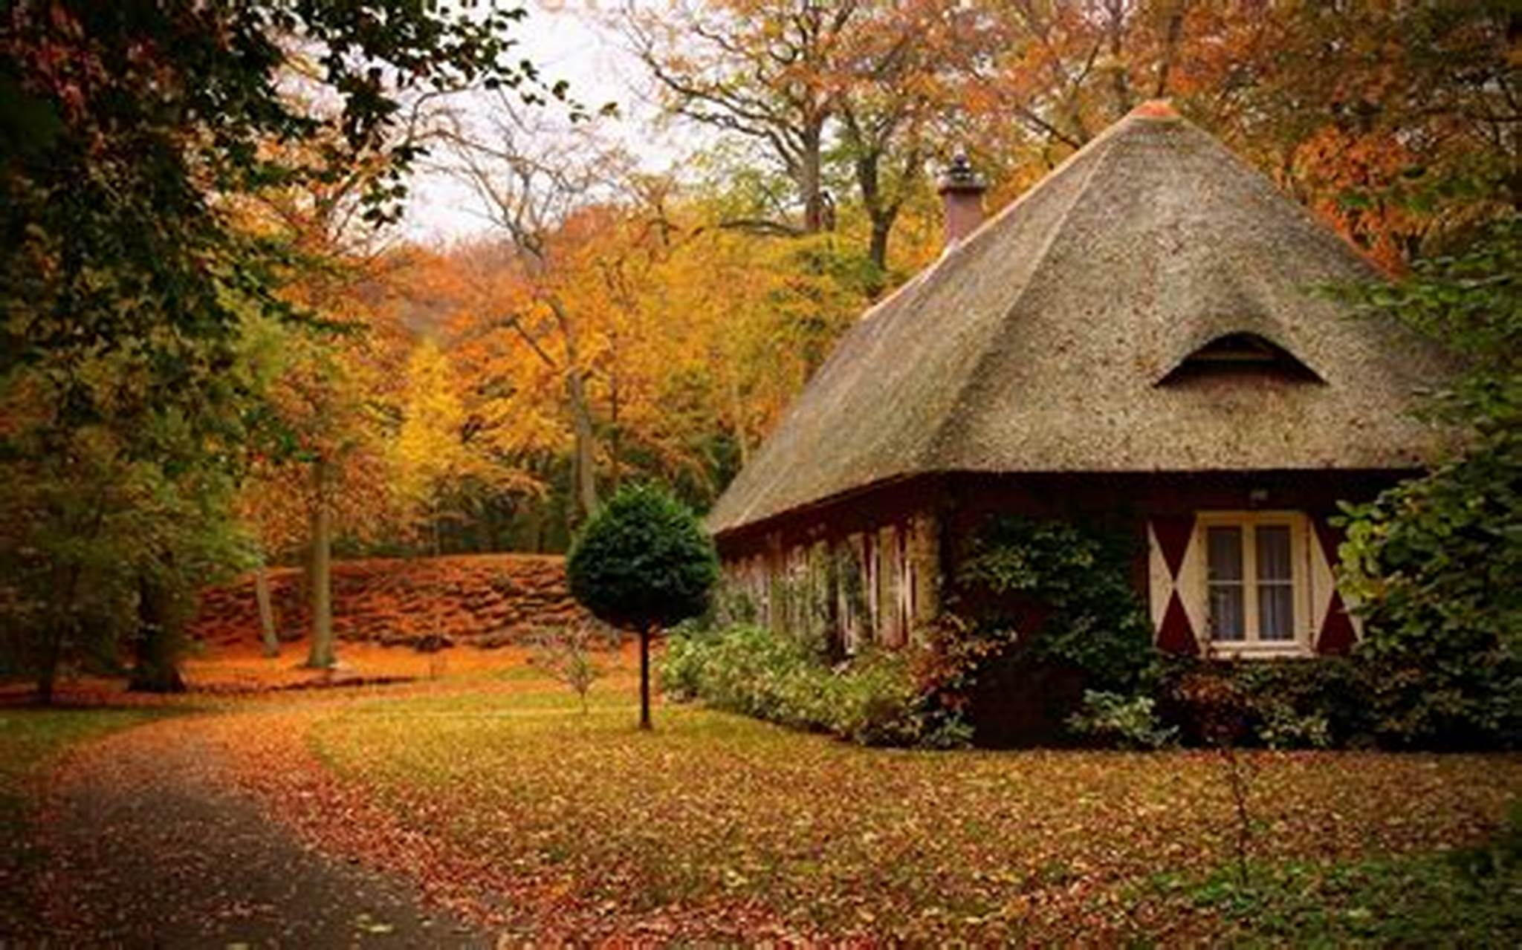

Slide 22
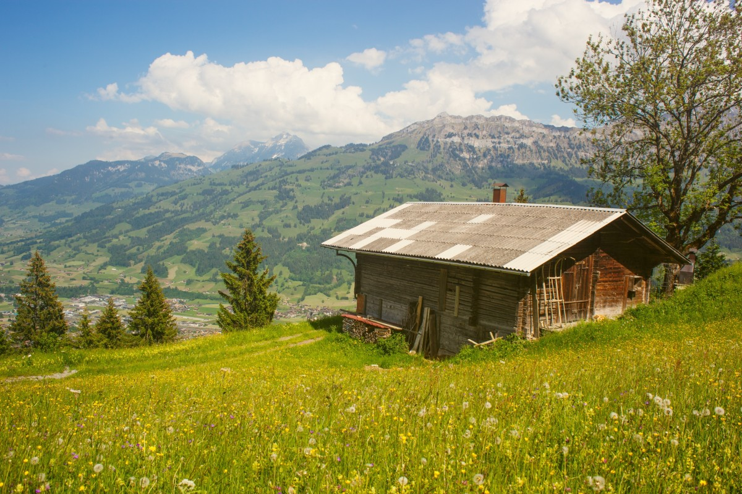

Slide 23
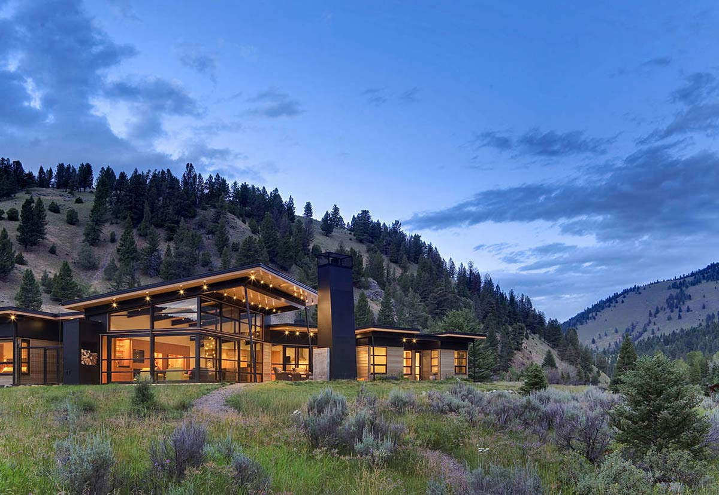

Slide 25
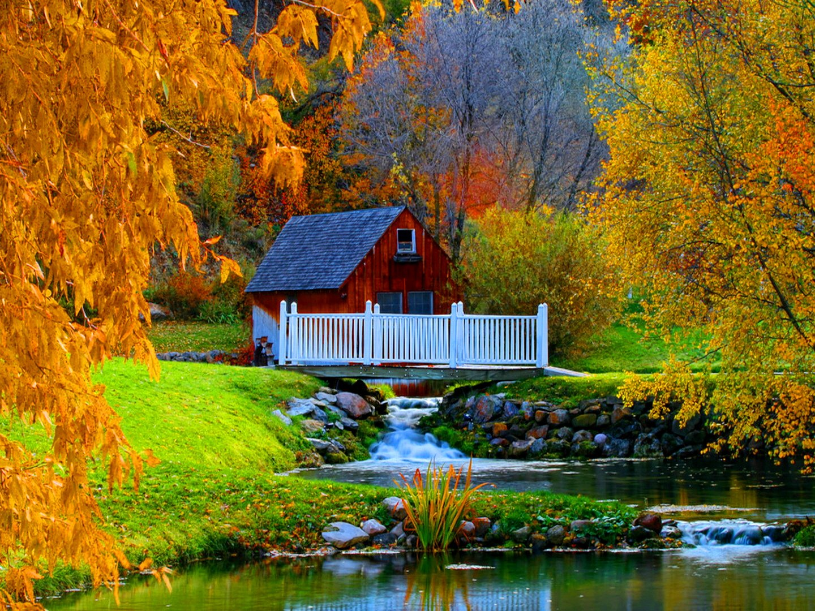

Slide 27
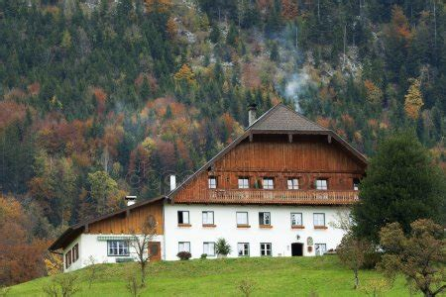
Home, home on the range

Slide 28
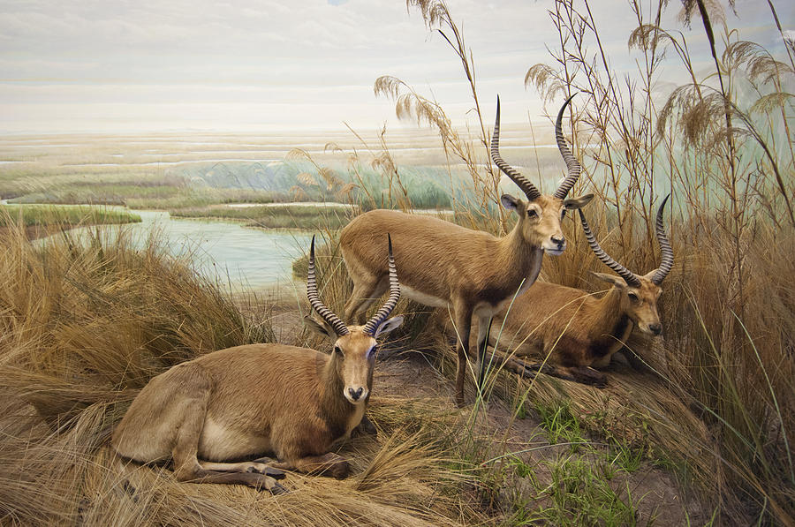
Where the deer and the antelope play

Slide 29
Where seldom is heard a discouraging word

Slide 30
And the skies are not cloudy all day

Slide 31
And the skies are not cloudy all day

