Slide 1
What a wonderful world
单位：华南师范大学外文学院
主题：Other People
作者：林立慧

Slide 2
I see trees of green

Slide 3
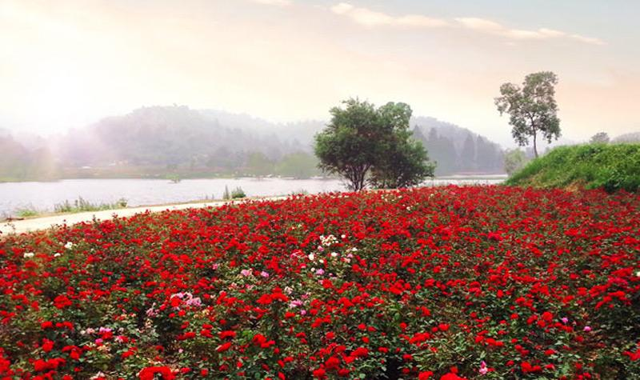
I see them bloom
red roses too
for me and you

Slide 4
what a wonderful world
And I think to myself

Slide 5
I see skies of blue
and clouds of white
The bright blessed day

Slide 6
the dark sacred night

Slide 7
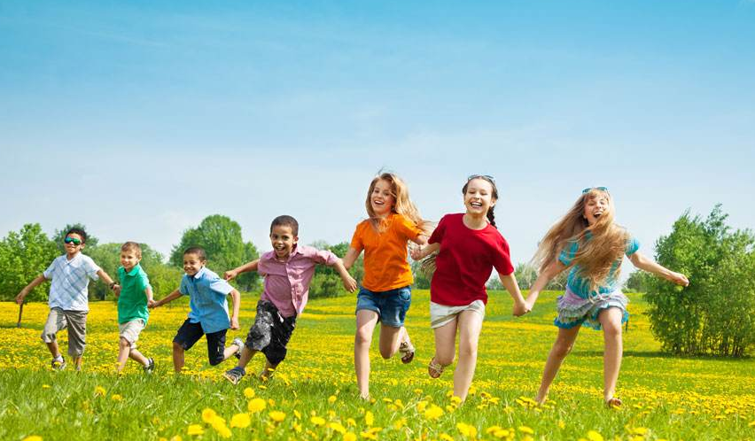
what a wonderful world
And I think to myself

Slide 8
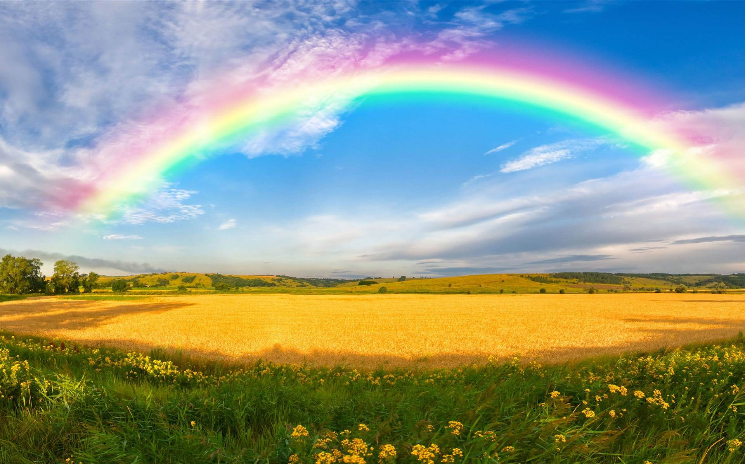
The colors of the rainbow
so pretty in the sky

Slide 9
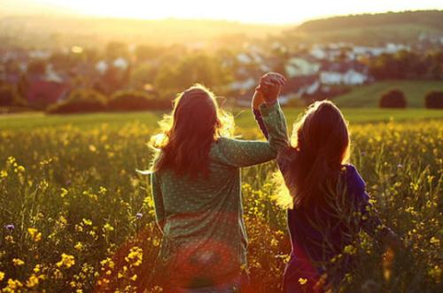
Are also on the faces
I see friends shaking hands
They're really saying I love you
of people passing by
saying how do you do

Slide 10
I watch them grow
I hear babies cry

Slide 11
They'll learn much more
than I'll never know

Slide 12
what a wonderful world
And I think to myself

Slide 13
Yes I think to myself
what a wonderful world

Slide 14
I see friends shaking hands
They're really saying I love you
saying how do you do

Slide 15
I watch them grow
I hear babies cry

Slide 16
They'll learn much more
than I'll never know

Slide 17
what a wonderful world
And I think to myself

Slide 18
Yes I think to myself
what a wonderful world

