Slide 1
Unit 5 Nelson Mandela
—a modern hero
Song: We are the world
Singer: Michael Jackson
主题：Other People
教材：人教版高中英语必修一
单位：华南师范大学外文学院
作者: 张莹

Slide 2
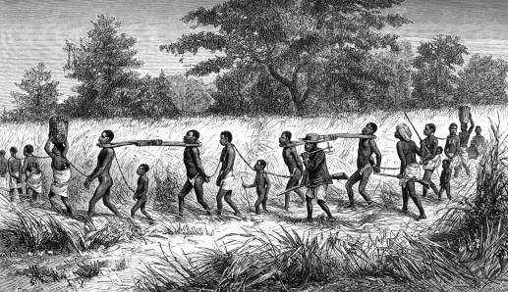
There is a time
when we should heed a certain call

Slide 3
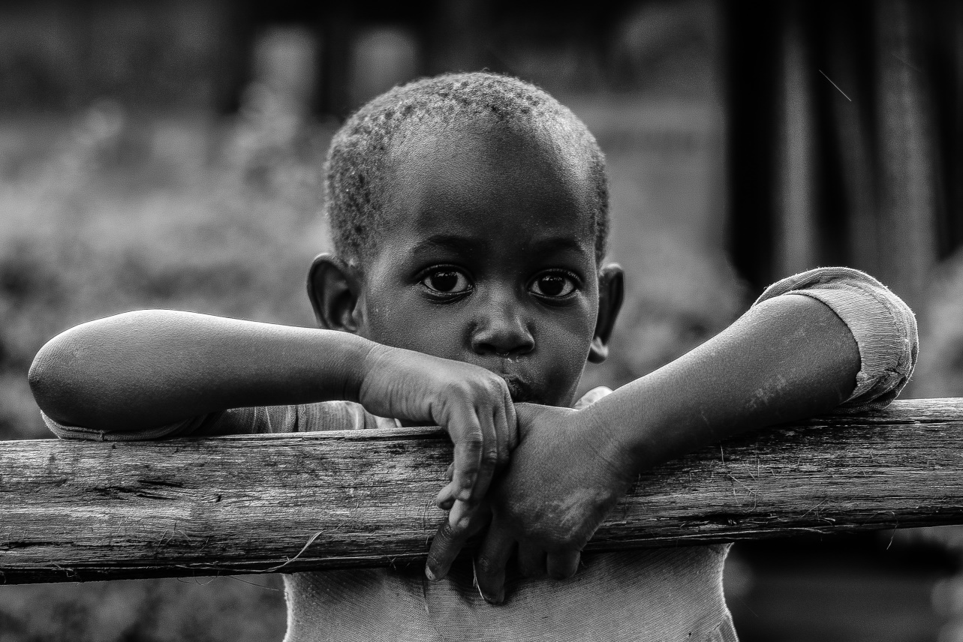
Cause the world
it seems it’s right in this line

Slide 4
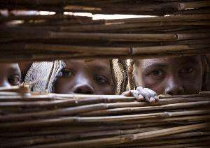
Cause there’s a chance for taking in needing our own lives

Slide 5
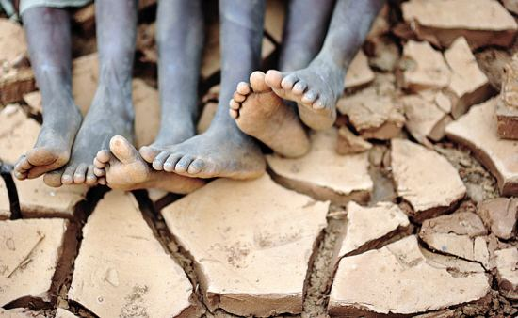
It seems we need nothing at all

Slide 6
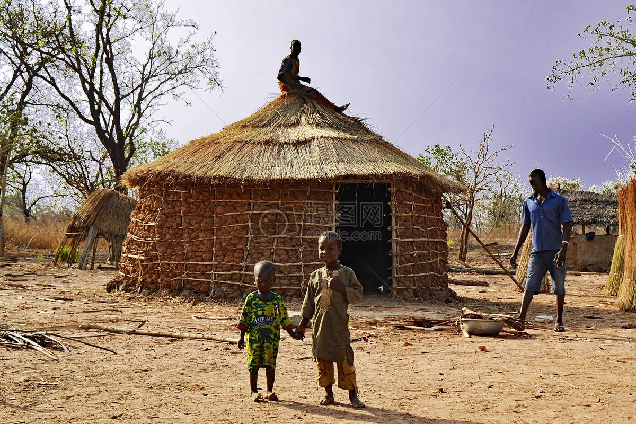
I used to feel
that I should give away my heart

Slide 7
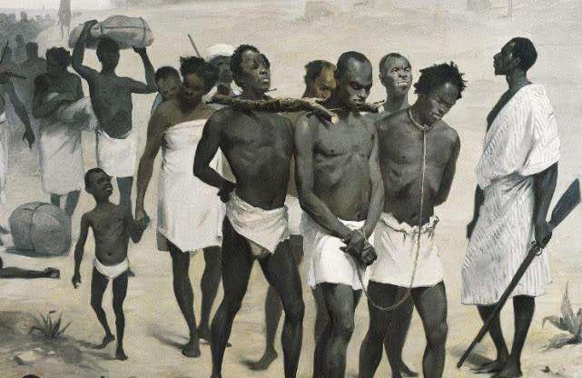
And it shows
that fear of needing them

Slide 8
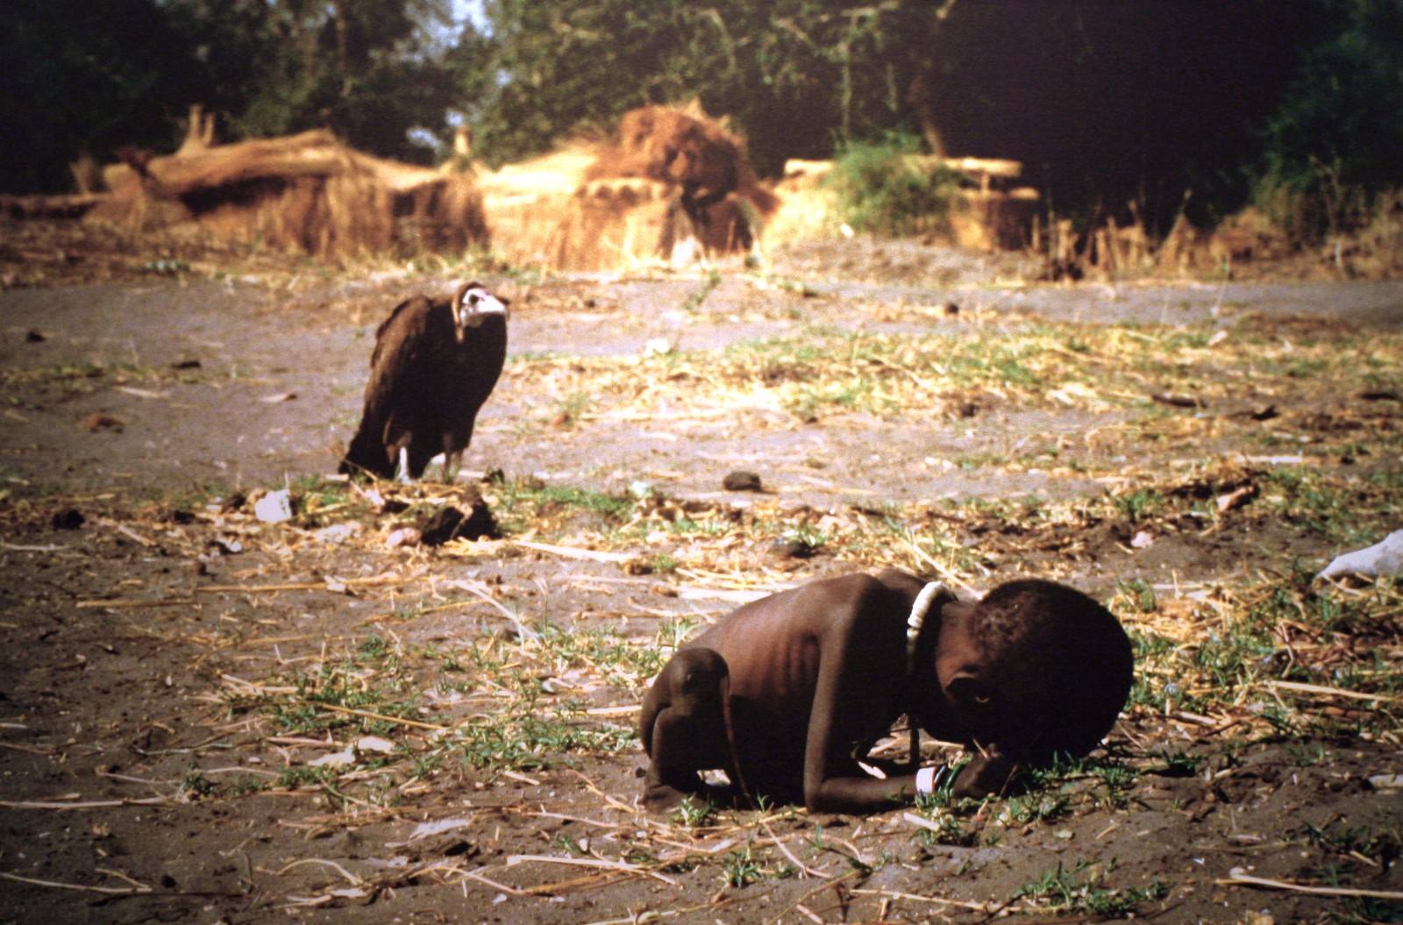
Then I read the headlines
and it said they’re dying there

Slide 9
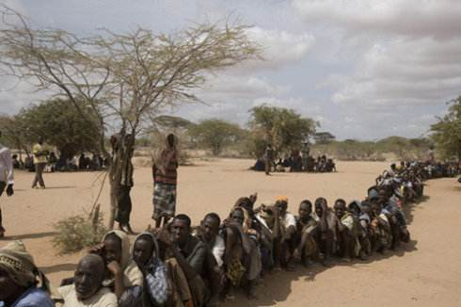
And it shows that we must heed instead

Slide 10
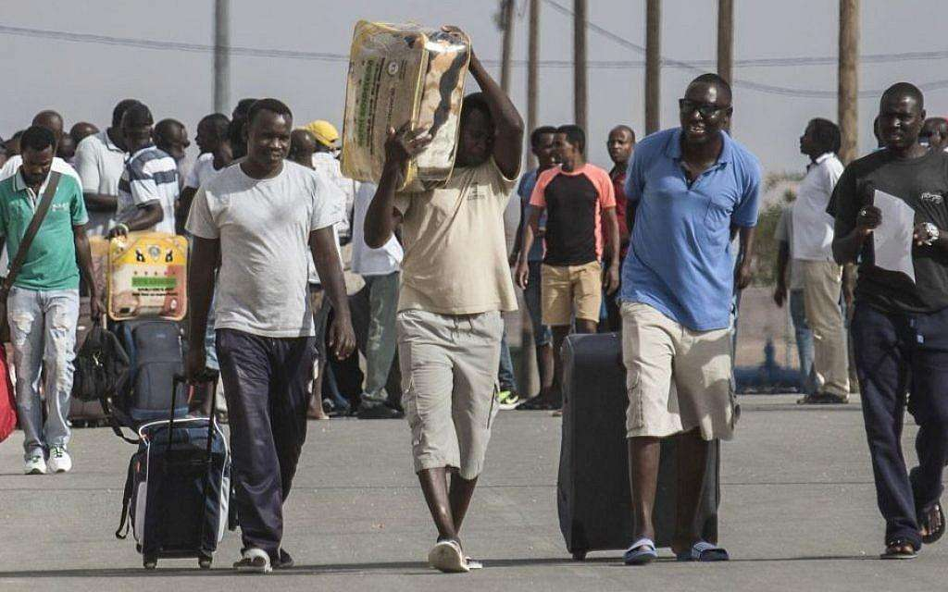
We are the world

Slide 11
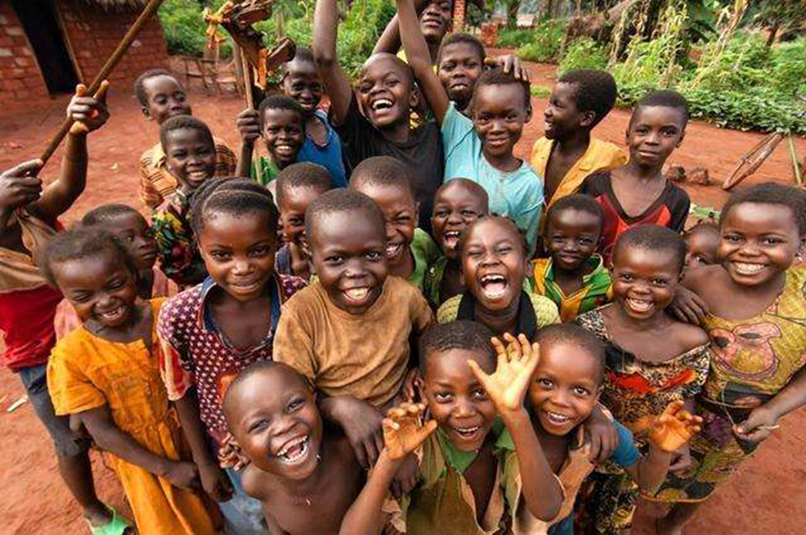
We are the children

Slide 12
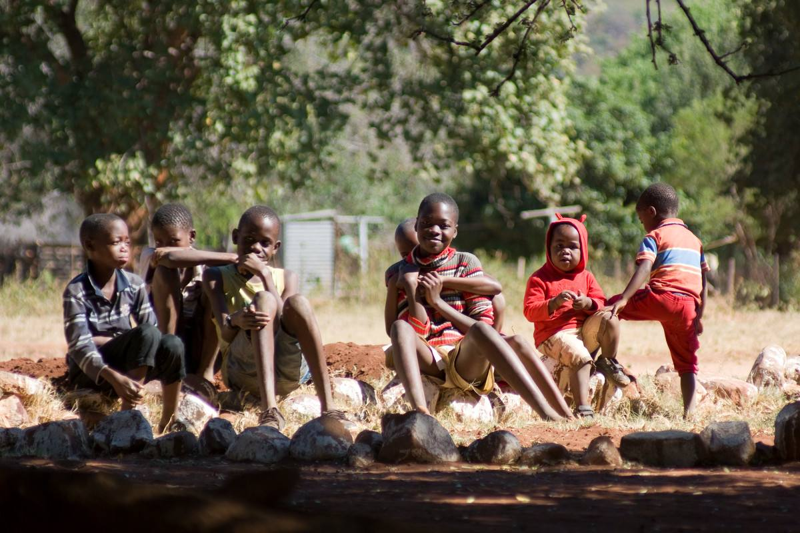
We are the ones who make a brighter day

Slide 13
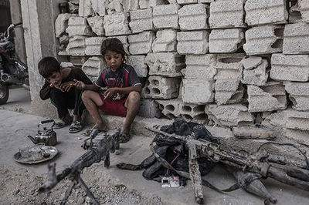
So let’s start giving

Slide 14
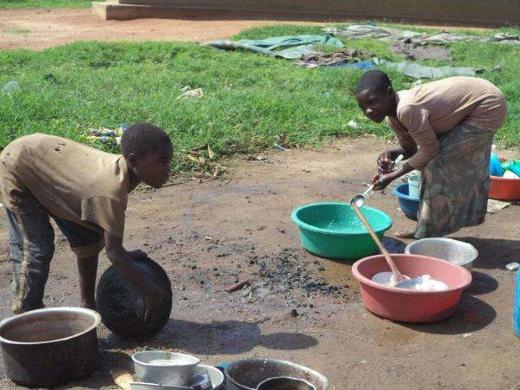
But there’s a chance we’re taking

Slide 15
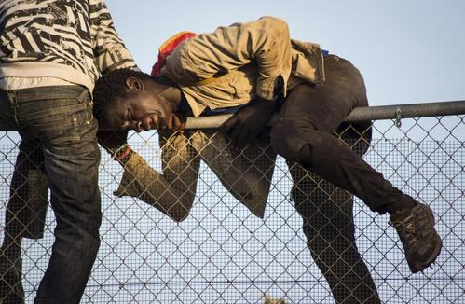
We’re taking our own lives

Slide 16
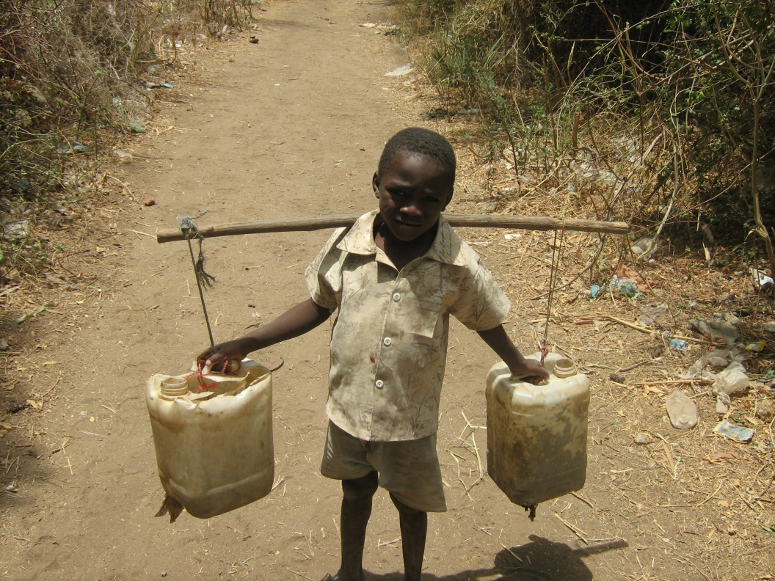
It’s true
we’ll make a brighter day just you and me

Slide 17
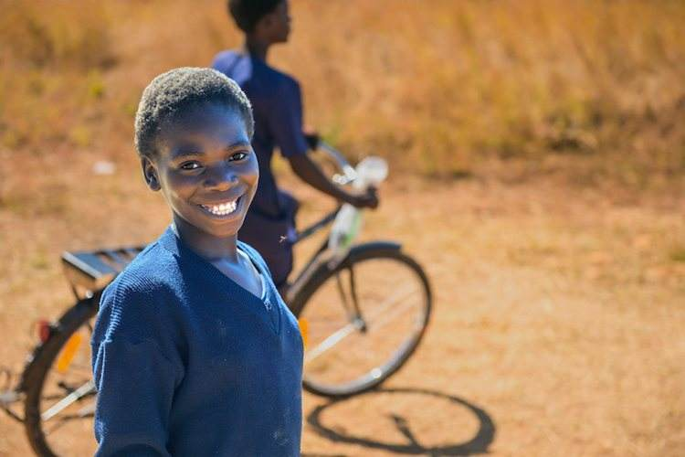
Give in your heart
and you will see that someone cares

Slide 18
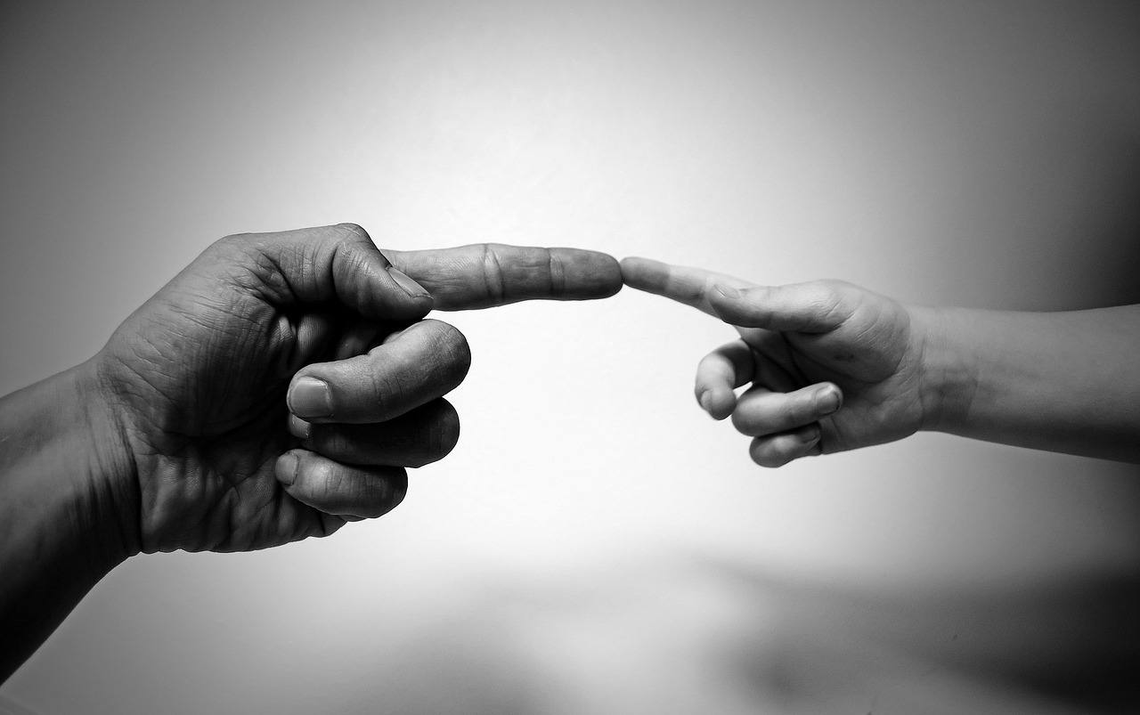
Cause you know that they can feed them all

Slide 19
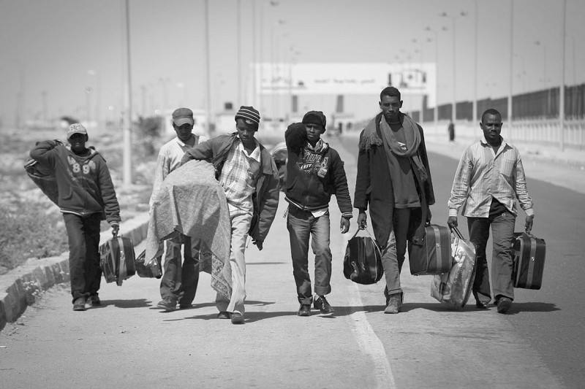
Then I read the paper
and it said that you’ve been denied

Slide 20
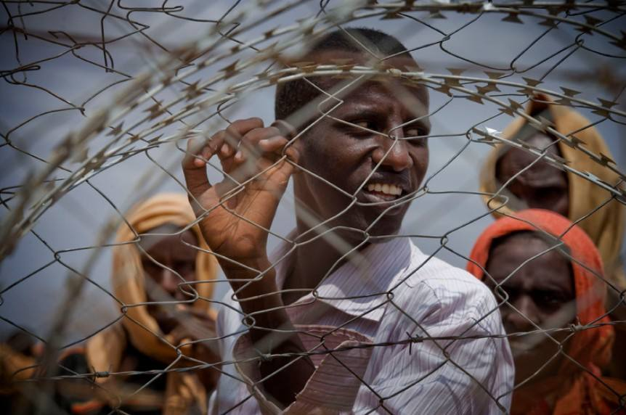
And it shows the second we will call

Slide 21
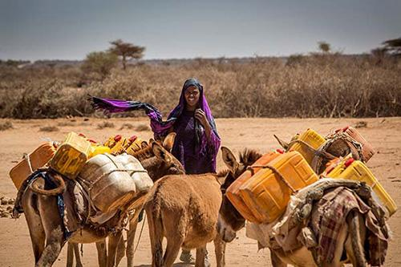
We are the world

Slide 22
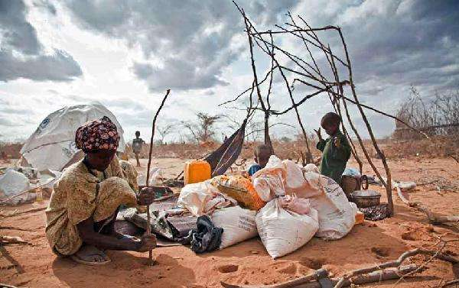
We are the children

Slide 23
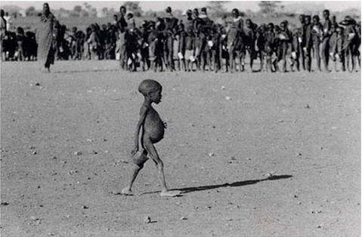
We are the ones
who make a brighter day

Slide 24
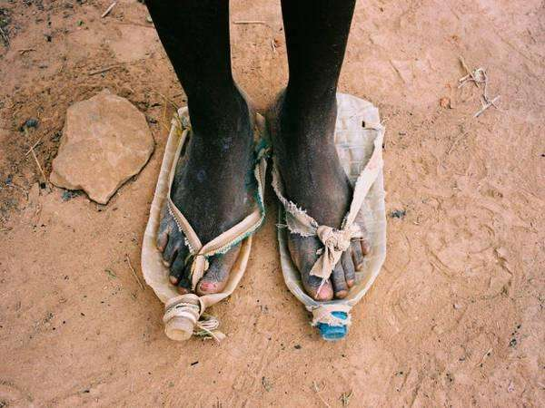
So let’s start giving

Slide 25
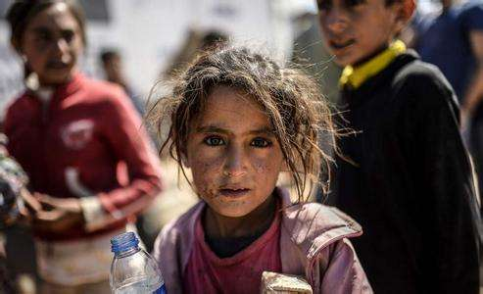
But there’s a chance we’re taking

Slide 26
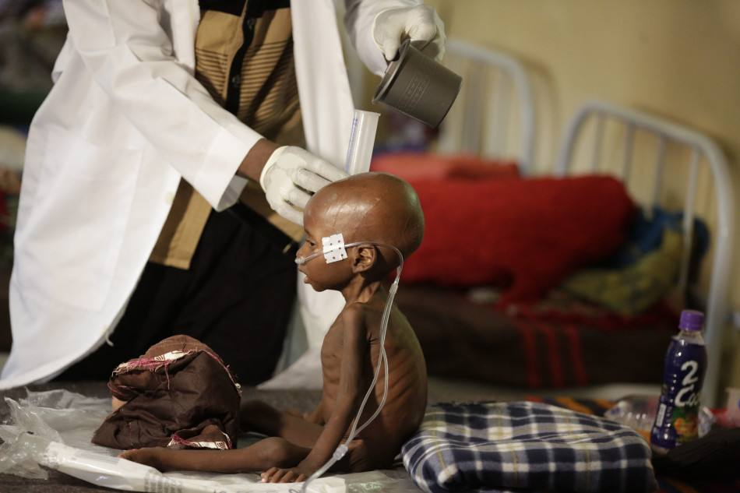
We’re taking our own lives

Slide 27
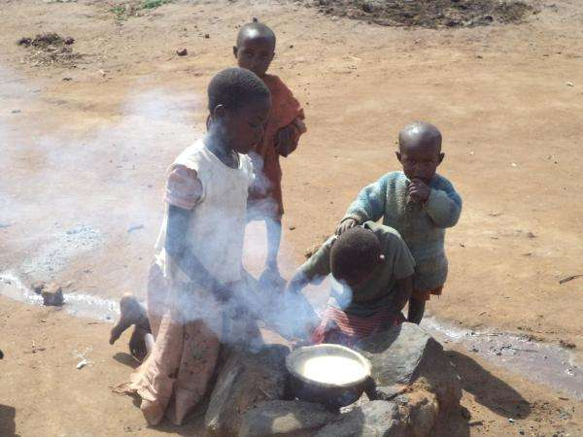
It’s true we’ll make a brighter day just you and me

Slide 28
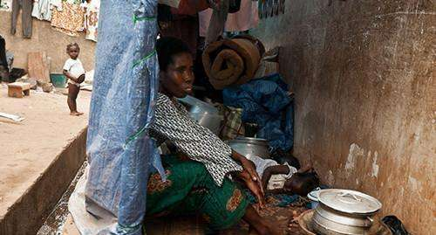
No there’s a time
when we must love them all

Slide 29
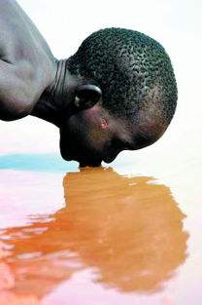
And it seems that life，
it don’t make love at all

Slide 30
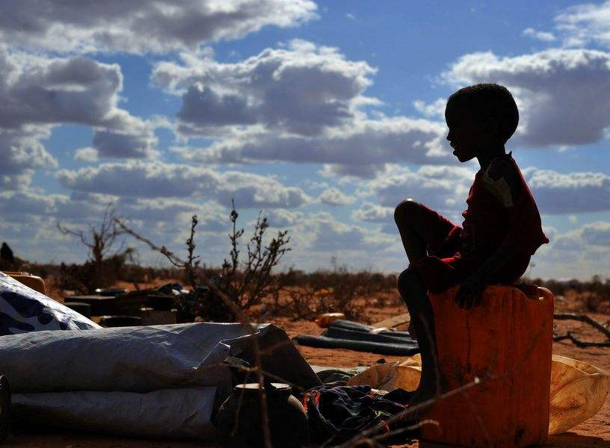
But if you’d be there,
and I’ll love you more and more

Slide 31
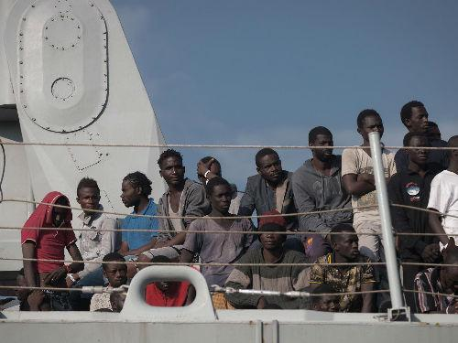
It seems in life, i didn’t do that

Slide 32
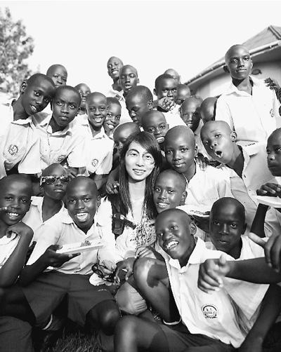
We are the world

Slide 33
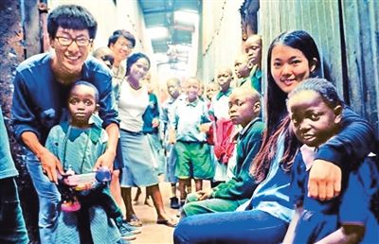
We are the children

Slide 34
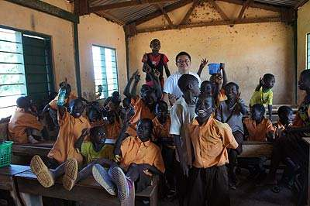
We are the ones who make a brighter day

Slide 35
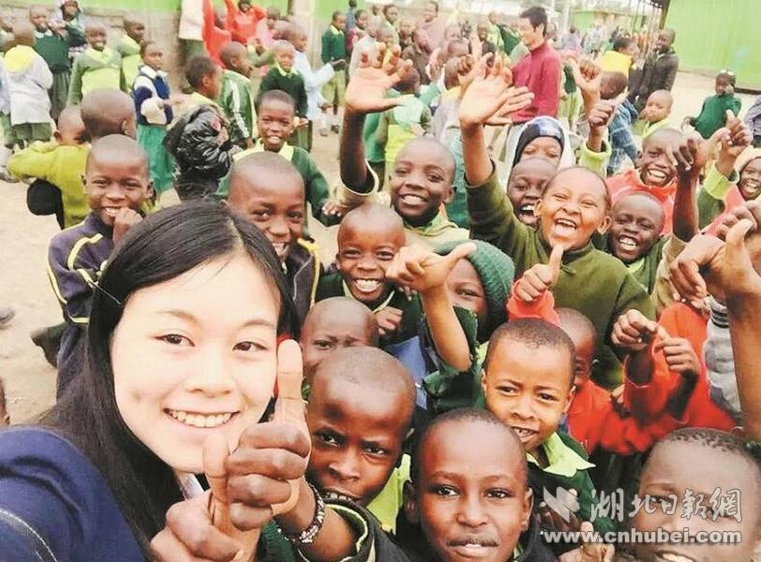
So let’s start giving

Slide 36
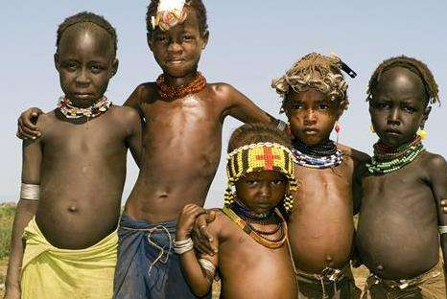
But there’s a chance we’re taking

Slide 37
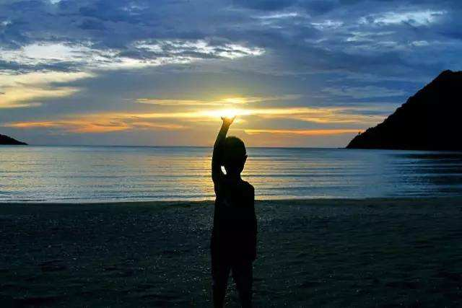
We’re taking our own lives

Slide 38
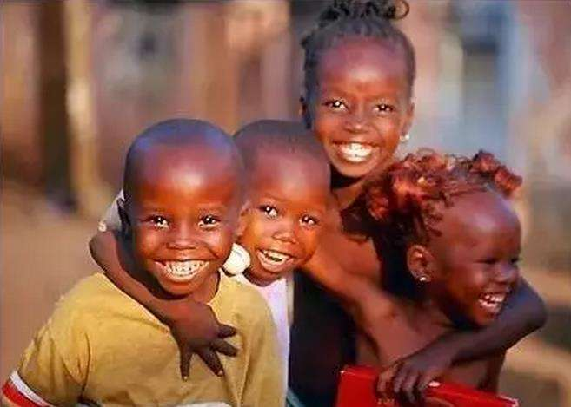
It’s true we’ll make a brighter day
just you and me

