Slide 1
Friends
王倩清
外国语言文化学院
英师四班

Slide 2
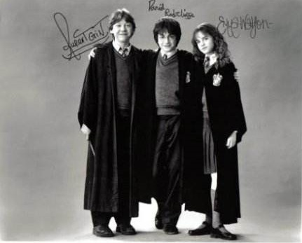
Should auld acquaintance be forgot
And never brought to mind

Slide 3
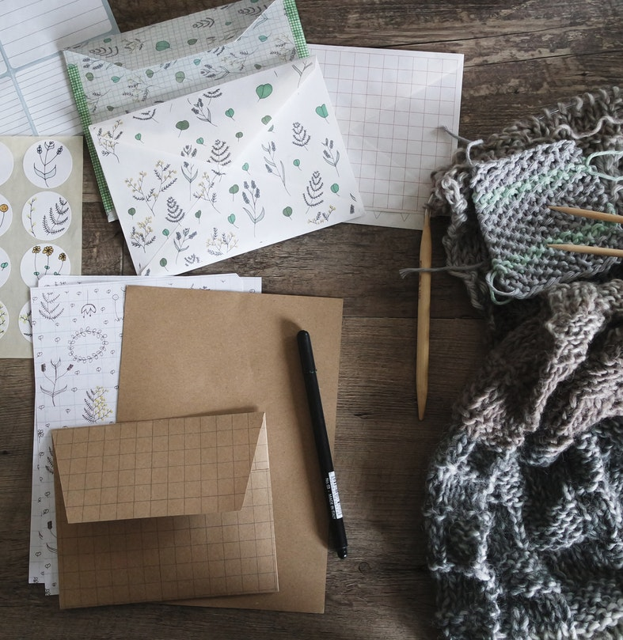
Should auld acquaintance be forgot
And days of auld lang syne

Slide 4
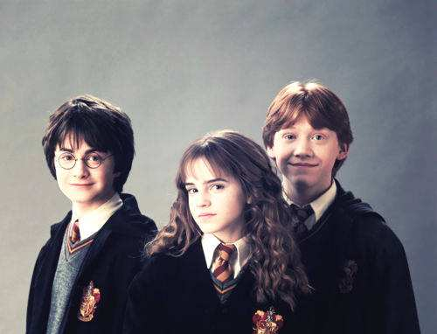
For auld lang syne my friends
For auld lang syne

Slide 5
We'll take a cup of kindness yet
For auld lang syne

Slide 6
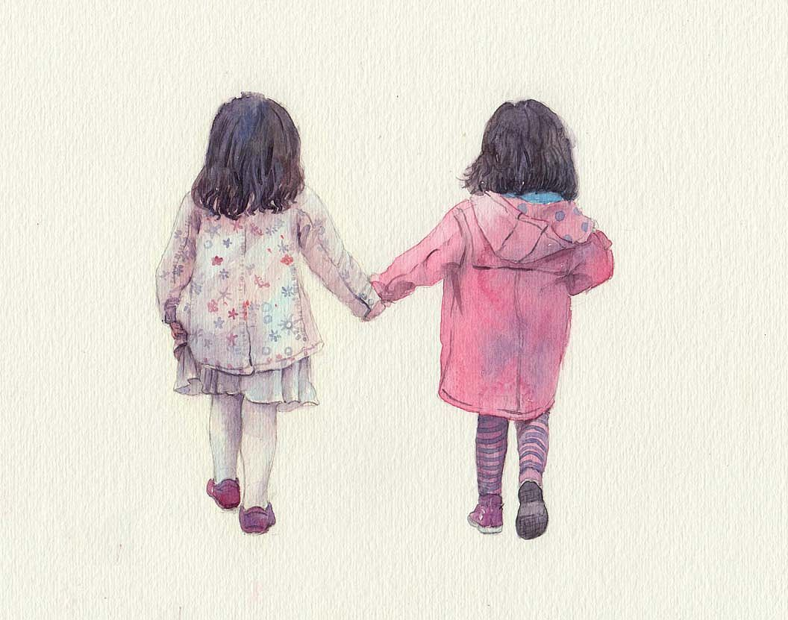

Slide 7
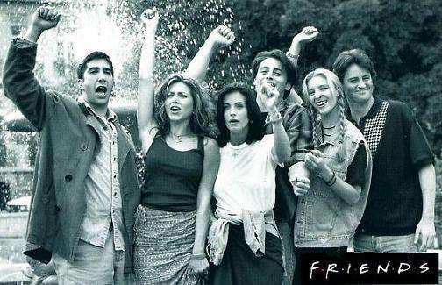
Should auld
Acquaintance be forgot
And never brought to mind

Slide 8
Should auld acquaintance be forgot
And days of auld lang syne

Slide 9
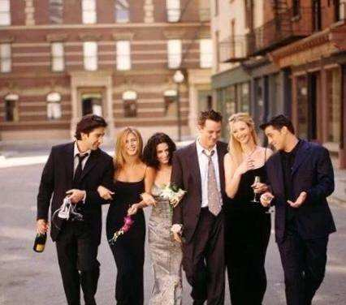
For auld lang syne my friends
For auld lang syne

Slide 10
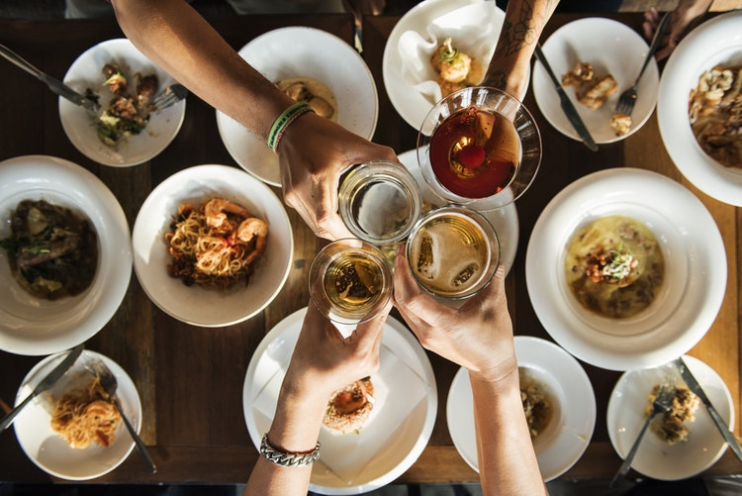
We'll take a cup
of kindness yet
For auld lang syne

Slide 11
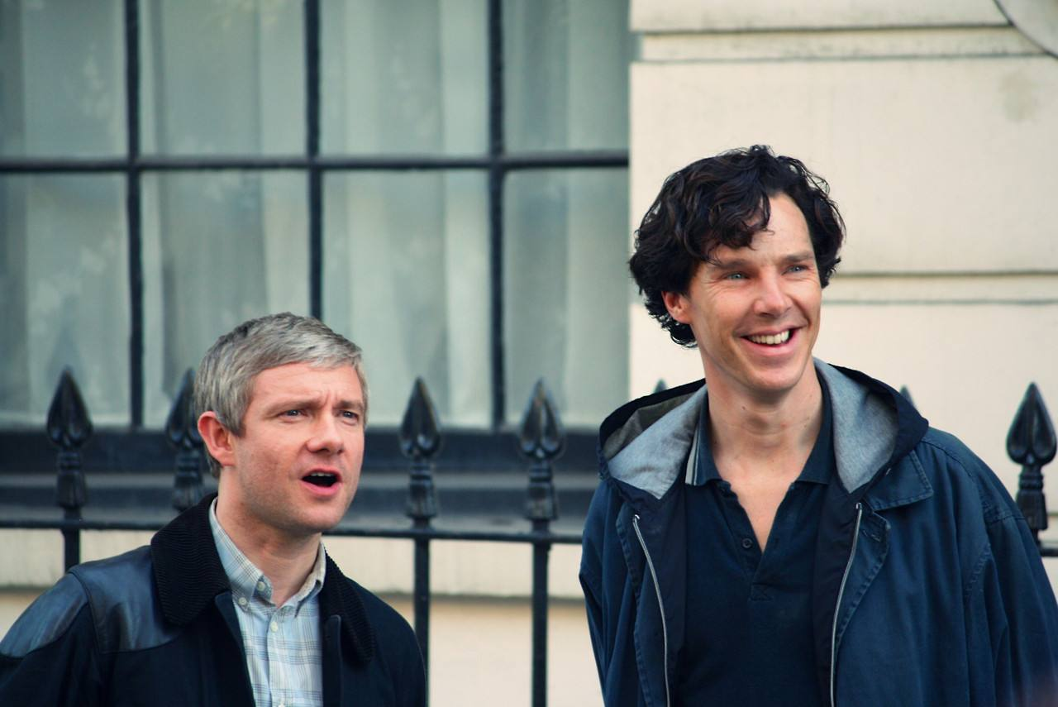
For auld lang syne my friends
For auld lang syne
We'll take a cup of kindness yet
For auld lang syne

Slide 12
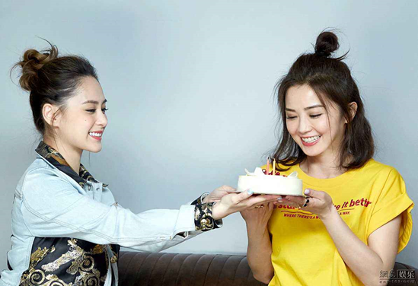
For auld lang syne my friends
For auld lang syne

Slide 14
