Slide 1
Jobs and careers
宋佳欣
华南师范大学外文学院

Slide 2
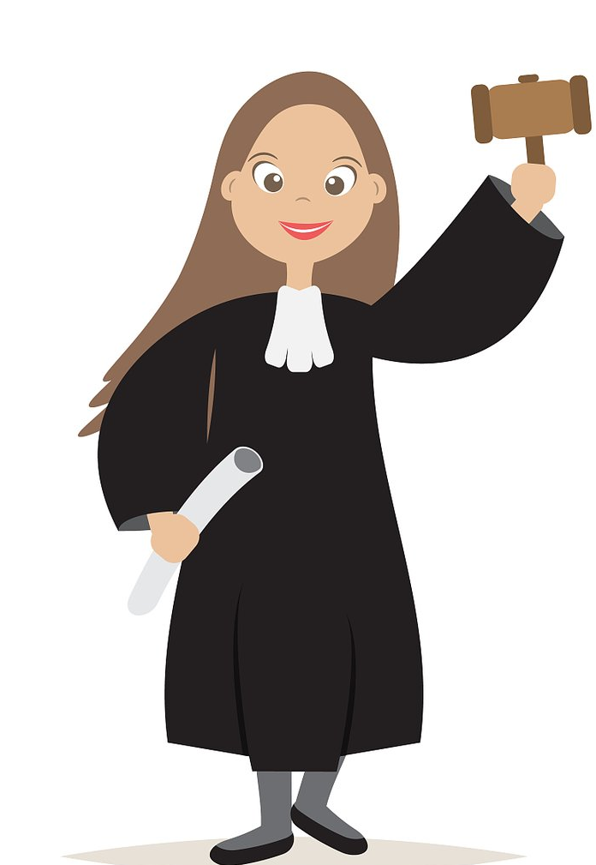
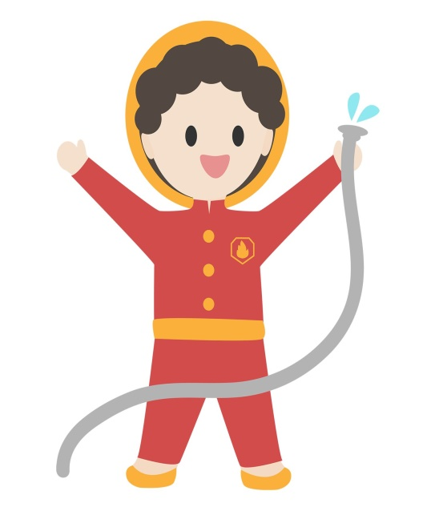
why not president be a dreamer
Doctor actor lawyer or a singer
police man
fire fighter
or a post man
you can be just the one you wanna be

Slide 3
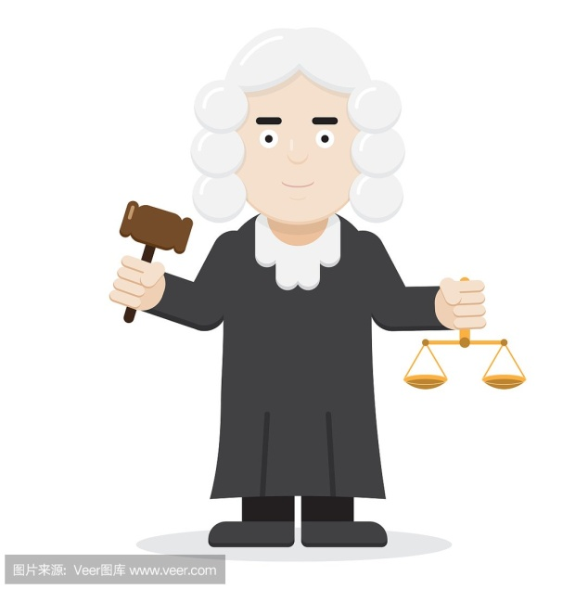
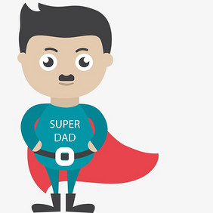
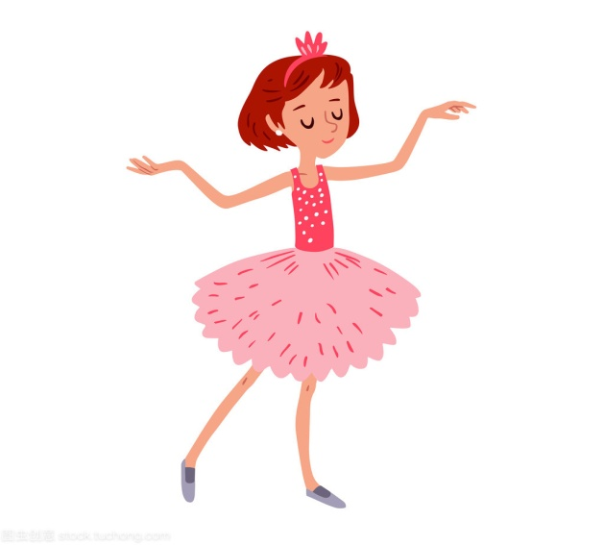
why not something like your old man?
lawyer
doctor
you can be just the one you wanna be
actor
or a singer

Slide 4
why not president be a dreamer?
I know that we all got one thing
that we all share together
you can be just the one you wanna be

Slide 5
We got that one nice dream
we live for
Coz nothing last for ever
just hold on to the team
you never know what life could bring
you play for

Slide 6
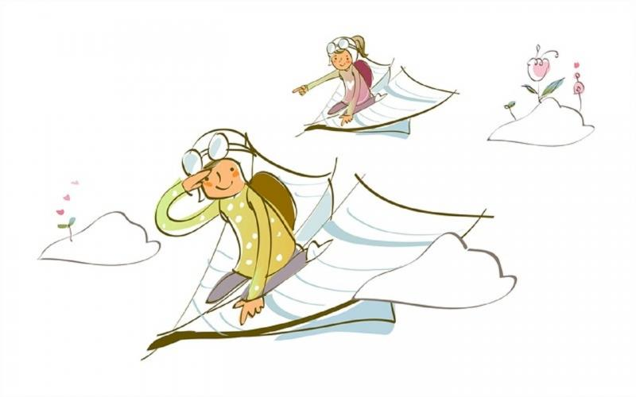
I know you could reach the top
make sure that you won't stop
be the one that you wanna be
now sing this with me

Slide 7
lawyer
doctor
actor
or a singer

Slide 8
why not president be a dreamer
you can be just the one you wanna be
police man
fire fighter
or a post man

Slide 9
why not something like your old man?
you can be just the one
you wanna be

Slide 10
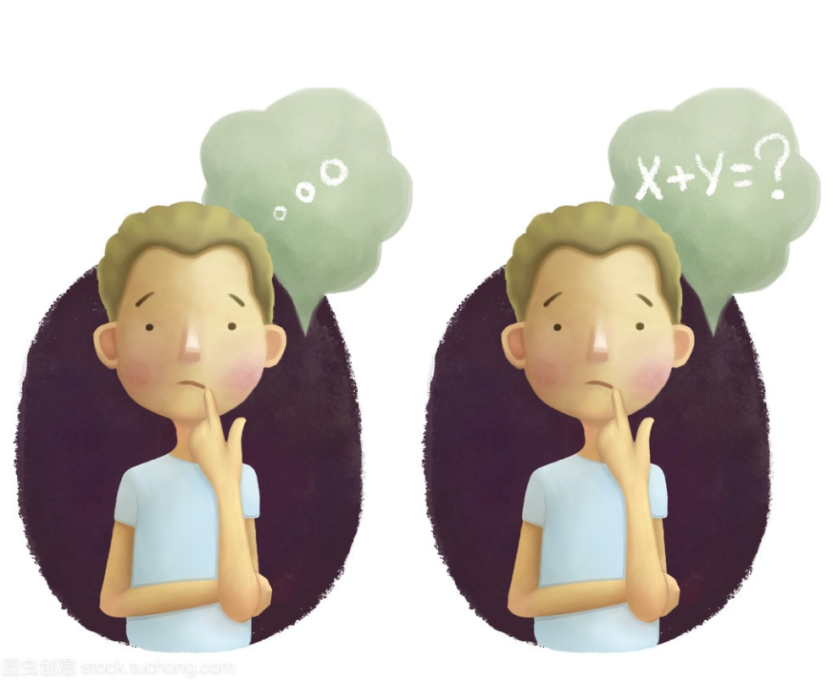
We may have different ways to think
but it doesn't really matter
we all caught up in the steam
of this life

Slide 11
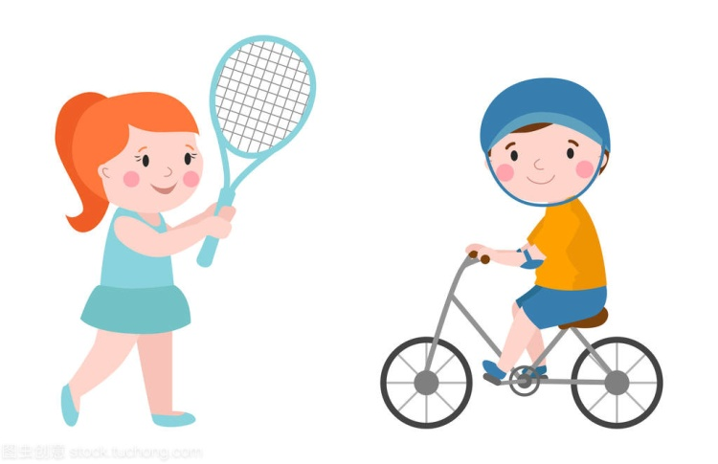
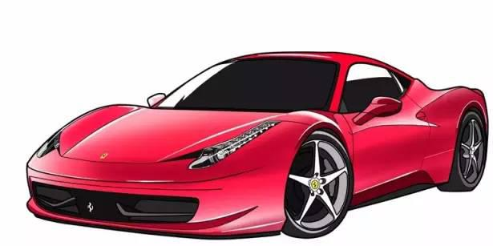
focus on every little thing
that's what does really matter
luxury cars and bling
That’s not real life

Slide 12
I know you could reach the top
make sure that you won't stop
be the one that you wanna be
now sing this with me

Slide 13
lawyer
doctor
actor
or a singer

Slide 14
why not president be a dreamer
you can be just the one you wanna be
police man
fire fighter
or a post man

Slide 15
why not something like your old man?
you can be just the one
you wanna be

Slide 16
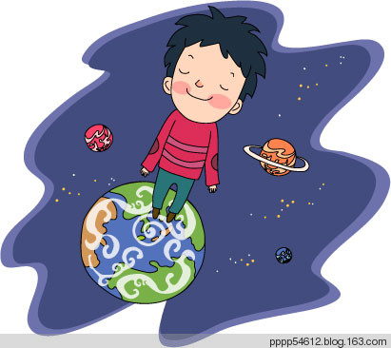
Last year I used to dream about this day
I hope I could inspire you
coz I've got all the love
coz I've got all love for you
Now I'm here I'm singing for you

Slide 17
lawyer
doctor
actor
or a singer

Slide 18
why not president be a dreamer
you can be just the one you wanna be
police man
fire fighter
or a post man

Slide 19
why not something like your old man?
you can be just the one
you wanna be

Slide 20
lawyer
doctor
actor
or a singer

Slide 21
why not president be a dreamer
you can be just the one you wanna be
police man
fire fighter
or a post man

Slide 22
why not something like your old man?
you can be just the one
you wanna be

Slide 23
lawyer
doctor
actor
or a singer

Slide 24
why not president be a dreamer
you can be just the one you wanna be
police man
fire fighter
or a post man

Slide 25
why not something like your old man?
you can be just the one
you wanna be

Slide 26
Be what you
Wanna be

