Slide 1
Traveling light Joel Hanson & Sara Groves
作者：邓昱琰
单位：华南师范大学外文学院

Slide 2
Well I was doubling over the load on my shoulders

Slide 3
Was a weight I carried with me everyday

Slide 4
Crossing miles of frustrations and rivers a raging

Slide 5
Picking up stones
I found along the way

Slide 6
I staggered
and I stumbled down
Pathways of trouble

Slide 7
I was hauling those souvenirs of misery

Slide 8
And with each step taken my back was breaking

Slide 9
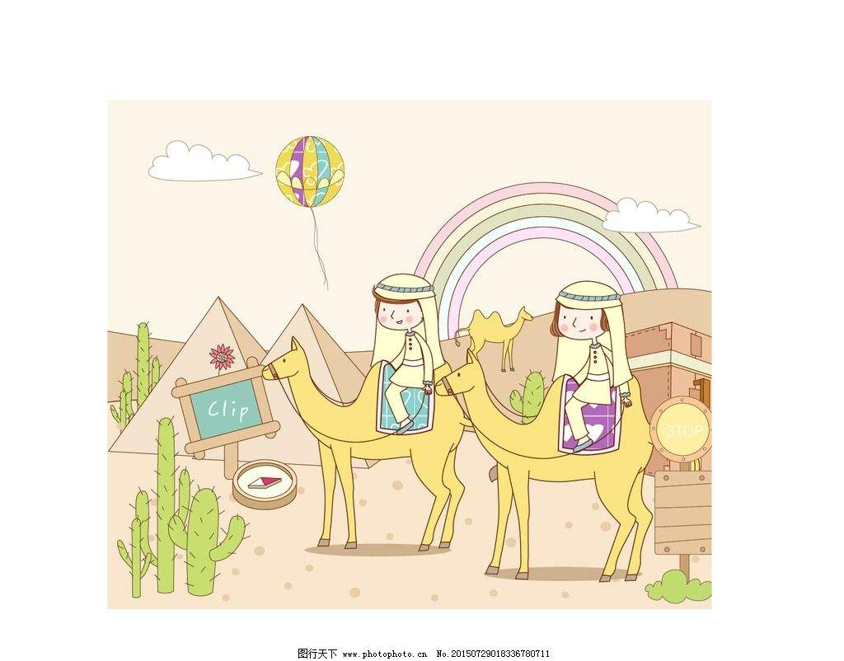
'Til I found the One who took it all from me

Slide 10
Down by the riverside I laid my burdens down,

Slide 11
Now I'm traveling light
My spirit lifted high

Slide 12
I found my freedom now

Slide 13
And I'm traveling light

Slide 14
Through the darkest alleys and loneliest valleys

Slide 15
I was dragging those
heavy chains of doubt and fear

Slide 16
Then with the one word spoken the locks were broken

Slide 17
Now He's leading me to places

Slide 18
Where there are no tears

Slide 19
Down by the riverside I laid my burdens down,

Slide 20
Now I'm traveling light My spirit lifted high

Slide 21
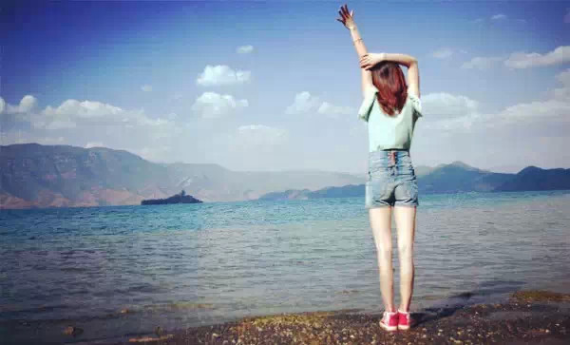
I found my freedom now And I'm traveling light

Slide 22
Thanks for watching

