Slide 1
主题：Interest and Hobby
歌曲：We’re all in this together
作者：丘雯雯
单位：华南师范大学外文学院

Slide 2
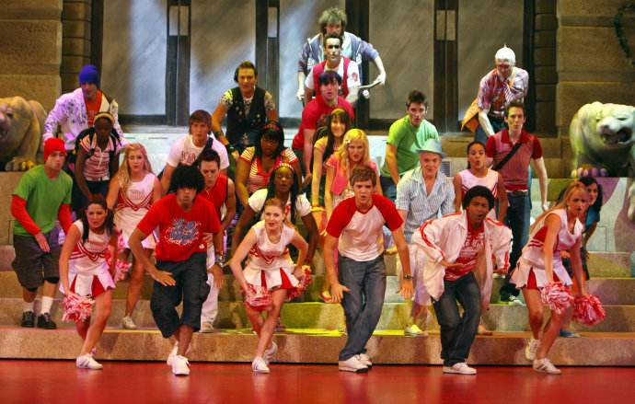
Together together together everyone

Slide 3
Together together come on let’s have some fun

Slide 4
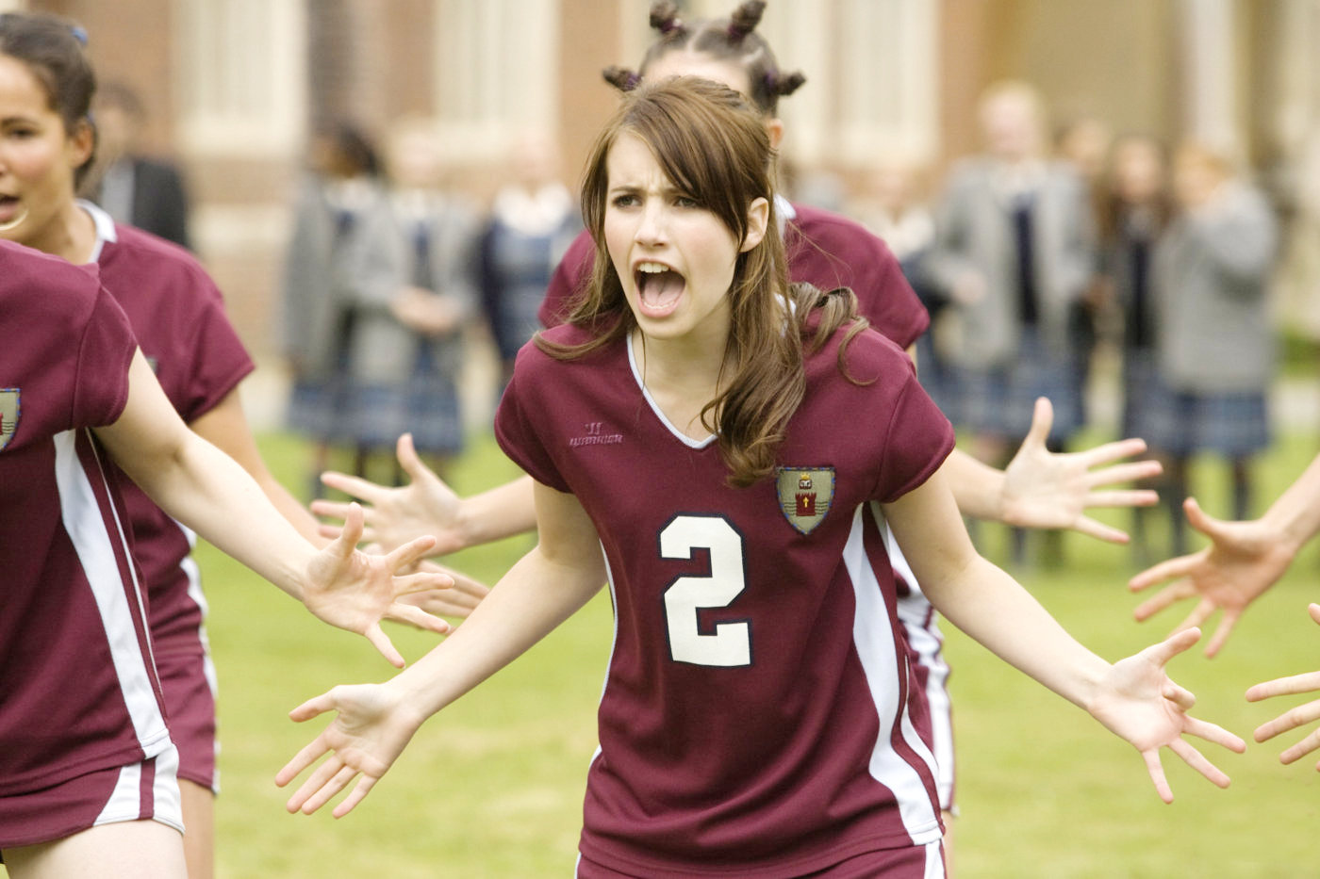
Together were there for each other every time

Slide 5
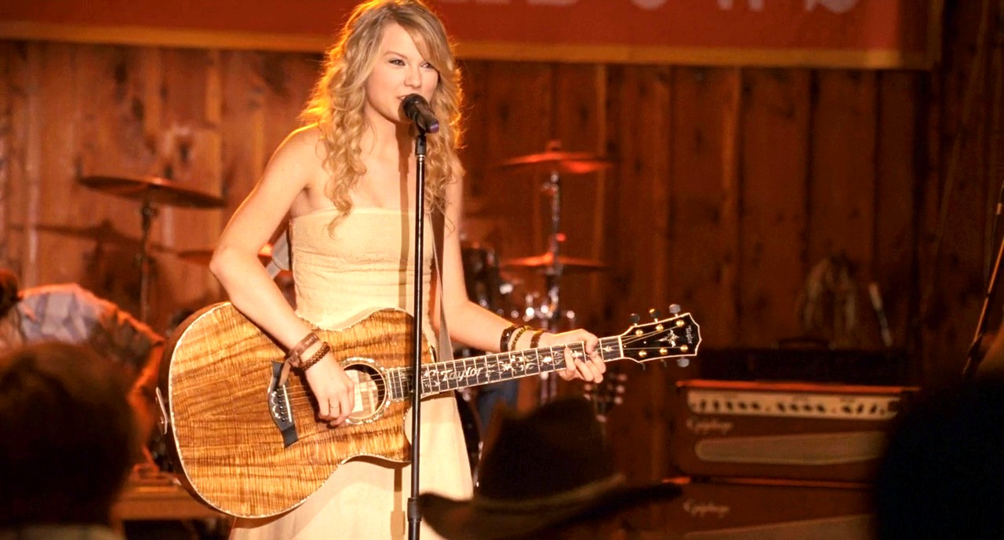
Together together come on let’s do this right

Slide 6
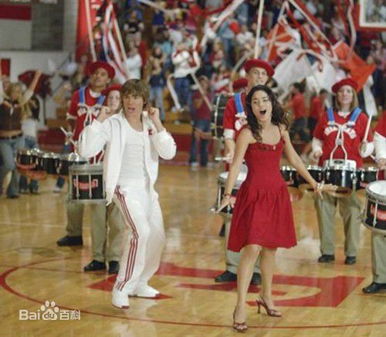
Here and now it’ s time for celebration

Slide 7
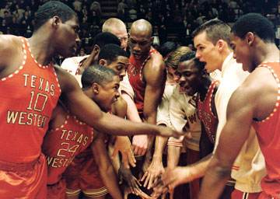
I finally figured it out (yeah yeah)

Slide 8
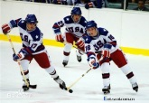
That all our dreams have no limitations

Slide 9
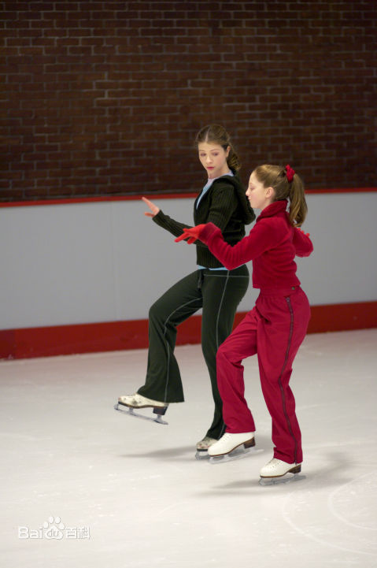
That's what it’s all about

Slide 10
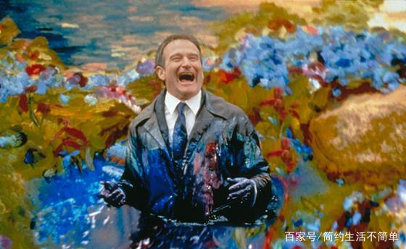
Everyone is special in their own way

Slide 11
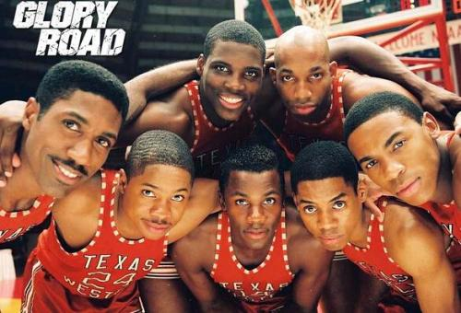
We make each other strong (make each other strong)

Slide 12
We’re not the same

Slide 13
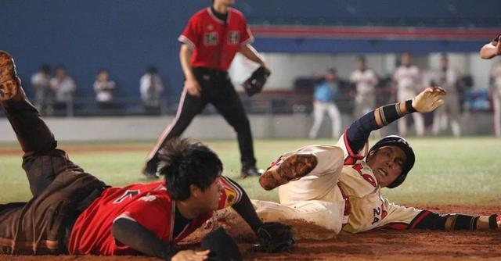
We’re different in a good way

Slide 14
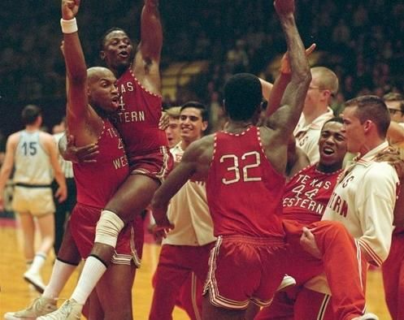
Together’s where we belong

Slide 15
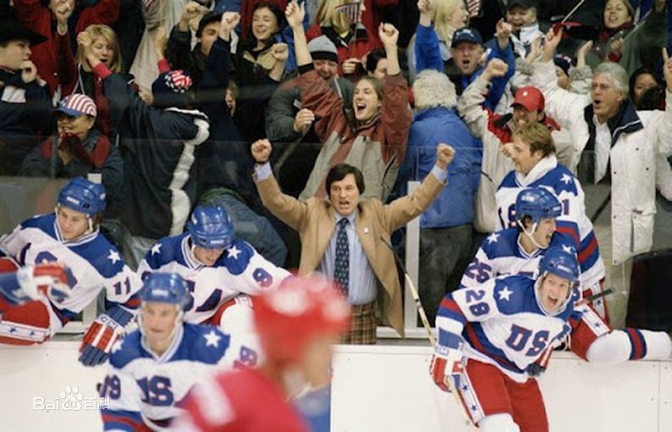
We're all in this together

Slide 16
Once we know

Slide 17
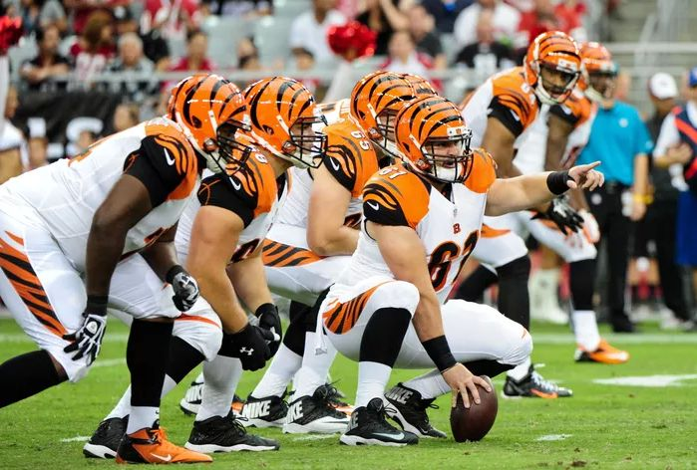
That we are

Slide 18
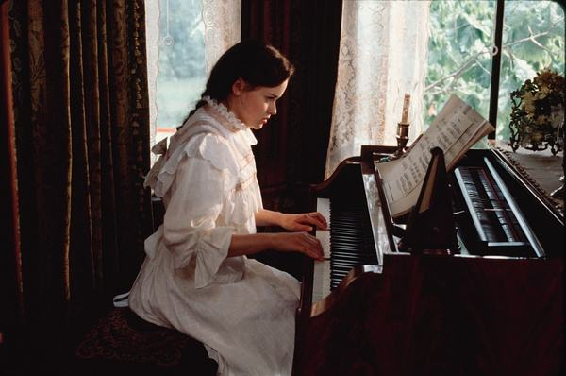
We're all stars

Slide 19
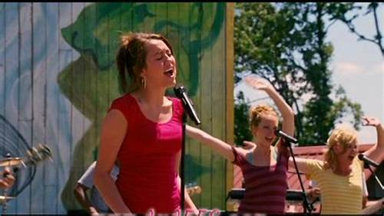
And we see that

Slide 20
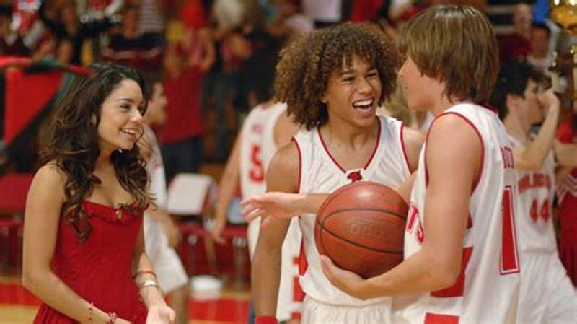
We're all in this together

Slide 21
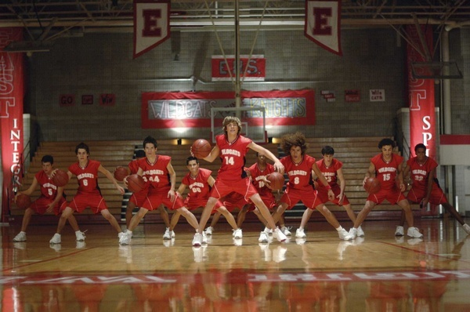
And it shows

Slide 22
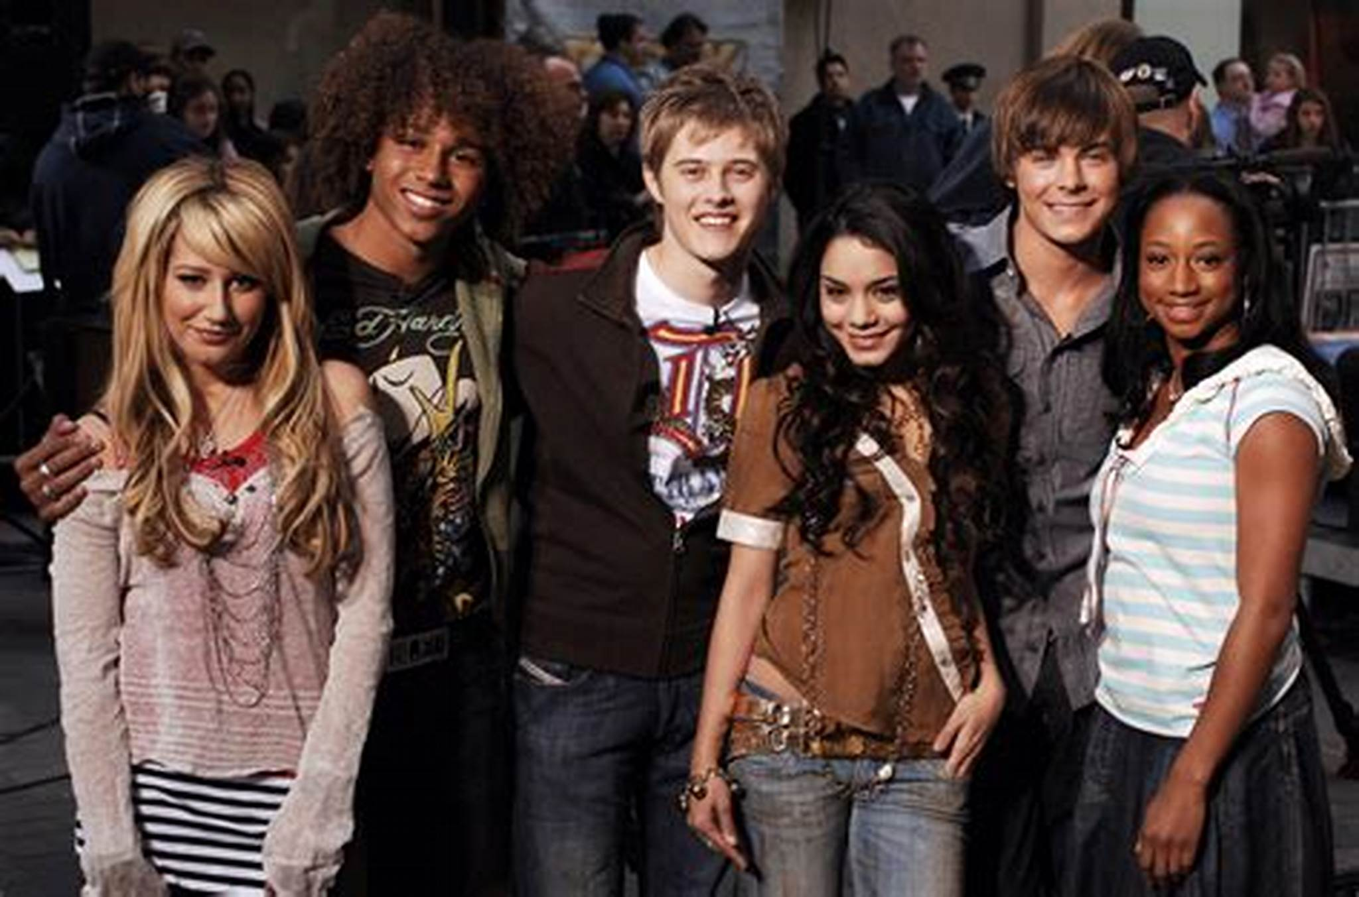
When we stand

Slide 23
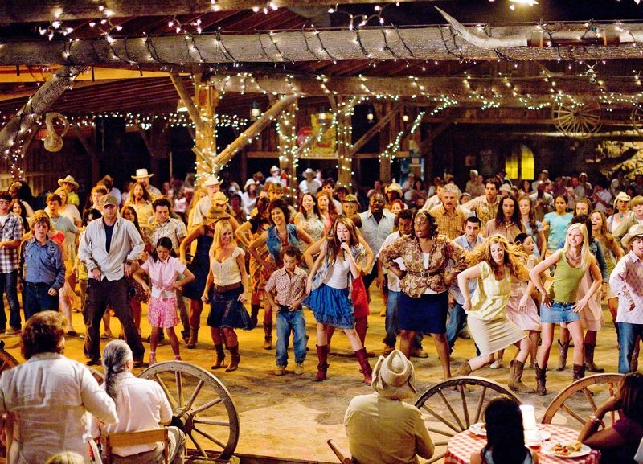
Hand in hand

Slide 24
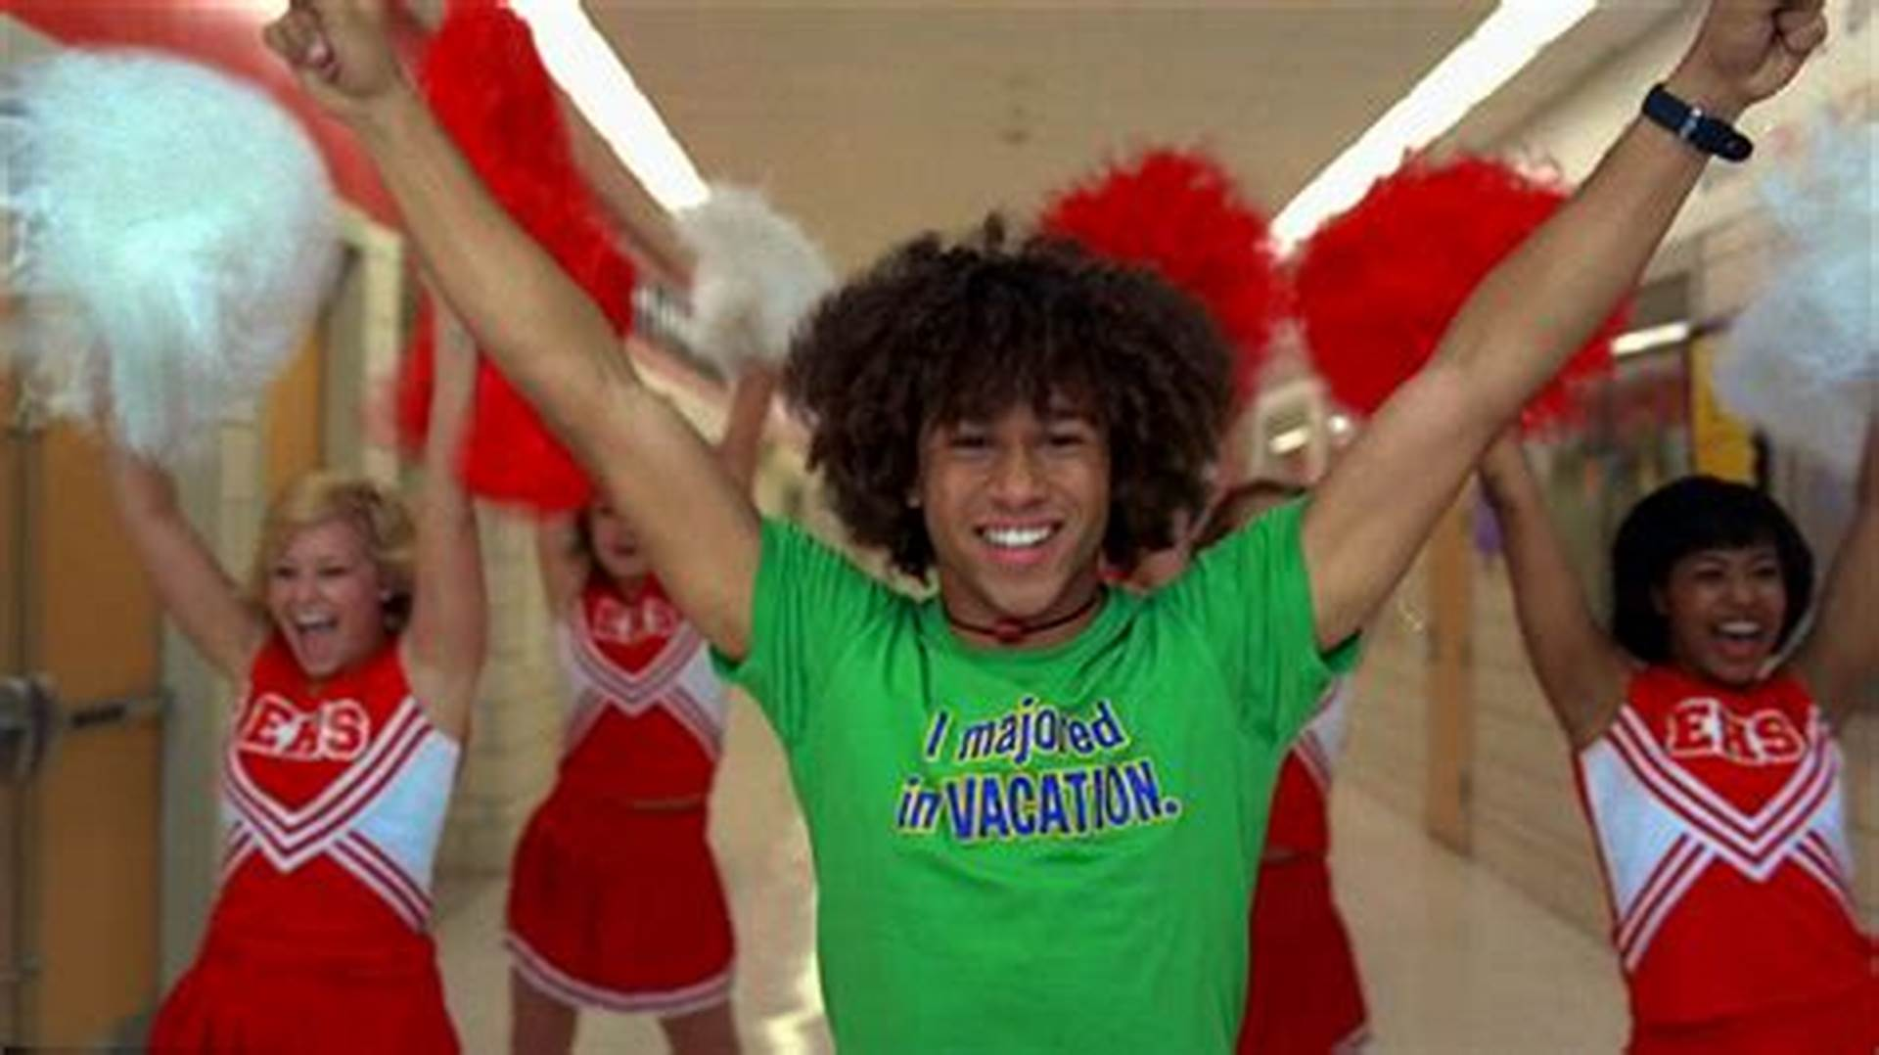
Make our dreams come true

Slide 25
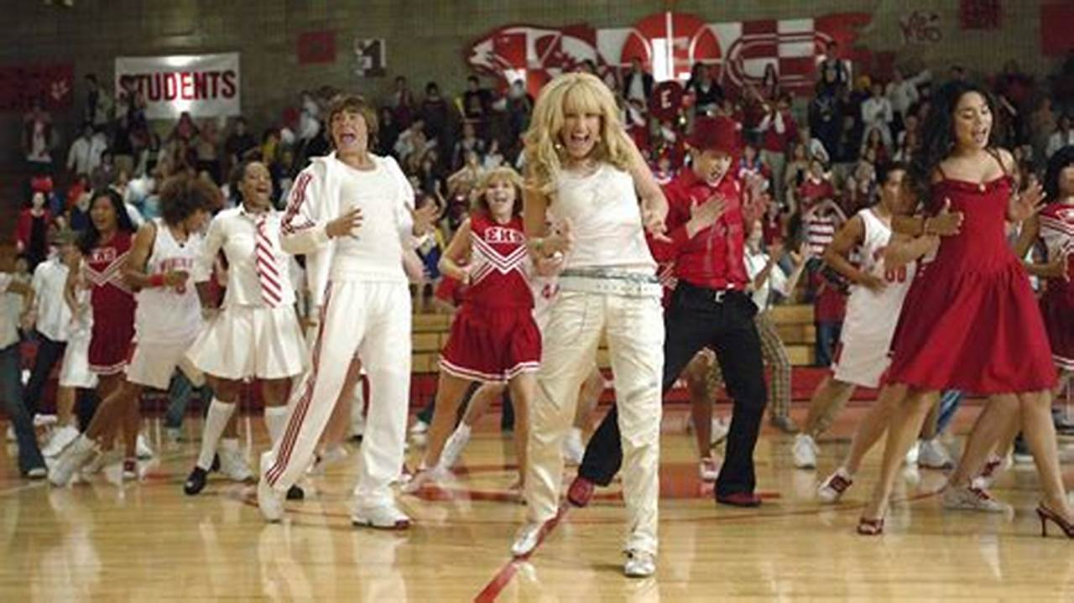
Together together together everyone

Slide 26
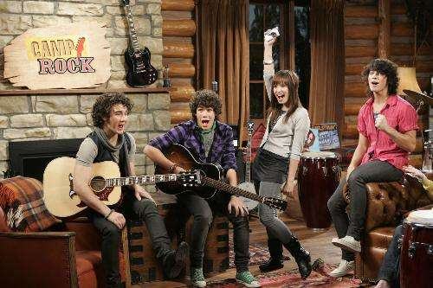
Together together come on let’s have some fun

Slide 27
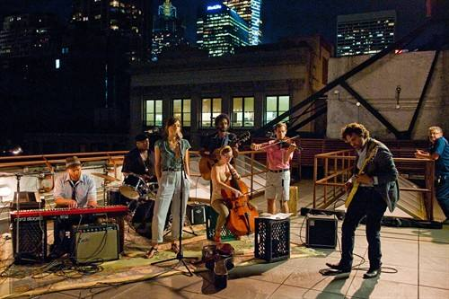
Together were there for each other every time

Slide 28
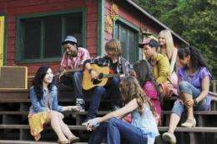
Together together come on let’s do this right

Slide 29
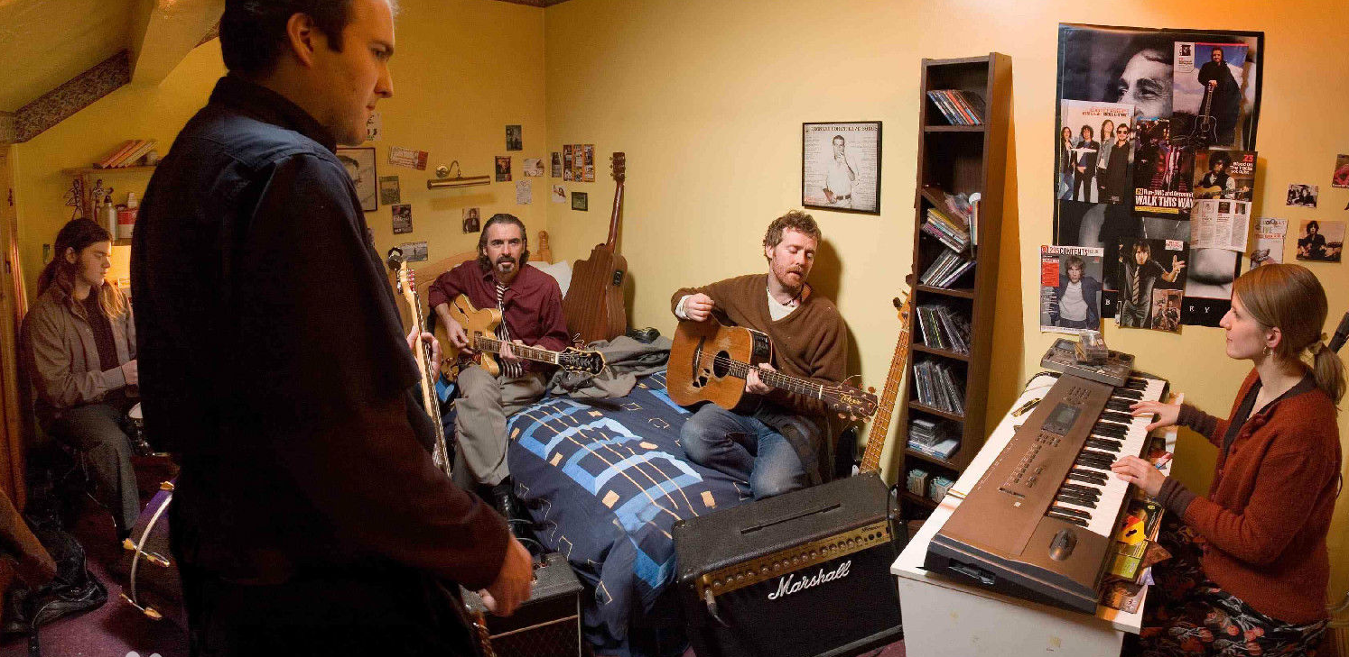
We're all here

Slide 30
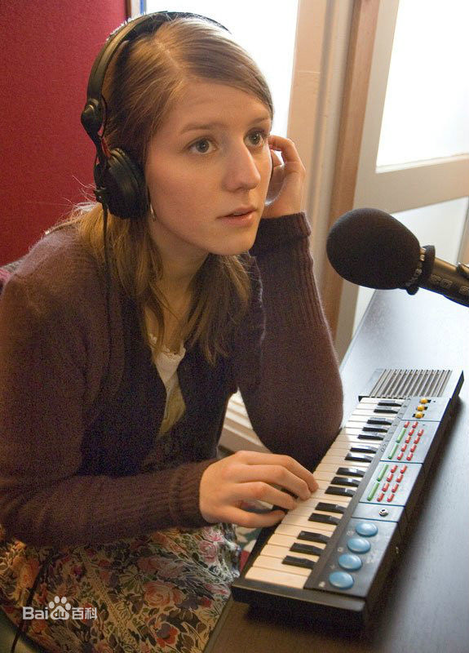
And speaking out with one voice

Slide 31
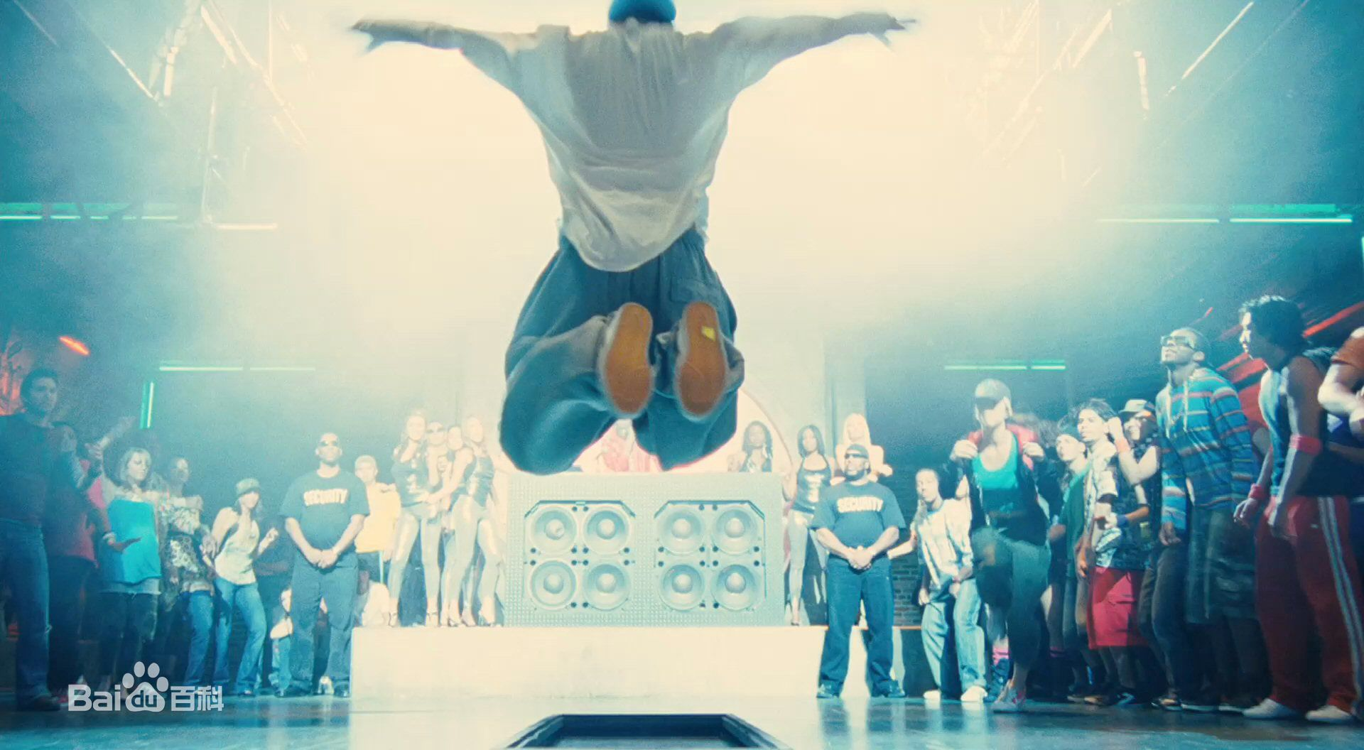
We're going to rock the house (rock the house)

Slide 32
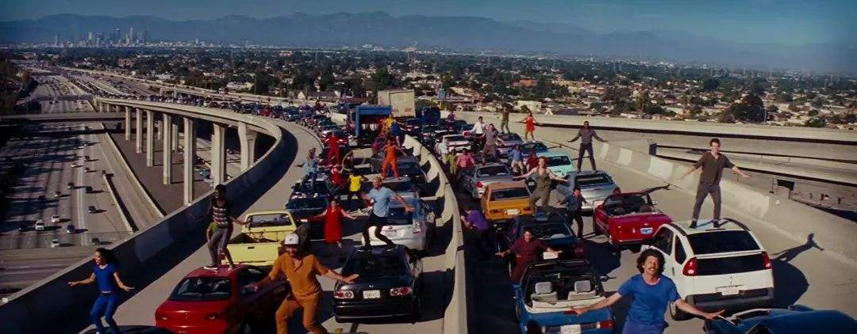
The party's on now everybody make some noise

Slide 33
Come on scream and shout

Slide 34
We've arrived because we stuck together

Slide 35
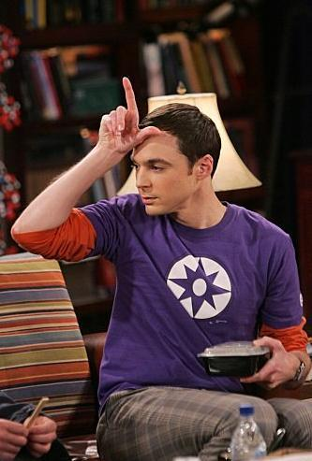
Champions one and all

Slide 36
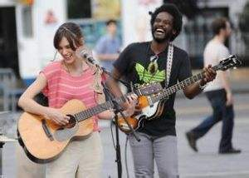
We're all in this together

Slide 37
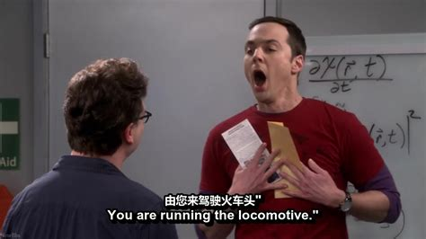
Once we know

Slide 38
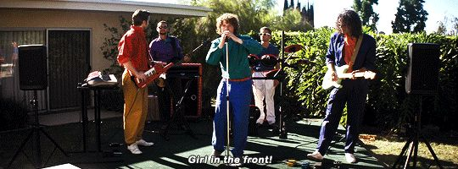
That we are

Slide 39
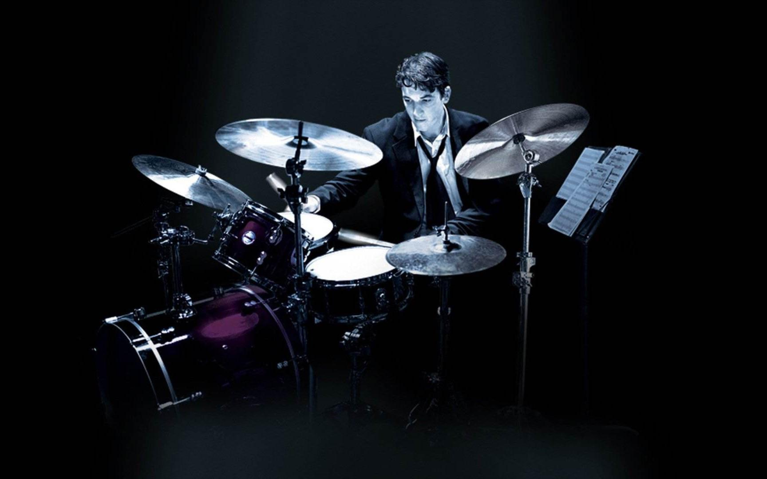
We're all stars

Slide 40
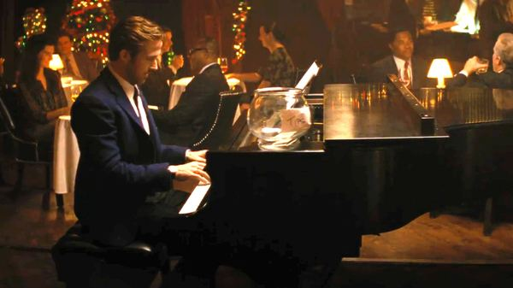
And we see that

Slide 41
We're all in this together

Slide 42
And it shows

Slide 43
When we stand

Slide 44
Hand in hand

Slide 45
Make our dreams come

Slide 46
We're all in this together

Slide 47
When we reach

Slide 48
We can fly

Slide 49
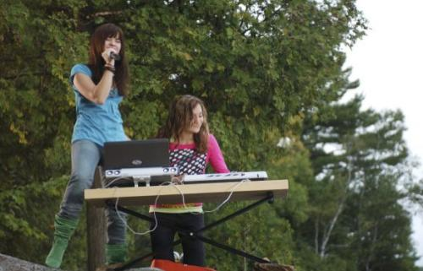
Know inside

Slide 50
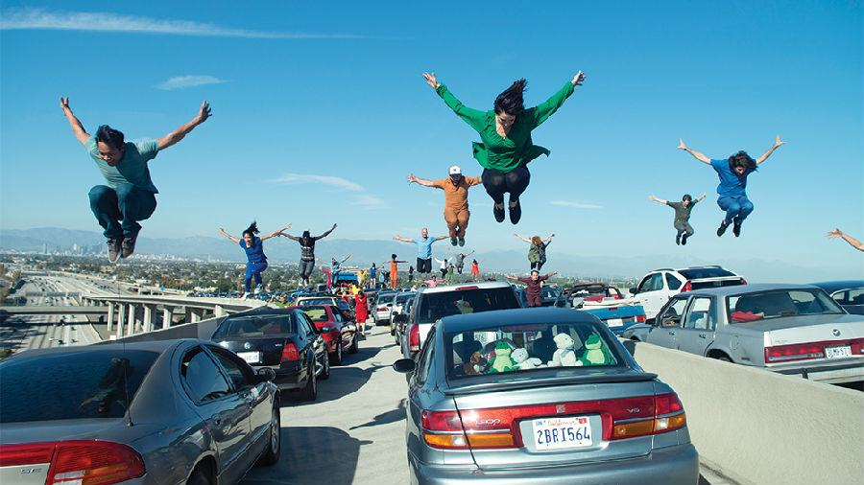
We can make it

Slide 51
We're all in this together

Slide 52
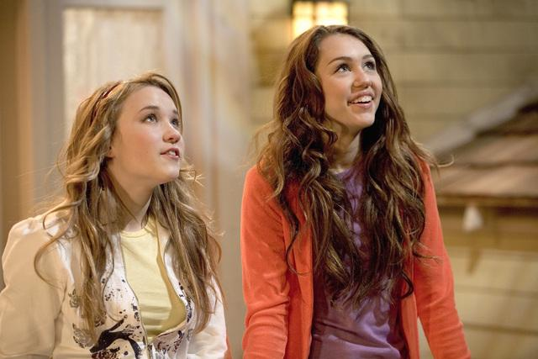
Once we see

Slide 53
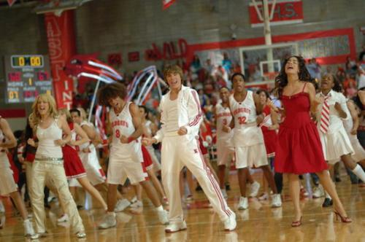
There’s a chance

Slide 54
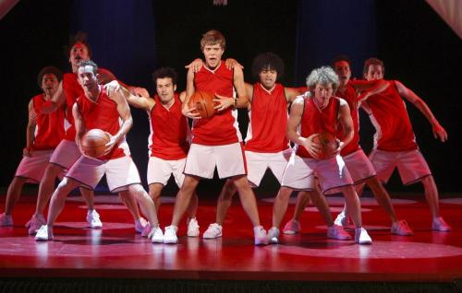
That we have

Slide 55
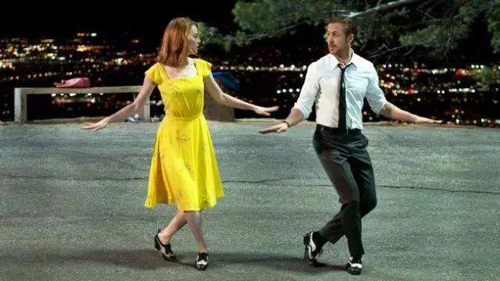
And we take it

Slide 56
Wild cats sing along

Slide 57
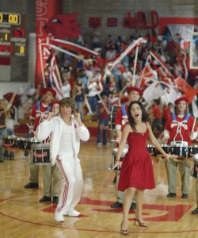
Yeah, you really got it going on

Slide 58
Wild cats in the house

Slide 59
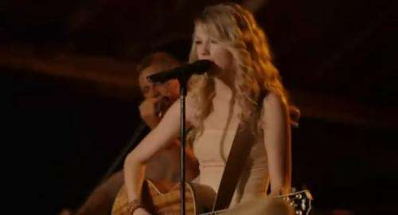
Everybody say it now

Slide 60
Wild cats everywhere

Slide 61
Wave your hands up in the air

Slide 62
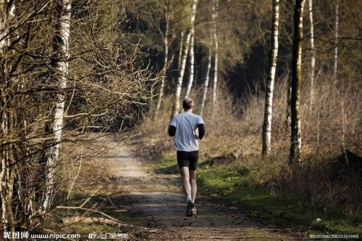
That's the way we do it

Slide 63
Let’s get to it

Slide 64
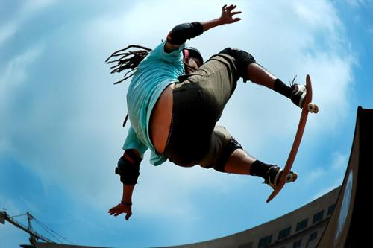
Time to show the world

Slide 66
We're all in this together

Slide 67
Once we know

Slide 68
That we are

Slide 69
We're all stars

Slide 70
And we see that

Slide 71
We're all in this together

Slide 72
And it shows

Slide 73
When we stand

Slide 74
Hand in hand

Slide 75
Make our dreams come

Slide 76
We're all in this together

Slide 77
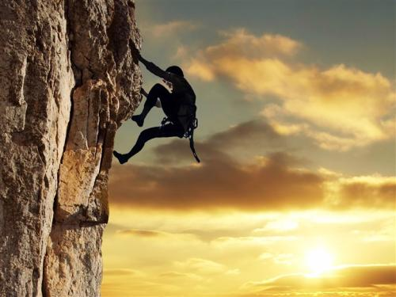
When we reach

Slide 78
We can fly

Slide 79
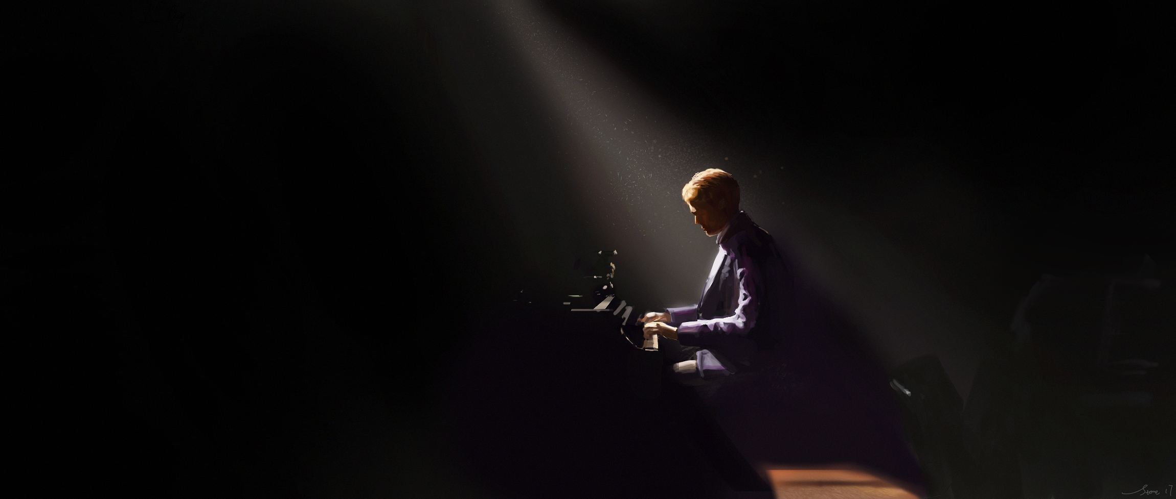
Know inside

Slide 80
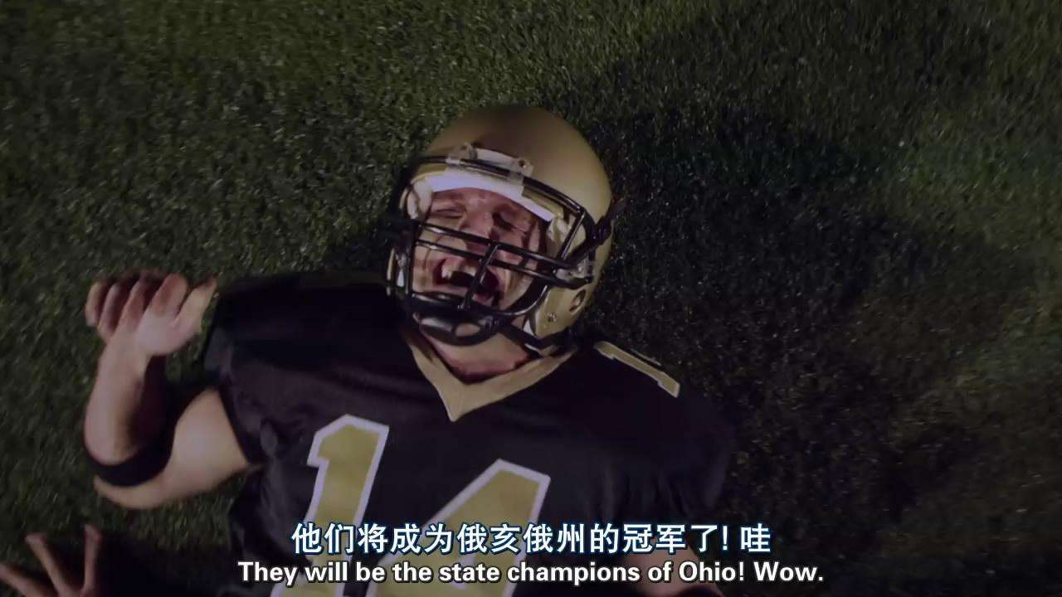
We can make it

Slide 81
We're all in this together

Slide 82
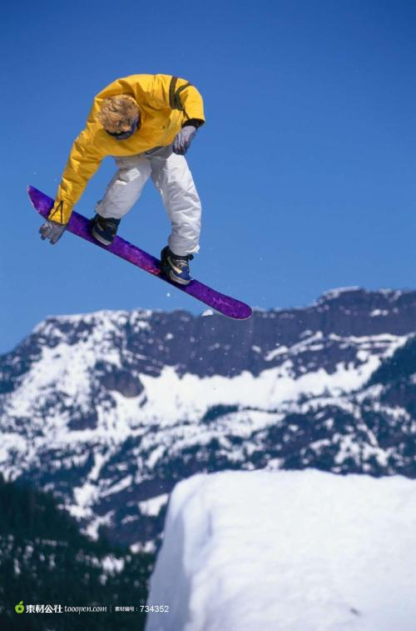
Once we see

Slide 83
There’s a chance

Slide 84
That we have

Slide 85
And we take it

Slide 86
Wild cats everywhere

Slide 87
Wave your hands up in the air

Slide 88
That's the way we do it

Slide 89
Let's get to it

Slide 90
Come on everyone!

