Slide 1
作者：高奕华
主题：学校信息
单位：华南师范大学外文学院

Slide 2

Black Box Recorder

Slide 3

This is the school song.
This is the school song.
This is the school song.
This is the school song.

Slide 4

Welcome to the school of song.
We'll help you
achieve perfection.
Destroy your record collection.
It's for your own protections.

Slide 5
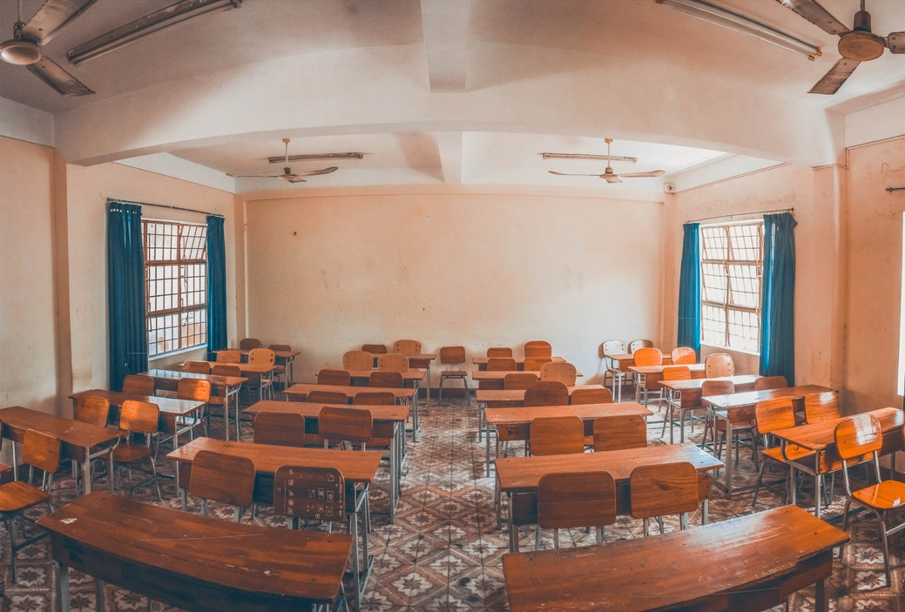
You're late again…
thank you so much for gracing
us with your presence..
no really, do sit down-

Slide 6


And what on earth is that you're wearing
This is an educational establishment not a night club

Slide 7


Put your hand up.
Don't mumble,
DON'T interrupt.

Slide 8

Wipe that idiotic smile off your face
When you're here you do what I say

Slide 9
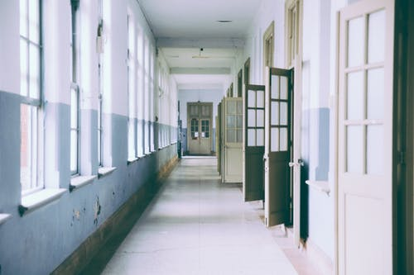
Walk in the corridors,
I said walk don't run

Slide 10


Double detention in the school of song

Slide 11

This is the school song.
This is the school song.
This is the school song.
……

Slide 12
The End
感谢您的耐心观看

