Slide 1
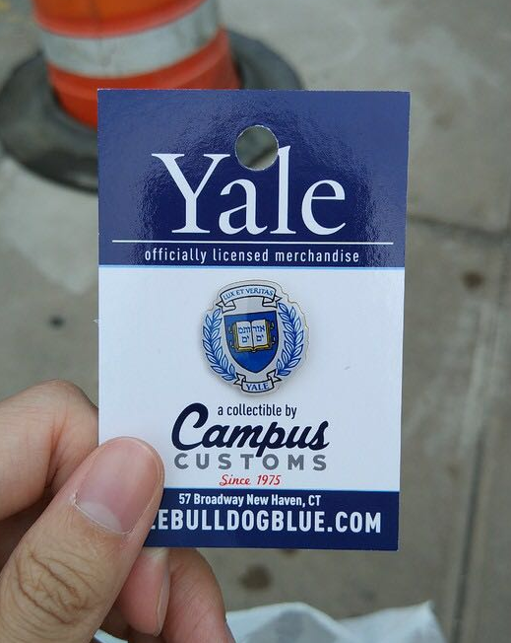
Why I Choose Yale?
北师大版初中英语 B7U2 School Life
主题：学校信息
作者：潘绮君
单位：华南师范大学外文学院

Slide 2
It’s a place where you'll learn quintessential knowledge.

Slide 3
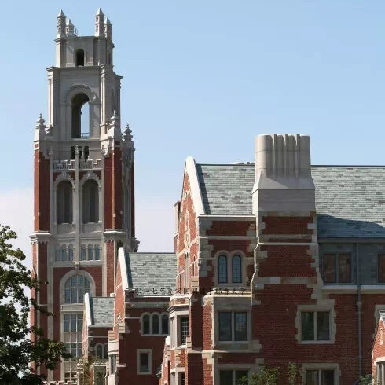
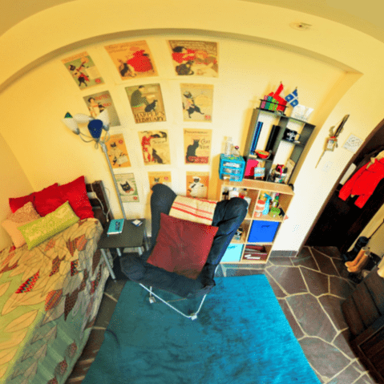
and you can live in a Residential College

Slide 4
and you can put your hearts into all the liberal arts.

Slide 5
And that's why I choose Yale.

Slide 6
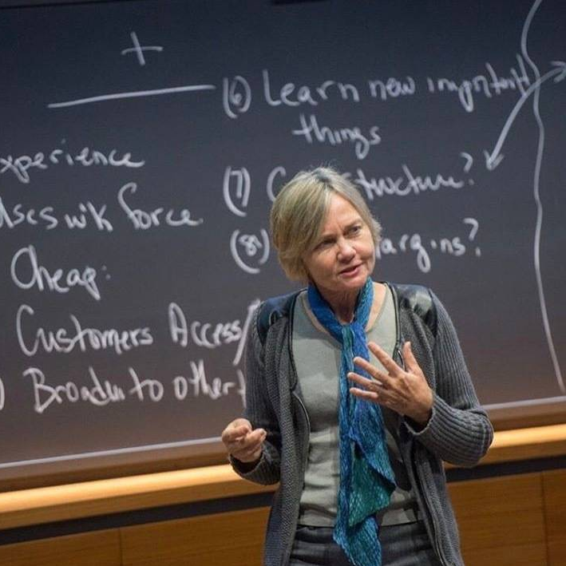
Of course, you'll get a first-rate education.

Slide 7
but also thrive on classmates’ conversation.

Slide 8
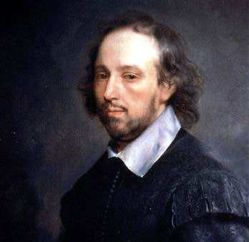
Here is where we thread
Shakespeare Studies and Pre-med.

Slide 9
and that's why I choose Yale.

Slide 10
Students here at Yale
come from everywhere around.

Slide 11
with every type of interest that can possibly be found.

Slide 12
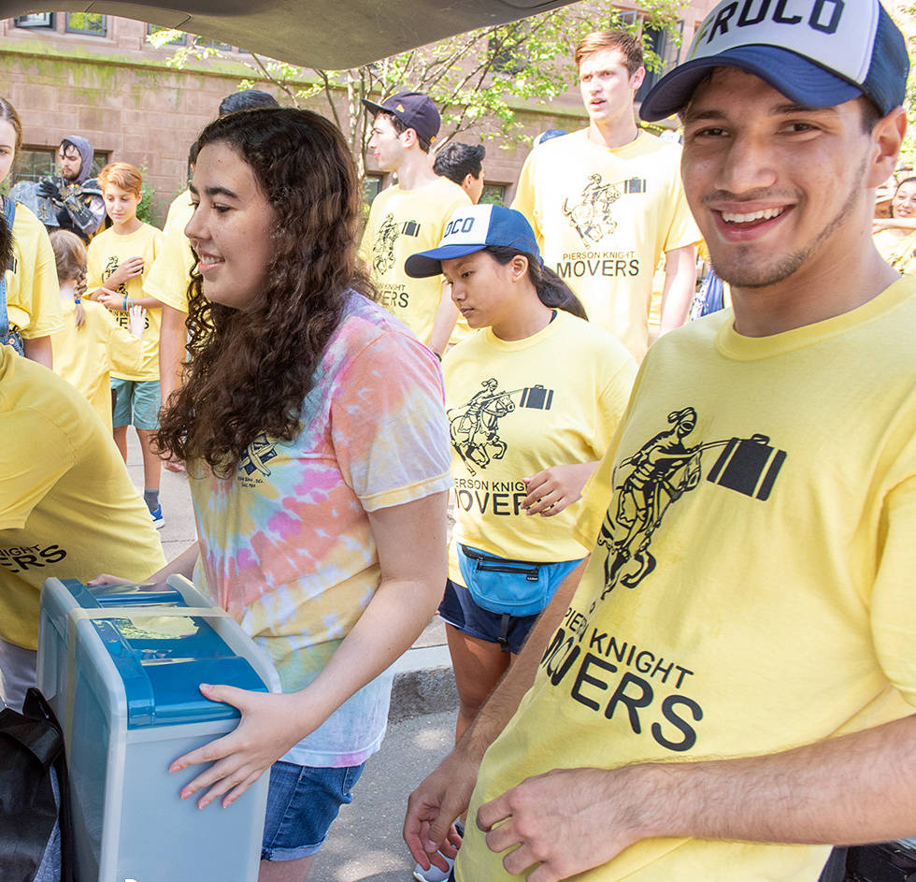
Do our passions divide us?

Slide 13
No, our colleges provide us
with family and common ground.

Slide 14
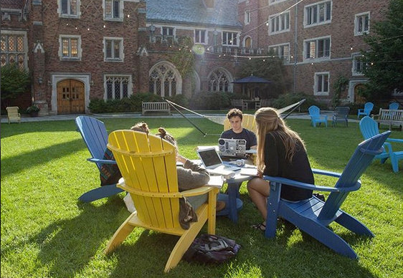
For all four years we'll all reside

Slide 15
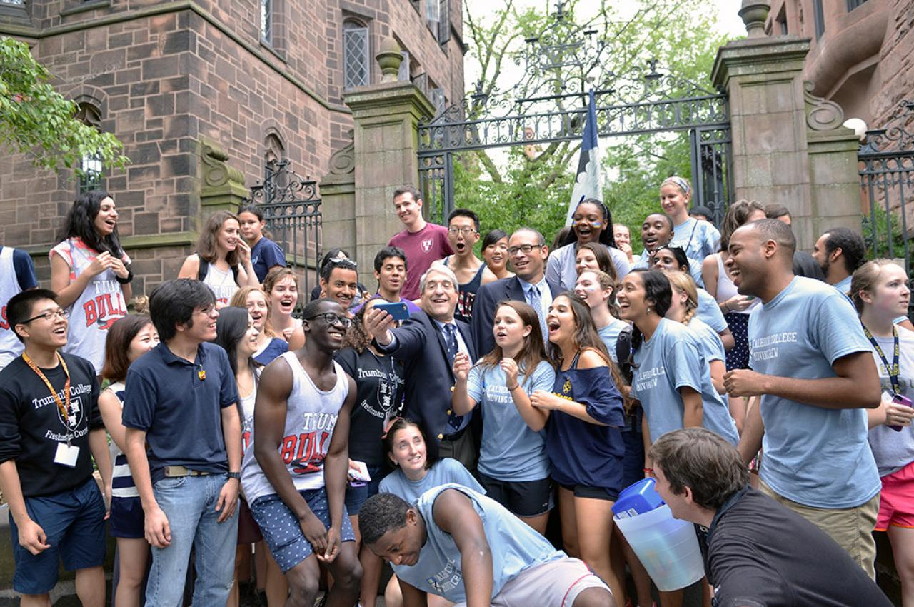
together in colleges united by pride.

Slide 16
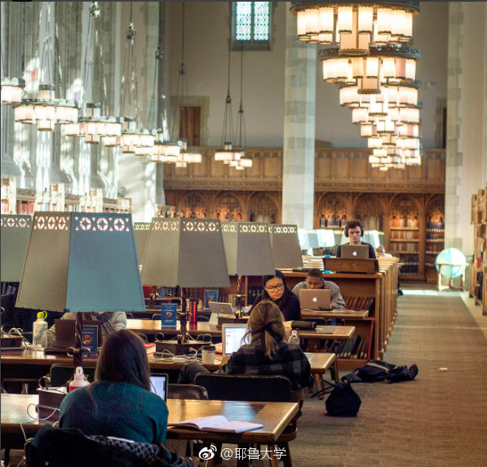
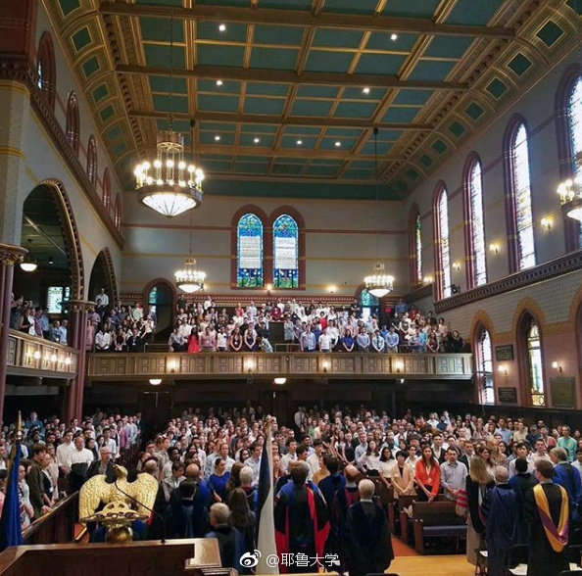
With such great facilities to hone your abilities

Slide 17
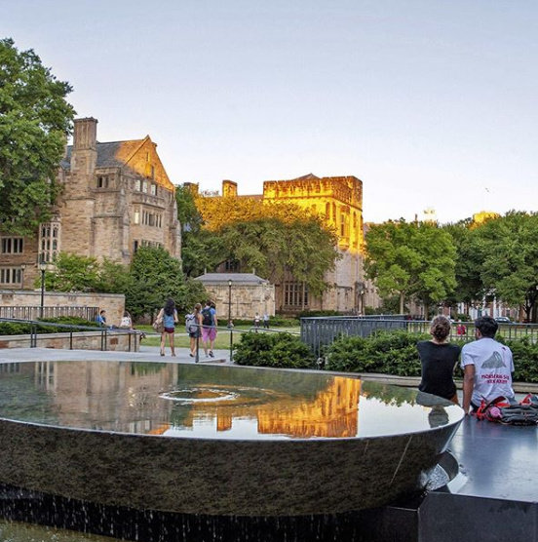
you'll never want to go outside.

Slide 18
Every college has a dining hall with a salad bar and grill.

Slide 19
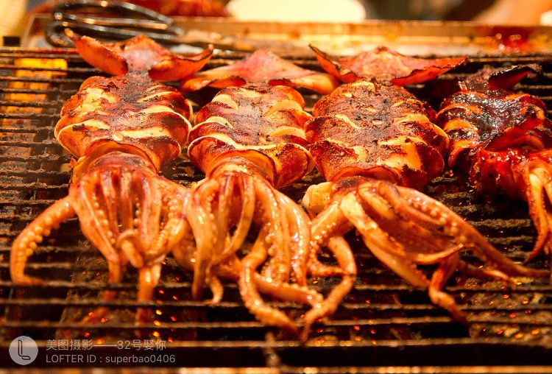
and organic options for every meal.

Slide 20
I'm going to eat my fill.

Slide 21
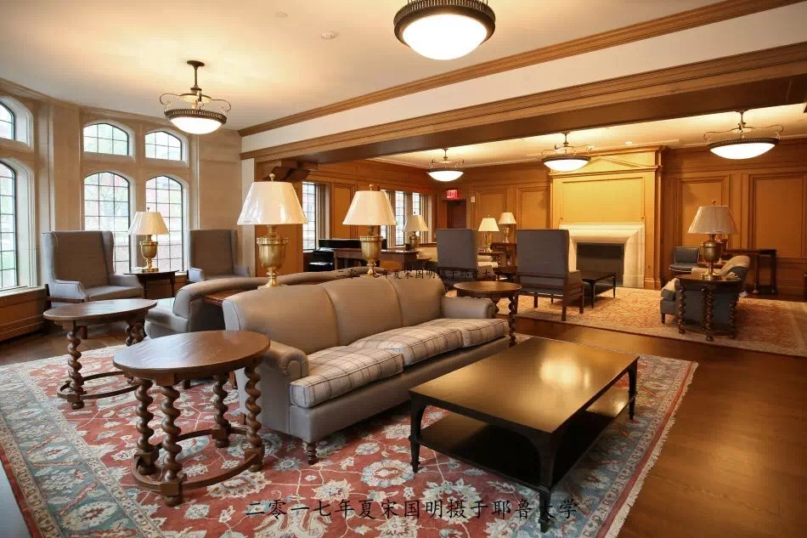
Each one has a common room, which we could not live without

Slide 22
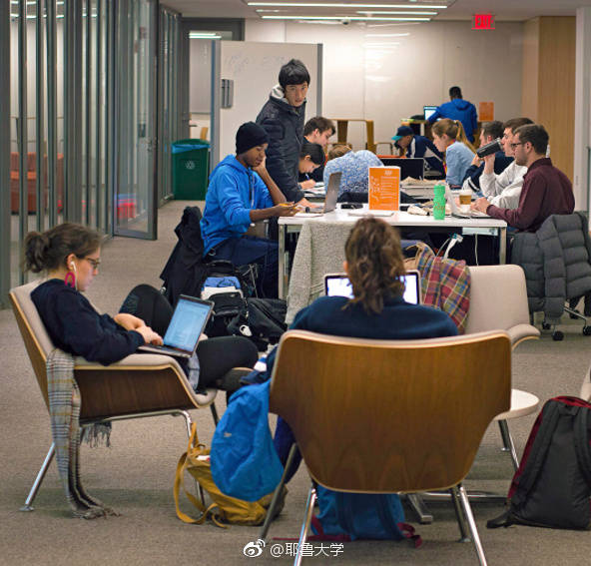
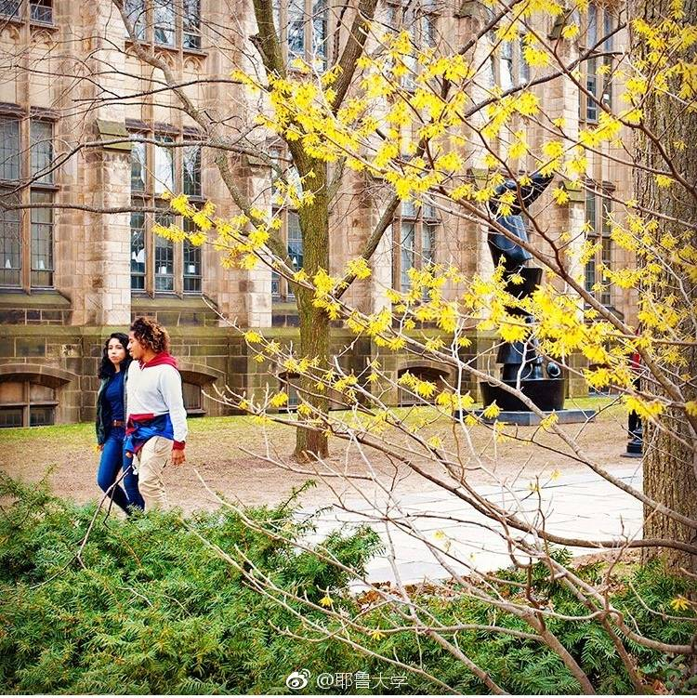
to study or to meet in groups or simply to hang out.

Slide 23
And when the dining halls are closed there's butteries for snacks.

Slide 24
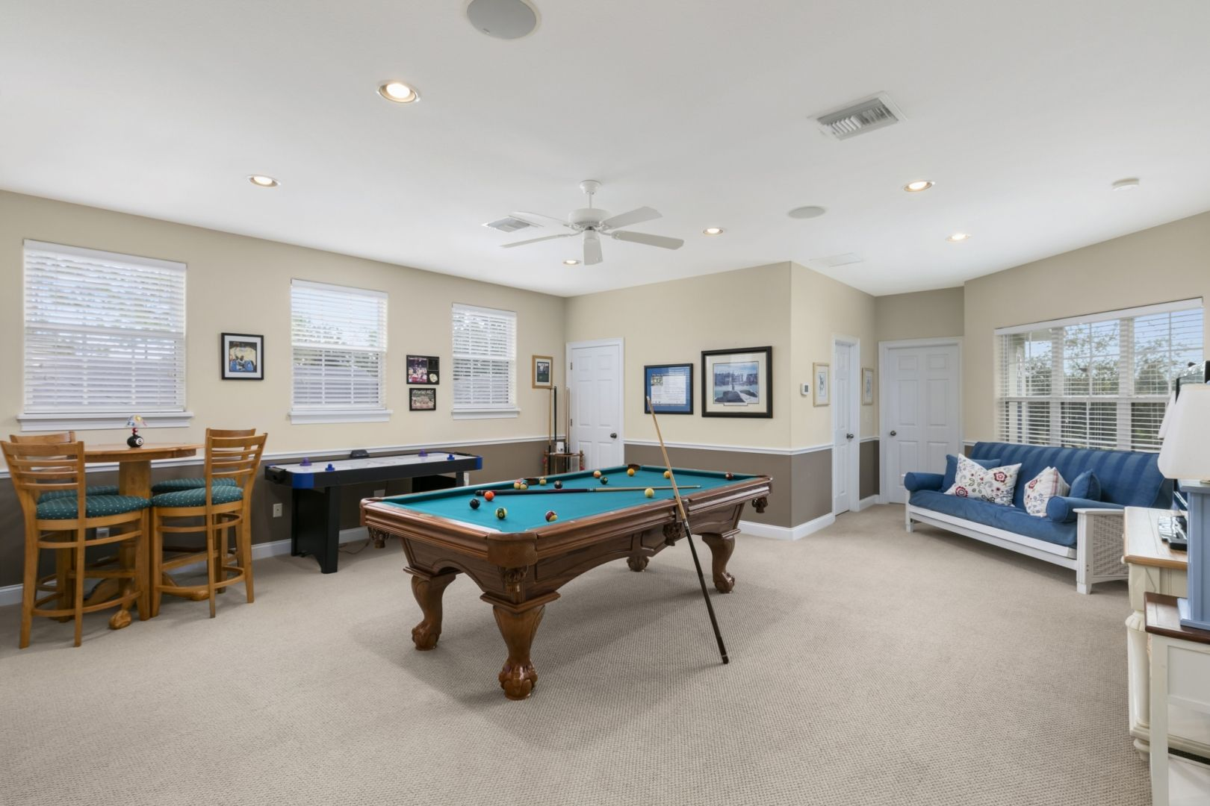
And if you need a study break there's game rooms to relax.

Slide 25
I can get to my college library without stepping foot outside.

Slide 26
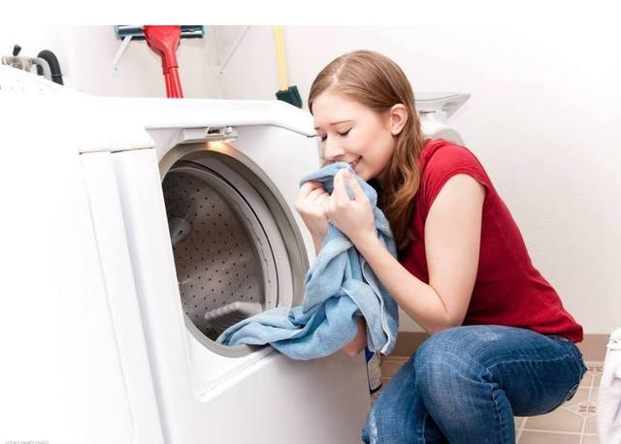
And just right down the hallway, my clothes are washed and dried.

Slide 27
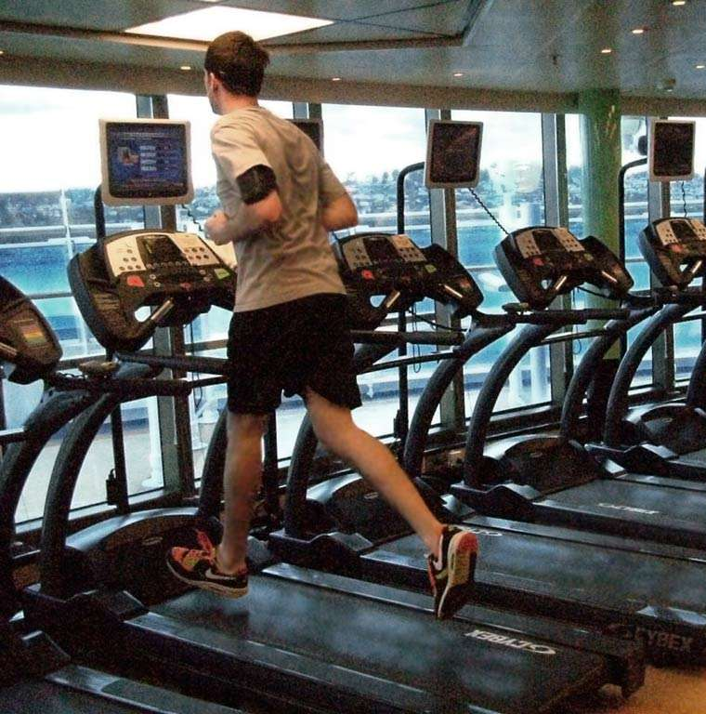
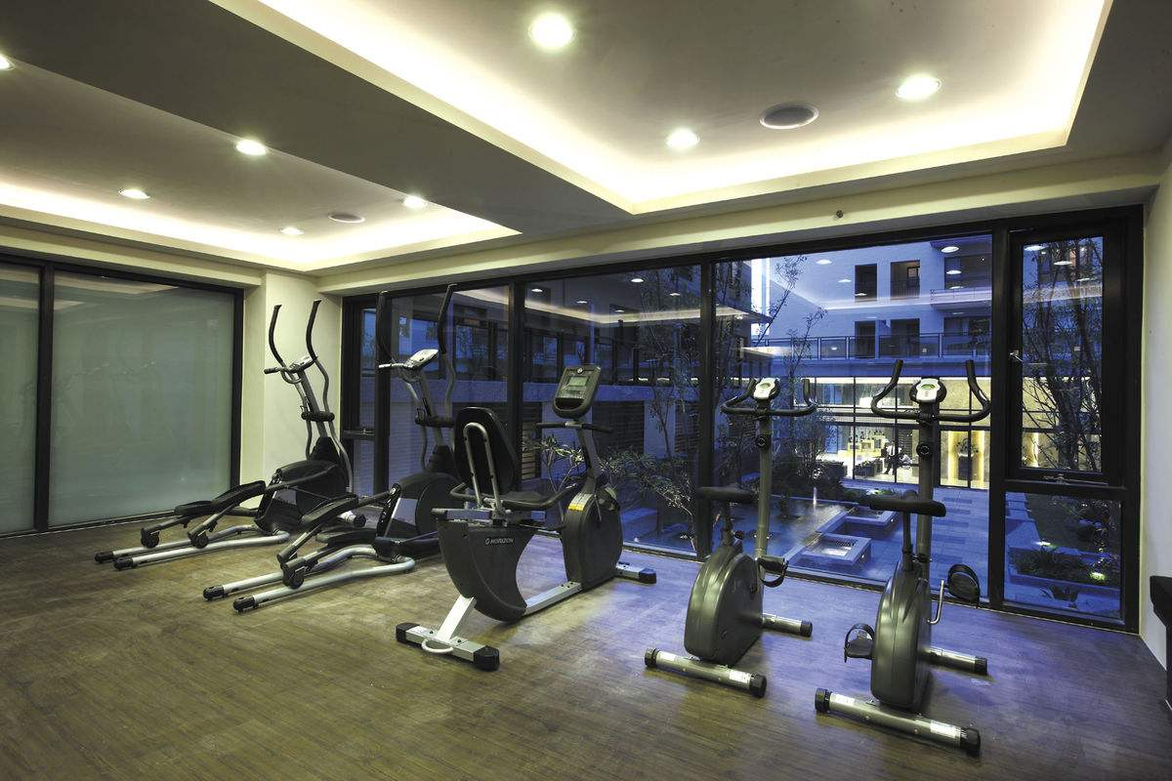
I work out in my college gym, a mere two floors below.

Slide 28
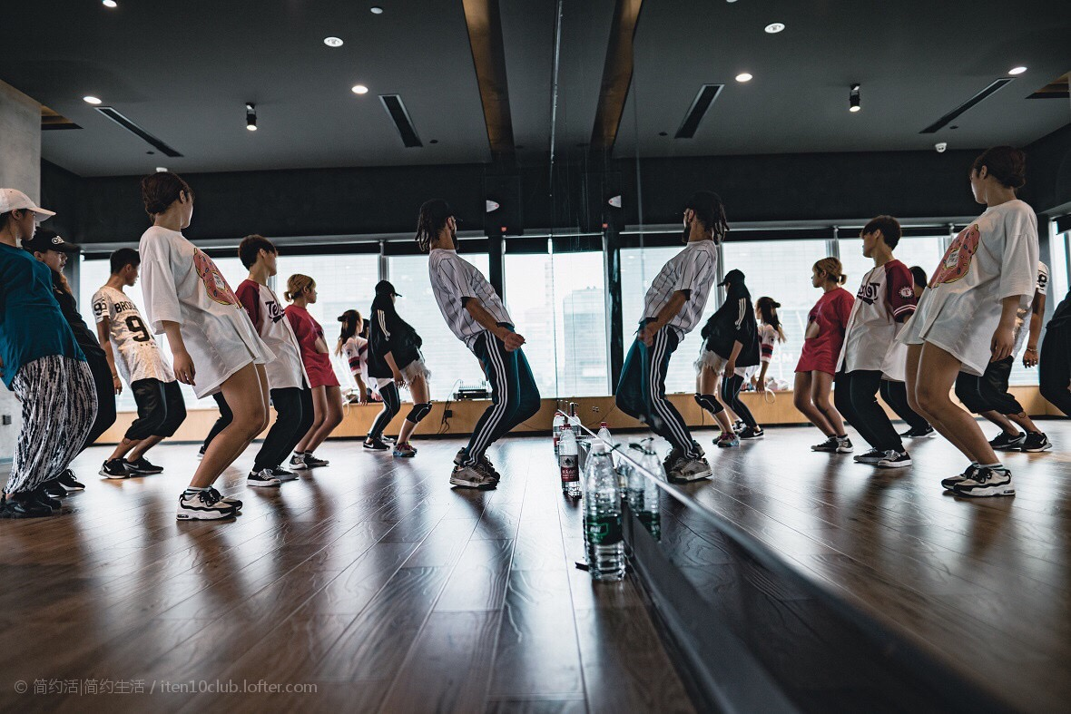
Then I meet my friends for rehearsal in the dance studio.

Slide 29
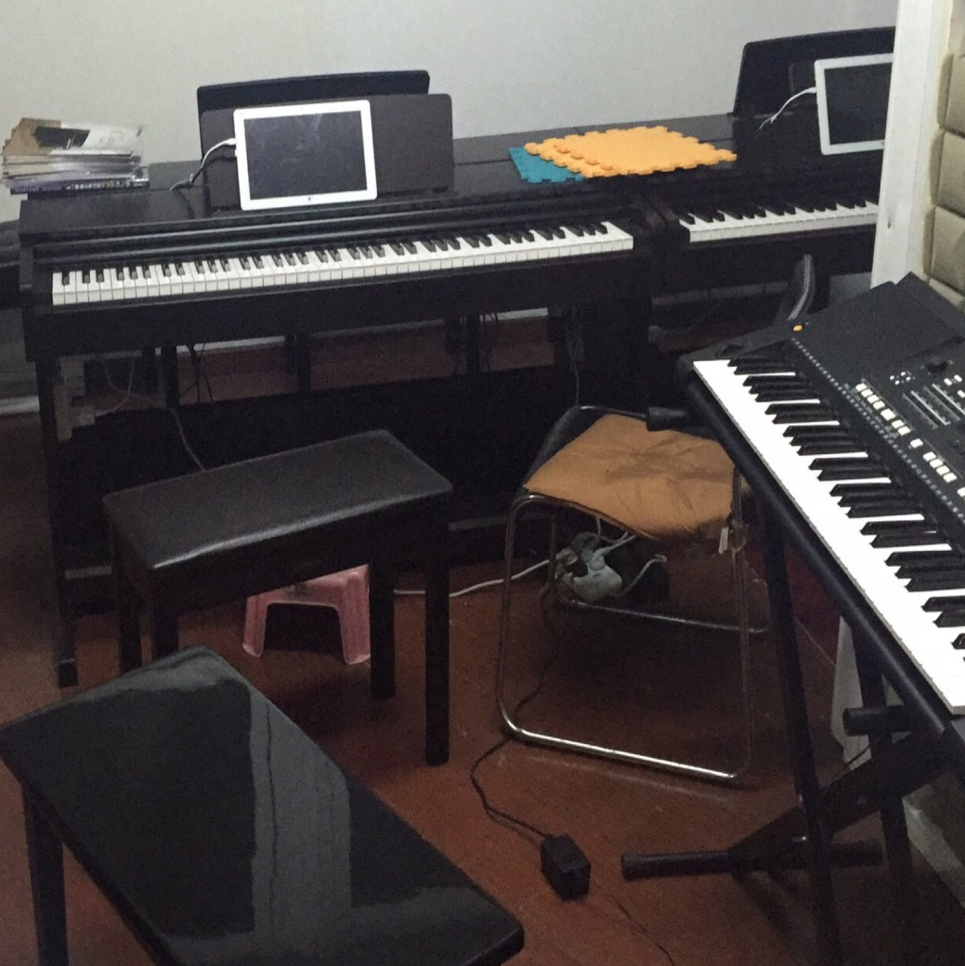
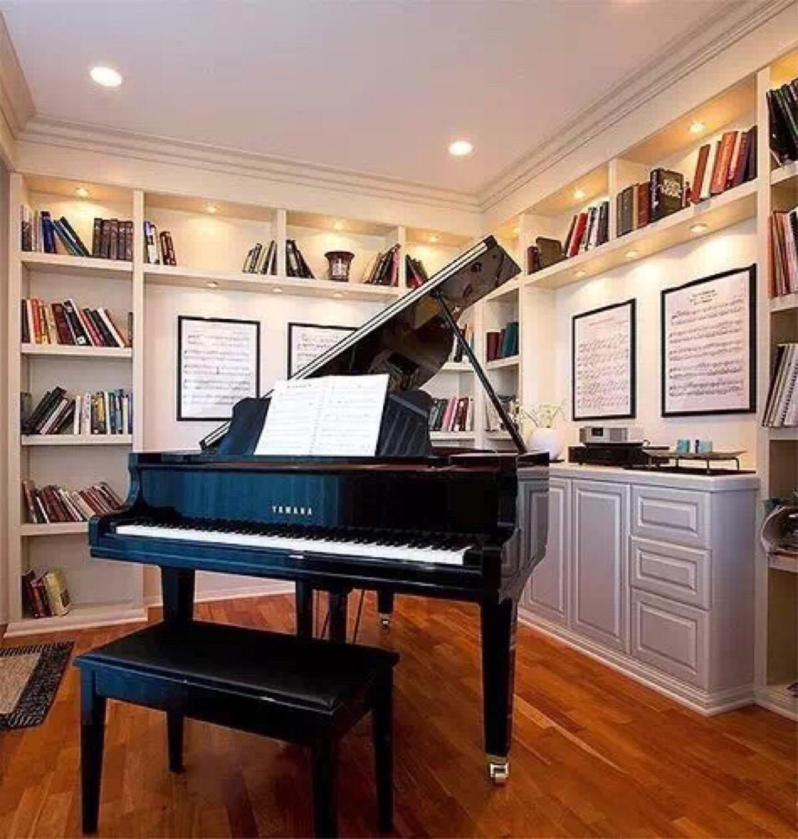
There are tons of music practice rooms where I can hone my skills.

Slide 30
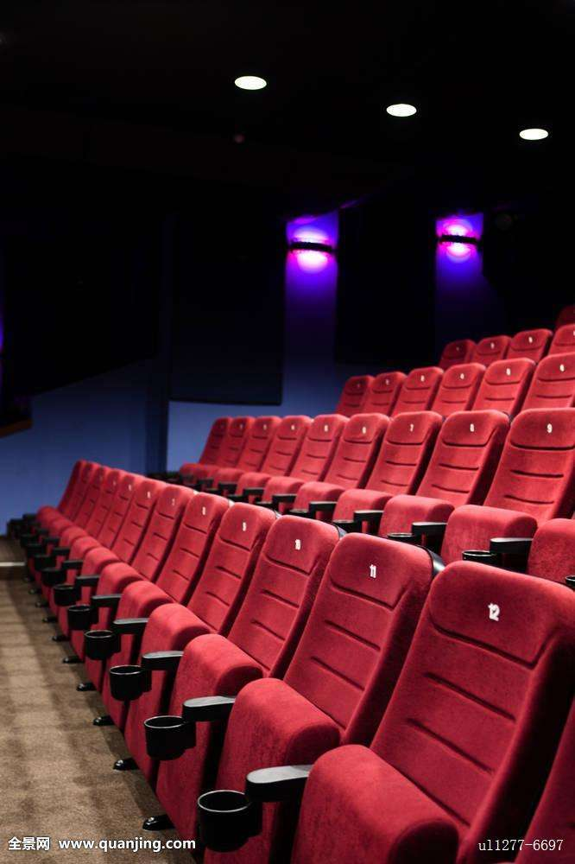
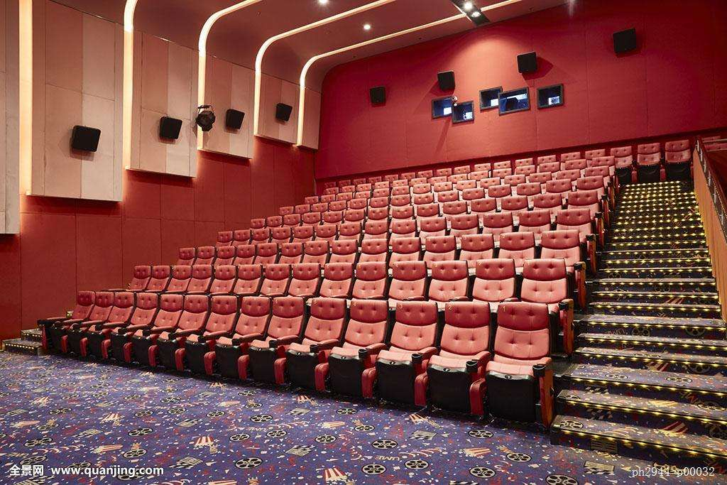
We even have a movie theater.

Slide 31
This one always gives me chills!

Slide 32
We don't have normal dorms at Yale.

Slide 33
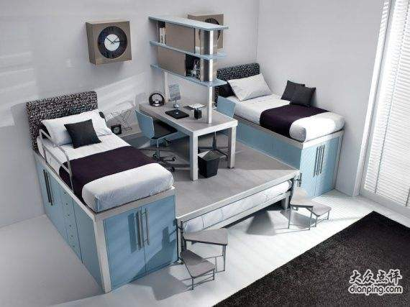
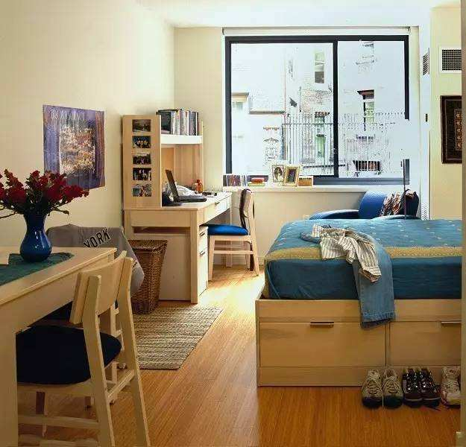
Instead, we live in suites.

Slide 34
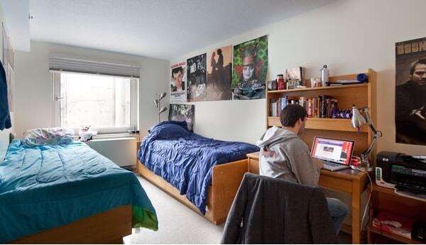
So you may have a roommate.

Slide 35
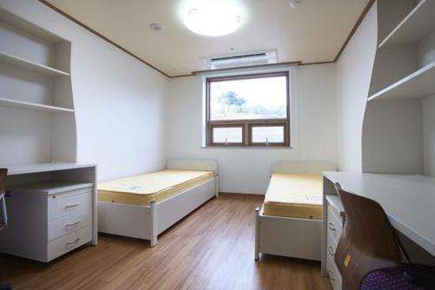
We have matching sheets!

Slide 36
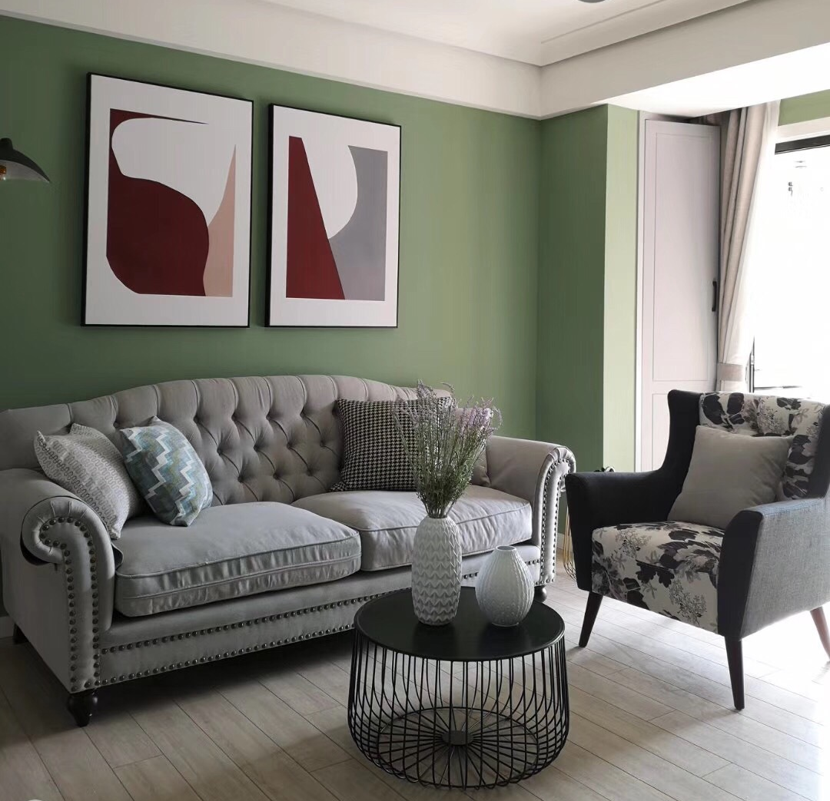
Outside there's a common room, so come and stay a while.

Slide 37
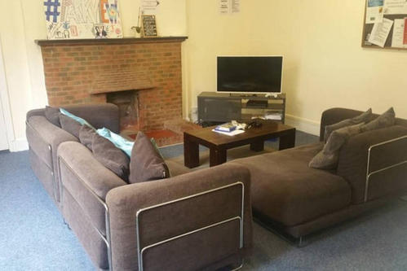
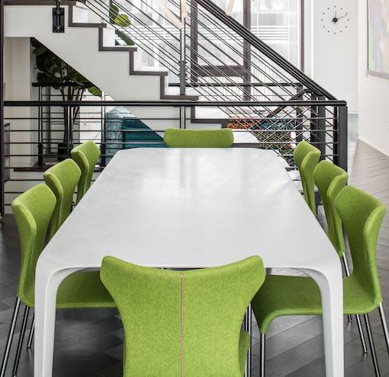
There's space for couches and TVs or a lava lamp if that's your style.

Slide 38
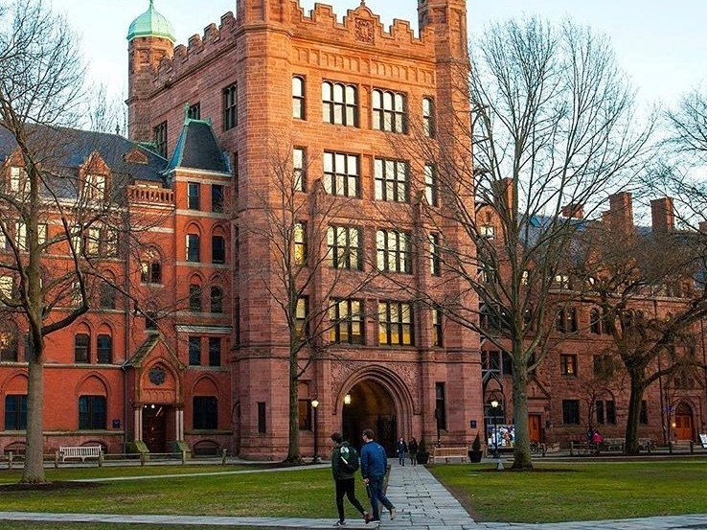
Residential Colleges, come give a cheer. Hey!

Slide 39
A place to call our home for all four years.

Slide 40
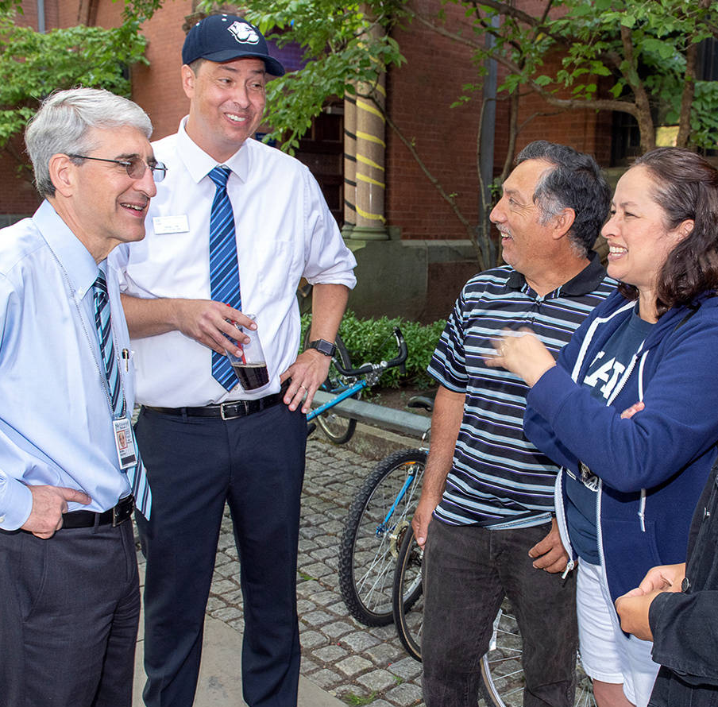
A sense of unity, immense community.

Slide 41
Our friendships will prevail.

Slide 42
That's why I choose YALE.

