Slide 1
Unit 5
作者：何丽容
单位：华南师范大学外文学院

Slide 2
Ode to my family
The Cranberries

Slide 3
Understand the things I say

Slide 4
Don't turn away from me

Slide 5
Cause I've spent half my life out there

Slide 6
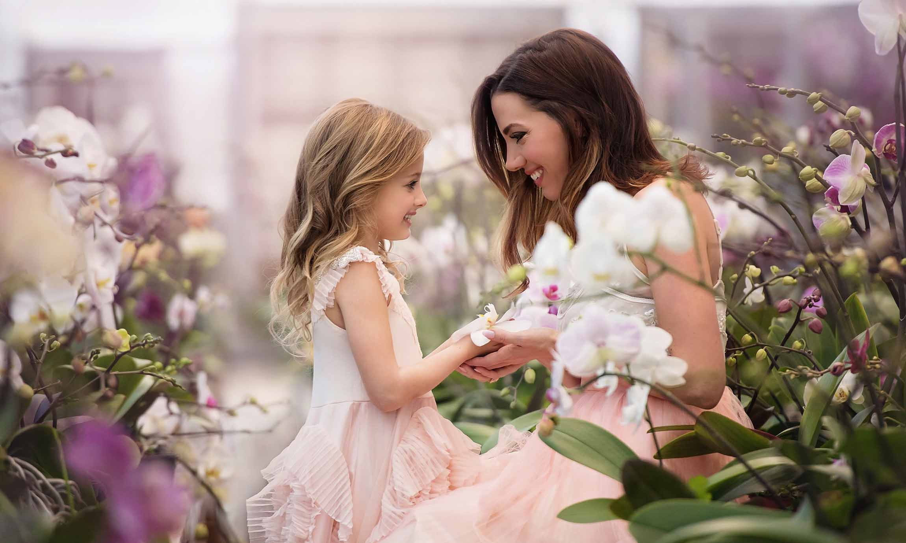
You wouldn't disagree

Slide 7
Do you see me
do you see

Slide 8
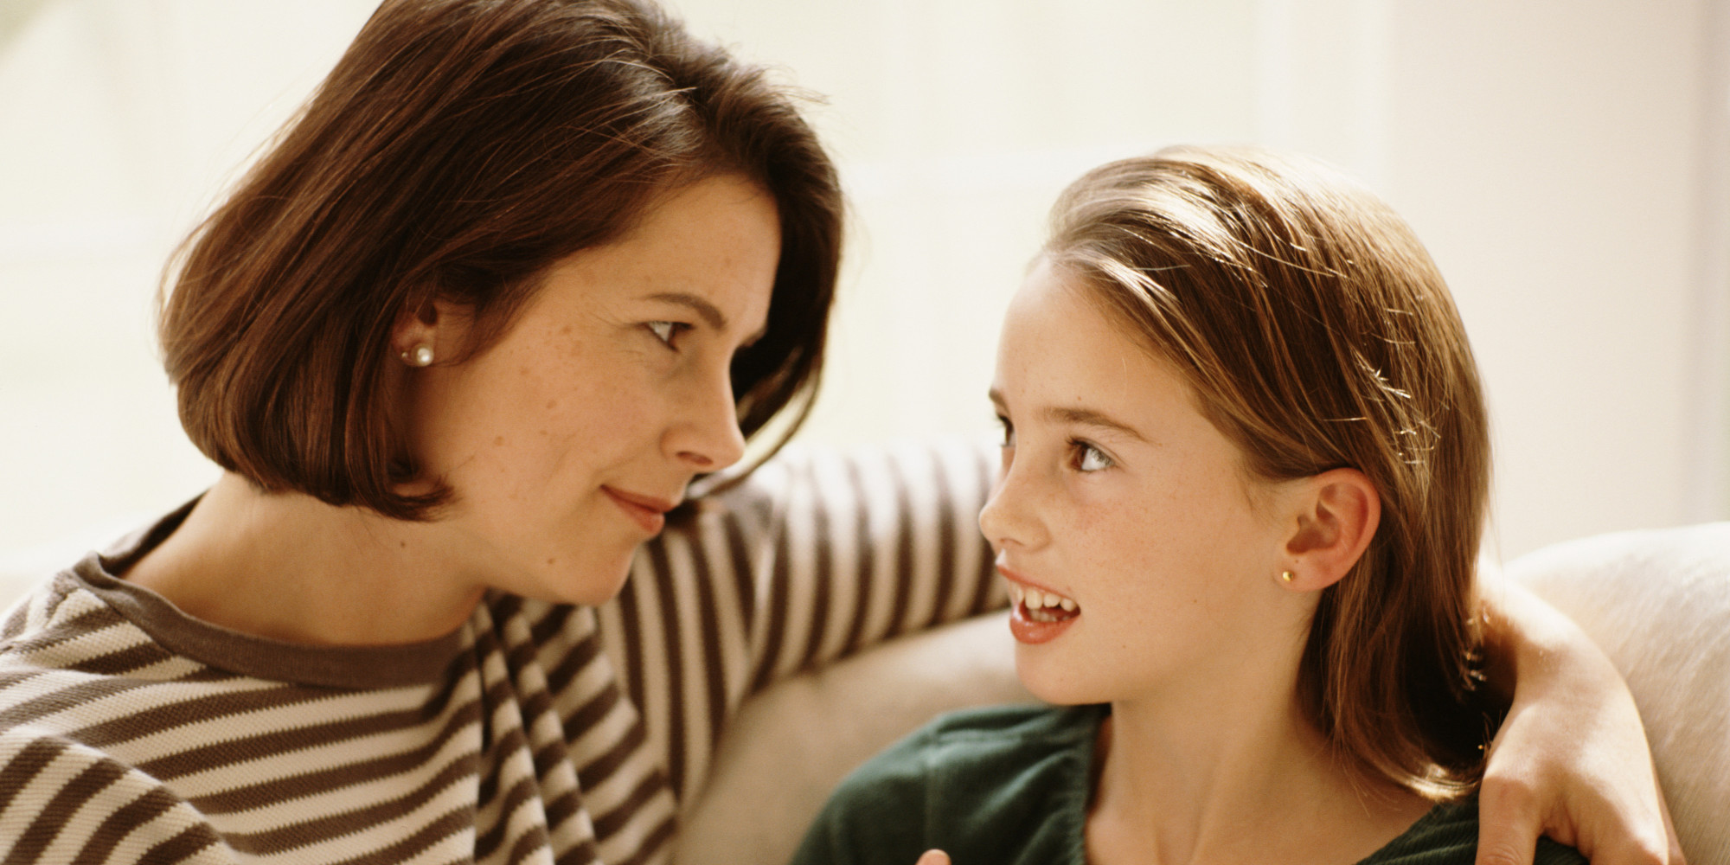
Do you like me standing there?
Do you like me

Slide 9
Do you notice
do you know

Slide 10
Do you see me
do you see me

Slide 11
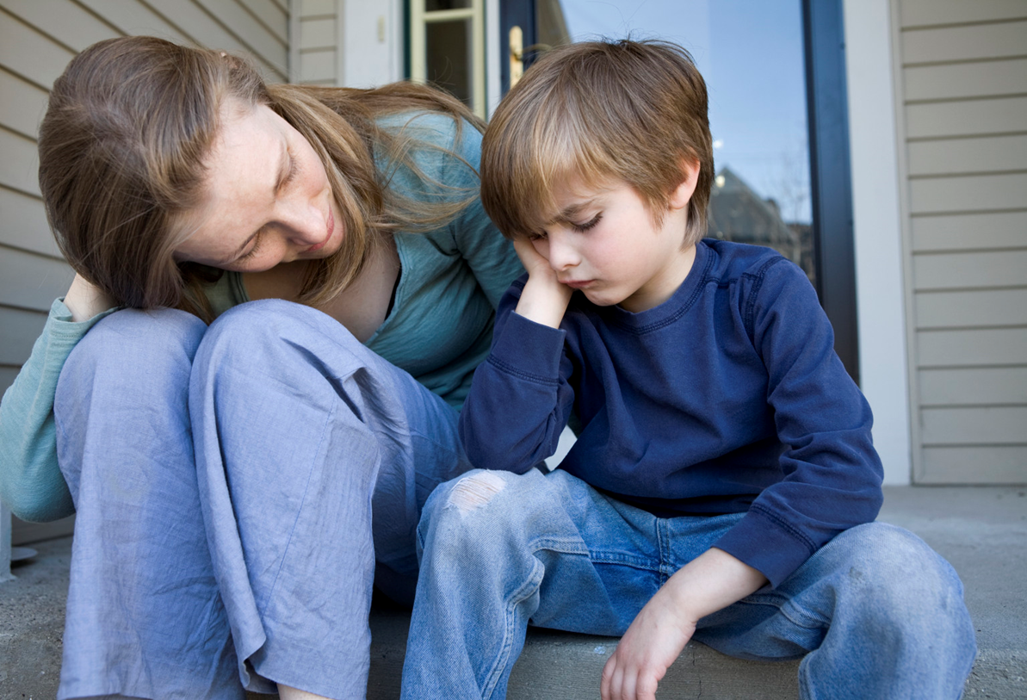
Does anyone care

Slide 12
Unhappiness where's when I was young

Slide 13
And we didn't give a damn

Slide 14
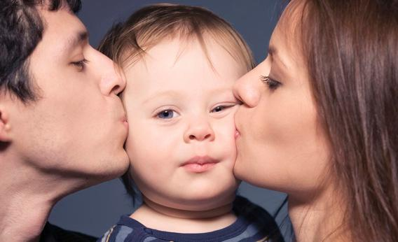
cause we were raised

Slide 15
To see life as fun and take it if we can

Slide 16
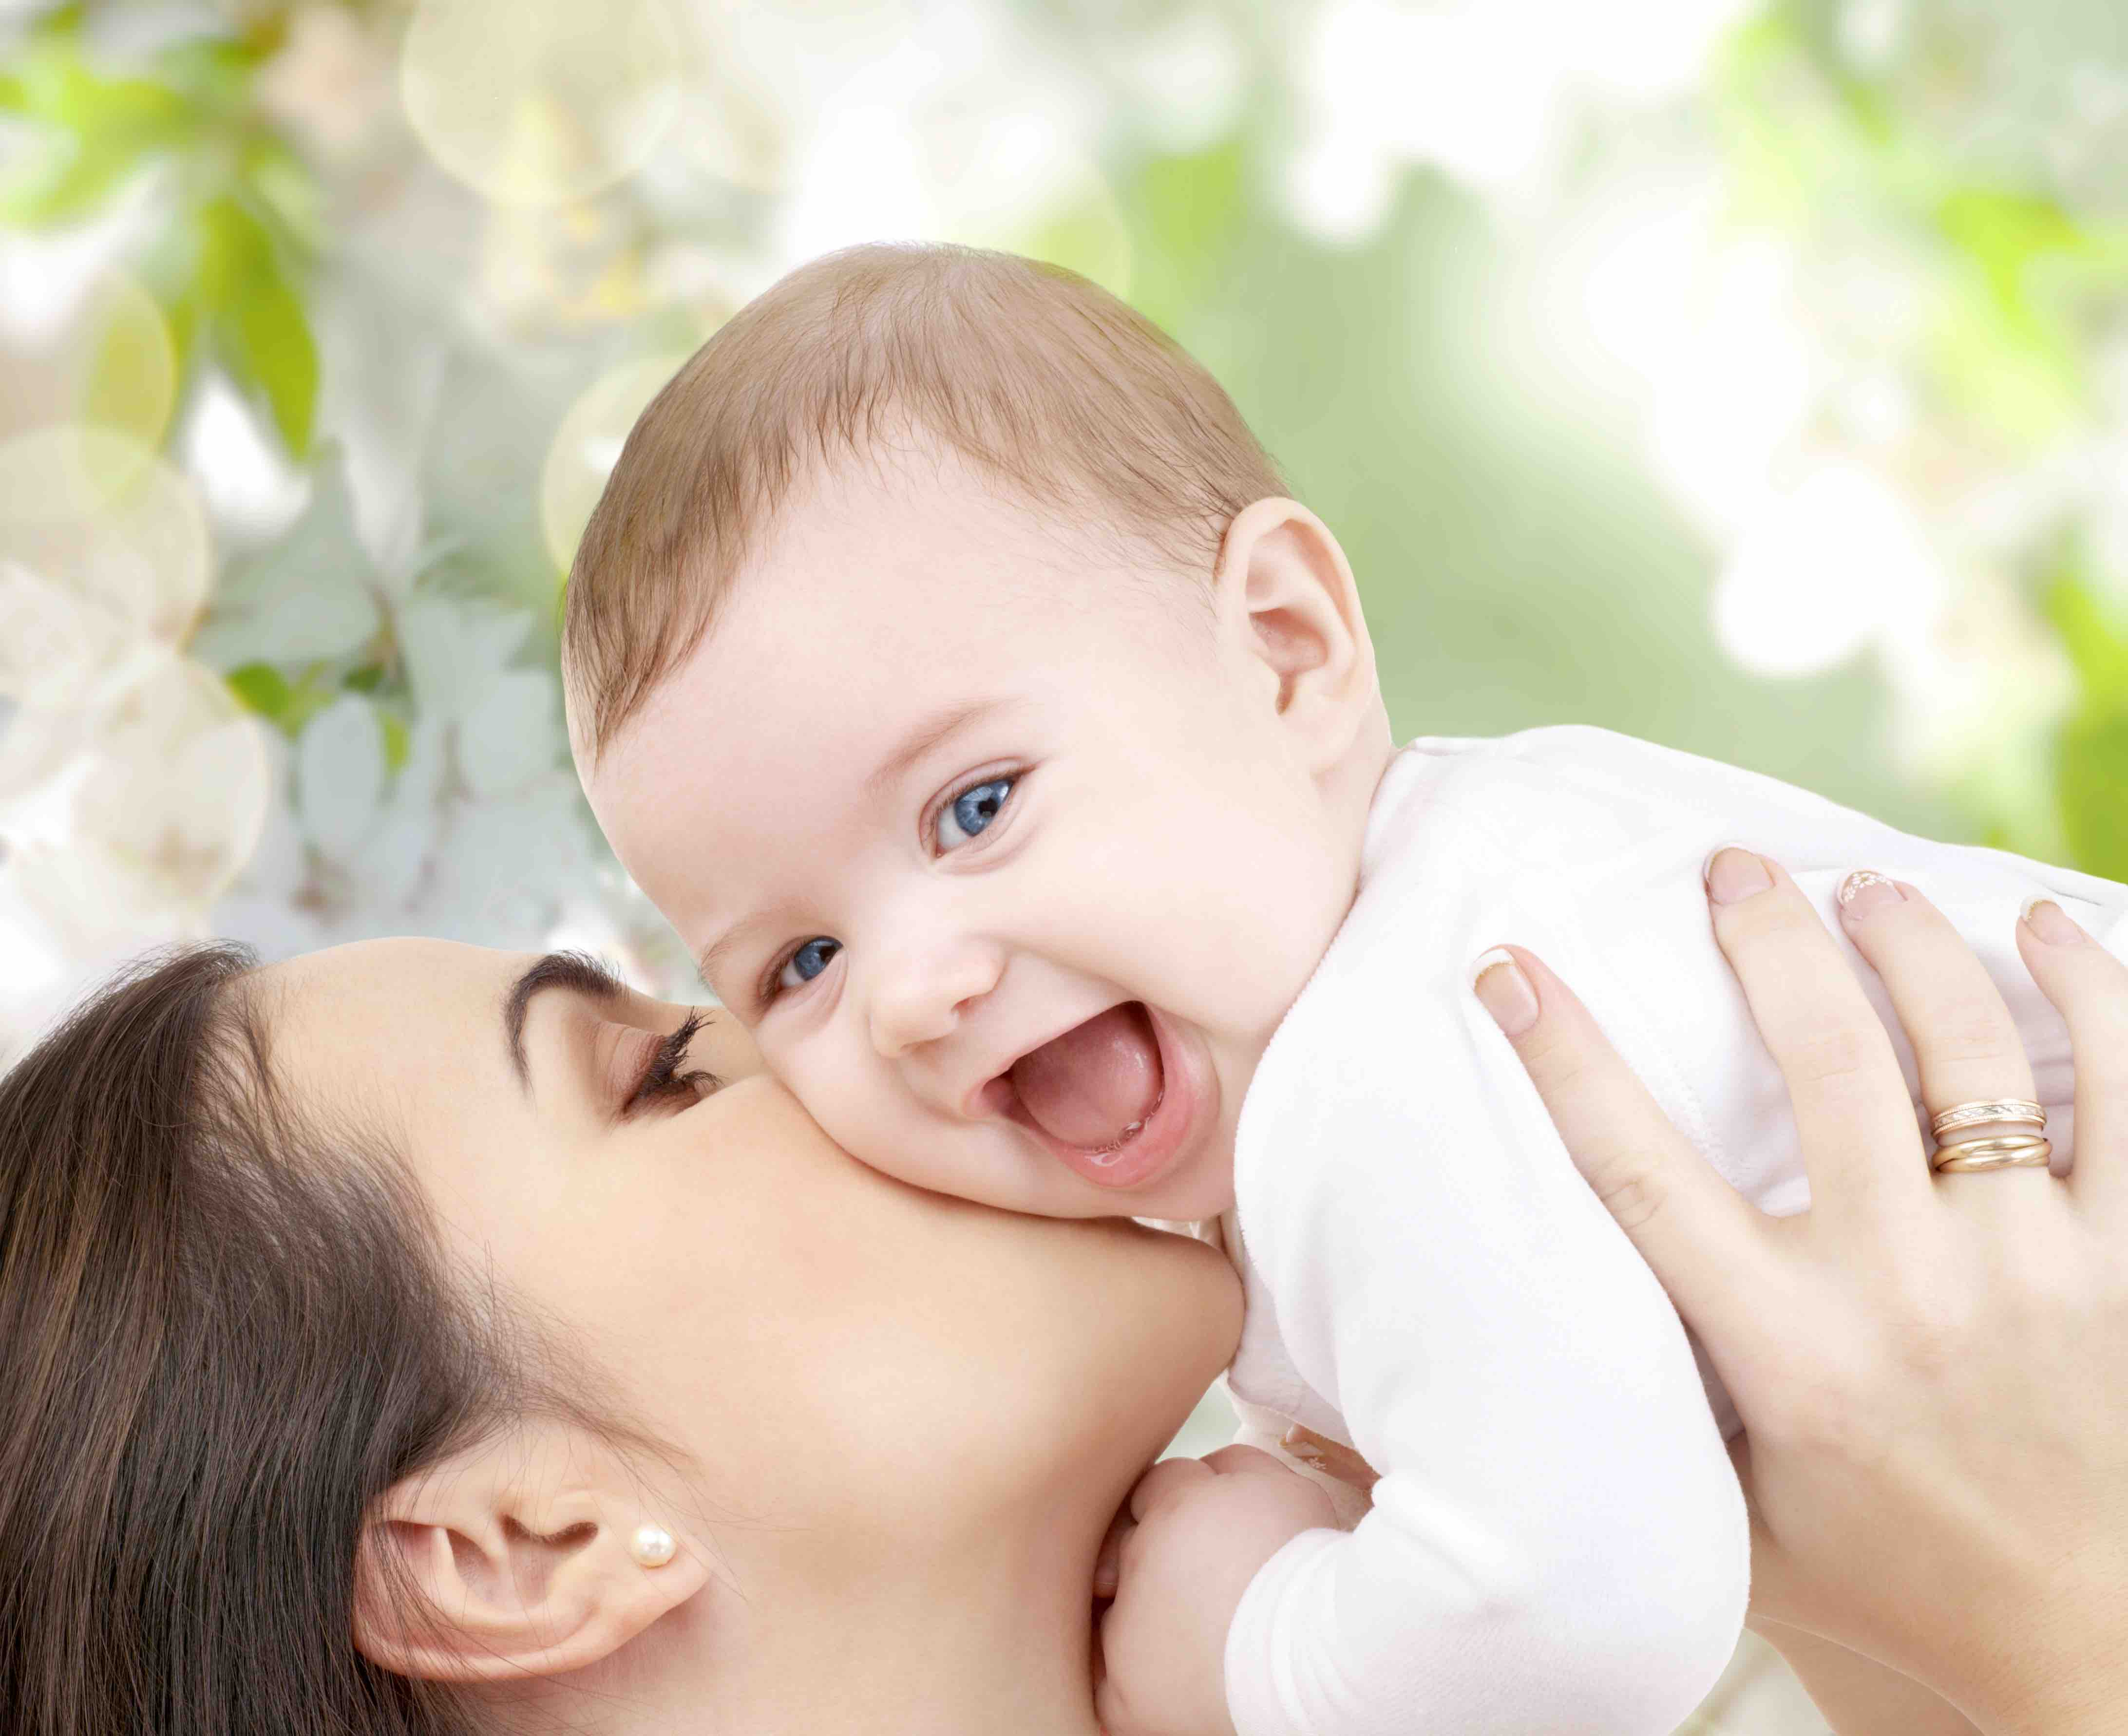
My mother
My mother
She'd hold me

Slide 17
She'd hold me when I was out there

Slide 18
My father
my father

Slide 19
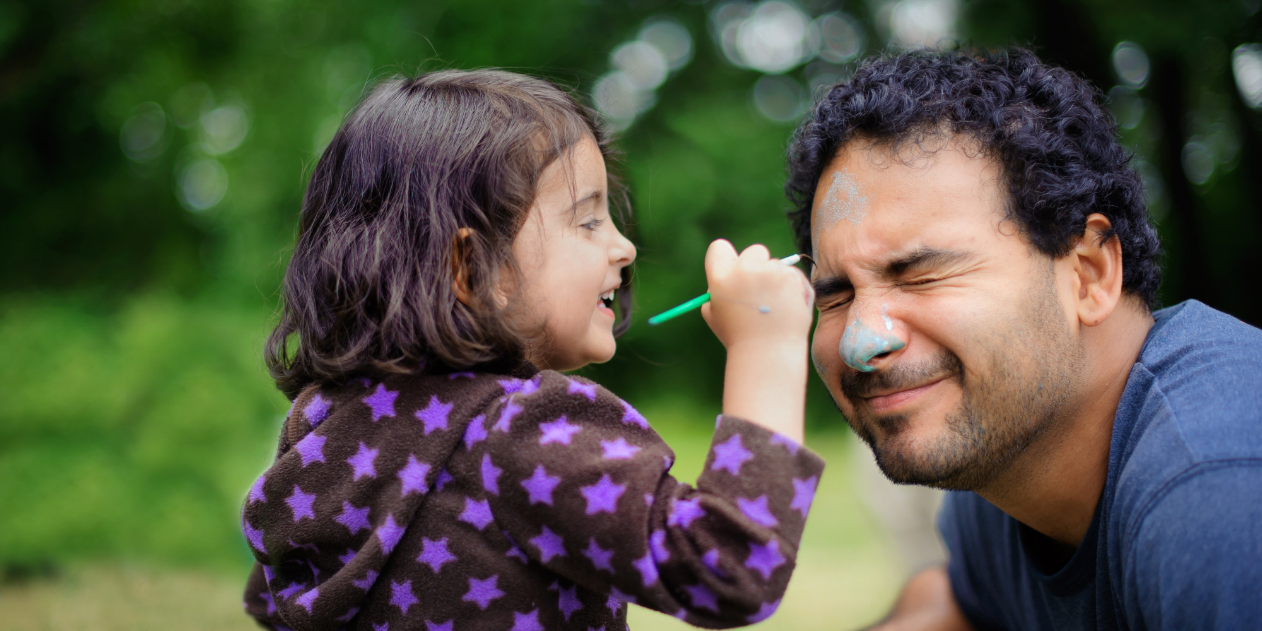
He liked me, well he liked me

Slide 20
Does anyone care

