Slide 1
人教版8A: Unit 3
I am more outgoing than my sister.
Song: I Am/Shades Of Life
- Billy Gilman
作者：邱卓然
单位：华南师范大学外文学院

Slide 2
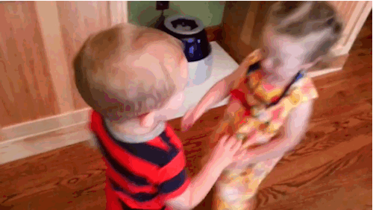
SKIP

Slide 3
I am black I am white
SKIP

Slide 4
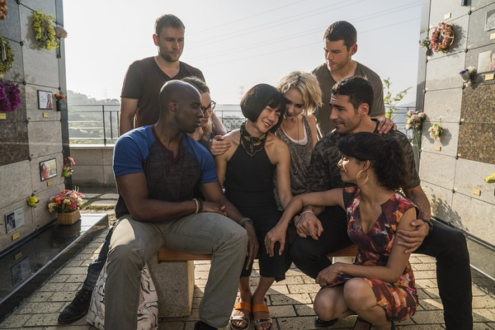
I am all skins in between
SKIP

Slide 5
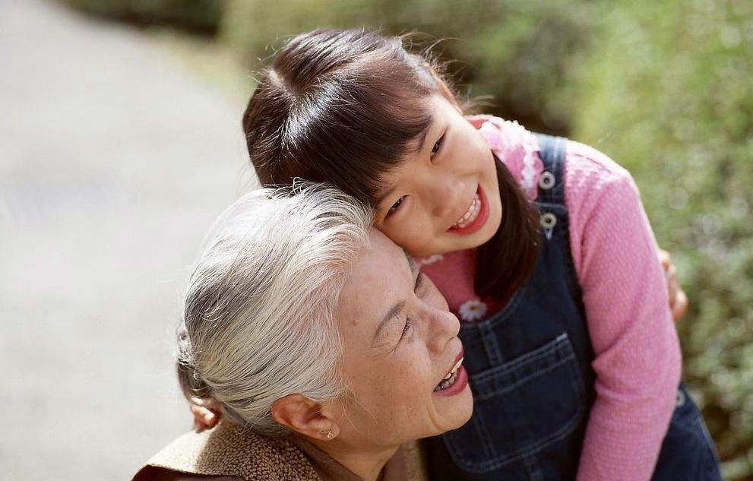
I am young
I am old
SKIP

Slide 6
I am each age that has been
SKIP

Slide 7
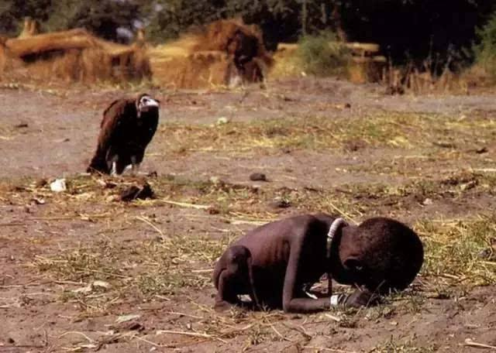
I am scrawny I am well fed
SKIP

Slide 8
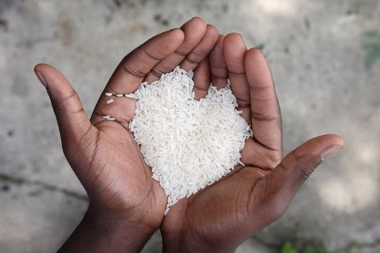
I am starving for attention
SKIP

Slide 9
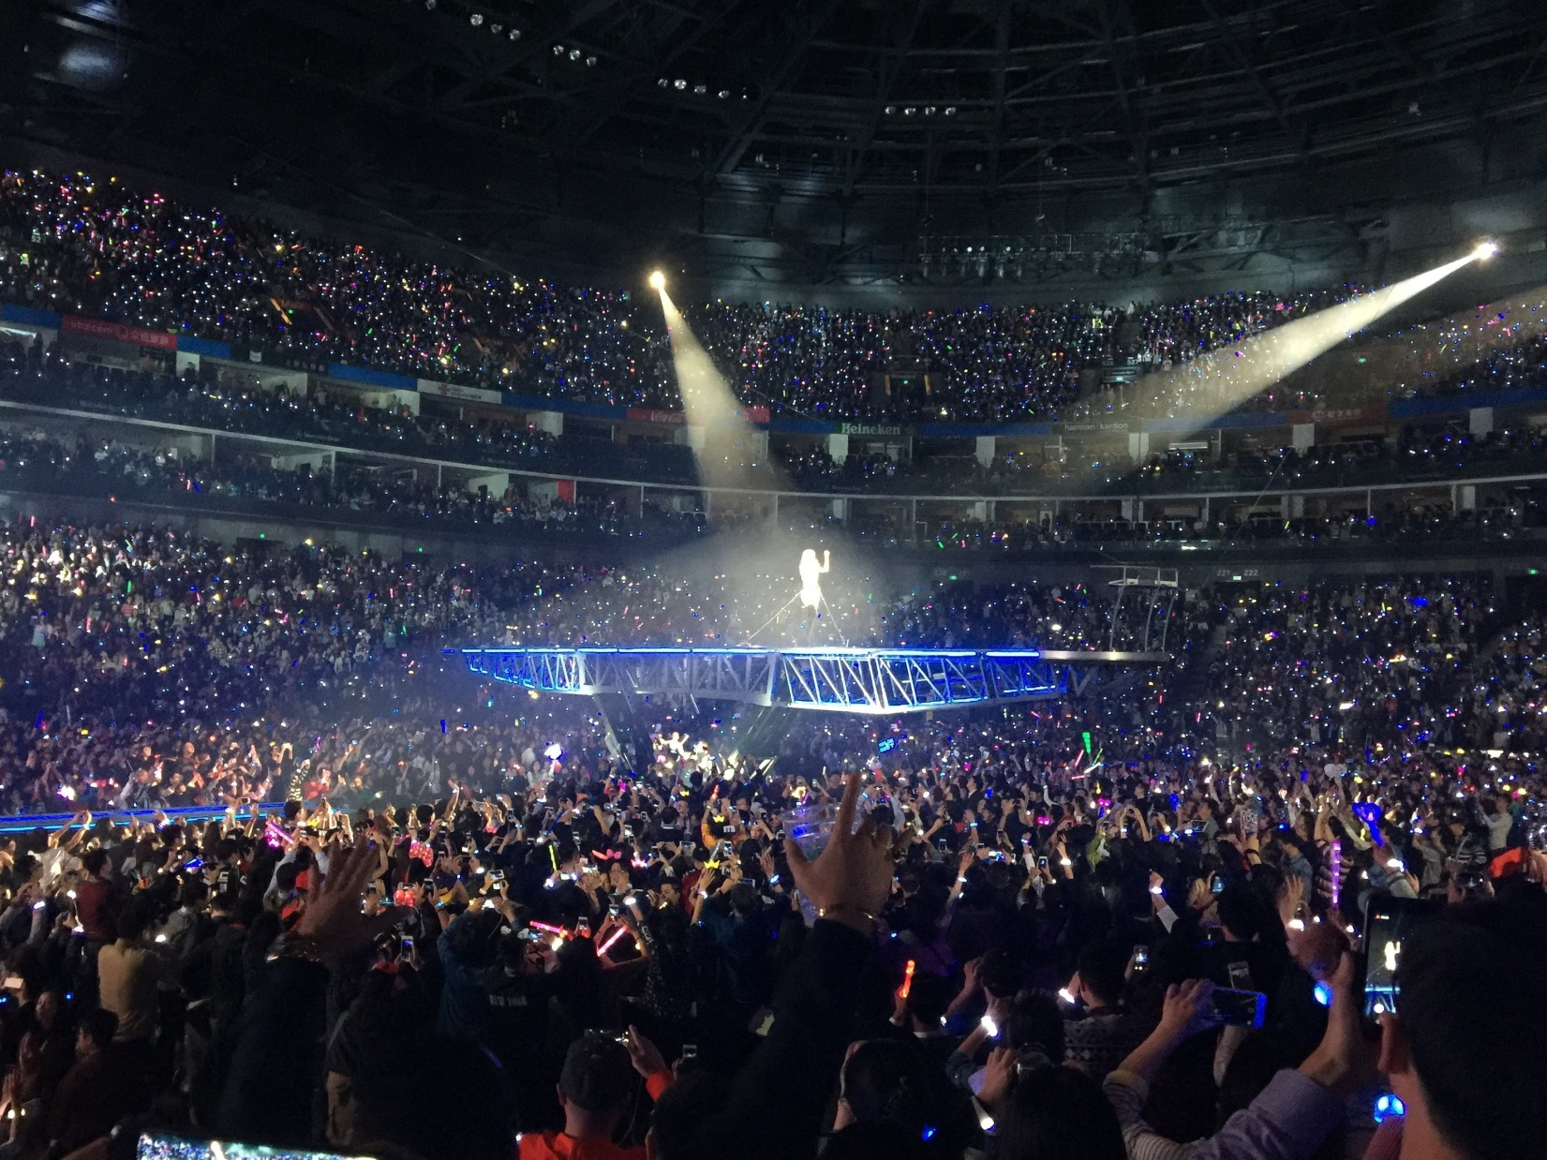
I am famous I am cryptic
SKIP

Slide 10
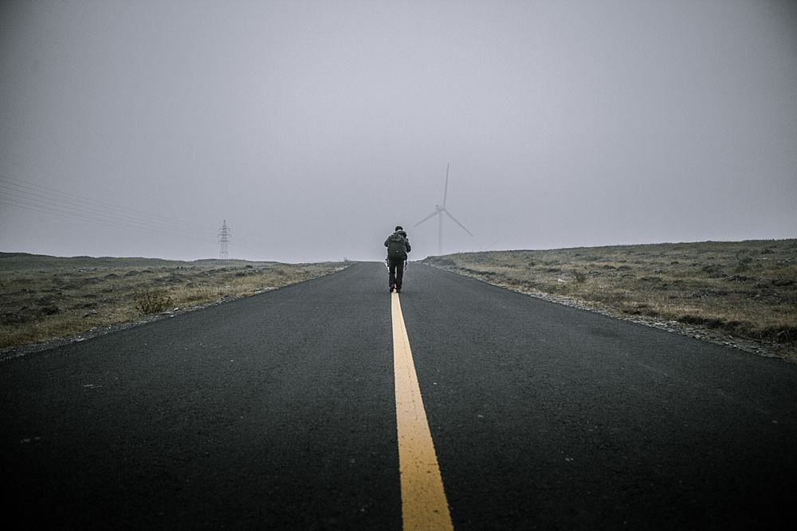
I am hardly worth the mention
SKIP

Slide 11
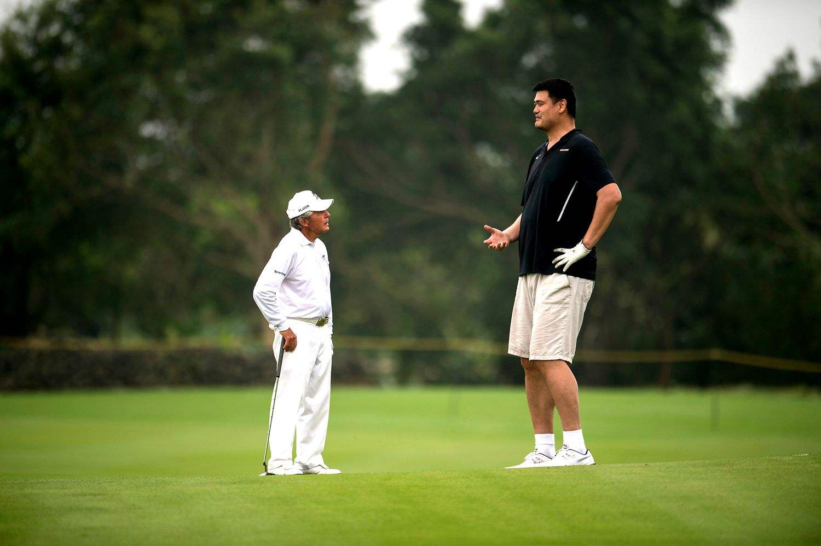
I am short
I am height
SKIP

Slide 12
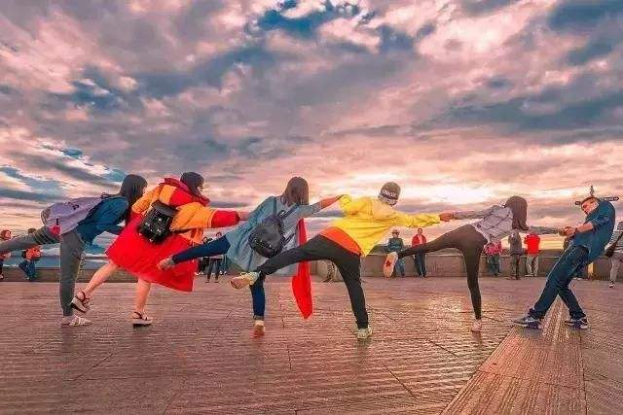
I am any frame or stature
SKIP

Slide 13
I am smart
I am challenged
SKIP

Slide 14
I am striving for a future
SKIP

Slide 15
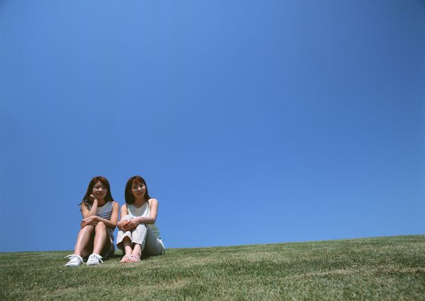
The color of sky is blues and grays
SKIP

Slide 16
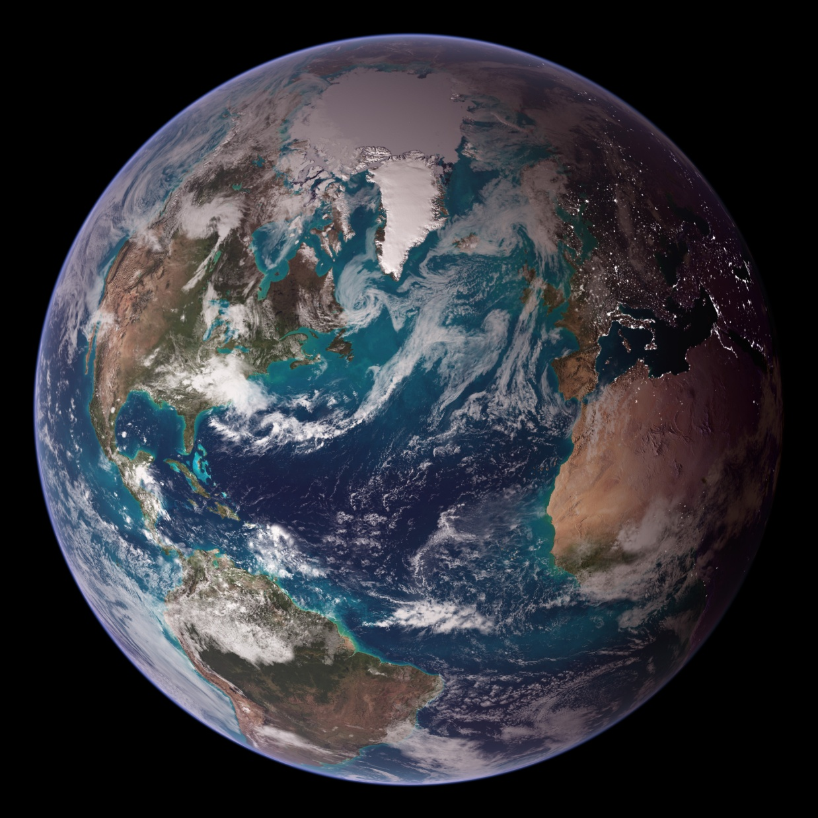
The color of earth is greens and browns
SKIP

Slide 17
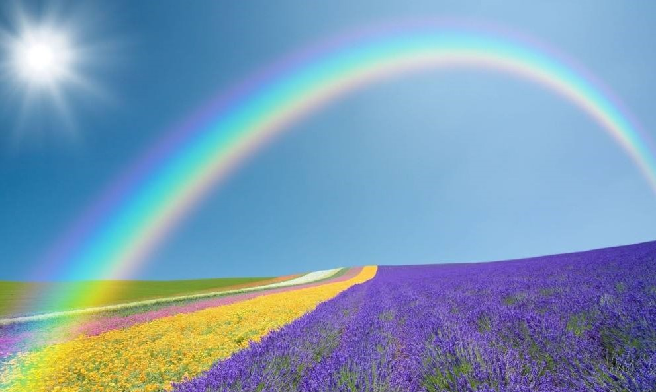
The color of hope is rainbows and purple
SKIP

Slide 18
And the color of peace is people together
SKIP

Slide 19
Shades of life
People together
SKIP

Slide 20
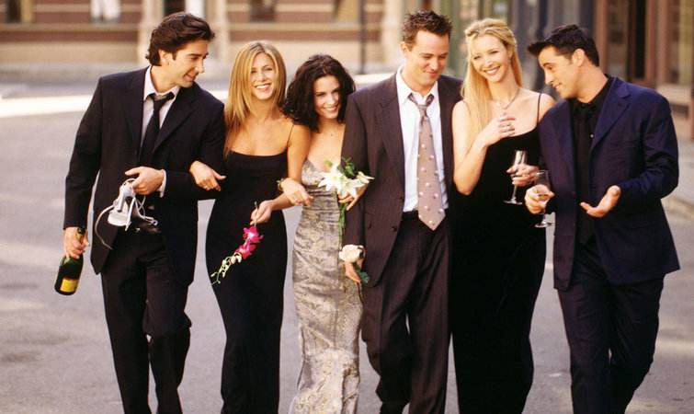
Shades of life
I am
SKIP

Slide 21
I am able I am weak
SKIP

Slide 22
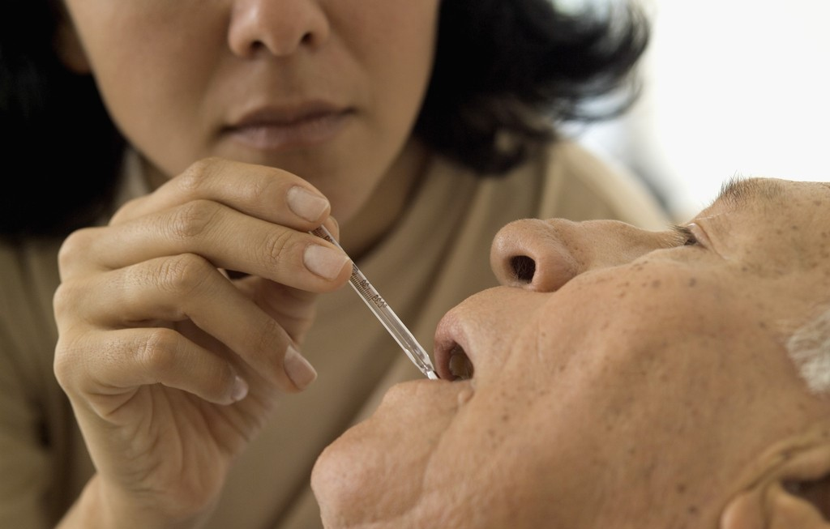
I am some strength
I am none
SKIP

Slide 23
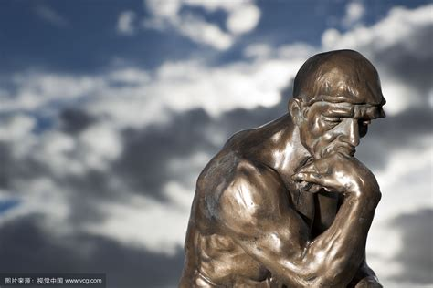
I am being I am thought
SKIP

Slide 24
I am all things said and done
SKIP

Slide 25
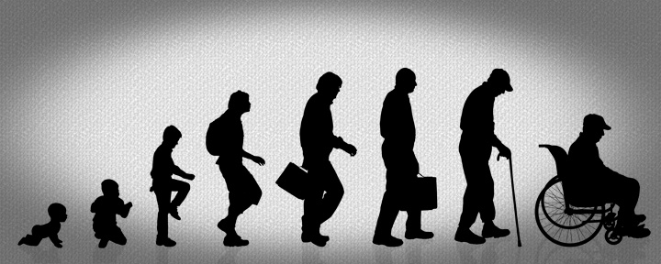
I am born I am died
SKIP

Slide 26
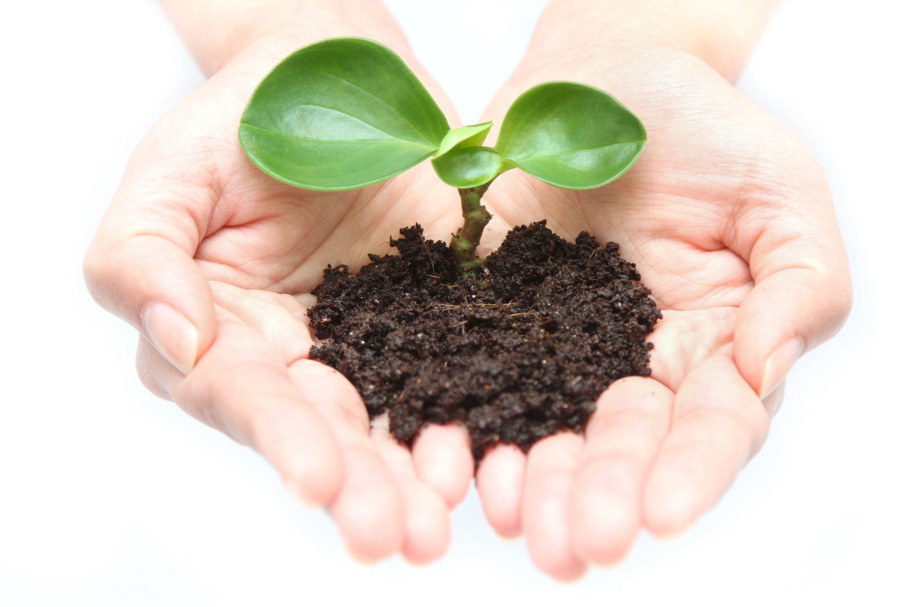
I am dust of humble roots
SKIP

Slide 27
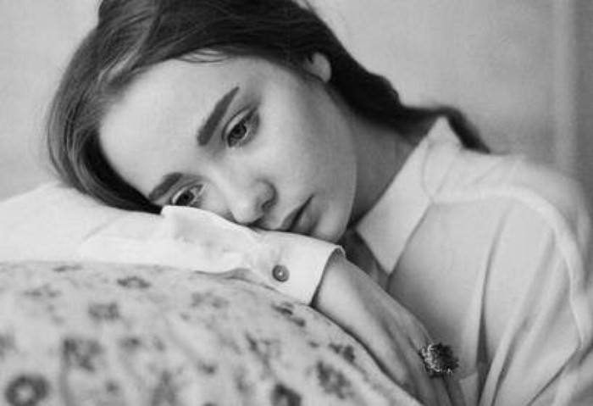
I am grace I am pain
SKIP

Slide 28
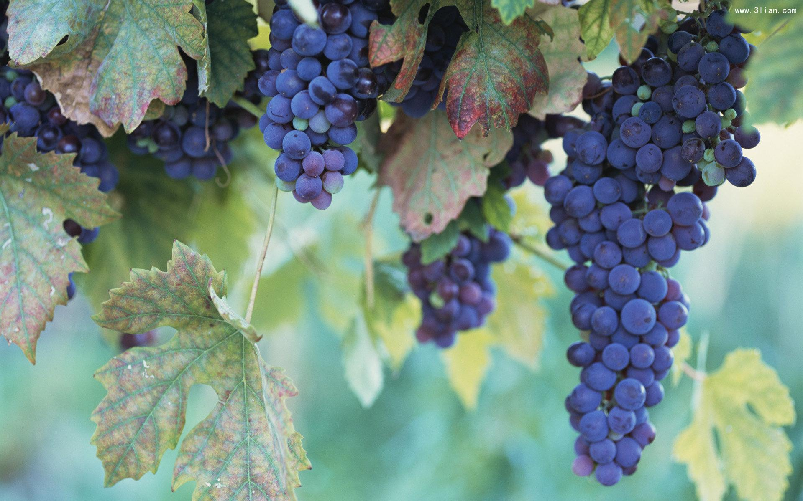
I am labor of willed fruits
SKIP

Slide 29
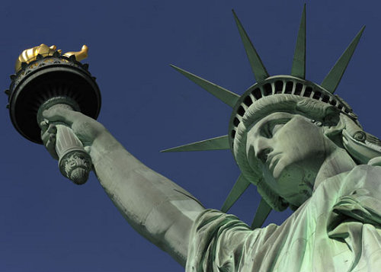
I am slave I am free
SKIP

Slide 30
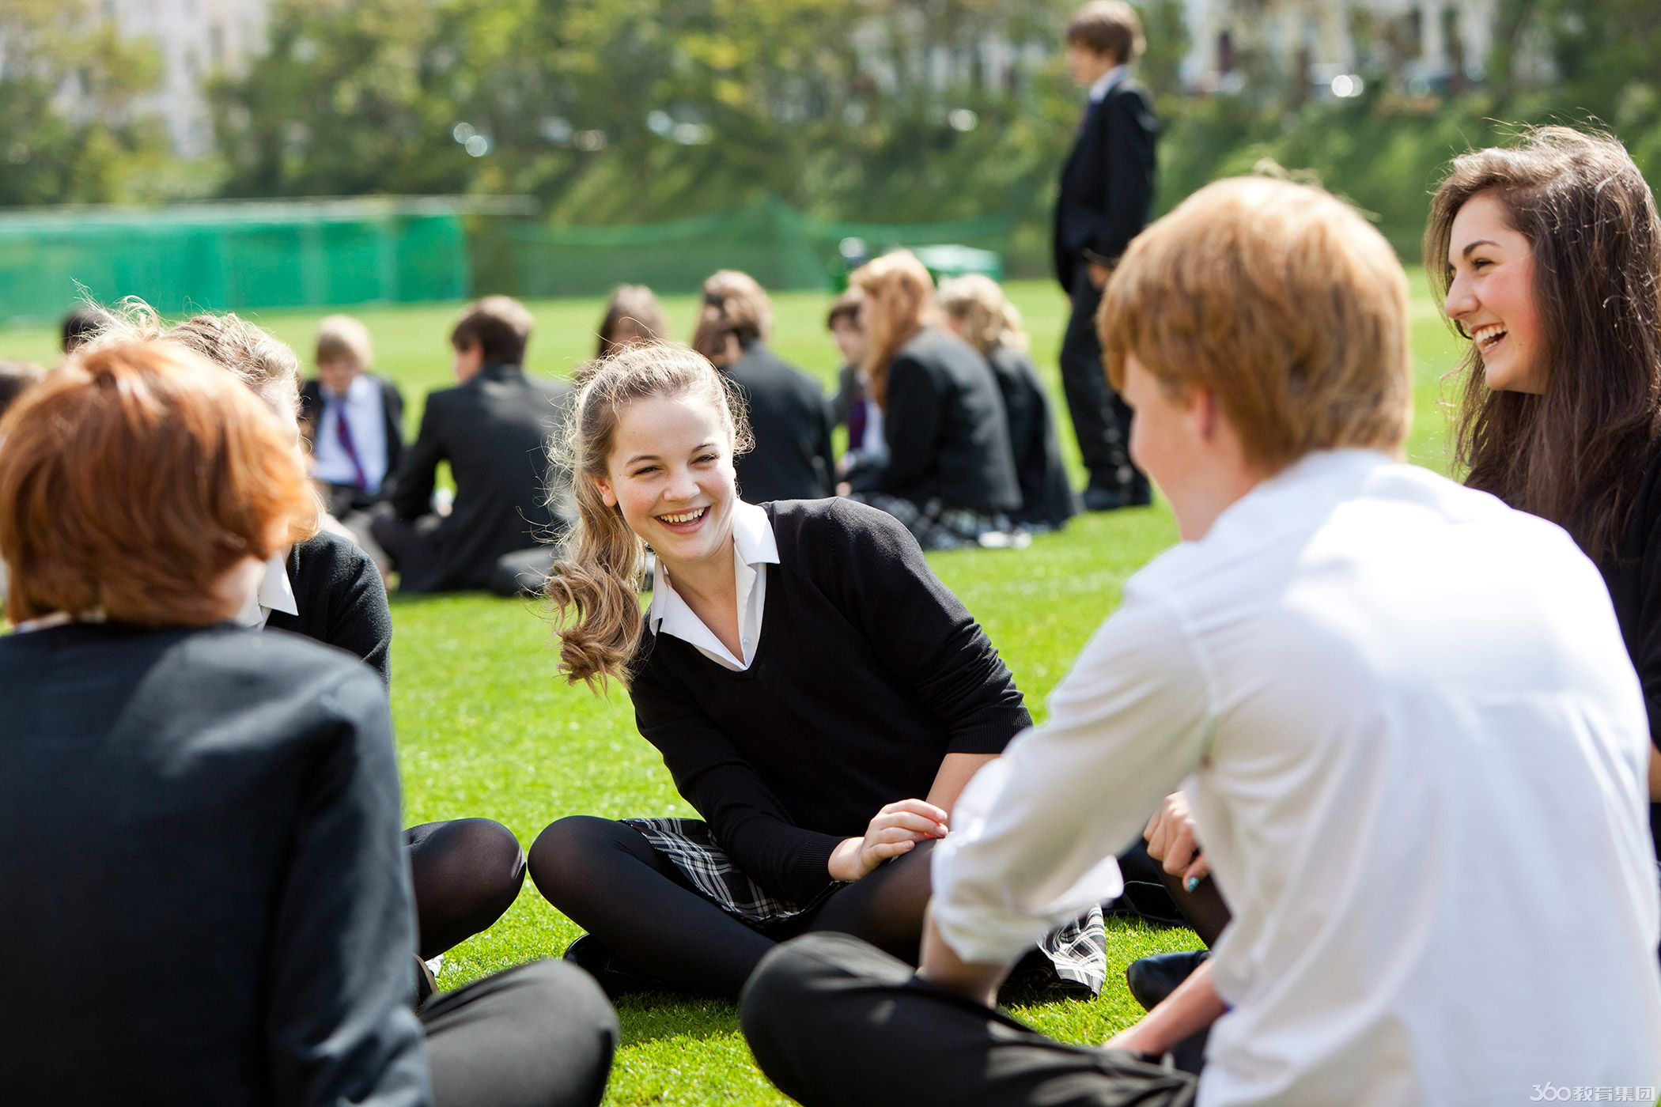
I am bonded to my life
SKIP

Slide 31
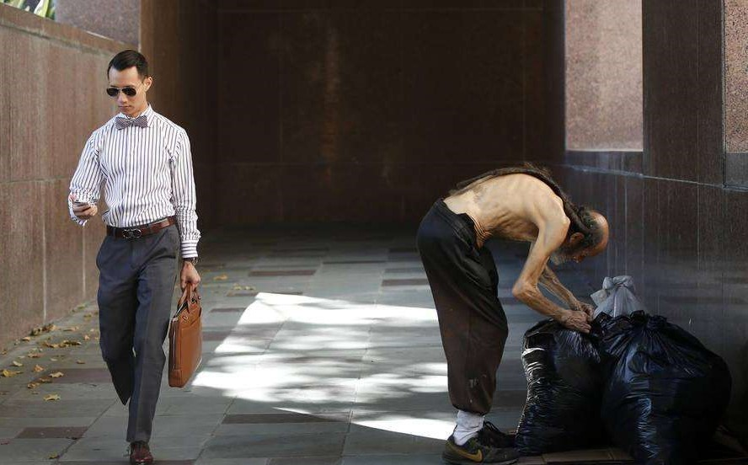
I am rich I am poor
SKIP

Slide 32
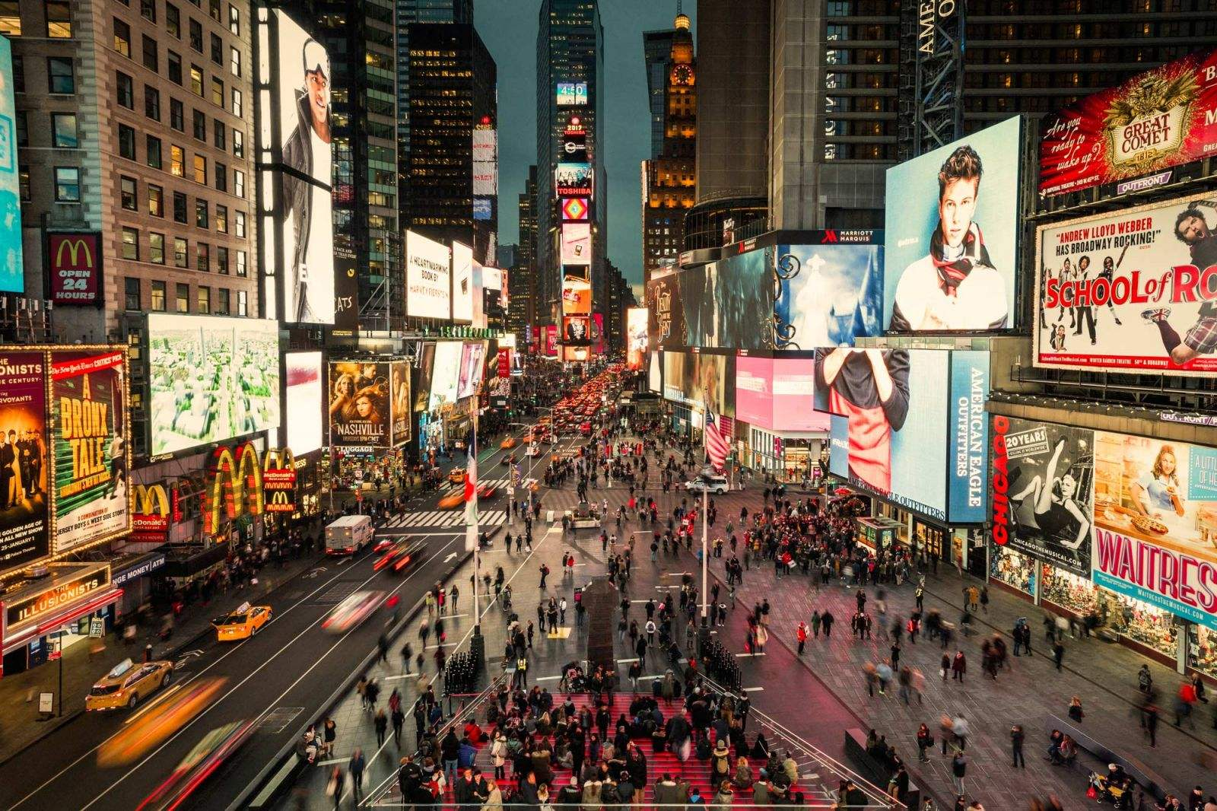
I am wealth amid strife
SKIP

Slide 33
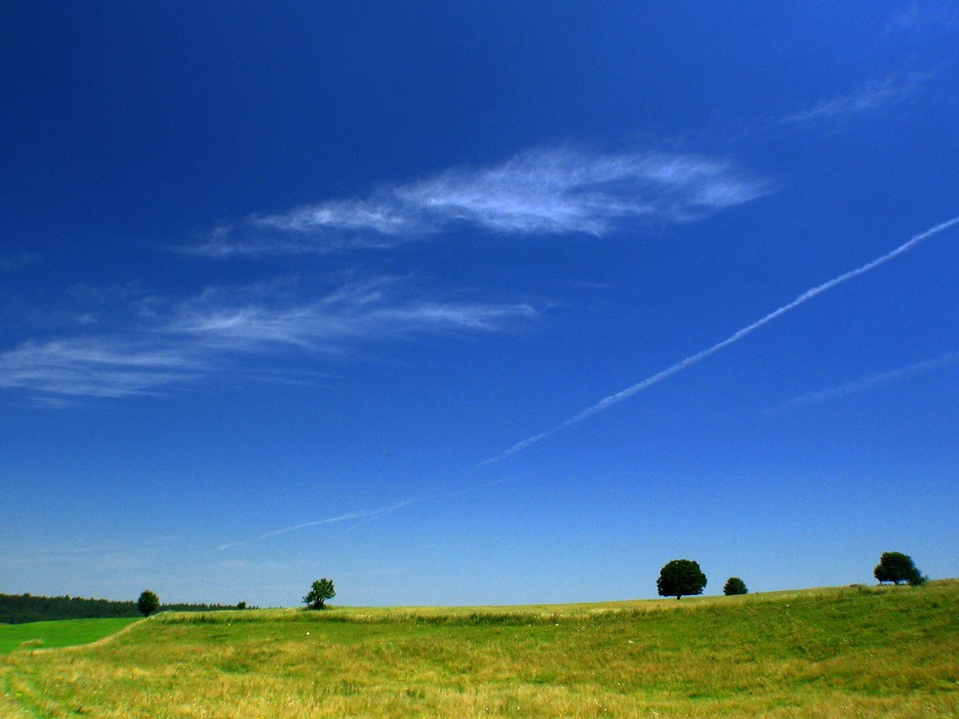
The color of sky is blues and grays
SKIP

Slide 34
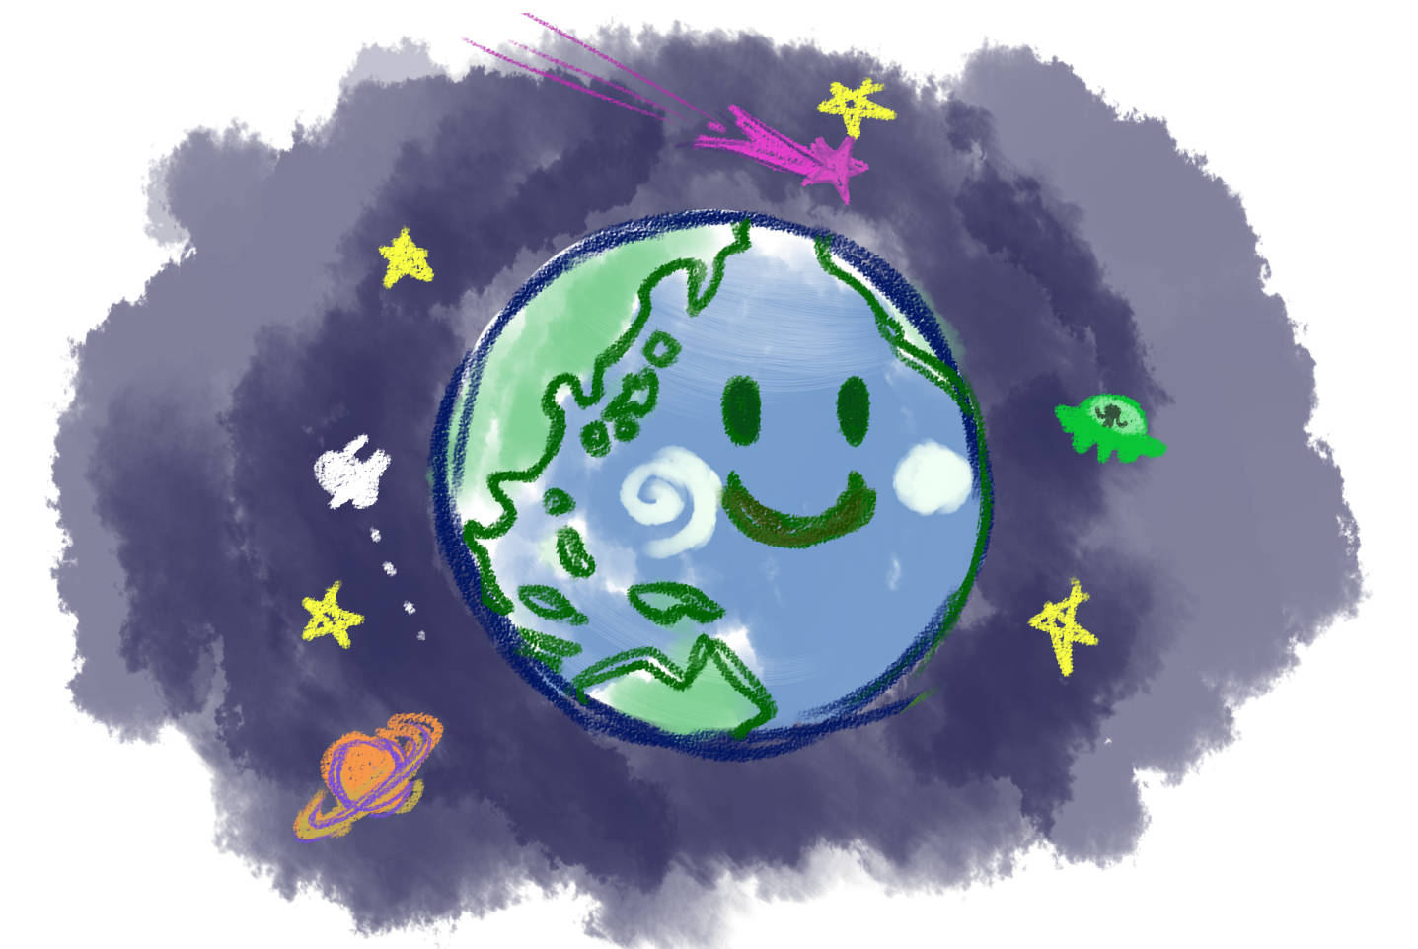
The color of earth is greens and browns
SKIP

Slide 35
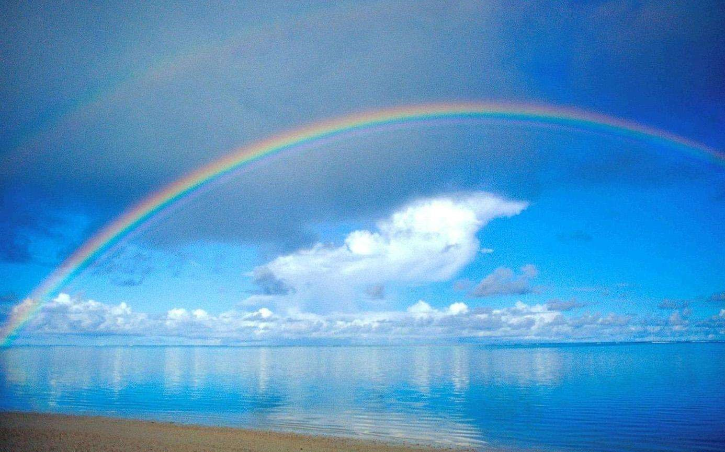
The color of hope is rainbows and purple
SKIP

Slide 36
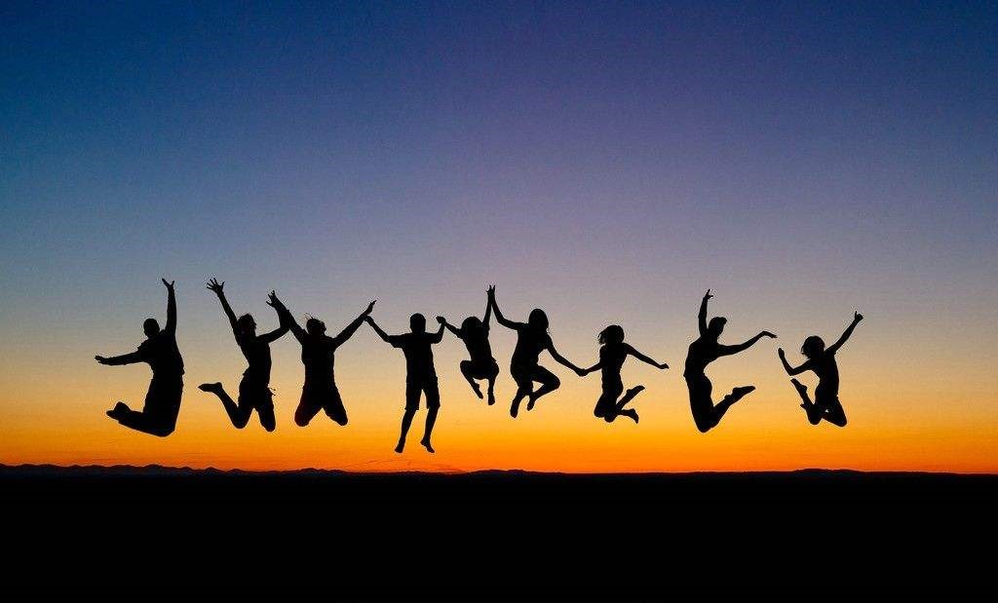
And the color of peace is people together
Shades of life
SKIP

Slide 37
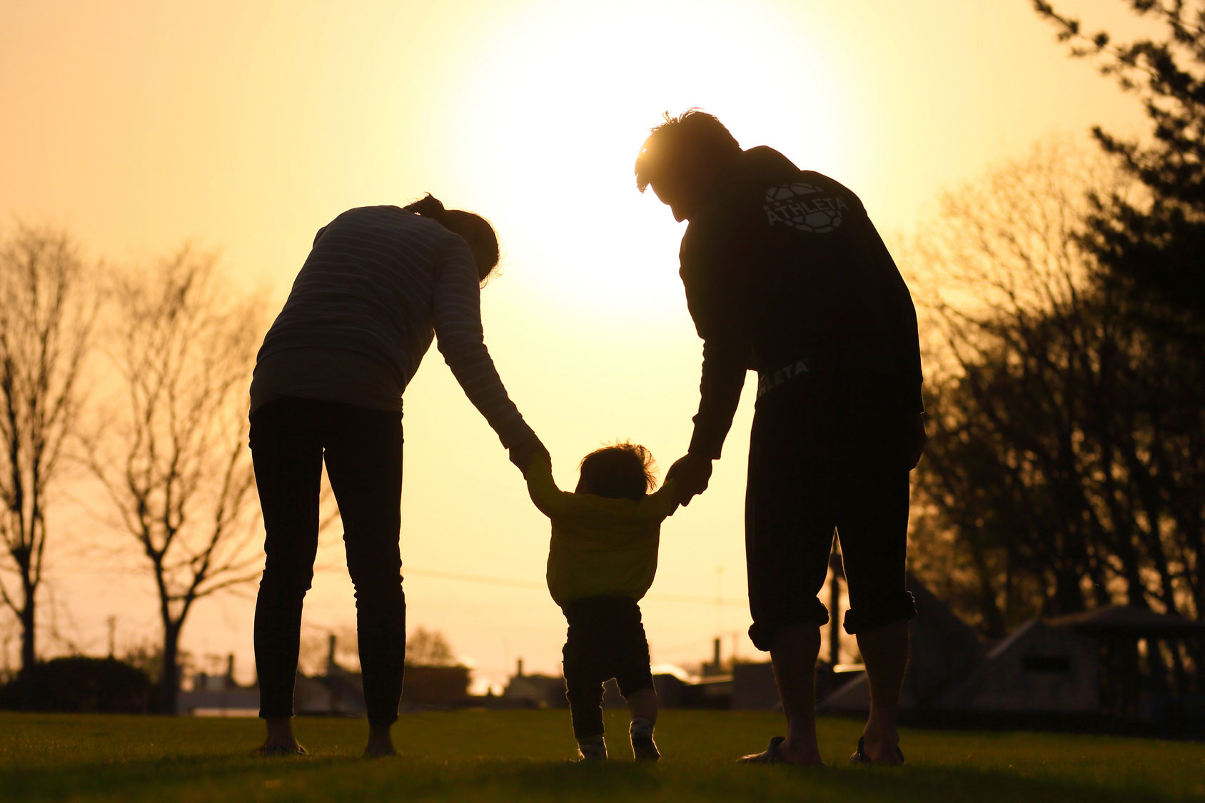
people together
Shades of life
SKIP

Slide 38
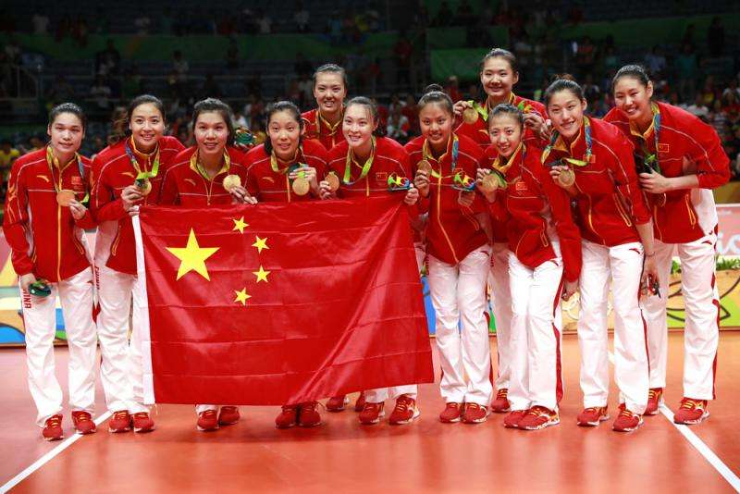
I am shadow I am glory
SKIP

Slide 39
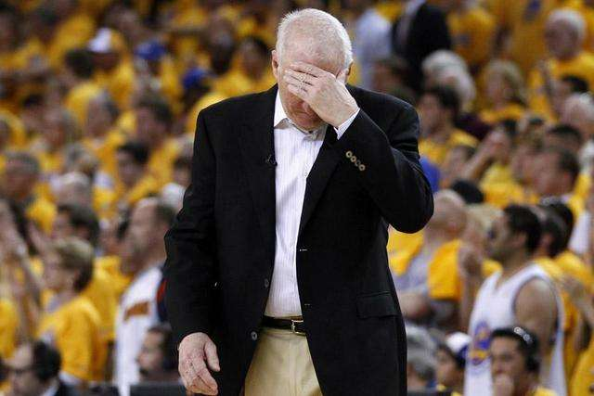
I am hiding from my shame
SKIP

Slide 40
I am hero I am loser
SKIP

Slide 41
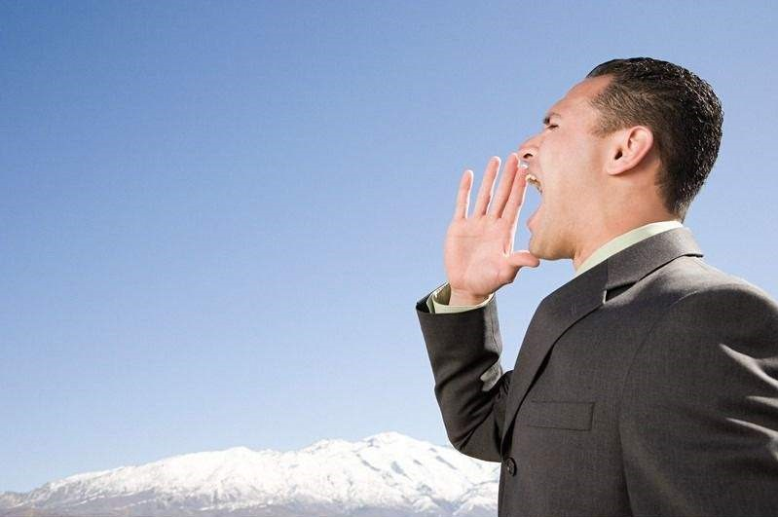
I am yearning for a name
SKIP

Slide 42
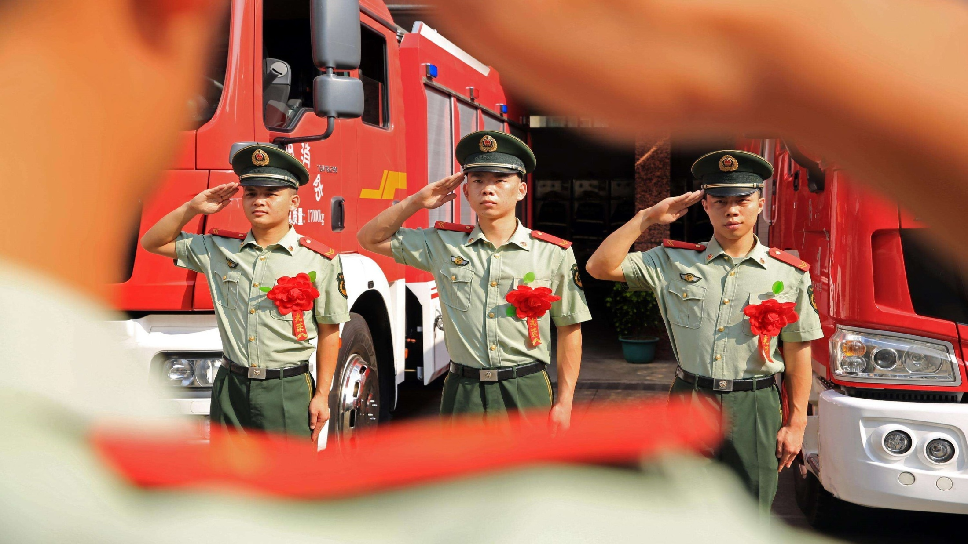
I am empty I am proud
SKIP

Slide 43
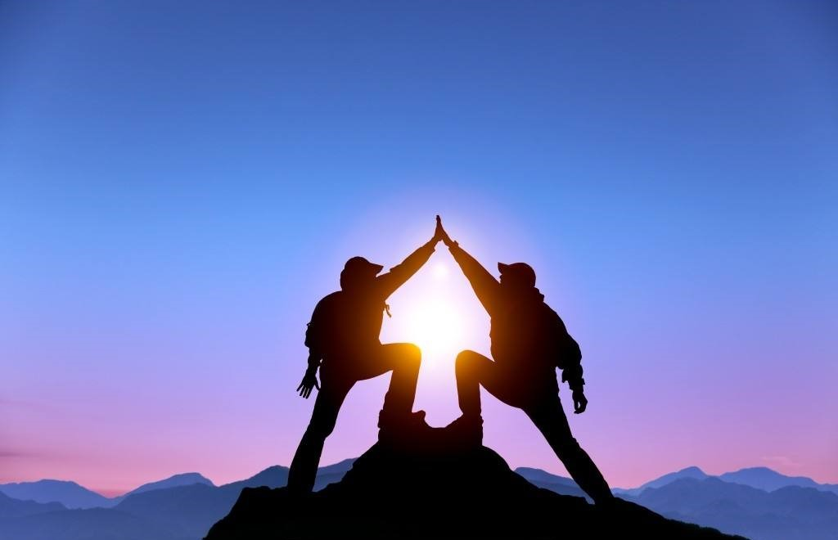
I am seeking my tomorrow
SKIP

Slide 44
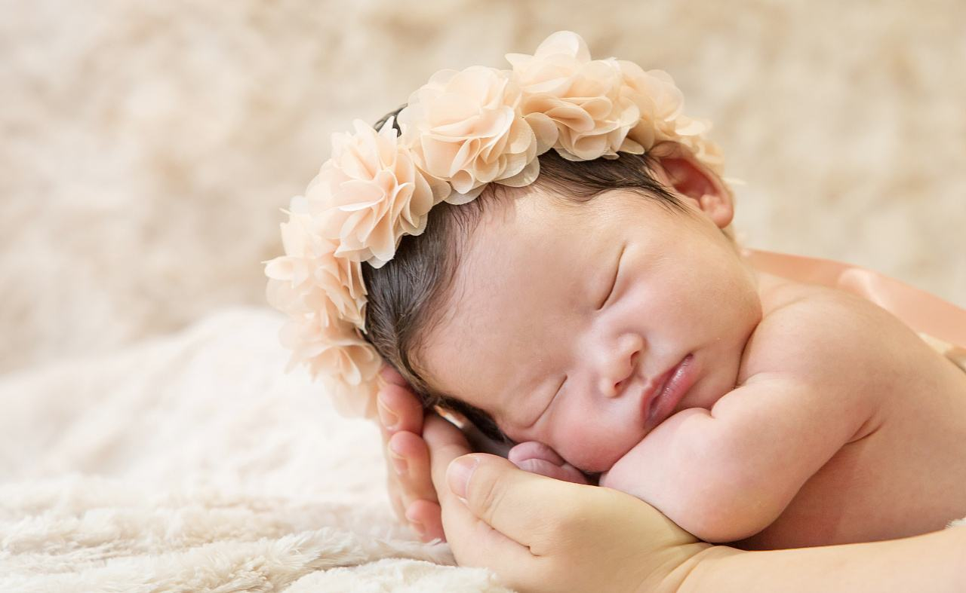
I am growing
I am fading
SKIP

Slide 45
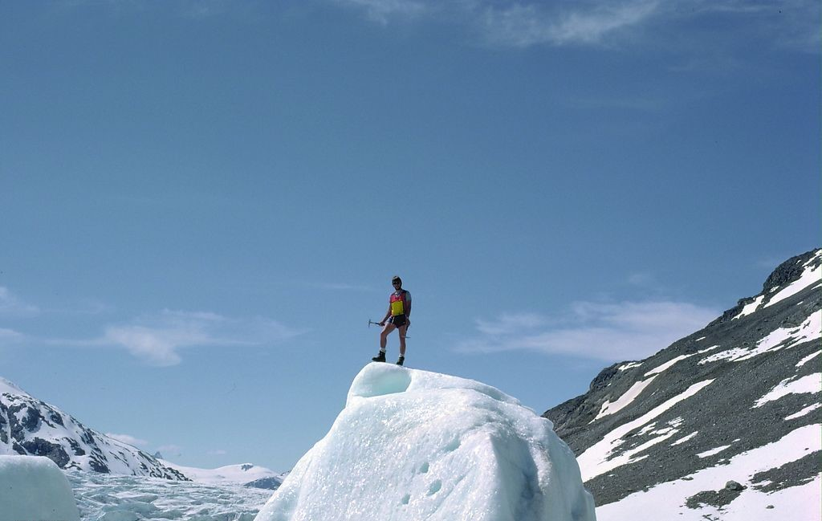
I am hope amid the sorrow
SKIP

Slide 46
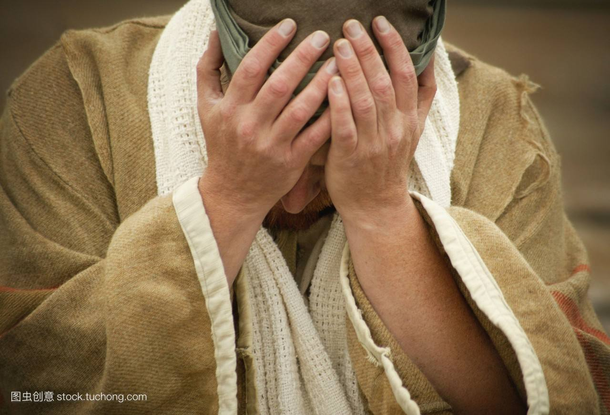
I am certain I am doubtful
SKIP

Slide 47
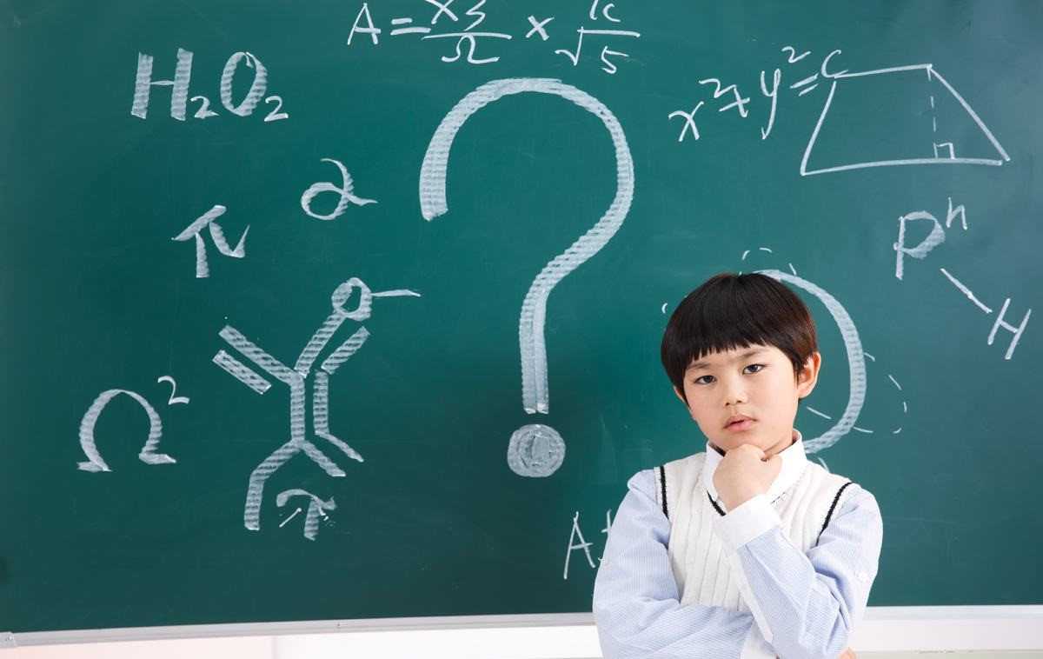
I am desperate for solutions
SKIP

Slide 48
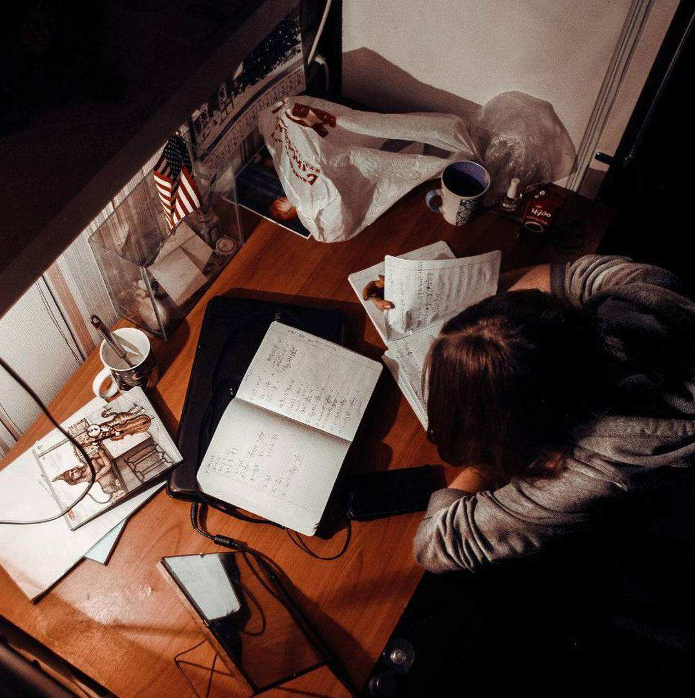
I am leader
I am student
SKIP

Slide 49
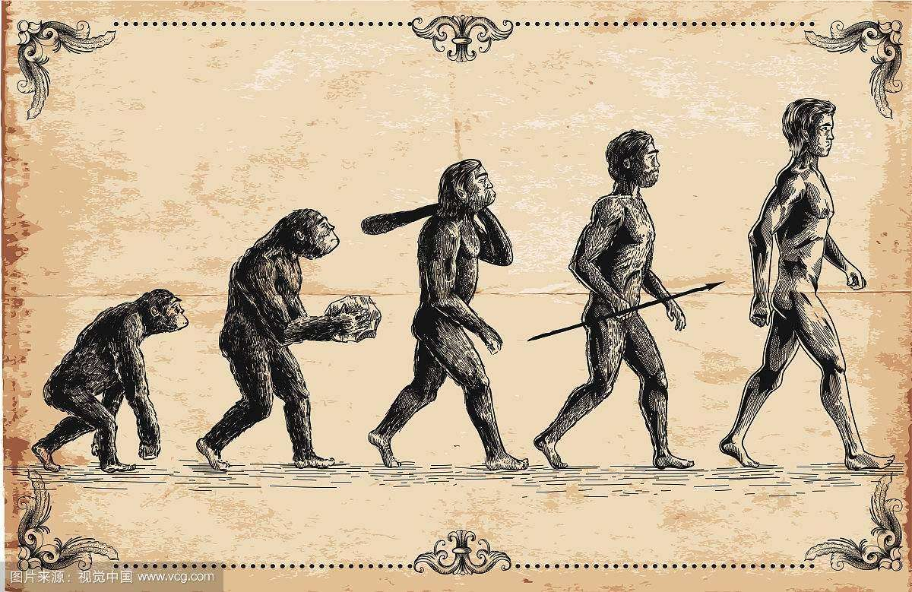
I am fate and evolutions
SKIP

Slide 50
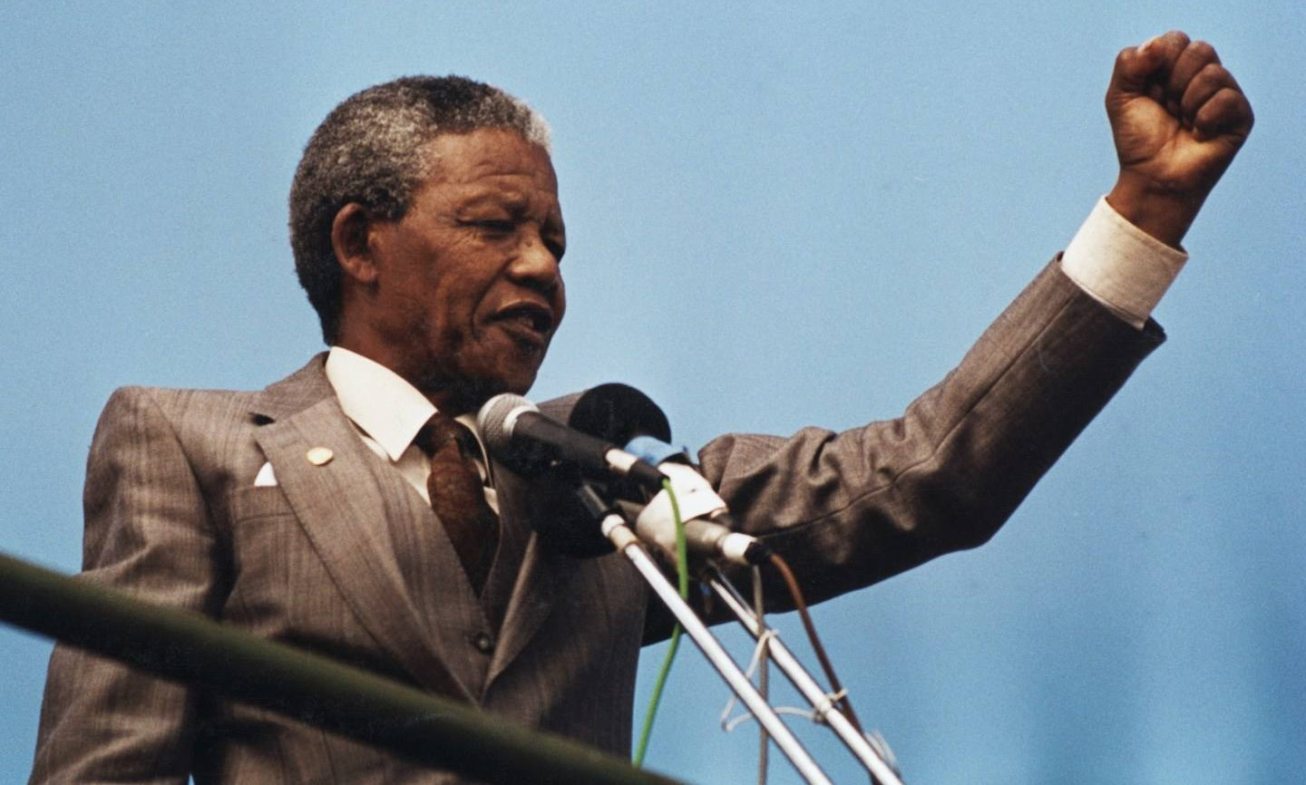
I am spirit I am voice
I am memory not recalled
SKIP

Slide 51
I am effort blocked and walled
I am chance I am cause
SKIP

Slide 52
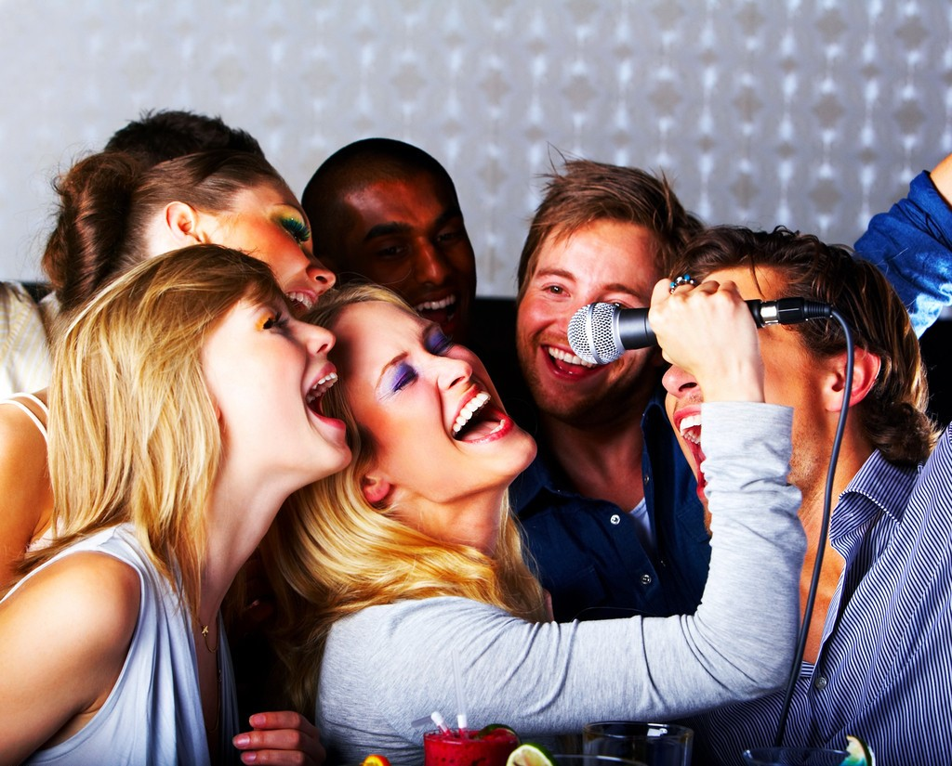
I am hymn I am heard
I am reasoned without rhymes
SKIP

Slide 53
I am past I am nearing
I am present in all times
SKIP

Slide 54
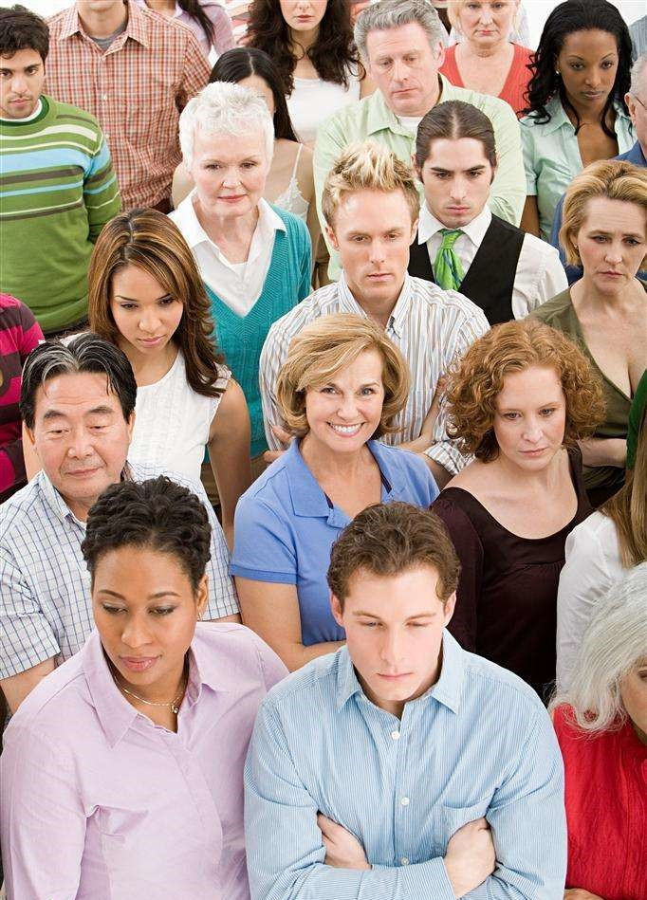
I am many I am no one
I am seasoned by each being
SKIP

Slide 55
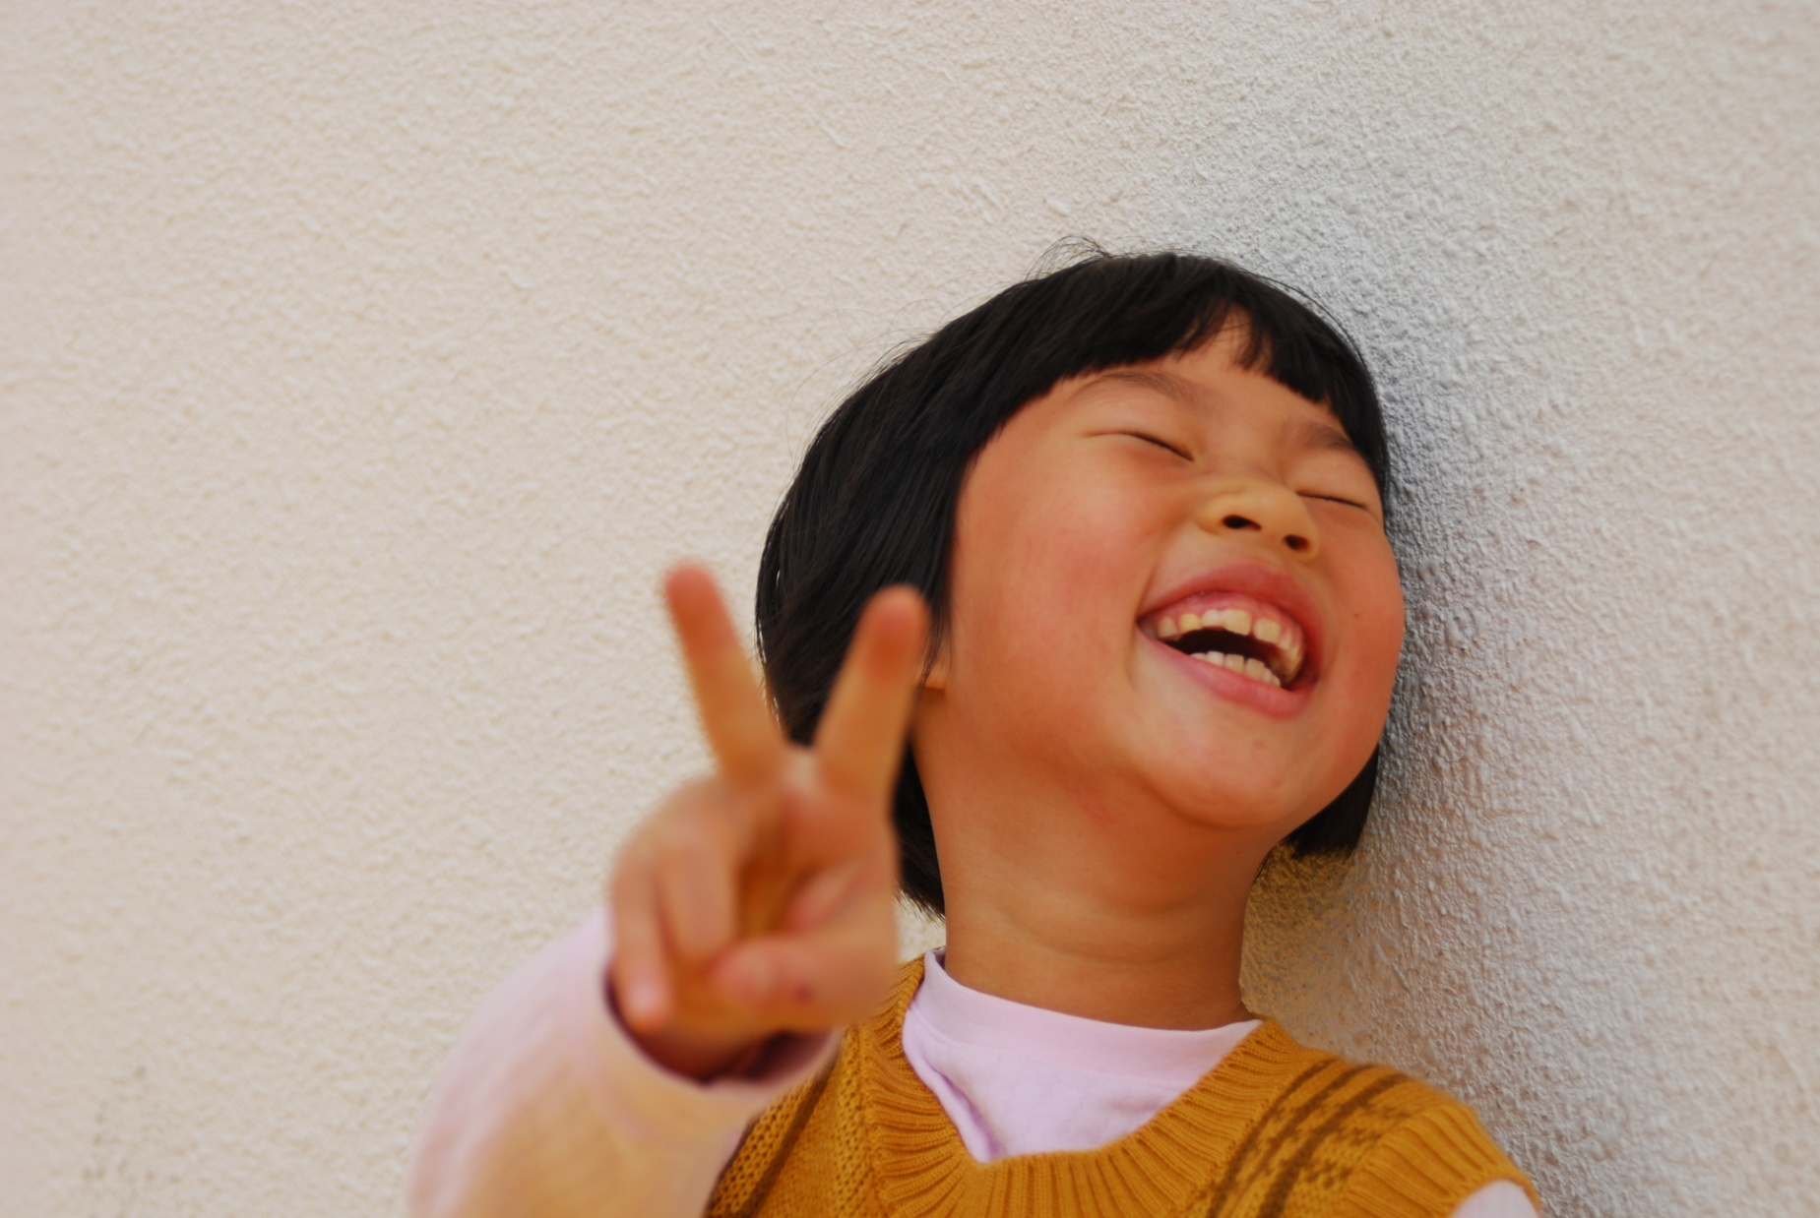
I am me I am you
I am all-souls now decreeing
SKIP

Slide 56
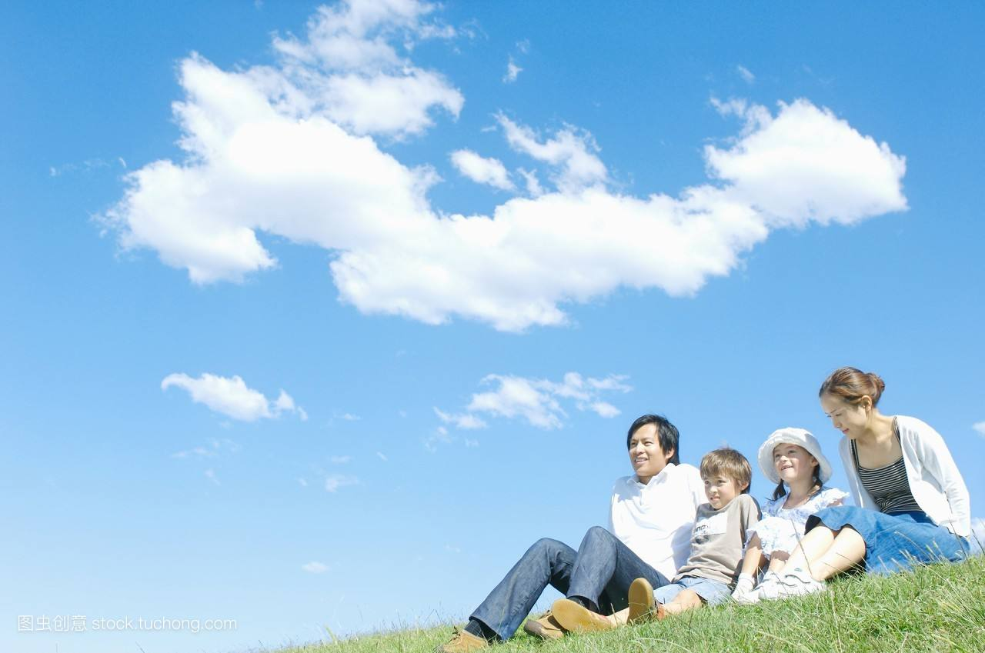
The color of sky is blues and grays
SKIP

Slide 57
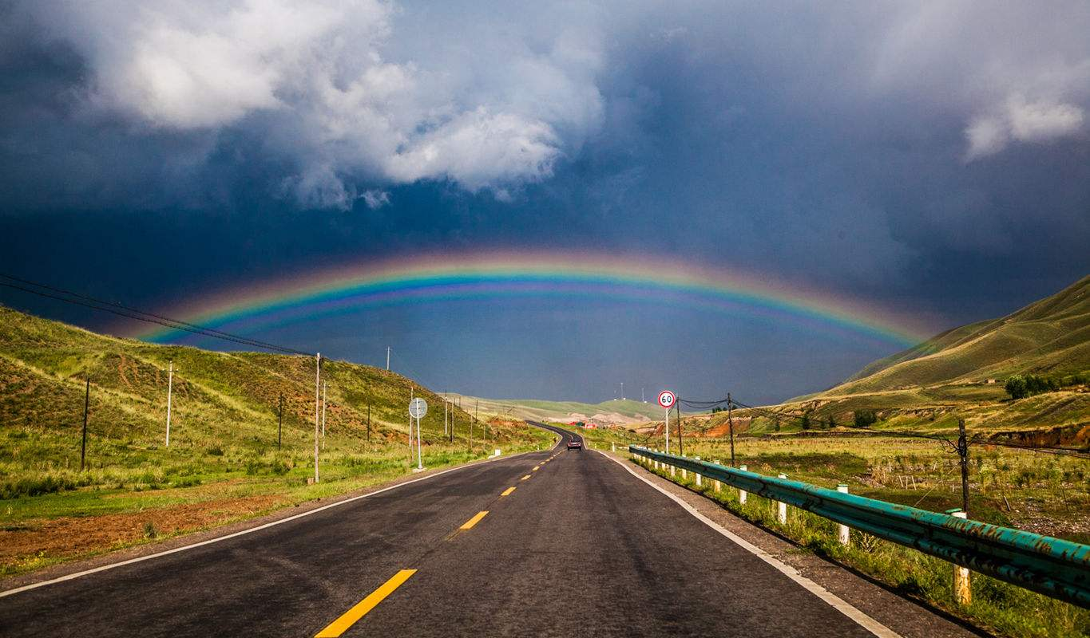
The color of earth is greens and browns
SKIP

Slide 58
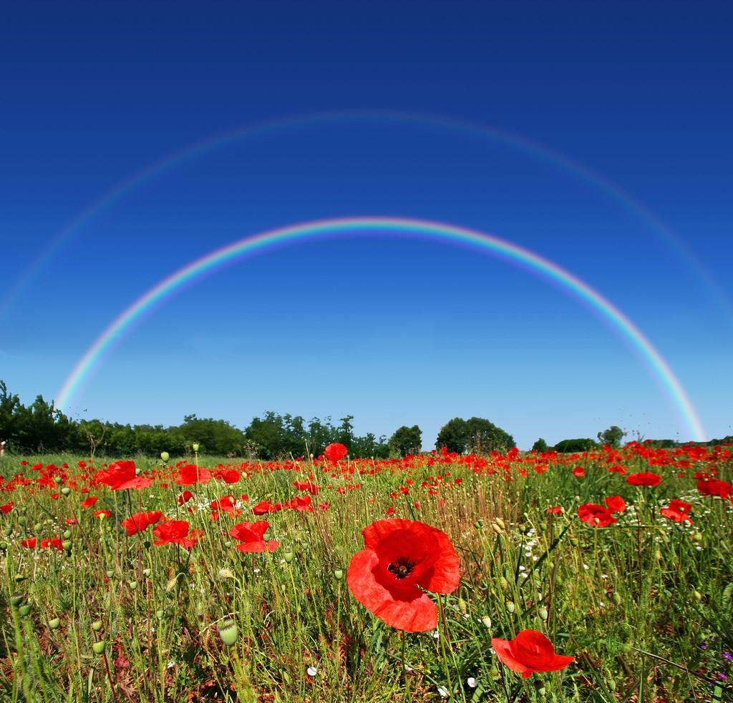
The color of hope is rainbows and purple
SKIP

Slide 59
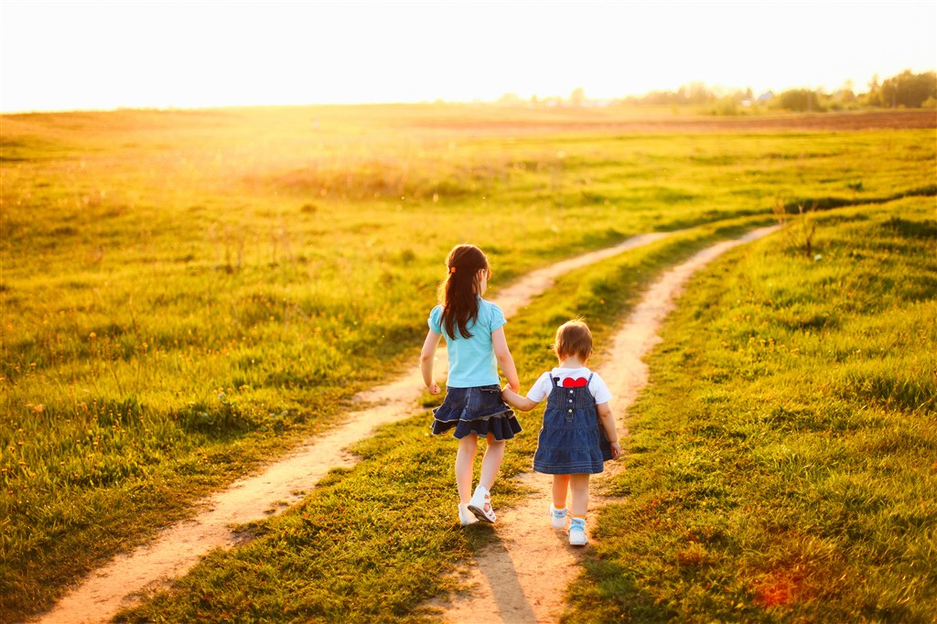
And the color of peace is people together
SKIP

Slide 60
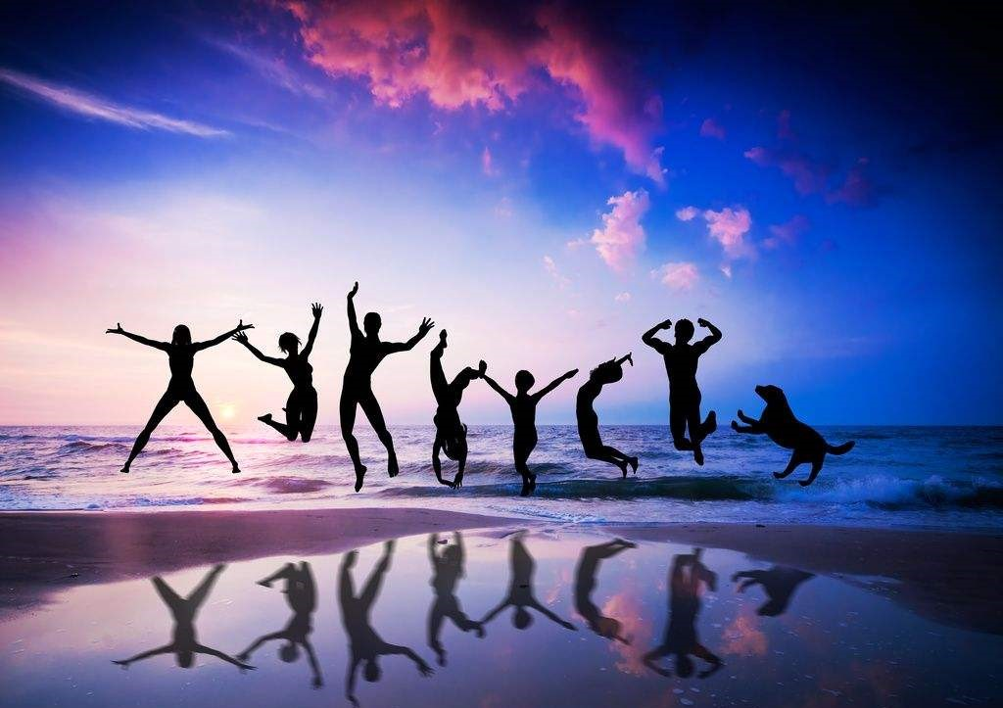
Shades of life
People together
SKIP

Slide 61
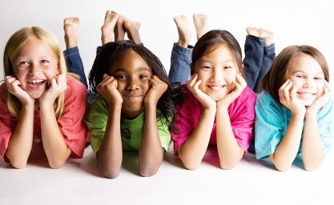
Shades of life
People together
SKIP

Slide 62
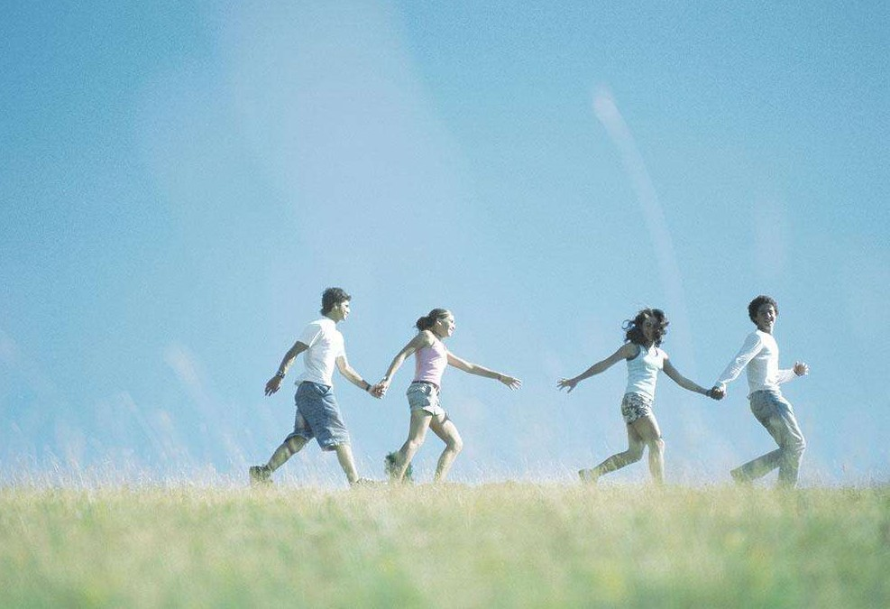
Shades of life
People together
SKIP

Slide 63
Shades of life
People together
SKIP

Slide 64
Shades of life
I am

