Slide 1

U15L4：Understanding song: Tell me why singer: Declan Gelbraith
作者：钟敏
单位：华南师范大学

Slide 2
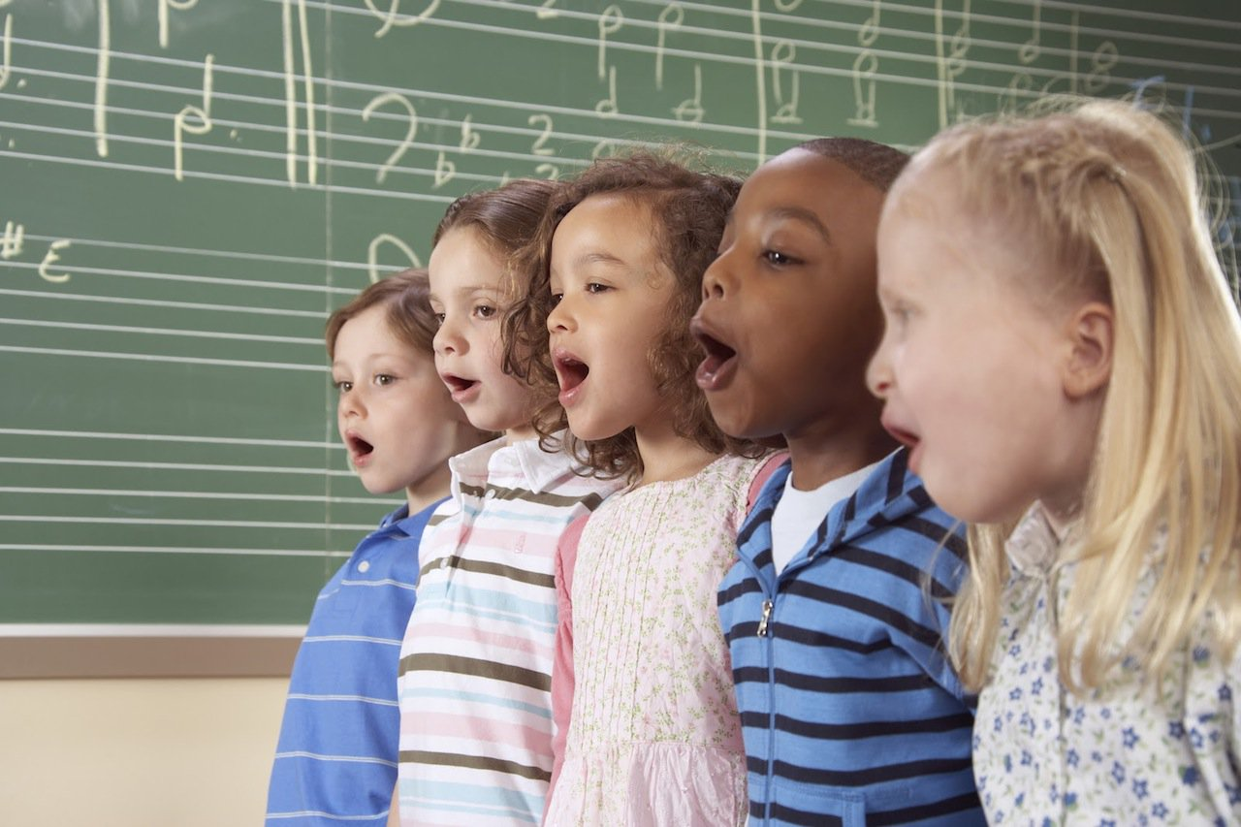
In my dream children sing

Slide 3

A song of love for every boy and girl

Slide 4

The sky is blue and fields are green

Slide 5
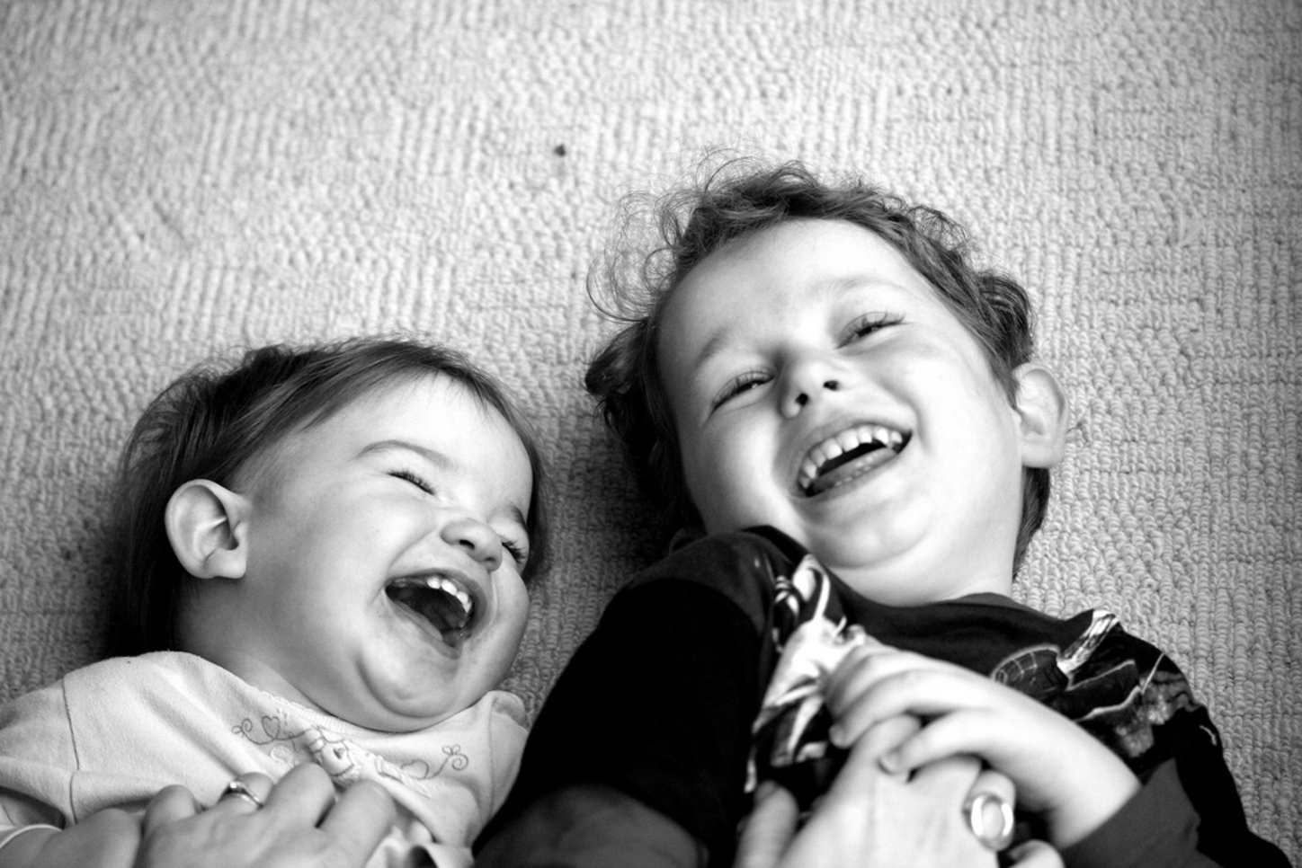
And laughter is the language of the world

Slide 6

Then I wake and all I see

Slide 7
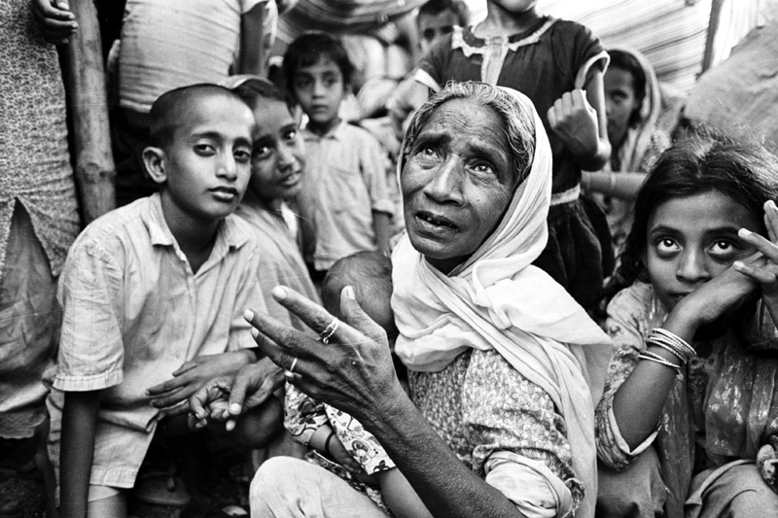
Is a world full of people in need

Slide 8
Tell me why why does it have to be like this

Slide 9

Tell me why why is there something I have missed

Slide 10
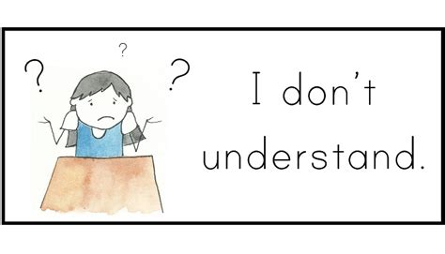
Tell me why why cos I don't understand

Slide 11

When so many need somebody

Slide 12

We don't give a helping hand

Slide 13

Tell me why

Slide 14
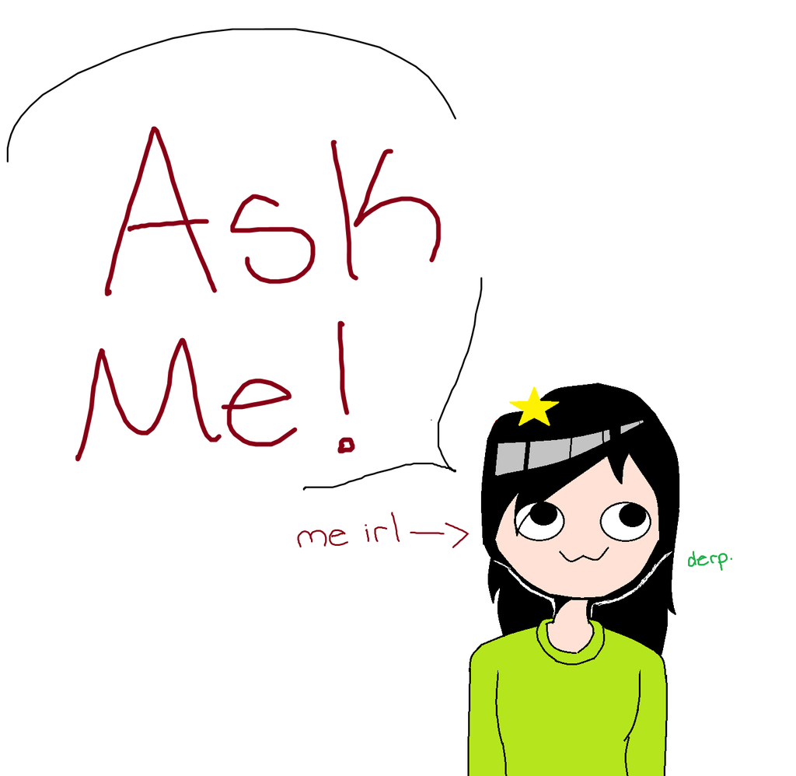
Everyday I ask myself

Slide 15

What will I have to do to ba a man

Slide 16

Do I have to stand and fight

Slide 17

To prove to everybody who I am

Slide 18

Is that what my life is for

Slide 19

To waste in a world full of war

Slide 20

Tell me why why does it have to be like this

Slide 21
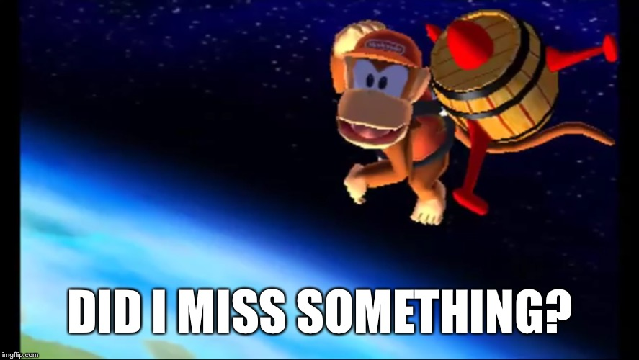
Tell me why why is there something I have missed

Slide 22

Tell me why why cos I don't understand

Slide 23

When so many need somebody

Slide 24
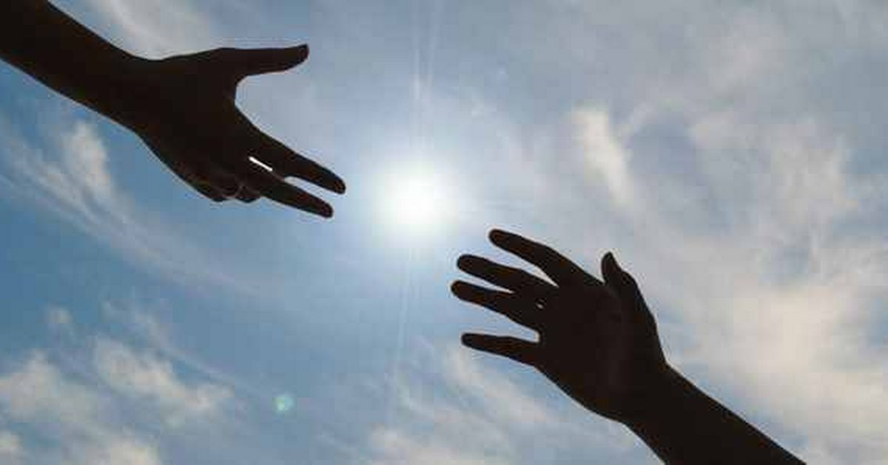
We don't give a helping hand

Slide 25

Tell me why
Just tell me why why why

Slide 26

Tell me why why does it have to be like this

Slide 27

Tell me why why is there something I have missed

Slide 28
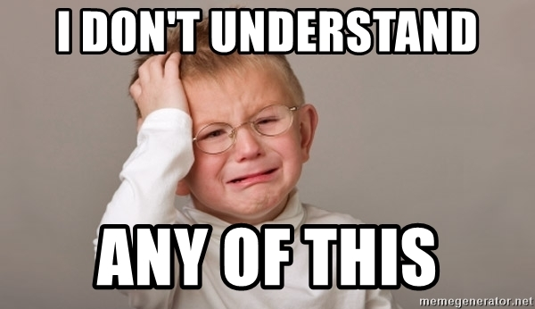
Tell me why why cos I don't understand

Slide 29

When so many need somebody, we don't give a helping hand

Slide 30
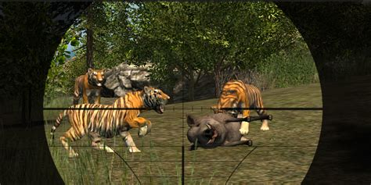
Tell me why why why does the tiger run
Tell me why why why do we shoot the gun
Tell me why why why do we never learn

Slide 31
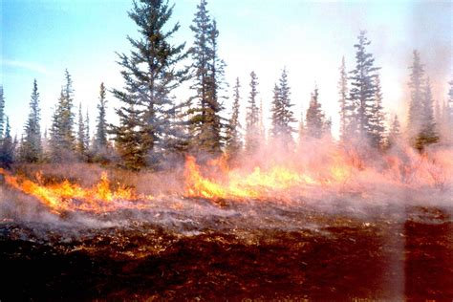
Can someone tell us why we let the forest burn

Slide 32

Why why do we said we care
Tell me why why why do we stand and stare
Tell me why why why do the dolphins cry

Slide 33
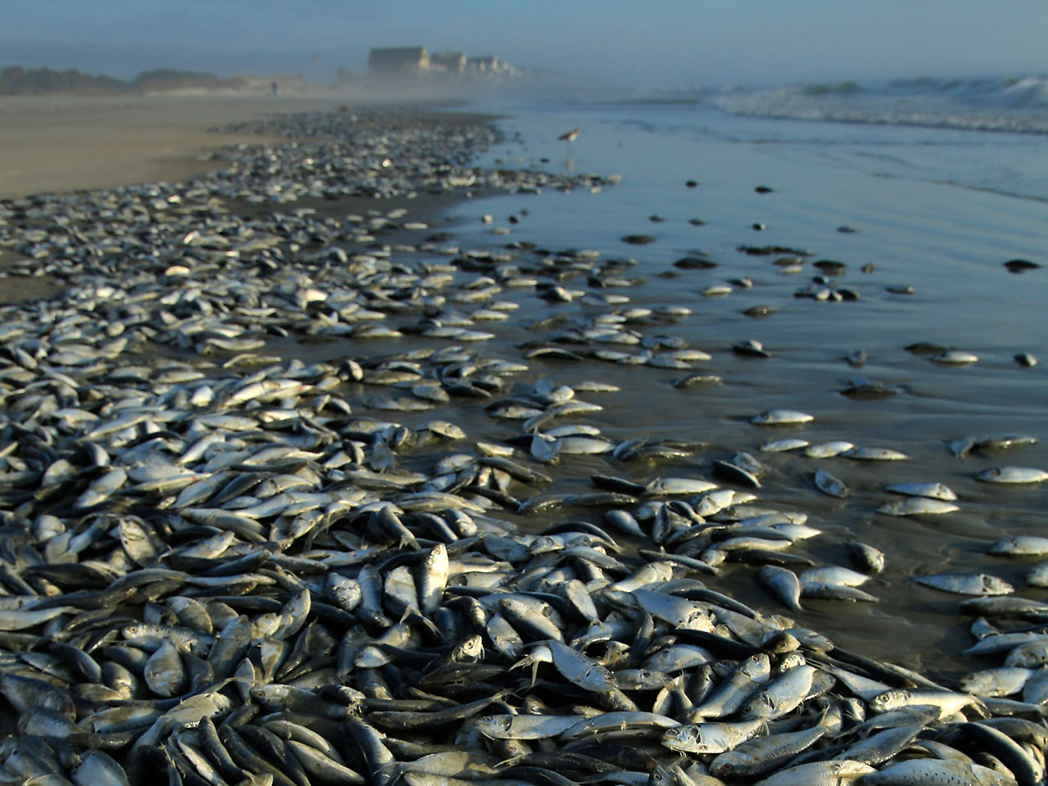
Can some one tell us why we let the ocean die

Slide 34

Why why if we're all the same
Tell me why why why do we pass the blame
Tell me why why why does it never end

Slide 35
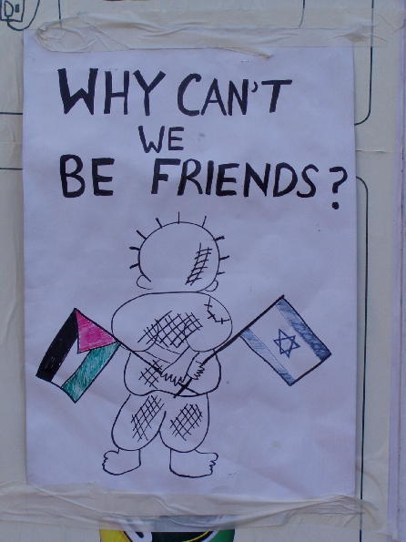
Can some one tell us why we cannot just be friends

Slide 36
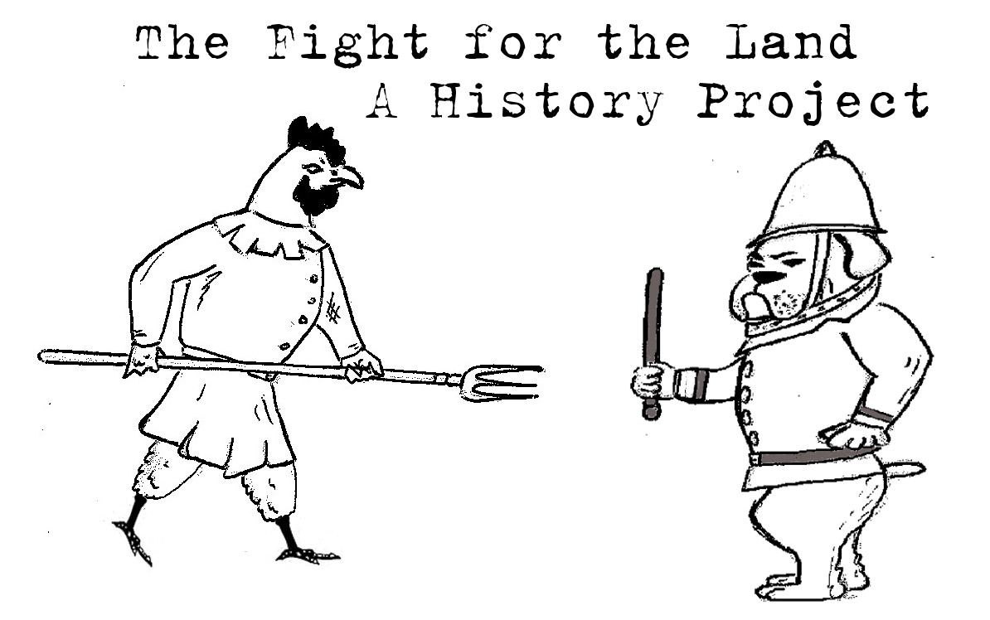
Why why do we close our eyes
Why why do the greedy lie
Why why do we fight for land

Slide 37

Can someone tell us why cos we don't understand

