Slide 1
High school
musical
Teacher
teacher
U15L2 Different schools
Song: high school musical
Singer: cast
Editor: 李彤瑶
单位：华南师范大学
华南师范大学
李彤瑶

Slide 2
Looking forward from center stage
to graduation day
time to get the future started!

Slide 3
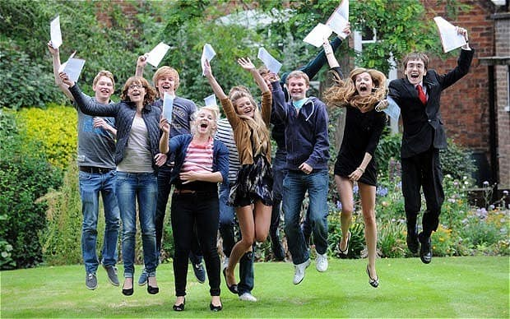
What we leave when we take with us no matter what
it's something we're a part of!

Slide 4
We learn to fly together side-by-side (Side-by-side)

Slide 5
I just hope the rest of my life to feel as good as my

Slide 6
High school musical!

Slide 7
Who says we have to let it go
its the best part weve ever known

Slide 8
Step into the future
but hold on to

Slide 9
High school musical!

Slide 10
Lets celebrate where we come from

Slide 11
The friends whove been there all along, just like

Slide 12
A High school (High School!) Musical!

Slide 13
Improvisation without a script
no ones written it
and now we have the chance too!

Slide 14
Someday we'll be lookin' back
Memories we'll have
all the songs that we lived through!

Slide 15
The best of times
so why leave them behind.

Slide 16
Why cant the rest of my life

Slide 17
Be like

Slide 18
High school musical!（yeah）

Slide 19
Who
says we have to let it go?

Slide 20
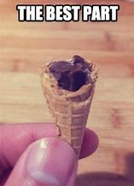
It's the best part we've ever known, (Yeah!)

Slide 21
Step into the future!

Slide 22
We'll hold on to

Slide 23
High school musical!

Slide 24
Lets celebrate where we come from

Slide 25
With friends who've been there all along, just right! (Thats right!)

Slide 27
Now we finally realize

Slide 28
it just took some time

Slide 29
You have to learn and live to see the truth

Slide 30
Learn to see the truth!

Slide 31
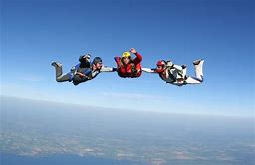
Nothing's ever impossible
into the future we all freefall!

Slide 32
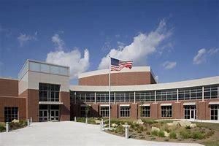
If and forever we'll always have High Schooool!

Slide 33
(Hiiiiiigh!)

Slide 34
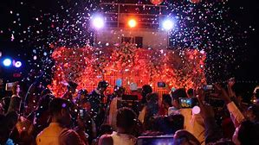
Turn the party, now celebrate!

Slide 35
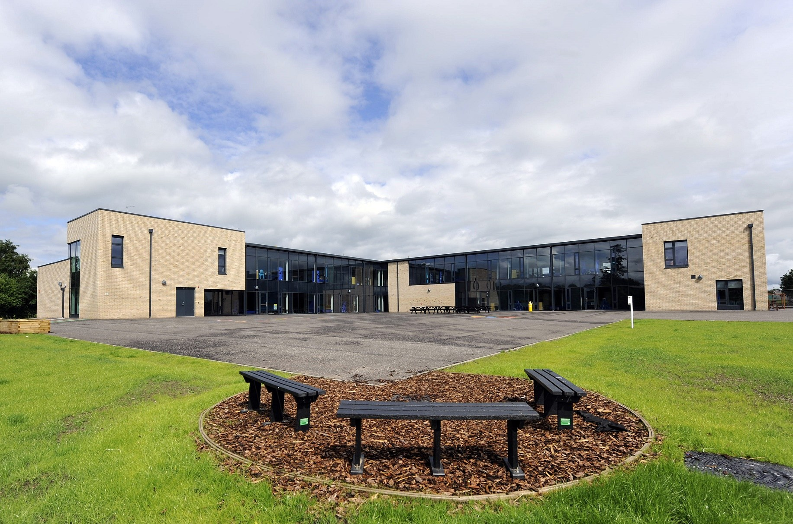
Schoool！

Slide 36
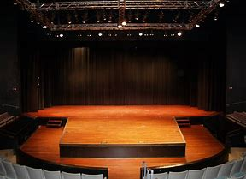
Cause the worlds one big stage

Slide 38
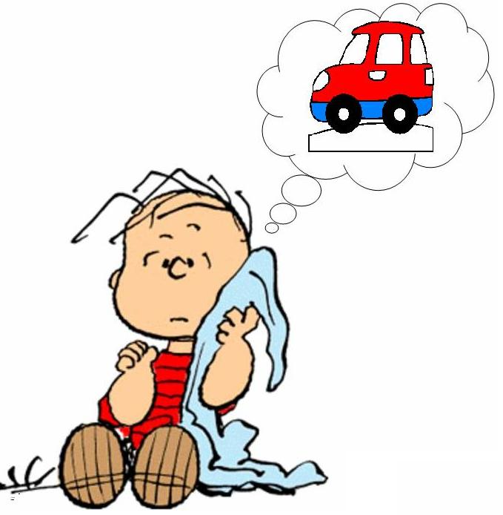
and in it what you want
it can be yours!

Slide 39
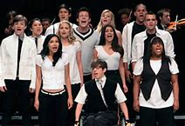
Everybody sing, yeah!

Slide 40
(Hiiiiiigh!)

Slide 41
Can it show us where we wanna go?

Slide 42
Its where the status is we know.

Slide 43
Schoool！

Slide 44
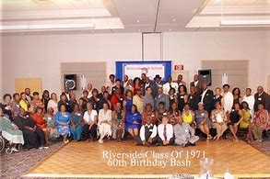
High school, lives on for Ever More

Slide 45
High school, High School Musical!

Slide 46
High school musical! (Yeah! Woooo!)

Slide 47
Who says we have to let it go

Slide 48
It's the best part we've ever known

Slide 49
Step into the future! (Heyy!)

Slide 50
But hold onto High school musical (Musical!)

Slide 51
Lets celebrate where we come from（ celebrate）

Slide 52
The friends whove been there all along! Oh yeeaaah!

Slide 53
I’ve always remembered being like a,

Slide 54
High school musical! (Yeeeeaaaaah!)

Slide 55
Who says we have to let it go

Slide 56
It's the best part we've ever known,(come on!)

Slide 57
Step into the future
but hold on to

Slide 58
High school musical, (Musical!)

Slide 59
Lets celebrate where we come from (Oooh, Yeah!)

Slide 60
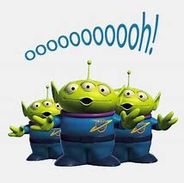

Slide 61
There’s a better!

Slide 62
Memories that last forever!!

Slide 63
I want the rest of
My life too
Feel just like
A (Feel just like a!)

Slide 64
HIGH SCHOOL MUSICAL!

