Slide 1
U15L1, Life-long Learning
Song: It’s My Life
Singer: Bon Jovi
作者：黄芷珺
单位：华南师范大学

Slide 2
This ain't a song
for the broken-hearted

Slide 3
No silent prayer for the faith-departed

Slide 4
I ain't gonna be
just a face in the crowd

Slide 5
You're gonna hear my voice

Slide 6
When I
shout it out loud

Slide 7
It's my life

Slide 8
I t ’ s NOW
OR NEVER

Slide 9
I ain't gonna live forever

Slide 10
I just want to live while I'm alive

Slide 11
(It's my life)
My heart is like an open highway

Slide 12
Like Frankie said
I did it my way

Slide 13
I just wanna live while I'm alive

Slide 14
It’s My Life

Slide 15
This is for the ones
who stood their ground

Slide 16
For Tommy and Gina
who never backed down

Slide 17
Tomorrow's getting harder make no mistake

Slide 18
Luck ain't even lucky

Slide 19
Got
to
make
your
own
breaks

Slide 20
It's my life

Slide 21
And it's
now or never

Slide 22
I ain't gonna live forever

Slide 23
I just want to live while I'm alive

Slide 24
(It's my life)
My heart is like an open highway

Slide 25
Like Frankie said
I did it my way

Slide 26
I just wanna live while I'm alive

Slide 27
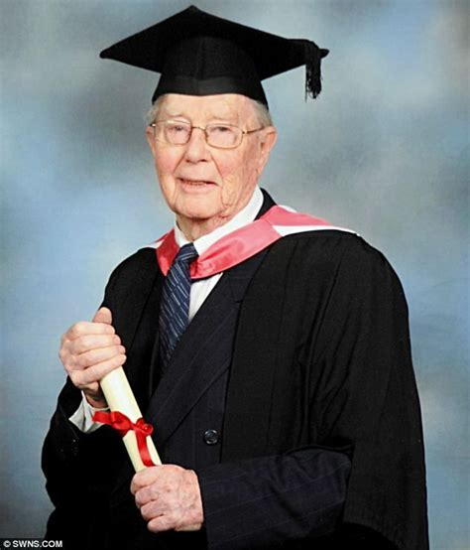
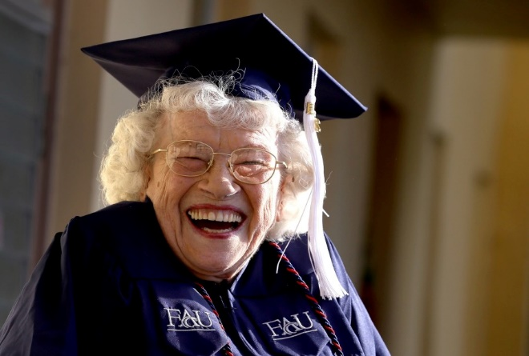
It’s
My
Life

Slide 28
Better stand tall
when they're calling you out

Slide 29
baby, don't back down
Don't bend,
don't break,

Slide 30
It's
my
life
And
it's
now
or
never

Slide 31
I ain't gonna live forever

Slide 32
I just want to live while I'm alive

Slide 33
(It's my life)
My heart is like an open highway

Slide 34
Like Frankie said
I did it my way

Slide 35
I just want to live while I'm alive

Slide 36
It’s My Life

Slide 37
And it’s now or never

Slide 38
I ain't gonna live forever

Slide 39
I just want to live while I'm alive

Slide 40
(It's my life)
My heart is like an open highway

Slide 41
Like Frankie said
I did it my way

Slide 42
I just want to live while I'm alive

Slide 43
It’s My Life

