Slide 1
SHE, U14L3, Success-“Nine to Five”
Song: What Faith can Do (Kutless)
Editor: 蓝碧琪
单位：华南师范大学
WHAT FAITH CAN DO

Slide 2
Everybody falls sometimes
Gotta find the strength to rise

Slide 3
From the ashes
And make a new beginning

Slide 4
Anyone can feel the ache
You think it's more than you can take

Slide 5
But you're stronger
Stronger than you know

Slide 6
Don't you give up now
The sun will soon be shining

Slide 7
You gotta face the clouds
To find the silver lining

Slide 8
I've seen dreams that move the mountains
Hope that doesn't ever end
Even when the sky is falling

Slide 9
I've seen miracles just happen
Silent prayers get answered
Broken hearts become brand new

Slide 10
That's what faith can do

Slide 12
It doesn't matter what you've heard
Impossible is not a word

Slide 13
It's just a reason
For someone not to try

Slide 14
Everybody's scared to death

Slide 15
When they decide to take that step
Out on the water

Slide 16
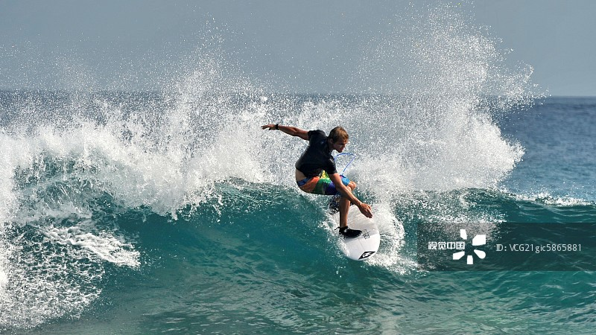
It'll be alright

Slide 17
Life is so much more
Than what your eyes are seeing

Slide 18
You will find your way
If you keep believing

Slide 19
I've seen dreams that move the mountains
Hope that doesn't ever end
Even when the sky is falling

Slide 20
I've seen miracles just happen

Slide 21
Silent prayers get answered
Broken hearts become brand new
That's what faith can do

Slide 22
Overcome the odds
You don't have a chance

Slide 23
When the world says you can't
It'll tell you that you can

Slide 24
I've seen dreams that move the mountains
Hope that doesn't ever end
Even when the sky is falling

Slide 25
And I've seen miracles just happen
Silent prayers get answered
Broken hearts become brand new

Slide 26
That's what faith can do

Slide 27
Even if you fall sometimes
You will have the strength to rise

