Slide 1
U14L1-Careers-Be what you wanna be
By Darin Zanyar
覃晓慧
华南师范大学

Slide 2
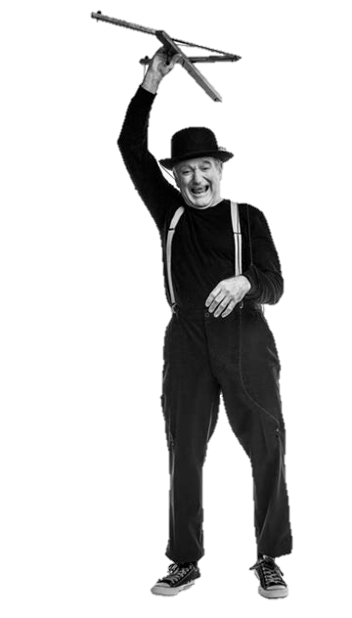
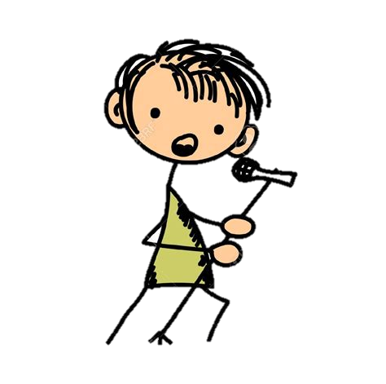
Doctor, actor, lawyer or a singer

Slide 3
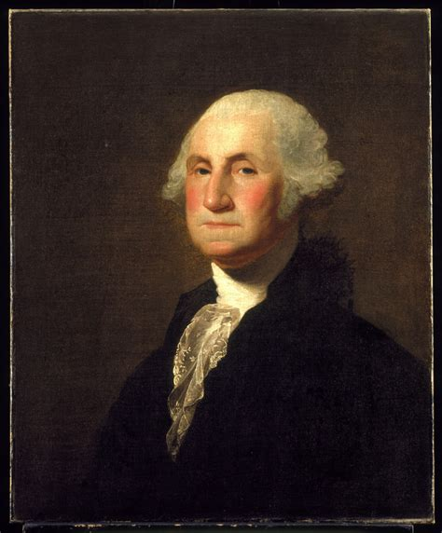
Why not president, be a dreamer
You can be just the one you wanna be

Slide 4
Police man, fire fighter or a post man
Why not something like your old man
you can be just the one you wanna be

Slide 5
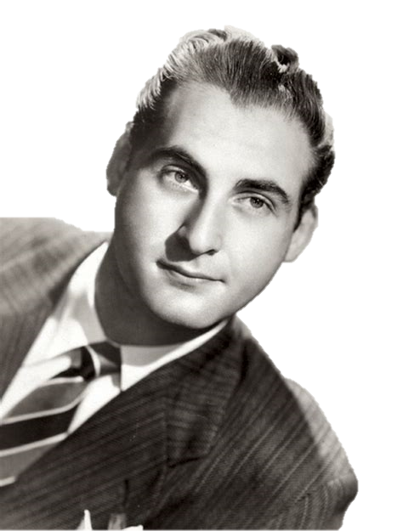
Doctor, actor, lawyer or a singer
You can be just the one
you wanna be
Why not president, be a dreamer

Slide 6
I know that we all got one thing
that we all share together.
We got that one nice dream
we live for.

Slide 7
You never know what life could bring,
cause nothing last for ever.
Just hold on to the team
you play for.

Slide 8
I know you could reach the top
Make sure that you won't stop
Be the one that you wanna be
Now sing this with me

Slide 9
Doctor, actor, lawyer or a singer
You can be just the one
you wanna be
Why not president, be a dreamer

Slide 10
Police man, fire fighter or a post man
Why not something like your old man
you can be just the one you wanna be

Slide 11
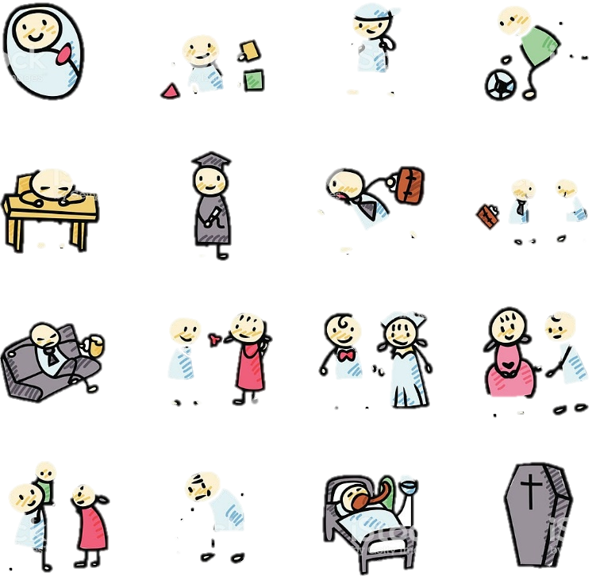
We may have different ways to think
but it doesn't really matter
we all caught up in the steam of this life
focus on every little thing
that's what does really matter

Slide 12
Luxury cars and bling
that's not real life

Slide 13
I know you could reach the top
Make sure that you won't stop
Be the one that you wanna be
Now sing this with me

Slide 14
Doctor, actor, lawyer or a singer
You can be just the one
you wanna be
Why not president, be a dreamer

Slide 15
Police man, fire fighter or a post man
Why not something like your old man
you can be just the one you wanna be

Slide 16
Thanks for watching!

