Slide 1
PEP,U13L2,Personalities and Jobs
Song: Be What You Wana Be
Singer:Darin
Editor:黄丽华
单位：华南师范大学

Slide 2
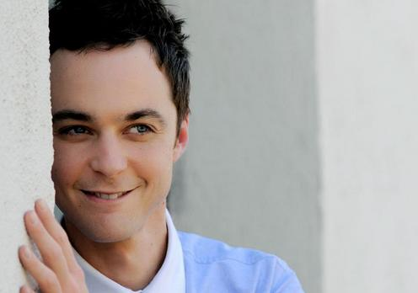
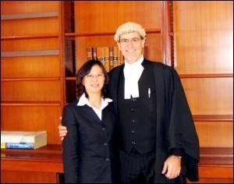
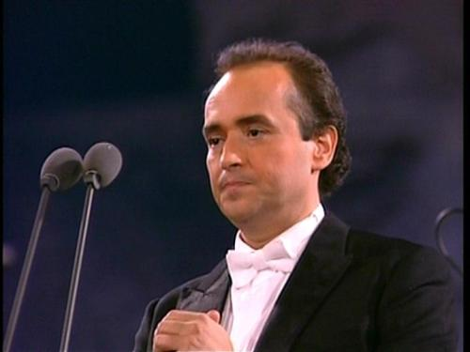
doctor, actor, lawyer or a singer

Slide 3
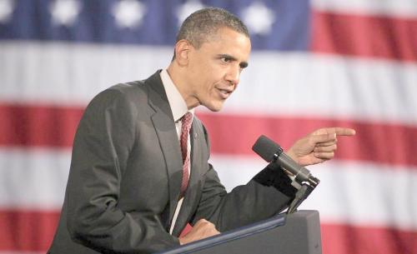
why not president, be a dreamer

Slide 4
you can be just the one you wanna be

Slide 5
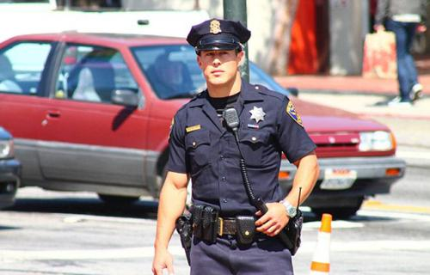
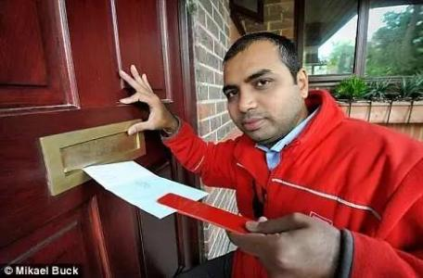
police man, fire fighter or a post man

Slide 6
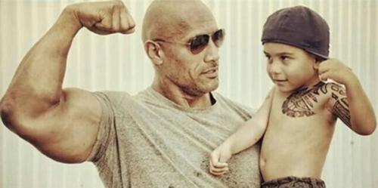
why not something like your old man

Slide 7
you can be just the one you wanna be

Slide 8
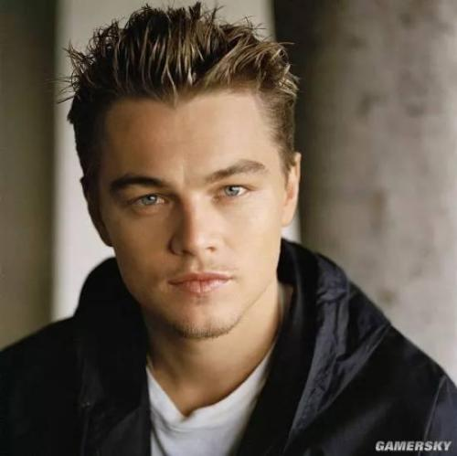
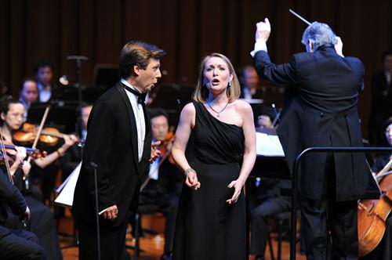
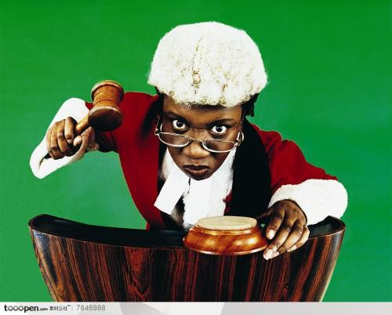
doctor, actor, lawyer or a singer

Slide 9
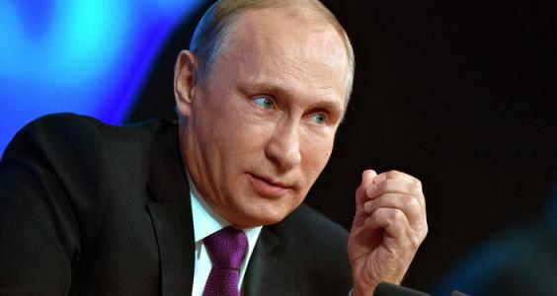
why not president, be a dreamer

Slide 10
you can be just the one you wanna be

Slide 11
i know that we all got one thing

Slide 12
that we all share together

Slide 13
we got that one nice dream

Slide 14
we live for

Slide 15
you never know what life could bring

Slide 16
coz nothing last for ever

Slide 17
just hold on to the team
you play for

Slide 18
i know you could reach the top

Slide 19
make sure that you won't stop

Slide 20
be the one that you wanna be

Slide 21
now sing this with me

