Slide 1
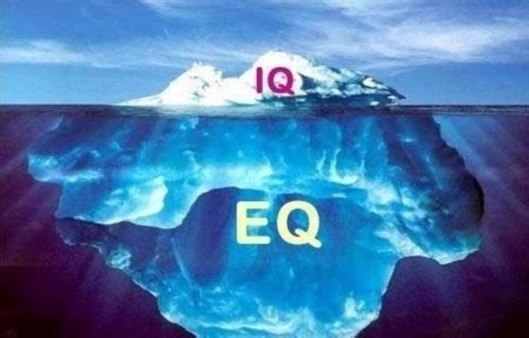
U13L1，EQ：IQ
Song: The Emotional Intelligence Song
Singer: Kristopher Stone
Editor: 蔡淑璇
单位：华南师范大学
教育信息技术学院

Slide 2
There’s a new kind of intelligence needed
So that history stops getting repeated.

Slide 3
There's something we all need
For our lives to make sense.
It's called emotional intelligence.

Slide 4
For me and for you
What it means is emotional literacy
You might hear it called EI or EQ.

Slide 5
with more and more emotional literacy.
What a wonderful world it's going to be
Emotional intelligence develops the mind
and helps us makes sense of our feelings inside.

Slide 6
is going to take more than “I hope and I care”!
Now peace has been sung about in many song
Everyone wants that we all get along.
Yet finding a road map to get us all there.

Slide 7
with more and more emotional literacy.
What a wonderful world it's going to be
Emotional intelligence develops the mind
and helps us makes sense of our feelings inside.

Slide 8
There’s a new kind of intelligence needed
So that history stops getting repeated.

Slide 9
without stuffing them down or acting them out
Managing feelings is what it's about

Slide 10
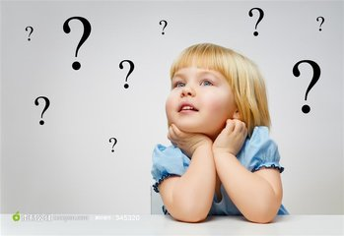
with more and more emotional literacy.
What a wonderful world it's going to be
Emotional intelligence develops the mind
and helps us makes sense of our feelings inside.

Slide 11
or we can learn a better way to be
We can drown in our unchecked feelings
or create more harmony
Emotions can do a lot of harm

Slide 12
with more and more emotional literacy.
What a wonderful world it's going to be
Emotional intelligence develops the mind
and helps us makes sense of our feelings inside.

Slide 13
We can build world harmony!
with more and more emotional literacy.
What a wonderful world it's going to be
Emotional intelligence develops the mind
and helps us makes sense of our feelings inside.

