Slide 1
请找找看这支视频里
有多少个广告吧
教材版本：北京师范大学出版社高中英语必修四
课文主题：U11L3- THE ADVERTISING GAME
歌曲名称：NEW SOUL ( APPLE MACBOOK 08 CM SONG)
单位：华南师范大学
作者：邱明丽

Slide 2
I'm a new soul

Slide 3
I came to this strange world

Slide 4
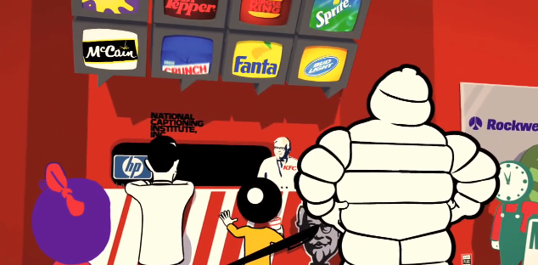
G I V E
&
T A K E
Hoping I could learn a bit about how to give and take

Slide 5
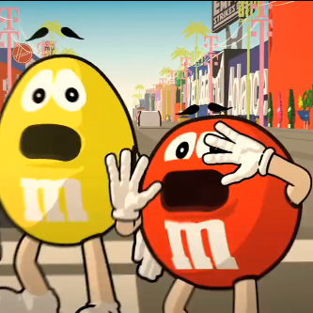
F E A R
J O Y
&
But since I came here, felt the joy and the fear

Slide 6
Finding myself making every possible mistake

Slide 7
La, la, la, la ……

Slide 8
La, la, la, la ……

Slide 9
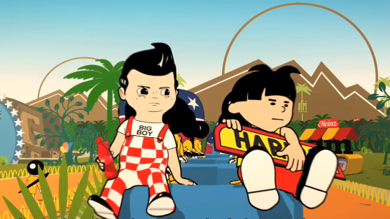
See I'm a young soul in this very strange world

Slide 10
T R U E
F A K E
&
Hoping I could learn a bit about what is true and fake

Slide 11
But why all this hate try to communicate

Slide 12
Finding trust and love is not always easy to make

Slide 13
La, la, la, la ……

Slide 14
La, la, la, la ……

Slide 15
This is a happy end

Slide 16
Cause you don't understand

Slide 17
Everything you have done

Slide 18
Why's everything so wrong

Slide 19
This is a happy end

Slide 20
Come and give me your hand

Slide 21
I'll take you far away

Slide 22
I'm a new soul

Slide 23
I came to this strange world

Slide 24
G I V E
&
T A K E
Hoping I could learn a bit about how to give and take

Slide 25
F E A R
J O Y
&
But since I came here, felt the joy and the fear

Slide 26
Finding myself making every possible mistake

Slide 27
New soul... la, la, la, la,...

Slide 28
In this very strange world...

Slide 29
Every possible mistake

Slide 30
END
Thanks for your watching
@IRIS

