Slide 1
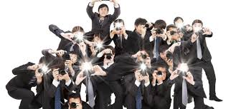
Paparazzi
高中英语北师大版
U11L2 Paparazzi
Song：Paparazzi
作者：李瑜
单位：华南师范大学

Slide 2
We are the crowd

Slide 3
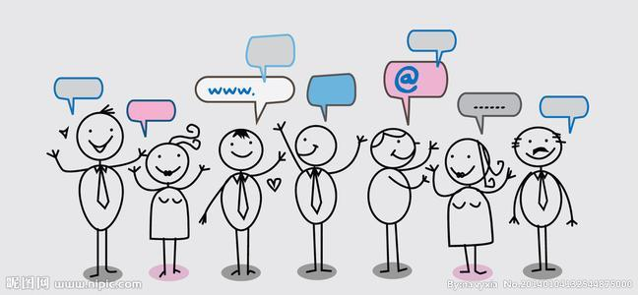
We're c-comin' out

Slide 4
Got my flash
on it's true

Slide 5
Need that picture of you

Slide 6
It's so magical

Slide 7
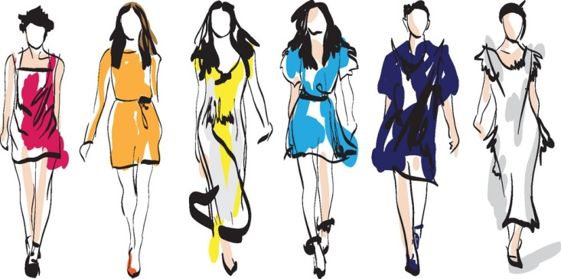
We'd be so fantastico

Slide 8
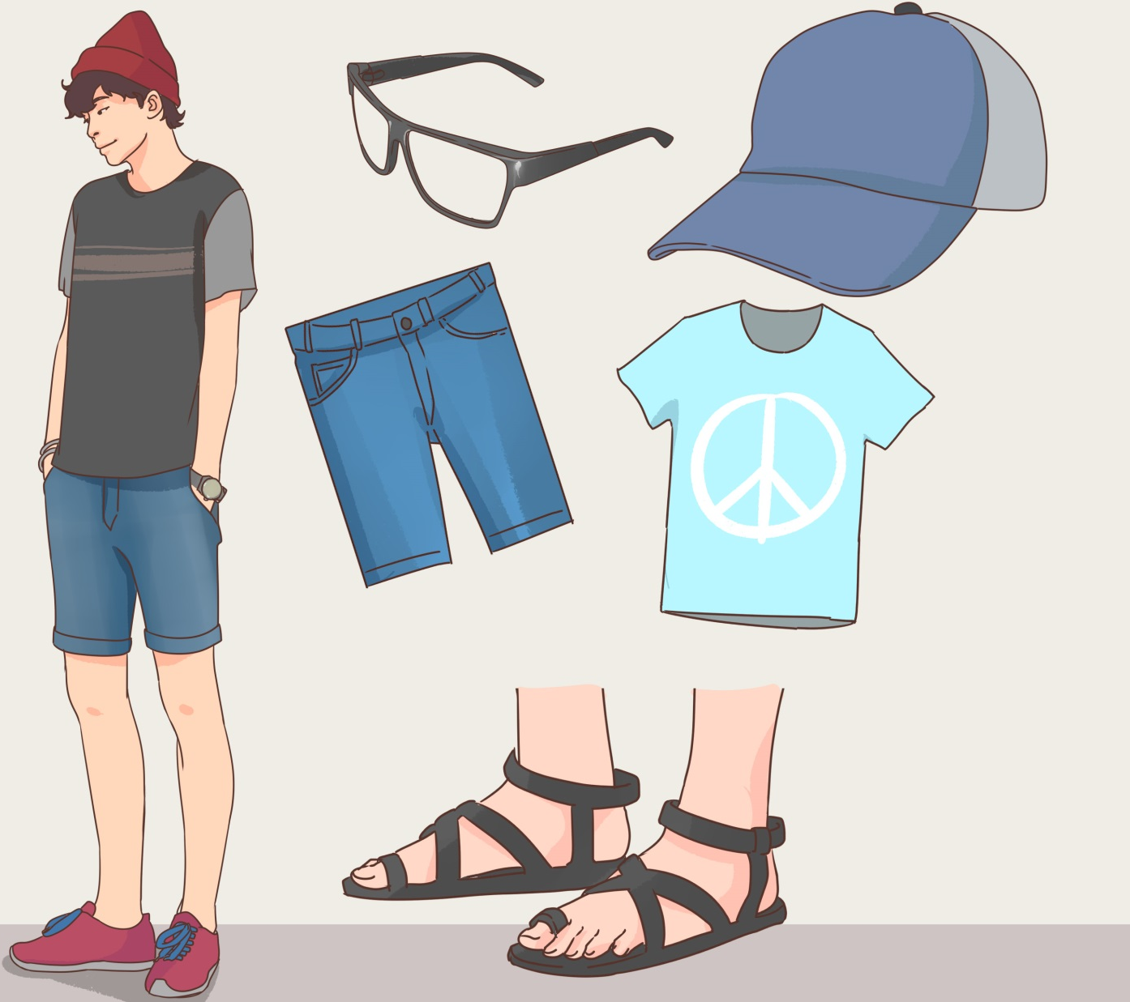
Leather and jeans
Garage Glamorous

Slide 9
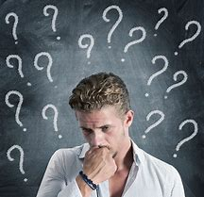
Not sure what it means

Slide 10
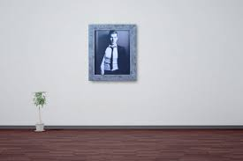
But this photo of us it don't have a price

Slide 11
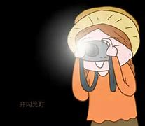
Ready for those flashing lights

Slide 12
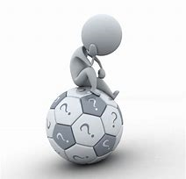
Cause you know that baby I...

Slide 13
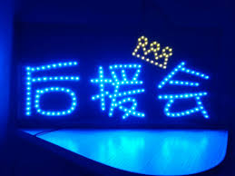
I'm your biggest fan

Slide 14
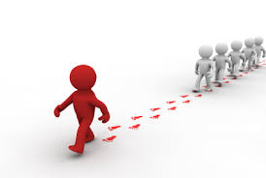
I'll follow you until you love me

Slide 15
Papa-Paparazzi

Slide 16
Baby there's no other superstar

Slide 17
You know that I'll be your...

Slide 18
Papa-Paparazzi

Slide 19
Promise I'll be kind

Slide 20
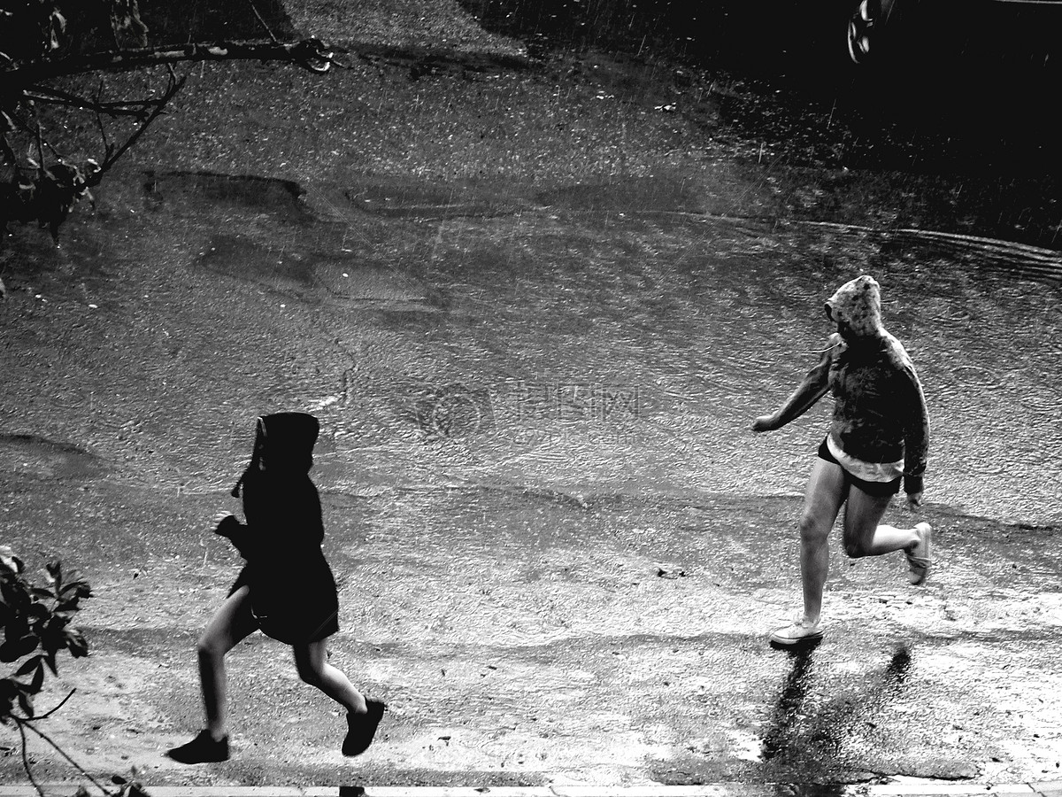
But I won't stop until that boy is mine

Slide 21
Baby you'll be famous

Slide 22
Chase you down until you love me

Slide 23
Papa-Paparazzi

Slide 24
I'll be your girl

Slide 25
Backstage at your show

Slide 26
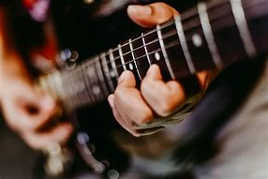
Velvet ropes and guitars

Slide 27
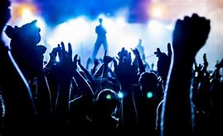
Yeah, cause you're my rock star In between the sets

Slide 28
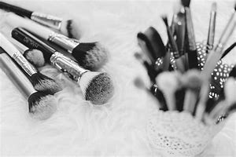
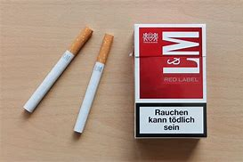
Eyeliner and cigarettes

Slide 29
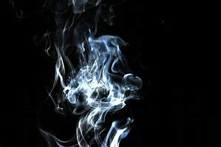
Shadow is burnt

Slide 30
Yellow dance and we turn

Slide 31
My lashes are dry

Slide 32
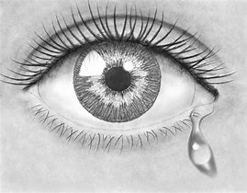
Purple teardrops I cry

Slide 33
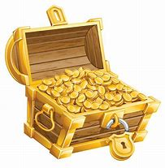
It don't have a price

Slide 34
Loving you is cherry pie

Slide 35
Cause you know that baby I...

Slide 36
I'm your biggest fan

Slide 37
I'll follow you until you love me

Slide 38
Papa-Paparazzi

Slide 39
Baby there's no other superstar

Slide 40
You know that I'll be your...

Slide 41
Papa-Paparazzi

Slide 42
Promise I'll be kind

Slide 43
But I won't stop until that boy is mine

Slide 44
Baby you'll be famous

Slide 45
Chase you down until you love me

Slide 46
Papa-Paparazzi

Slide 47
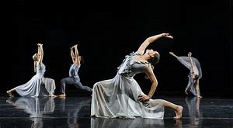
Real good, We dance in the studio
Snap Snap to that shit on the radio

Slide 48
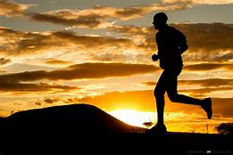
Don't stop for anyone

Slide 49
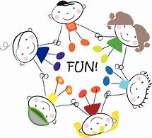
We're plastic, but we still have fun

Slide 50
I'm your biggest fan

Slide 51
I'll follow you until you love me

Slide 52
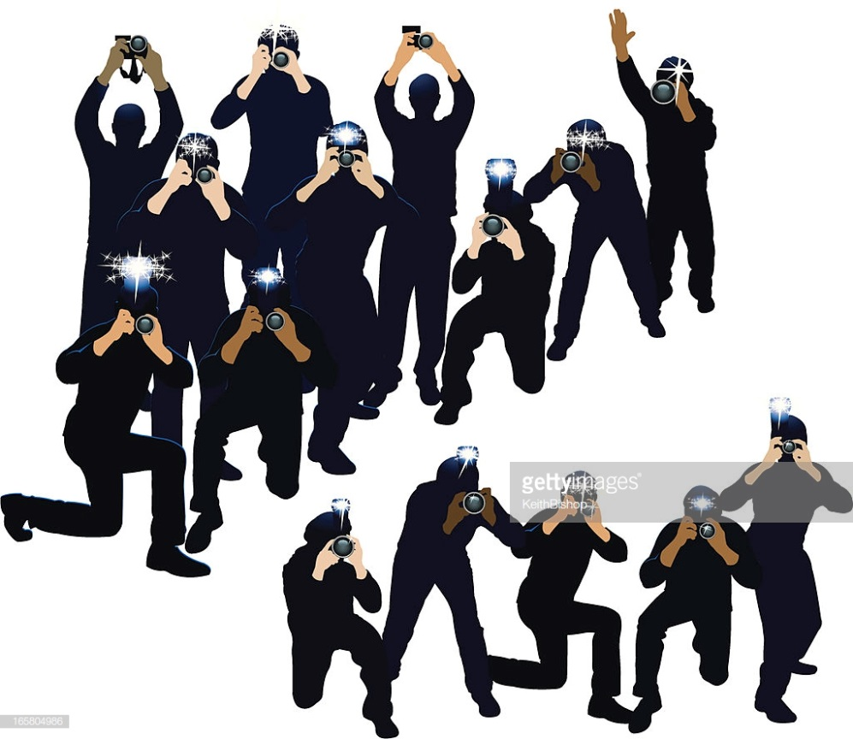
Papa-Paparazzi

Slide 53
Baby there's no other superstar

Slide 54
You know that I'll be your...

Slide 55
Papa-Paparazzi

Slide 56
Promise I'll be kind

Slide 57
But I won't stop until that boy is mine

Slide 58
Baby you'll be famous

Slide 59
Chase you down until you love me

Slide 60
Papa-Paparazzi

Slide 61
Thanks!

