Slide 1
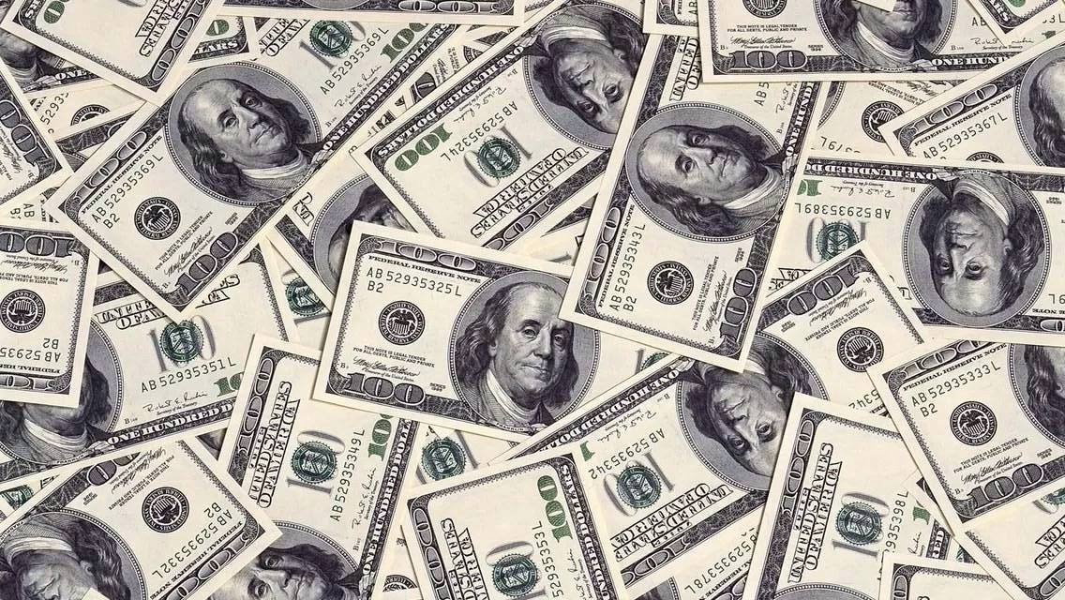
PEP, U10L3, “Your money”
Song: Price tag
Singer：Jessie J
Editor: 许曼栩
单位：华南师范大学

Slide 2
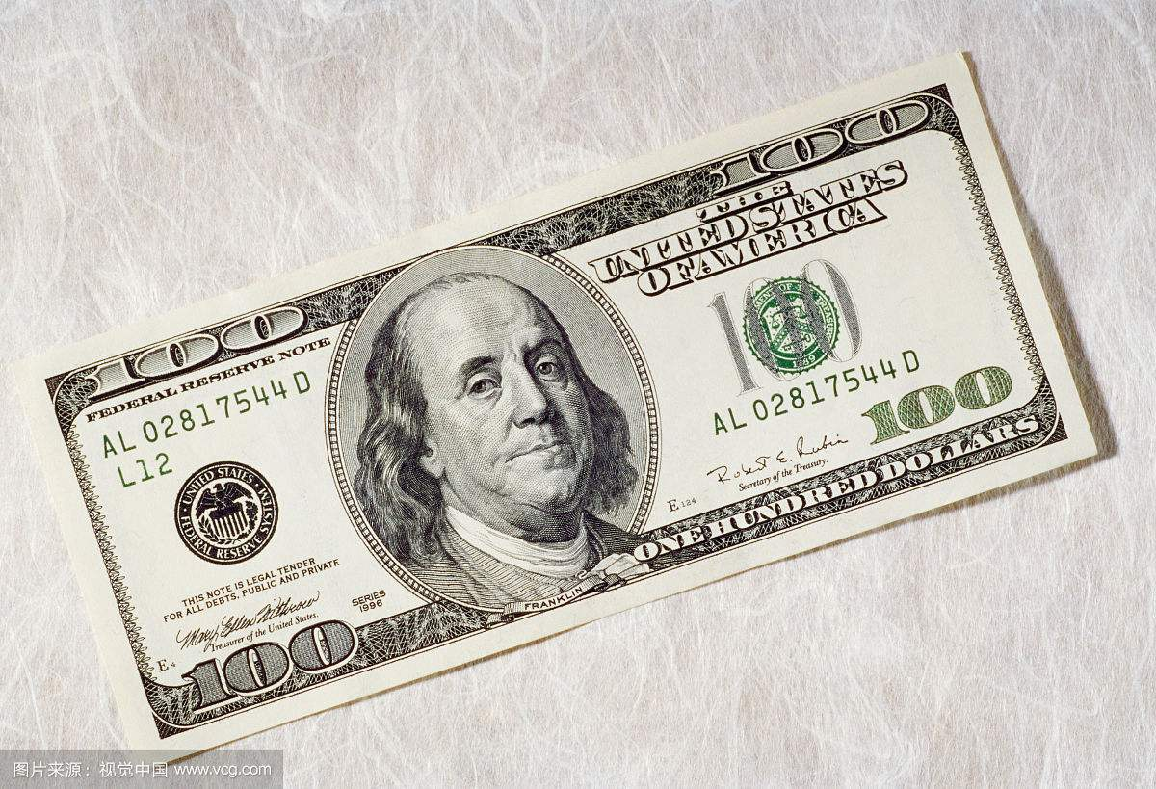
Okay ，coconut man，moon heads and pea
You ready?

Slide 3
Seems like everybody's got a price

Slide 4
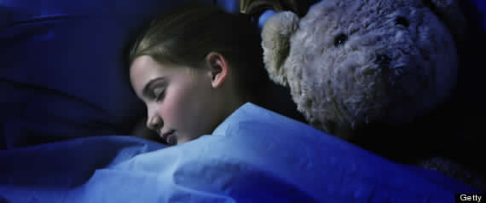
I wonder how they sleep at night

Slide 5
When the sale comes first
And the truth comes second

Slide 6
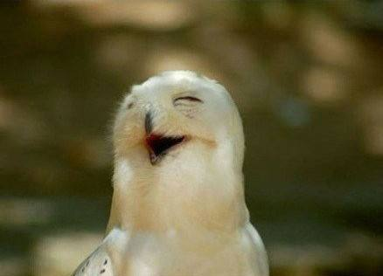
Just stop, for a minute and smile

Slide 7
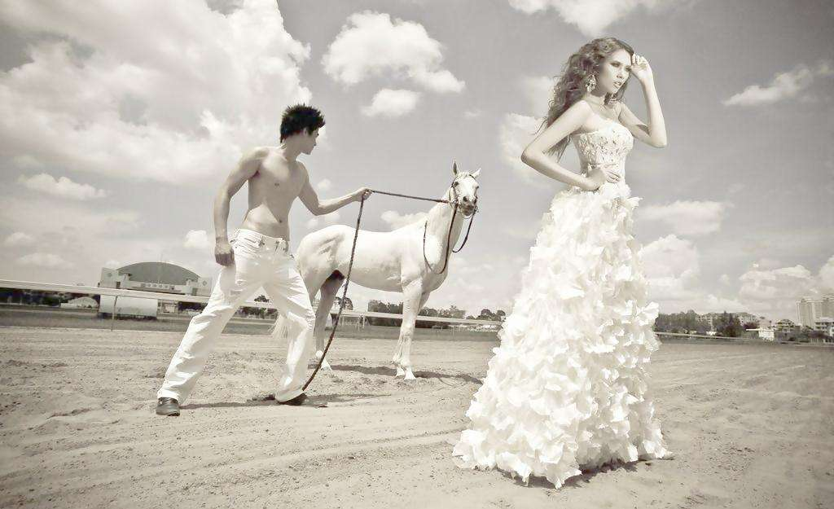
Why is everybody so serious
Acting so damn mysterious

Slide 8
You got your shades on your eyes
and your heels so high

Slide 9
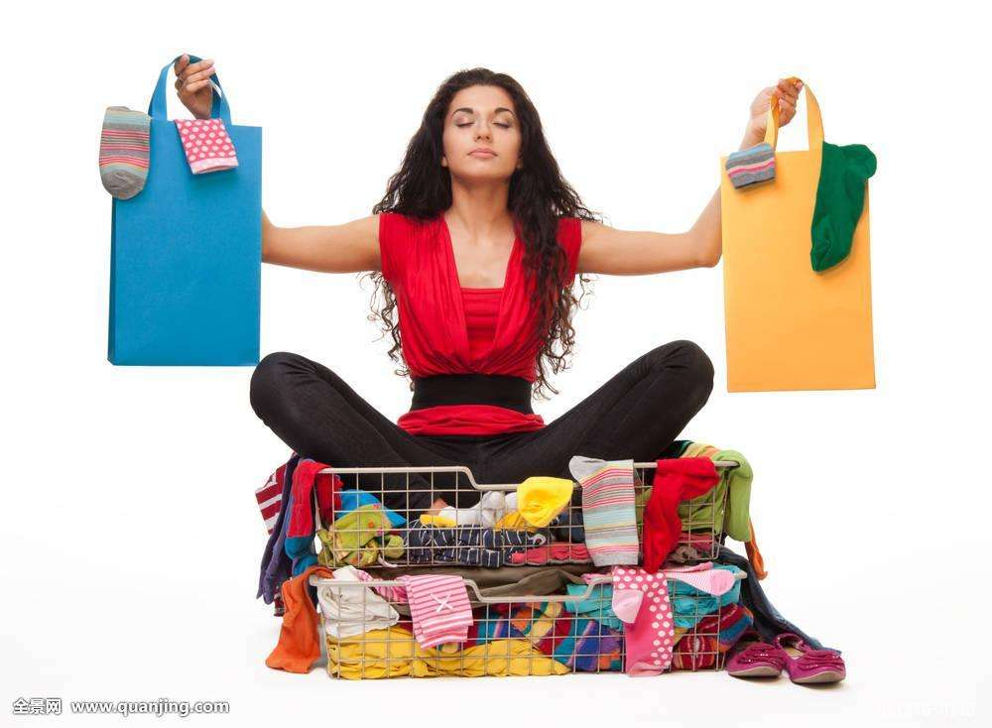
That you can't even have a good time

Slide 10
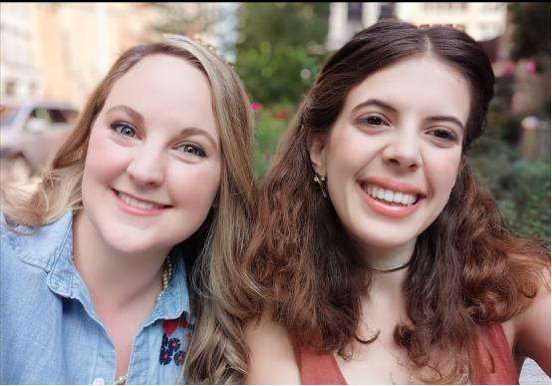
Everybody looks to their left (yeah)
Everybody looks to their right (ha)

Slide 11
Can you feel that (yeah)
We're pay them with love tonight

Slide 12
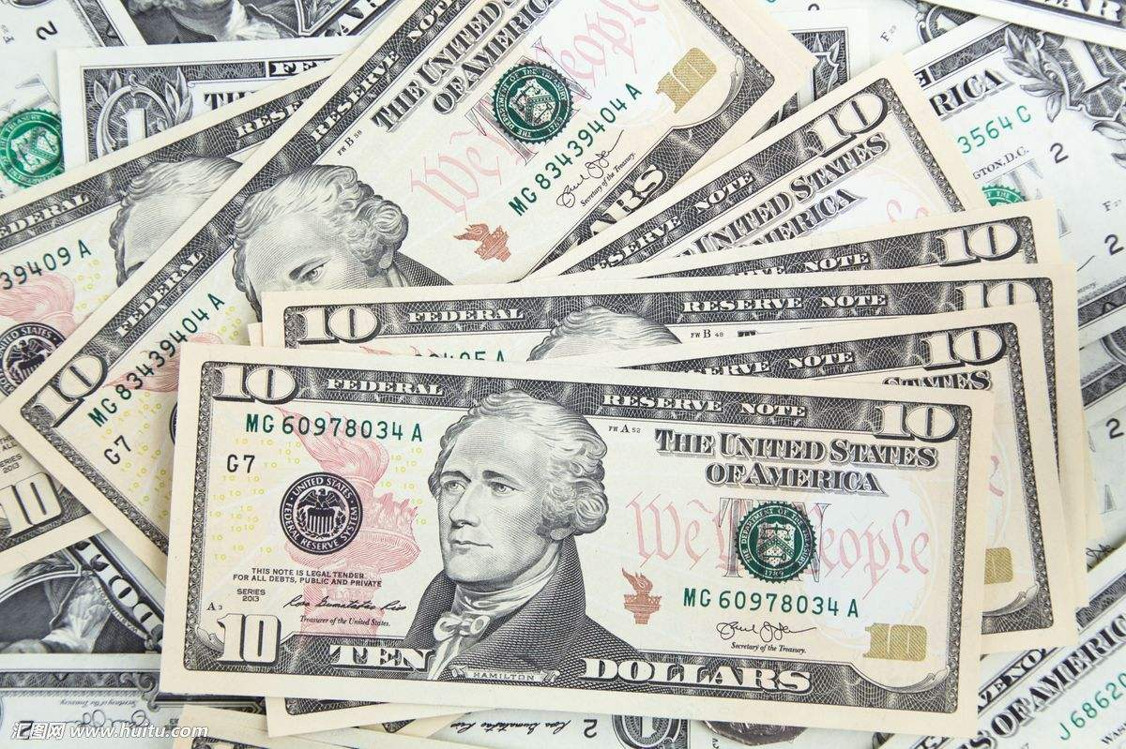
It's not about the money, money, money

Slide 13
We don't need your money, money, money
We just wanna make the world dance

Slide 14
Forget about the price tag
ain't about the (uh) ka-ching ka-ching
ain't about the (yeah) ba-bling ba-bling
wanna make the world dance

Slide 15
Forget about the price tag

Slide 16
We need to take it back in time
When music made us all unite!
and it wasn't low blows and video hoes

Slide 17
Am i the only one getting...tired?
Why is everybody so obsessed?
Money can't buy us happiness.
Can we all slow down and enjoy right now
Guarantee we'll be feeling all right.

Slide 18
Everybody looks to their left (yeah)
Everybody looks to their right (ha)

Slide 19
Can you feel that (yeah)
We're pay them with love tonight
It's not about the money, money, money

Slide 20
We don't need your money, money, money
We just wanna make the world dance

Slide 21
Forget about the price tag
ain't about the (uh) ka-ching ka-ching
ain't about the (yeah) ba-bling ba-bling
Wanna make the world dance
Forget about the price tag，ay ay ay

Slide 22
Thank you

