Slide 1
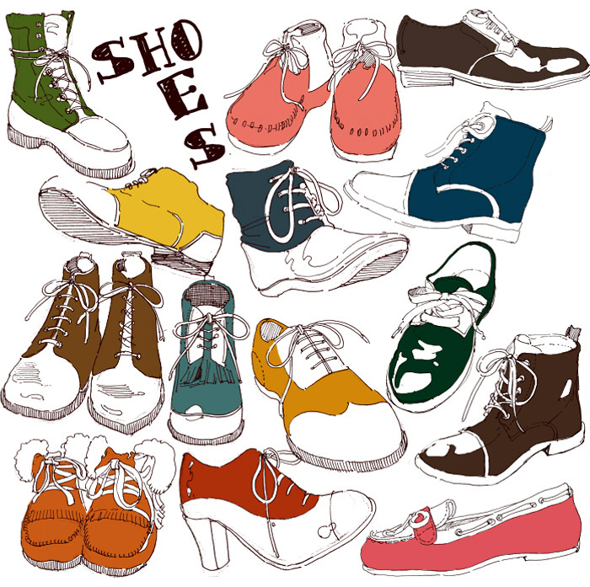
U10L2, The Right Price
Song: Shoe Shopping
Singer: Old Dominion
作者: 陈伟清
单位：华南师范大学

Slide 2
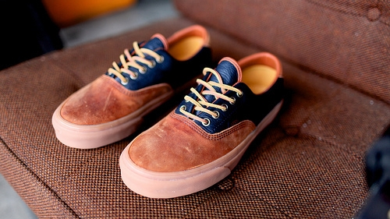
Some don’t last the way they should

Slide 3
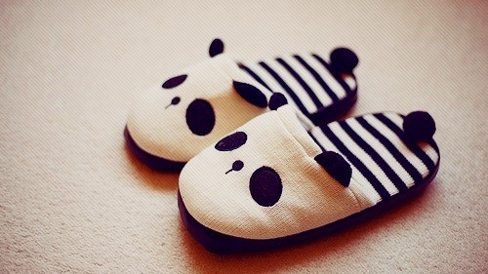
Some make you feel good for a little while

Slide 4
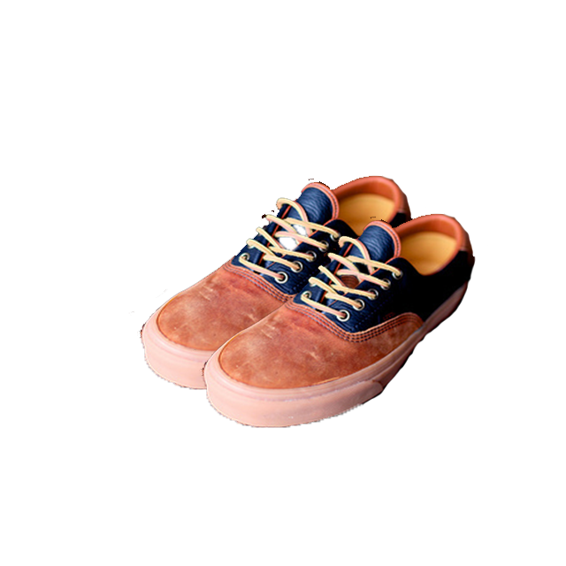
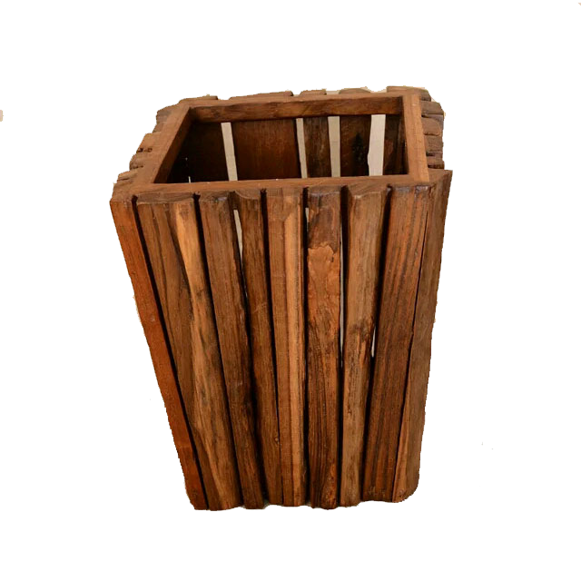
And then you throw them away

Slide 5
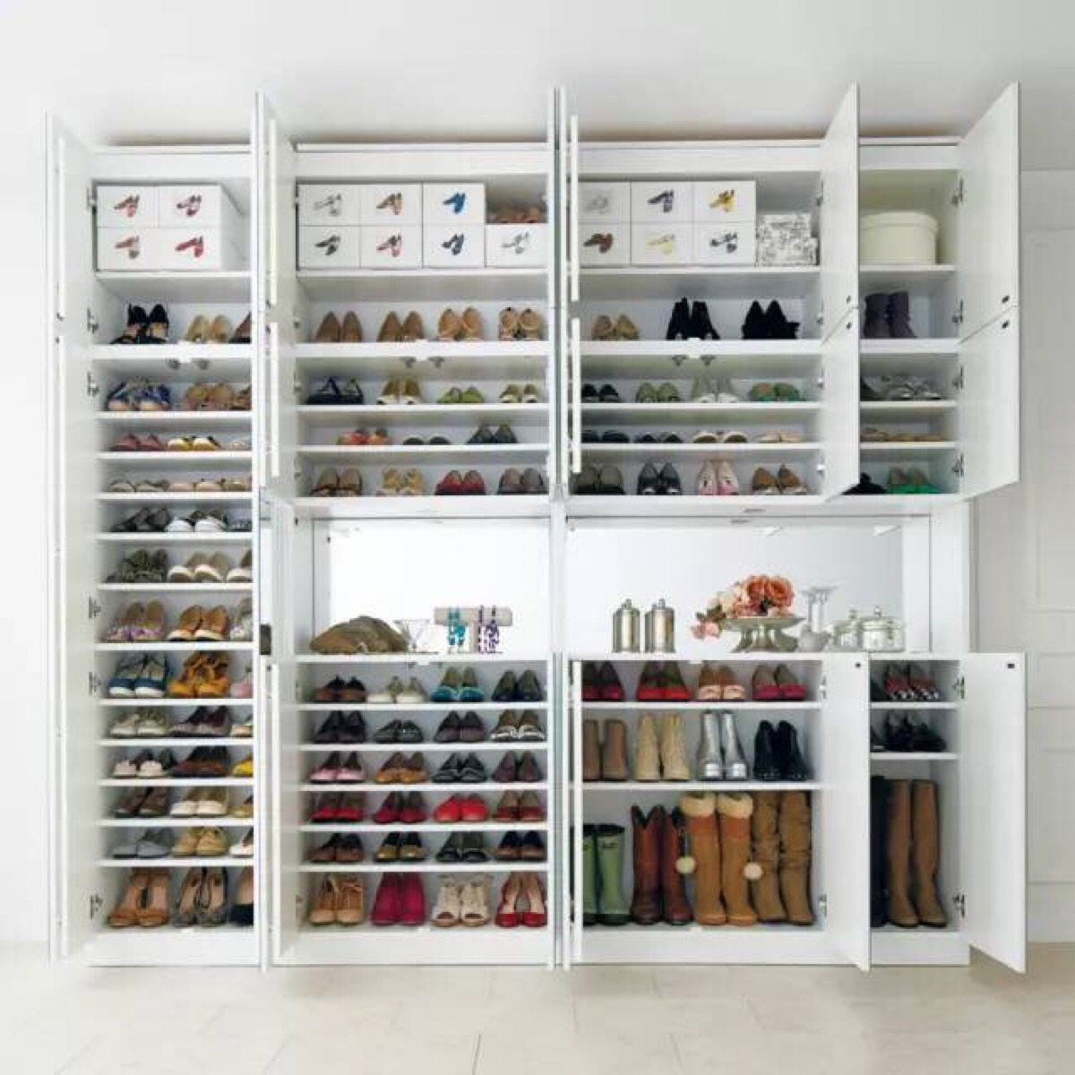
Some are up on a shelf for some other time

Slide 6
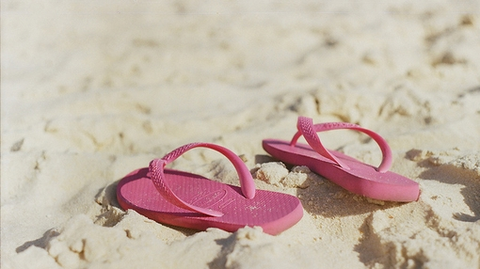
Some are high dollar some aren't worth a dime

Slide 7
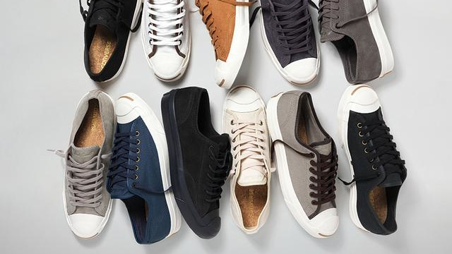
But you keep them anyway

Slide 8
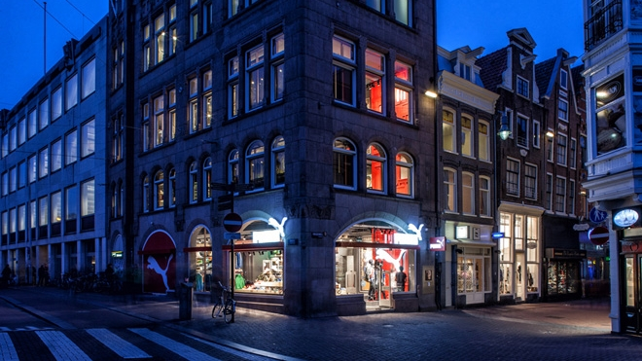
Everybody's looking for something

Slide 9
So how do I catch your eye eye eye

Slide 10
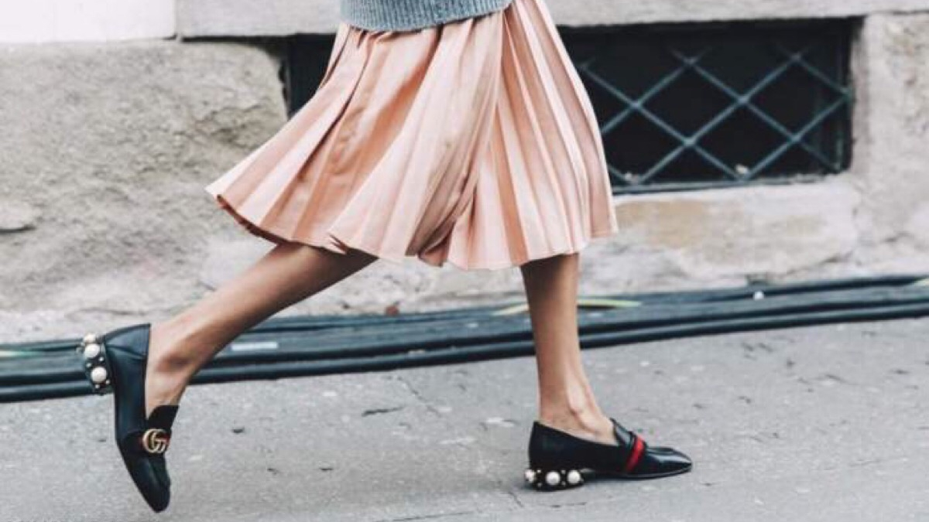
If you're shoe shopping walk a mile with me

Slide 11
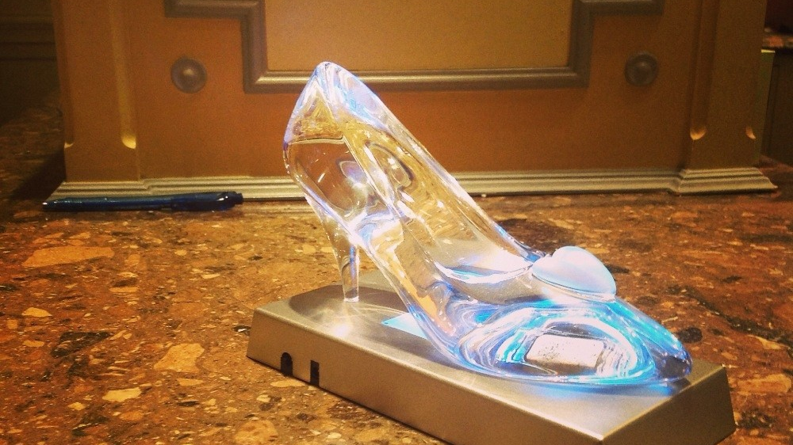
Slip a Cinderella slipper right on your feet

Slide 12
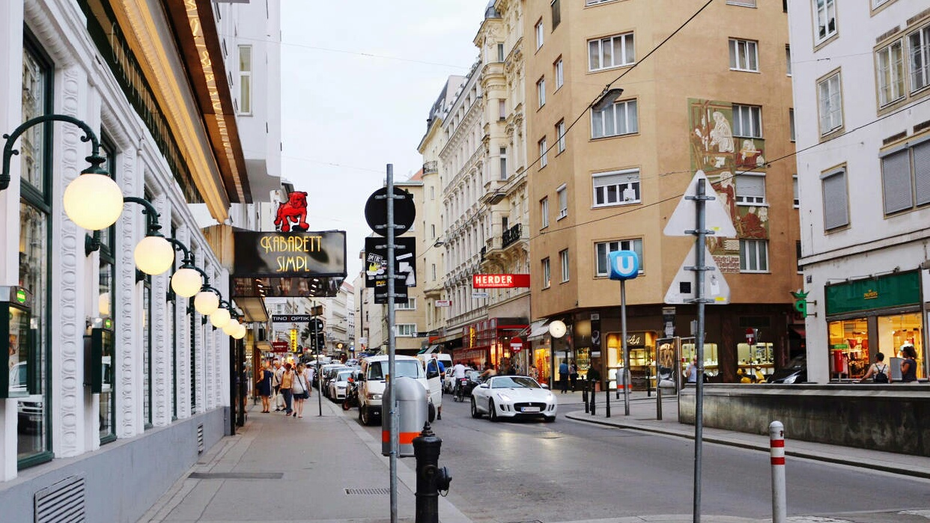
Take my arm strut down the street tonight

Slide 13
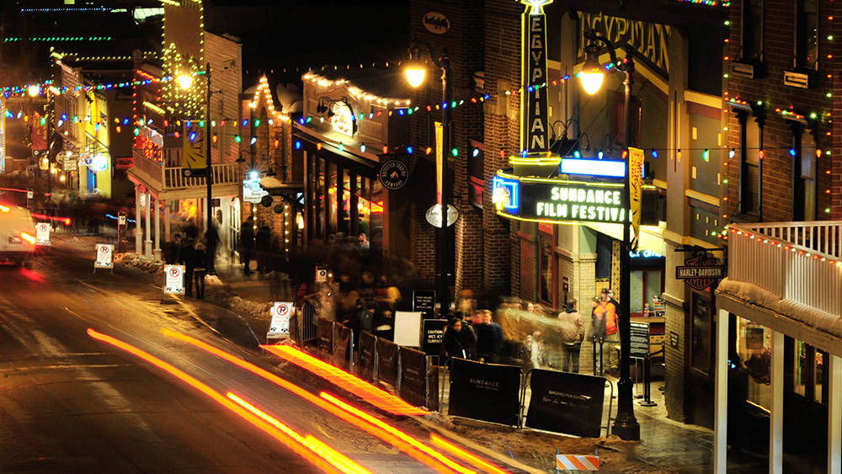
Strut down that street tonight

Slide 14
If you're downtown on the browse about

Slide 15
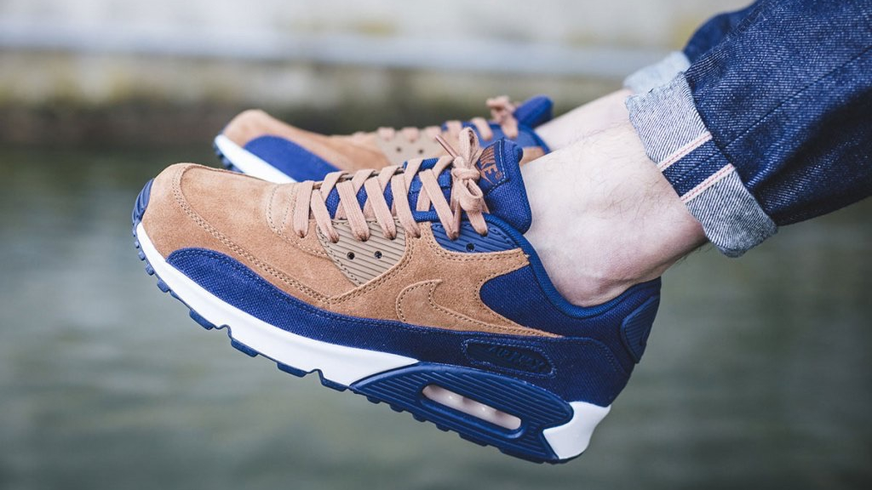
Looking for the perfect fit how's about

Slide 16
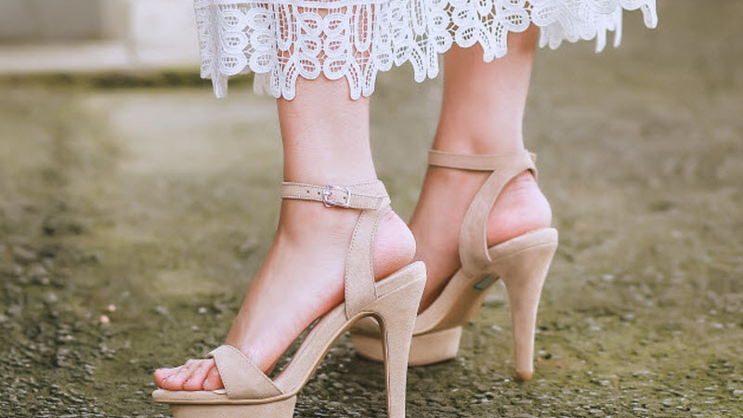
Some high heel high top pump them up flip flop

Slide 17
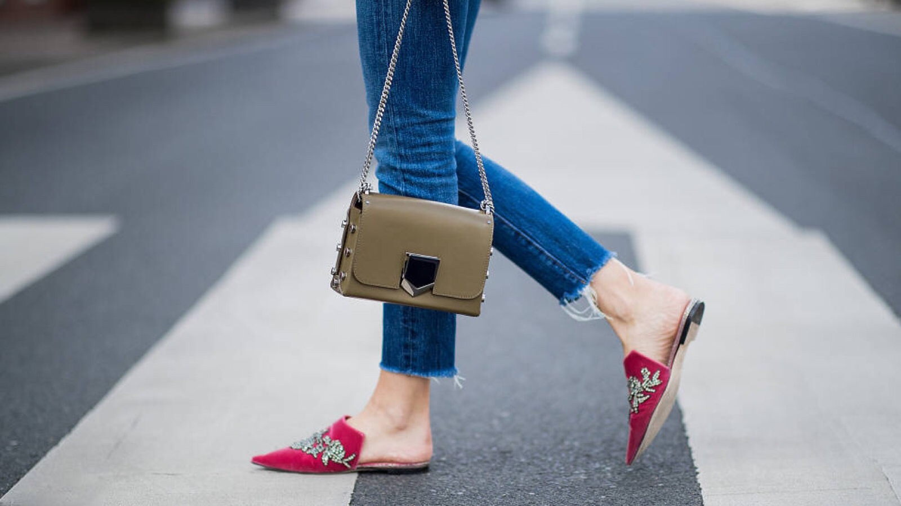
Heads up lucky penny loafer on a sidewalk

Slide 18
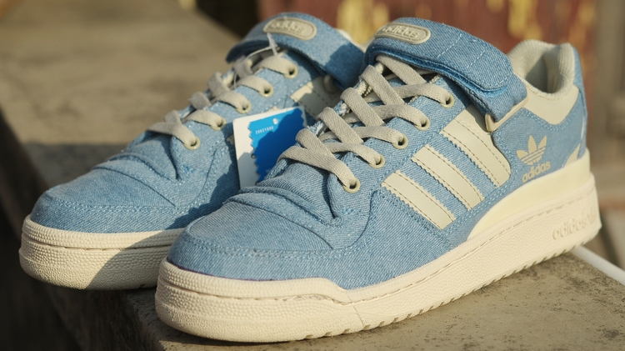
Patent leather blue suede tailor made whatever you like

Slide 19
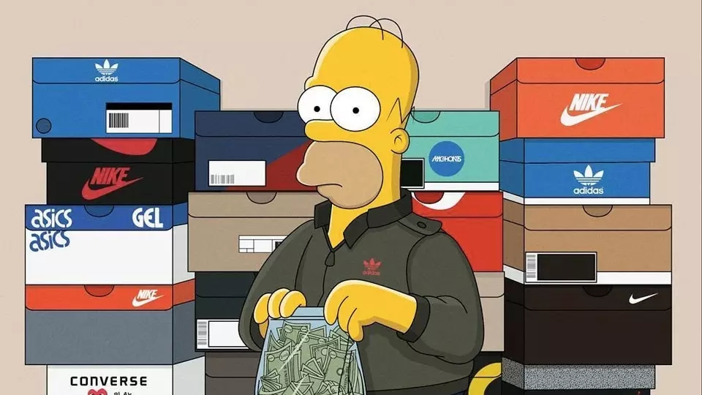
If you're shoe shopping try me on for size

Slide 20
I’m feeling blue
You're stepping on cracks you're breaking your back

Slide 21
I’m feeling blue
You're working so damn hard just to make it look easy

Slide 22
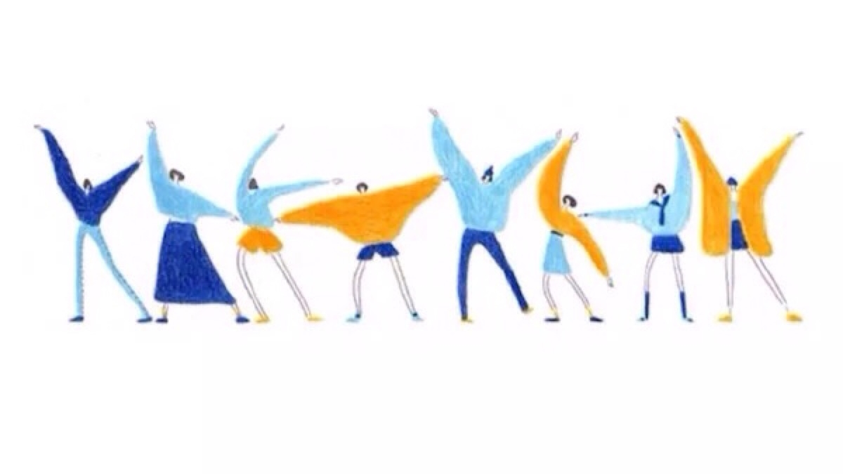
Come dance with me cause dancing's free

Slide 23
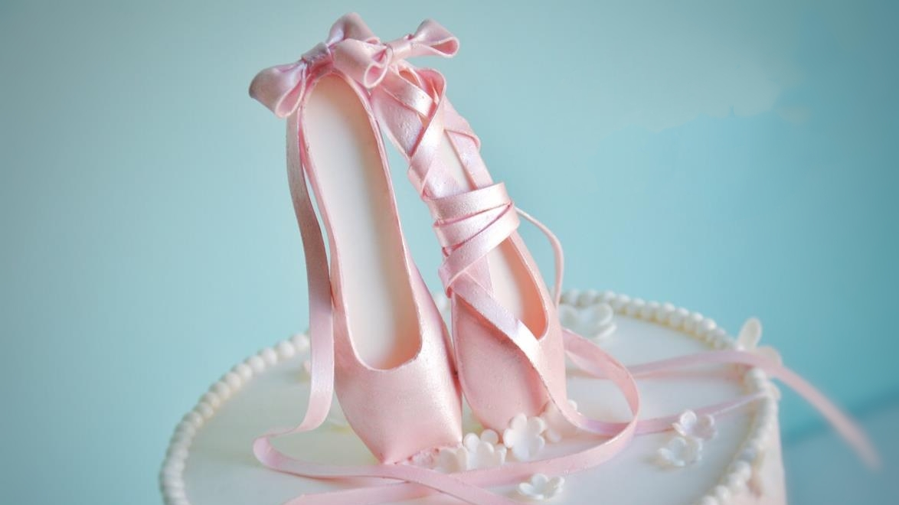
Let me sweep you right off your feet

Slide 24
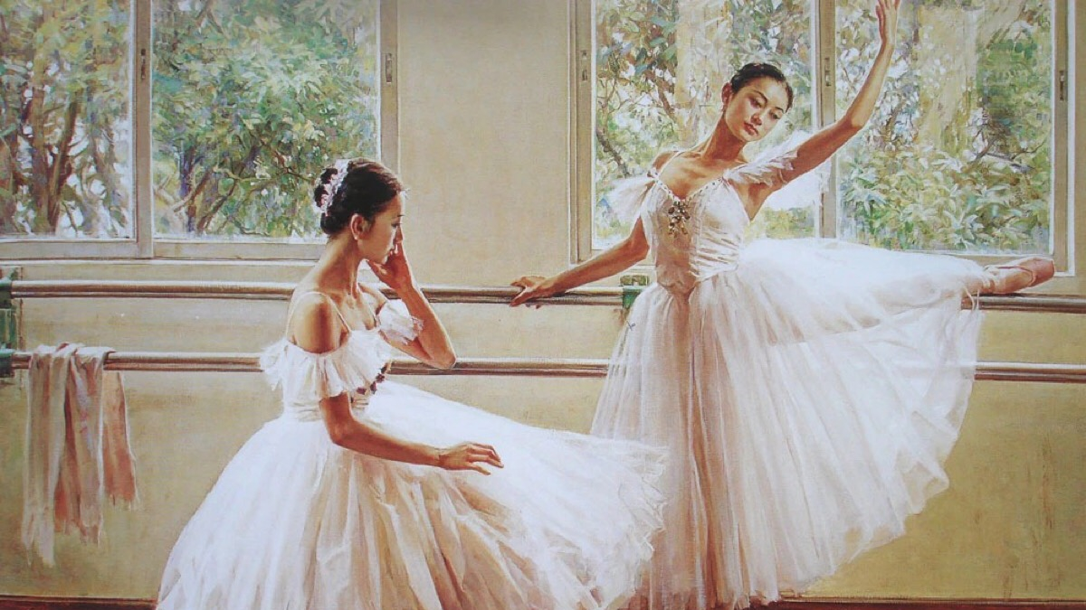
Whatever your style is girl that's what mine is

Slide 25
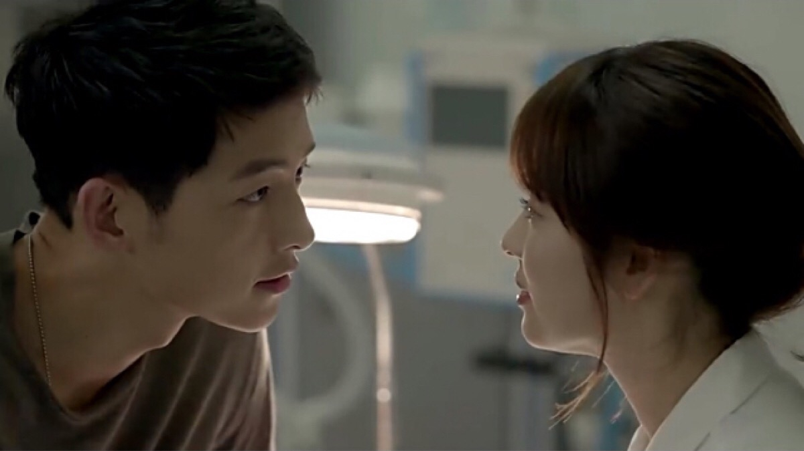
I could go good with your eyes

Slide 26
If you're shoe shopping walk a mile with me

Slide 27
Slip a Cinderella slipper right on your feet

Slide 28
Take my arm strut down the street tonight

Slide 29
Strut down that street tonight

Slide 30
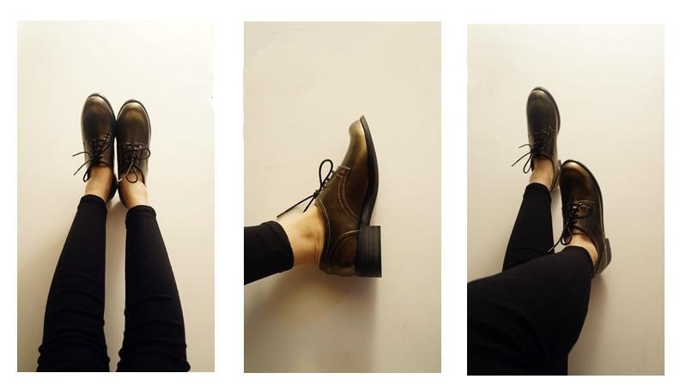
If you're downtown on the browse about

Slide 31
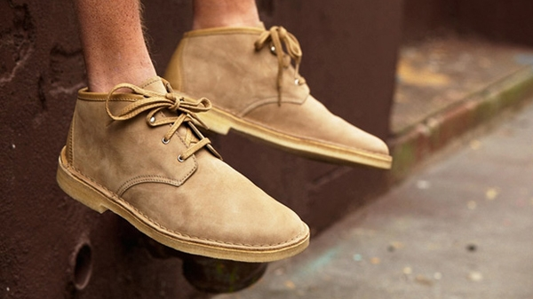
Looking for the perfect fit how's about

Slide 32
Some high heel high top pump them up flip flop

Slide 33
Heads up lucky penny loafer on a sidewalk

Slide 34
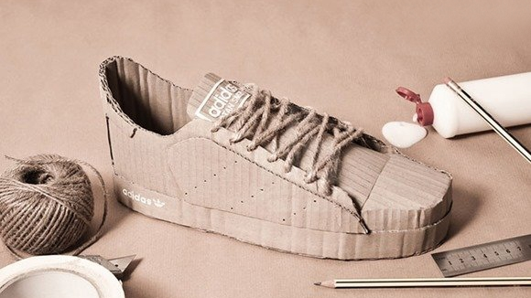
Patent leather blue suede tailor made whatever you like

Slide 35
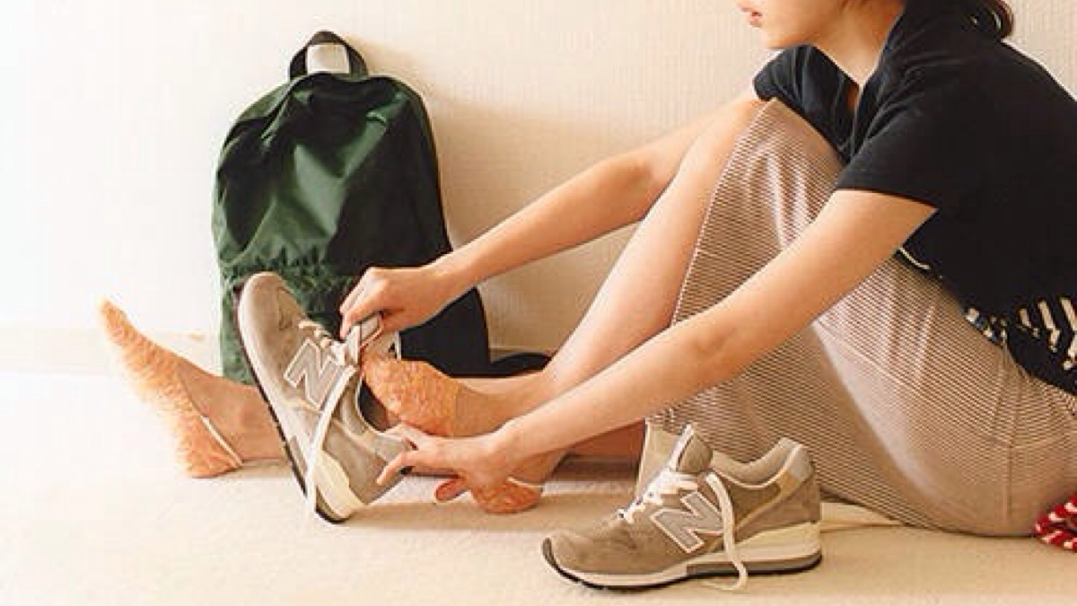
If you're shoe shopping try me on for size

