Slide 1
高中英语北师大版
Unit10 Lesson1 A Material World
作者：黄淳华
单位：华南师范大学

Slide 2
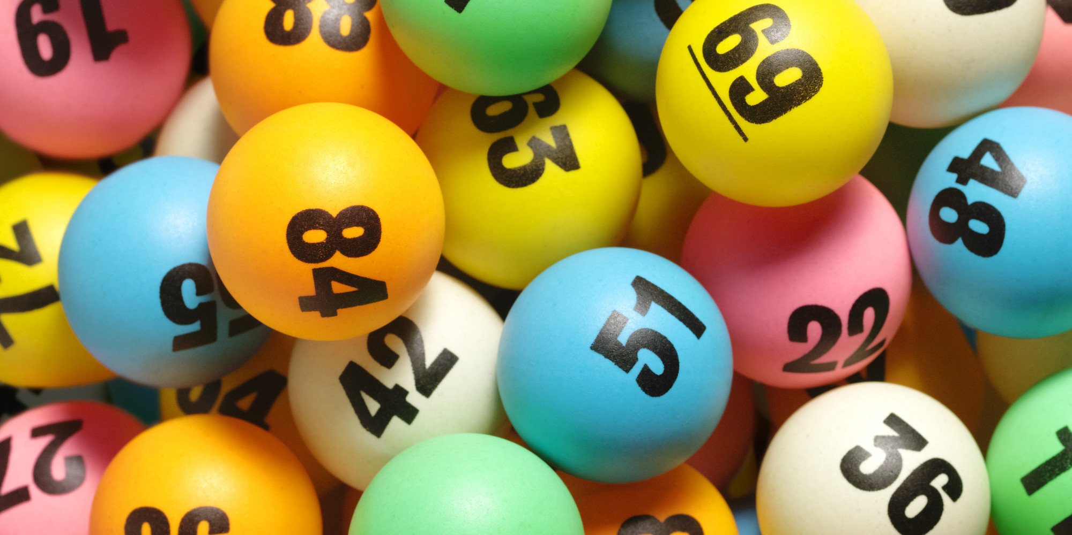
Lately,
I don’t need to do the lottery.

Slide 3
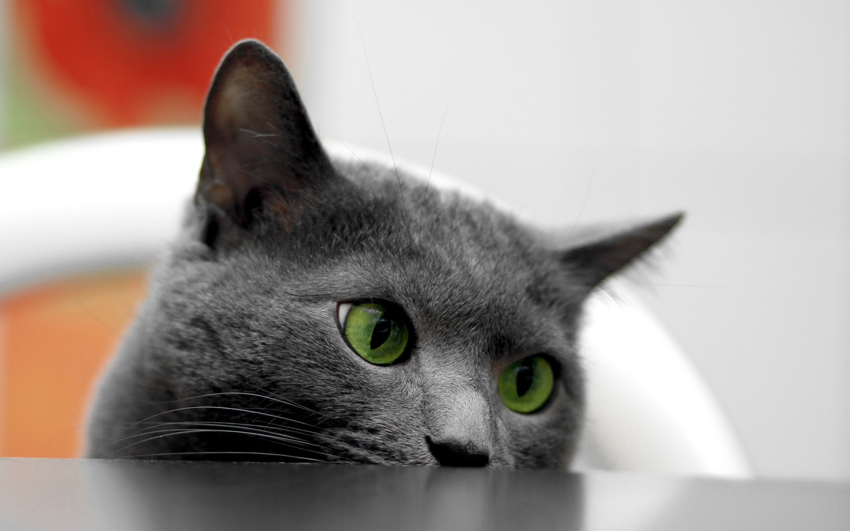
I just think about you,
that’s good enough for me.

Slide 4
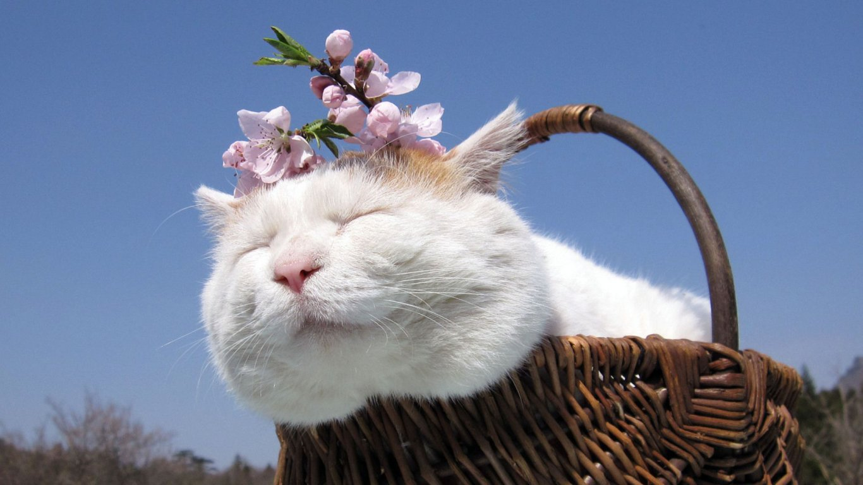
Who knew,
I would ever feel this way.

Slide 5
Head in clouds.

Slide 6
Each day a holiday.

Slide 7
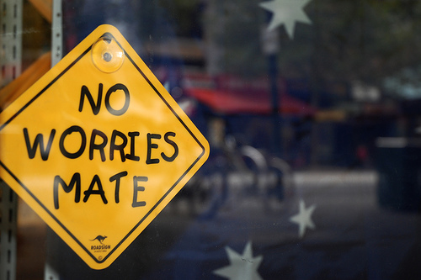
All my worries start to fade
Till they are dot.

Slide 8
On the horizon and the sunlight,
blind these spots.

Slide 9
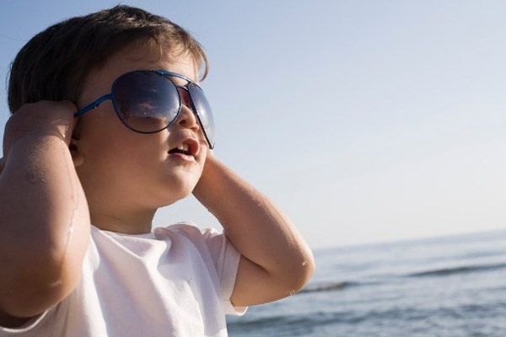
I will put on my favorite
Shades.

Slide 10
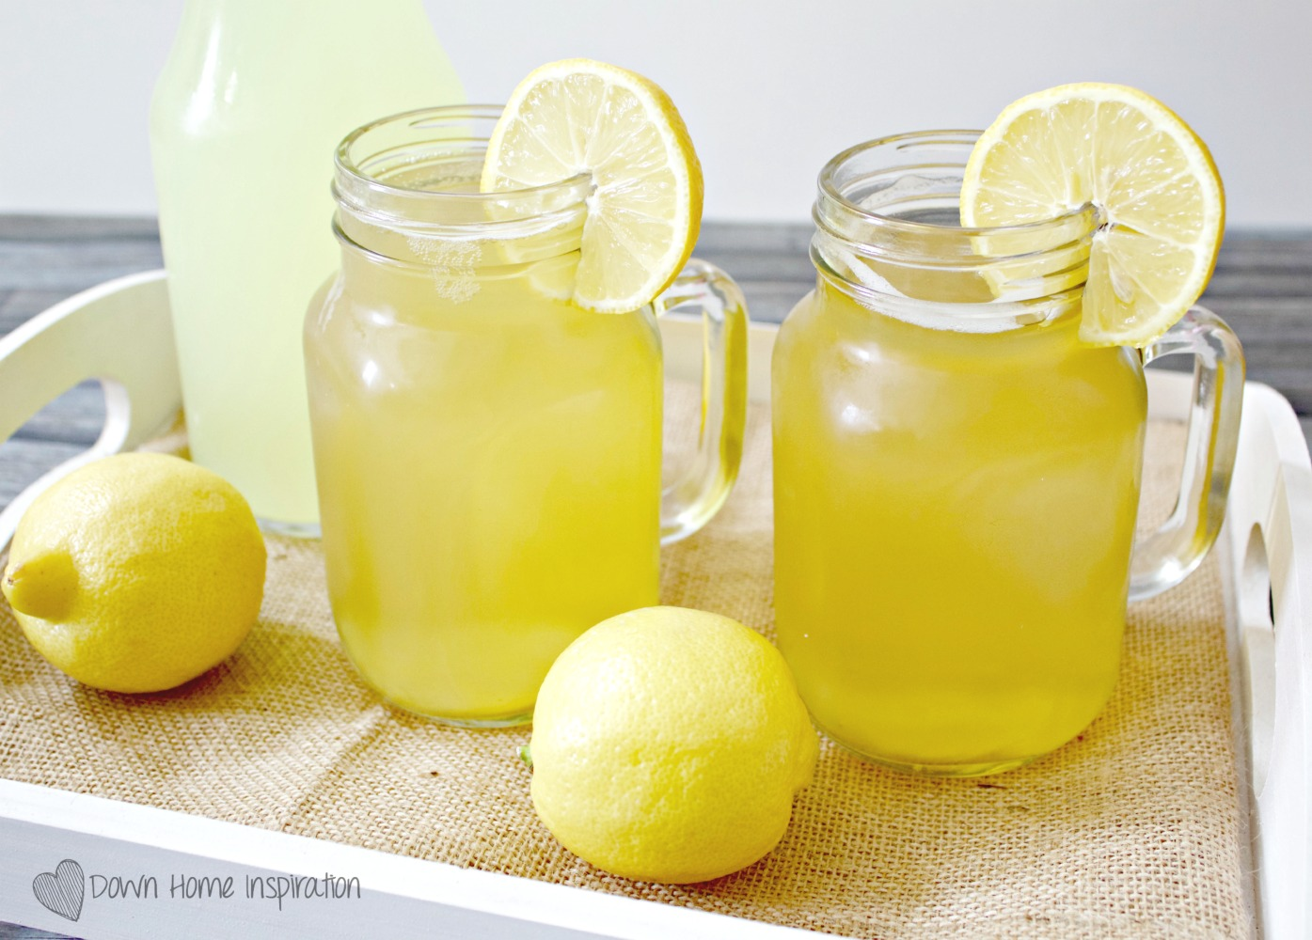
Sip a glass of lemonade.

Slide 11
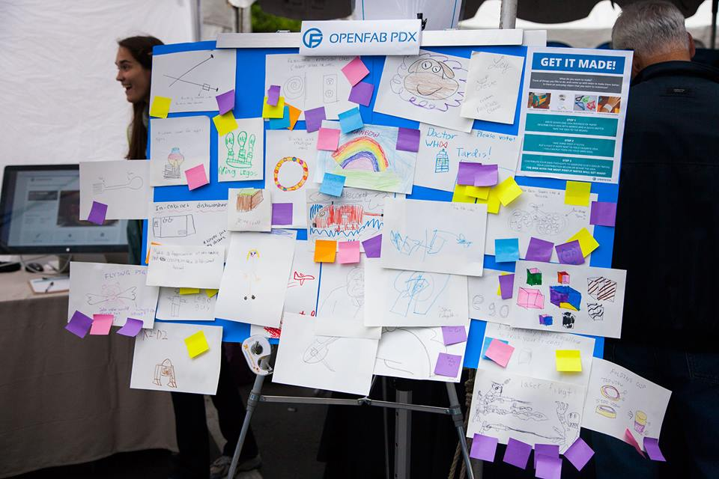
Don’t need any more,
cause I’ve already got it made.

Slide 12
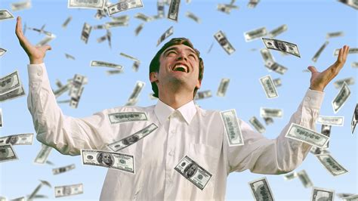
You got me feeling,
got me feeling like a .
millionaire

Slide 13
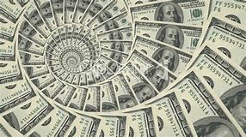
A life I aspire to.

Slide 14
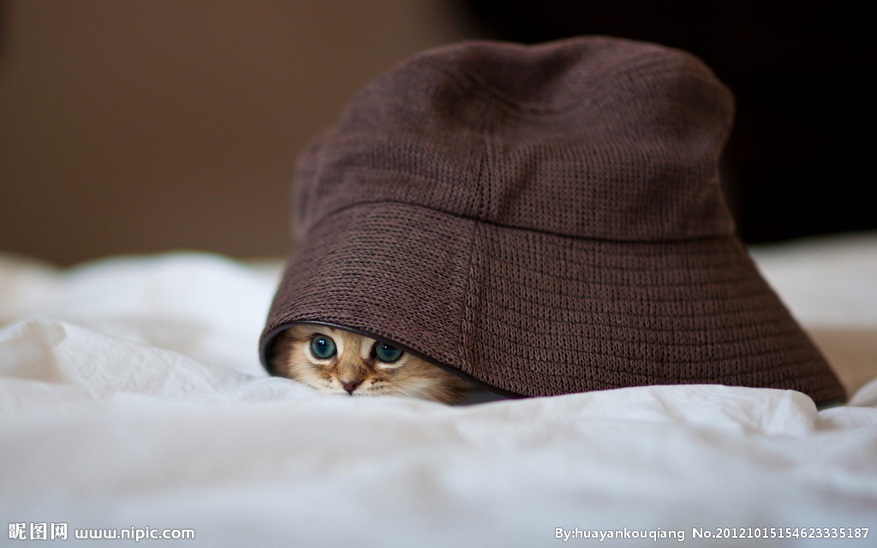
You got me thinking,
got me thinking that
I don’t have a care.

Slide 15
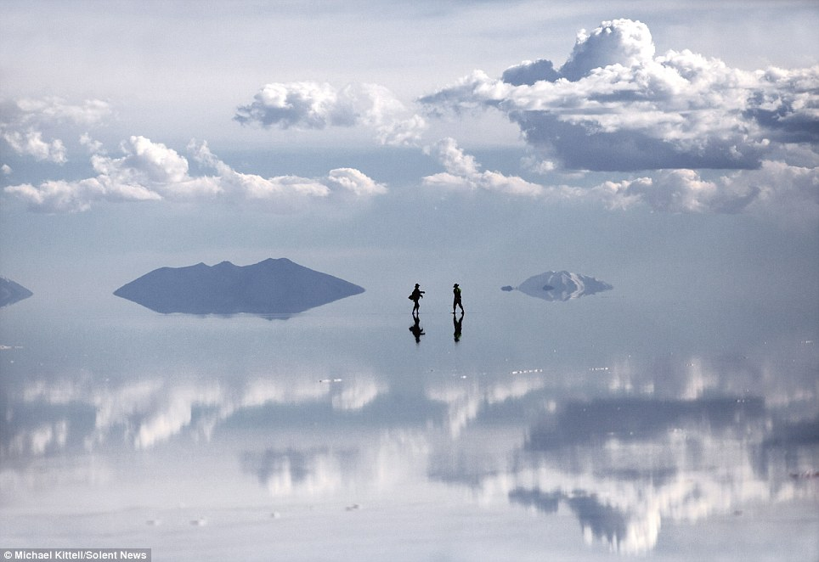
You lift me up and I walk on air.

Slide 16
I feel the wind blow
through my hair.

Slide 17
You got me feeling,
got me feeling like a .
millionaire

Slide 18
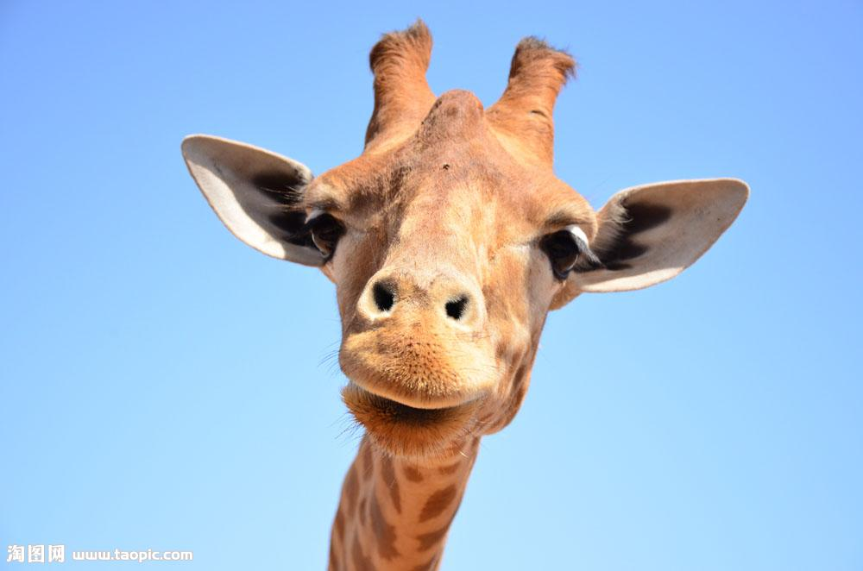
Yeah~yeah~yeah~yeah~

