Slide 1
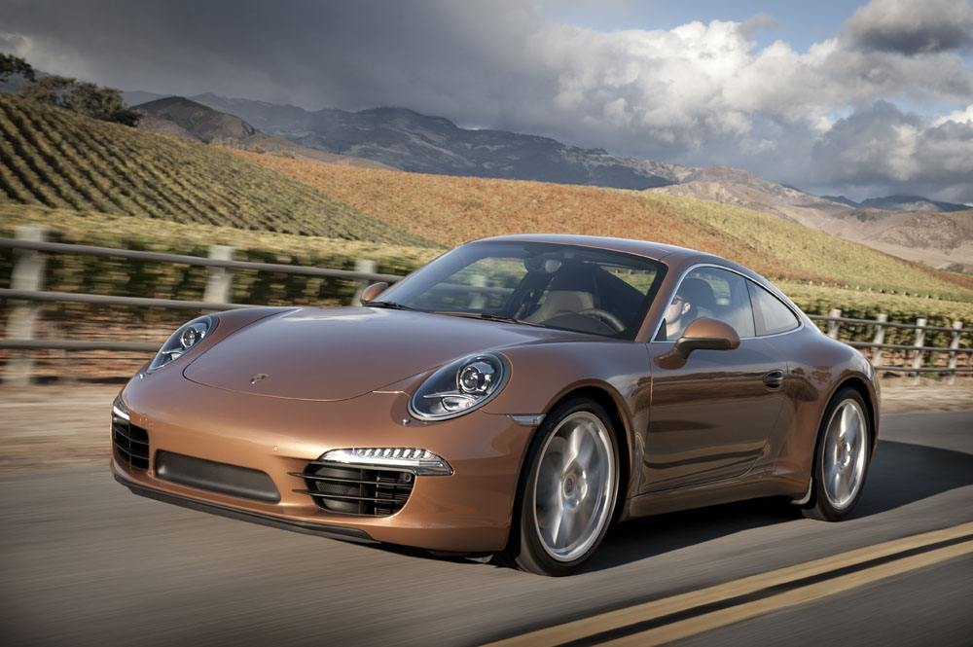
PEP, M3U9, Wheels—“Car culture”
Song: Speed
Singer：Montgomery Gentry
Editor: Lucy 肖潇
单位：华南师范大学

Slide 2
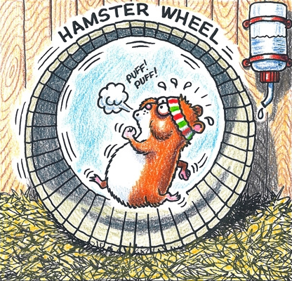
I'm tired of spinning my wheels

Slide 3
I need to find a place where my heart can go to heal
I need to get there pretty quick

Slide 4
Hey mister,
what you got out on that lot you can sell me in a pinch

Slide 5
Maybe one of them souped up muscle cars

Slide 6
The kind that makes you think
you're stronger than you are

Slide 7
Color don't matter,
no I don't need leather seats
All that really concerns me is:

Slide 8
Speed
How fast will it go

Slide 9
Can it get me over her quickly

Slide 10
Zero to sixty,
can it outrun her memory

Slide 11
Yeah, what I really need
Is an open road
An' a whole lot of speed

Slide 12
I'd like to trade in this old truck

Slide 13
'Cause it makes me think of her and that just slows me up

Slide 14
See, it's the first place we made love where we used to sit and talk

Slide 15
On the tailgate all night long,
but now she's gone

Slide 16
An' I need to move on
So give me：

Slide 17
Speed, an' how fast will it go

Slide 18
Can it get me over her quickly

Slide 19
Zero to sixty,
can it outrun her memory

Slide 20
Yeah, what I really need
Is an open road
An' a whole lot of speed

Slide 21
Throw me them keys so I can put some miles between us

Slide 22
Tear off that rear view mirror, there's nothing left to see here, yeah

Slide 23
Let me lean on that gas,
oh she catches up fast
So give me:

Slide 24
Speed
How fast will it go

Slide 25
Can it get me over her quickly

Slide 26
Zero to sixty,
can it outrun her memory

Slide 27
Yeah, what I really need
Is an open road
An' a whole lot of speed

Slide 28
That's what I need

Slide 29
I'm tired of spinning my wheels
I'm tired of spinning my wheels

Slide 30
Thank you!

