Slide 1
PEP, M3U9, Clean Machines
Song: I'm in Love with My Car
Singer：Queen
Editor: Jacky 刘小梅
单位：华南师范大学

Slide 2
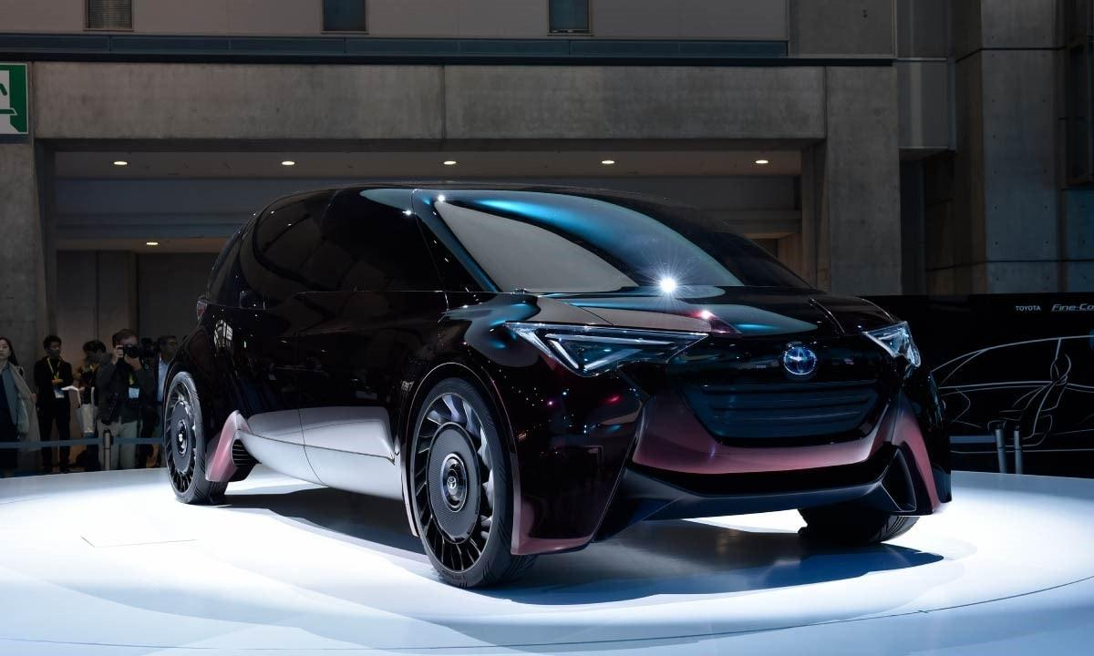
The machine of a dream

Slide 3
Such a clean machine

Slide 4
With the pistons a pumpin'

Slide 5
And the hub caps all gleam

Slide 6
When i'm holdin' your wheel

Slide 7
All i hear is your gear

Slide 8
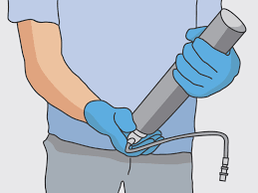
When my hand's on your grease gun

Slide 9
Oh it's like a disease son

Slide 10
I'm in love with my car

Slide 11
Gotta feel for my automobile

Slide 12
Get a grip on my boy racer rollbar

Slide 13
Such a thrill when your radials squeal

Slide 14
Told my girl i'll have to forget her
Told my girl i'll have to forget her

Slide 15
Rather buy me a new carburetor

Slide 16
So she made tracks sayin'

Slide 17
This is the end now

Slide 18
Cars don't talk back
They're just four wheeled friends now

Slide 19
When i'm cruisin' in overdrive

Slide 20
Don't have to listen to no run of the mill talk jive

