Slide 1
PEP U9L1: On Your Bike
Song: Ride
Singer: Joe Satriani
作者: 陈恺欣
单位：华南师范大学

Slide 2
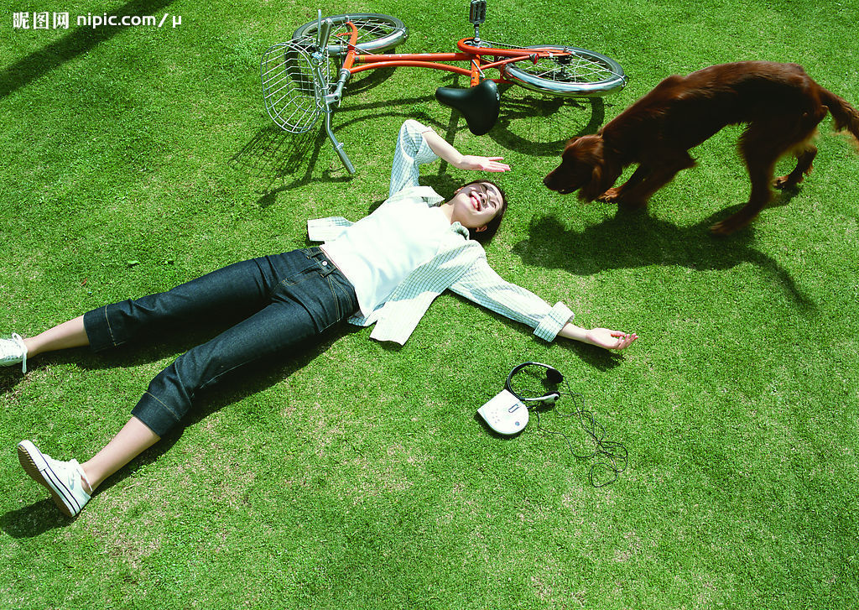
I know some people
like to take life easy,

Slide 3
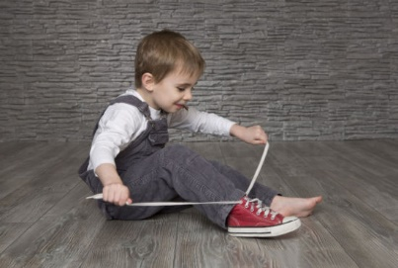
That＇s not my style.

Slide 4
I＇m not the type
to let this life tease me,

Slide 5
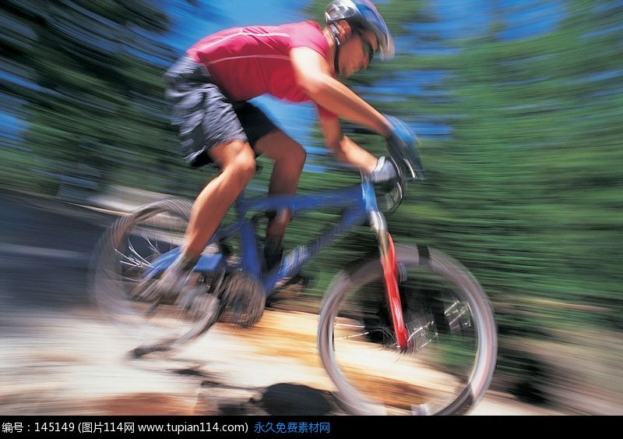
I＇m gonna make it wild.

Slide 6
I just wanna ride,

Slide 7
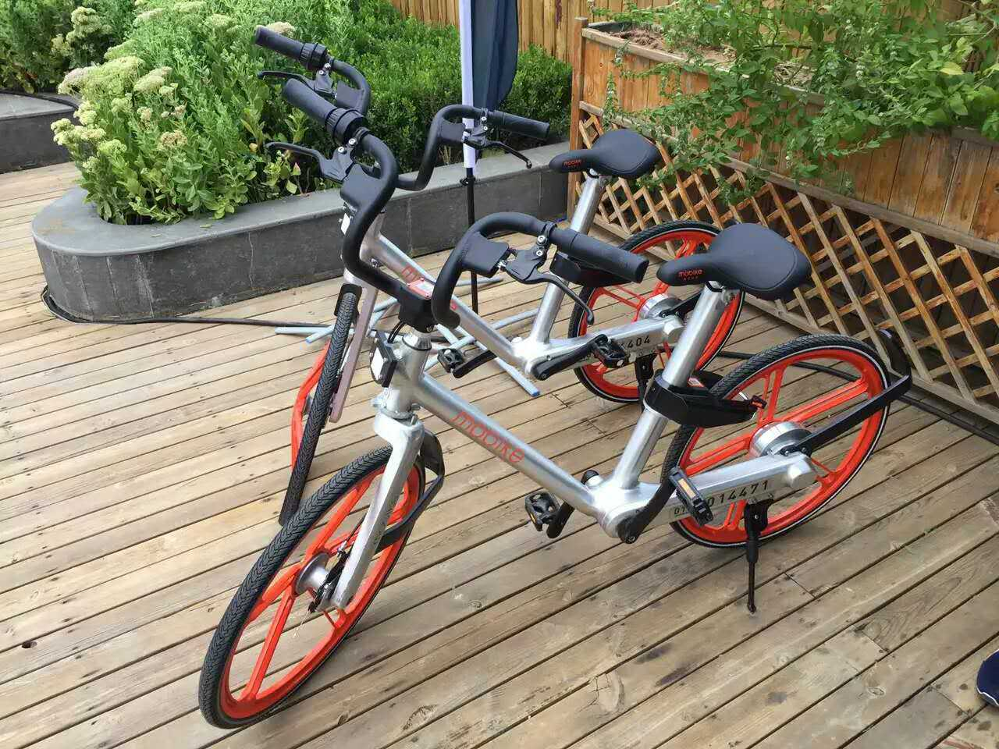
Get on my bike and ride.

Slide 8
Some people think
you＇ve got to
like your life one way,

Slide 9
I disagree.

Slide 10
I＇m not gonna pay attention to them anyway,

Slide 11
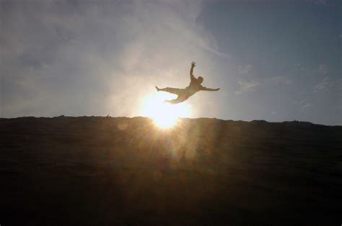
It＇s got nothing, nothing to do with me.

Slide 12
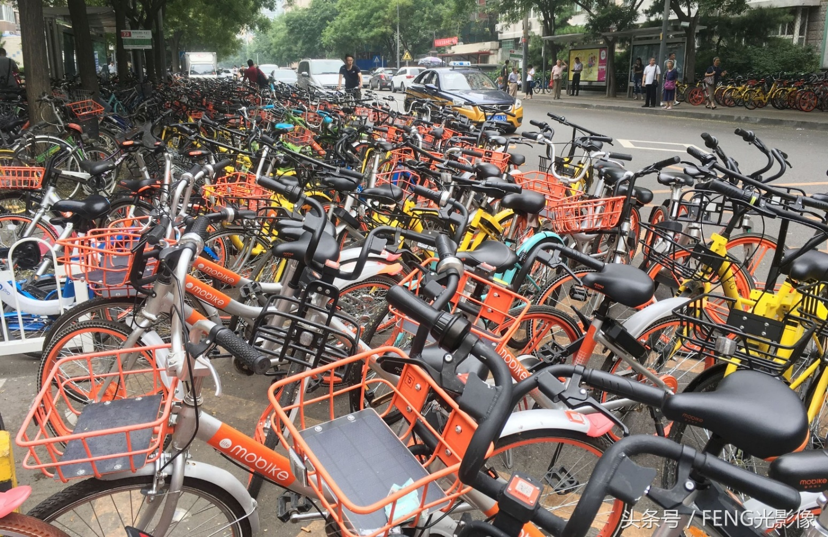
Life is so short, we’ve got

Slide 13
No time to waste at all.

Slide 14
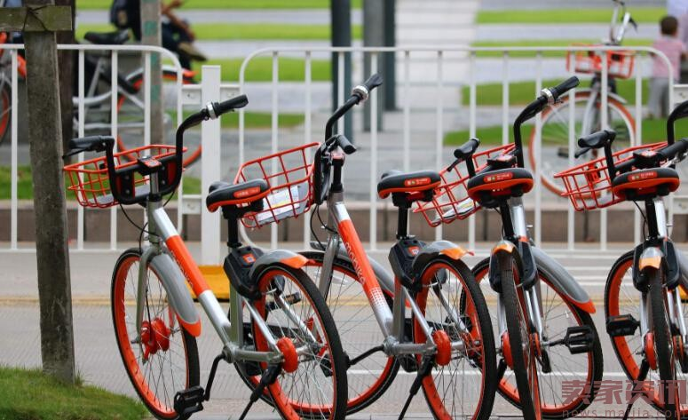
I just wanna ride,

Slide 15
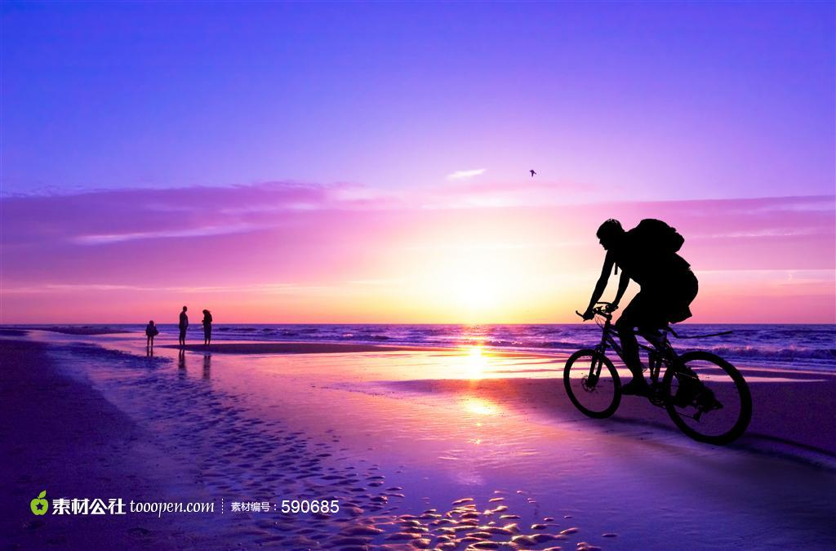
Get on my bike and ride.

Slide 16
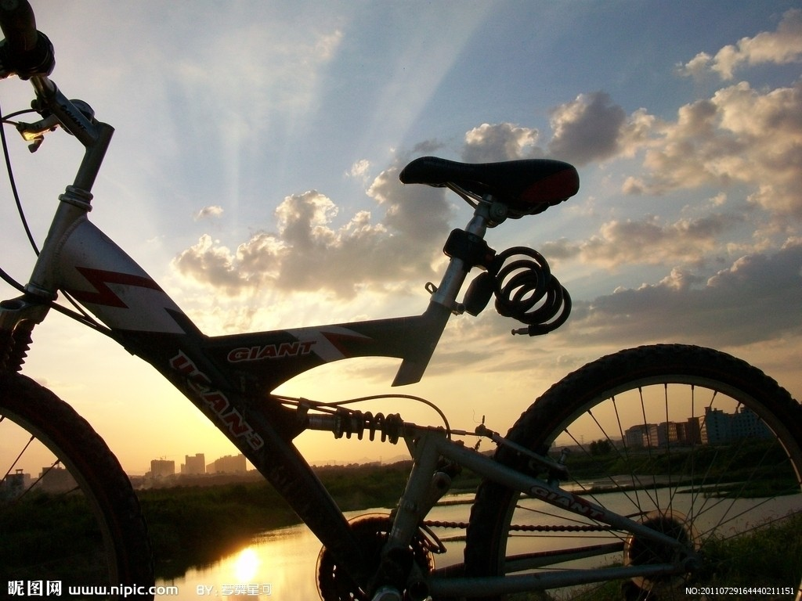
I just wanna ride,

Slide 17
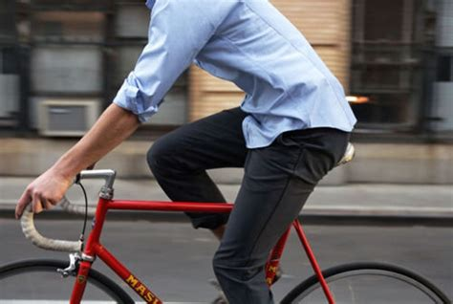
Get on my bike and ride.

Slide 18
I see the road, as it opens up before me,

Slide 19
I feel the heat.

Slide 20
I＇m gonna go where I want,
when I want to.

