Slide 1
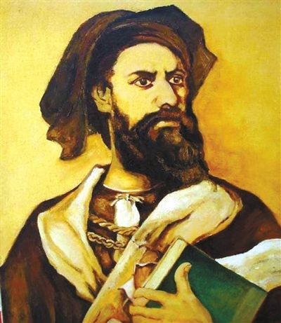
U8L3 Marco Polo
Song: A Place called Xanadu
Singer：Teri Wood
Editor: 刘星雨
学号：20162180141

Slide 2
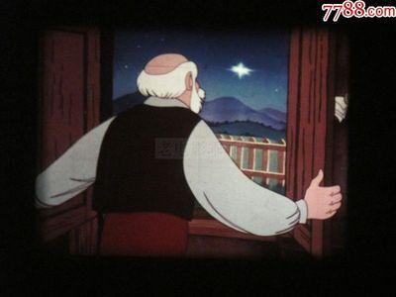
If you look to the east you'll see a new star
Shining high in the evening sky for you

Slide 3
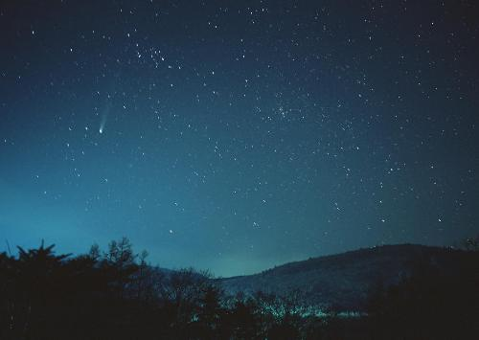
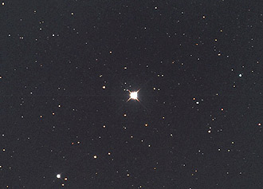
You'll see that star no matter where you are

Slide 4
If you've a heart that's brave and true

Slide 5
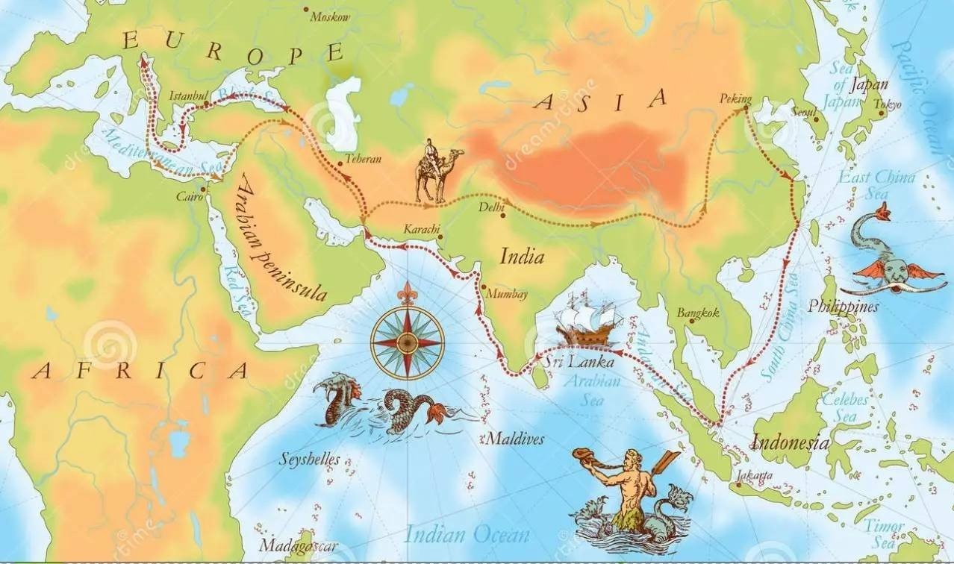
You will go on a journey filled with wonders
Off to places beautiful and new

Slide 6
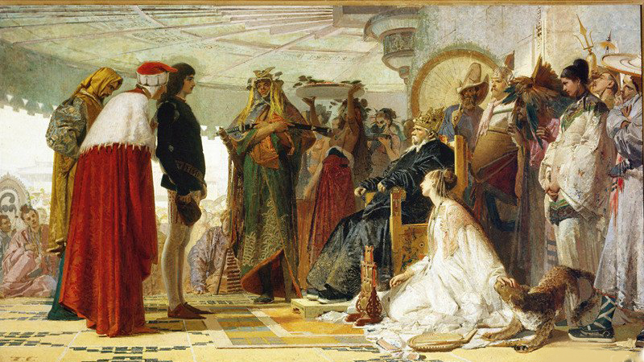
You'll find your way by trying every day
To reach a place called Xanadu

Slide 7
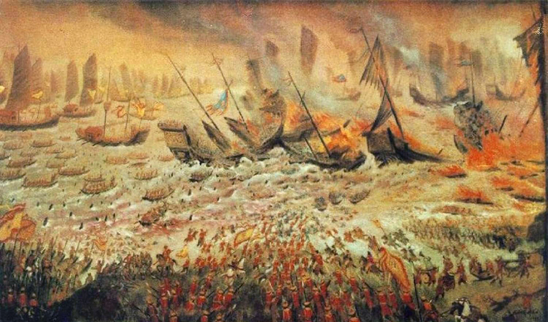
Got the world to showing many wonders
And the field that heading you are not worn

Slide 8
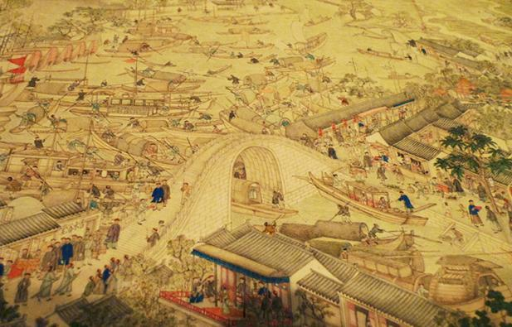
You’ll find what’s true and what life really means to you
So let your heart and spirit soar

Slide 9
Go with courage strength and understanding
Now that I will always think of you

Slide 10
A way so far no matter where you are
Your heart remains in Xanadu

