Slide 1
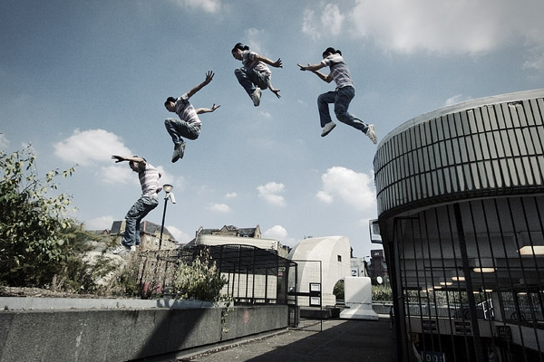
北京师范大学，英语必修三，U8L2,Extreme Sports
Song: Jump
Singer：Madonna
Editor: 孙莹
单位：华南师范大学

Slide 2
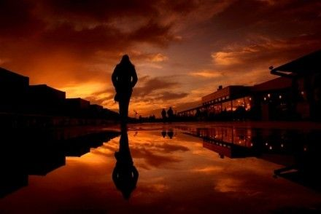
I haven't got much time to waste
It's time to make my way

Slide 3
I'm not afraid I'll face
But I'm afraid to stay

Slide 4
I'm going down my own road
And I can make it alone

Slide 5
All work and no fighting
I'll find a place of my own

Slide 6
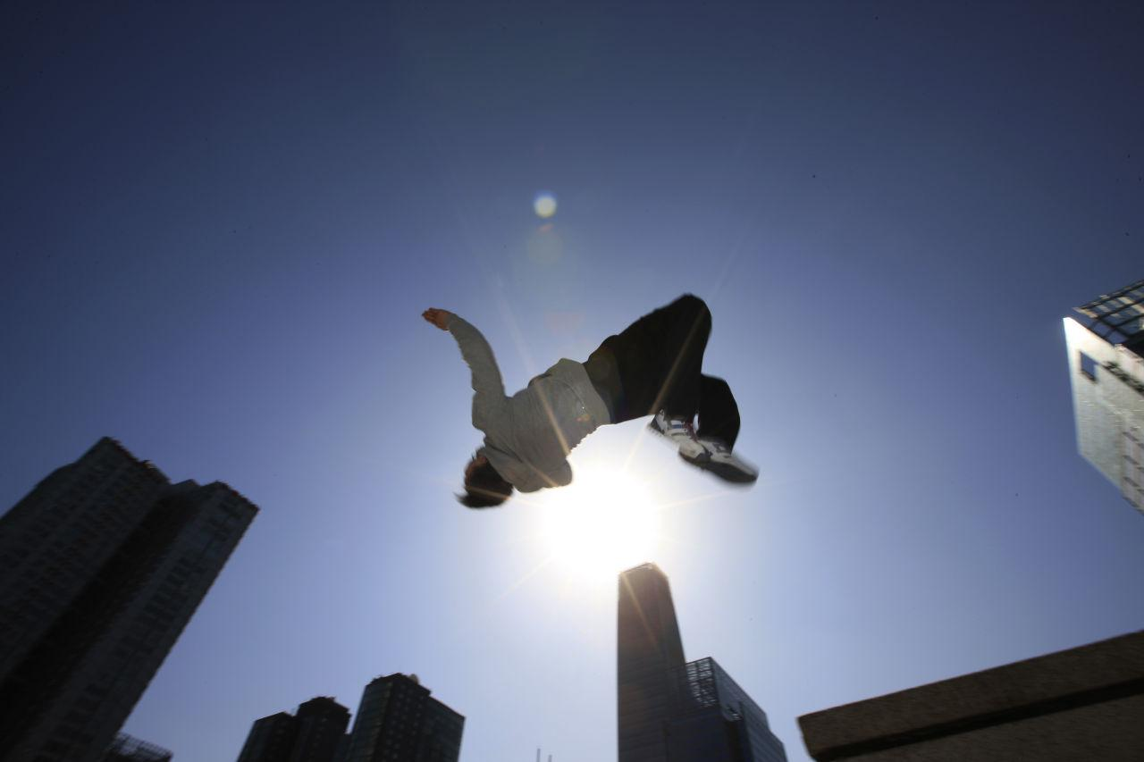
Are you ready to jump
Get ready to jump
Don't ever look back' oh baby

Slide 7
Yes' I'm ready to jump
Just take my hands
Get ready to jump

Slide 8
We learned our lesson from the start'
My sisters and me

Slide 9
The only thing you can
Depend on is your family

Slide 10
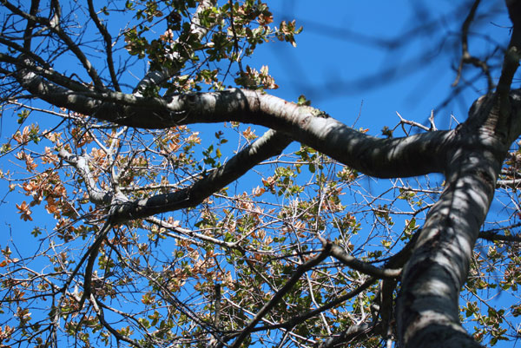
And life's gonna drop you down
Like the limbs of a tree

Slide 11
It sways and it swings and it bends
Until it makes you see

Slide 12
Are you ready to jump
Get ready to jump
Don't ever look back' oh baby

Slide 13
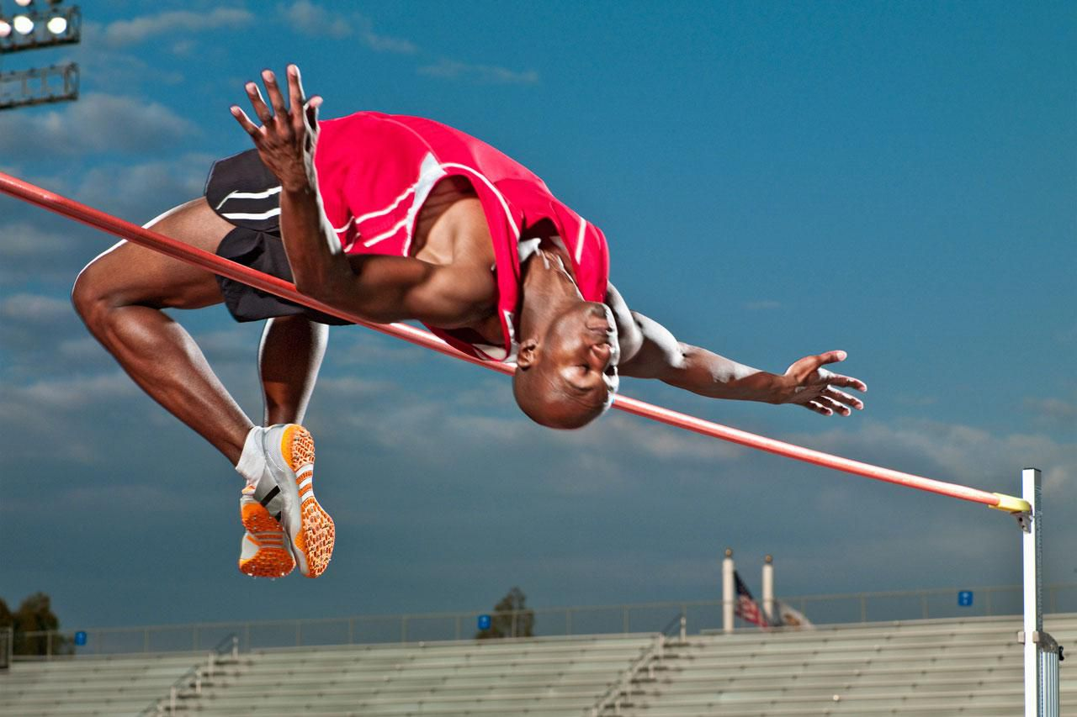
Yes' I'm ready to jump
Just take my hands
Get ready to' are you ready

Slide 14
All work and no fighting'
I'll find a place of my own

Slide 15
It sways and it swings and it bends
Until you make it your own

Slide 16
I can make alone

Slide 17
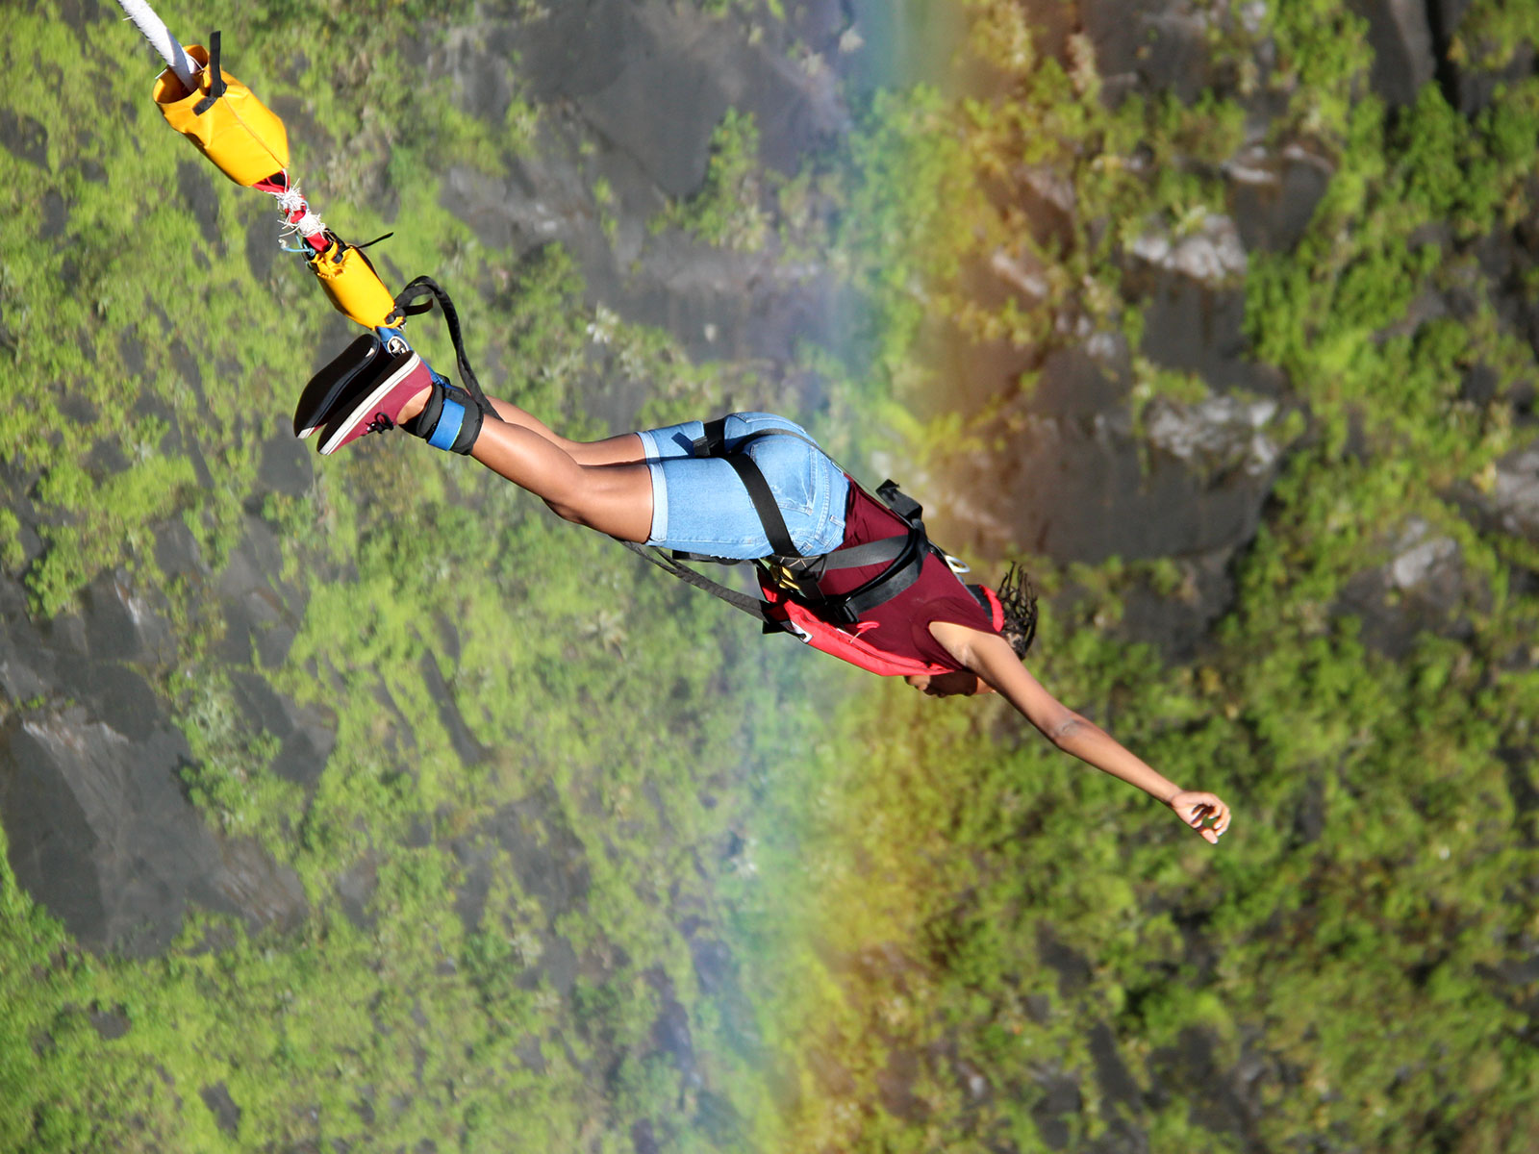
Are you ready to jump
Get ready to jump
Don't ever look back' oh baby

Slide 18
Yes' I'm ready to jump
Just take my hands
Get ready to jump

Slide 19
Are you ready to jump
Get ready to jump
Don't ever look back' oh baby

Slide 20
Yes' I'm ready to jump
Just take my hands
Get ready to' are you ready

