Slide 1
U7L3：The Sea
Song: A Sailor Went to Sea
Singer: Play School
作者：宋亭羽
单位：华南师范大学

Slide 2
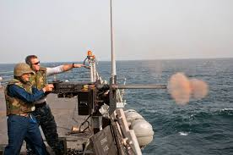
A sailor went to sea, sea, sea
To see what she could see, see, see.

Slide 3
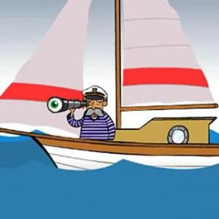
But all that she could see, see, see
Was the bottom of the deep blue sea, sea, sea.

Slide 4
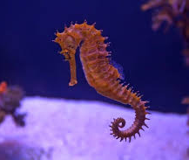
A seahorse！

Slide 5
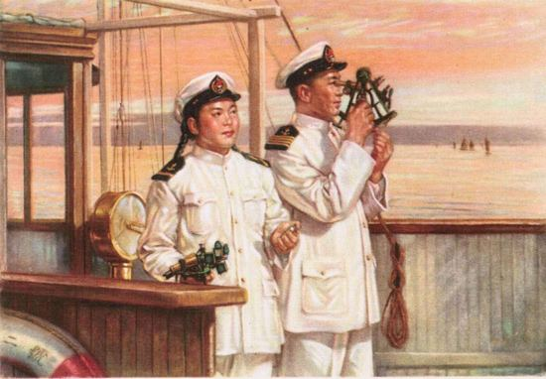
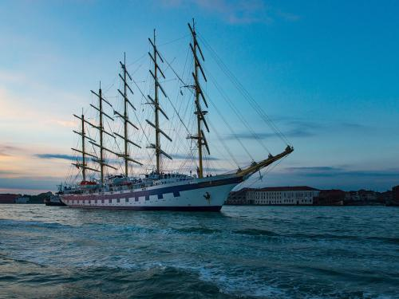
A sailor went to sea, sea, sea
To see what she could see, see see.

Slide 6
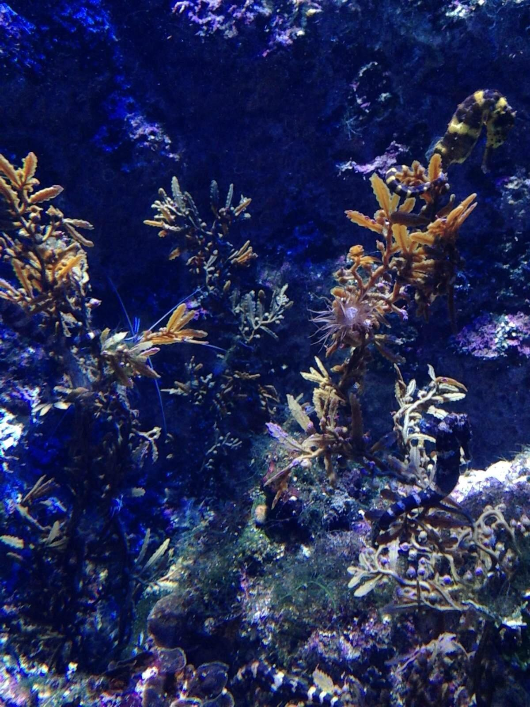
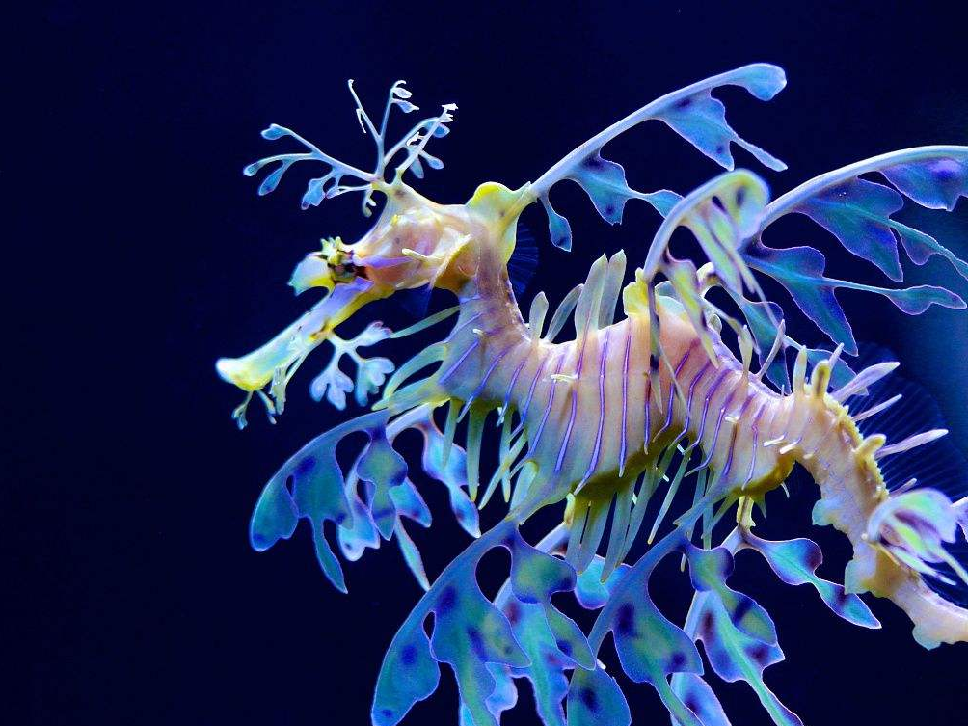
But all that she could see, see, see
Was a seahorse swims in the sea, sea, sea.

Slide 7
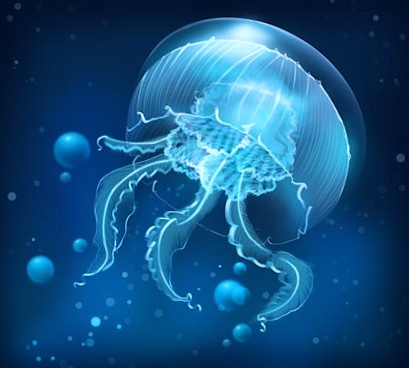
A jellyfish！

Slide 8
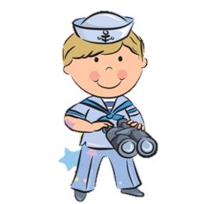
A sailor went to sea, sea, sea
To see what she could see, see, see.

Slide 9
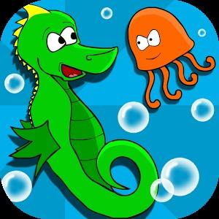
But all that she could see, see, see
Was a jellyfish swims in,
a seahorse swims in the sea, sea, sea.

Slide 10
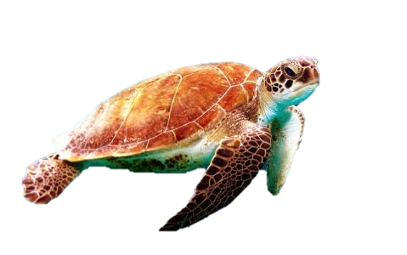
A turtle！

Slide 11
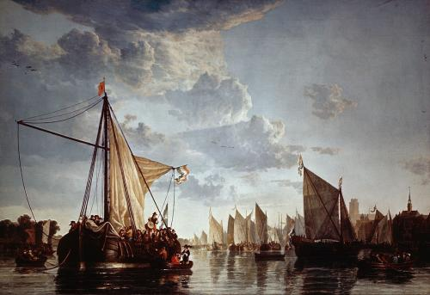
A sailor went to sea, sea, sea
To see what she could see, see, see.

Slide 12
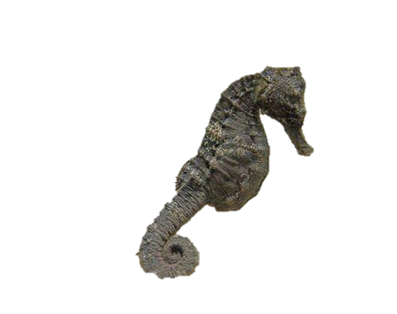
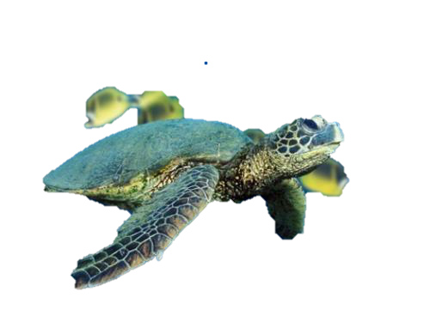
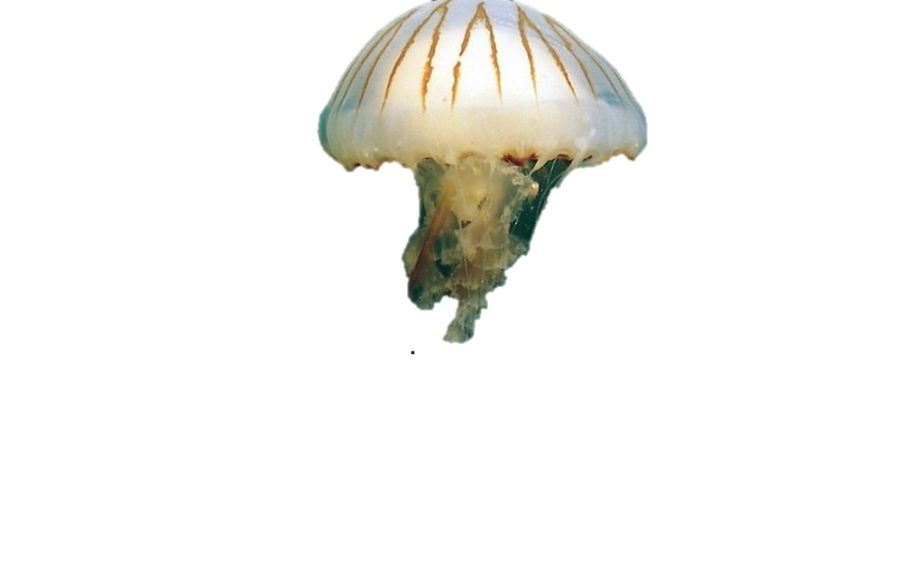
But all that she could see, see, see
Was a turtle swims in, a jellyfish swims in，a seahorse swims in the sea, sea, sea.

Slide 13
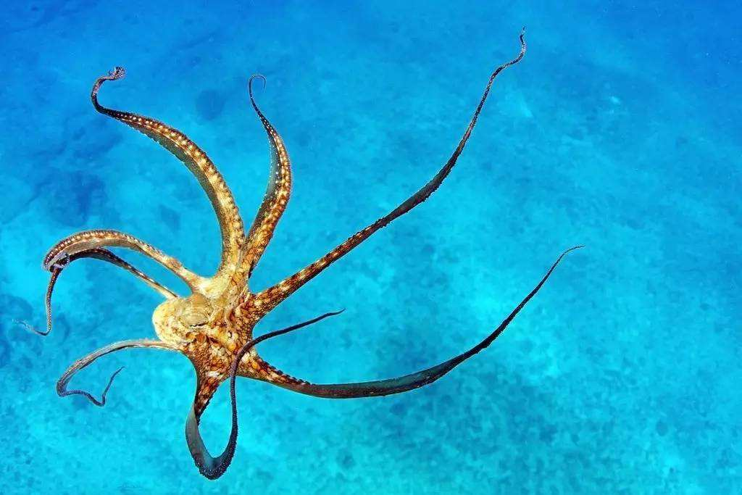
An octopus！

Slide 14
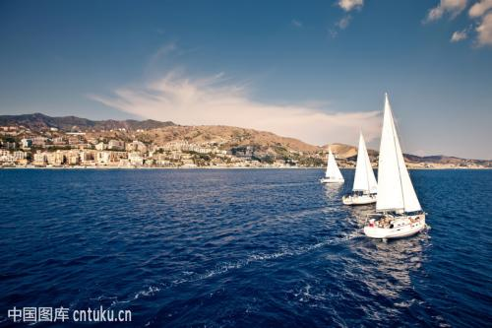
A sailor went to sea, sea, sea
To see what she could see, see, see.

Slide 15
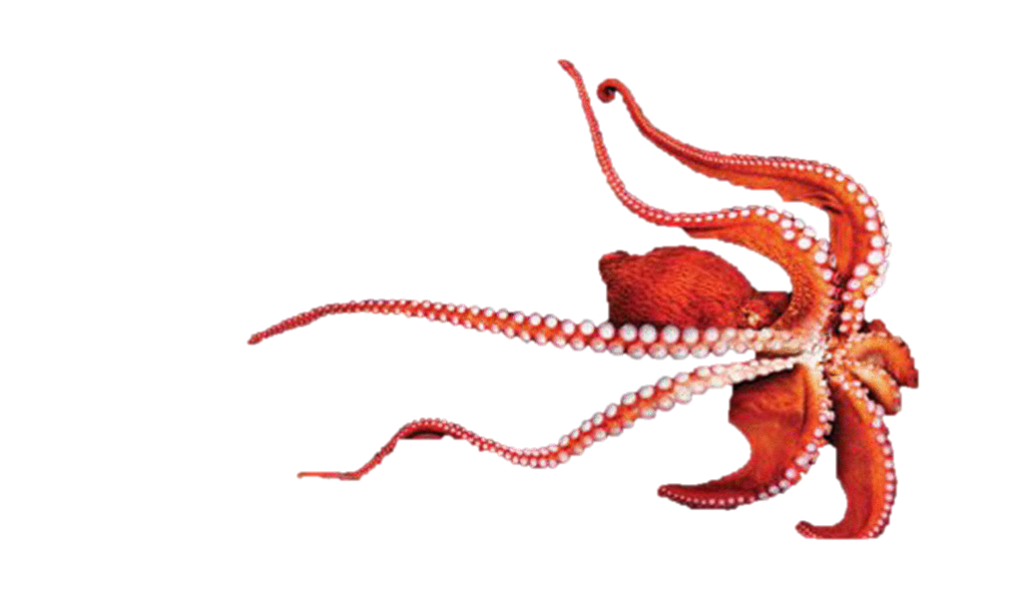
But all that she could see, see, see
Was an octopus swims in, a turtle swims in,
a jellyfish swims in, a seahorse swims in the sea, sea, sea.

Slide 16
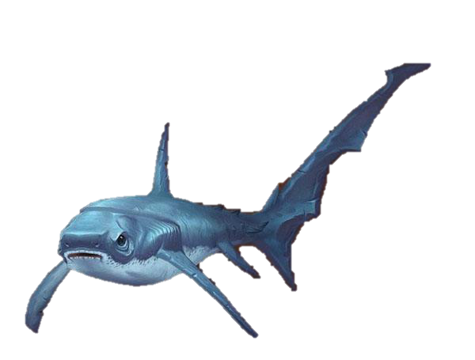
A baby shark！

Slide 17
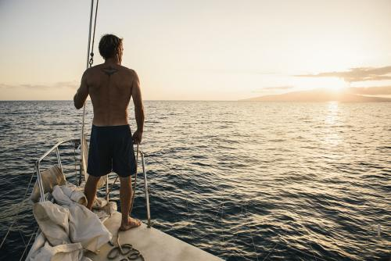
A sailor went to sea, sea, sea
To see what she could see, see, see.

Slide 18
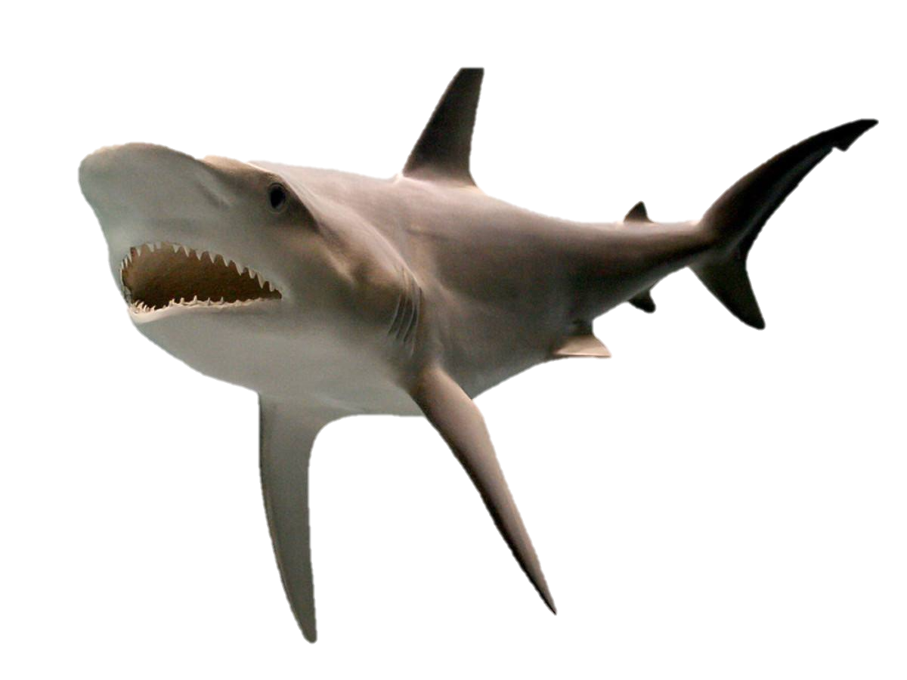
But all that she could see, see, see
Was a baby shark swims in, an octopus swims in, a turtle swims in, a jellyfish swims in，a seahorse swim in the sea, sea, sea.

Slide 19
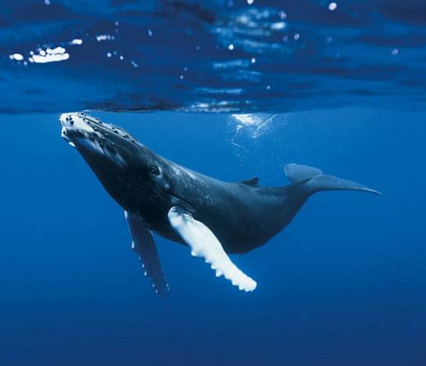
A blue whale！

Slide 20
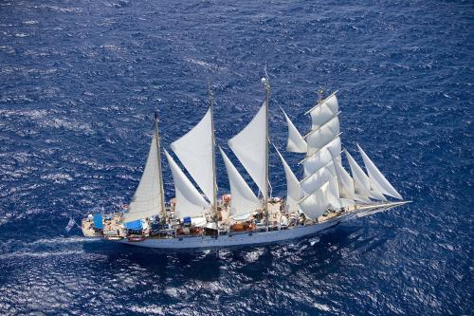
A sailor went to sea, sea, sea
To see what she could see, see, see.

Slide 21
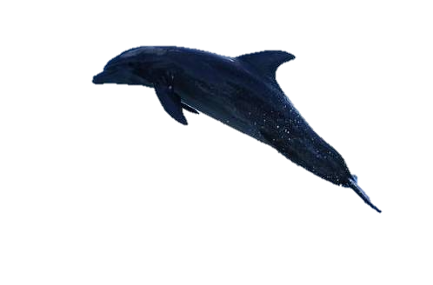
But all that she could see, see, see
Was a blue whale swims in, a baby shark swims in, an octopus swims in, a turtle swims in,
a jellyfish swims in, a seahorse swims in the sea, sea, sea.

