Slide 1
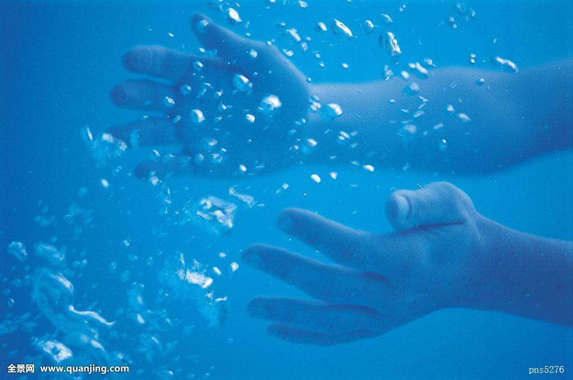
PEP, U7L2, Protecting the Sea
Song: Sea Turtle are Special to Me
Editor:赵正弘
单位：华南师范大学

Slide 2
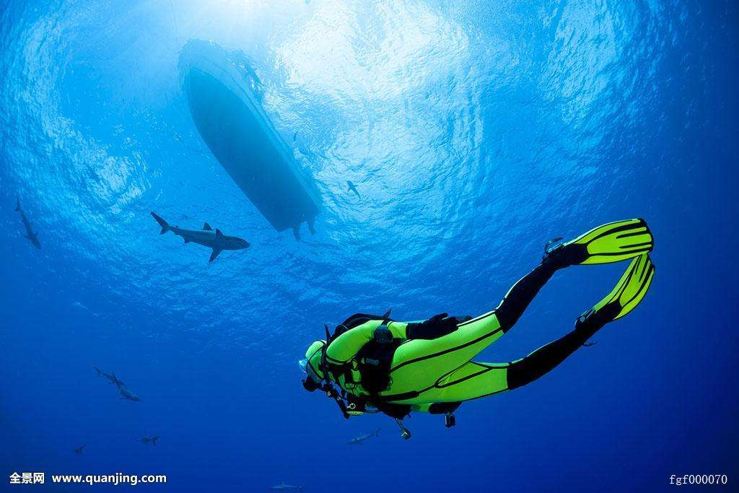
Gracefully gliding throughout the sea

Slide 3
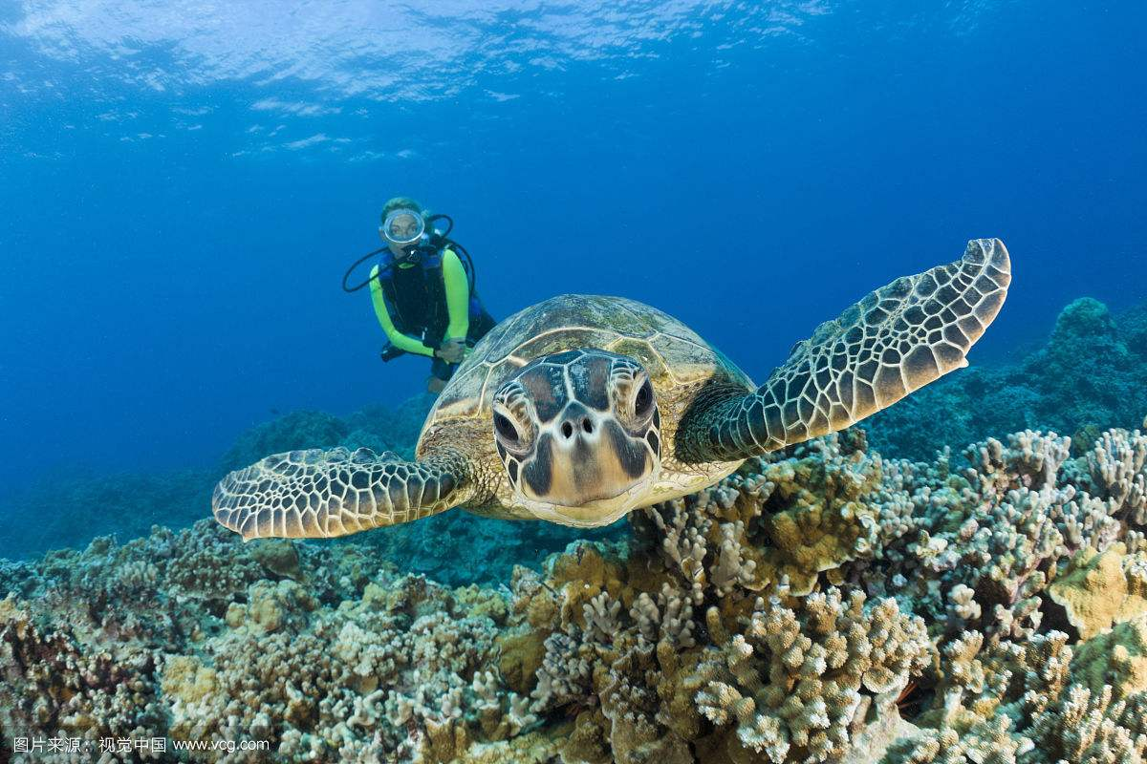
To see one is rare an opportunity

Slide 4
Because they are an endangered species

Slide 5
We need to be careful to protect these

Slide 6
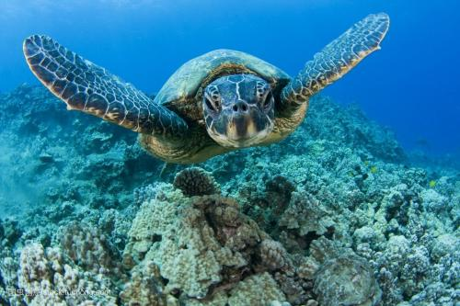
Sea turtles are green and a sight to be seen

Slide 7
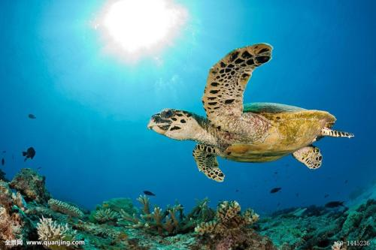
Sea turtles are rare so we need to take care

Slide 8
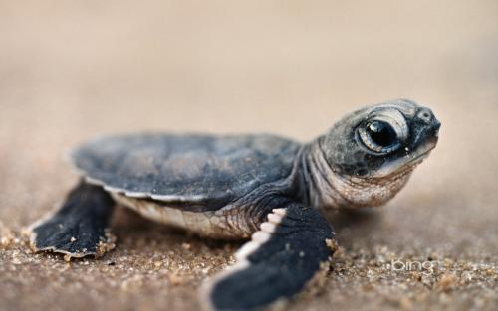
Sea turtles have shells that protect very well

Slide 9
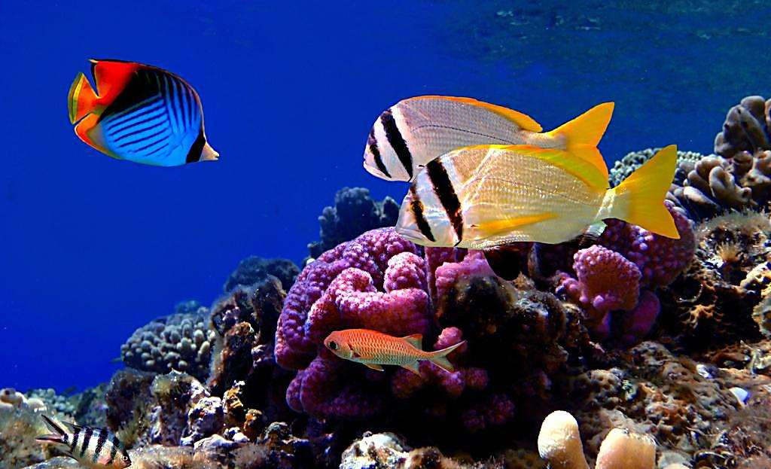
Like all creatures in the sea turtles are special to me

Slide 10
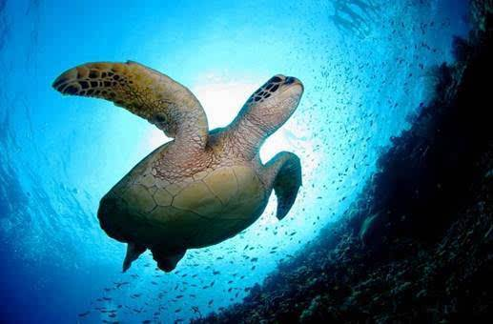
Their streamlined bodies and their flipper like limbs

Slide 11
Help them travel long distances when they swim

Slide 12
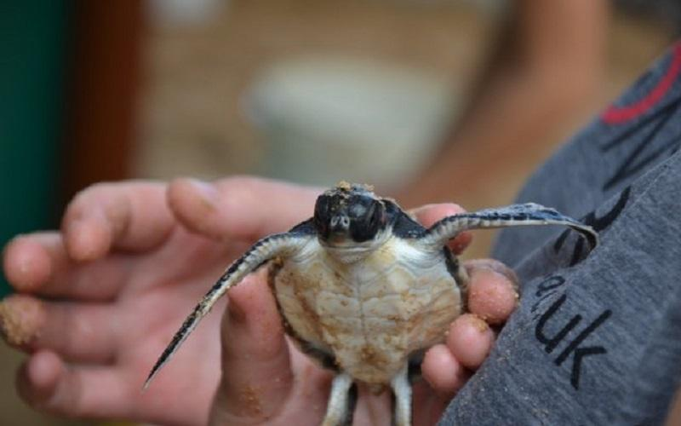
We all love turtles and they are reptiles

Slide 13
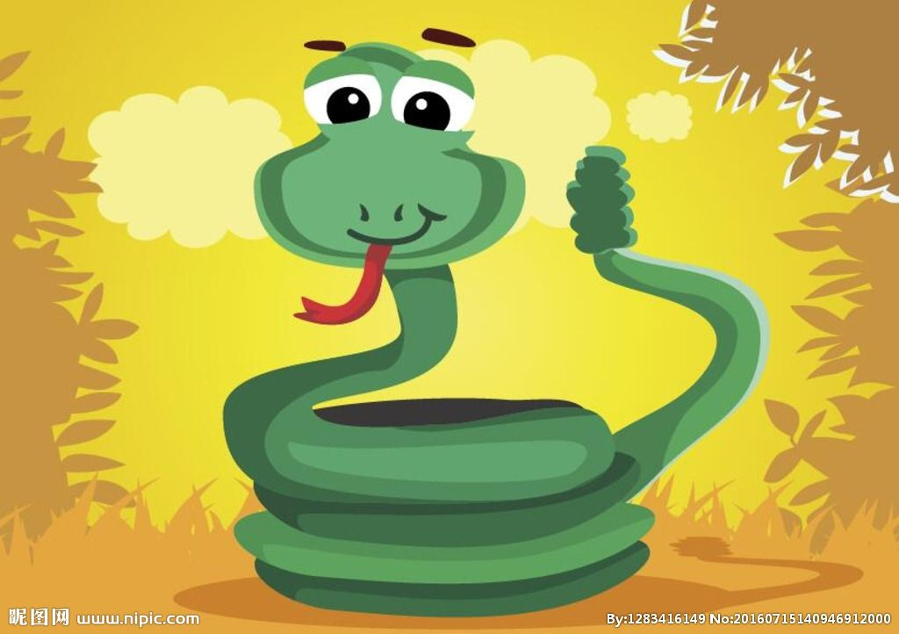
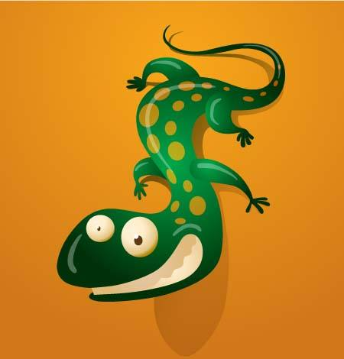
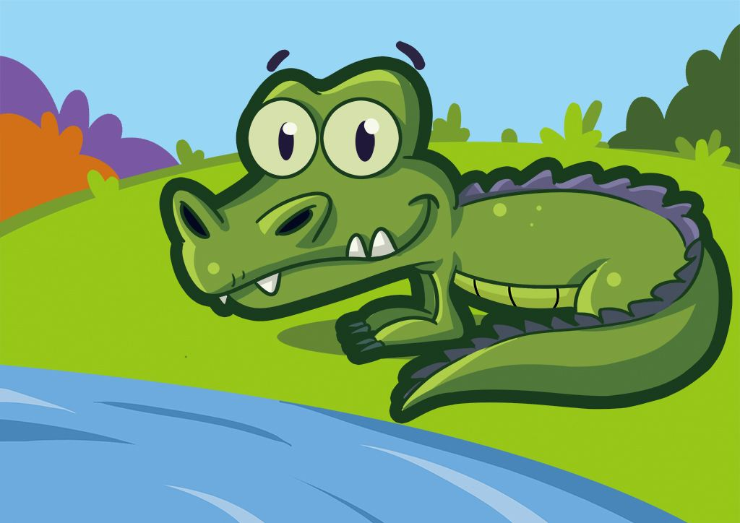
Like snakes and lizards and crocodiles

Slide 14
Sea turtles are green and a sight to be seen

Slide 15
Sea turtles are rare so we need to take care

Slide 16
Sea turtles have shells that protect very well

Slide 17
Like all creatures in the sea turtles are special to me

Slide 18
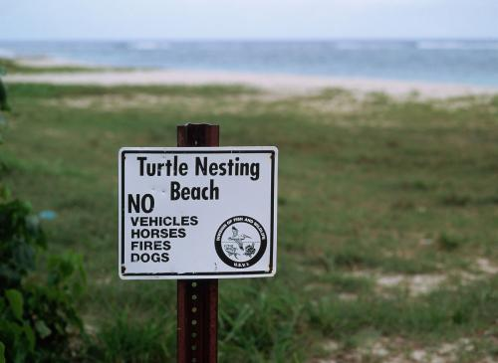
When the momma sea turtle wants to make her nest

Slide 19
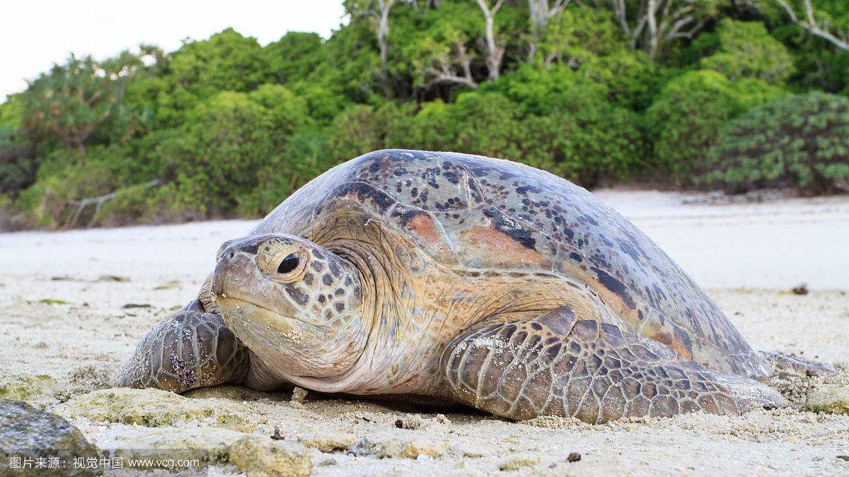
She picks out the beach that she likes a best

Slide 20
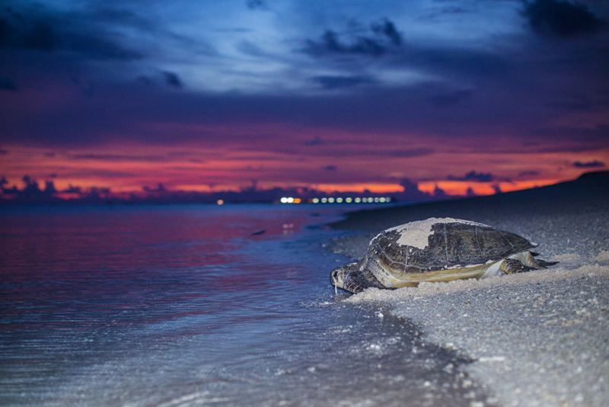
She lays her eggs and back to the sea she goes

Slide 21
So it’s our job to make sure everyone knows

Slide 22
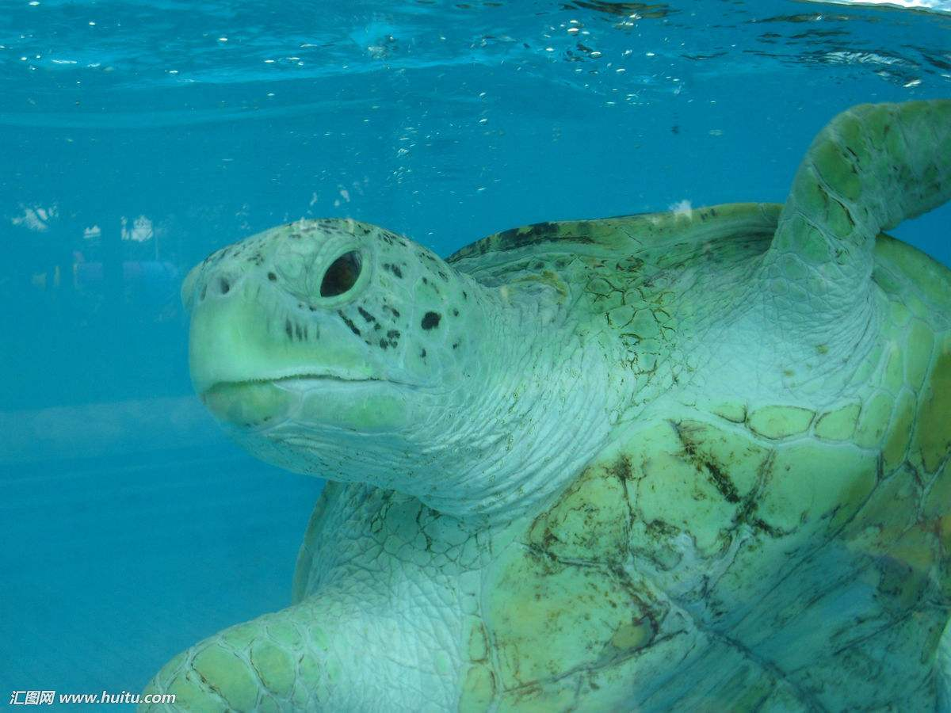
Sea turtles are green and a sight to be seen

Slide 23
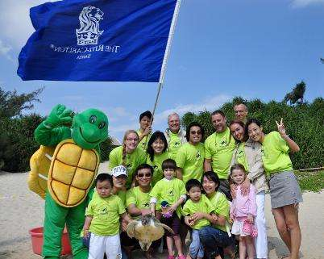
Sea turtles are rare so we need to take care

Slide 24
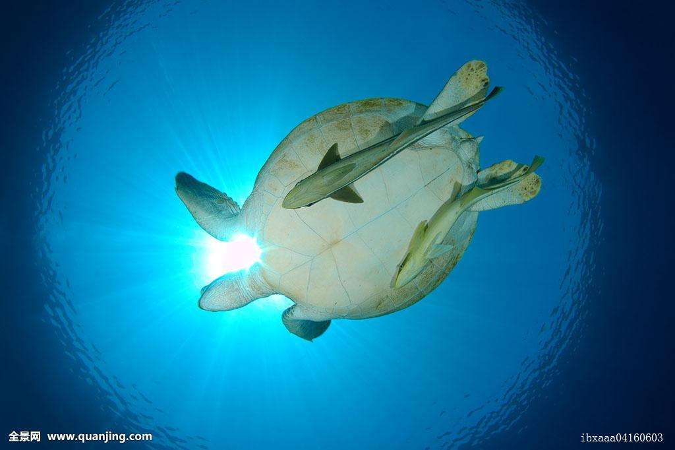
Sea turtles have shells that protect very well

Slide 25
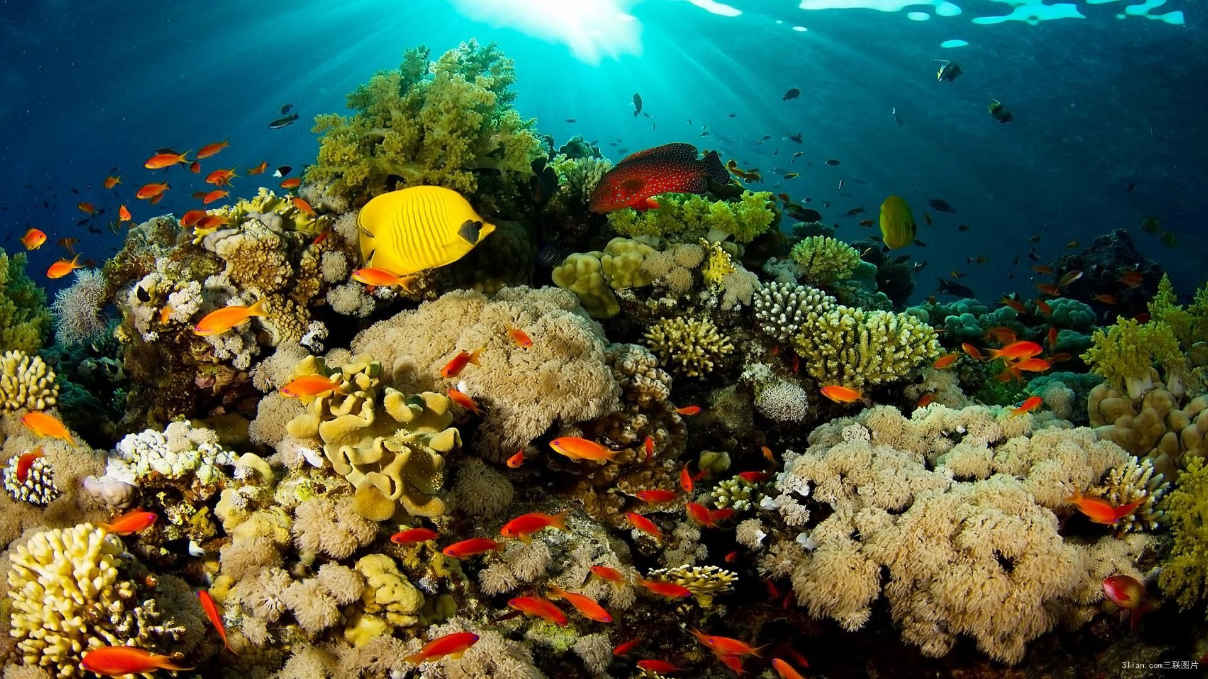
Like all creatures in the sea turtles are special to me

Slide 26
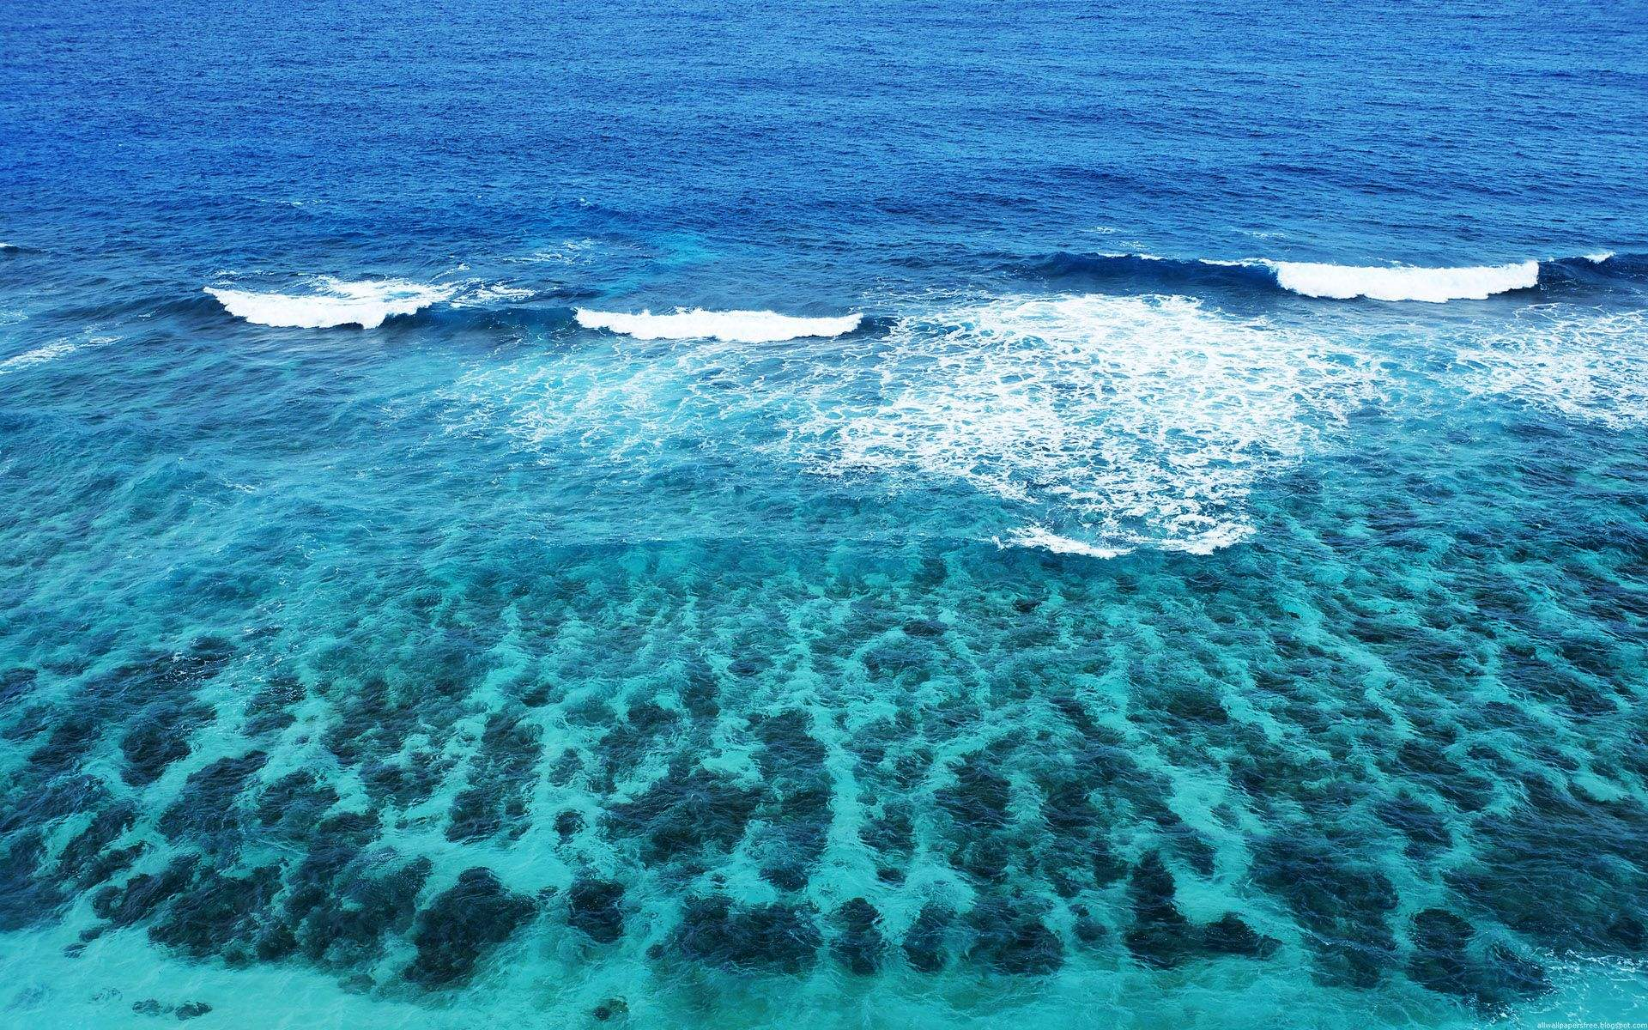
Thank you

