Slide 1
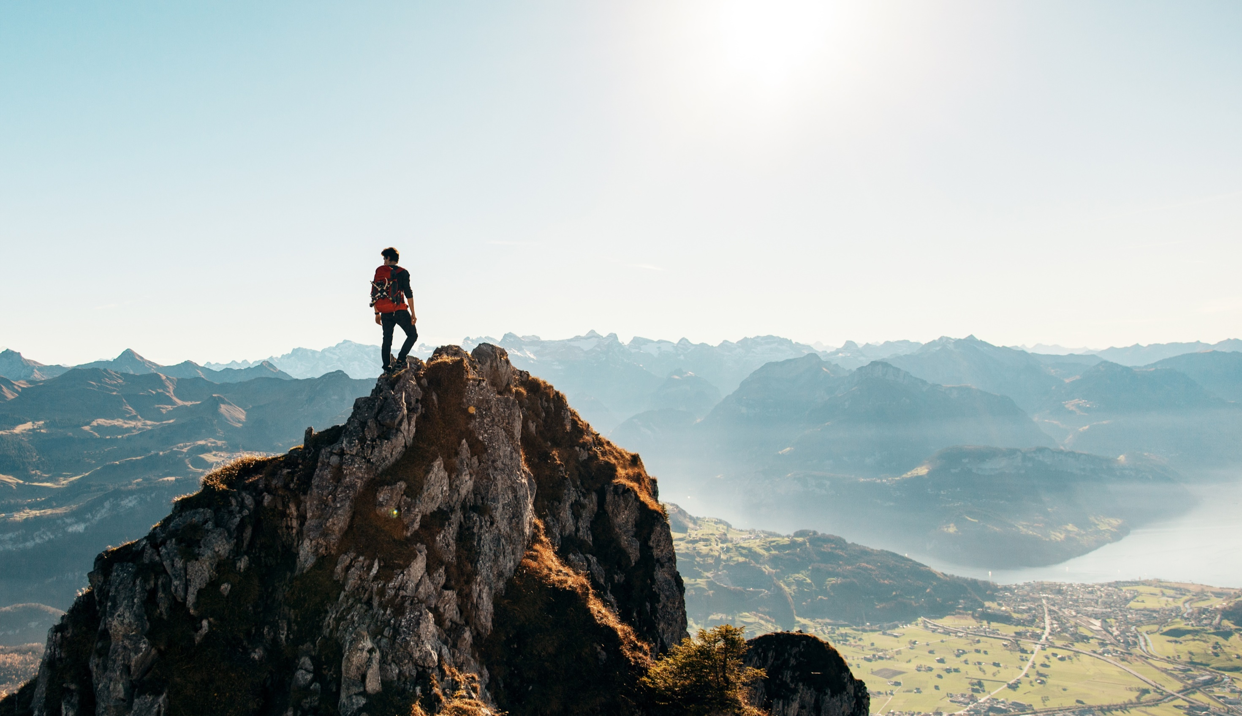
Breakaway
Singer：Kelly Clarkson
单元：Unit 7& Lesson 1
主题：The Spirit of Explorers 作者：李依颖 单位：华南师范大学

Slide 2
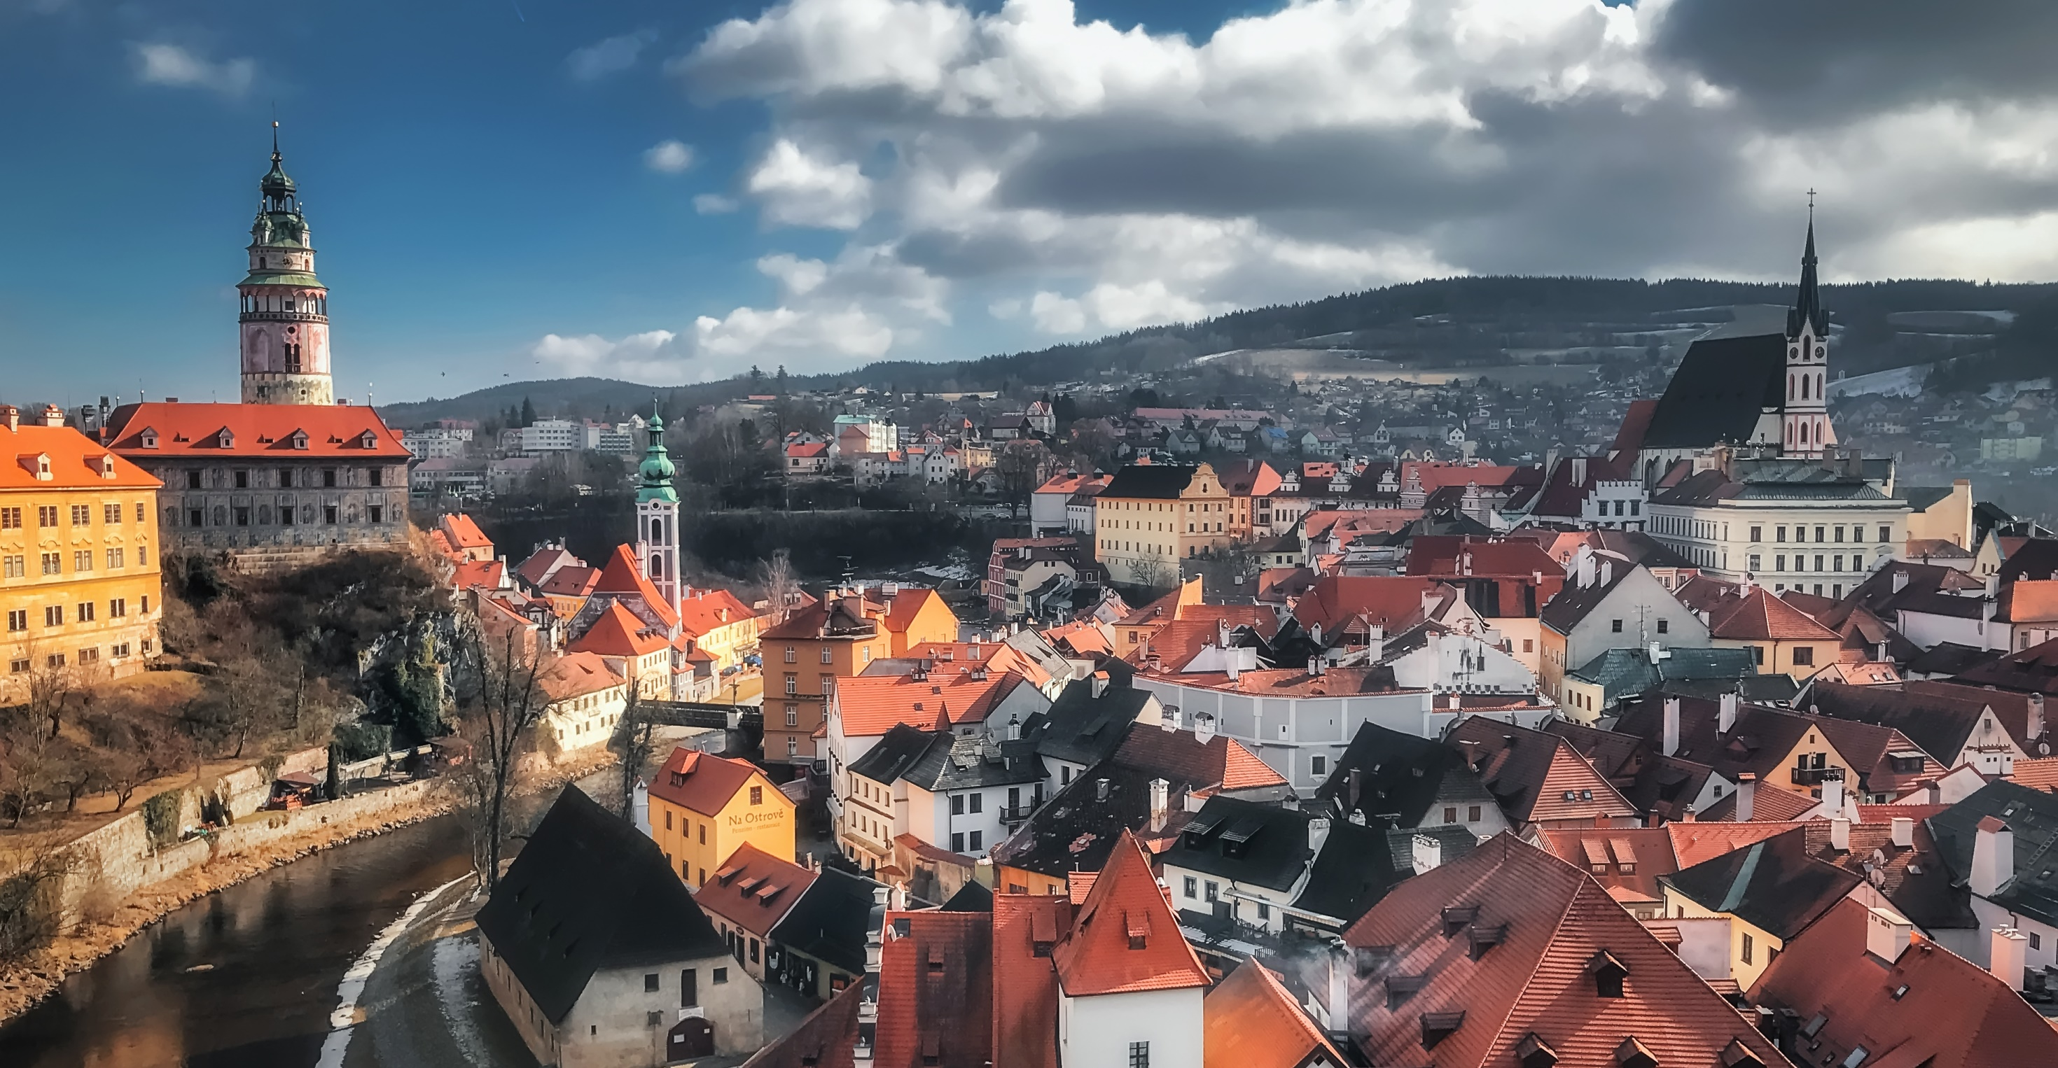
Grew up in a small town
Breakaway · Kelly Clarkson

Slide 3
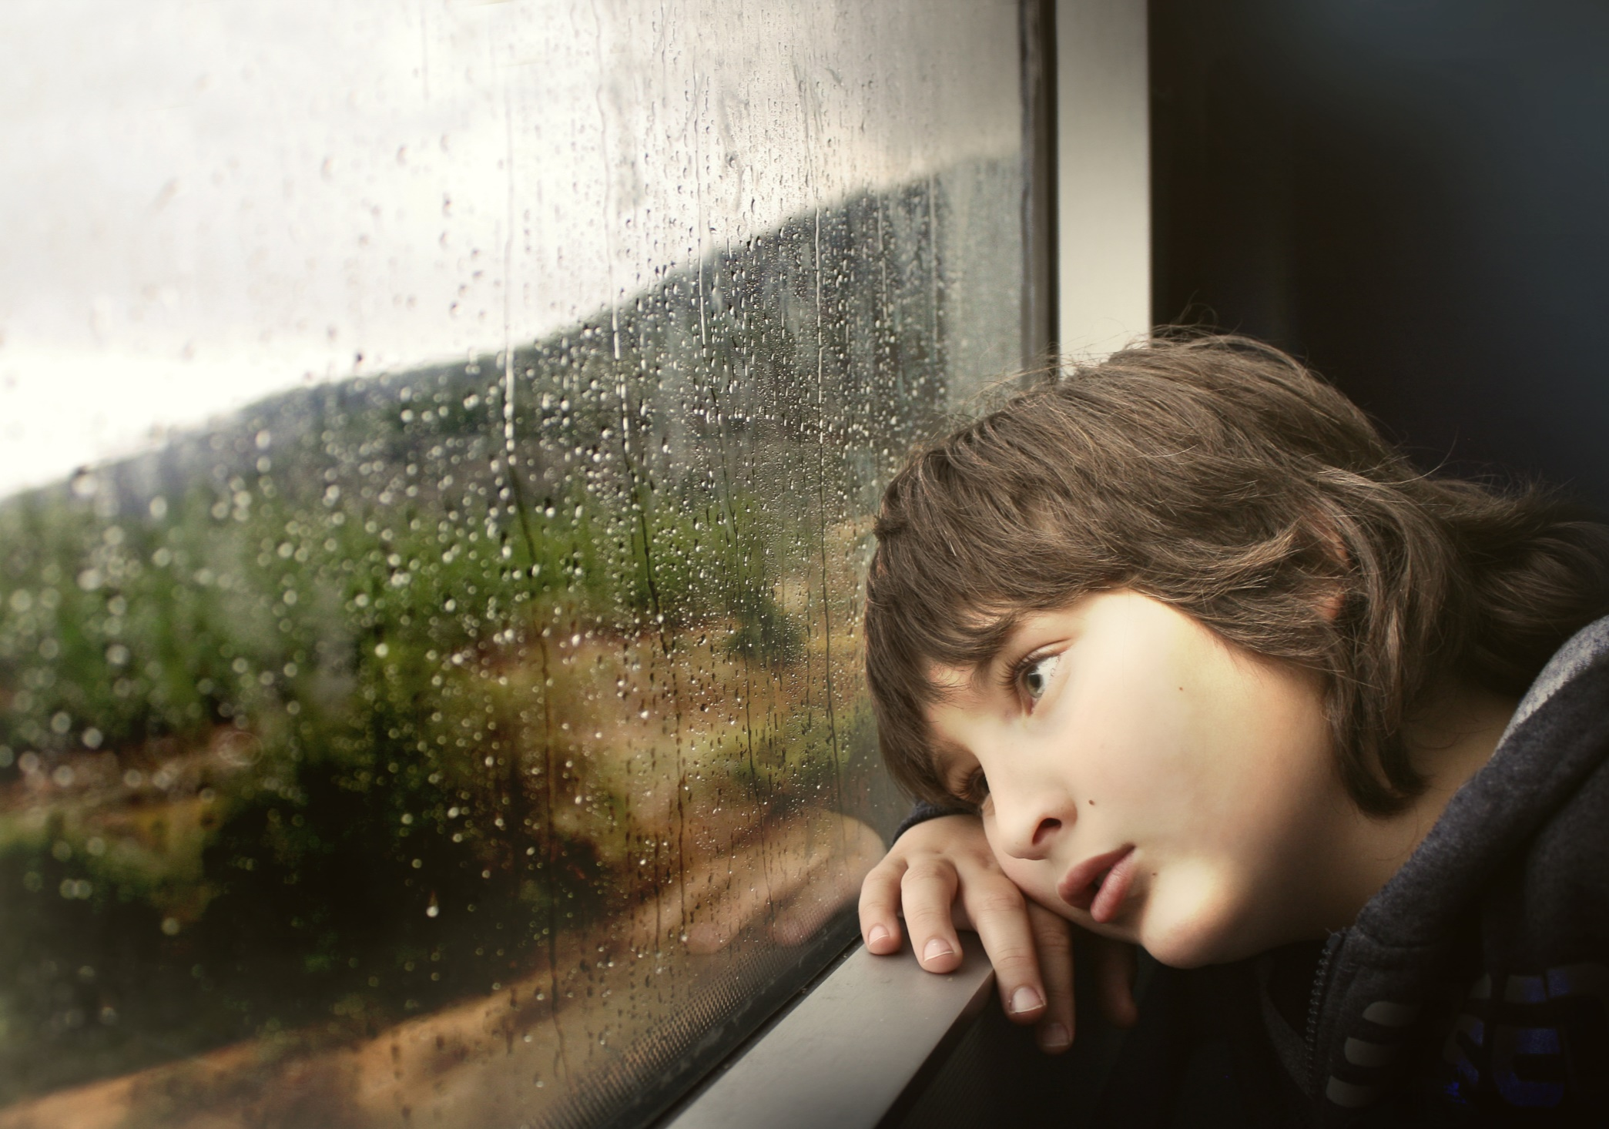
And when the
rain would
fall down
I'd just
stared out
my window
Breakaway · Kelly Clarkson

Slide 4
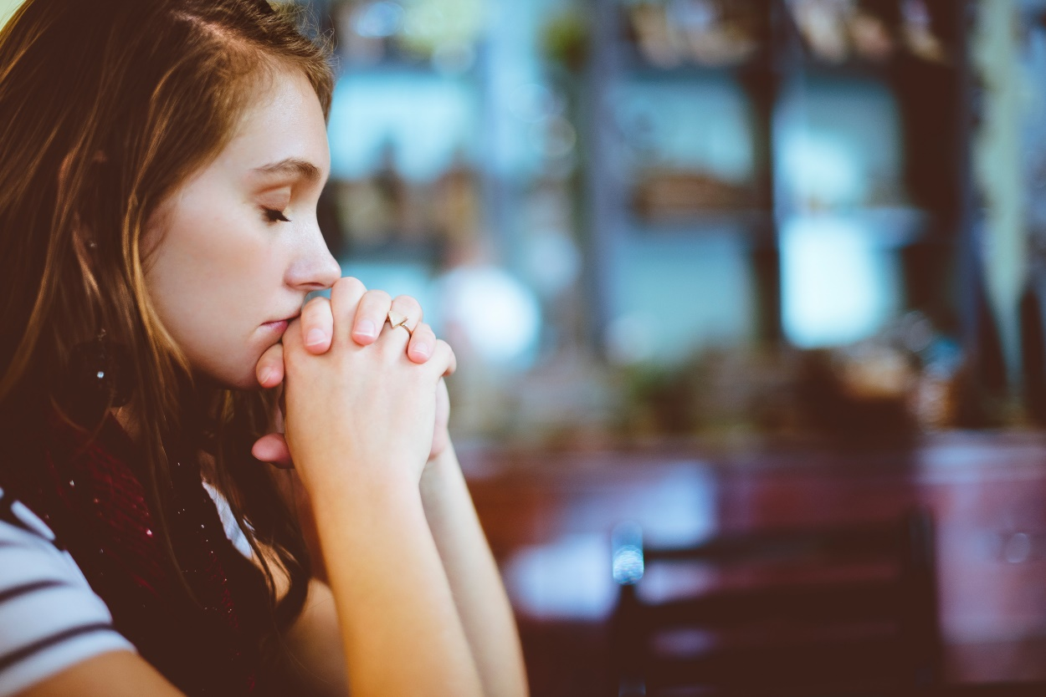
Dreaming of
what could-be
And if I'd end up happy
I would pray
Breakaway · Kelly Clarkson

Slide 5
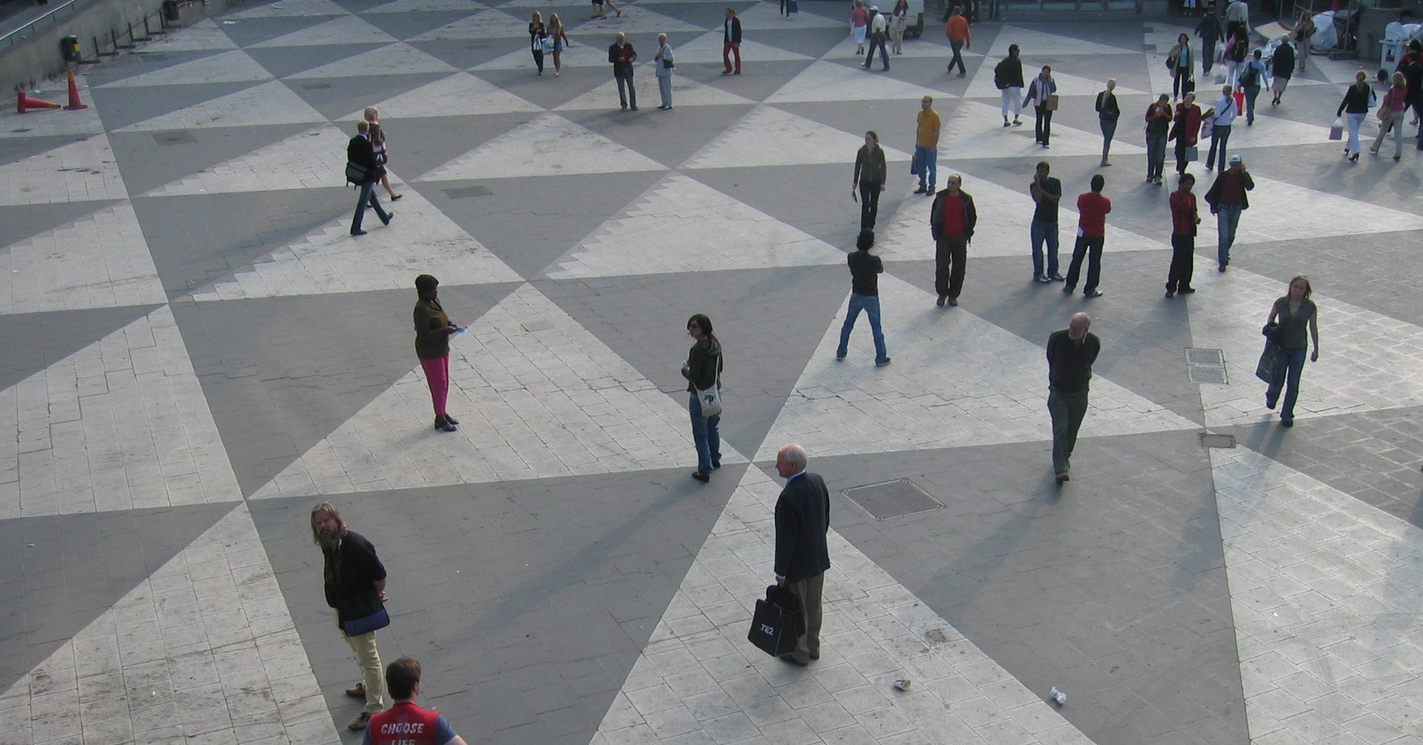
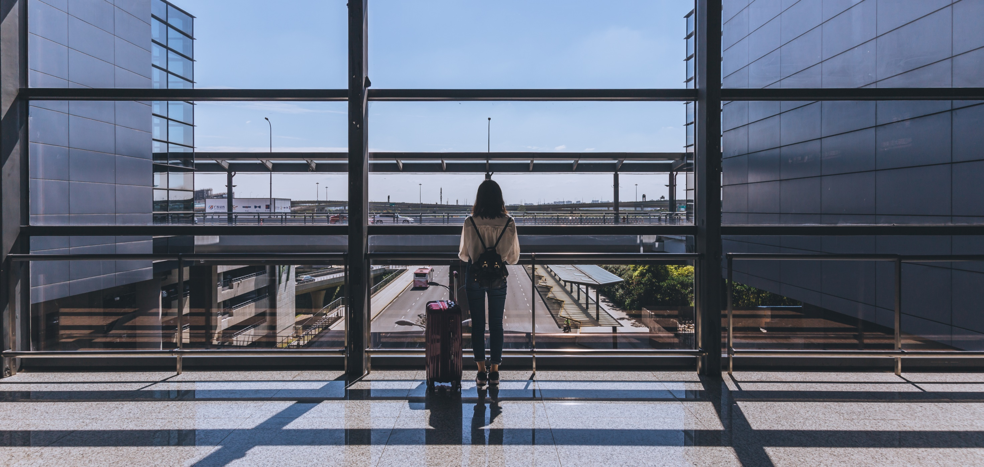
Trying not to reach out
Trying hard to reach out
But when I'd try to speak out
Felt like no one could hear me
But when I'd try to speak out
Breakaway · Kelly Clarkson

Slide 6
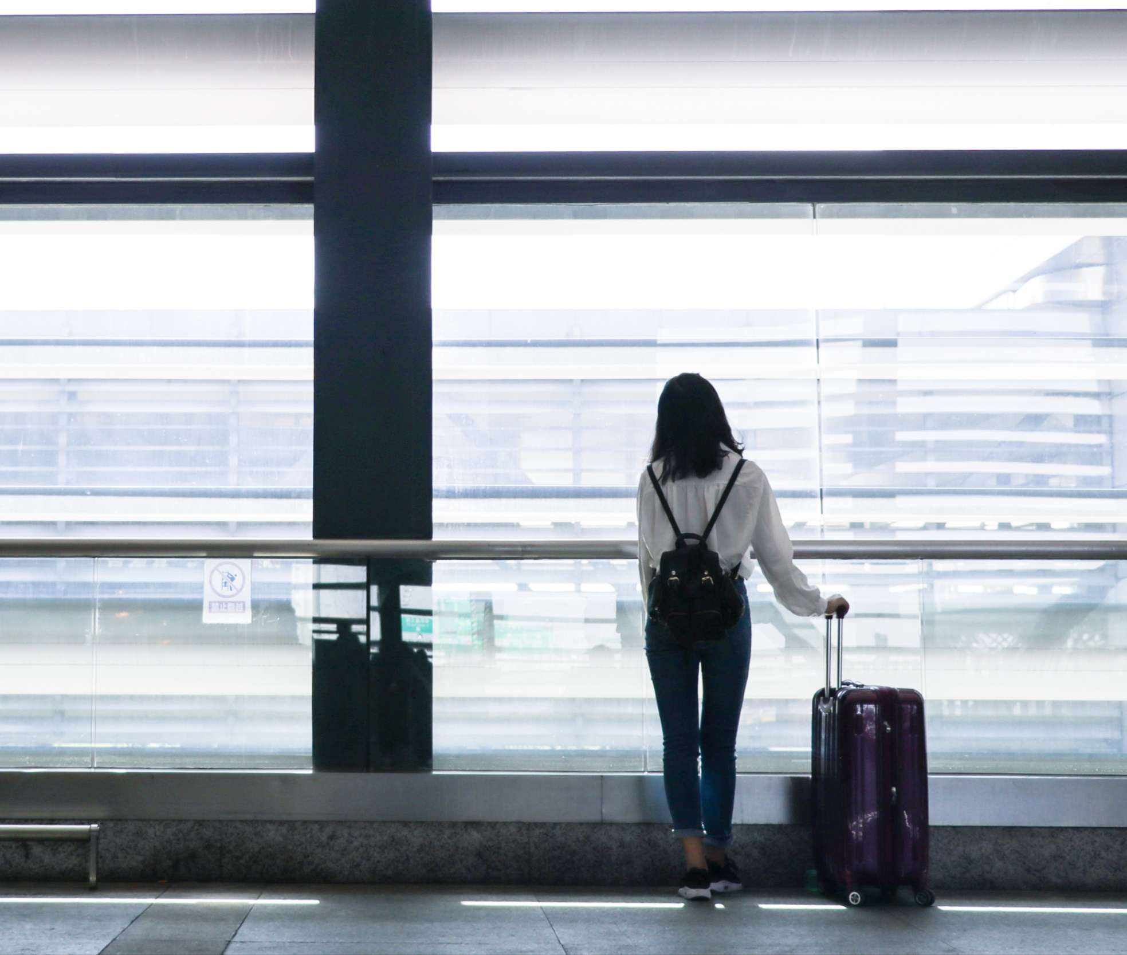
Wanted to
belong here
But
something felt
so wrong here
Breakaway · Kelly Clarkson

Slide 7
So I pray
I could breakaway
Breakaway · Kelly Clarkson

Slide 8
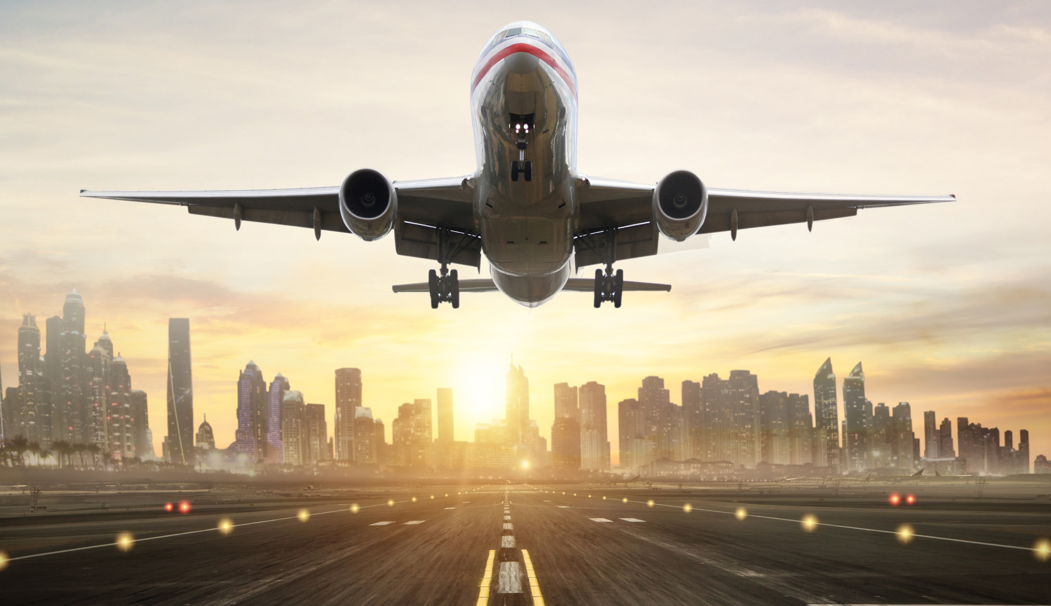
I'll spread my wings
and I'll learn how to fly
Breakaway · Kelly Clarkson

Slide 9
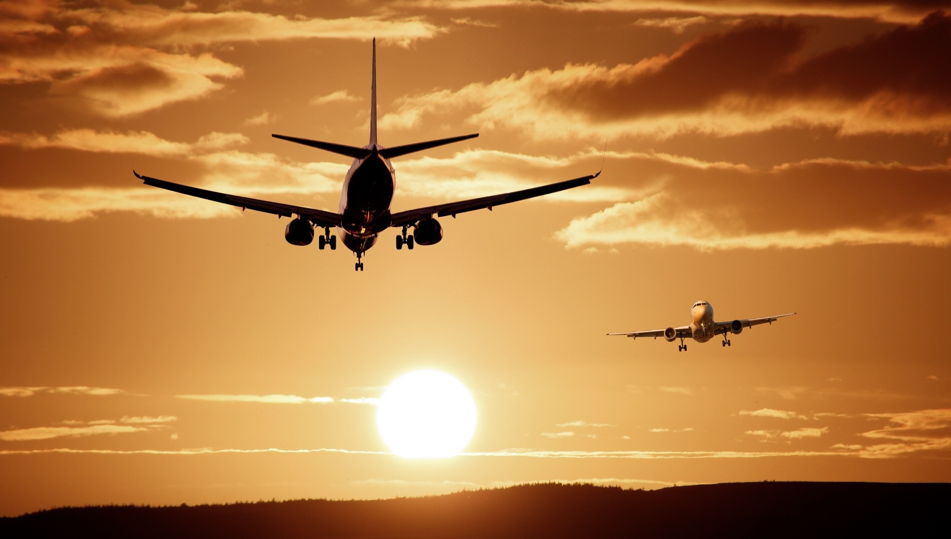
I'll do what it takes
tilI' touch the sky
Breakaway · Kelly Clarkson

Slide 10
I'll make a wish
Take a chance
Make a change
And Breakaway
Breakaway · Kelly Clarkson

Slide 11
Out of the darkness and into the sun
But I won't forget all the ones that I loved
Breakaway · Kelly Clarkson

Slide 12
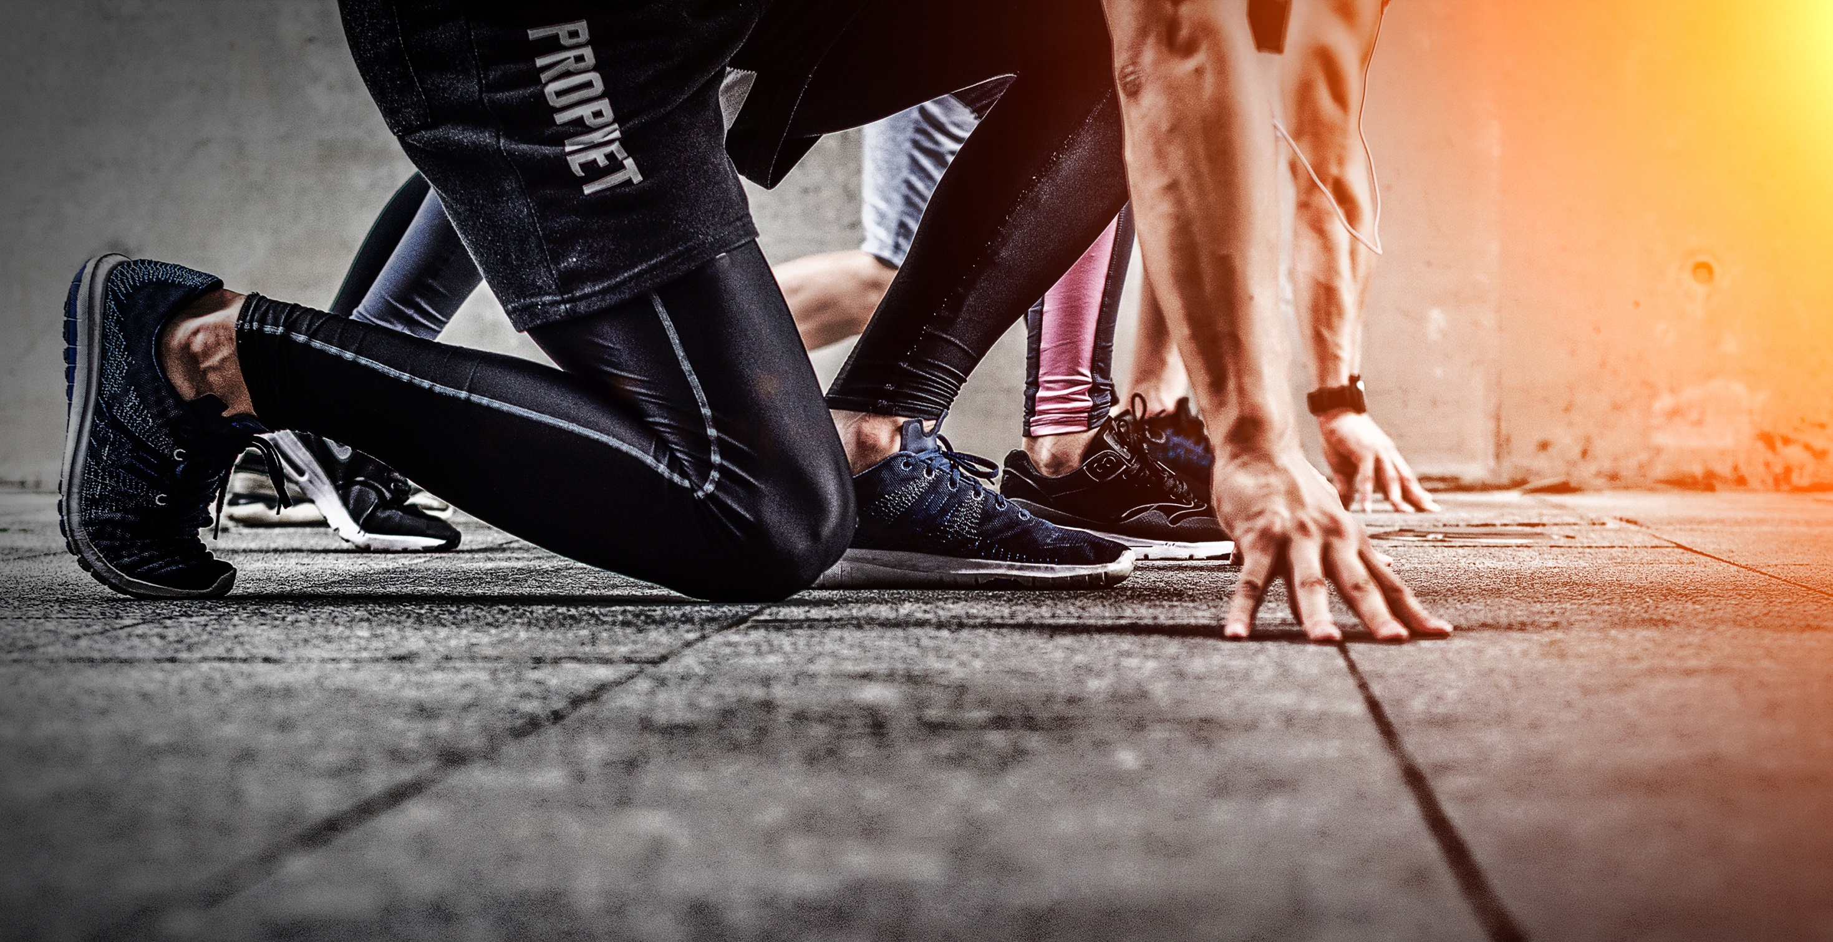
I'll take a risk
Take a chance
Make a change
Breakaway · Kelly Clarkson

Slide 13
And
Breakaway
Breakaway · Kelly Clarkson

Slide 14
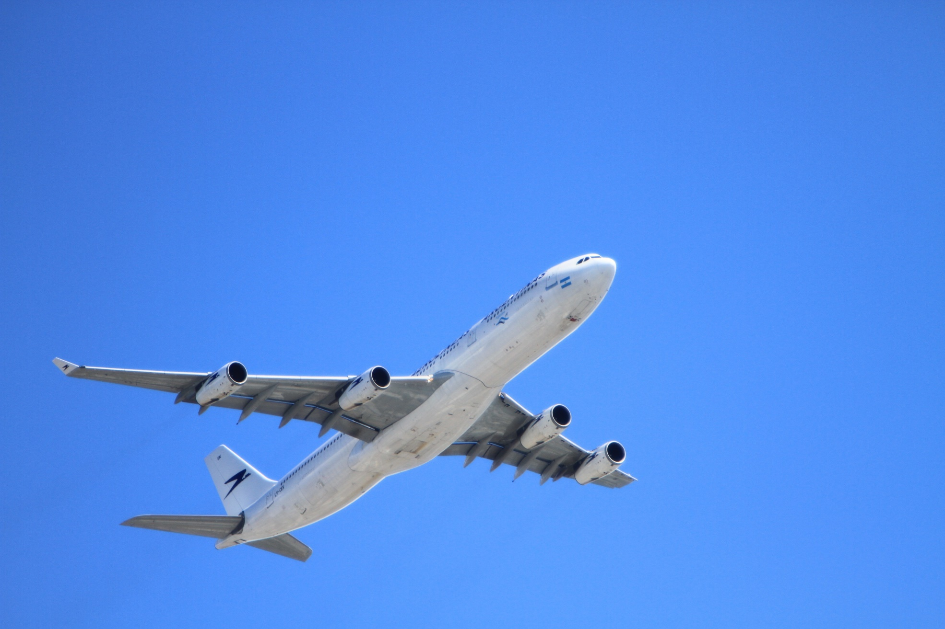
Want to feel the warm breeze,
Sleep under a palm tree,
Feel the rush of the ocean.
Get on board a fast train
Travel on a jet plane, far away
And breakaway
Breakaway · Kelly Clarkson

Slide 15
I'll spread my wings
and I'll learn how to fly
Breakaway · Kelly Clarkson

Slide 16
I'll do what it takes
tilI' touch the sky
Breakaway · Kelly Clarkson

Slide 17
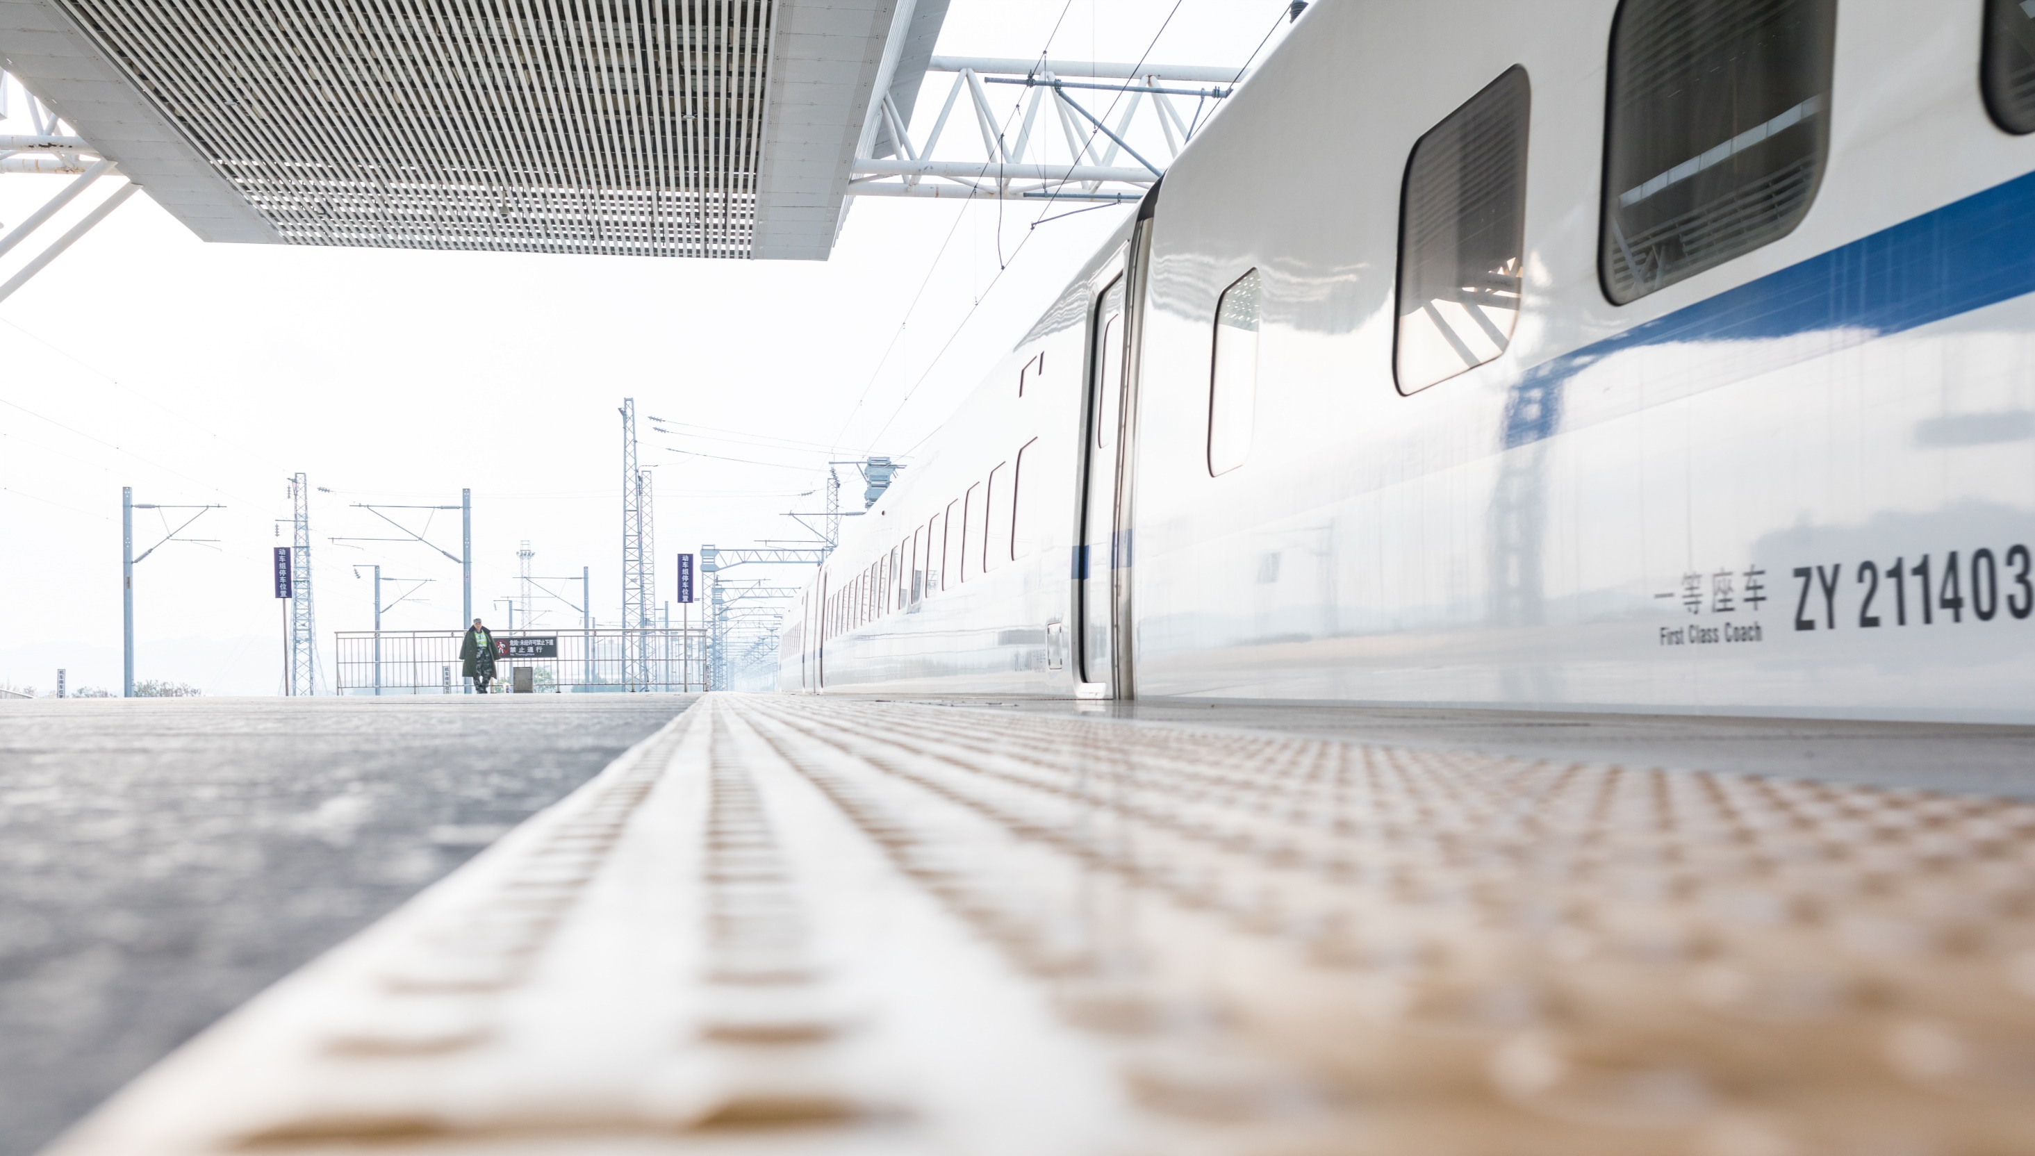
I'll make a wish
Take a chance
Make a change
Breakaway · Kelly Clarkson

Slide 18
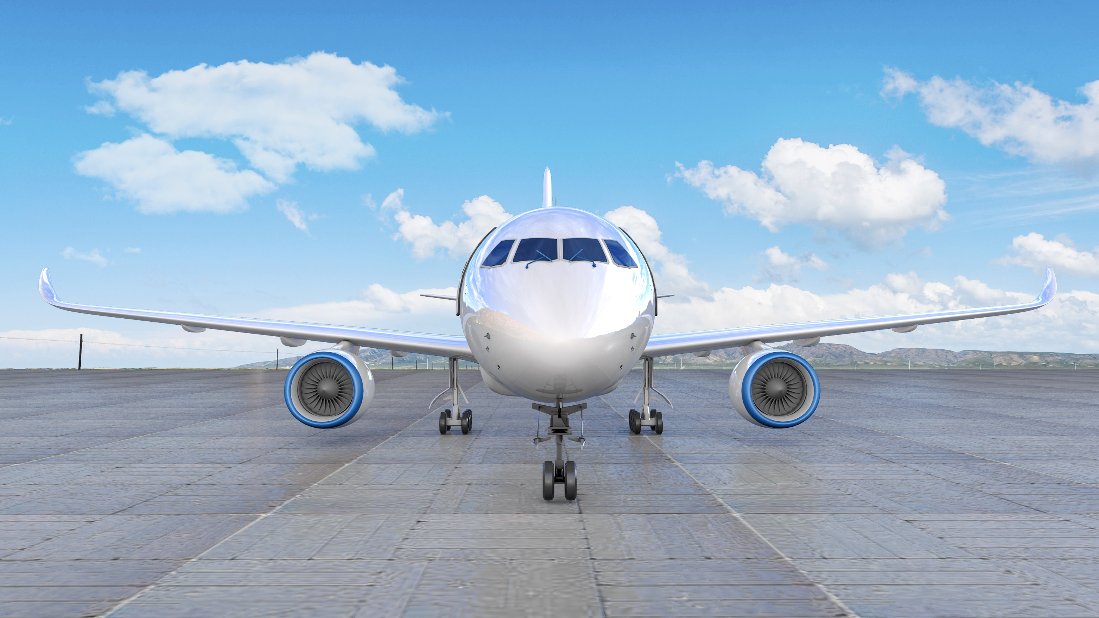
And breakaway
Breakaway · Kelly Clarkson

Slide 19
Out of the darkness
and into the sun
But I won't forget
all the ones that I loved
Breakaway · Kelly Clarkson

Slide 20
I'll take a risk
Take a chance
Make a change
Breakaway · Kelly Clarkson

Slide 21
And Breakaway
Breakaway · Kelly Clarkson

Slide 22
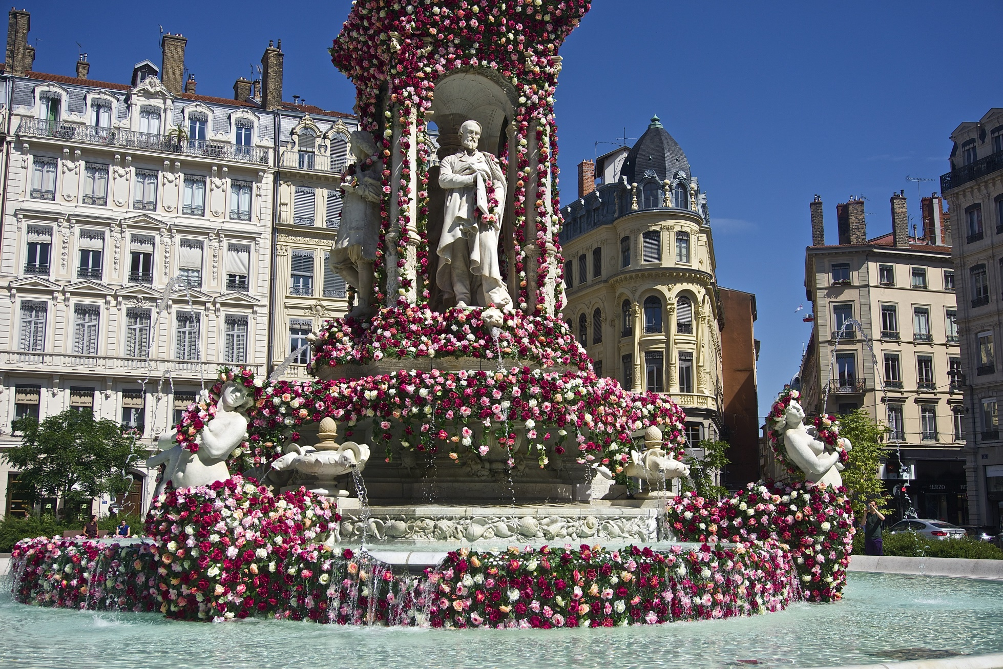
Buildings with a hundred floors
Swinging around revolving doors
Breakaway · Kelly Clarkson

Slide 23
Maybe I don't know where they'll take me but
I'll take a risk
Take a chance
Make a change
Gotta keep moving on, moving on
Breakaway · Kelly Clarkson

Slide 24
Fly away
Breakaway
Breakaway · Kelly Clarkson

Slide 25
I'll spread my wings
and I'll learn how to fly
Breakaway · Kelly Clarkson

Slide 26
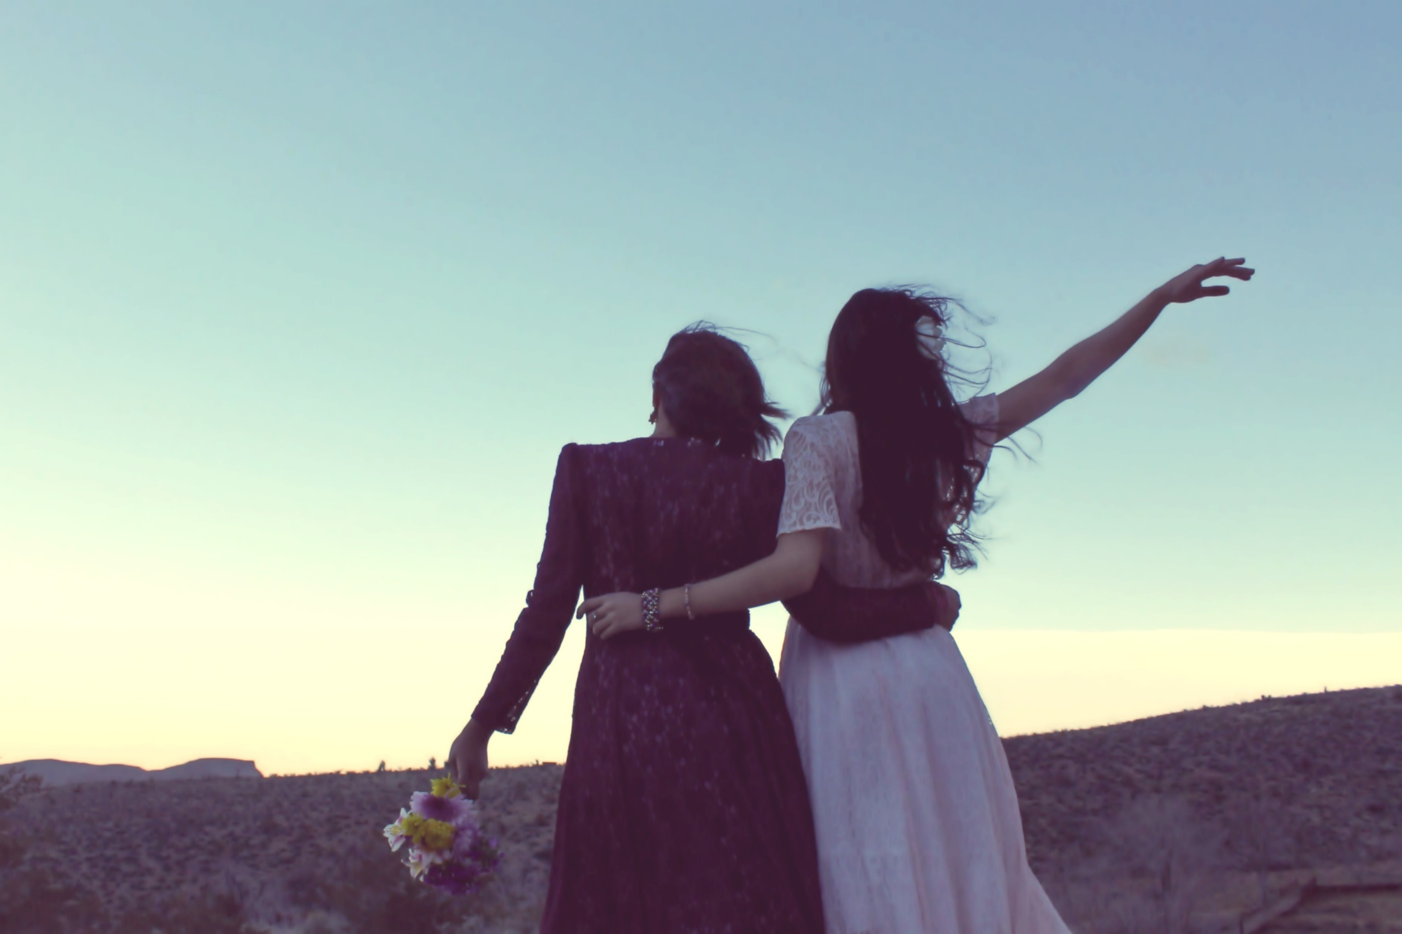
Though it's not easy to tell you goodbye
Breakaway · Kelly Clarkson

Slide 27
I gotta take a risk
Take chance
Make a change
And breakaway
Breakaway · Kelly Clarkson

Slide 28
Out of the darkness and into the sun
But I won't forget the place I come from
Breakaway · Kelly Clarkson

Slide 29
I gotta take a risk
Take a chance
Make a change
Breakaway · Kelly Clarkson

Slide 30
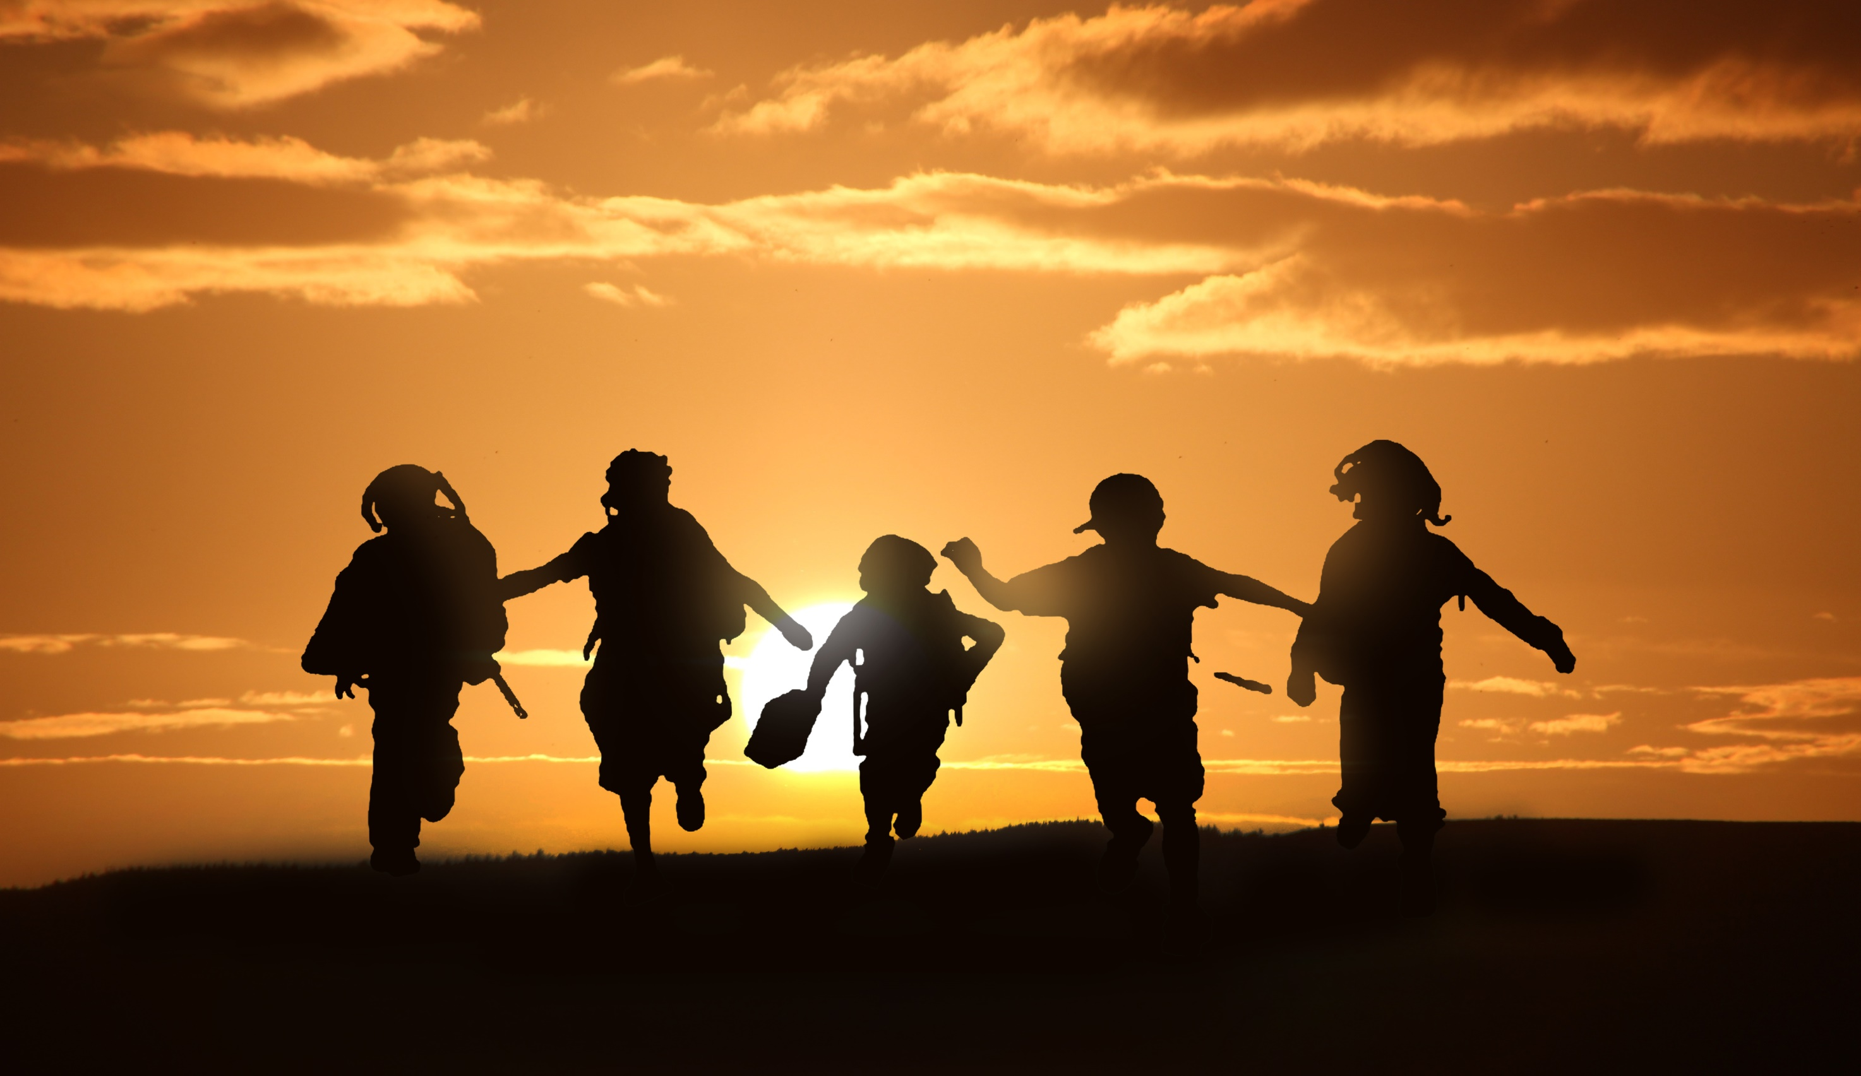
And breakaway
Breakaway
Breakaway ………
Breakaway · Kelly Clarkson

Slide 31
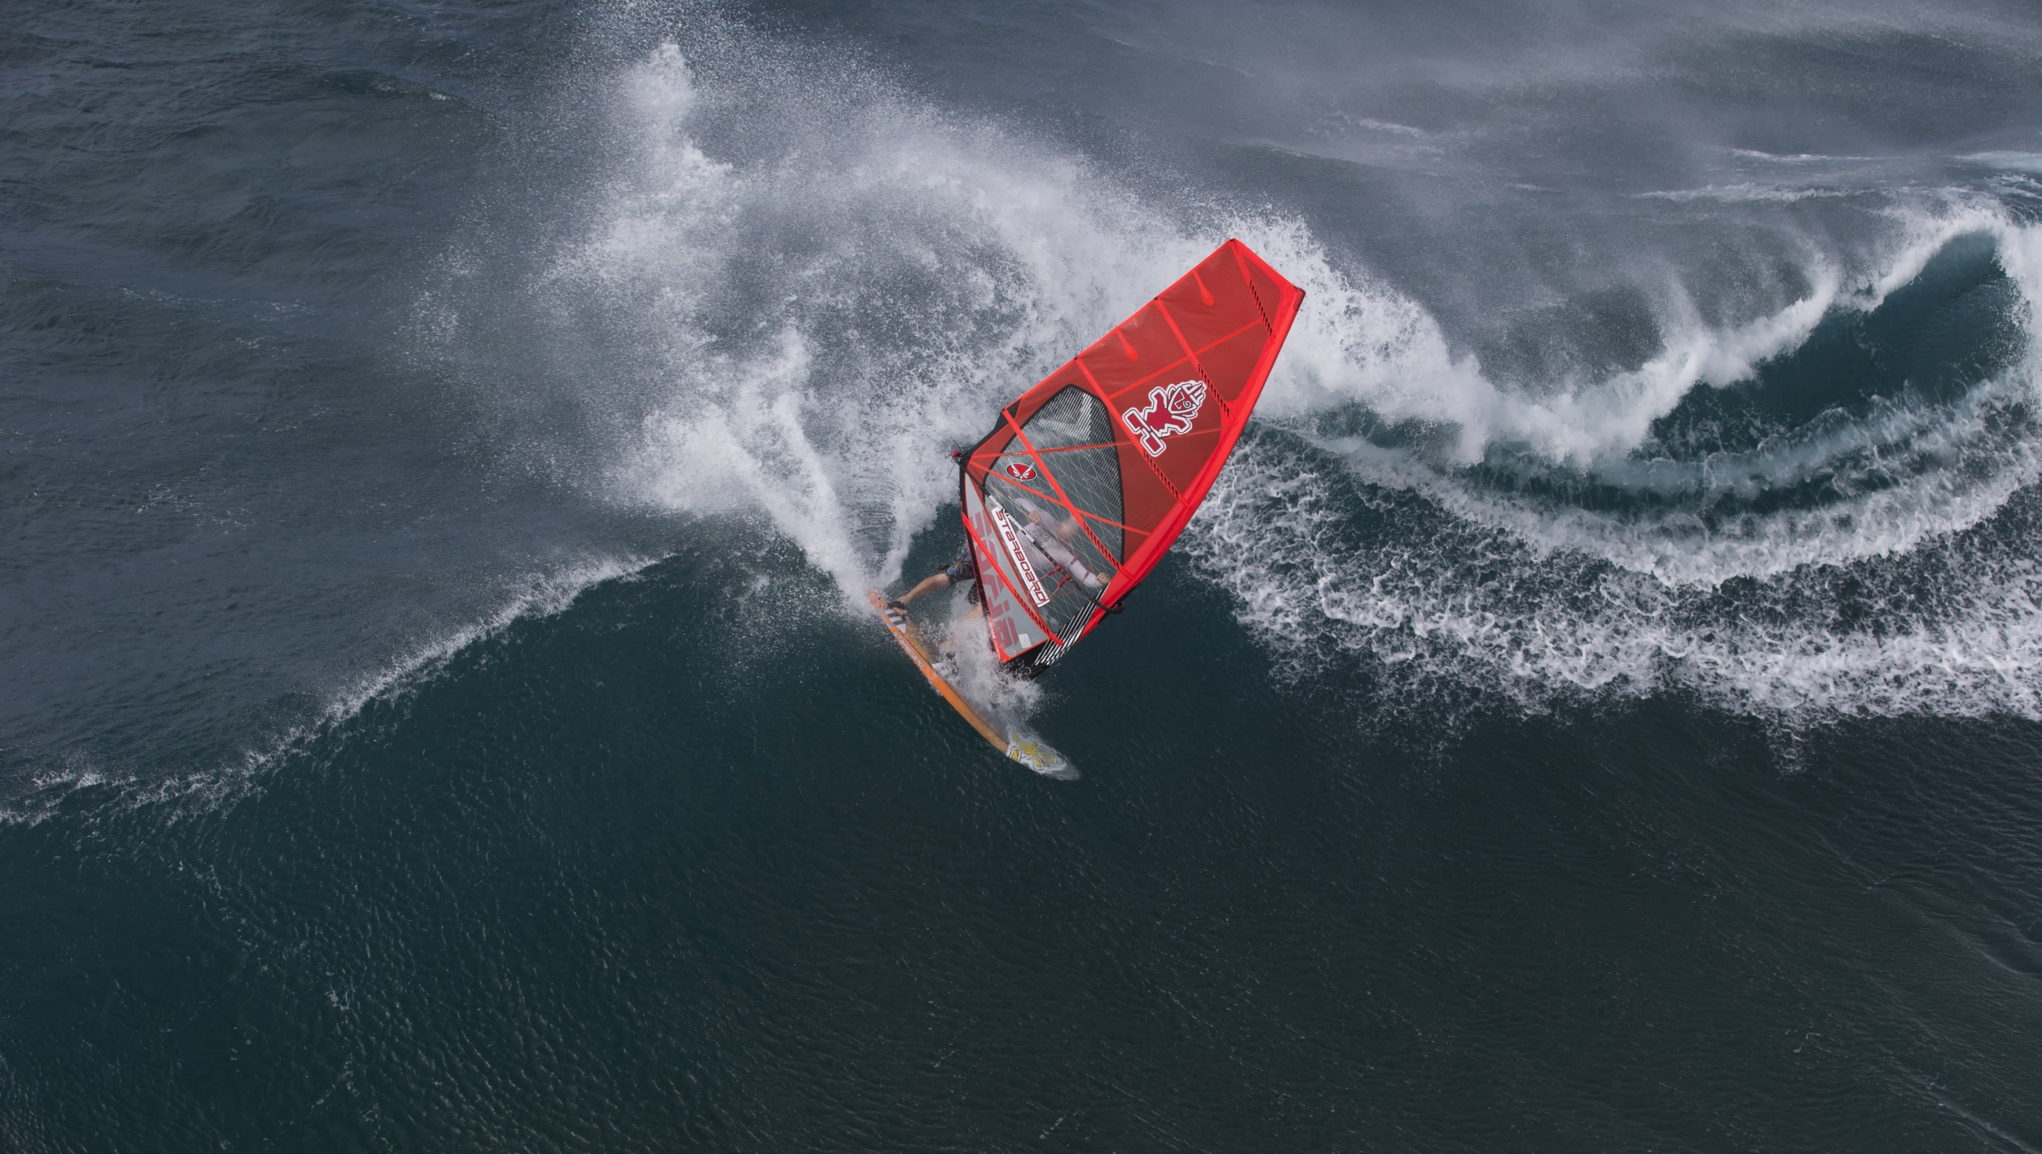
END
作者：李依颖
Breakaway · Kelly Clarkson

