Slide 1
高中英语北师大版 U6 L3 Chinese Paper Art
华南师范大学 卢健楠

Slide 2
Starry starry night

Slide 3
Paint your palette blue and grey

Slide 4
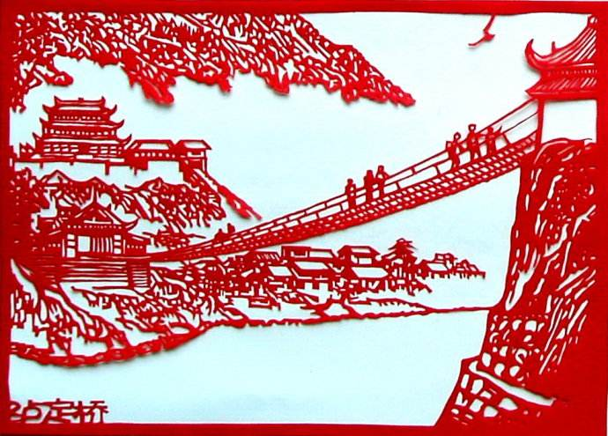
Look out on a summer's day
with eyes that know the darkness in my soul

Slide 5
Shadows on the hills
sketch the trees and the daffodils

Slide 6
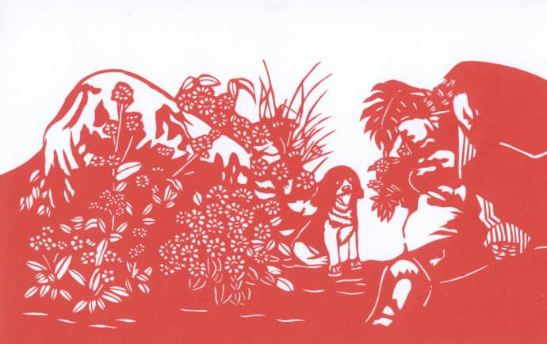
Catch the breeze and the winter chills

Slide 7
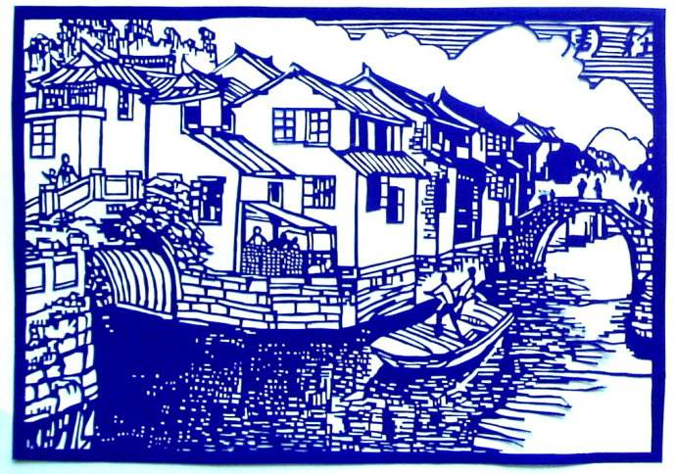
in colors on the snowy linen land

Slide 8
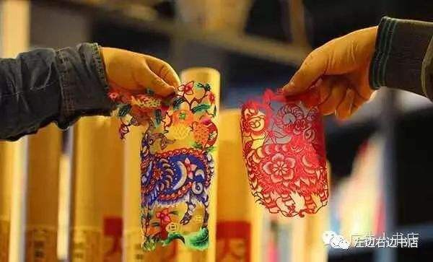
And now I understand
what you tried to say to me

Slide 9
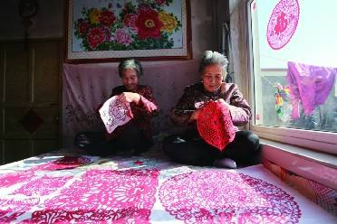
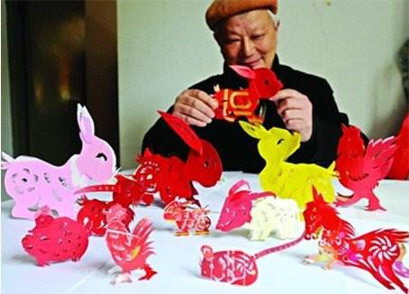
And how you suffered for your sanity
and how you tried to set them free

Slide 10
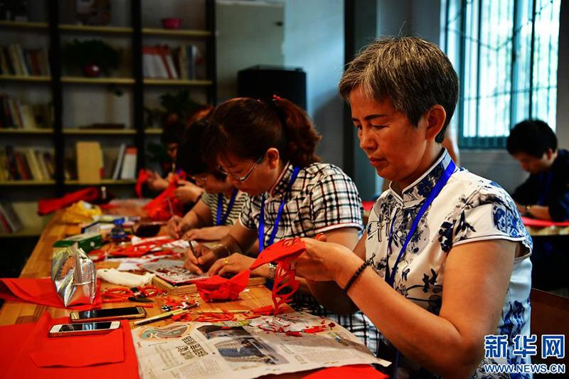
They would not listen
they did not know how

Slide 11
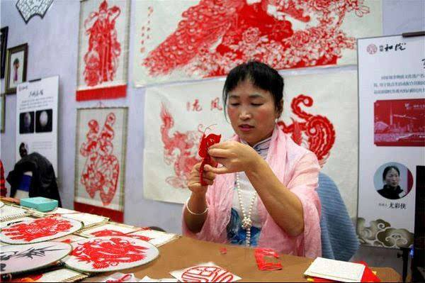
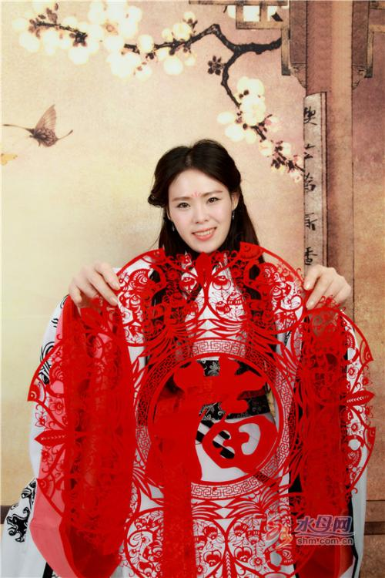
Perhaps they'll listen now

Slide 12
Starry starry night

Slide 13
Flaming flowers that brightly blaze,

Slide 14
Swirling clouds in violet haze

Slide 15
Reflect in Vincent’s eyes of china blue
Colors changing hue, morning fields of amber grain

Slide 16
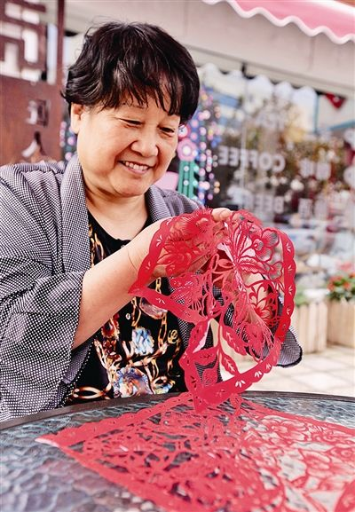
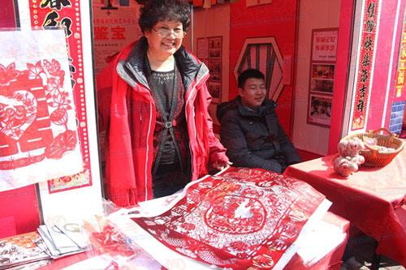
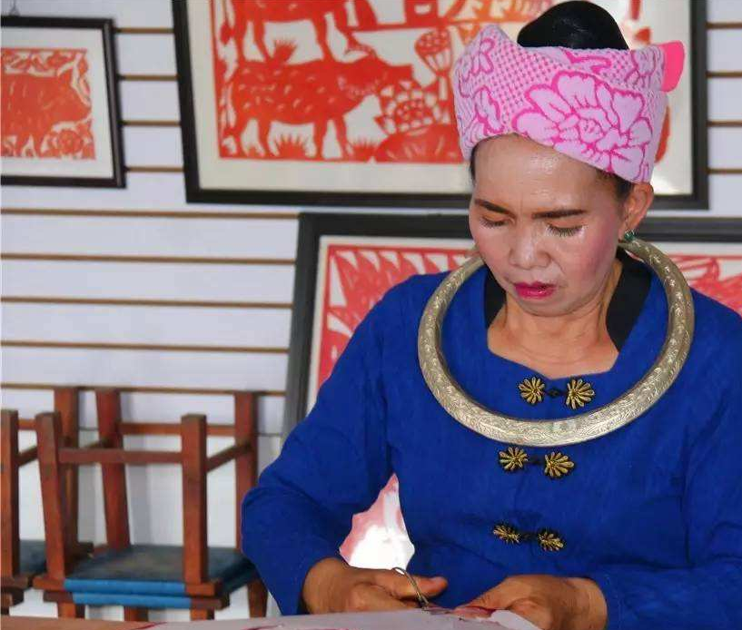
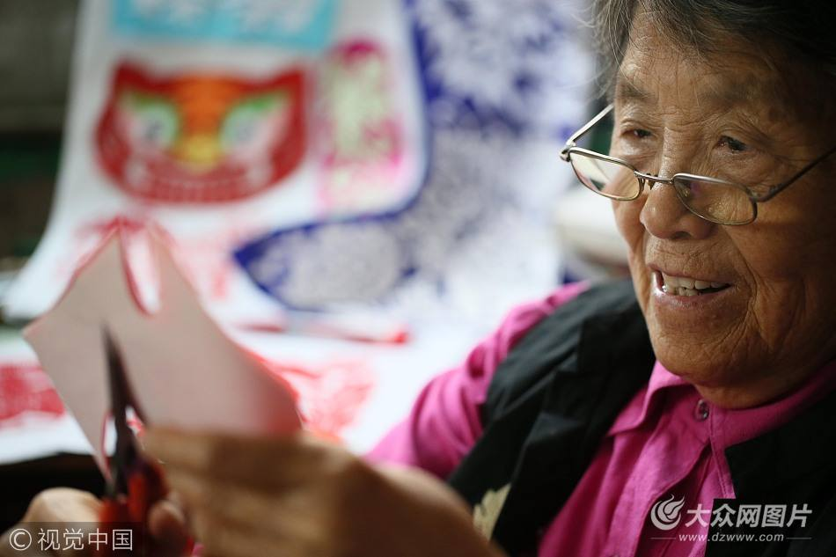
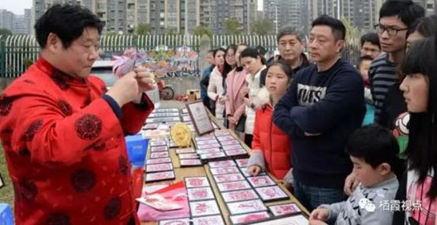
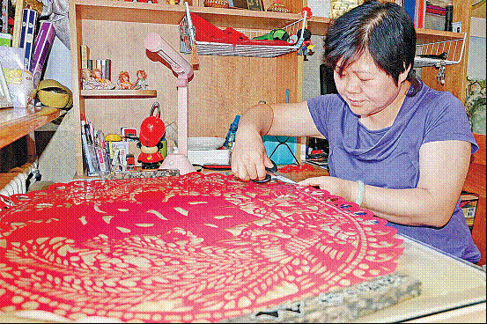
Weathered faces lined in pain
Are smoothed beneath the artist’s loving hand

