Slide 1

PEP, U5L4, Rhythm—“Let’s Dance”
Song: Swan Lake
Singer：Dark Moor
Editor: 李可颖
单位：华南师范大学外文学院

Slide 2
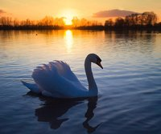
Her soul will be a swan

Slide 3
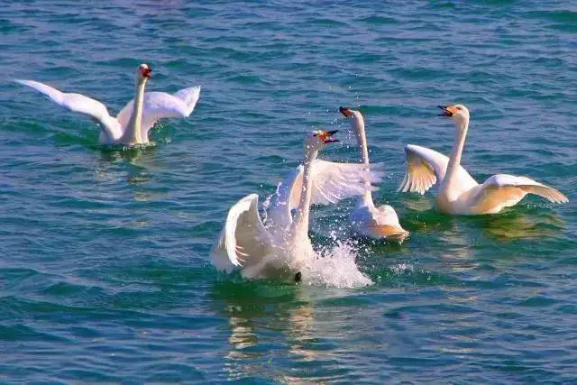
Until

Slide 4
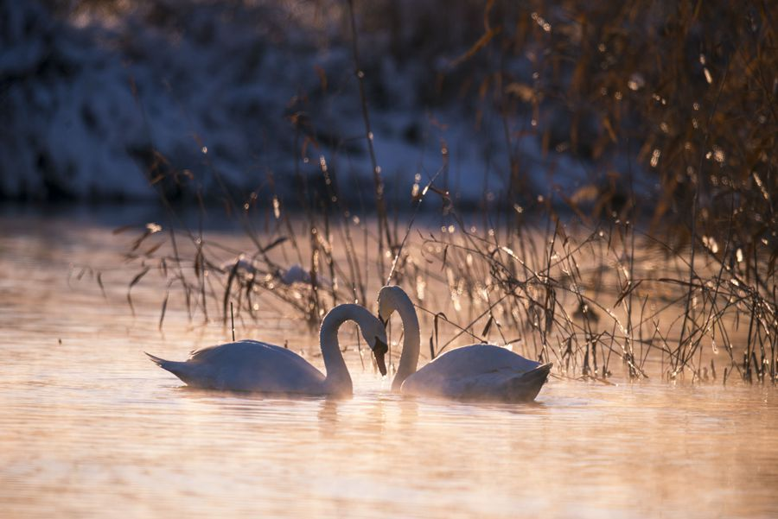
She feels

Slide 5
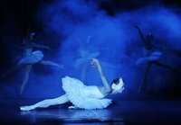
The love of nobleman

Slide 6
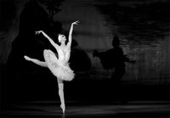
Forever her soul will be a swan

Slide 7
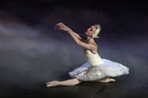
Until

Slide 8
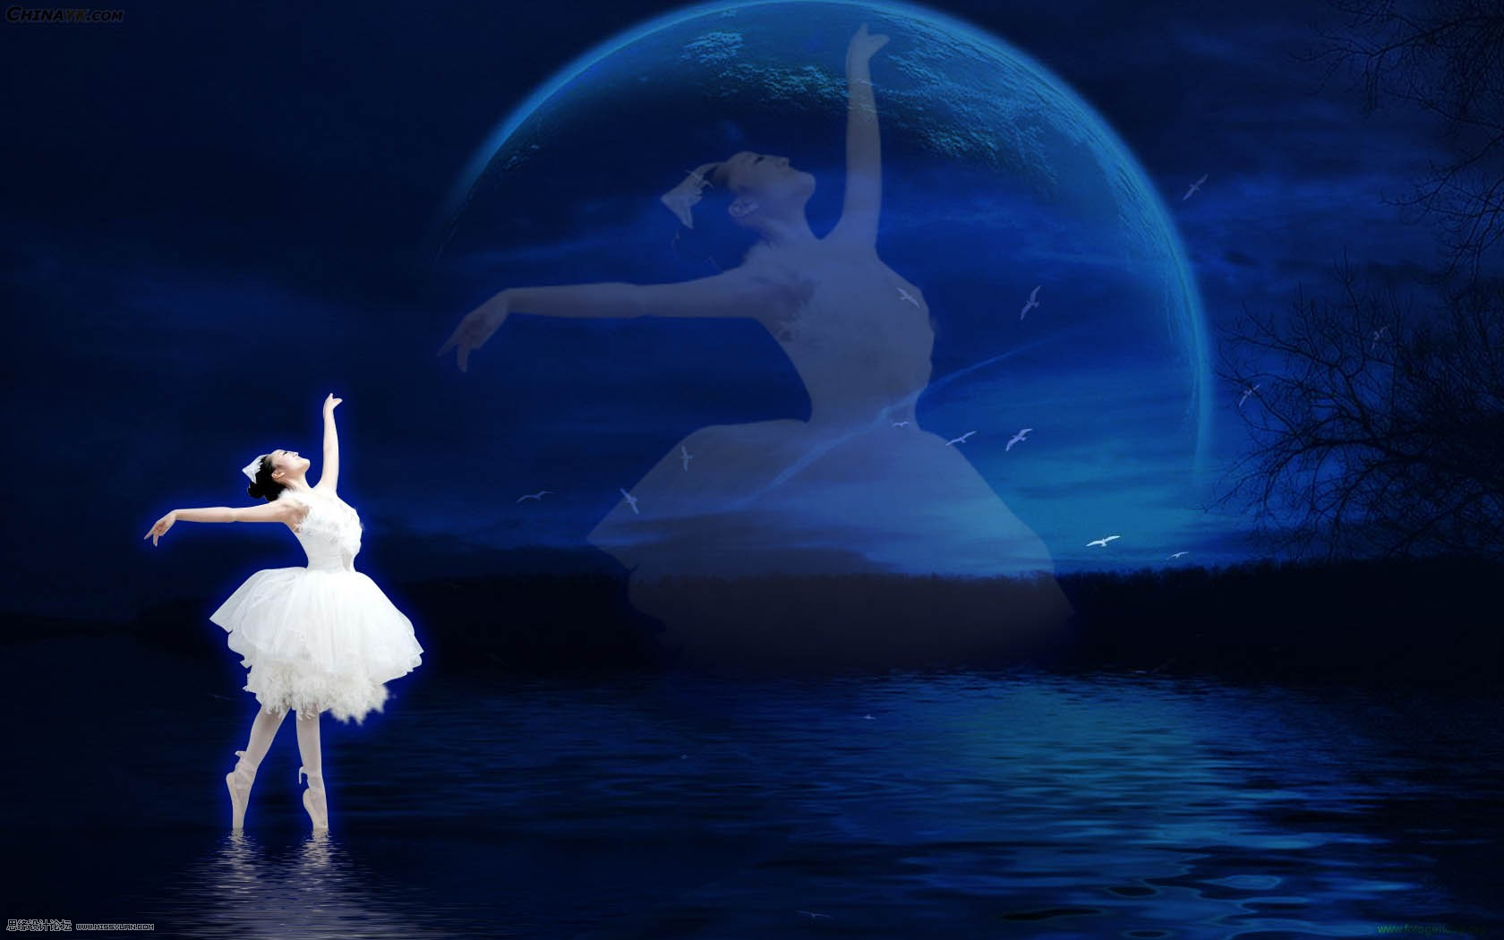
She feels

Slide 9
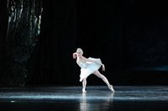
The love of nobleman

Slide 10
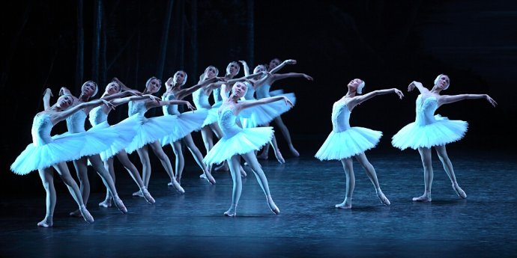
In swan lake

Slide 11
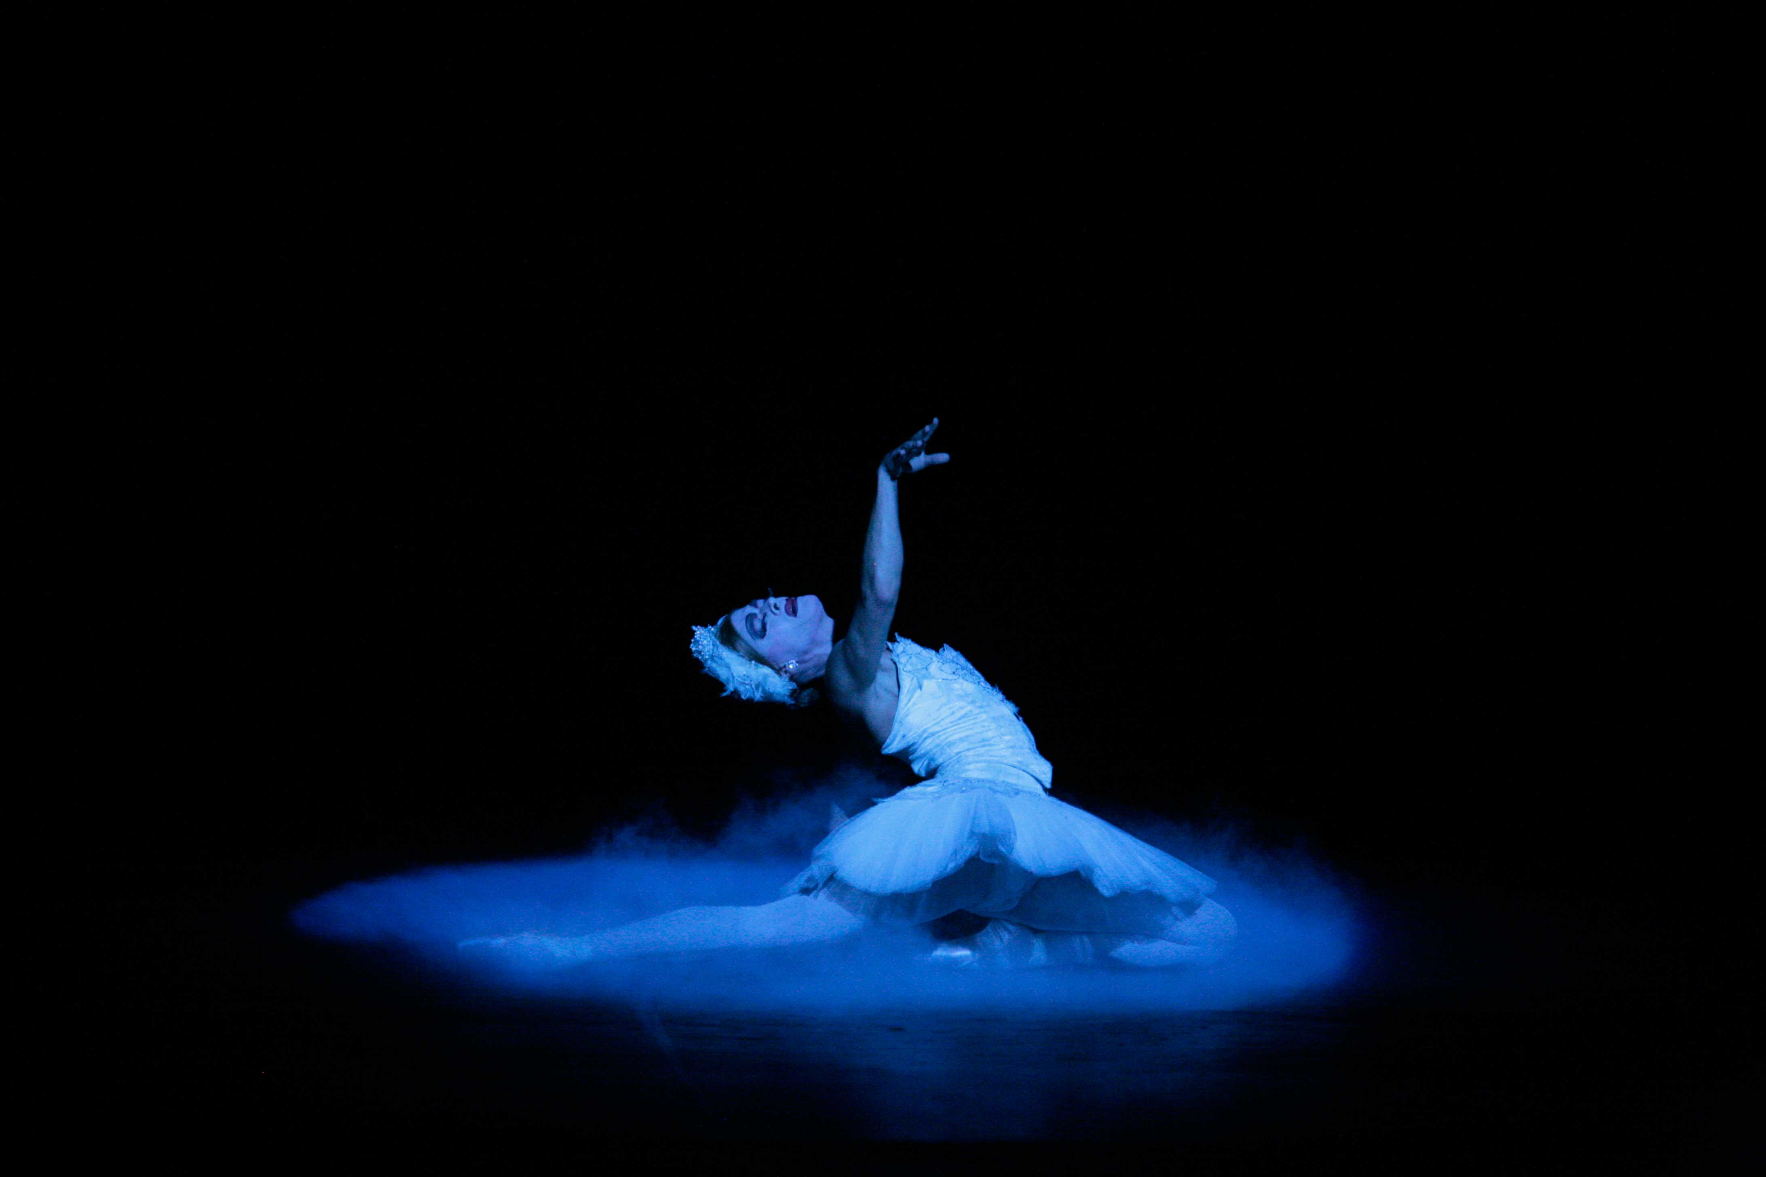
In swan lake

Slide 12
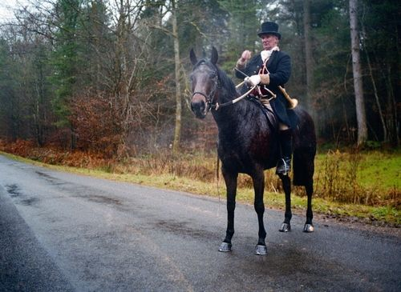
Tired to ride in the royal hunt

Slide 13
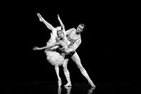
To listen sweet lies that I am wont wont

Slide 14
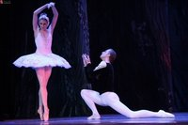
I am the prince!

Slide 15

The future king!

Slide 16
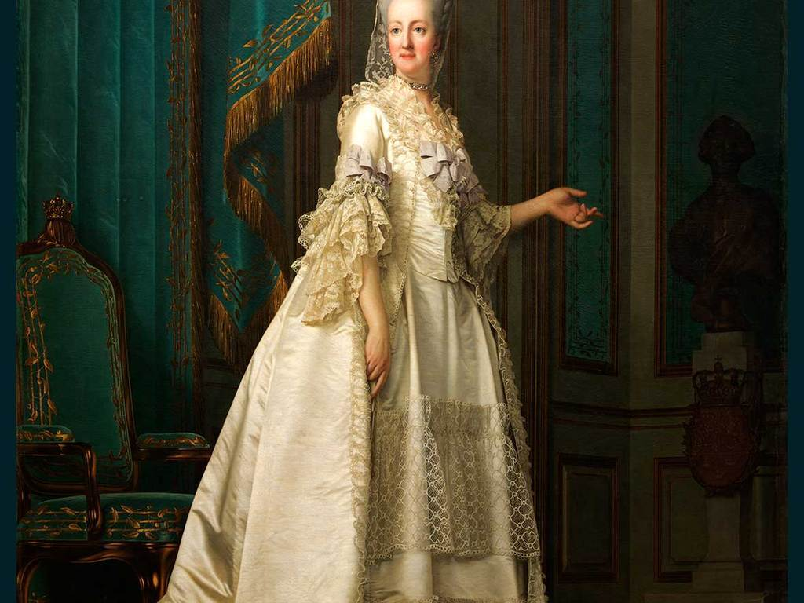
Boomed in my head my mother's voice

Slide 17
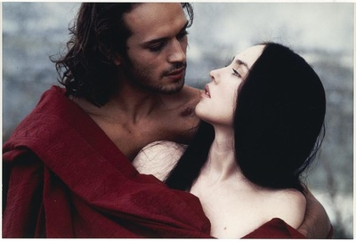
Take to wife! should be my choice

Slide 18
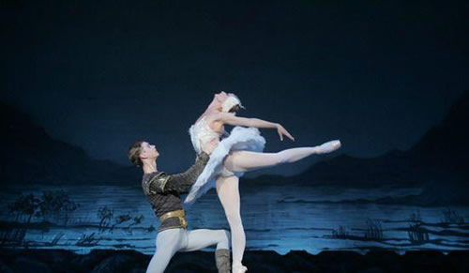
Oh, cruel fate!

Slide 19
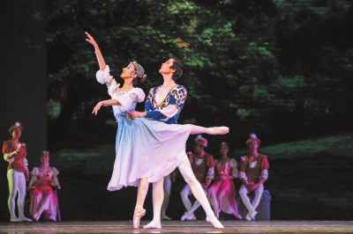
That my soul hate!

Slide 20
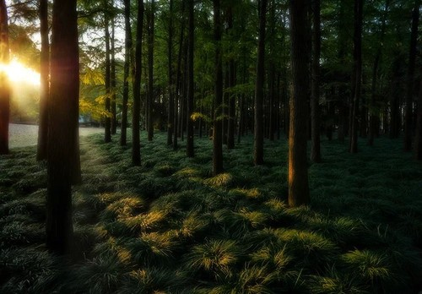
To forget all I fled into the woods

Slide 21
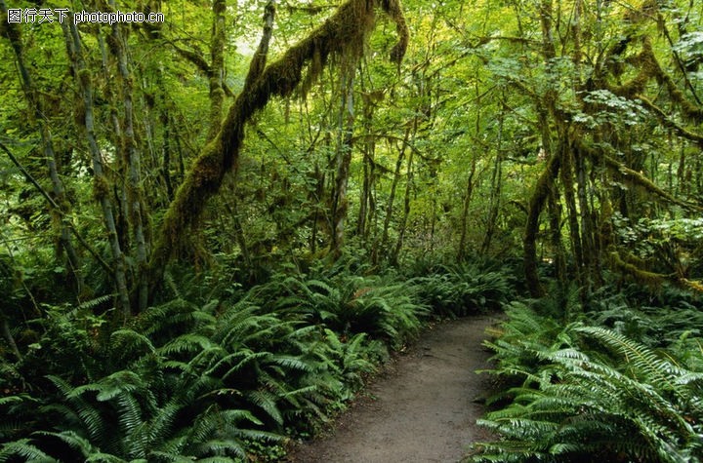
Searching preys goods

Slide 22
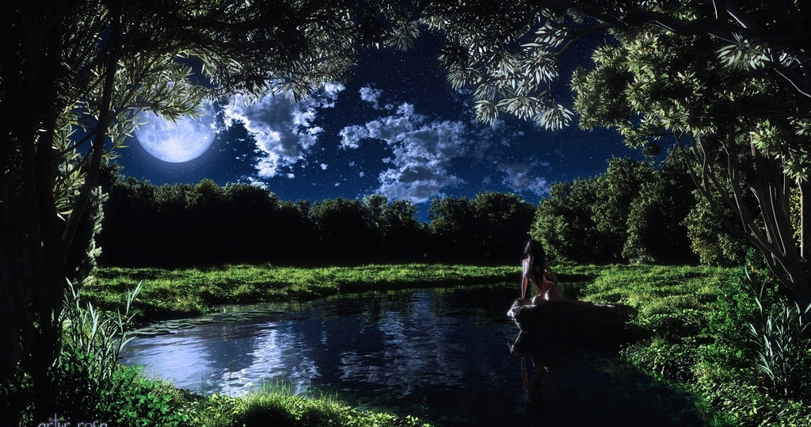
Then I saw the lake
Searching preys goods

Slide 23

Lost in the deep forest

Slide 24
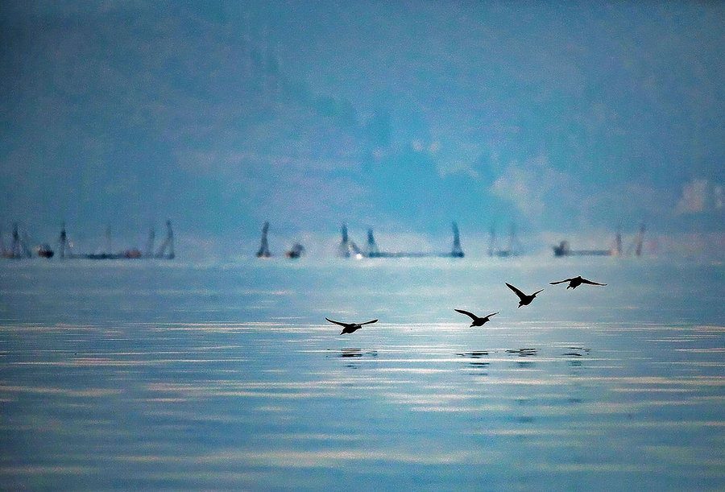
And its water chorused

Slide 25
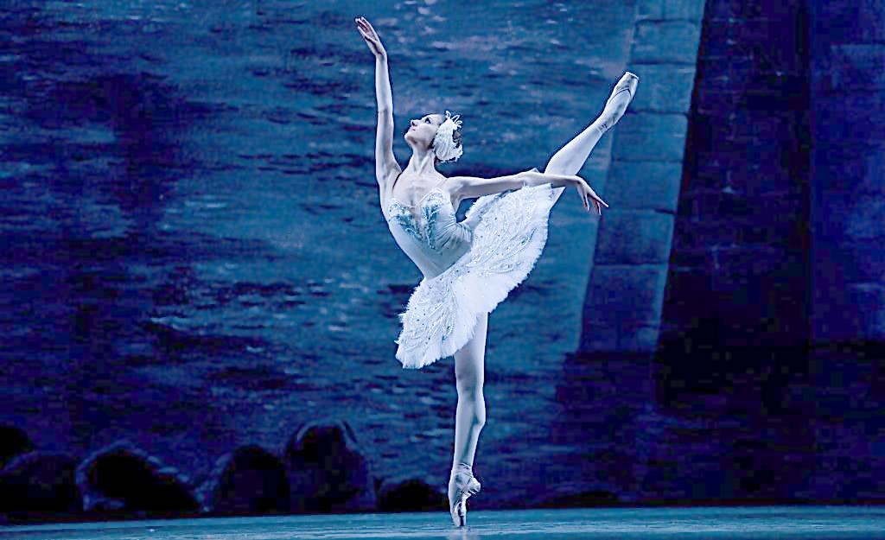
An odd melody

Slide 26
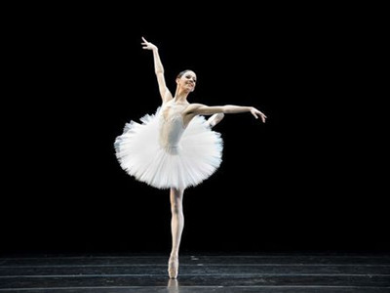
Swans of nice white feather on the dusk

Slide 27
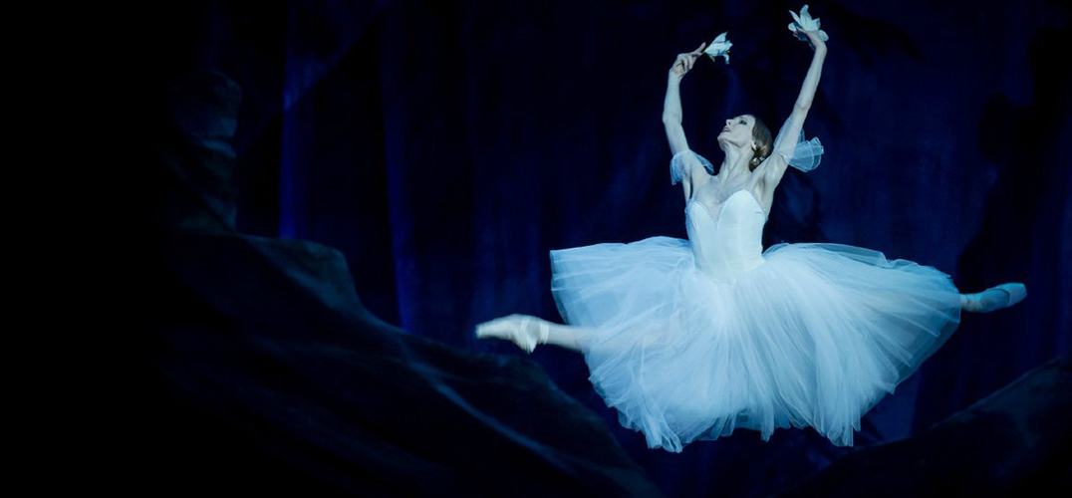
Swam in a dance in harmonious masque

Slide 28
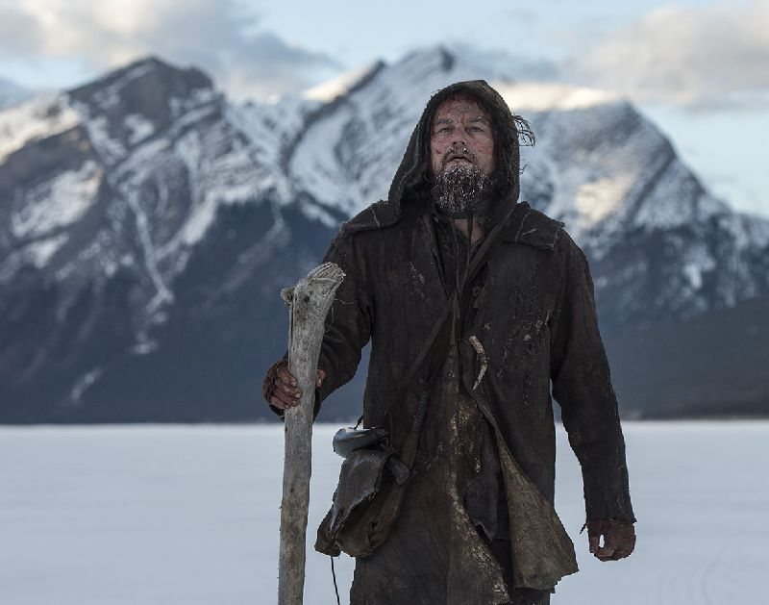
Hunter I am!

Slide 29

My bow was prepared

Slide 30
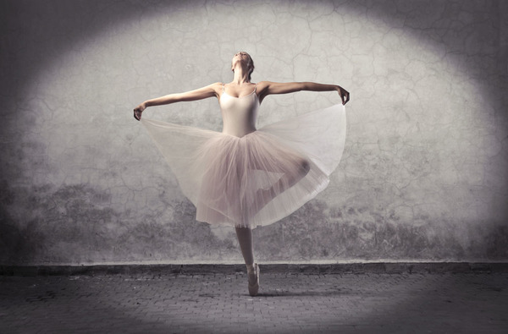
But her beauty was shown me in the depth

Slide 31
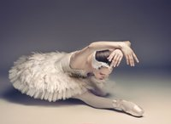
Spouting, silent, from the lake

Slide 32
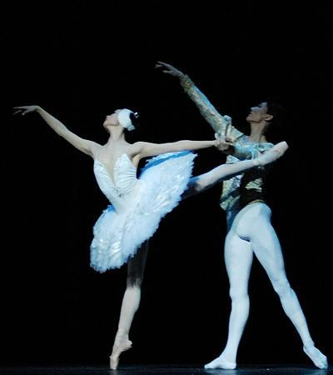
And her pale look kept a sad poem

Slide 33
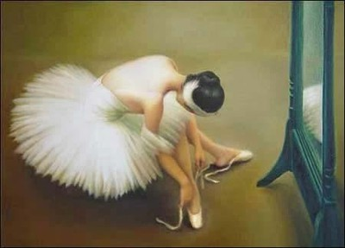
Lost in despair

Slide 34
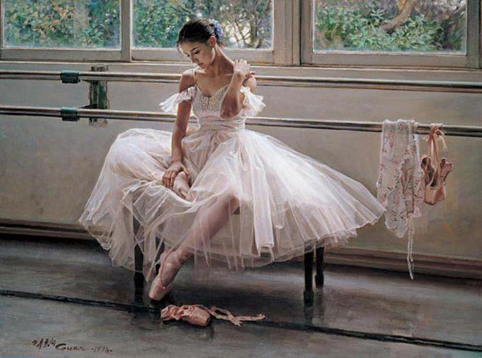
Dragged into the warlock's lair

Slide 35
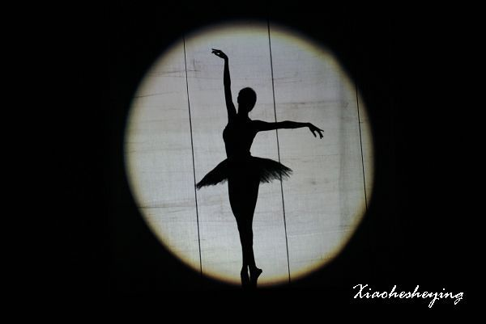
In the shadows

