Slide 1
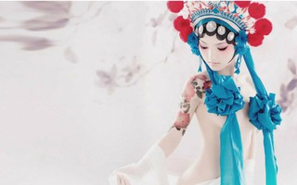
PEP, U5L2,Beijing Opera
Song: If You Feel My Love (Chaow Mix)
Singer：Blaxy Girls
Editor: 李秀红
单位：华南师范大学

Slide 2
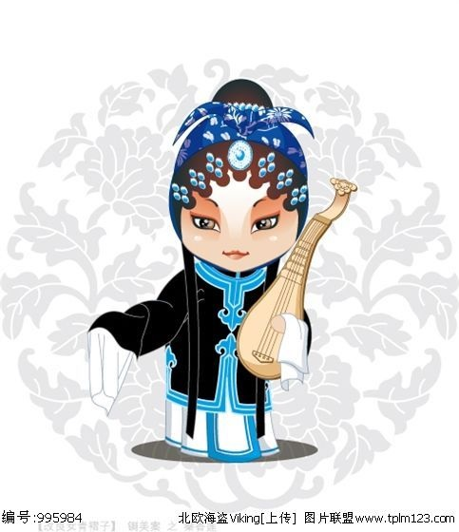
近前看其详上写着
秦香莲三十二岁

Slide 3
状告当朝驸马郎
欺君王瞒皇上

Slide 4
悔婚男儿招东床

Slide 5
近前看其详上写着
秦香莲三十二岁

Slide 6
状告当朝驸马郎
欺君王瞒皇上

Slide 7
悔婚男儿招东床

Slide 8
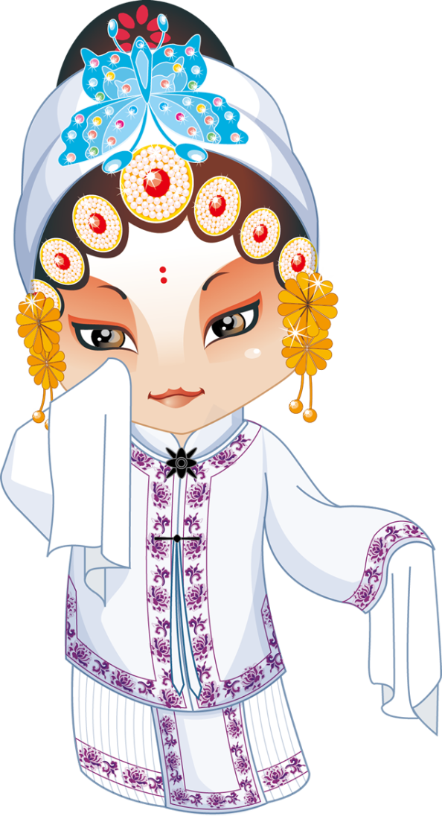
If You Feel My Love

Slide 9
Can You Hear My Thoughts

Slide 10
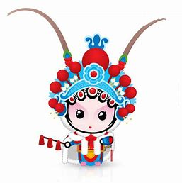
Can You Feel Everything

Slide 11
And If You Hear My Thoughts

Slide 12
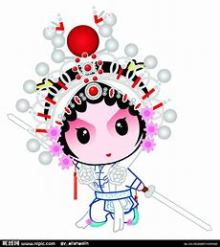
Can You Feed My Soul

Slide 13
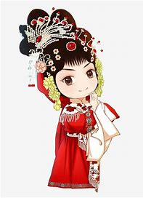
Can You Save It Too

Slide 14
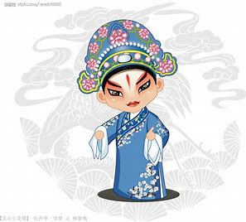
You' re Not The One That I Need

Slide 15
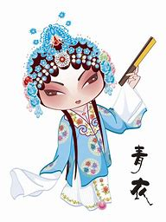
To Stay High On My Feet

Slide 16
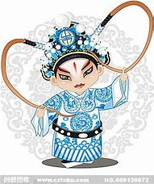
Don‘t Need You To Succeed

Slide 17
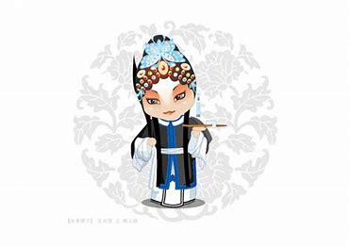
Can You Feel That Hate That Runs To You

Slide 18
Can You Feel It Too

Slide 19
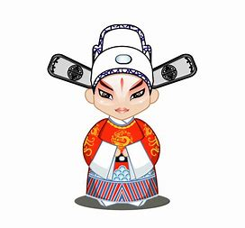
If You Wanna Lie To Me

Slide 20
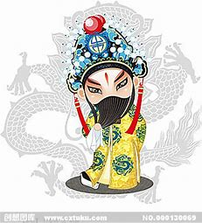
You Must Change The File

Slide 22
It Will Be Just Fine

Slide 23
If You Ever See Yourself

Slide 24
Just The Way You Are

Slide 25
Don‘t Come Back And Cry For Me
Cause You‘ve Gone Too Far

Slide 26
If You Wanna Lie To Me

Slide 27
You Must Change The File

Slide 29
It Will Be Just Fine

Slide 30
If You Ever See Yourself

Slide 31
Just The Way You Are

Slide 32
Don‘t Come Back And Cry For Me
Cause You‘ve Gone Too Far

Slide 33
If You Wanna Be With Me

Slide 34
Baby …

Slide 35
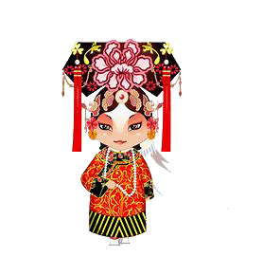
You Must Be The Way I Want

Slide 36
Baby …

Slide 37
If You Wanna Be With Me

Slide 38
Baby …

Slide 39
You Must Be The Way I Want

Slide 40
秦香莲三十二岁

Slide 41
状告当朝驸马郎
欺君王瞒皇上

Slide 42
悔婚男儿招东床

Slide 43
If You Feel My Love

Slide 44
Can You Hear My Thoughts

Slide 45
Can You Feel Everything

Slide 46
And If You Hear My Thoughts

Slide 47
Can You Feed My Soul

Slide 48
Can You Save It Too

Slide 49
You' re Not The One That I Need

Slide 50
To Stay High On My Feet

Slide 51
Don‘t Need You To Succeed

Slide 52
Can You Feel That Hate That Runs To You

Slide 53
Can You Feel It Too

Slide 54
If You Wanna Lie To Me

Slide 55
You Must Change The File

Slide 57
It Will Be Just Fine

Slide 58
If You Ever See Yourself

Slide 59
Just The Way You Are

Slide 60
Don‘t Come Back And Cry For Me
Cause You‘ve Gone Too Far

Slide 61
If You Wanna Lie To Me

Slide 62
You Must Change The File

Slide 64
It Will Be Just Fine

Slide 65
If You Ever See Yourself

Slide 66
Just The Way You Are

Slide 67
Don‘t Come Back And Cry For Me
Cause You‘ve Gone Too Far

Slide 68
If You Wanna Be With Me

