Slide 1
高中英语北师大版
Unit 4 Cyberspace
Lesson 4 Virtual Tourism
Title：Acukland & New Zealand
Song：God Defend New Zealand
Editor：曾晓莹
单位：华南师范大学

Slide 2
God of nations at Thy feet

Slide 3
In the bonds of love we meet

Slide 4
Hear our voices, we entreat

Slide 5
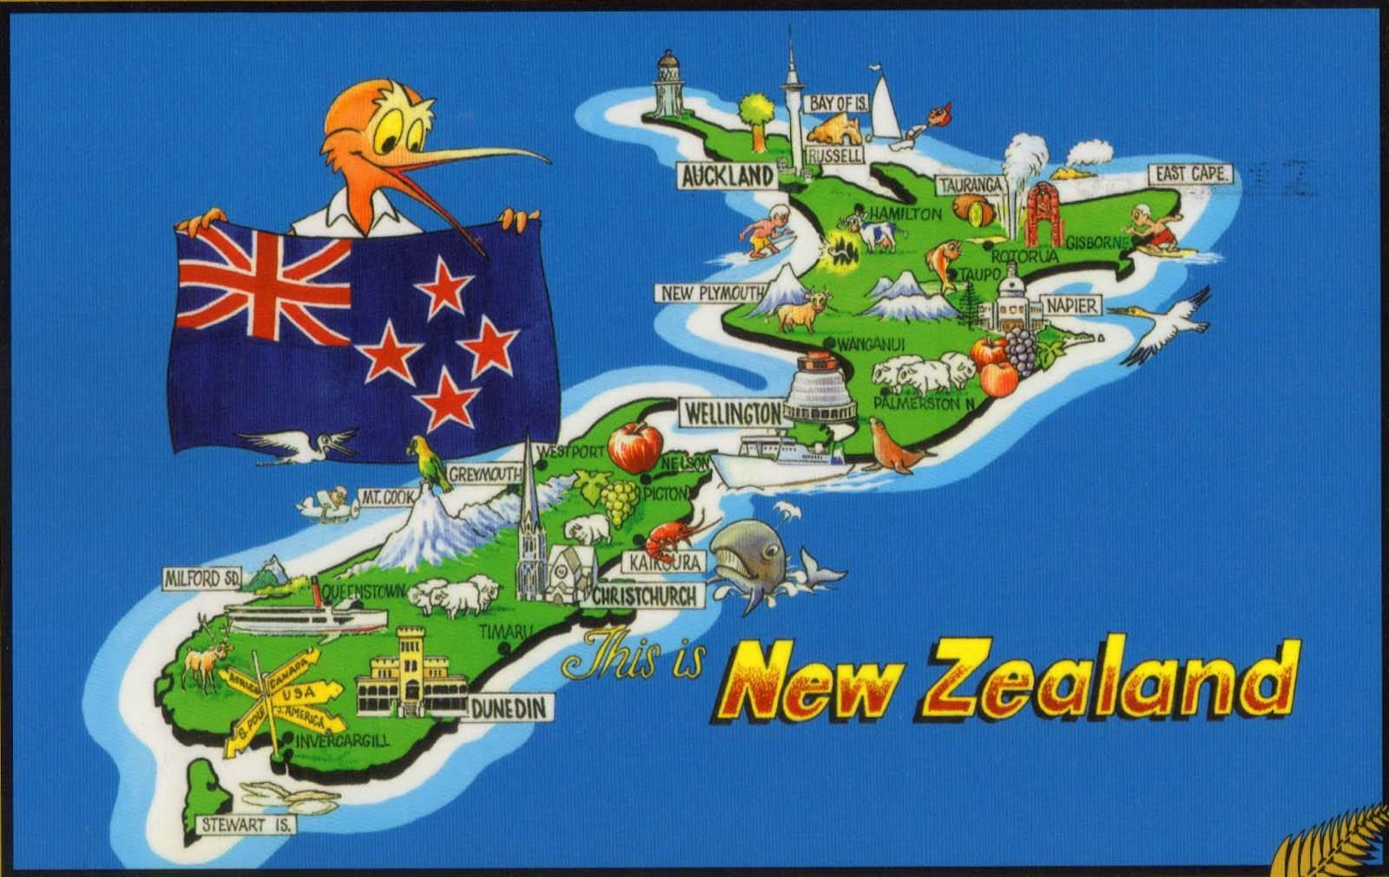
God defend our free land.

Slide 6
Guard Pacific's triple star

Slide 7
From the shafts of strife and war

Slide 8
Make her praises heard afar

Slide 9
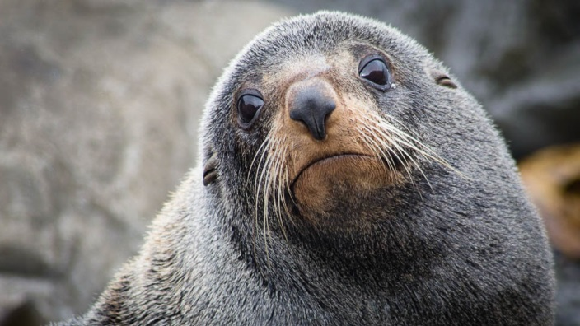
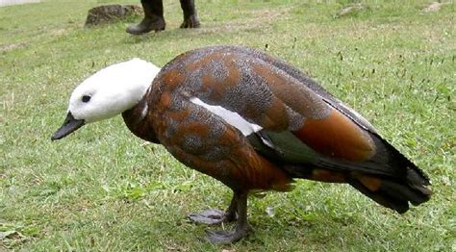
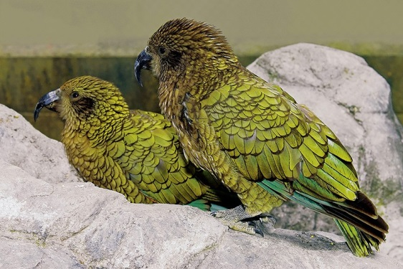
God defend New Zealand

Slide 10
E Ihowā Atua

Slide 11
O ngā iwi mātou rā

Slide 12
Āta whakarangona

Slide 13
Me aroha noa

Slide 14
Kia hua ko te pai

Slide 15
Kia tau tō atawhai

Slide 16
Manaakitia mai

Slide 17
Aotearoa

Slide 18
Men of every creed and race

Slide 19
Gather here before Thy face

Slide 20
Asking Thee to bless this place

Slide 21
God defend our free land

Slide 22
From dissension, envy, hate

Slide 23
And corruption guard our State

Slide 24
Make our country good and great

Slide 25
God defend New Zealand

Slide 26
Thank You！

